Slide 1


PLC Based
Automatic Bottle Filling System
Professor: Dr.Afshar
Winter 2022

Slide 2
Teamwork
Melika Salehian | 25%
Maryam Heydari | 25%
Fatemeh Karrar | 25%
Mahban Jafari | 25%

Slide 3
1.
Filling is the task that is carried out by a machine and this process is widely used in many industries.
In this project, the filling of the bottle is controlled by using a controller known as PLC which is also the heart of the entire system. For the conveyor system, a dc motor has been selected for better performance and ease of operation. A sensor has been used to detect the position of the bottles.

Slide 4
1.1: Evaluation of Process
Bottle Pre-Wash
Bottle Wash
Bottle Sterilization
Bottle Rinse
Filling and Capping

Slide 5
2. FlowChart
First we have push button which sometimes can be interpreted as an automatic and manual button based on situation and user decision then if the button was pushed it will go to next level otherwise it will feedback to itself.

Slide 6
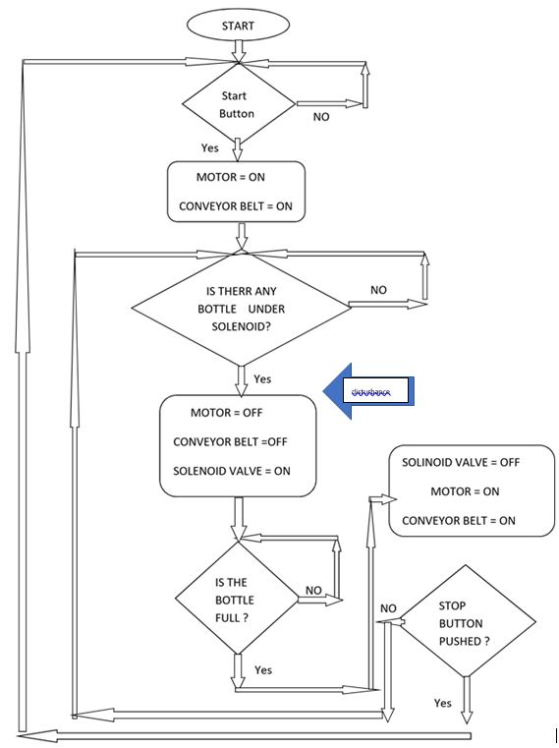
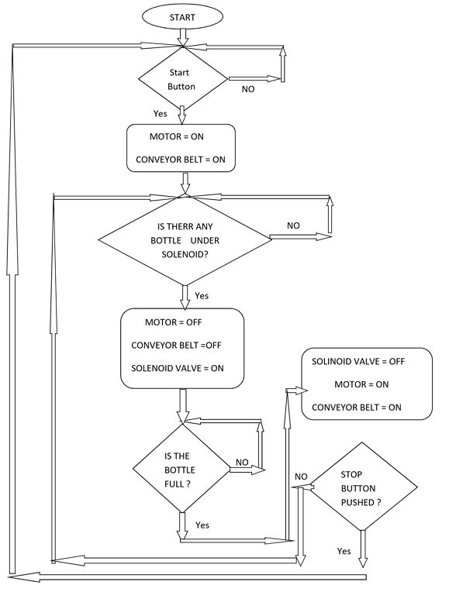

Slide 7
3. Algorithm
STEP 1 : Press the "START" Push Button.
STEP 2 : Then the "MOTOR" starts and the conveyor moves forward.
STEP 3 : If the sensor detects the presence of bottle which is in position with the solenoid valve, then the conveyor will stop.
STEP 4 : If the sensor does not detects any presence of the bottle, the conveyor keeps on moving.
STEP 5 : After some delay the valve turn "ON" and the bottle will get filled till the timer gets off.
STEP 6 : After the bottle is filled delay is provide and then after the delay the motor starts running.
STEP 7 : And the process respects itself repeats itself from step 3

Slide 8
4.Manual Mode
In automatic mode every valve and every sensor will be checked automatically and it will alarm the user if anything is no longer working accordingly, but as we switch to manual mod the system will alarm the user to let him know that the system will no longer check itself and everything need to be done manually.
In both automatic and manual system in case of emergency an alarm will be set off in automatic mode the breaks will work automatic and stop the setup and the valve will be closed to prevent from the liquid from licking, but in manual it will the operators job.

Slide 9
5.Safety Procedure
Before reopening after each shutdown, You need to check the water tank, chain plate, conveyor belt, etc. for abnormalities, and pay attention to whether the water source, power supply are connected. Power QF, power indicator light is on, fault indicator light and emergency stop indicator light are not on, you can press the start button on the operation control box and the start switch at the filling place to start the overall operation of the machine. Press the stop button at the installation place and the control box. After stopping, the main power supply should be turned off.
The sensor is a high-precision, high-sealing, high-sensitivity device. Impact and overload are strictly prohibited. It must not be touched during work.

Slide 10
6.Before the main Process
In our project we are only focusing on water bottle filling but it can be not only water for example it can also be used in juice filling in that case one of our input which is the liquid we want to fill our bottle with it.so before it comes to this part in needs to go through another process and combine with the right amount and also the get inserted with some substance to make it last for a longer time.
And for water we also add this substance plus something else to make sure the water doesn’t have any taste. If the factory is making its own bottle we also have to take them as inputs from other part so now by having both the part and filling liquid the process will began. The output will be bottles that were sealed and now it's ready for packaging so the next department will have the bottles one by one and make a package with 6 of them and then it’s ready for shipping

Slide 11
7.Redundancy
In this system we can add an extra sensor for measuring the level of liquid so incase our first sensors were not working properly, it will come to the circuits and the work will continue as it was programed. The other section that we can use a redundancy in it is the conveyor. If the break in conveyor encounter a problem the whole procedure will go sideways so we put another breaker incase that the first one run into some difficulties the other one will come in hand and the procedure will continue.

Slide 12
8.define disturbance
If we want to define disturbance in a simple way, we can say that it's something unwanted that got added to our system along the way and we don’t have any control over it. Usually the first thing that comes to mind is the effect of media. The surrounding of the system can add a lot of noise and unwanted disturbance to our system.in our case our liquid’s temperature can be influenced by its surroundings and the easiest way to prevent it is to make sure a good isolation is installed around the tank. The other disturbance which is common between systems is our inputs. The density of input can be manipulated by others involved and we don’t have a control over it.so if our liquid were anything with a desirable density we need to check it before pouring it into the bottles.

Slide 13
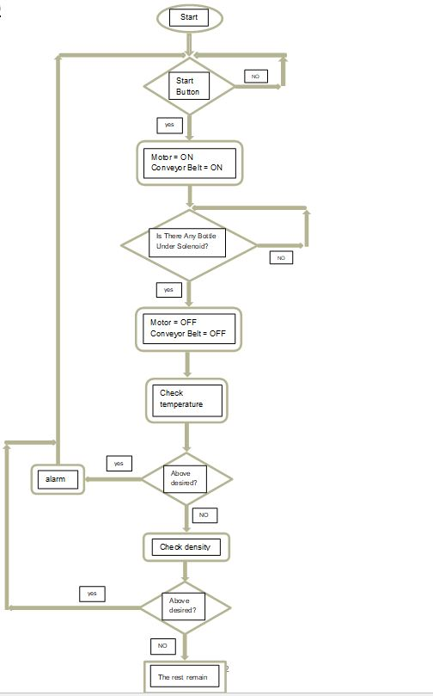
9.

Slide 14
11. Hardware
HARDWARE REQUIREMENT SPECIFICATION
1. Water Float Switch 2. Photoelectric Sensor
3. DC geared motor 4. Water pump
5. SMPS(Switch Mode Power Supply) 6. Solenoid Valve
(DC or AC to DC load)
7. Water tank 8. Switches
9. Relays 10. Conveyor System
11. Temperature Sensor(RTD) 12. Level Sensor

Slide 15
14. Disturbance in the surface sensor, or photoelectric sensor
The surface sensor allows the various containers to be filled without wasting a substance, which can sometimes cause significant loss in the long run (such as perfume), Pharmaceuticals, mercury, etc.), in cases such as pharmaceutical products where the percentage of substance, and total amount of a product is very important.
Disruption of the temperature sensor: By causing a disturbance in this sensor in case of system malfunctions the temperature rises above the allowable level, the alarm is not activated and the safety of the system is endangered. Also, changing the temperature of the liquid changes its density. Constant duration of weight is injected more or less than the specified amount into the container.
Another case is the disturbance and change in the volume of material inside the tank, the larger the volume of material inside the tank, the more pressure is placed behind the pump, thus it changes the flow rate of the pump (volume of material passing through the pump per unit time).

Slide 16
14. Disturbance in the surface sensor, or photoelectric sensor
Another disorder is related to the change of material concentration, which also has a great effect on changing the volume of pumped material per unit time.
To solve the problems, the simplest way is to place a low-volume feed tank between the storage tank and the device so that the increase or decrease in the volume of liquid in it has less impact on the pump.
Secondly, at the beginning of each working day, the device should be set to trial and error once. This type of mechanism is suitable for semi-concentrated materials such as edible and industrial oils, dilute materials that do not foam. To prevent problems in activating alarms and to ensure the security of the system, several temperature sensors can be used to activate the alarm replacement sensors in case of failure of one of the sensors.

Slide 17
15.power outage
In the event of a power outage, an emergency power generator is placed in the basement to be activated in the power outage. As soon as the generator is activated, all sensors start from the beginning.
To prevent water leakage, a flowmeter is installed in the tank outlet valve. If the value displayed by the flowmeter increases significantly, the possibility of pipe leakage increases and the water must be cut off.
In the event of a water leak or any adverse conditions, the emergency switch installed in the system acts like a global stop and shuts off the entire system.

Slide 18
17.SELECTION OF PLC
There are some main factors to choose a PLC for any application. They are:
· Input and output
· Memory size
· System speed
· Compatibility to HMI
· Easily communicable

Slide 19
17.SELECTION OF PLC
Different PLCs have different number of I/O ports. And in some, adding external I/O cards can increase number of I/O ports.
S7-1200 has the characteristics as below:
· Bit Memory (M) 8192 bytes
· On – board digital I/O 14 inputs/ 10 outputs
· On – board analog I/O 2 inputs
· Voltage range 85 to 264 VAC
· Input current (max. load) • CPU only – 100 mA at 120VAC; 50mA at 240 VAC . CPU with all expansion accessories – 300mA at 120 VAC; 150mA at 240 VAC.

Slide 20
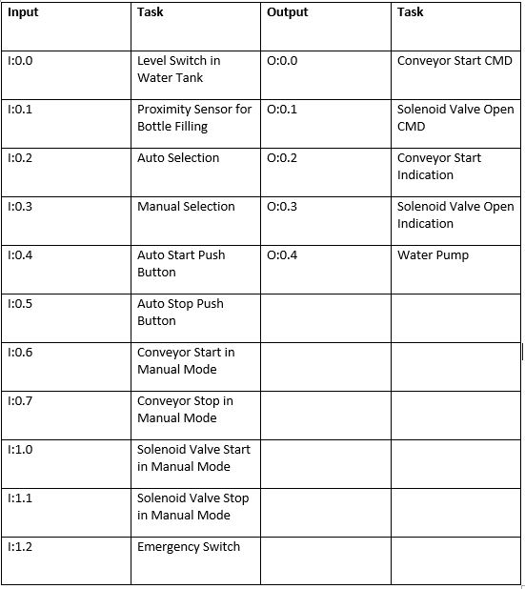
18. Input / Output

Slide 21
19. Power Budget
The CPU has an internal power supply that provides power for the CPU, the signal modules, signal board and communication modules and for other 24VDC user power requirements.
5VDC logic budget supplied by the CPU and the 5VDC power requirements of the signal modules, signal boards and communication modules.

Slide 22
LADDER DIAGRAM
Siemens

Slide 23
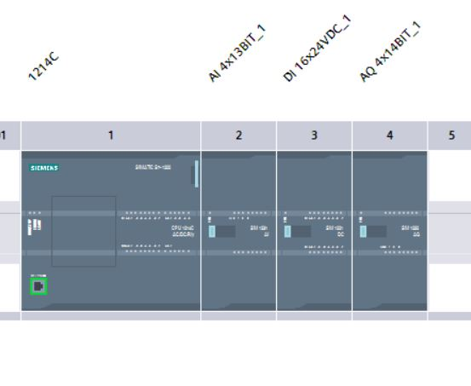
20. PLC LADDER DIAGRAM
Device configuration:

Slide 24
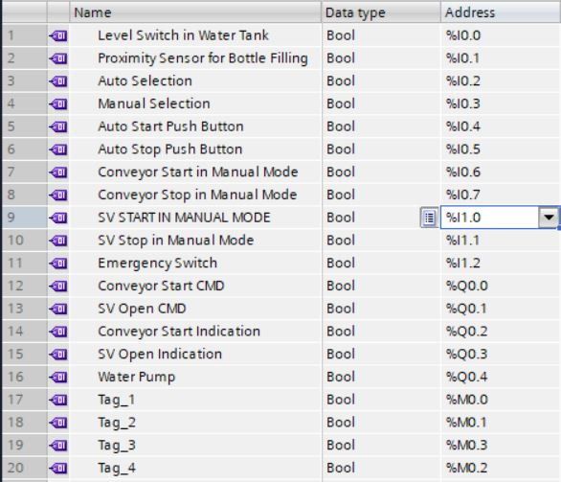
20. PLC LADDER DIAGRAM
Tags:

Slide 25
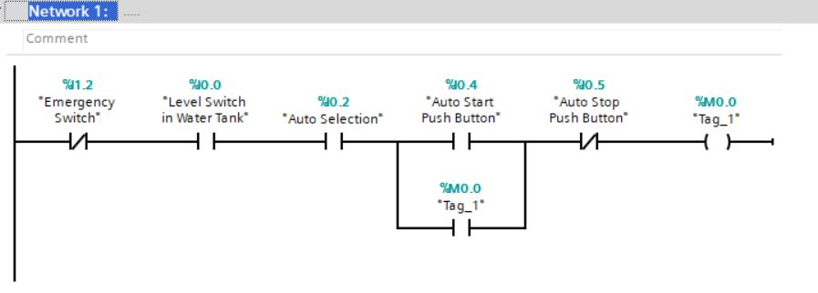
20. PLC LADDER DIAGRAM
Function Block:

Slide 26
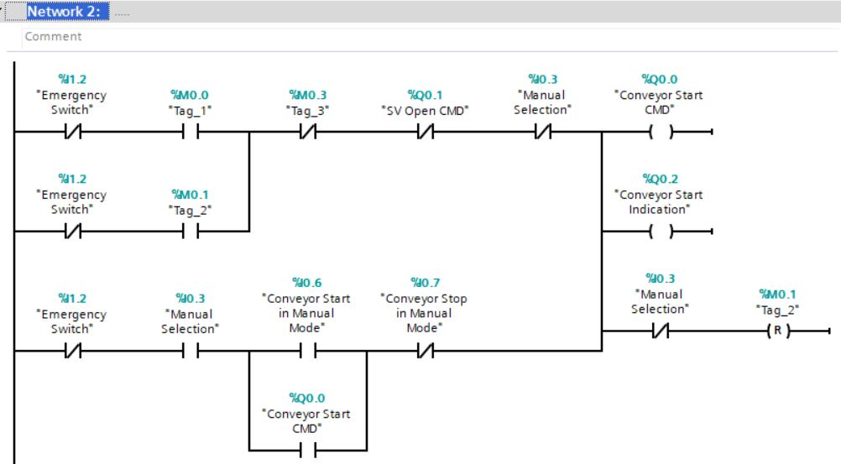
20. PLC LADDER DIAGRAM
Function Block:

Slide 27
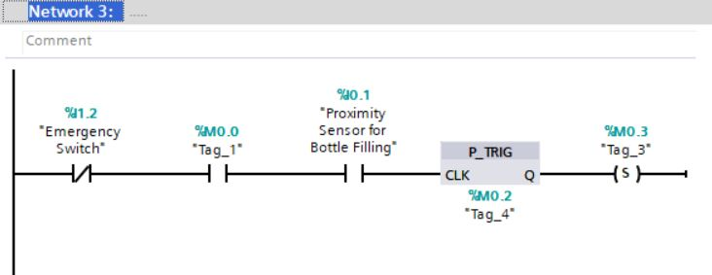
20. PLC LADDER DIAGRAM
Function Block:

Slide 28
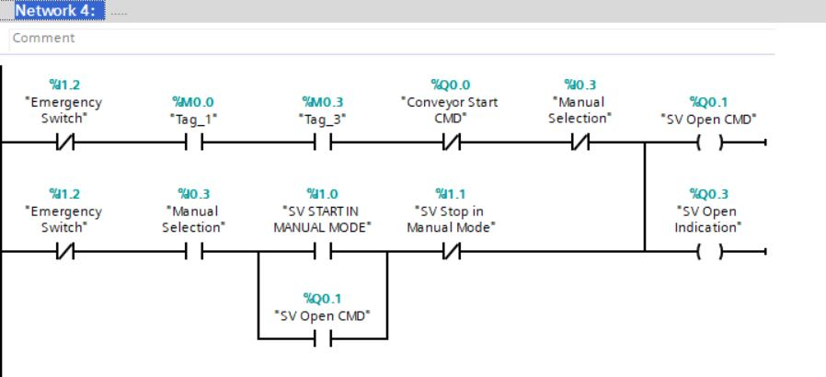
20. PLC LADDER DIAGRAM
Function Block:

Slide 29
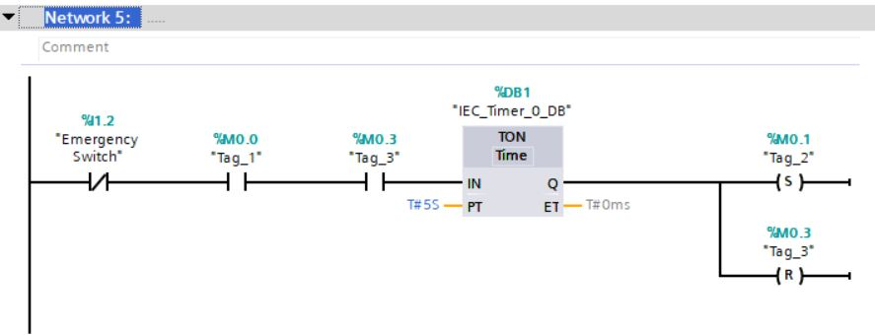
20. PLC LADDER DIAGRAM
Function Block:

Slide 30
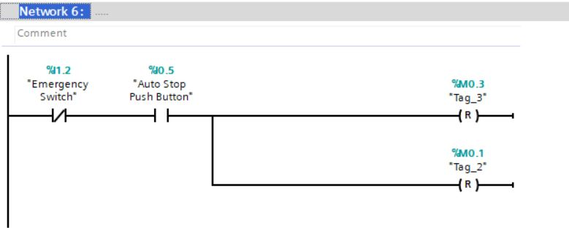
20. PLC LADDER DIAGRAM
Function Block:

Slide 31
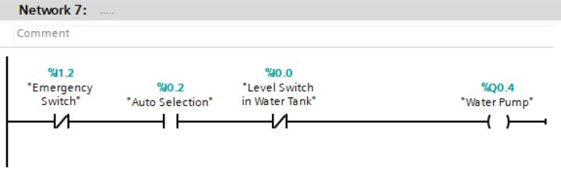
20. PLC LADDER DIAGRAM
Function Block:

Slide 32
Thanks!
ANY QUESTIONS?

