Slide 1
PROCESS IMPROVEMENT PROJECT
Mahboobeh Hosseini
MBC 638 Data Analysis and Decision Making

Slide 2
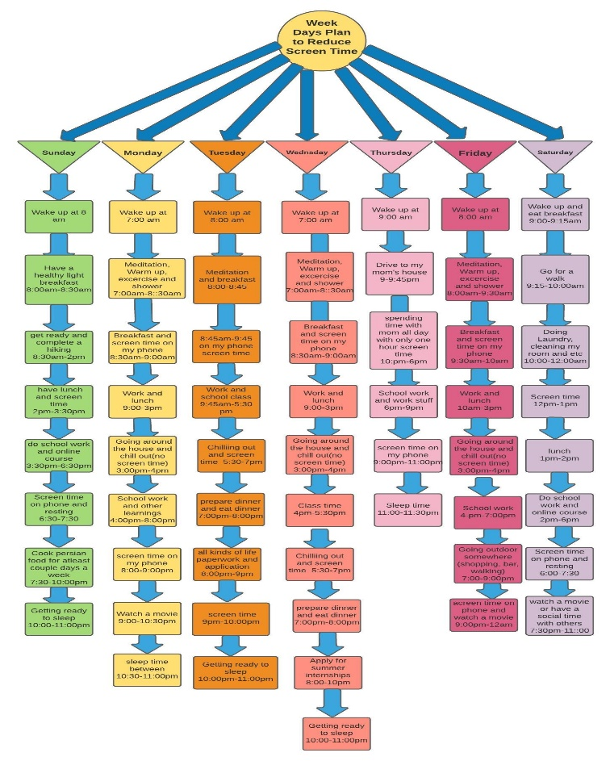
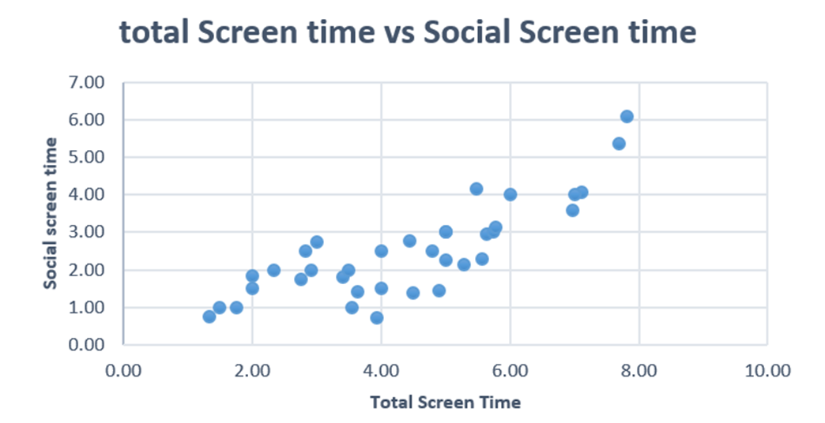
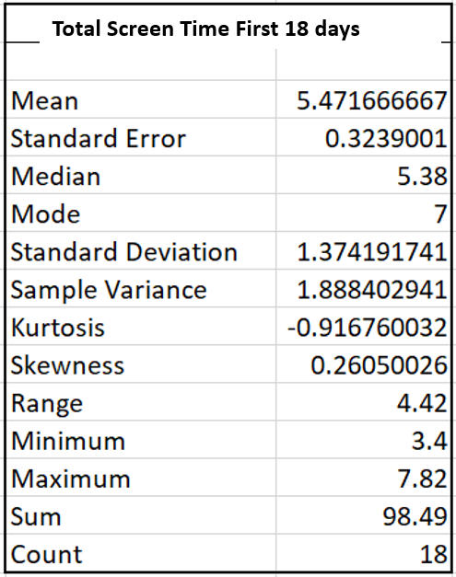
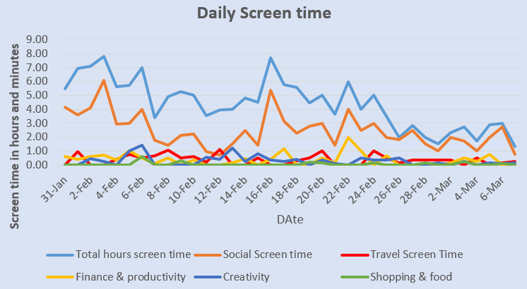
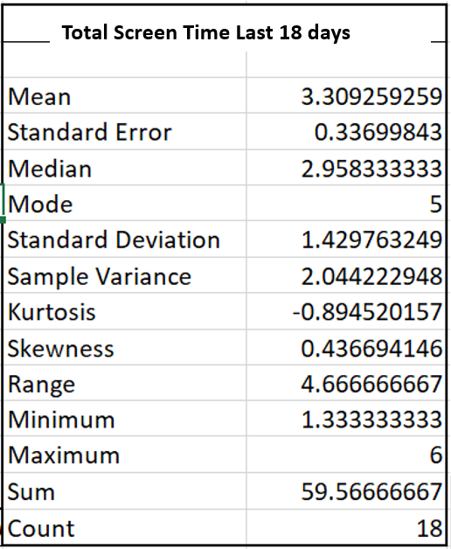
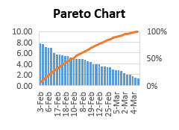
DEFINE
MEASURE
ANALYZE
IMPROVE
CONTROL
Problem Statement
Excess use of my phone is interrupting my productivity at work, school, and exercise routines
Baseline
36 samples in total
Objective
Reduce Screen time to less than or equal to 3 hours a day
Action Plan
Collecting data for 36
Days and analyzing how screen time and SQL changes between the first half and second half of data
Data Collected
36 data sample has been collected
Screen time in different categories were measured
The measurement was through my iPhone 11 setting
Some of the measurement such as pick up numbers and time intervals have not been used in Analysis phase
Tools
Data Measurement Plan
Line chart
Analysis tools
Pareto Chart
Scatterplot
Positive correlation between total and social screen time
Chi-Square for screen time categories and days of week performed
No relationship found
Action Plan
Limit social apps screen time
Turn off notifications
Implement a process plan
A Process plan is created
Descriptive statistics performed
Tools
Control charts
Next Steps
Track future data points using baseline control chart
Make improvement based on Control chart data
Monitor SQL for improvements
Line shows screen time is moving down
SQL = 1.3
SQL = 0
Social Screen time (Orange Line) → highest
Mean is high
Mean is low → there have been improvement

Slide 3
DEFINE STEP
Problem Statement
This project will focus on analysis of my screen time, finding the areas I am spending most of my time on my phone and suggest ways that I can decrease my screen time on those specific areas. Solving this problem will help me to improve my physical and mental health which leads me to do better at school and work and have better communication to the real world around me.
Goal
My goal in this project is to decrease my screen time specially the times I am on my phone to maximum 3 hours a day and instead use those hours to focus on my health and refreshing my mind and increasing my productivity.
Scope
The scope of this project will be analyzing the screen time that is reported on my phone since this is the only device that I might spend time on some unnecessary activities.
Baseline
Baseline was determined by pulling data from the past 36 days (this is max data available) to see the screen time from each day.
Operational Definitions
Our input is the time that I spent on different kinds of activities on my screen and the output is the total screen time
Action Plan
Collecting data and finding out the areas I mostly spend my time on
Figure out how the screen time categories is effected by the days of the weeks
Set boundaries and limits for specific activities on my devices
Identify correlation between variables

Slide 4
DEFINE STEP
Current Process:
My current process is not under control.
I am not paying attention to how long I spend on my phone screen
I am not being careful or deliberate with my screen time
I am not currently finding techniques and tricks to decrease my screen time
In this bar chart here, the first half of the data is shown and we will later see how will the second half improve after the control plan
We can see the screen time in hours on y variable and different days on x variable. It is showing the screen time in different categories in different bar columns for each day.
Figure 1

Slide 5
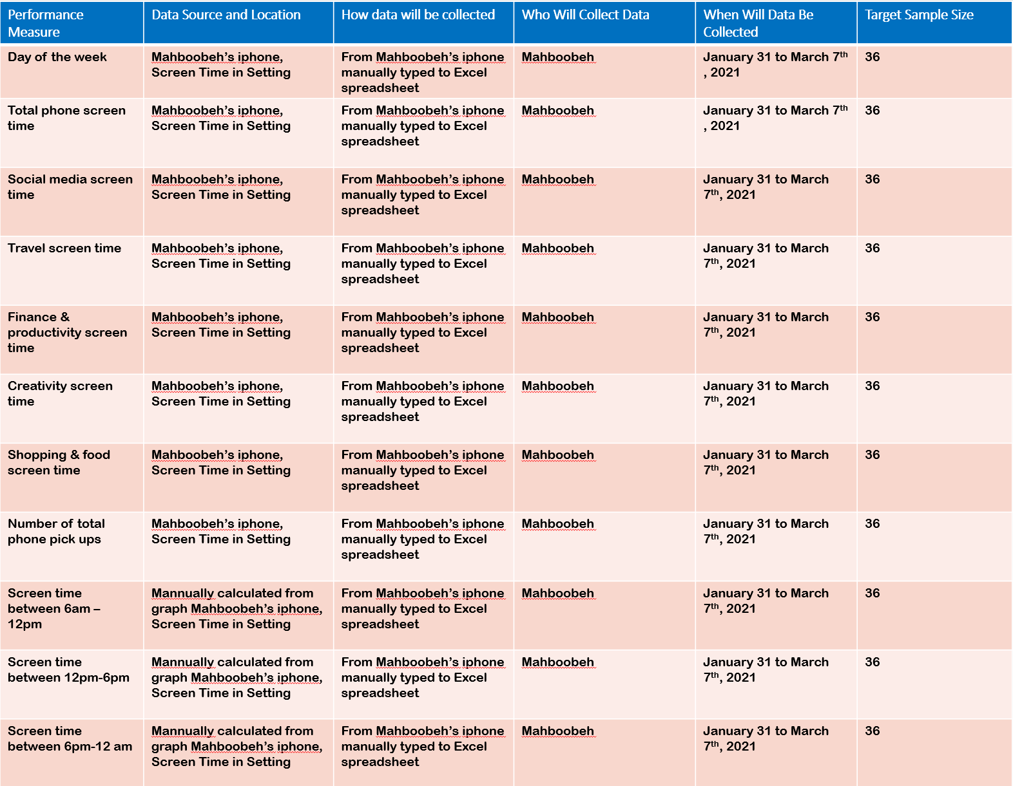
Data Measurement Plan

Slide 6
MEASUREMENT STEP
Sample Size :
The scope of this this project is quiet small since the data for screen time on my phone was not available for more than a certain timeline . For this presentation, I chose to focus mainly on my screen time on my phone since the data on that was readily available for 36 days and appropriate to use for many of the tools we’ve discussed this quarter.
Data collected
As It is also explained in the Data measurement plan table, the data collected are as follows:
Day of the week Total phone screen time
Social media screen time Travel screen time
Finance & productivity screen time Creativity screen time
Shopping & food screen time Number of total phone pick ups
Screen time between 6am – 12pm Screen time between 12pm-6pm
Screen time between 6pm-12 am
I collected the screen time data on categorized activities on my phone and took the advantage of the graphs on my setting which filtered the time intervals in the day so I know that what is the frequency of my screen time in different times of the day. Knowing the numbers of pick ups will also tell me how many times I would actually leave other works outside of my phone and get distracted by my phone for different reasons.
Data Type
Most of the data is continuous the day of the week that we are collecting the data on can be filtered to see how it can effect the data which would count as discrete data.
Measurement Error
My measurement error is minimal as all my data is collected from my phone setting. However, the data which is collected from the graph on time intervals could possibly have errors since I measured them based on the graph bar but I tried to estimate the y axis on the graph as close as possible to the number.

Slide 7

MEASUREMENT STEP
SQL DEFINITION
Sigma Quality Levels are based on DPMO (Defects per million opportunities)
Here is how we calculate it.
The Figure 2 shows how screen time in different categories changes over 36 days
Second half data
SQL
D = | 1
U = | 19
D * U = | 19
A = | 11
A/DU | 0.579
DPO * 100 | 057.89 %
DPO * 1000000 | 578947
SQL | 1.3
I calculated SQL in two different timelines:
(Jan 31-Feb 16) and
(Feb 17-March 6)
to see how it improved
First half data
SQL
D = | 1
U = | 17
D * U = | 17
A = | 17
A/DU | 1
DPO * 100 | 100%
DPO * 1000000 | 100000
SQL | 0
Figure 2
Screen Time measurement for 36 Days (Jan31-March7)

Slide 8
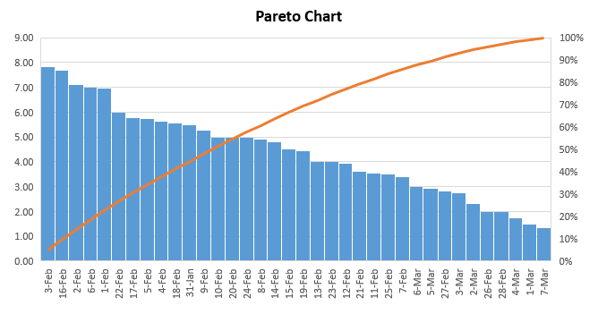
ANALYZE STEP
Trend & Pareto Chart
To better understand the overall trending of the delivery times, a trend chart and Pareto chart were created showing total screen time by day.
Key Findings
The overall trend shows the Screen time have been decreasing starting from the second half of data. This was a key finding in showing the impact of me getting aware of the outcomes that excess use of my phone would have for me and trying to change my screen time habits.
The peaks that we see in the trend chart in the middle and toward the end of February can be due to my use of phone for following up with the tax file issues that my mom and I had in that month and we had to stay on call lines for long hours of time.
Figure 3
Figure 4

Slide 9
ANALYZE STEP
Correlation
As we saw on slide 7 (Figure 2), The social screen time was the highest between all other categories that increased the total screen time through the 36 days that we observed. So here to better understand the social screen time and the total screen time correlation, we can see a scatterplot
That shows their relationship.
In contrast to Social screen time, we also can see correlation between travel stuff related screen time on figure 6.
Key Findings
On figure 5, we can see that there is a positive correlation between total screen time and social screen time which is quiet strong. However, there is no correlation between total screen time and the travel screen time. This observation helps me to know that for working on my goal of decreasing screen time, I need to consider limiting using social platforms.
Figure 5
Figure 6

Slide 10
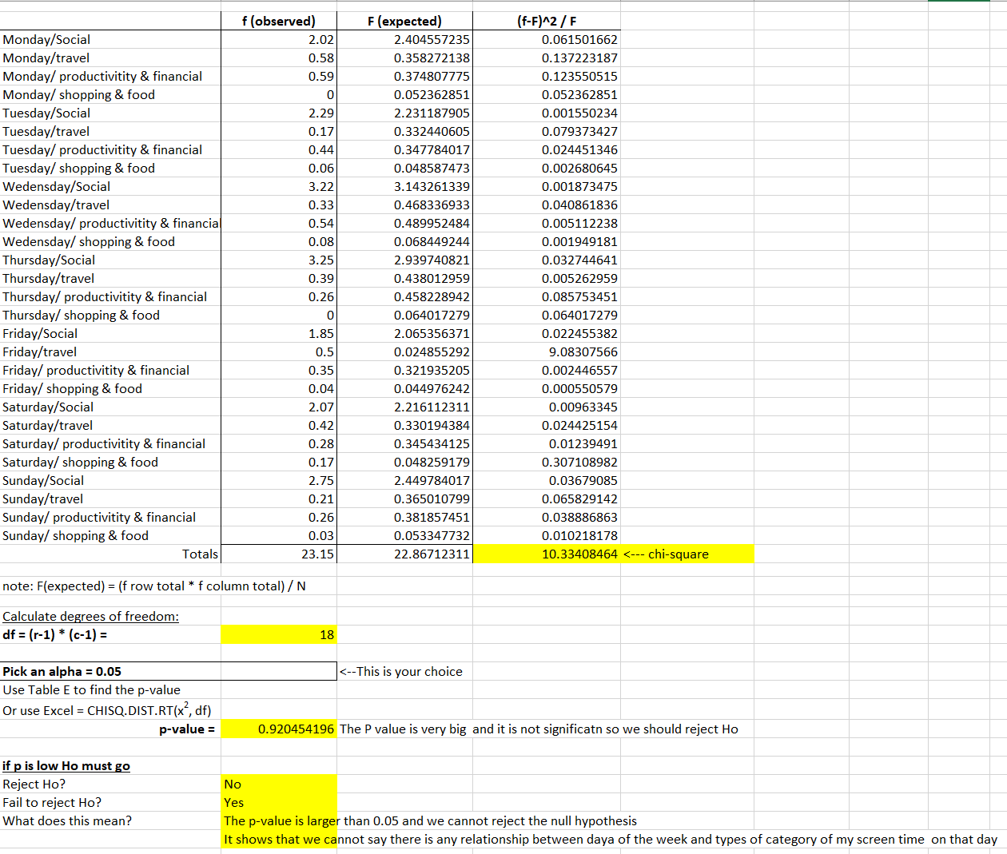
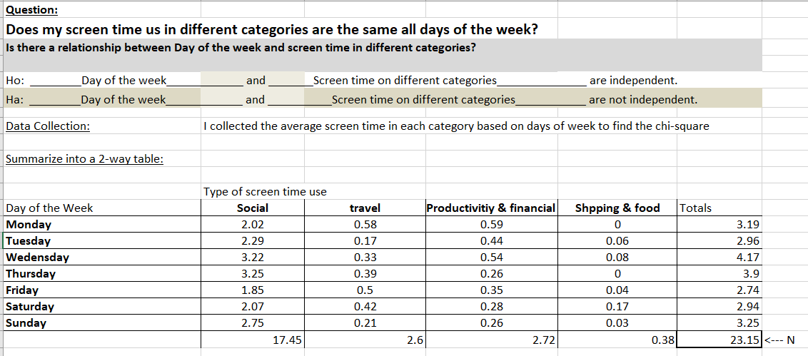
ANALYZE PHASE
Chi-Square – Test for Independence
To be able to track patterns on the data and find out factors that are important to know to change my screen time habits, I performed a Chi-square analysis. This test was done to see if there is any relationship between the days of the week and category of the screen time that I had on my phone.
In order to do that, as you can see in Figure 7 , I made a 2-way table that shows the days of the week on rows and type of screen time use on the columns. In Figure 8, I calculated the chi square and the P-value.
Key Findings
The P- value was not significant and I could not reject the Null hypothesis. I figured out that there is no relationship between the days of the week and the screen time categories.
The reason for my finding is that after the pandemic, My week days and weekend are basically the same since I work evenly on all days of the week and study the same amount as well. So my screen time might be very random and unrelated depends on the day of the week.
Figure 7
Figure 8
10

Slide 11
ANALYZE & IMPROVE STEP
Summary Statistics
To better understand the overall summary of our data set, I did a summary statistics of data, one for the first half days and one for the second half days that we did the observation on.
Figure 9 and 10 both will help us to know what is the mean, medium and mode of our screen time in these two time interval, how much it is improved and how far I am into my improvement process.
Key Findings
As we see in Figure 9 and 10, the skewness for the first 18 days is 0.26 which mean it is skewed to the right and the screen time is going down. However, the skewness in the last 18 days does almost doubles and it is 0.44 which means the screen time is decreasing with a more ratio and that is definitely good news for the improving phase.
Also the mean Screen time for the second half of data decreased from 5.47 to 3.31. The maximum and minimum screen time and Mode are all improved and decreased in the last 18 days as well.
Figure 9
Figure 10

Slide 12

IMPROVE STEP
Improvement suggestions
Add Screen Limit: As we had the social screen time as the highest, it is a good idea to add screen limit on my social platforms in my phone setting specially the social media apps and the ones that are not used in the case of emergency and work or school.
Turn off notifications: I need to turn off my notification for my social media on my phone so I can access them whenever I am ready for it. It prevents me from picking up my phone due to noticing my notifications.
Implement a process plan: I can create an ideal schedule as a model for myself to decrease my screen time and become more productive. On figure 11, I built a process plan that includes a detailed schedule on days of the week for me to have a balance on my work, school, exercise, and screen time along with the other activities.
Figure 11

Slide 13
CONTROL STEP
Moving average and individual chart
Additionally, I utilized Control Charts to measure whether my process for measuring my total screen time was out of control. This analysis tool shows if the range of my data stayed within control throughout the process.
As we see in Figure 12 and 13 in the control charts below, the middle point in the data the screen time is off the limits and more than the Upper limit. Toward the second half of data, we see a great improvement and decrease in screen time.
For future improvement, I can create the new control chart for new data and see how much I could success in staying on my screen time limit comparing to the charts below.
Figure 12
Figure 13

