Slide 1
Developing with Contiki-NG in Code Composer Studio
Convenient step-debugging for all platforms

Slide 2
Prerequisites
Setup the Software Development Environment for Contiki-NG
http://processors.wiki.ti.com/index.php/Contiki_setting_up_sw
In short:
Clone the Contiki-NG repository
git clone https://github.com/contiki-ng/contiki-ng.git
Checkout the CC13x0/CC26x0 driverlib submodules from the cloned repository
cd contiki-ng/arch/cpu/cc26xx-cc13xx/lib && git submodule update --init -- .

Slide 3
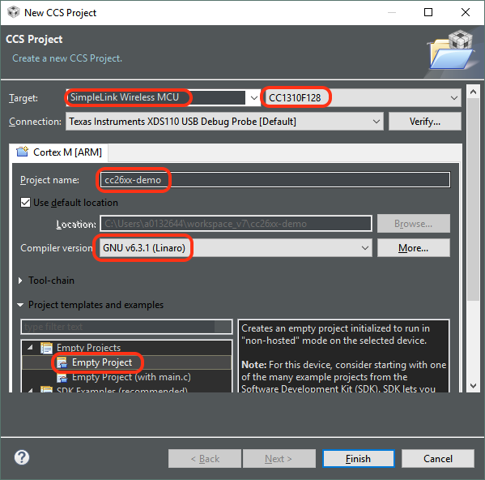
1. Create an empty CCS project
Create a new CCS project
File -> New -> CCS Project
Make sure correct Target device is selected
Name the project to whatever your liking
Make sure GNU compiler is selected, as well as the Empty Project template

Slide 4
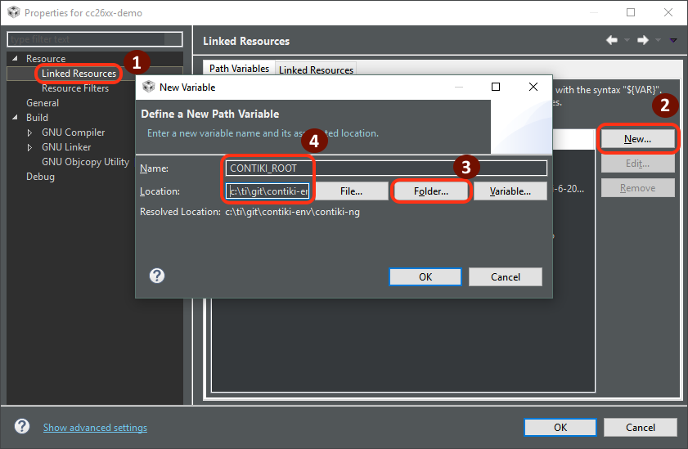
2. Add a path variable for Contiki
Add path variable in project preferences
Just for Convenience
Allows us to refer to the Contiki source folder later
Makes it possible to switch to another contiki folder without changing the project

Slide 5
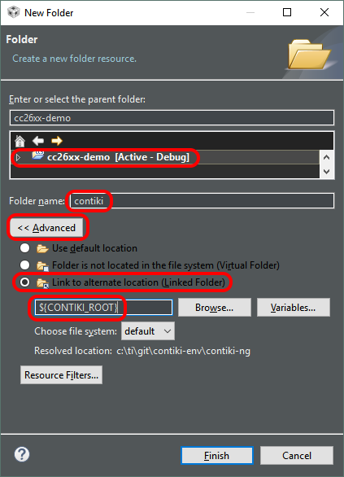
3. Add Contiki sources
Add new folder
Right click project -> New -> Folder
Click advanced settings
Add a link based on the CONTIKI_ROOT variable
This allows to browse Contiki files whithout copying them into the project folder.
CCS may find .cfg files in the Contiki source tree and asks whether it should build them with XDCTools. Click «No».

Slide 6
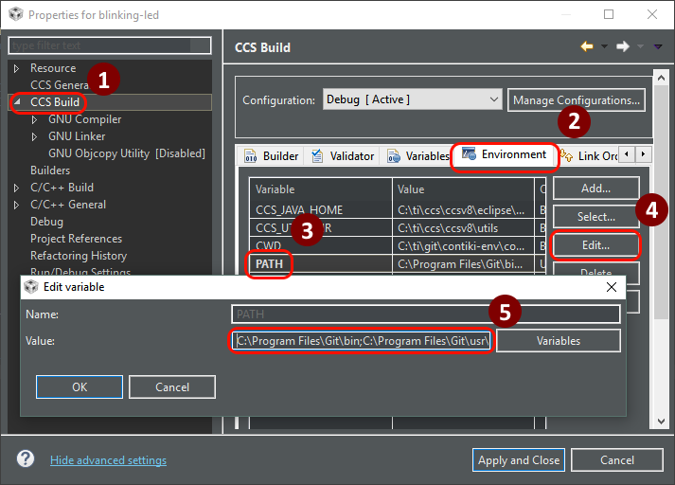
4. Adjust PATH Environment Variable
The Contiki build system needs git, make and some other shell tools to be in the PATH environment variable
Git Bash provides all the necessary GNU tools, and is a commonly used git distribution for Windows
Be sure both /bin and /usr/bin paths are added
Example: Prepend the following
C:\Program Files\Git\bin;C:\Program Files\Git\usr\bin;

Slide 7
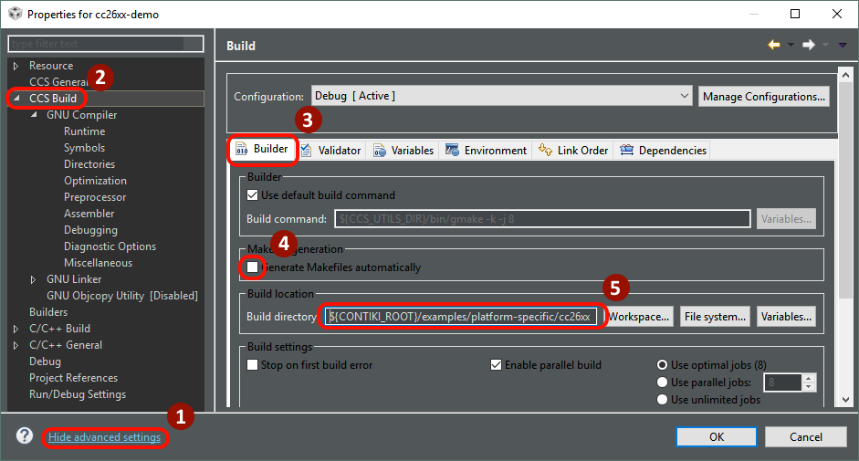
5. Adjust Builder settings
Make sure you are viewing advanced settings
Do not let CCS generate makefiles
For building an example, use the example’s source directory as build directory
Note: When creating your own applications, put the application sources and the Makefile into your project directory, not in the Contiki directory.

Slide 8
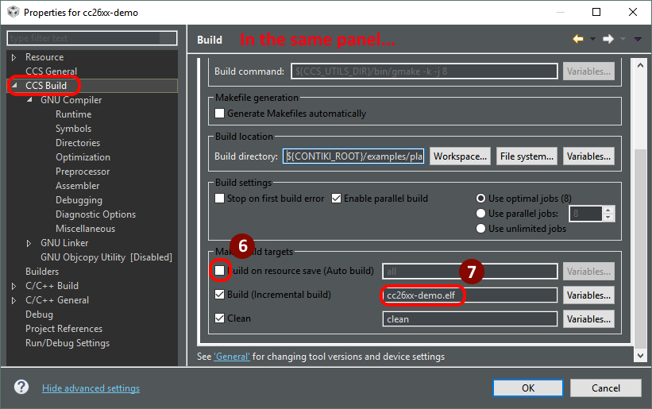
6. Modify the build target
In the same panel, uncheck build on save
It is sufficient to build the executable (*.elf)
No need to do hex conversion, which requires the srecord command

Slide 9
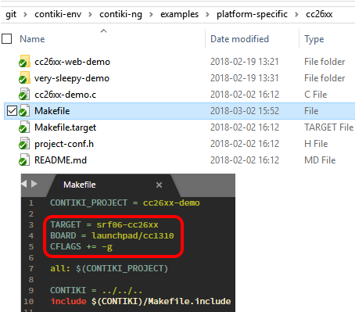
7. Add board and target variables, debug symbols
You can set those variables either in the Makefile or in the CCS environment just like PATH
TARGET=srf06-cc26xx for CC13x0 and CC26x0 devices
BOARD=launchpad/cc1310 for the CC1310 launchpad
Add CFLAGS += -g to enable debug symbols

Slide 10
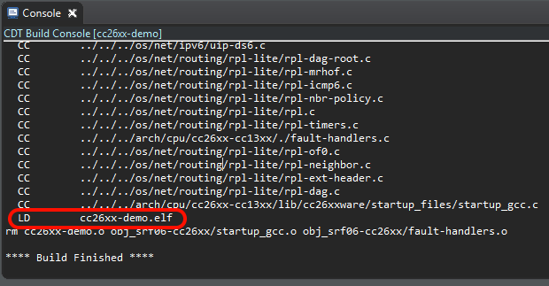
8. Build the project
CCS should now be able to build the *.elf file
If something goes wrong, it is usually due to tools not being found. Check the PATH environment variable in that case.

Slide 11

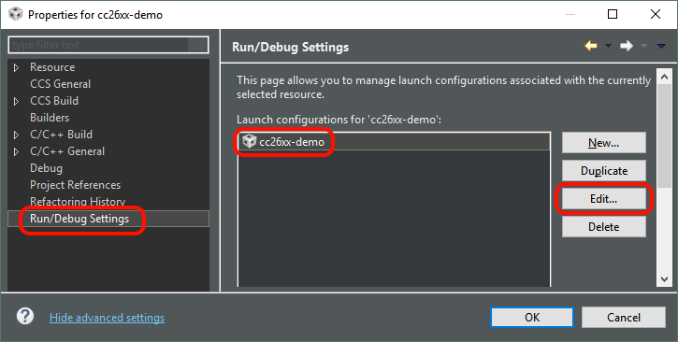
9. Create a default debug session
Start a debug session and let CCS create a default debug configuration for the XDS110 debug interface
This is expected to fail because the executable filepath guessed by CCS is wrong
Open the newly created launch session for that project

Slide 12
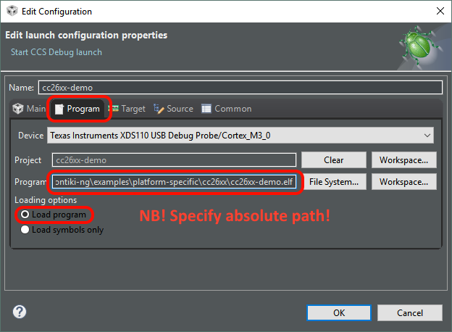
10. Set the correct executable path
CCS tries to deduce the executable filepath from a magic variable
But we are building it with an external makefile
The executable path needs to be hard-coded (unless we find a simpler solution)

Slide 13
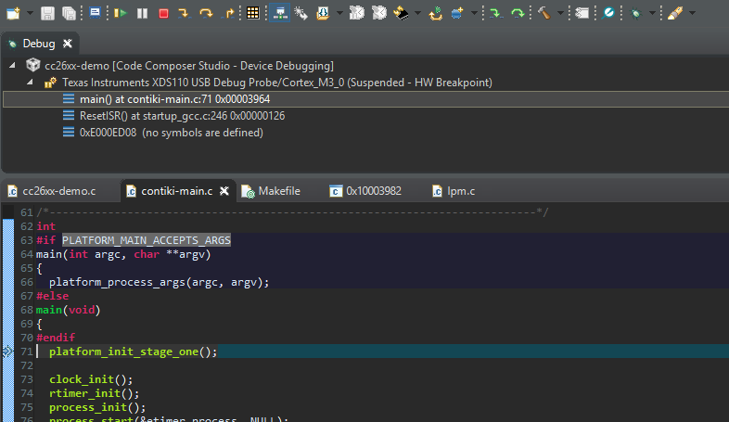
11. Start debugging
Now that the launch configuration points to the correct file, start the debug session again
You are now able to step through the source code

