Slide 1

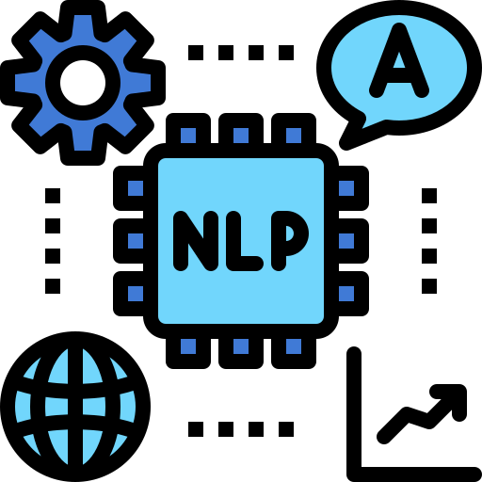

NOT LOW-RESOURCE ANYMORE: ALIGNER ENSEMBLING, BATCH FILTERING, AND NEW DATASETS FOR BENGALI-ENGLISH MACHINE TRANSLATION
Tahmid Hasan∗ , Abhik Bhattacharjee
Presented by:
Md Mahbub Alam Prithibi
ID:20101243
Group:10
Research Assistant(RA): 1.Humaion Kabir Mehedi
2. Farah Binte Haque

Slide 2
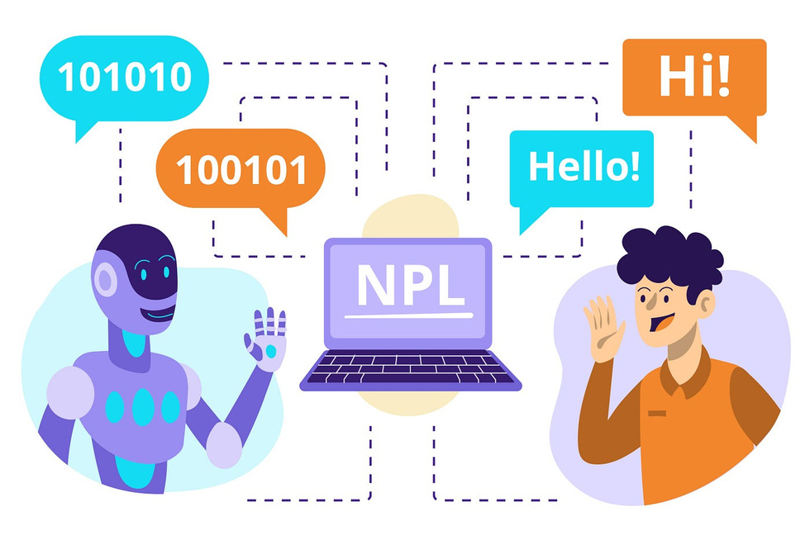
TABLE OF CONTENT
Introduction
Methodology
Datasets and Evaluation data
Experiments and Results
Related works
Conclusion and future works

Slide 3


INTRODUCTION
This leads to a significant improvement in translation quality, as evidenced by a 9 BLEU score increase over previous approaches, and contributes to elevating Bengali from its low-resource status in machine translation.
The paper outlines the challenges in Bengali-English machine translation, mainly due to the lack of high-quality parallel corpora. Bengali, despite being widely spoken, is underrepresented in translation literature. The paper addresses this gap by developing a customized sentence segmenter for Bengali, proposing two novel methods (aligner ensembling and batch filtering for creating a parallel corpus.
There was a detailed discussion of the stage for the detailed methodologies and experiments that follow, highlighting the significance of this research in the context of global language representation in machine translation.

Slide 4

METHODOLOGY
The methodology in the paper involves several key steps:
Sentence Segmentation: Implementing a custom sentence segmenter for Bengali to enhance alignment quality.
Aligner Ensembling: Selecting and combining different sentence aligners to optimize the alignment of Bengali-English sentence pairs.
Batch Filtering: Filtering the aligned data in batches to ensure quality and relevance of the parallel corpus.
Data Compilation: Merging various sources, including corpora from subtitles, TED talks, and other specialized texts, to create a diverse and extensive parallel corpus.
Experimentation: Conducting experiments with different model configurations and pre-processing techniques to evaluate the effectiveness of the newly created datasets.
These methods collectively contribute to significantly improving the quality of Bengali-English machine translation.

Slide 5

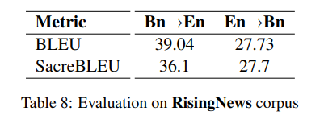
DATASETS AND EVALUATION
Datasets
Evaluation
The datasets used in the paper for Bengali-English machine translation include:
The creation of new evaluation datasets were described. These datasets are designed to more accurately assess the performance of Bengali-English translation systems.
Sentence-Aligned Corpora:
Document-Aligned Corpora:
Included Glosbe online dictionary example sentences, MediaWiki Content Translations, Ubuntu localization files
Open Subtitles 2018 corpus from OPUS, TED corpus, SUPara corpus
Additional Sources:
Translations of over 100 books, Bangladesh Law Documents, Human Rights Watch (HRW) reports, Wikipedia sections (Wiki Sections)

Slide 6

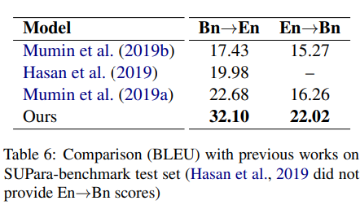
EXPERIMENT AND RESULTS
The experimental setup in the paper involves custom sentence segmentation for Bengali, aligner ensembling to improve alignment quality, batch filtering to refine the parallel corpus, and the compilation of a large-scale, diverse corpus. This corpus is then preprocessed and used to train neural machine translation models, specifically the Transformer model. The performance of these models is evaluated using BLEU scores and other metrics, comparing them with previous studies and automatic translators on newly created and existing test sets. This approach significantly improves Bengali-English machine translation.
Result
The paper's results show significant improvements in Bengali-English machine translation. The custom sentence segmenter and novel aligner ensembling and batch filtering techniques led to the creation of a high-quality parallel corpus of 2.75 million sentences. This corpus helped in achieving more than a 9 BLEU score improvement over previous approaches. The paper also introduces a new test set of 1,000 pairs for evaluating Bengali-English translation, contributing to the elevation of Bengali from its low-resource status in machine translation. The results indicate the effectiveness of the methods proposed in the paper for enhancing machine translation in low-resource language pairs.

Slide 7
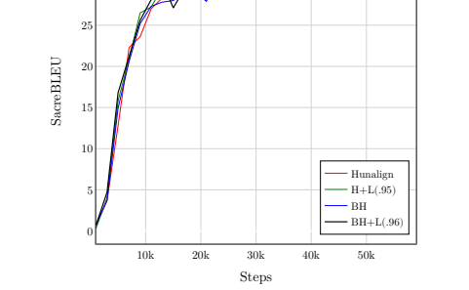

RELATED WORK
Related work included reviews of existing literature in the field, focusing on previous efforts in machine translation, especially for low-resource languages like Bengali

Slide 8

CONCLUSION AND FUTURE WORK
Future work:
In conclusion, the paper emphasizes the successful development of a custom sentence segmenter for Bengali, the implementation of aligner ensembling, and batch filtering methods, leading to the creation of a 2.75 million sentence Bengali-English parallel corpus. This significantly improved machine translation performance, helping elevate Bengali from its low-resource status.
For future work, the authors plan to design segmentation-agnostic aligners and further explore the LASER toolkit for sentence alignment and filtering. They also intend to investigate semi-supervised and unsupervised approaches, leveraging monolingual data, and explore multilingual machine translation for other low-resource Indic

Slide 9

THANK YOU.

