Slide 1

KHOOZO
From First Post to Finished Task
A complete walkthrough of the Khoozo platform — task posting, admin moderation,
and the bidding marketplace that connects neighbours who need help with those who can give it.
ADMIN APP
TASK POSTER JOURNEY
BIDDER JOURNEY
Notes:
Title slide: Khoozo is a hyperlocal task marketplace. This deck walks through the full lifecycle end-to-end: a user posts a task, the admin team moderates it, and the marketplace of bidders/helpers takes over from there.

Slide 2
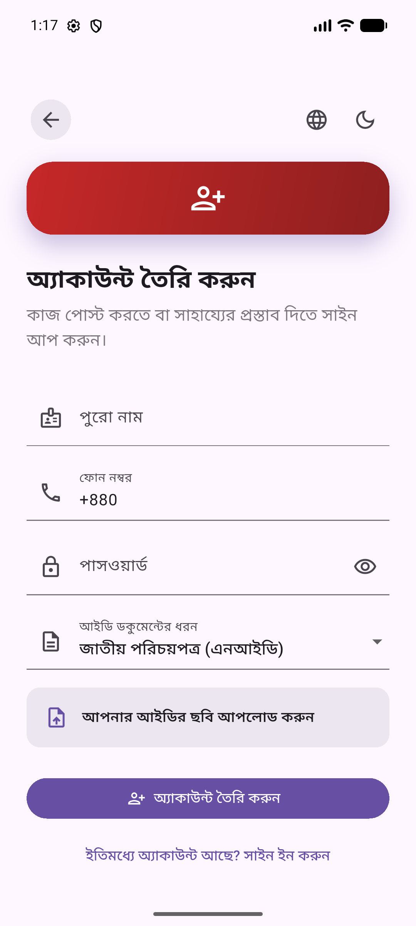
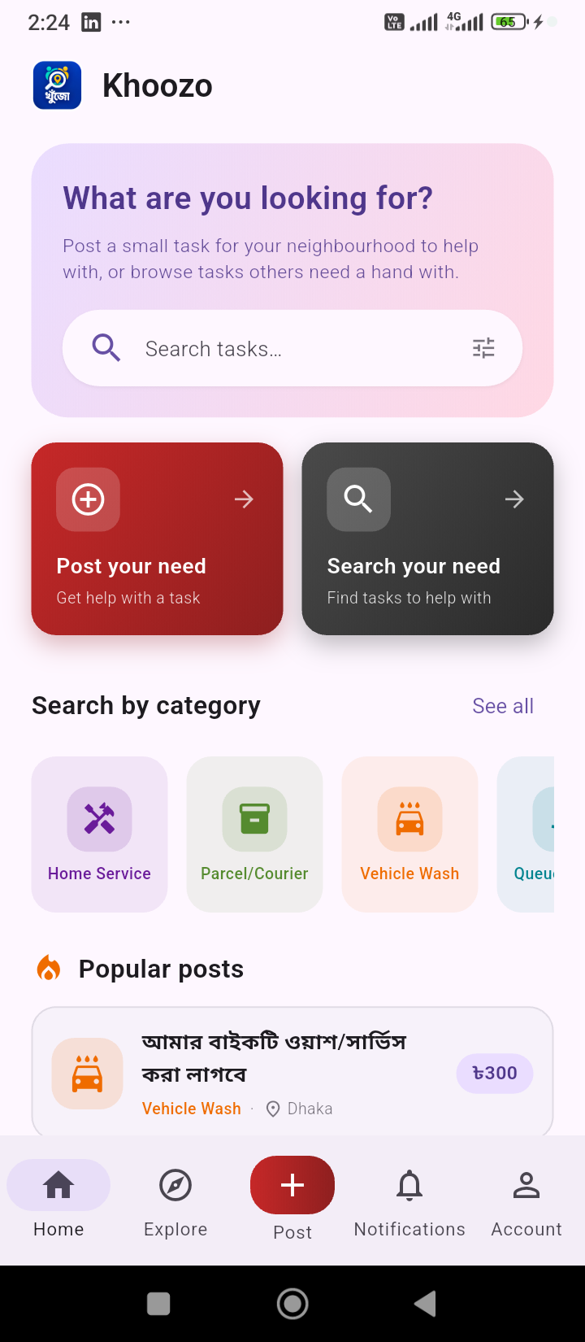
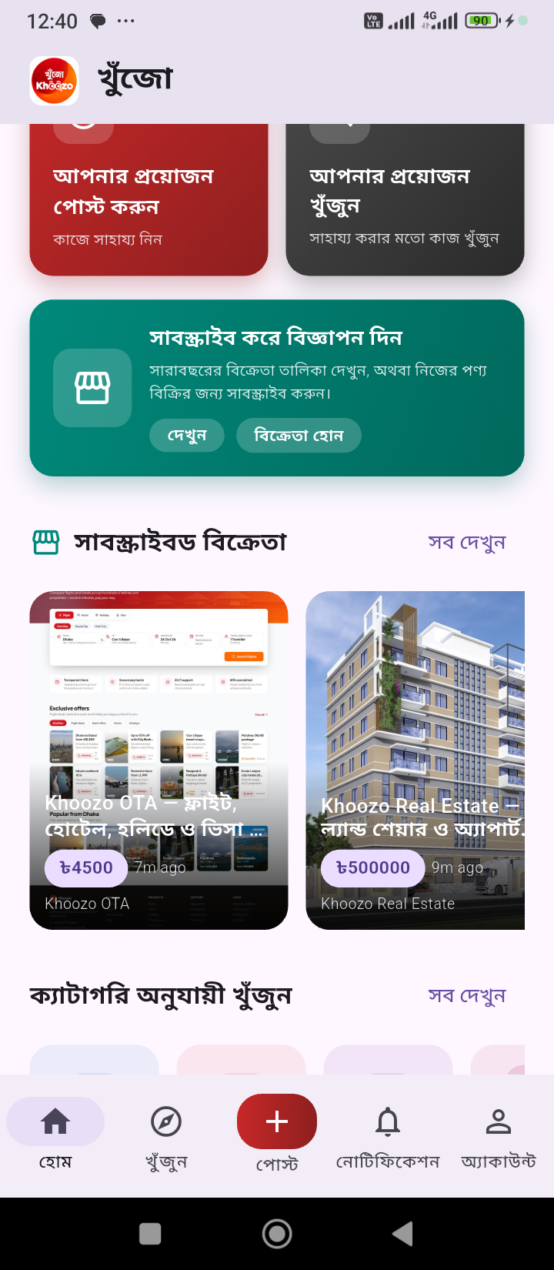
PROVIDER
STEP 1 · THE LIFECYCLE BEGINS
Sign Up & Land on Home
A new user signs up in seconds and lands on the Khoozo home screen.
The home feed leads with one clear choice: post a need, or search for one to help with.
Subscribed-seller storefronts (OTA, real estate) sit right on the home feed too.
Sign Up
Home
Subscribed Sellers
Notes:
Entry point for the task-poster journey: account creation then the home screen, which is the shared hub for both posting and browsing.

Slide 3
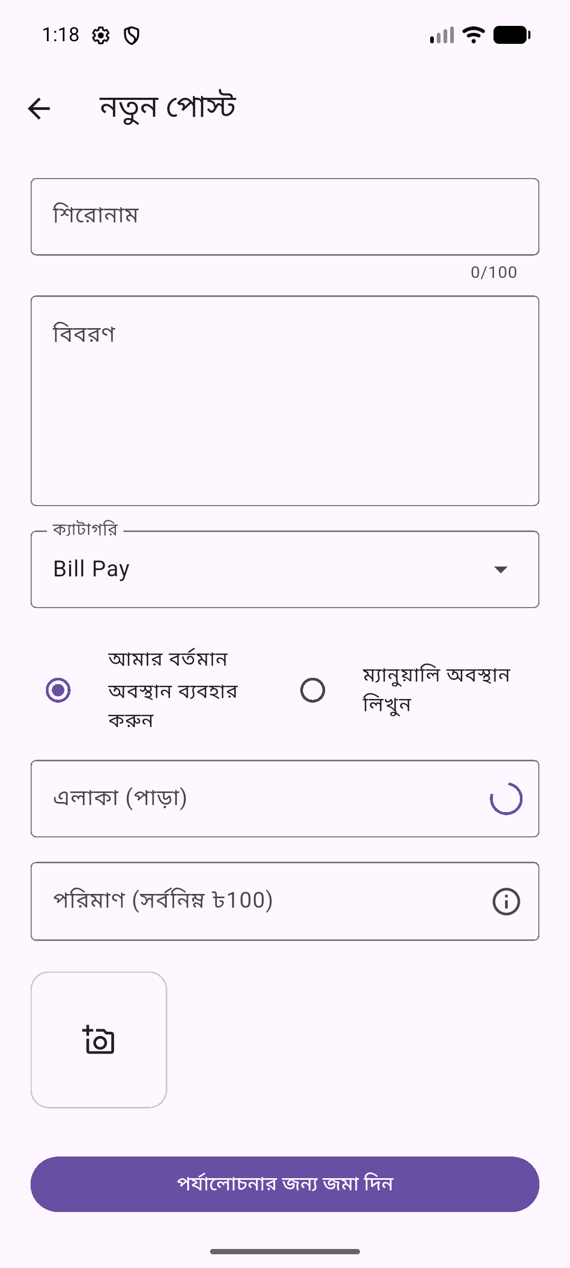
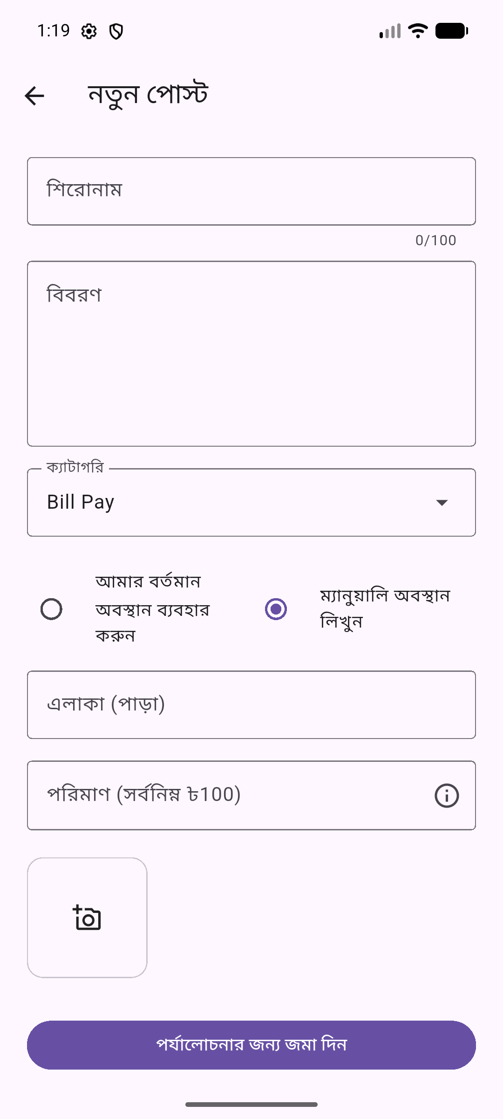
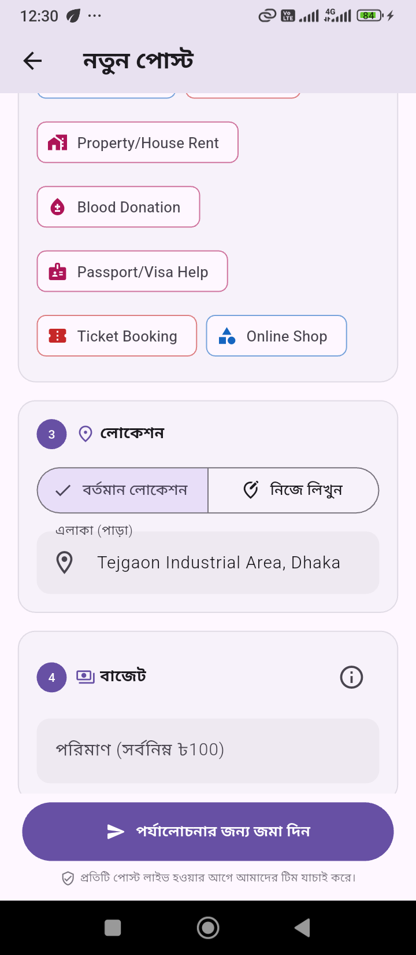
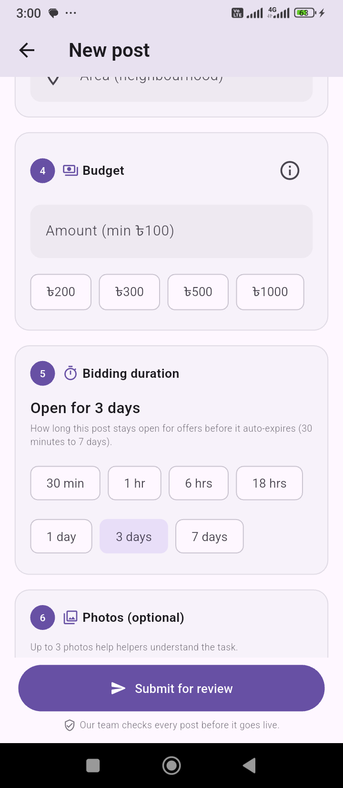
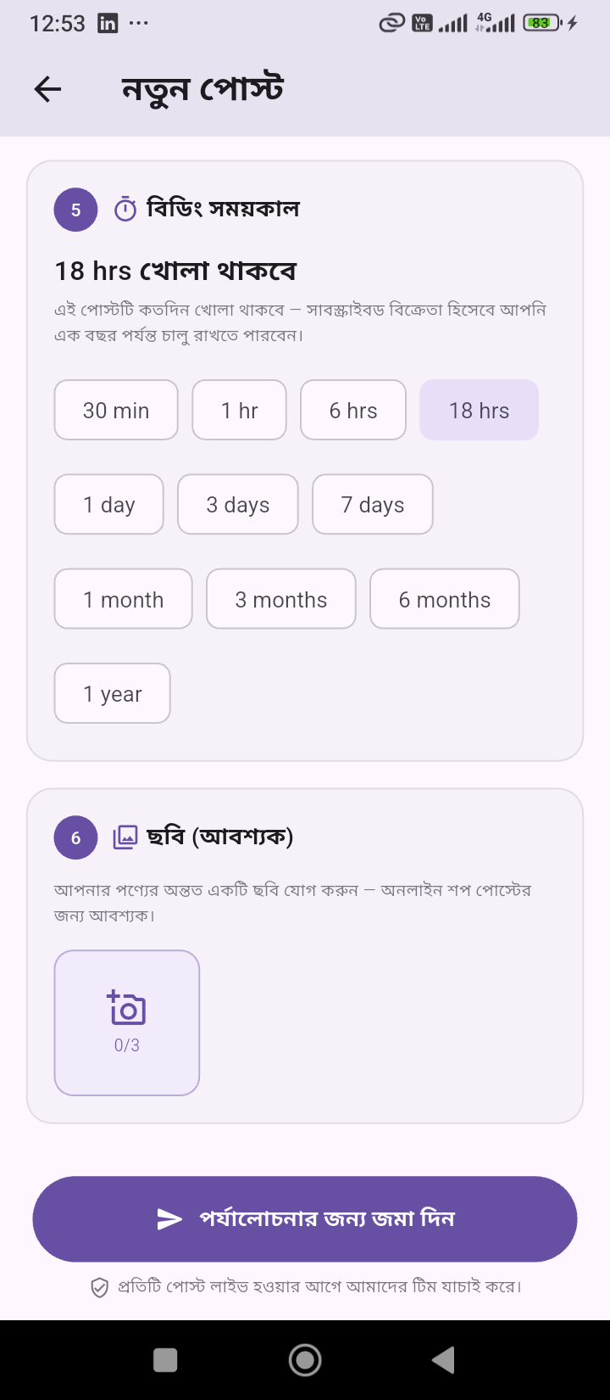
PROVIDER
STEP 2 · TASK POSTER
Create a Task in a Few Guided Steps
Pick a category — Home Service, Parcel, Ticket Booking, Online Shop and more.
Set the location: current GPS position or a manually typed address.
Set a budget and choose how long bidding stays open, from 30 minutes to a year.
1. Category
2. Location
GPS Location
3. Budget
4. Bid Duration
Notes:
The post-creation wizard: category, location, budget and bidding duration are all configured before submission.

Slide 4
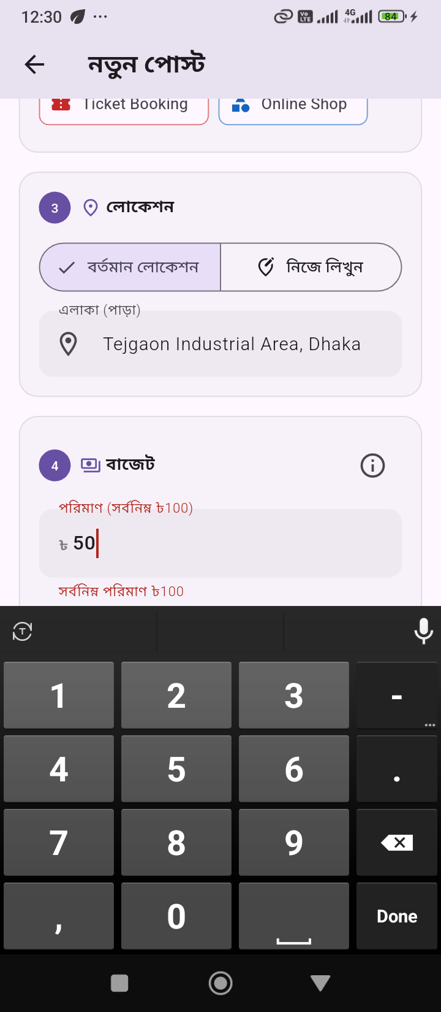
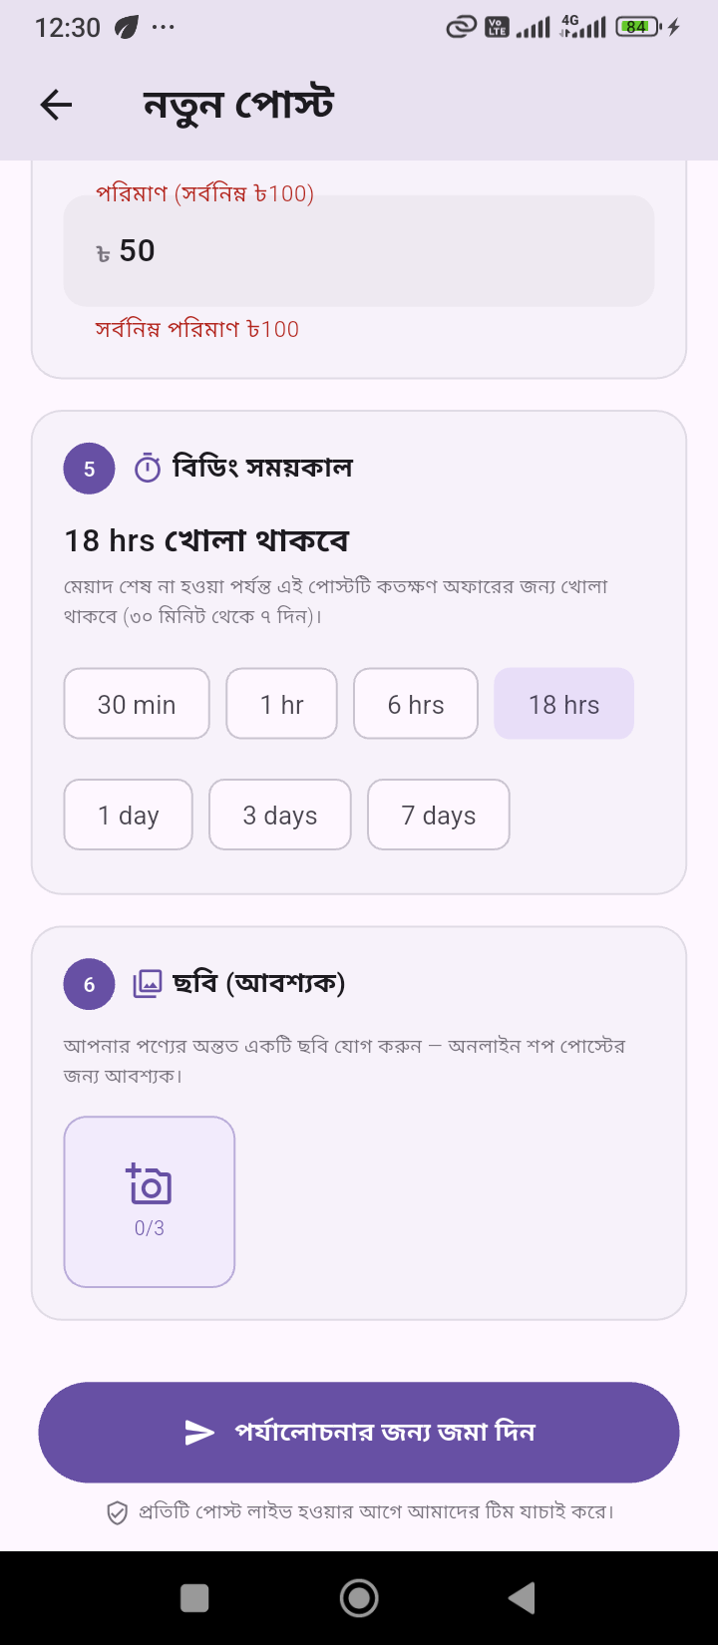
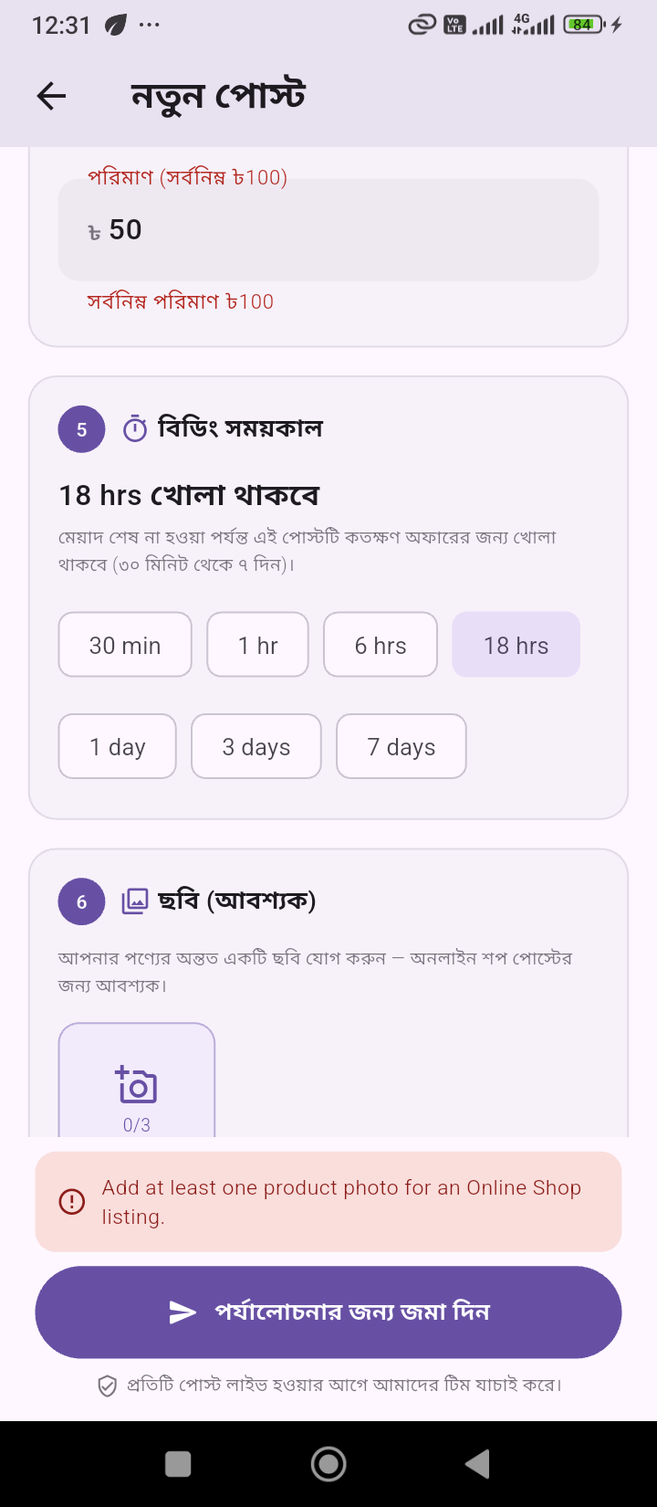
PROVIDER
STEP 3 · TASK POSTER
Built-In Guardrails Keep Posts Clean
Minimum-budget validation stops unrealistic offers before they go live.
Online Shop listings require at least one product photo.
Submission is blocked with a clear message until every requirement is met.
Budget Check
Photo Required
Blocked Submit
Notes:
Validation layer that runs before a post can be submitted for review — keeps data quality high before it ever reaches the admin queue.

Slide 5

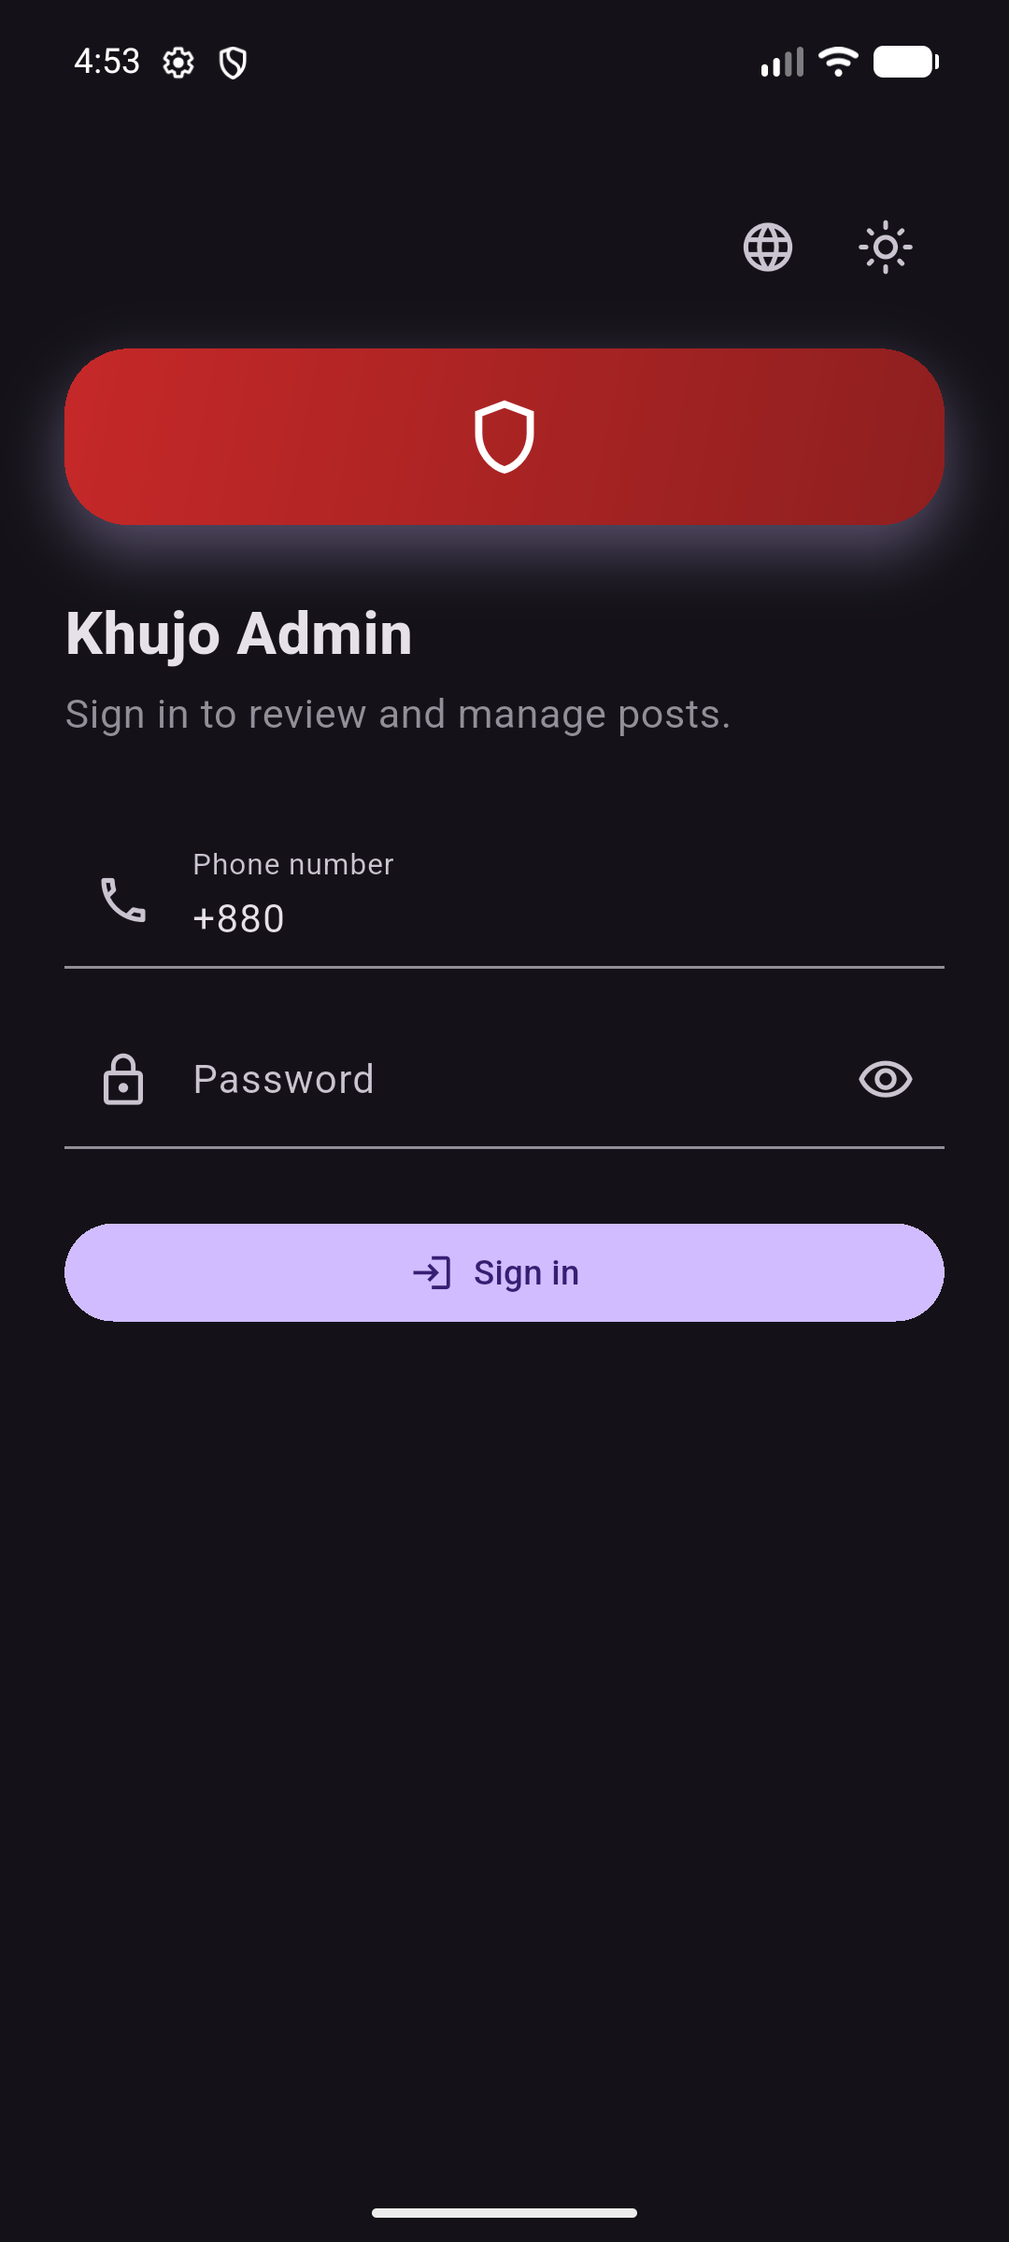
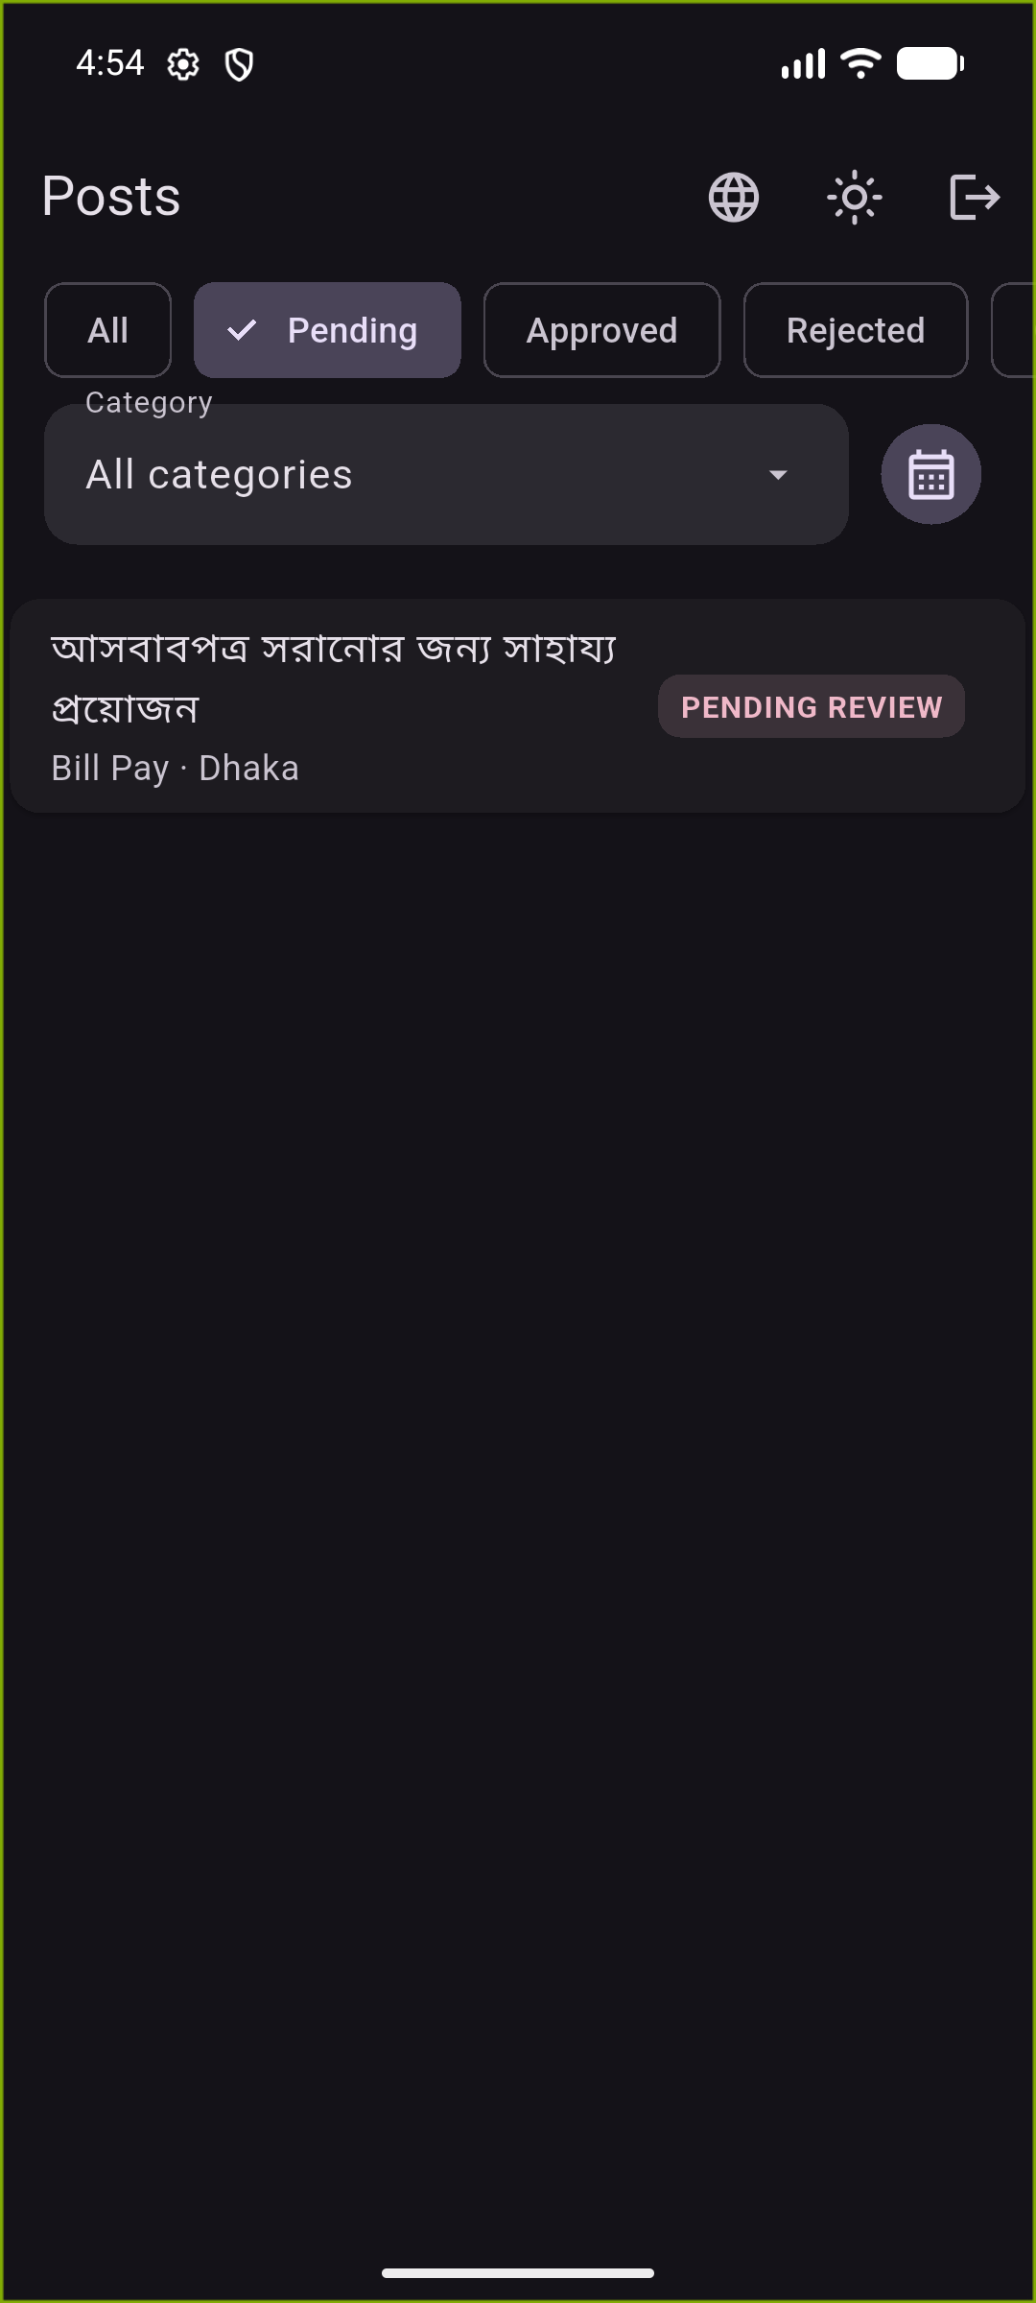
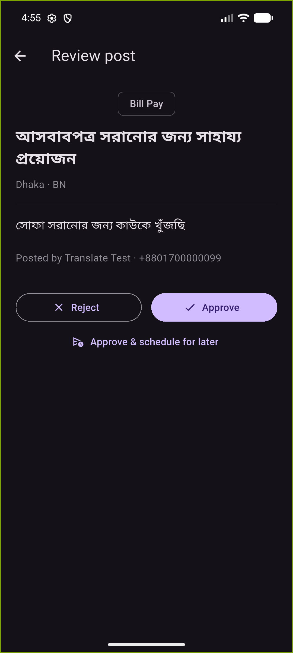
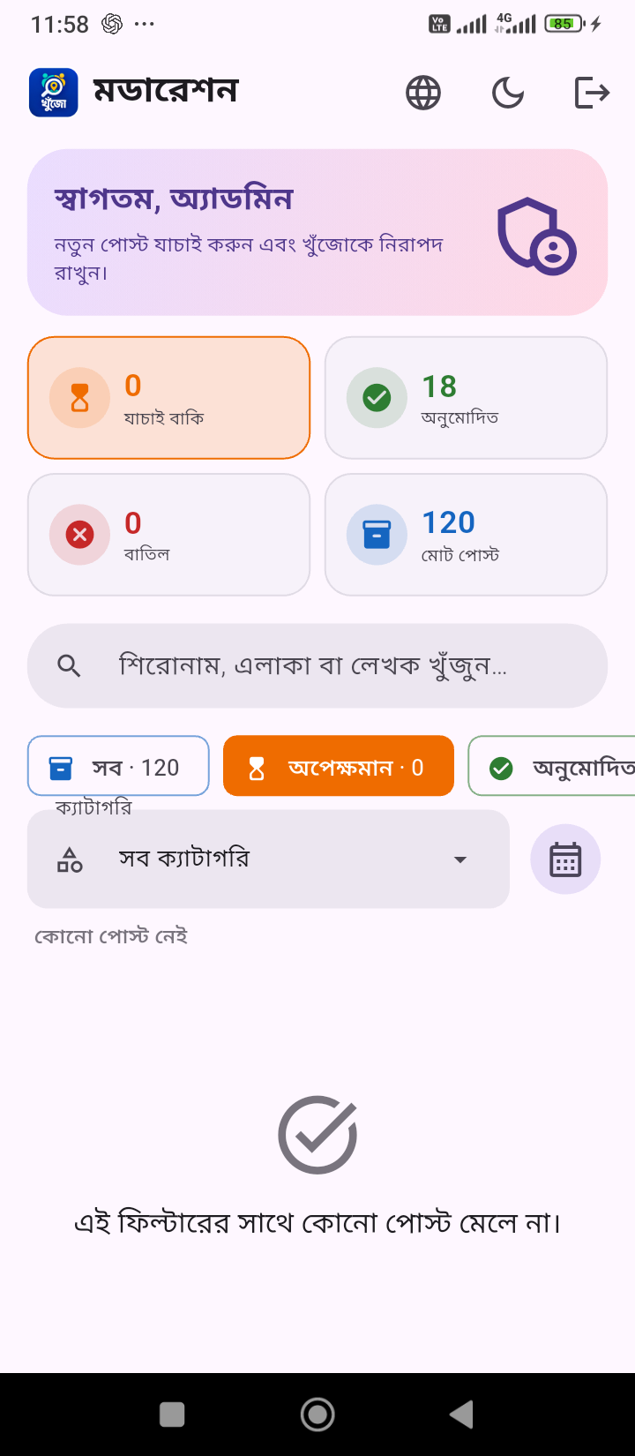
ADMIN
STEP 4 · BEHIND THE SCENES
The Admin App Reviews Every Post
Every submitted post lands in a moderation queue before it ever reaches the marketplace.
Admins filter by category and open each post's full detail to review it.
One decision — approve or reject — and the queue clears, instantly unlocking the post for bidders.
1. Admin Launch
2. Admin Login
3. Moderation Queue
4. Review Post
5. Queue Cleared
Notes:
This is the hinge of the whole lifecycle: nothing a task-poster creates reaches the bidder marketplace until an admin reviews and approves it here. Internally this is presented as a 5-step reveal — launch, login, queue, review, cleared — to show the admin workflow end-to-end.

Slide 6
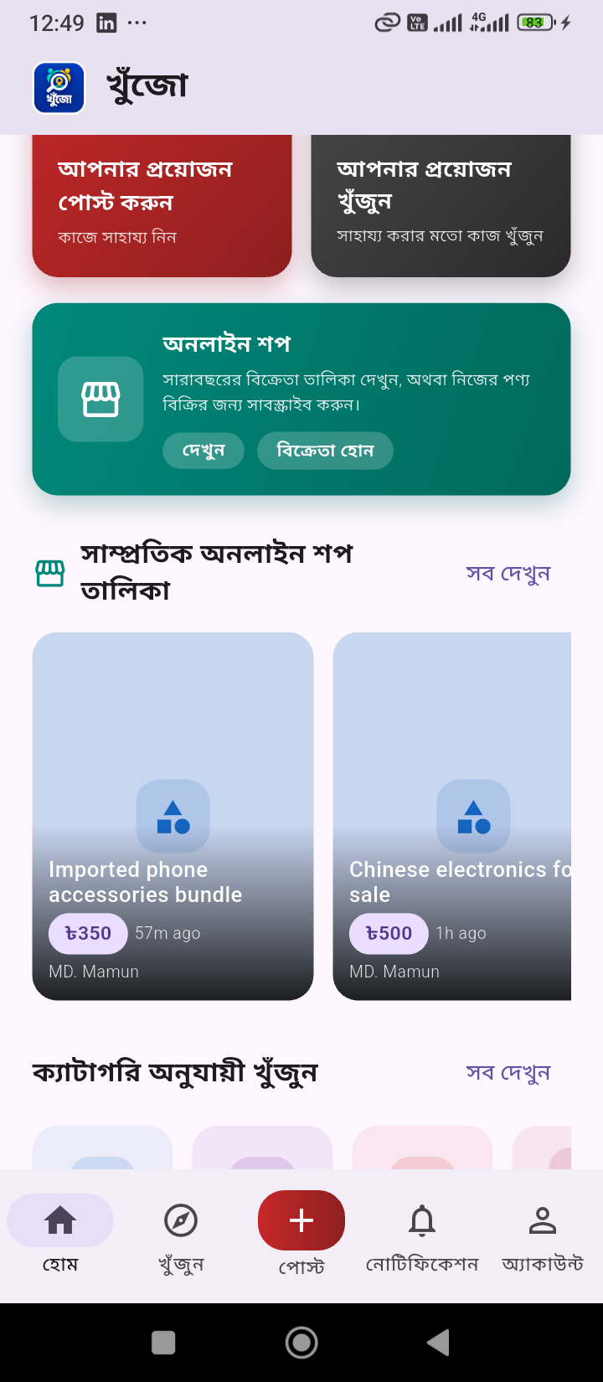
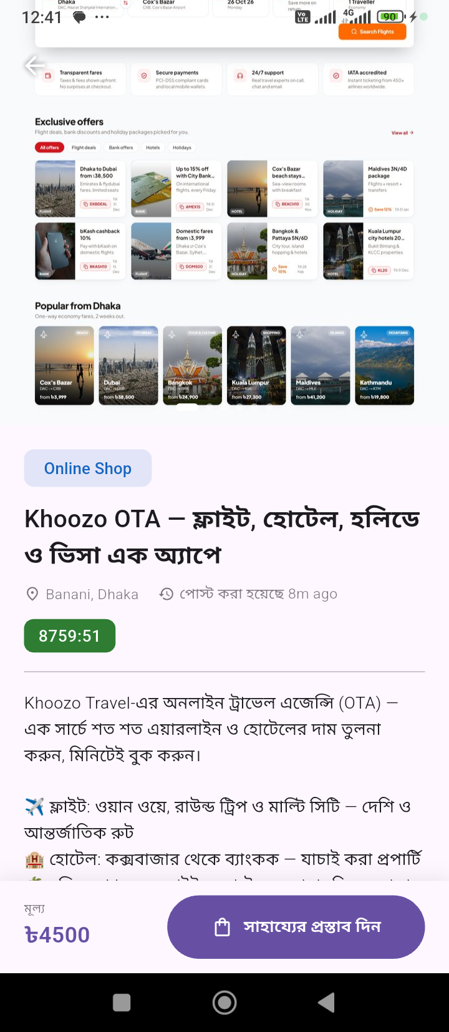
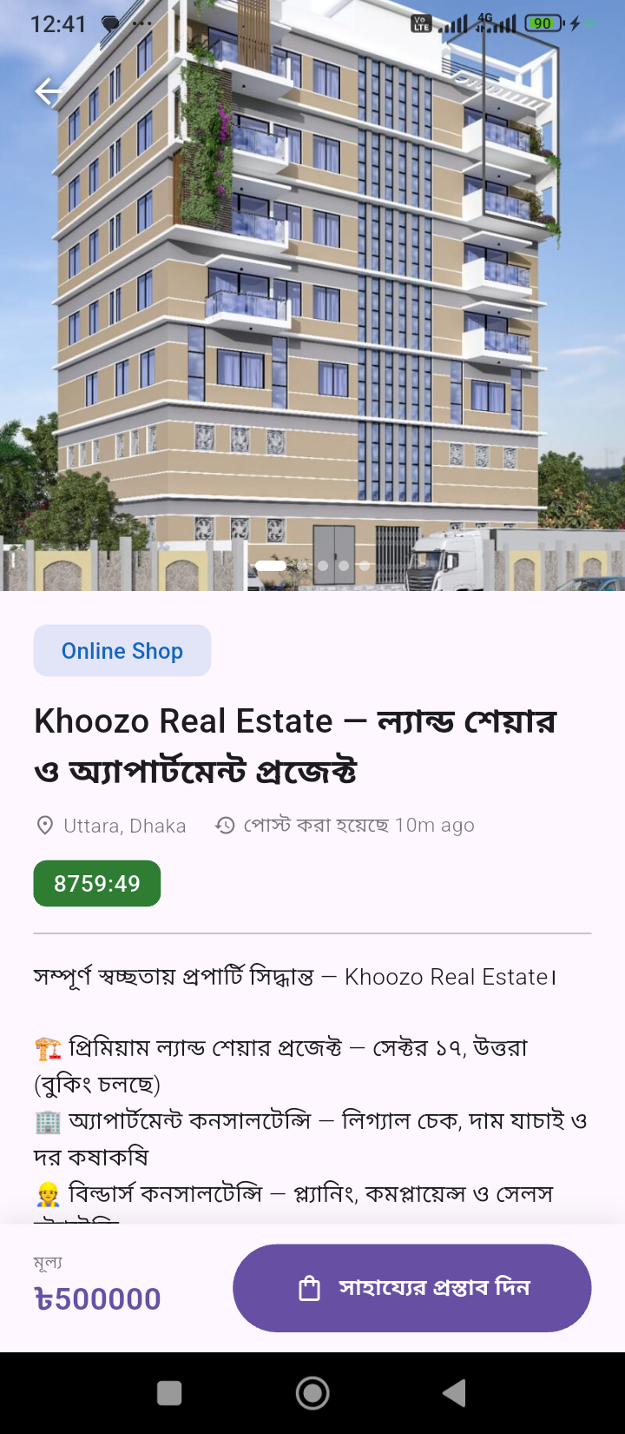
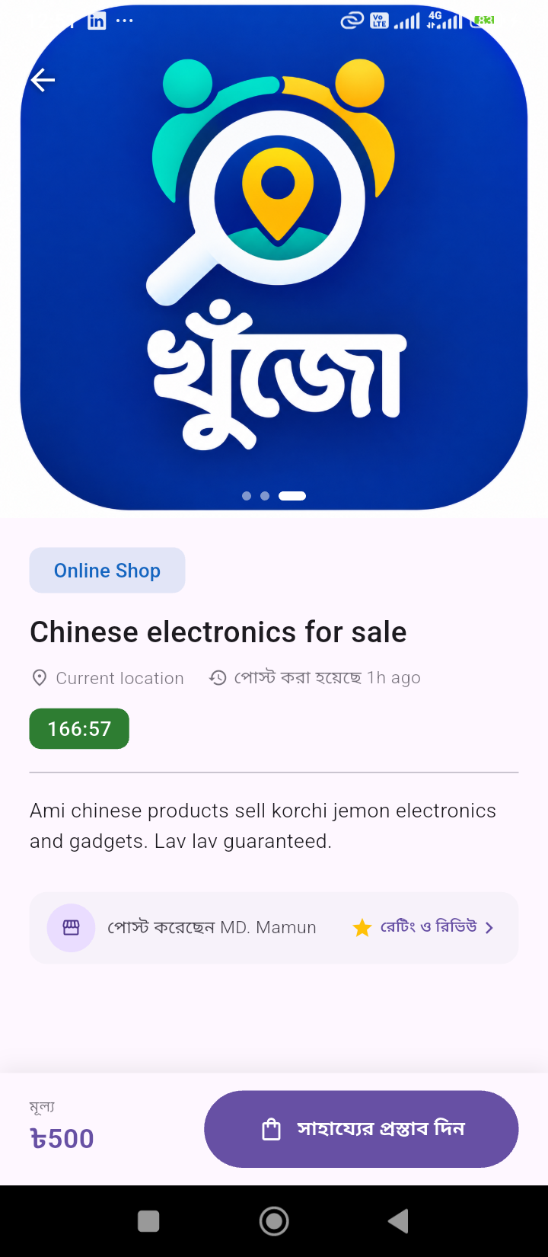
BIDDER
STEP 5 · THE BIDDER JOURNEY
Approved Posts Go Live for Bidders
Once approved, posts surface instantly on Home and Explore.
Khoozo spans multiple verticals: everyday tasks, OTA travel bookings, real estate.
A scrollable 'recent listings' overlay keeps fresh opportunities front and centre.
Recent Listings
Khoozo OTA
Real Estate
Online Shop
Notes:
The discovery side for a bidder/helper: the home feed and explore surfaces now show the task that was just approved by admin.

Slide 7
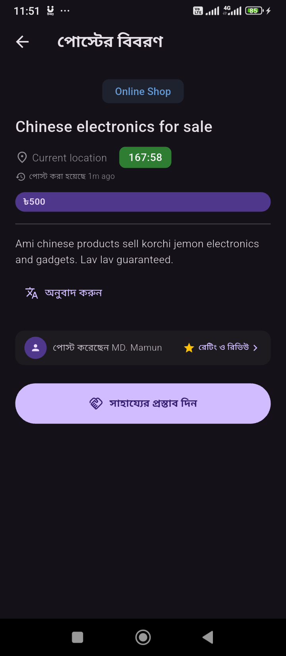
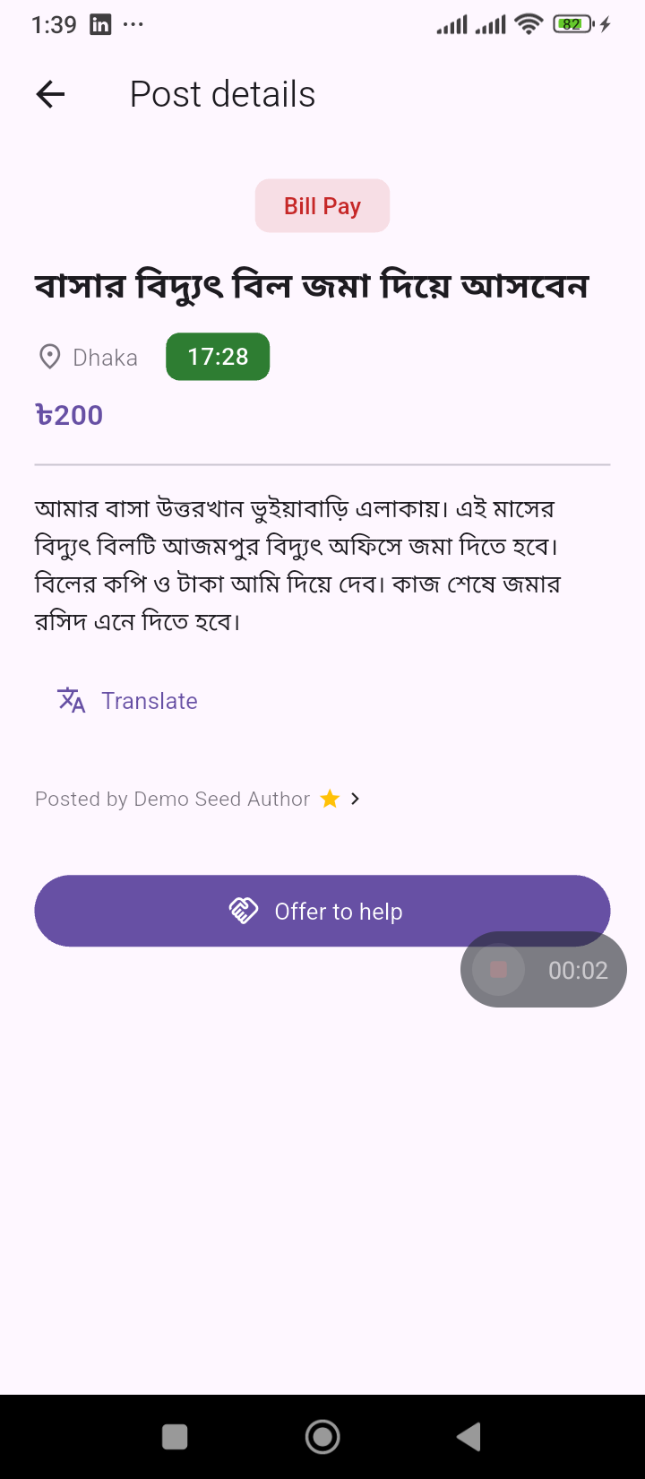
BIDDER
STEP 6 · THE BIDDER JOURNEY
Inspect the Task Before Bidding
Full task detail: description, budget, and a live countdown to bidding close.
A translate shortcut helps bidders read posts written in another language.
Everything a helper needs to decide is visible before they commit to an offer.
Listing Detail
Bidding Countdown
Notes:
Detail view with the live bidding-window countdown — this is what converts a browser into a bidder.

Slide 8
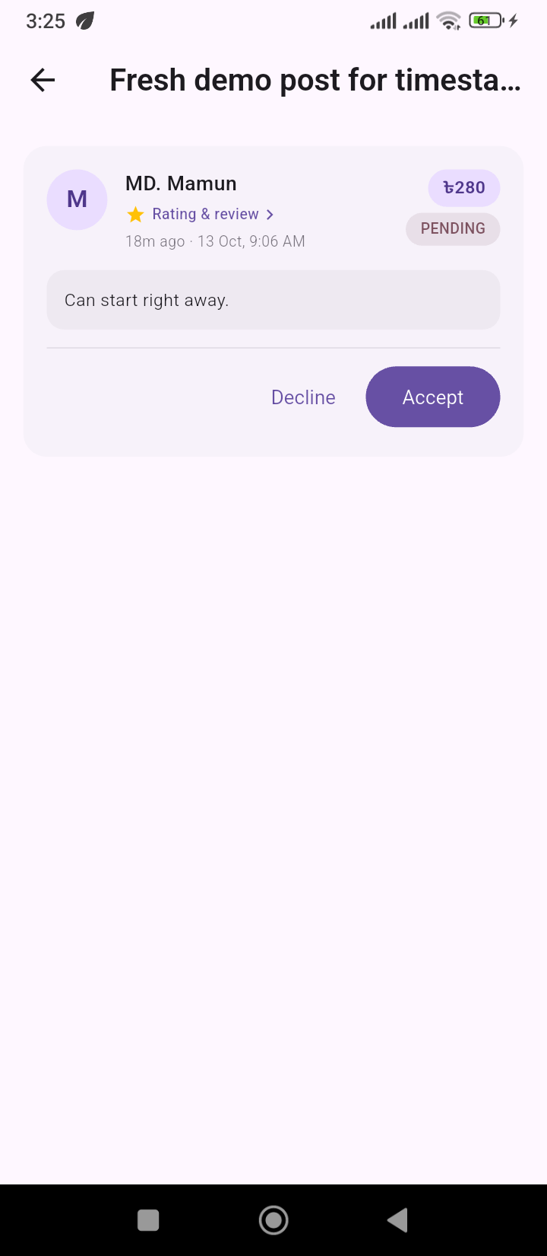
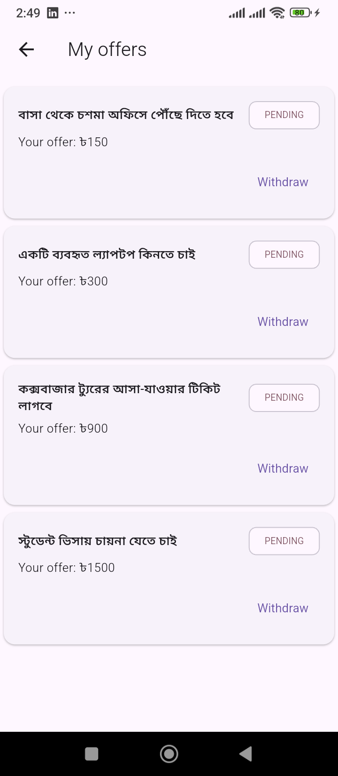
BIDDER
STEP 7 · THE BIDDER JOURNEY
Log In and Place an Offer
A guest is prompted to log in right at the point of making an offer.
Offers carry an amount and an optional note — e.g. "15 minutes away, can start now."
Every offer placed shows up immediately in the bidder's own 'My Offers' list.
Post an Offer
My Offers
Notes:
The core bidding action: authenticate, then submit an offer with amount and message. Offers can be withdrawn while still pending.

Slide 9
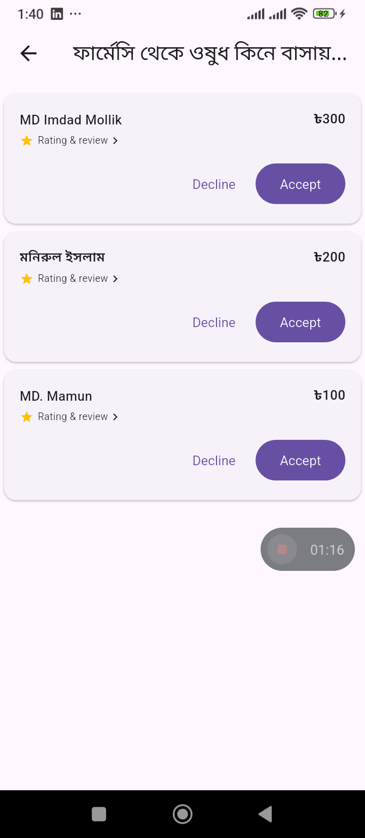
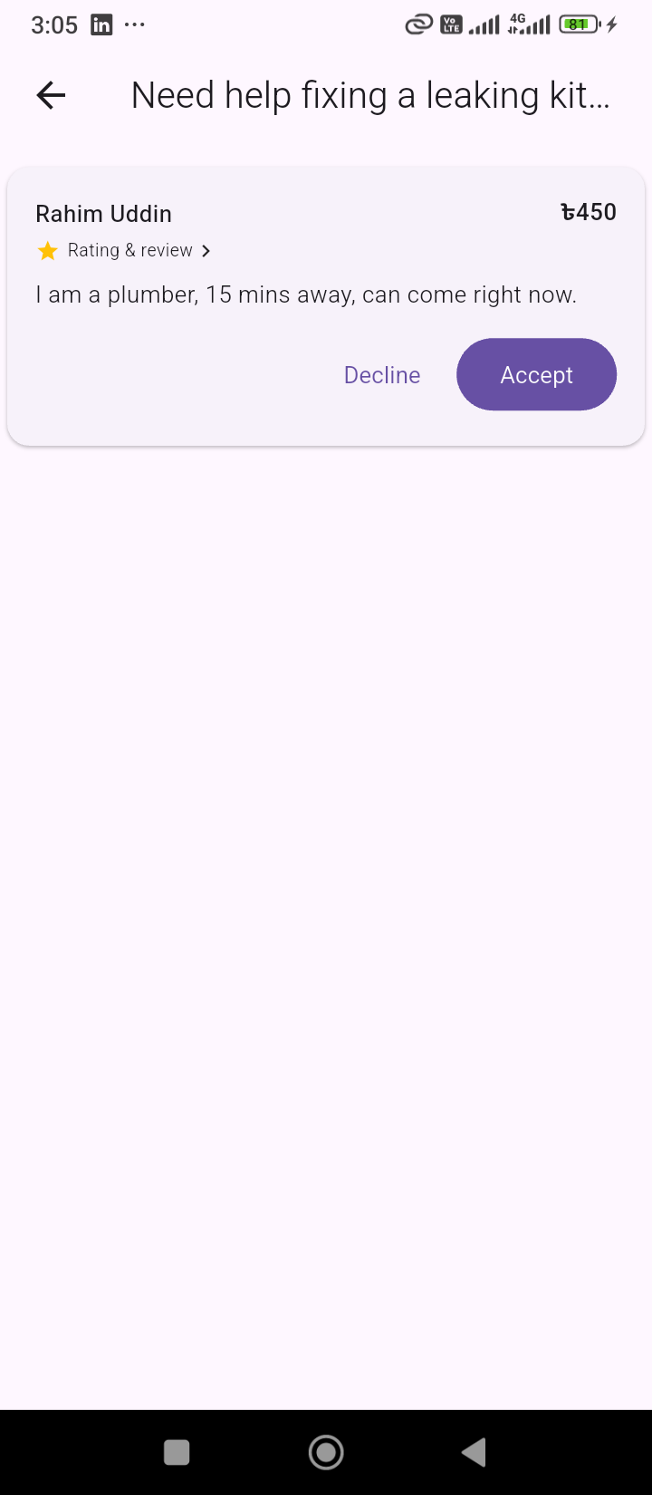
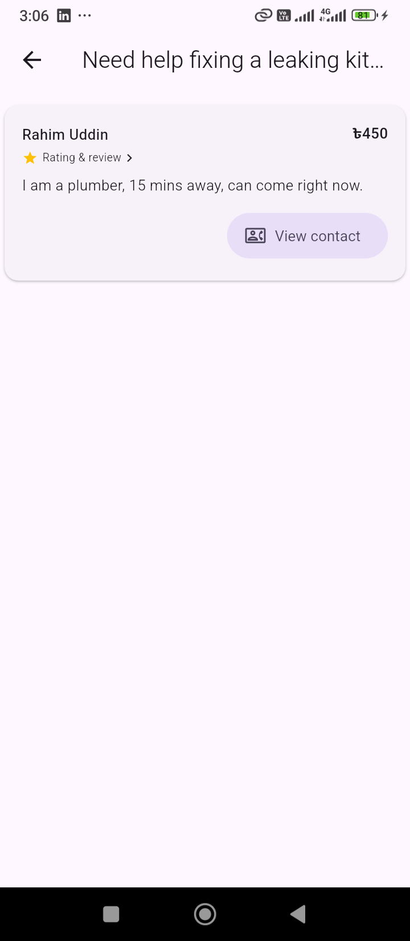
PROVIDER
STEP 8 · BACK TO THE TASK POSTER
Review Offers and Accept the Best One
Every incoming offer appears with the bidder's rating, price, and message.
The poster compares offers side by side, then accepts or declines with one tap.
Accepting an offer instantly closes bidding and confirms the match.
Bid List
Offer Received
Offer Accepted
Notes:
Control returns to the task-poster: they now see every offer the bidding round produced and choose who does the work.

Slide 10
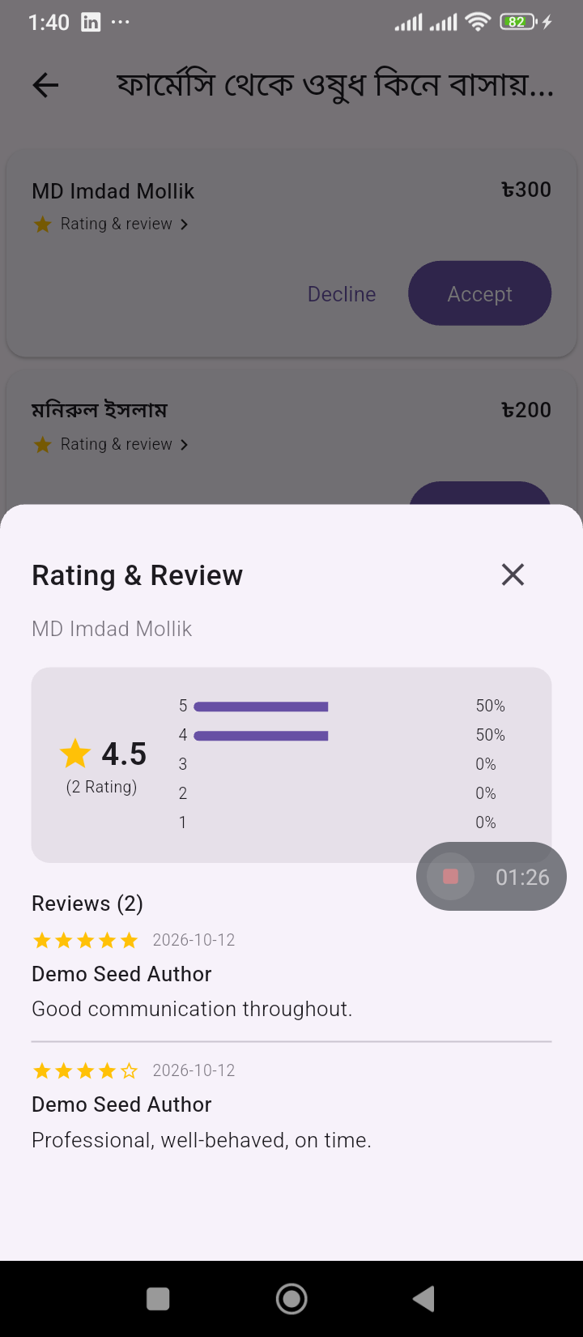
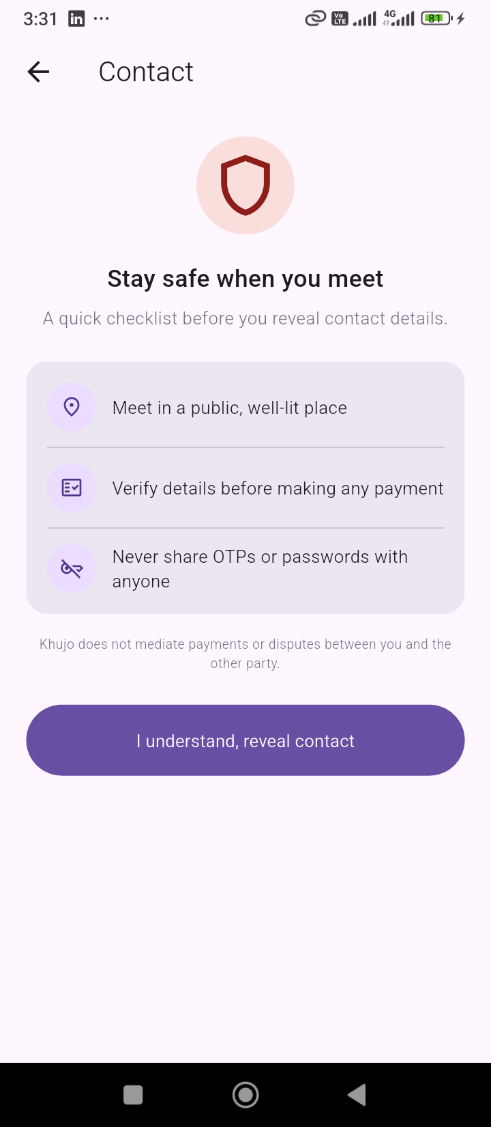
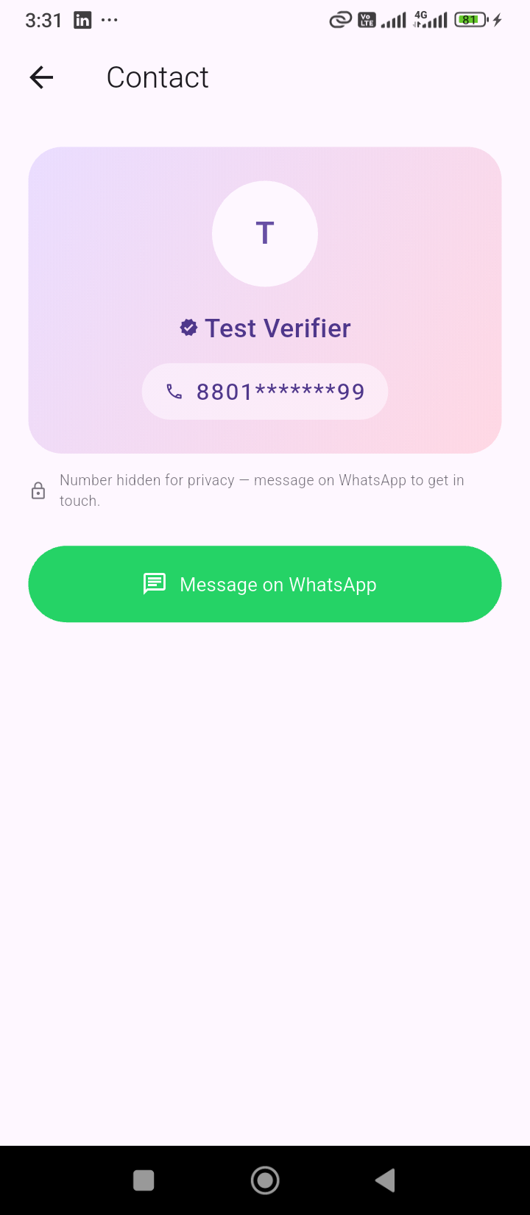
BIDDER
STEP 9 · THE BIDDER JOURNEY
Trust Signals Unlock Safe Contact
Ratings and reviews travel with every bidder's profile, visible before acceptance.
A safety checklist appears before any phone number is revealed.
Once both sides are ready, contact details are revealed so work can begin.
Bidder Rating
Safety Checklist
Contact Revealed
Notes:
Trust and safety layer that sits between 'offer accepted' and the two parties actually meeting or calling each other.

Slide 11
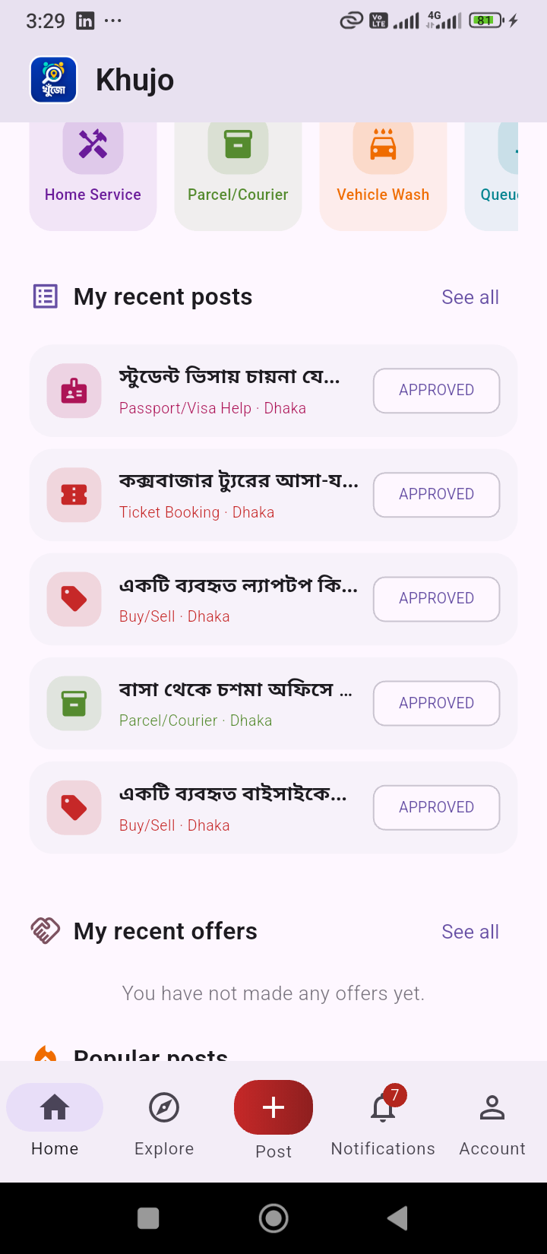
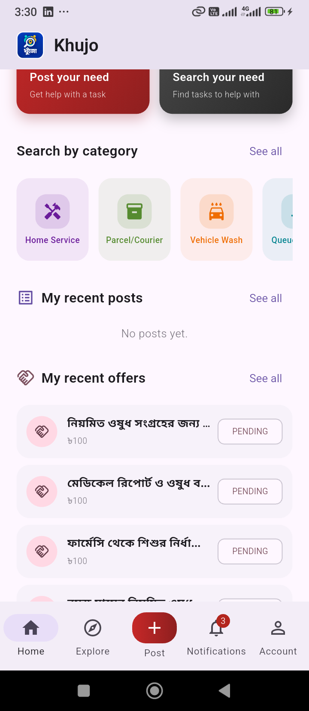
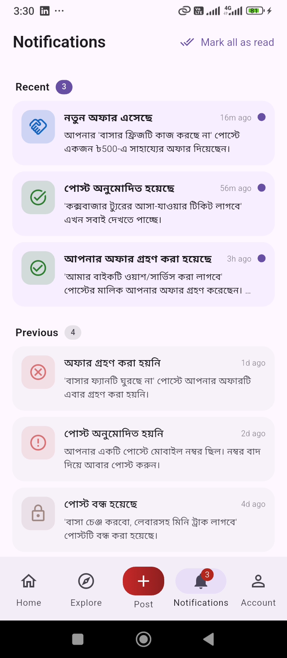
BIDDER
STEP 10 · THE BIDDER JOURNEY
A Dashboard to Track Every Offer
One dashboard rolls up a user's recent posts and recent offers together.
Bidders see every offer they've placed and its live status at a glance.
Notifications keep both sides updated the moment anything changes.
My Dashboard
Recent Offers
Notifications
Notes:
Every Khoozo user is both a potential poster and a potential bidder, so the dashboard and notifications unify both roles in one place.

Slide 12
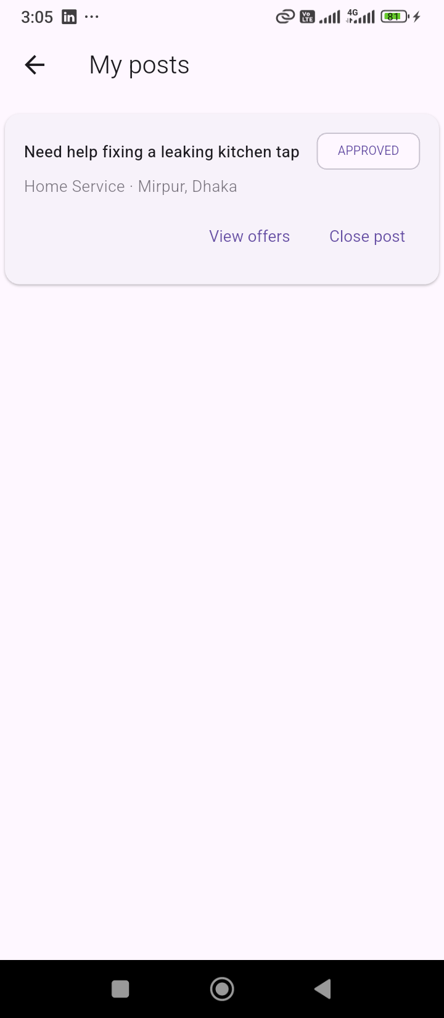
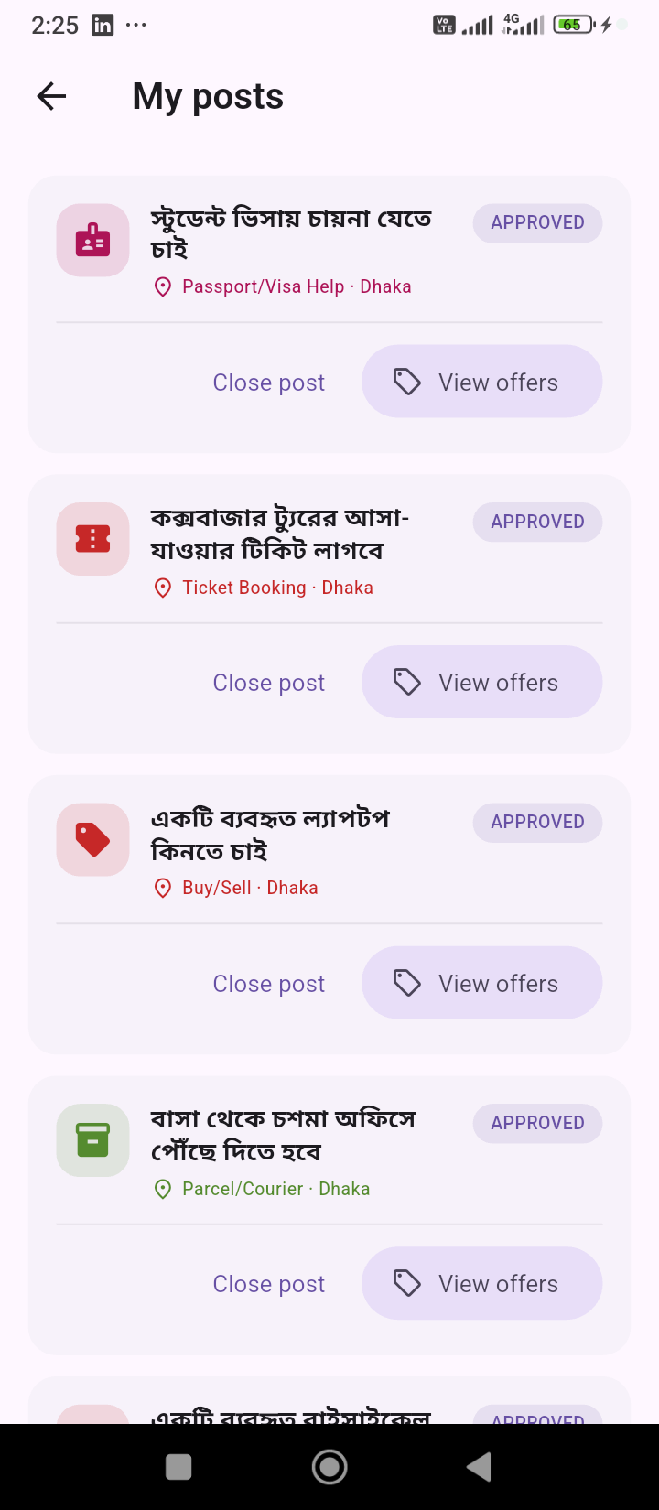
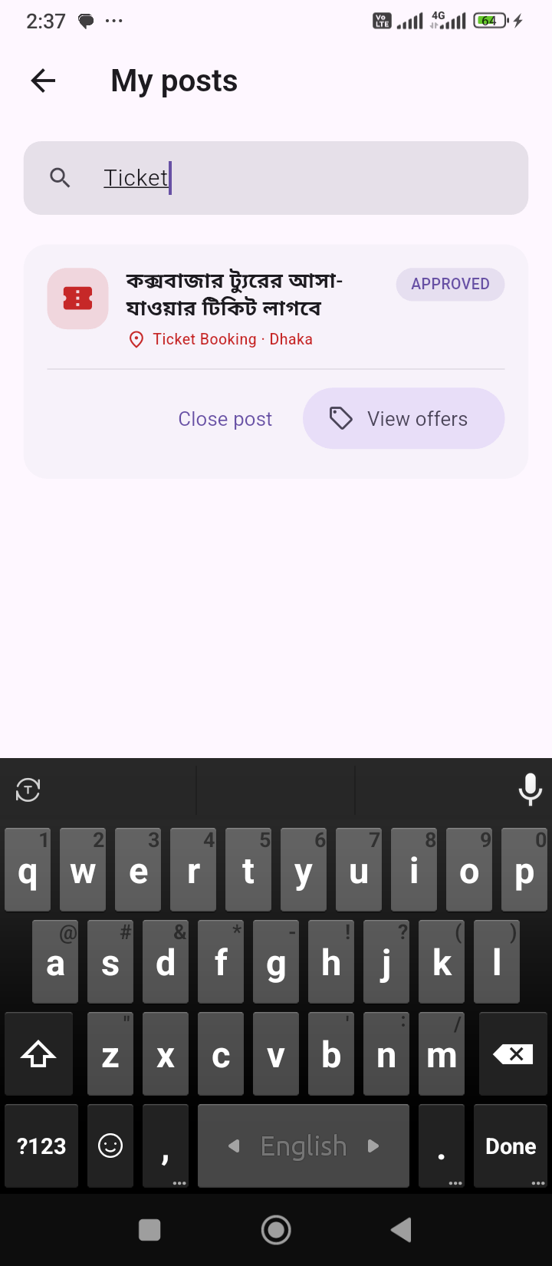
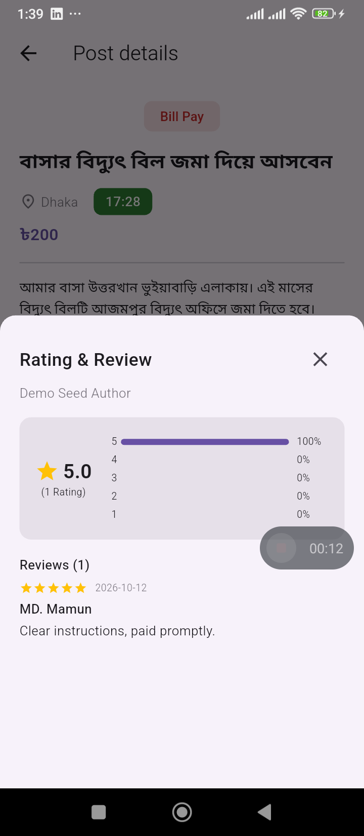
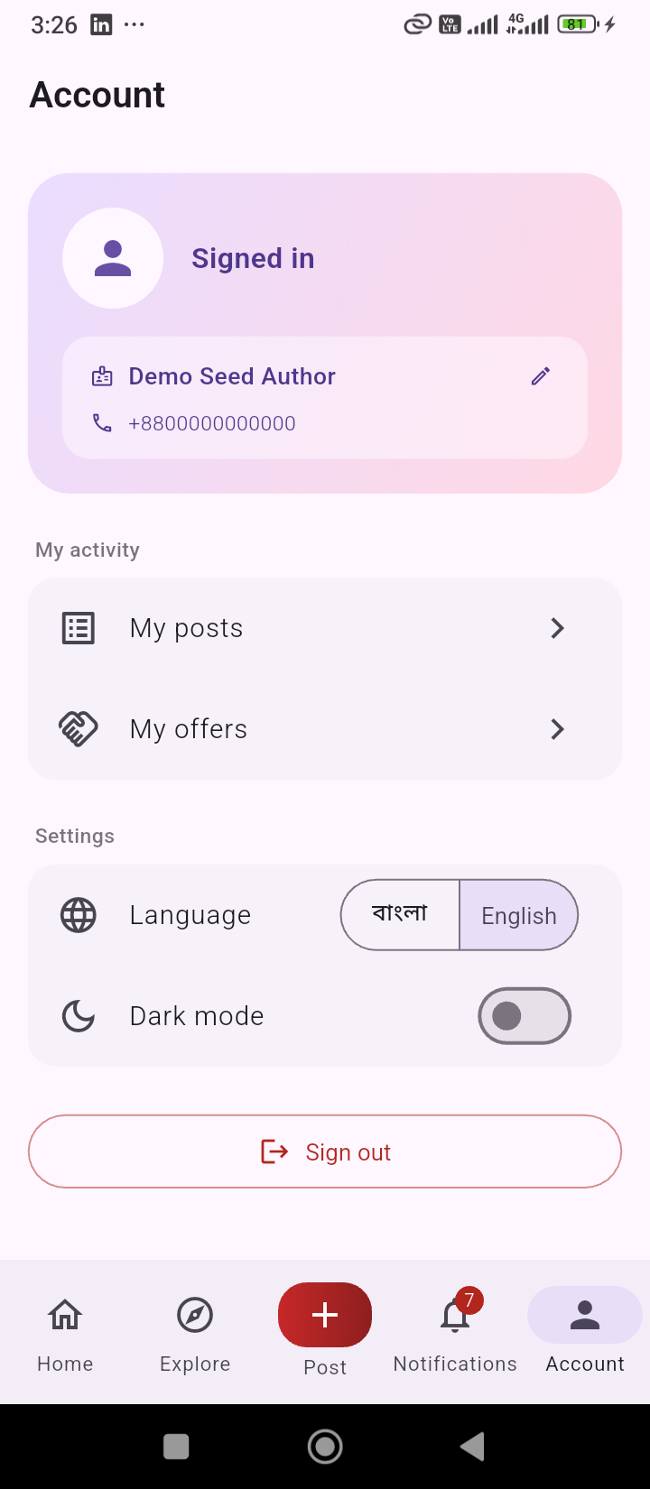
PROVIDER
STEP 11 · THE LIFECYCLE COMPLETES
Manage Posts, Rate Help, Own Your Profile
'My Posts' tracks every task a poster has ever created, with quick search.
After the work is done, the poster rates and reviews the bidder who helped.
A simple profile editor keeps the poster's own details accurate and current.
My Posts
Posts Redesign
Search Posts
Rate the Helper
Edit Profile
Notes:
The loop closes here: the task-poster manages their post history and rates the bidder, feeding the trust signals that power the next cycle.

Slide 13
One Loop. Two Roles. One Marketplace.
Post → Admin Review → Live Marketplace → Bid → Accept → Trust → Repeat
Thank you
Notes:
Closing slide: the whole Khoozo lifecycle is one continuous loop shared by every user, who can be a task-poster one day and a bidder the next, moderated at every step by the admin team.

