Slide 1
CSE 4105 · SYSTEM PROGRAMMING
Lecture 7.2
QEMU: firmware → GRUB → kernel → our init
SeaBIOS (version 1.16.3-debian-1.16.3-2)
Booting from DVD/CD...
GNU GRUB version 2.12
GRUB: loading the kernel...
GRUB: loading the initramfs...
*** myinit: I am PID 1, started by
the kernel as /init ***
Booting Linux
from power-on to your own PID 1
Md Mahbub E Noor
Assistant Professor, Department of CSE
University of Barishal

Slide 2




What you will learn today
Name the stages from power-on to the first user program, and what each one loads.
Today's plan (60 min)
0–5
Recap of 7.1
Compare BIOS and UEFI booting, and say what a boot loader does.
5–15
Firmware
15–25
Boot loader
25–45
Kernel start-up
Follow start_kernel, rest_init and kernel_init in the real source.
45–55
PID 1
55–60
Checkpoint
Write your own PID 1 in C, boot it in QEMU, and read a kernel panic.
Lab 7.2: myinit.c, your own init, booted in QEMU.
2 / 27

Slide 3
Quick recap of Lecture 7.1
Who is PID 1, and who is PID 2?
PID 1: the first user program (init). PID 2: kthreadd, the parent of all kernel threads. Today: who creates them, and in which order.
Q1
What does /proc show before it is mounted?
Nothing: an empty folder. Today your own init must mount it.
Q2
What did the bootstrap loader of Lecture 5.1 do?
A tiny absolute loader at a fixed address that loads a bigger program. A PC does the same, in several stages.
Q3
3 / 27

Slide 4
The boot chain: each stage loads the next
firmware
boot loader
kernel
initramfs
PID 1
BIOS or UEFI, in a chip on the motherboard
GRUB, on the disk
vmlinuz, a compressed file in /boot
a small archive, also in /boot
/init, then systemd on Ubuntu
tests the hardware, finds a boot device
loads the kernel and the initramfs into RAM
unpacks itself, starts every subsystem
a first root file system in RAM, with /init
starts every other program
SAME AS C
DIFFERENT FROM C
Beck's bootstrap, in stages
Lecture 5.1: a tiny loader at a fixed address loads a bigger program. A PC does this three times: firmware → GRUB → kernel.
But the hardware is bigger
Before anything can be loaded, memory, disks and screens must be found and set up. That is most of the work, and most of the time.
Book: Bovet & Cesati, Appendix A (system startup); Beck §3.4.3 (bootstrap loaders)
4 / 27

Slide 5
Power-on: the firmware
PART 1
BIOS, UEFI, and the 512-byte boot sector you wrote in Lecture 5.1.
5 / 27

Slide 6
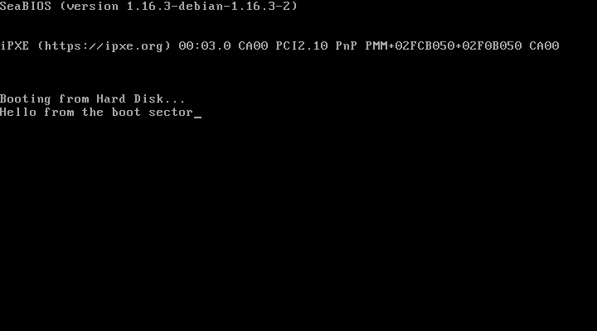
BIOS: load sector 0 to 7C00 and jump
Power on: the CPU starts in 16-bit real mode, running firmware code from the chip.
1
POST (power-on self test): find RAM, disks, keyboard, screen.
2
Read sector 0 (512 bytes) of the boot disk to address 7C00.
3
Last two bytes 55 AA? Jump to 7C00. If not, try the next device.
Real: boot.bin from Lecture 5.1 as a QEMU hard disk. SeaBIOS (the BIOS in QEMU) loads it and it prints its message.
4
512 bytes is too small for a kernel. So the boot sector loads more of the boot loader from the disk: GRUB's first stage does exactly that.
Book: Bovet & Cesati, Appendix A (the BIOS, the boot loader)
6 / 27

Slide 7
UEFI: the modern firmware, and how to tell which one you have
 | BIOS (legacy) | UEFI
Since | 1981 (IBM PC) | about 2010 on PCs
CPU mode at hand-over | 16-bit real mode | 32- or 64-bit mode
Finds the boot loader in | sector 0 of a disk (512 bytes) | a file on a FAT partition: \EFI\…\*.efi
Boot loader format | raw machine code | a PE program, the Windows .exe format
Extra | – | Secure Boot: runs only signed boot loaders
same kernel booted with UEFI firmware (OVMF) in QEMU (real)
$ ls /sys/firmware
acpi dmi efi memmap
$ ls /sys/firmware/efi
config_table efivars …
$ dmesg | grep efi | head -1
efi: EFI v2.7 by Ubuntu
distribution of EDK II
Try it on the lab PC: ls /sys/firmware/efi. If the folder exists, the PC booted with UEFI; if not, with BIOS (or UEFI in legacy mode). Our BIOS boot in QEMU had no efi folder: acpi dmi memmap only. The kernel shows the firmware's world as files in /sys (Lecture 7.1).
7 / 27

Slide 8
The boot loader: GRUB
PART 2
Load two files into RAM, pass a command line, jump.
8 / 27

Slide 9
GRUB loads the kernel and the initramfs (real boot)
iso/boot/grub/grub.cfg
the boot, on the serial console (real)
serial --unit=0 --speed=115200
terminal_output serial
set timeout=3
menuentry "CSE 4105: Ubuntu kernel + our init" {
linux /boot/vmlinuz console=ttyS0 quiet panic=-1
initrd /boot/initramfs.cpio.gz
}
Booting from DVD/CD...
GNU GRUB version 2.12
The highlighted entry will be executed
automatically in 0s.
GRUB: loading the kernel...
GRUB: loading the initramfs...
… our init prints /proc/cmdline:
BOOT_IMAGE=/boot/vmlinuz console=ttyS0
quiet panic=-1
linux
loads the kernel file into RAM and remembers the command line after it.
initrd
loads the initramfs archive next to it. GRUB reads files, so it understands file systems (here ISO 9660; on a PC ext4).
boot
jumps into the kernel. GRUB adds BOOT_IMAGE= to say which file it was: the kernel prints it in /proc/cmdline.
9 / 27

Slide 10
vmlinuz: one file, three ways to be started
Ubuntu's kernel file (real)
MZ at byte 0
the start of a PE (Windows .exe) header: UEFI can run the kernel directly as an EFI program.
$ file vmlinuz
Linux kernel x86 boot executable bzImage,
version 6.8.0-146-generic … RO-rootFS …
$ ls -l vmlinuz → 15 067 528 bytes
$ od -A x -t x1z -N 2 vmlinuz
000000 4d 5a >MZ<
$ od -A x -t x1z -j 0x1fe -N 6 vmlinuz
0001fe 55 aa 00 00 48 64 72 53 >U...HdrS<
55 AA at byte 510
a boot-sector signature, from the days when the kernel could boot itself from a floppy.
HdrS at byte 0x202
the Linux boot protocol header: a C struct (setup_header) where GRUB writes the command line and initramfs address.
SAME AS C
DIFFERENT FROM C
Like the ELF header
A header the loader reads to know what to load and where (Lecture 6). GRUB is the loader here.
But compressed
vmlinuz is the kernel compressed, plus a small program that unpacks it in RAM first: "z" in the name.
10 / 27

Slide 11
The kernel starts itself
PART 3
start_kernel(), rest_init(), and the birth of PID 1 and PID 2.
11 / 27

Slide 12
start_kernel(): every subsystem, in order
init/main.c, Linux 6.8 (real lines, shortened)
Call | Starts | Lecture
setup_arch | CPU, firmware memory map (e820) | 7.2
trap_init | exception handlers (divide by 0, page fault) | 13
mm_core_init | the memory allocator | 11
sched_init | the process scheduler | 8
init_IRQ, time_init | interrupts and the timer tick | 13
vfs_caches_init | the virtual file system | 12
874 void start_kernel(void)
875 {
895 pr_notice("%s", linux_banner);
897 setup_arch(&command_line);
905 pr_notice("Kernel command line: …
931 trap_init();
932 mm_core_init();
944 sched_init();
976 init_IRQ();
984 time_init();
1008 console_init();
1056 vfs_caches_init();
1072 arch_call_rest_init();
} /* never returns */
C link: start_kernel is the kernel's main(): a long list of function calls, one per subsystem. Part B of the course is basically this list.
Book: Love, LKD Ch. 1–2; Bovet & Cesati, Appendix A
12 / 27

Slide 13
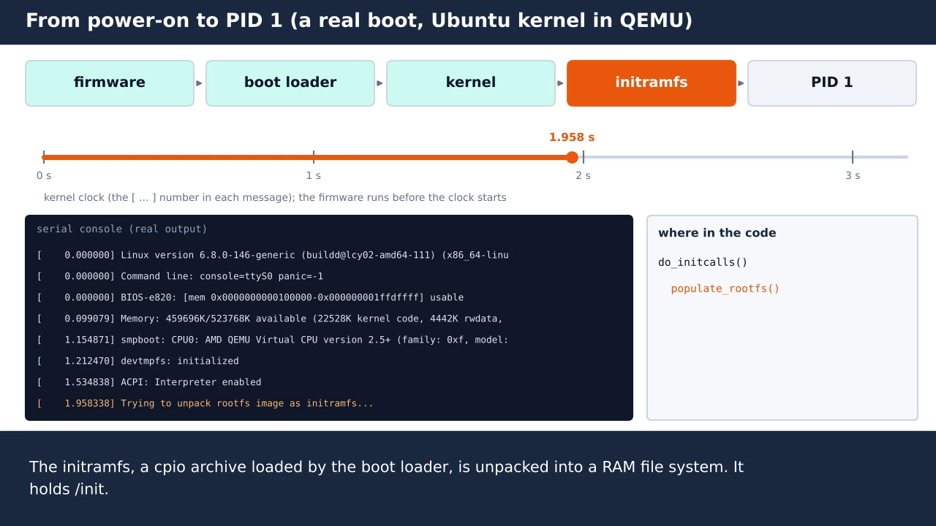
Watch one real boot, message by message
Watch for
1. The firmware has no timestamp: the kernel clock starts at 0.
2. Each message is a printk from one function.
3. Memory is known after 0.1 s.
4. The initramfs is unpacked at about 2 s.
5. Run /init ends the kernel's own work.
Click the video to play or pause. About 1½ minutes, no sound.
13 / 27

Slide 14
rest_init(): why init is PID 1 and kthreadd is PID 2
init/main.c, Linux 6.8 (real, shortened)
PID 0: the boot thread itself
After creating the other two, it becomes the idle task: it runs when nothing else can. That is the PPID 0 you saw in 7.1.
683 void rest_init(void)
684 {
689 /* We need to spawn init first so that it
obtains pid 1, however the init task will
end up wanting to create kthreads … */
695 pid = user_mode_thread(kernel_init, NULL, CLONE_FS);
…
708 pid = kernel_thread(kthreadd, NULL, NULL, …);
…
730 cpu_startup_entry(CPUHP_ONLINE); /* idle */
731 }
PID 1: kernel_init
Created first, on purpose (the comment says so). It finishes the kernel's set-up, then becomes your /init.
PID 2: kthreadd
Created second. Every later kernel thread is made by it: PPID 2.
C link: user_mode_thread(kernel_init, …) is like pthread_create(&t, NULL, func, NULL): start a new thread of control that runs a C function. The PID is given in creation order: 1, then 2.
14 / 27

Slide 15
kernel_init(): looking for a program to become PID 1
init/main.c, Linux 6.8 (real, shortened)
/init in the initramfs (or rdinit=…)
1
159 static char *ramdisk_execute_command = "/init";
… in kernel_init():
1466 if (ramdisk_execute_command) {
1467 ret = run_init_process(ramdisk_execute_command);
1468 if (!ret) return 0;
… init= from the command line, then:
1497 if (!try_to_run_init_process("/sbin/init") ||
1498 !try_to_run_init_process("/etc/init") ||
1499 !try_to_run_init_process("/bin/init") ||
1500 !try_to_run_init_process("/bin/sh"))
1501 return 0;
1503 panic("No working init found. …");
init=… from the command line
2
/sbin/init, /etc/init, /bin/init, /bin/sh
3
nothing found: panic
4
run_init_process() ends in kernel_execve("/init", …): the same exec that a shell uses to start a program (Lecture 8). PID 1 stops being kernel code and becomes your C program.
15 / 27

Slide 16
The initramfs: a first root file system in RAM
mkinitramfs.sh (lab)
Why it exists
The real root disk may need a driver that is a module (Lecture 7.1), on the disk itself. The initramfs carries those modules and a small /init that loads them, mounts the real root, then hands over.
mkdir -p rootfs/proc rootfs/sys rootfs/dev rootfs/bin
cp init rootfs/init
cp kinfo_static rootfs/bin/kinfo
cd rootfs && find . | cpio -o -H newc \
| gzip > ../initramfs.cpio.gz
cpio
An old, simple archive format (like tar). The kernel has its own unpacker: "Trying to unpack rootfs image as initramfs" in the boot log.
zcat initramfs.cpio.gz | cpio -tv (real)
drwxr-xr-x proc
drwxr-xr-x dev
drwxr-xr-x sys
-rwxr-xr-x init 826008 bytes
-rwxr-xr-x bin/kinfo 968048 bytes
Why -static
The initramfs has no libc.so and no ld.so (Lecture 5.2). A static program needs nothing: 826 KB for a small init.
16 / 27

Slide 17
PID 1: the first user program
PART 4
Yours, in the lab. And what happens when it goes wrong.
17 / 27

Slide 18
Our own init: 50 lines of ordinary C
myinit.c (lab reference, shortened)
./boot.sh (lab, real)
int main(int argc, char *argv[]) {
printf("*** myinit: I am PID %d …", getpid(), …);
mount("proc", "/proc", "proc", 0, NULL);
mount("sysfs", "/sys", "sysfs", 0, NULL);
show("kernel:", "/proc/sys/kernel/osrelease");
show("command line:", "/proc/cmdline");
pid_t pid = fork();
if (pid == 0) { /* child */
execv("/bin/kinfo", args);
_exit(127);
}
waitpid(pid, &status, 0); /* parent */
reboot(RB_POWER_OFF); /* never return */
}
*** myinit: I am PID 1, started by
the kernel as /init ***
kernel: 6.8.0-146-generic
command line: console=ttyS0 quiet panic=-1
… kinfo's output (Lecture 7.1) …
myinit: child 78 (kinfo) exited
with status 0
myinit: all done, powering off.
[ 2.420903] reboot: Power down
C link: fork + exec + wait is how every program after PID 1 is born, including the ones your shell starts. Lecture 8 opens it up.
18 / 27

Slide 19
When PID 1 goes wrong: three real kernel panics
1. init returns
2. no /init, no root disk
3. the wrong PID 1
serial console (real)
serial console (real)
serial console (real)
starter: main() ends with return 0;
myinit: all done.
Kernel panic - not syncing:
Attempted to kill init!
exitcode=0x00000000
initramfs without /init
VFS: Cannot open root device ""
Please append a correct "root="
Kernel panic - not syncing:
VFS: Unable to mount root fs
on unknown-block(0,0)
boot.sh with EXTRA=rdinit=/bin/kinfo
Processes: 0 user processes,
0 kernel threads
Kernel panic - not syncing:
Attempted to kill init!
PID: 1 Comm: kinfo
PID 1 must never end: every orphaned process is given to it. kernel/exit.c line 840 panics.
No /init, so the kernel tried a root disk; none was given. The fix: an init, or root=/dev/…
kinfo became PID 1: /proc was never mounted, so it saw nothing; then it ended.
19 / 27

Slide 20
The kernel is relocated too: KASLR
the last line of four panics (real)
0xffffffff81000000
where System.map says _text is (Lecture 7.1): the address the kernel was linked for.
Kernel Offset: 0x9e00000 from 0xffffffff81000000
Kernel Offset: 0x25e00000 from 0xffffffff81000000
Kernel Offset: 0x27200000 from 0xffffffff81000000
booted with nokaslr on the command line:
Kernel Offset: disabled
+ a random offset
chosen at every boot, so start_kernel is somewhere else each time. An attacker cannot know where kernel code is.
SAME AS C
DIFFERENT FROM C
Same as ASLR and M records
Lecture 5.2: a PIE program gets a random base at every run. Lecture 5.1: a relocating loader adds the load address to address fields. The kernel's decompressor does both to the kernel itself.
But who relocates the relocator?
There is no ld.so before the kernel runs. The small decompressor program in vmlinuz picks the offset and applies the kernel's own relocation table, then jumps in.
20 / 27

Slide 21
On the lab PC: systemd is PID 1
commands to run on the lab PC (Ubuntu)
Same job as our init
Mount /proc and /sys, start programs with fork + exec, wait for them, never exit.
$ ps -o pid,ppid,comm -p 1,2
# 1 0 systemd
# 2 0 kthreadd
$ ls -l /sbin/init
# /sbin/init -> /lib/systemd/systemd
$ systemd-analyze
# firmware + loader + kernel + userspace
$ systemctl list-units --type=service | head
Much more
Starts hundreds of services in parallel, restarts them when they crash, logs their output (journalctl), shuts down cleanly.
systemd-analyze
Prints how long each boot stage took on that PC: firmware, loader, kernel, user space. Compare with our 2.4 s QEMU boot.
 | SIC bootstrap (5.1) | PC with Linux
Started by | hardware, at address 0 | firmware chip, then GRUB
Loads | object code from device F1, to address 80 | kernel + initramfs from disk, anywhere (KASLR)
Then jumps to | 80 | the kernel, then /init, then systemd
21 / 27

Slide 22
Boot your own init in QEMU
LAB 7.2
myinit.c: three TODOs, one deliberate kernel panic.
22 / 27

Slide 23
Lab 7.2 tasks, step by step
1
Get a kernel
sudo cp /boot/vmlinuz-$(uname -r) vmlinuz && sudo chmod a+r vmlinuz: the lab PC's own kernel.
2
Boot the starter
gcc -Wall -static -o init myinit_starter.c, ./mkinitramfs.sh, ./boot.sh. Read the panic: why?
3
TODO 1: mount
Mount /proc and /sys. Now the kernel version and command line appear.
4
TODO 2: fork + exec
Build kinfo with -static, run it as a child of your init, print its exit status.
5
TODO 3: never exit
sync() and reboot(RB_POWER_OFF): QEMU powers off cleanly, no panic.
6
Experiments
EXTRA=rdinit=/bin/kinfo ./boot.sh; EXTRA=nokaslr; boot with -m 128. Note what changes.
Quit a stuck QEMU with Ctrl-A then X. Submit: myinit.c and the serial output of your final boot.
23 / 27

Slide 24
Checkpoint: test yourself
Q1
The BIOS loads how many bytes from the boot disk, and to where?
→ 512 bytes (sector 0) to address 7C00
Q2
How can you tell whether a Linux PC booted with UEFI?
→ /sys/firmware/efi exists
Q3
Which two files does GRUB load into RAM?
→ the kernel (vmlinuz) and the initramfs
Q4
Why does init get PID 1 and kthreadd PID 2?
→ rest_init creates init first, then kthreadd
Q5
Your /init returns 0. What happens?
→ kernel panic: Attempted to kill init!
24 / 27

Slide 25


Key ideas from today
Boot = a chain of loaders: firmware → GRUB → kernel → initramfs → PID 1.
BIOS loads a 512-byte sector to 7C00; UEFI runs a .efi program from a FAT partition.
GRUB loads vmlinuz and the initramfs and passes the command line (BOOT_IMAGE=…).
start_kernel starts every subsystem; rest_init makes PID 1 (init) and PID 2 (kthreadd).
PID 1 must never exit; fork + exec + wait is how it starts everything else.
The kernel is relocated at every boot (KASLR), like a PIE program.
25 / 27

Slide 26
Homework 7.2 (due before Lecture 8.1)
From boot1.log (lab files) find the times of: the banner, "Memory:", the initramfs unpack and "Run /init". Which stage takes longest?
1. Boot timeline
Your initramfs has no /init but has /bin/sh (busybox). What does the kernel run, and why? Use the kernel_init code on slide 15.
2. The fallback list
Change myinit to start kinfo twice, one after the other. Predict the two child PIDs before you boot, then check.
3. Two inits
Use od on your vmlinuz: find MZ, 55 AA and HdrS. Read the 2 bytes after HdrS: which boot protocol version is it?
4. Read the header
In 8–10 sentences compare our boot with Beck's bootstrap loader (5.1): who starts it, what it loads, where, and how it ends.
5. Compare
26 / 27

Slide 27
Next lecture and reading
Main text
NEXT: LECTURE 8.1
R. Love, Linux Kernel Development, 3rd ed., Ch. 3 (process management). Bovet & Cesati, Appendix A (system startup) for today.
Processes
Source
What a process is to the kernel: task_struct, process states, fork, exec, exit and wait — the calls your init used today, opened up.
Linux 6.8: init/main.c (start_kernel, rest_init, kernel_init), kernel/exit.c, init/do_mounts.c. Linux v6.8 source online: elixir.bootlin.com/linux/v6.8.
Tools
qemu-system-x86, cpio, gzip, gcc -static: all offline once installed.
Lab files
lab7_files.zip: myinit_starter.c, kinfo_starter.c, mkinitramfs.sh, boot.sh, logs.
27 / 27

