Slide 1
LECTURE 1 · INTRODUCTION TO DATA SCIENCE
Turning data into decisions
Welcome! No coding or statistics background needed, just curiosity.
Md Mahbub E Noor · University of Barishal · [Course code] · [Semester]
Notes:
Good morning, everyone, and welcome to Introduction to Data Science! Before anything else, a promise: you do not need to be a programmer or a math genius to succeed in this course. If you can ask "why?" and you are willing to be a little stubborn with a problem, you are ready. Look at the picture on the right: a cloud of messy dots, and a line running through them that points somewhere. That is this whole course in one image. Data is the dots, messy and noisy. Data science is finding the line, the pattern, and using it to make a decision. Quick warm-up: turn to the person next to you and tell them one thing you would love to predict if you had the data. Exam results? Tomorrow's traffic? The next cricket score? [Take three or four answers.] Hold on to those ideas. By the end of the semester, you will know how to actually attempt them.

Slide 2
What is data science?
Using data to answer questions and make better decisions.
Math & Statistics
Machine learning
Coding
Math & statistics: tell a real pattern from luck
Data Science
Coding: handle data too big for a spreadsheet
Traditional research
Danger zone!
Domain knowledge: ask questions that matter
Domain knowledge
Data science lives where all three overlap.
Adapted from Drew Conway's data science Venn diagram (2010)
Md Mahbub E Noor
Lecture 1: Turning data into decisions
University of Barishal
2 / 13
Notes:
So what actually is data science? My one-line definition: using data to answer questions and make better decisions. Doing that well takes three ingredients. Math and statistics tell you whether a pattern is real or just luck. Coding lets you work with data far too big for a spreadsheet. And domain knowledge, understanding the field you work in, whether that is medicine, farming or cricket, tells you which questions are worth asking in the first place. Now look at the overlaps. Math plus coding gives you machine learning. Math plus domain knowledge is traditional research, the way scientists have worked for centuries. And coding plus domain knowledge without statistics? That is the danger zone: you can produce confident, beautiful-looking results that are simply wrong. Data science sits in the middle, where all three meet. Here is the good news: nobody walks in strong in all three. Most of you are strong in one, maybe none yet. This course builds each of them, step by step.

Slide 3
What is data?
Most data science starts with a table. Here are four text messages, described as data.
message | length | contains "free" | has a number | label
Claim your FREE gift now | 24 | yes | no | spam
Class moved to room 305 | 23 | no | yes | ham
Free entry: text WIN to 80086 | 29 | yes | yes | spam
Ok, see you at the library | 26 | no | no | ham
One row = one example
a single message, patient or sale
One column = one feature
a measured property, used as input (X)
Label column = the answer
what we want to predict (y)
A model learns how the feature columns relate to the label, then predicts the label for new rows. In Lecture 5 this table has 5,572 rows; in Lecture 6 we call the features X and the label y.
Md Mahbub E Noor
Lecture 1: Turning data into decisions
University of Barishal
3 / 13
Notes:
Before we go further, what do we actually mean by data? Most of the time: a table. Each row is one example, here one text message; the highlighted row is one example. Each column is a feature: something we can measure about the example, like its length or whether it contains the word free. And one special column, the label, is the answer we care about: spam or ham, where ham means a normal message. Ask the class: which features would you add? [Contains a link, number of capital letters, time sent.] Choosing good features is a big part of data science. Machine learning then means finding how the features relate to the label, so we can predict the label for messages we have never seen. Keep this picture in mind: it is exactly the table we will build and use in Lectures 5 and 6.

Slide 4
Why learn data science?
1
2
3
Data is everywhere
Better decisions
Skills that travel
Every tap, purchase and scan leaves a data trail.
Swap guesses for evidence: what to stock, whom to treat first.
Health, finance, farming, research: all need people who read data.
Md Mahbub E Noor
Lecture 1: Turning data into decisions
University of Barishal
4 / 13
Notes:
Why should you care? Three reasons. First, data is everywhere. Every time you tap your phone, buy something, or visit a clinic, a record is created. That data exists whether or not anyone understands it. Second, data leads to better decisions. A shop owner deciding how much to stock, a doctor deciding which patient to see first, a farmer deciding when to plant. Data does not replace judgment, but it lets you check your gut against evidence. Third, these skills travel: whatever you end up doing, there is data, and there is a shortage of people who can read it carefully. One honest warning, and I will keep repeating it: data can also mislead. Part of what you learn here is when NOT to trust a number.

Slide 5
Traditional software vs. data science
TRADITIONAL SOFTWARE
Rules
Program
A person writes the rules
Answers
Data
DATA SCIENCE
Data
Learning
The computer learns the rules
Rules (a model)
Answers (examples)
 | Traditional software | Data science
Example | Calculator, payroll system | Spam filter, face unlock
Output | Exact, the same every time | A prediction, with some uncertainty
Best when | The rules are known exactly | The rules are too complex to write by hand
Md Mahbub E Noor
Lecture 1: Turning data into decisions
University of Barishal
5 / 13
Notes:
This slide is the mental shift I most want you to take home today. In traditional software, a person writes the rules. A calculator knows exactly how addition works; the programmer typed those rules in, you give it data, and it gives you answers. Now try writing rules for a spam filter. 'If the email says FREE, it is spam'? Spammers just write 'FR33'. You would need thousands of rules and you would still lose. So data science flips the arrows. We give the computer data AND the answers, thousands of messages people already marked as spam or not spam, and it learns the rules itself. The output of learning is a model: a set of rules nobody typed. The price of this power is uncertainty. A calculator is never 'probably right'. A spam filter is. So a big part of this course is learning to measure how right a model is, and when to trust it.

Slide 6
Live demo: can you write rules that catch spam?
1
2
3
Write rules
Let it learn
Try your own
Keywords like "free" catch 4 of 8 messages. Every fix opens a new hole.
A model trained on 30 labeled messages learns its own clues.
Type any message and see which words look spammy to the model.
Md Mahbub E Noor
Lecture 1: Turning data into decisions
University of Barishal
6 / 13
Notes:
Now switch to the demo page, spam-demo.html. It is a single file that works without internet: copy it to the classroom PC and open it in any browser. Two minutes: in step 1, ask the class for keywords and show how each fix breaks something else. In step 2, press Train and point out that nobody typed the learned words. In step 3, take two messages from students. Finish with the honest caveat on the page: a toy model, tested on 8 messages I wrote, shows the idea, not real performance. [Demo file: spam-demo.html on the course share.]

Slide 7
The data science lifecycle
1
2
3
4
5
6
Ask
Collect
Clean
Explore
Model
Share
Will the river flood this week?
River levels and rainfall
Fill missing sensor readings
Plot rain vs. river level
Forecast tomorrow's level
Early alerts to farmers
A loop, not a line: exploring often sends you back to ask a better question. Modeling is one step of six.
Md Mahbub E Noor
Lecture 1: Turning data into decisions
University of Barishal
7 / 13
Notes:
How does raw data become a decision? Let us follow one real question: will the river flood this week? Ask: a vague worry becomes a precise question. Collect: river gauge readings, rainfall records. Clean: sensors fail, someone typed 999 instead of 9.99, a whole week is missing. Real data is messy, and fixing it is real work. Explore: we draw charts. Does the river rise a day or two after heavy rain? Model: now we build something that predicts tomorrow's level. Share: a prediction sitting in a laptop saves no one. We turn it into an alert a farmer can act on. Two things to notice. The process loops: exploring often shows your question was wrong. And the flashy part, modeling, is just one box out of six.

Slide 8
You already use data science every day
1
2
Recommendations
Healthcare
What will you watch next? Learns from your history and what similar people enjoyed.
Does this X-ray look healthy? Learns from past scans labeled by doctors.
3
4
Finance
Maps and travel
Is this payment fraud? Learns from normal spending and past fraud cases.
How long will this trip take? Learns from live speeds of phones on the road.
Md Mahbub E Noor
Lecture 1: Turning data into decisions
University of Barishal
8 / 13
Notes:
You have almost certainly used data science today. When a video app suggests what to watch, it is learning from your history and from people with similar taste. In hospitals, models learn from scans doctors have already labeled and help flag the ones that need a closer look; the doctor still decides. When your bank or mobile wallet blocks a strange payment, a model has learned what your normal spending looks like. And a map app's travel time combines live speeds from other phones. The pattern: every application is a question plus the data it learns from, run through the same lifecycle. Quick exercise: which app on your phone uses data science the most? [Take two or three answers.]

Slide 9
The road ahead: from zero to a spam detector
Lecture | Topic | You will be able to
1 | What is data science? | Explain what data science is and how models learn
2.1 to 2.3 | Getting started, Python basics, debugging | Run code offline and online; read and fix errors
3.1 to 3.3 | Decisions, lists and tuples, loops | Build a rule-based spam filter, and see it fail
4.1 to 4.2 | Functions, dictionaries | Count words and score messages from examples
5 | Real data with pandas | Load, clean and explore 5,572 real messages
6 | Build a spam detector | Train, test and honestly evaluate a real model
[7 onwards] | [Remaining course topics] | [To be added]
Md Mahbub E Noor
Lecture 1: Turning data into decisions
University of Barishal
9 / 13
Notes:
Here is the road for the first part of the course. Every lecture adds one piece, and in Lecture 6 you build a real machine learning model on real data. If you have never written a line of code, you are exactly who this is designed for. [Adjust the last row to the rest of your syllabus.] And the mindset, which matters more than any tool: curiosity beats perfection; your code will break, and error messages are clues, not insults; and whenever someone shows you a number, ask: how do we know?

Slide 10
How this course works
Item | Details
Classes and labs | [Days, times, rooms]. Labs use Jupyter Notebook on the lab PCs (offline)
At home | Google Colab (online), or Jupyter if you install Anaconda on a laptop
Assessment | [Homework __%] · [Quizzes __%] · [Midterm __%] · [Project __%] · [Final __%]
Homework | After every lecture from Lecture 2. Submit your .ipynb file on [LMS / Google Classroom]
Late work | [Late policy]
Help | Office hours: [day, time, room] · Contact: [email]
Md Mahbub E Noor
Lecture 1: Turning data into decisions
University of Barishal
10 / 13
Notes:
Fill in the placeholders before class. Explain the homework rhythm clearly: there is homework after every lecture from Lecture 2 onwards, and it is graded mainly on honest effort and explanation, not on getting every answer right. Mention that lab PCs have no internet, so we use Jupyter Notebook in the lab, and that the notebook files move between lab and home.

Slide 11
Using AI tools in this course
1
2
3
Allowed
Not allowed
Always
[For example: asking an AI to explain an error message or a concept, like a tutor.]
[For example: submitting code or answers generated by an AI as your own work.]
You must be able to explain every line you submit. [Say whether and how AI use must be disclosed.]
Md Mahbub E Noor
Lecture 1: Turning data into decisions
University of Barishal
11 / 13
Notes:
Replace the bracketed examples with your official policy. Whatever you decide, say it on day one, before the first homework. The reasoning to share with students: AI tools are good at explaining and often wrong at fixing; and homework exists to build your skills, which only happens if you do the thinking. The 'explain every line' rule is easy to check in class and fair to everyone.

Slide 12
BEFORE NEXT CLASS
Your first mission
?
1
Lab: check that Jupyter Notebook opens on your lab PC. Home: open Google Colab if you have internet.
2
Spot one everyday decision that data could improve. Write it in one sentence.
Questions?
3
Bring one question about data you are curious about.
No question is too basic, today especially.
Office hours: [day, time, room] · Contact: [email]
Md Mahbub E Noor
Lecture 1: Turning data into decisions
University of Barishal
12 / 13
Notes:
Before we wrap up, your first mission. It is small, but please do it. One: check your tools. In the lab, Jupyter Notebook; at home, Colab if you have internet. If something does not work, bring the error message to the next lab. Two: find one decision in your everyday life that data could improve. Which bus to take, when to study, how much to cook for the family. Write it in one sentence. Three: bring one question you are genuinely curious about. Now, questions. No question is too basic today. If you are wondering about something, at least five other people in this room are wondering the same thing. [If the room is quiet, prompt: 'Who here has never written code? Good, you are in the right place. What worries you most about this course?']

Slide 13
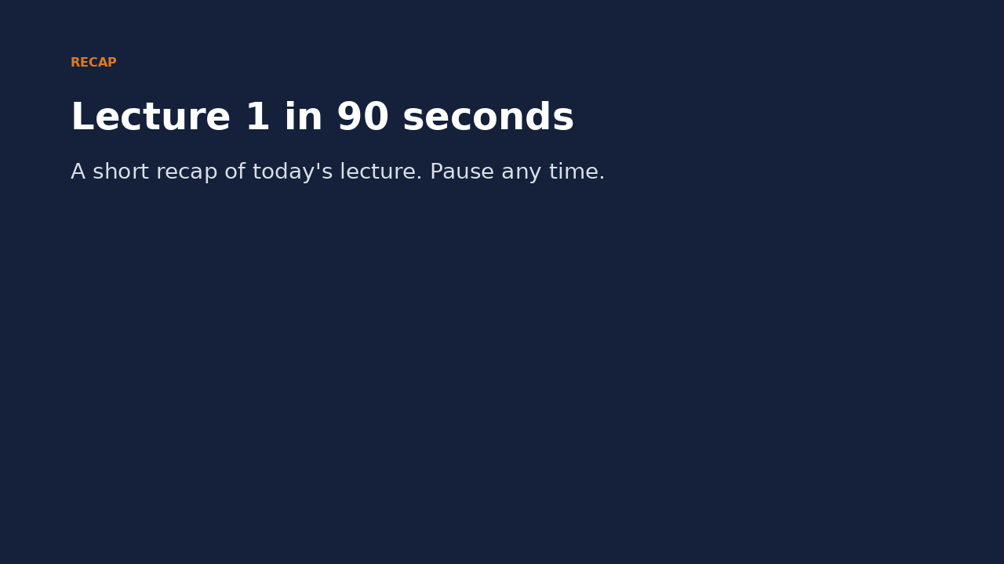
Recap: Lecture 1 in 90 seconds
Click to play or pause. Watch it again at home to revise.
Md Mahbub E Noor
Lecture 1: Turning data into decisions
University of Barishal
13 / 13
Notes:
Play this at the end of class, or leave it for students to revise at home. It is silent: pause on each card and ask the class for an example.

