Slide 1
LECTURE 5
Real data with pandas
Today's key line of code
df = pd.read_csv(url, sep="\t")
df["label"].value_counts()
Exploring 5,572 real text messages
Introduction to Data Science · Md Mahbub E Noor · University of Barishal
Notes:
Welcome back. So far we have used messages we typed ourselves, six or ten at a time. Real data science starts when the data is too big to read by eye. Today we load a real, published dataset of more than five thousand SMS messages and explore it like detectives. We will use pandas, the most widely used data tool in Python. New notebook: Lecture5.

Slide 2
Where we are on the road to a spam detector
Today
L2
L3
L4
L5
L6
Python basics
Decisions and loops
Counting words
Real data
Build the model
Today you will
1
Load a real dataset from the internet with pandas
2
Look inside a table: rows, columns, single messages
3
Count spam and normal messages
4
Add new columns and compare groups
5
Clean out duplicates, and see why they matter
Md Mahbub E Noor
Lecture 5: Real data with pandas
University of Barishal
2 / 18
Notes:
Lecture 5 of our journey. This is the Collect, Clean and Explore part of the lifecycle from Lecture 1. Remember I said most of the real work happens there? Today you will see why. Next lecture we build the model, and everything we notice today will explain its results.

Slide 3
Meet the dataset: SMS Spam Collection
1
2
3
5,572 real messages
Where from
Its limits
Real SMS messages, each labeled by people as spam or ham (normal).
Published in 2011 by Almeida and Hidalgo, and shared on the UCI Machine Learning Repository.
Mostly UK and Singapore messages from around 2011. Today's scams and our local slang are not in it.
Md Mahbub E Noor
Lecture 5: Real data with pandas
University of Barishal
3 / 18
Notes:
Every dataset has a story, and you must know it before trusting it. This one contains 5,572 real text messages collected for research and published in 2011 by Almeida and Hidalgo. Each message was labeled spam or ham. It is freely available on the UCI Machine Learning Repository, one of the classic sources for teaching data. The third card is the most important: the messages are mostly from the UK and Singapore, around 2011. Keep that in mind; it will explain some surprising results next lecture.

Slide 4
Load the data in one line
import pandas as pd loads the library, nicknamed pd
Code
import pandas as pd
url = ("https://raw.githubusercontent.com/"
"justmarkham/pycon-2016-tutorial/"
"master/data/sms.tsv")
df = pd.read_csv(url, sep="\t", header=None,
names=["label", "message"])
print(df.shape)
read_csv reads a table from a file or web link
sep="\t": columns are separated by tabs
df (DataFrame) is a table; .shape is (rows, columns)
Output
(5572, 2)
Md Mahbub E Noor
Lecture 5: Real data with pandas
University of Barishal
4 / 18
Notes:
import brings in a library, a big box of ready-made functions that other people wrote. By convention, everyone nicknames pandas as pd. read_csv reads a table, here directly from a web link. This file separates columns with tab characters, written as backslash t, and has no header row, so we name the two columns ourselves: label and message. df is short for DataFrame, pandas' word for a table. shape says 5572 rows and 2 columns. Please type the link carefully, or copy it from the course page.

Slide 5
In the lab (offline): load from a file
Lab PCs have no internet, so the web link cannot work
Code
df = pd.read_csv("sms.tsv", sep="\t", header=None,
names=["label", "message"])
print(df.shape)
Copy sms.tsv into the same folder as your notebook
Output
Then give read_csv the file name instead of the link
(5572, 2)
Same data, same result. At home in Colab, either way works
Md Mahbub E Noor
Lecture 5: Real data with pandas
University of Barishal
5 / 18
Notes:
This is the version we use in the lab. The file sms.tsv is on the course share; copy it next to your notebook. If you get FileNotFoundError, the file is in the wrong folder: Jupyter looks in the folder the notebook is in. At home in Colab you can keep using the link, or upload sms.tsv with the Files panel on the left.

Slide 6
Look before you leap
df.head() shows the first 5 rows. Long messages are cut short with ... on screen, but the full text is still there.
Code
print(df.head())
Output
label message
0 ham Go until jurong point, crazy.. Available only ...
1 ham Ok lar... Joking wif u oni...
2 spam Free entry in 2 a wkly comp to win FA Cup fina...
3 ham U dun say so early hor... U c already then say...
4 ham Nah I don't think he goes to usf, he lives aro...
Md Mahbub E Noor
Lecture 5: Real data with pandas
University of Barishal
6 / 18
Notes:
Always look at your data before doing anything clever. head shows the first five rows. Each row has a number on the left, called the index, then the label and the message. Notice the language: 'Ok lar... Joking wif u oni'. This is real, informal SMS text with slang and abbreviations. The third row is a typical spam: a competition entry with a phone number and premium rates. Real data is messy, and that is normal.

Slide 7
Read one message in full
df["message"] selects one column
Code
full = df.loc[2, "message"]
print(full)
print(len(full))
.loc[2, "message"] selects row 2, column message
Read a few messages yourself before modeling
Output
Free entry in 2 a wkly comp to win FA Cup final tkts 21st
May 2005. Text FA to 87121 to receive entry question(std
txt rate)T&C's apply 08452810075over18's
155
What clues would you use to spot spam?
Md Mahbub E Noor
Lecture 5: Real data with pandas
University of Barishal
7 / 18
Notes:
loc lets you pick a specific row and column, here row 2, the message column. Let's read this spam properly. Ask the class: what clues do you see? [Free entry, win, a phone number, 'text FA to 87121', rates, T and C's.] Notice that many clues are numbers and short codes. Our models only see words, but numbers like 87121 count as words too. Write down your clues; we will check them against what the model learns in Lecture 6.

Slide 8
How much spam is there?
value_counts() counts each label
Only about 13% of messages are spam
A lazy model that always says "ham" would be about 87% right
Remember this number: it is the score to beat
Code
print(df["label"].value_counts())
Md Mahbub E Noor
Lecture 5: Real data with pandas
University of Barishal
8 / 18
Notes:
value_counts counts how many times each label appears. 4,825 ham, 747 spam: roughly 87 percent normal, 13 percent spam. This is called class imbalance, and it is common: spam, fraud and disease are usually the rare cases. Here is a trap. Imagine a 'model' that ignores the message and always answers ham. It would be right about 87 percent of the time, and completely useless. So when someone tells you their spam model is 87 percent accurate, the right answer is: that is what doing nothing gets you. In Colab you can draw this chart with df['label'].value_counts().plot(kind='bar').

Slide 9
Spam messages are longer
.str.len() measures every message at once
A new column: df["length"]
groupby("label") splits the table by label
Spam averages about twice the length of ham
Code
df["length"] = df["message"].str.len()
avg = df.groupby("label")["length"].mean()
print(avg.round(1))
Md Mahbub E Noor
Lecture 5: Real data with pandas
University of Barishal
9 / 18
Notes:
Here is pandas' superpower. One line measures the length of all 5,572 messages; no loop needed. We store it as a new column. Then groupby splits the table into ham and spam, and mean averages each group. Spam messages average about 139 characters, ham about 72. Why? Spammers pack in offers, prices, phone numbers and terms and conditions; friends text 'ok see u'. Length alone is a clue, but not proof: a long message from your teacher is still ham.

Slide 10

Watch it: filtering and grouping
WATCH FOR
The filter asks a True/False question of every row
Rows answering False are dropped
groupby splits rows into one group per label
mean() is computed inside each group
Click the video to play, click again to pause. Silent: talk the class through it.
Md Mahbub E Noor
Lecture 5: Real data with pandas
University of Barishal
10 / 18
Notes:
These are 8 real rows from the dataset, so the averages differ from the full-dataset numbers on the previous slide: the video says so at the end. Use it to show what pandas does to rows, which is invisible in the code.

Slide 11
Clean out duplicate messages
duplicated() marks rows seen before
Code
print(df.duplicated().sum())
df = df.drop_duplicates()
print(df.shape)
print(df["label"].value_counts())
403 messages appear more than once
Spammers send the same text to many people
Duplicates could leak into both training and testing, so we drop them
Output
403
(5169, 3)
label
ham 4516
spam 653
Name: count, dtype: int64
Md Mahbub E Noor
Lecture 5: Real data with pandas
University of Barishal
11 / 18
Notes:
Cleaning step. 403 rows are exact duplicates. Spam campaigns send the same text to thousands of people, so this is natural. Why remove them? Next lecture we split the data into messages the model studies and messages we test it on. If the same message is in both, the test becomes an open-book exam: the model has already seen the answer. Scores would look better than they really are. After dropping duplicates we have 5,169 messages. This kind of care is what separates trustworthy data science from impressive-looking numbers.

Slide 12
Test a rule on real data
str.contains("free") checks every message at once
Code
text = df["message"].str.lower()
df["has_free"] = text.str.contains("free")
share = df.groupby("label")["has_free"].mean()
print(share.round(3))
Mean of True/False = the share that is True
"free" appears in far more spam than ham
Output
label
ham 0.014
spam 0.259
Name: has_free, dtype: float64
Yet 3 in 4 spam messages never say "free"
Md Mahbub E Noor
Lecture 5: Real data with pandas
University of Barishal
12 / 18
Notes:
Let's test the 'free' rule from Lecture 3, on real data this time. For each message: does it contain free? Then, per label, what share of messages do? A useful trick: the average of True and False values is the share of Trues. About 26 percent of spam contains 'free', against about 1.4 percent of ham. So it is a strong clue, but look at the other side: about three quarters of spam never says 'free' at all. A single-word rule misses most spam. We need many clues combined, which is exactly what a trained model does.

Slide 13
Your turn
7 minutes
1
Pick a word you think signals spam (e.g. "call", "txt", "win")
Code
word = "call"
df["has_word"] = text.str.contains(word)
print(df.groupby("label")["has_word"].mean())
spam = df[df["label"] == "spam"]
print(spam["message"].sample(3))
2
Compute the share of spam and ham containing it
3
Is it a better clue than "free"?
4
Bonus: print 3 random spam messages with .sample(3)
Md Mahbub E Noor
Lecture 5: Real data with pandas
University of Barishal
13 / 18
Notes:
Seven minutes. Students choose their own word, so answers vary; that is the point. Ask two or three pairs to share their best clue. Typical strong clues in this dataset: 'txt', 'claim', 'prize', 'call'. Note the filter line: df[df['label'] == 'spam'] keeps only spam rows. That pattern, a condition in square brackets, is one of the most useful in pandas.

Slide 14
Common pandas mistakes
Read the last line of an error first. It names the problem.
What you typed | What Python says | What it means
print(df["Label"]) | KeyError: 'Label' | Column names are case-sensitive. The column is "label".
print(df.lenght) | AttributeError: 'DataFrame' object has no attribute 'lenght' | Typo in a name. Check spelling, or print(df.columns).
print(df["message"].lower()) | AttributeError: 'Series' object has no attribute 'lower' | A column is not a single string. Use .str.lower() for text columns.
Md Mahbub E Noor
Lecture 5: Real data with pandas
University of Barishal
14 / 18
Notes:
KeyError with a column name almost always means a capital letter or a typo; print(df.columns) shows the real names. AttributeError means pandas does not know that name, again usually a typo. The third one catches everyone: a column holds thousands of strings, so string methods go through .str. Say it aloud: column dot str dot lower.

Slide 15
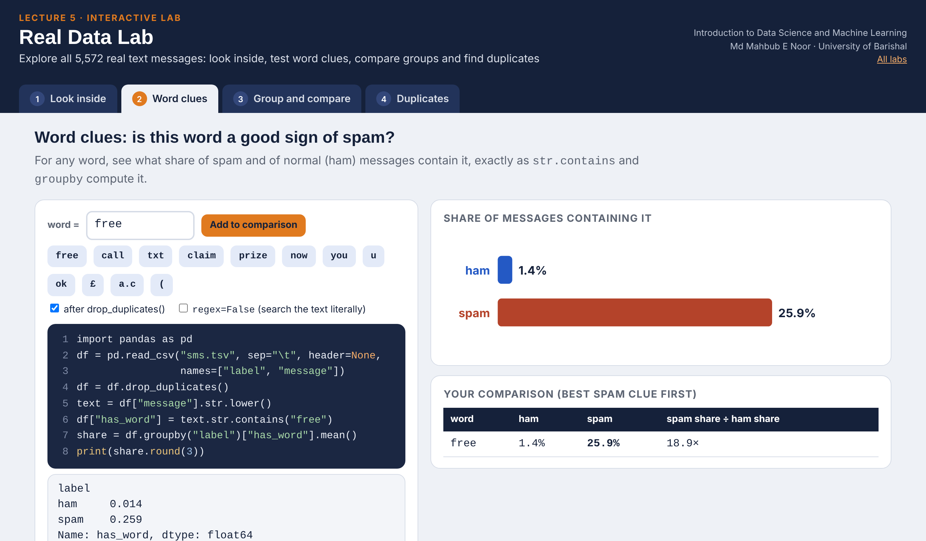
Interactive lab: Real Data Lab
In the lab you can
1 Look inside
head, tail, filters and df.loc on all 5,572 real messages.
2 Word clues
Share of spam and ham containing any word you choose.
3 Group and compare
Lengths by label, and can length alone find spam?
4 Duplicates
See what repeats and how duplicates leak into a test.
Open the lab ►
Works offline in any browser
Labs_open_in_browser/
L5_Real_Data_Lab.html
Md Mahbub E Noor
Lecture 5: Real data with pandas
University of Barishal
15 / 18
Notes:
Open the Real Data Lab (double-click; works offline: the whole SMS dataset is inside the page). Word clues replaces the 'Your turn' slide: let pairs race to find a better clue than 'free', then show '(' and 'a.c' to explain that str.contains uses patterns. In Group and compare, press 'Find the best rule' for 'length > t': the answer is 'never say spam'. A clear difference in averages is not enough to classify, which sets up Lecture 6.

Slide 16
Today's toolkit
import pandas as pd | Load the pandas library
pd.read_csv(url) | Read a table from a file or link
df.shape, df.head() | Size, and a first look
df["col"] | Select one column
df.loc[row, "col"] | Select a single cell
value_counts() | Count each value
df["new"] = ... | Add a column
df.groupby("label") | Split by label to compare groups
drop_duplicates() | Remove repeated rows
df[df["label"]=="spam"] | Keep only matching rows
Md Mahbub E Noor
Lecture 5: Real data with pandas
University of Barishal
16 / 18
Notes:
Today's toolkit: ten pandas moves that cover a surprising amount of everyday data work. Next lecture is the one we have been building towards: we turn these 5,169 cleaned messages into a trained spam detector, test it honestly, and try it on our own messages. Please make sure your notebook from today runs from top to bottom before next class.

Slide 17
Homework 5
Due before Lecture 6 · [date]
1
Load it yourself
2
Read like a detective
3
Best single clue
In a new notebook, load the dataset, print its shape, and count the labels.
Print 5 spam messages with spam["message"].sample(5, random_state=<your roll number>). List 3 patterns you notice.
Test 3 words of your choice. For each, print the share of spam and ham containing it. Which is the best clue, and why?
4
Make a chart
5
Think
Plot average length by label with .plot(kind="bar", title="..."). Give it a clear title.
A model always predicts "ham". What is its accuracy after removing duplicates? Why would it still be useless?
Submit on [LMS / Google Classroom]: your notebook file HW5_<your ID>.ipynb, or a Colab link set to “Anyone with the link can view”.
Md Mahbub E Noor
Lecture 5: Real data with pandas
University of Barishal
17 / 18
Notes:
Homework 5. Task 2 uses each student's roll number as the random seed, so everyone reads different messages and answers cannot simply be copied. Task 5 key: after dropping duplicates there are 4,516 ham out of 5,169 messages, so always-ham scores about 87.4 percent, yet it catches zero spam. That sentence, 'accuracy can hide total failure on the rare class', is the key idea to reinforce. Good task 3 answers compare the gap between spam and ham shares, not just the spam share.

Slide 18

Recap: Lecture 5 in 90 seconds
Click to play or pause. Watch it again at home to revise.
Md Mahbub E Noor
Lecture 5: Real data with pandas
University of Barishal
18 / 18
Notes:
Play this at the end of class, or leave it for students to revise at home. It is silent: pause on each card and ask the class for an example.

