Slide 1
LECTURE 6
Build a real spam detector
Today's key line of code
model = MultinomialNB()
model.fit(X_train_counts, y_train)
From 5,169 messages to a working model, step by step
Introduction to Data Science · Md Mahbub E Noor · University of Barishal
Notes:
This is the lecture we have been building towards since the very first day. Today, in about forty lines of Python, you will train a real machine learning model on real messages, test it honestly, and try it on messages you write yourself. Every step uses something you already learned: variables, lists, counting words, pandas. New notebook: Lecture6. Let's go slowly and do every step together.

Slide 2
Where we are on the road to a spam detector
Today
L2
L3
L4
L5
L6
Python basics
Decisions and loops
Counting words
Real data
Build the model
Today you will
1
Load and clean the data (Lecture 5)
2
Split into training and test sets
3
Turn words into numbers
4
Train a Naive Bayes model
5
Predict, evaluate honestly, and try your own messages
Md Mahbub E Noor
Lecture 6: Build a real spam detector
University of Barishal
2 / 21
Notes:
The finish line. Look how the pieces connect: loading and cleaning is Lecture 5; turning words into numbers is the count_words function from Lecture 4, done at scale; the model itself is the one from the Lecture 1 demo. Today we add the most important new idea in machine learning: never grade a model on the questions it studied.

Slide 3
Seven steps from raw text to predictions
1
2
3
4
5
6
7
Load and clean
Split
Words to numbers
Train
Predict
Evaluate
Try it
pandas, Lecture 5
new today
count_words, Lecture 4
Naive Bayes, Lecture 1 demo
new today
new today
your own messages
The same seven steps work for most classification problems: plant disease photos, speech emotion, fraud.
Md Mahbub E Noor
Lecture 6: Build a real spam detector
University of Barishal
3 / 21
Notes:
Here is the plan for today, seven steps. Each one gets its own slide and its own cell in your notebook. I strongly suggest putting a text cell with the step name above each code cell; your notebook becomes your own tutorial. This same seven-step shape works for almost any classification problem, not only spam: diagnosing plant disease from photos, classifying emotions in speech, detecting fraud. Learn the shape once, reuse it forever.

Slide 4
Step 1: Load and clean
Same loading code as Lecture 5; in the lab use "sms.tsv" instead of url
Code
import pandas as pd
url = ("https://raw.githubusercontent.com/"
"justmarkham/pycon-2016-tutorial/"
"master/data/sms.tsv")
df = pd.read_csv(url, sep="\t", header=None,
names=["label", "message"])
df = df.drop_duplicates()
X = df["message"]
y = df["label"]
print(df.shape)
Drop duplicates so test messages are truly new
5,169 unique messages remain
X = the messages (input), y = the labels (answer)
Output
(5169, 2)
Md Mahbub E Noor
Lecture 6: Build a real spam detector
University of Barishal
4 / 21
Notes:
Step one is familiar. Load, drop duplicates, done. Then two new names that you will see in every machine learning tutorial in the world. Capital X is the input: what the model looks at, here the message text. Small y is the answer we want it to learn to predict, here the label. Machine learning is learning a function from X to y.

Slide 5
Step 2: Split into study and exam sets
The model studies the training set (80%)
Code
from sklearn.model_selection import train_test_split
X_train, X_test, y_train, y_test = train_test_split(
X, y, test_size=0.2, random_state=42,
stratify=y)
print(len(X_train), len(X_test))
We grade it on the test set (20%) it has never seen
stratify=y keeps the same spam share in both
Output
4135 1034
random_state=42 makes the split repeatable
Md Mahbub E Noor
Lecture 6: Build a real spam detector
University of Barishal
5 / 21
Notes:
This is the most important idea of the day. If I give you the exam questions to study, a perfect score proves nothing. Same for models. So we hide 20 percent of the messages, 1,034 of them, and never let the model see them during training. Only at the end do we test on them. stratify makes sure both parts have about 13 percent spam; without it, by bad luck the test set could have too few spam messages. random_state fixes the shuffle so all of us get identical results today. sklearn is scikit-learn, the standard machine learning library in Python; it is already installed in Colab.

Slide 6
Step 3: What "words to numbers" means
Models only understand numbers. CountVectorizer builds a table: one row per message, one column per word, each cell a count.
Message | win | free | prize | now | lunch | class
Win a free prize, win now | 2 | 1 | 1 | 1 | 0 | 0
Free lunch now | 0 | 1 | 0 | 1 | 1 | 0
See you in class | 0 | 0 | 0 | 0 | 0 | 1
This is count_words() from Lecture 4, done for every message and arranged as a table. Word order is lost: it is a “bag of words”.
Md Mahbub E Noor
Lecture 6: Build a real spam detector
University of Barishal
6 / 21
Notes:
Before the code, the idea. A model cannot read. It needs numbers. So we build a table: one row for each message, one column for each word in the vocabulary, and each cell says how many times that word appears in that message. 'Win a free prize, win now' has win twice. This is exactly count_words from Lecture 4, done for every message and arranged as a table. It is called a bag of words, because word order is thrown away, like emptying the words into a bag. Question for the class: what information do we lose? [Word order: 'not free' and 'free' look alike.]

Slide 7
Step 3: Words to numbers, in code
fit_transform on training data: learn the vocabulary, then count
Code
from sklearn.feature_extraction.text import (
CountVectorizer)
vec = CountVectorizer()
X_train_counts = vec.fit_transform(X_train)
X_test_counts = vec.transform(X_test)
print(X_train_counts.shape)
transform on test data: count only, using that vocabulary
7,680 different words learned
Never fit on the test set: that would peek at the exam
Output
(4135, 7680)
Md Mahbub E Noor
Lecture 6: Build a real spam detector
University of Barishal
7 / 21
Notes:
CountVectorizer builds that table for us. It also lowercases everything and strips punctuation, solving the 'prize,' problem from Lecture 4. Crucial detail: fit_transform on the training messages means learn the vocabulary AND count. On the test set we only call transform: count using the vocabulary we already learned. Words that appear only in the test set are ignored, just as they would be for a brand-new message in real life. The result: 4,135 rows and 7,680 word columns.

Slide 8
Step 3, up close: fit learns, transform reuses
fit reads the training messages and builds the vocabulary
Code
demo = CountVectorizer()
demo.fit(["win a free prize", "see you in class"])
print(demo.get_feature_names_out())
print(demo.transform(["free class tomorrow"]).toarray())
transform counts words using that vocabulary only
Output
"tomorrow" was never seen in training, so it is ignored
['class' 'free' 'in' 'prize' 'see' 'win' 'you']
[[1 1 0 0 0 0 0]]
"a" is dropped: by default, one-letter words are skipped
Md Mahbub E Noor
Lecture 6: Build a real spam detector
University of Barishal
8 / 21
Notes:
A tiny example makes fit and transform concrete. fit on two training messages learns seven words, in alphabetical order. Notice 'a' is missing: CountVectorizer ignores single-character tokens by default. Then transform turns a new message into counts over exactly those seven columns: free 1, class 1, and 'tomorrow' is simply not there, because it never appeared in training. That is why the test set must go through transform, never fit: its columns must match what the model learned.

Slide 9
Step 4: Train the model
Multinomial Naive Bayes: the model from Lecture 1's demo
Code
from sklearn.naive_bayes import MultinomialNB
model = MultinomialNB()
model.fit(X_train_counts, y_train)
print("Training done!")
fit = learn from examples: counts words per label
Training takes well under a second
Output
This is our spam_score idea, with proper probabilities
Training done!
Md Mahbub E Noor
Lecture 6: Build a real spam detector
University of Barishal
9 / 21
Notes:
Here is the moment. Two lines. MultinomialNB is Naive Bayes, the same kind of model you played with in the Lecture 1 demo. fit means learn from the examples. What does it actually learn? For each word, how common it is in spam and how common in ham, turned into probabilities. That is our spam_score from Lecture 4, done properly, with fair proportions instead of raw counts, which solves the imbalance problem from Homework 4. It runs in a fraction of a second. The hard work was all in the preparation.

Slide 10
Step 5: Predict messages it has never seen
predict labels all 1,034 test messages
Code
predictions = model.predict(X_test_counts)
check = pd.DataFrame({"message": X_test.str[:28],
"truth": y_test,
"predicted": predictions})
print(check.sample(6, random_state=42))
Put truth and prediction side by side
Here 5 of 6 are right; one spam slipped through
Output
message truth predicted
2599 Okie... Thanx... ham ham
1207 As a SIM subscriber, you are spam spam
5147 Get your garden ready for su spam spam
3332 How much it will cost approx ham ham
788 Ever thought about living a spam ham
1972 Enjoy ur life. . Good night ham ham
Next: count mistakes over the whole test set
Md Mahbub E Noor
Lecture 6: Build a real spam detector
University of Barishal
10 / 21
Notes:
Now we ask the model to label the 1,034 test messages it never studied. To see what happened, we build a small table with the start of each message, the true label and the prediction, and look at six random rows. Five are right. One spam, 'Ever thought about living a...', was predicted as ham: it sounds like a normal friendly message at the start. Checking a few rows by eye is a great habit, but we need a number for all of them. That is step six.

Slide 11
Step 6: Evaluate, and compare with doing nothing
Code
98.2%
from sklearn.metrics import accuracy_score
acc = accuracy_score(y_test, predictions)
baseline = (y_test == "ham").mean()
print(f"Model accuracy: {acc:.1%}")
print(f"Always say ham: {baseline:.1%}")
Our model
87.3%
Output
Model accuracy: 98.2%
Always say ham: 87.3%
Always says "ham"
Error rate falls from 12.7% to 1.8%
Md Mahbub E Noor
Lecture 6: Build a real spam detector
University of Barishal
11 / 21
Notes:
Accuracy is the share of test messages labeled correctly: about 98 percent. Impressive? Remember Lecture 5: always answering ham already scores about 87 percent on this test set. So the honest way to report it is: the model cuts the error rate from about 13 percent to about 2 percent. Always compare with a simple baseline. Any result reported without a baseline should make you suspicious, including in research papers.

Slide 12
Step 6: Which mistakes does it make?
Code
Predicted ham
Predicted spam
from sklearn.metrics import confusion_matrix
print(confusion_matrix(y_test, predictions,
labels=["ham", "spam"]))
Truly ham
898
5
Output
Normal messages let through
False positive: real message sent to spam
[[898 5]
[ 14 117]]
Truly spam
14
117
Rows: the truth. Columns: the prediction.
5 normal messages wrongly flagged
False negative: spam slipped through
Spam caught
14 of 131 spam missed: about 1 in 9
Which mistake is worse for a user?
Md Mahbub E Noor
Lecture 6: Build a real spam detector
University of Barishal
12 / 21
Notes:
Accuracy hides which kind of mistake is made. A confusion matrix shows it. Rows are the truth, columns are the prediction. Top left: normal messages correctly let through. Bottom right: spam correctly caught. The two other cells are the mistakes. Top right: normal messages wrongly sent to spam, called false positives. Bottom left: spam that slipped through, false negatives. Discussion question: which mistake is worse? [Missing a spam is annoying; losing a message from your bank, doctor or employer to the spam folder can be serious.] Real filters are tuned with that cost in mind. Our model misses about 1 in 10 spam messages, which accuracy alone hid.

Slide 13
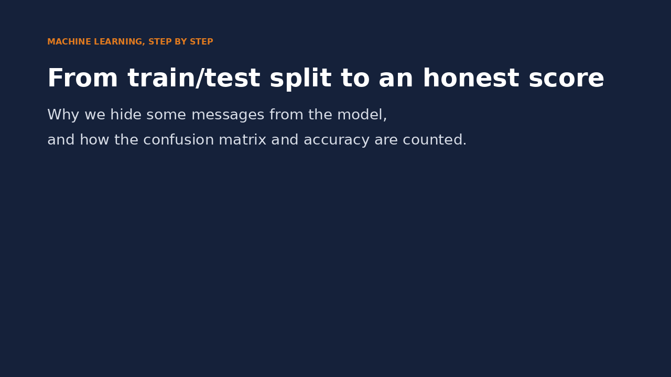
Watch it: from split to an honest score
WATCH FOR
stratify keeps the spam share equal in both parts
The test set stays hidden during training
Each test message lands in one matrix cell
Accuracy compared with always saying ham
Click the video to play, click again to pause. Silent: talk the class through it.
Md Mahbub E Noor
Lecture 6: Build a real spam detector
University of Barishal
13 / 21
Notes:
The dots are illustrative (one dot stands for many messages); the confusion matrix and accuracy numbers are our real results. Pause on each matrix cell and ask the class which kind of mistake is worse.

Slide 14
Step 7: Try your own messages
New text goes through the same vec.transform
Code
tests = [
"Congratulations! You won a free prize. Call now!",
"Are we still meeting at the library tomorrow?",
"Your parcel is waiting, pay the delivery fee"]
new_counts = vec.transform(tests)
print(model.predict(new_counts))
print(model.predict_proba(new_counts).round(2))
predict_proba gives [ham, spam] probabilities
Classic prize spam: caught with near certainty
Output
['spam' 'ham' 'ham']
[[0. 1. ]
[1. 0. ]
[0.83 0.17]]
A modern parcel scam slips through: it is not like 2011 spam
Md Mahbub E Noor
Lecture 6: Build a real spam detector
University of Barishal
14 / 21
Notes:
The fun part. Any new message must go through the same transform, so it becomes a row with the same 7,680 word columns. The prize message is caught with essentially 100 percent confidence. The library message is correctly normal. But look at the third: a parcel delivery scam, very common today, is labeled ham. Why? Remember the dataset card: messages from around 2011. Parcel scams were not common in that data, so the model never learned their words. A model knows only the world its data came from. This is the most important lesson of the series. Invite students to call out messages to test live.

Slide 15
Look inside: what did it learn?
For each word: how much more likely in spam than ham
Code
import numpy as np
words = vec.get_feature_names_out()
lp = model.feature_log_prob_
diff = lp[1] - lp[0]
top = np.argsort(diff)[-10:][::-1]
print(list(words[top]))
Top clues: claim, prize, guaranteed, www
"150p" is a UK price code, a sign of the data's origin
Nobody typed these rules; they came from the data
Output
['claim', 'prize', '150p', 'tone', 'co', 'www', '18',
'guaranteed', '500', '1000']
Md Mahbub E Noor
Lecture 6: Build a real spam detector
University of Barishal
15 / 21
Notes:
Machine learning should not be a black box to you. This code asks the model which words push hardest towards spam. You do not need to understand every line yet; the idea is: for each word, compare its probability in spam with its probability in ham, then show the ten biggest differences. Compare with the clues you wrote down in Lecture 5. 150p is 150 pence, a UK premium-rate price, and the numbers 500 and 1000 come from prize offers. Nobody typed these rules. And notice again how local they are: this list would look different for spam in Bangladesh today.

Slide 16
Honest limits of our model
1
2
Old, foreign data
One small test
Mostly UK and Singapore messages from around 2011. New scam styles are unseen.
1,034 test messages, one random split. Another split gives a slightly different score.
3
4
Words only
Mistakes have costs
It ignores word order, the sender and links. "FR33" tricks can still work.
A real message lost in the spam folder can matter more than one spam let through.
Md Mahbub E Noor
Lecture 6: Build a real spam detector
University of Barishal
16 / 21
Notes:
Good data scientists state their limits before anyone asks. One: the data is old and from other countries; for a filter in Bangladesh today, we would need local, recent, labeled messages, including Bangla and Banglish text. Two: one test split of about a thousand messages; with a different random_state the accuracy moves a little. More careful methods like cross-validation come later in the course. Three: bag of words ignores order and context. Four: the costs of errors are not equal. None of this makes the model bad. It makes it honest. Honest limits are what make results trustworthy.

Slide 17
The whole pipeline, start to finish
Everything from today in one cell. This short program is a complete, real machine learning project.
Code
Output
import pandas as pd
from sklearn.model_selection import train_test_split
from sklearn.feature_extraction.text import CountVectorizer
from sklearn.naive_bayes import MultinomialNB
from sklearn.metrics import accuracy_score
url = ("https://raw.githubusercontent.com/justmarkham/"
"pycon-2016-tutorial/master/data/sms.tsv")
df = pd.read_csv(url, sep="\t", header=None,
names=["label", "message"]).drop_duplicates()
X_tr, X_te, y_tr, y_te = train_test_split(
df["message"], df["label"], test_size=0.2,
random_state=42, stratify=df["label"])
vec = CountVectorizer()
model = MultinomialNB().fit(vec.fit_transform(X_tr), y_tr)
pred = model.predict(vec.transform(X_te))
print(f"Accuracy: {accuracy_score(y_te, pred):.1%}")
Accuracy: 98.2%
Md Mahbub E Noor
Lecture 6: Build a real spam detector
University of Barishal
17 / 21
Notes:
Here is the entire project in one cell. Compare it with Lecture 2, when print Hello was new. In five lectures you have gone from zero to a complete, real machine learning pipeline: load, clean, split, vectorize, train, predict, evaluate. Please take a moment to appreciate that. Everything else in this course, and in much of machine learning, is a variation on this shape with better data, better features, or better models.

Slide 18
Two classic machine learning mistakes
Read the last line of an error first. It names the problem.
What you typed | What Python says | What it means
model.predict(["Win cash now"]) | ValueError: Expected 2D array, got 1D array instead: | The model needs numbers. Use model.predict(vec.transform([...])).
vec2 = CountVectorizer() X_bad = vec2.fit_transform(X_test) model.predict(X_bad) | ValueError: X has 3320 features, but MultinomialNB is expecting 7680 features as input. | A new vocabulary no longer matches the model. Fit only on training data; use vec.transform for new text.
Md Mahbub E Noor
Lecture 6: Build a real spam detector
University of Barishal
18 / 21
Notes:
Two mistakes almost everyone makes once. First, passing raw text to predict: the model only understands the count table, so text must go through vec.transform. Second, and more serious: fitting a new vectorizer on the test set. The columns no longer match what the model learned, so Python complains about the number of features. The deeper rule behind it: the test set must be treated as if it arrives in the future. You may not learn anything from it.

Slide 19
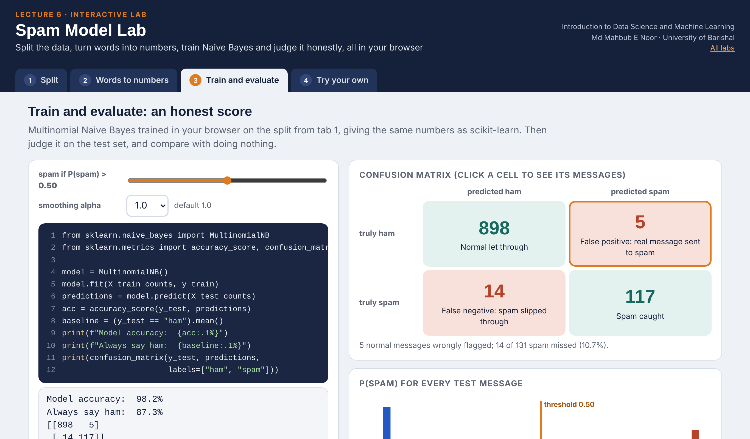
Interactive lab: Spam Model Lab
In the lab you can
1 Split
Change test_size, random_state and stratify; see every message.
2 Words to numbers
Build the bag-of-words table that CountVectorizer makes.
3 Train and evaluate
Confusion matrix you can click, and a threshold slider.
4 Try your own
Word-by-word evidence for any message you type.
Open the lab ►
Works offline in any browser
Labs_open_in_browser/
L6_Spam_Model_Lab.html
Md Mahbub E Noor
Lecture 6: Build a real spam detector
University of Barishal
19 / 21
Notes:
Open the Spam Model Lab (double-click; works offline). The model is trained in the browser and gives exactly scikit-learn's numbers: 98.2% and [[898, 5], [14, 117]] for random_state=42. Click the false-positive cell and read the five messages together. Then move the threshold to show the trade-off between missed spam and lost real messages. In Try your own, students try to fool the model (homework part 4).

Slide 20
Homework 6: mini-project
Due: [date, about two weeks from today]
1
Rebuild it
2
Baseline and mistakes
3
Experiment
Type the full pipeline in your own notebook, one step per cell, with a text cell explaining each step in your own words.
Report accuracy, the always-ham baseline, and the confusion matrix. Explain each cell of the matrix in one sentence.
Try CountVectorizer(stop_words="english") and random_state=7. What changes? Keep a small table of results.
4
Fool the model
5
Local test
6
Reflect
Write 3 spam messages designed to slip through. Did they? Explain why they worked or failed.
Collect 10 SMS (5 spam, 5 normal), remove all personal details, and test them. How many are right? Why might this differ from the test score?
One paragraph: would you trust this filter on your own phone? What would you change first?
Submit on [LMS / Google Classroom]: your notebook file HW6_<your ID>.ipynb, or a Colab link set to “Anyone with the link can view”.
Md Mahbub E Noor
Lecture 6: Build a real spam detector
University of Barishal
20 / 21
Notes:
The final homework is a mini-project; give students two weeks if you can. Task 5 is the heart of it: testing on local, current messages usually gives a noticeably worse result than 98 percent, especially for Bangla or Banglish text. That gap is the real lesson about data and the world it comes from. Remind students to remove names, phone numbers and any private content before using real messages. For task 3, stop words removes very common words like 'the' and 'you'; results may barely change or even get slightly worse, and that is a perfectly good finding to report. Grade on clarity of explanation and honesty, not on accuracy numbers.

Slide 21
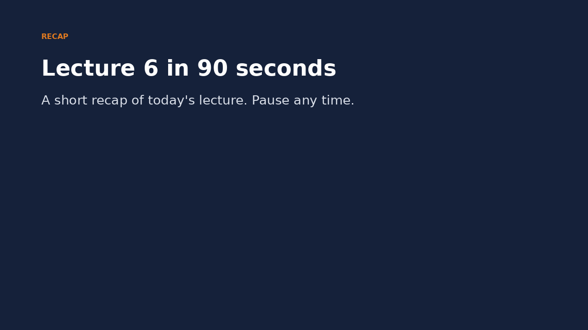
Recap: Lecture 6 in 90 seconds
Click to play or pause. Watch it again at home to revise.
Md Mahbub E Noor
Lecture 6: Build a real spam detector
University of Barishal
21 / 21
Notes:
Play this at the end of class, or leave it for students to revise at home. It is silent: pause on each card and ask the class for an example.

