Slide 1
LECTURE 7
Seeing data
Today's key line of code
df["length"].hist()
df["length"].describe()
Charts and basic statistics: the foundation of machine learning
Introduction to Data Science · Md Mahbub E Noor · University of Barishal
Notes:
Welcome to the machine learning part of the course. Before a model can learn from data, we must be able to see the data and summarise it with a few numbers. Today: averages, spread, correlation and charts. New notebook: Lecture7. Lab: make sure sms.tsv and students.csv are in your folder.

Slide 2
The road ahead: machine learning
Today
L7
L8
L9
L10
L11
L12
L13
L14
Charts and stats
What is ML?
Regression
Classification
Evaluation
Features
Clustering
Responsible ML
Today you will
1
Summarise a column with mean, median and spread
2
Calculate a mean and standard deviation by hand
3
Draw histograms, bar charts, scatter plots and box plots
4
Measure how two columns move together with correlation
5
Know why correlation is not causation
Md Mahbub E Noor
Lecture 7: Seeing data
University of Barishal
2 / 20
Notes:
Here is the second half of the course: eight lectures plus practice classes, ending with your own machine learning project. Today is the foundation: models learn patterns, and charts and statistics are how we see patterns ourselves first.

Slide 3
Mean and median: two kinds of average
mean() adds everything and divides by the count
Code
import pandas as pd
marks = pd.Series([55, 62, 68, 70, 71, 74, 78, 99])
print(marks.mean())
print(marks.median())
marks2 = pd.Series([55, 62, 68, 70, 71, 74, 78, 300])
print(marks2.mean())
print(marks2.median())
median() is the middle value after sorting
One extreme value pulls the mean, not the median
Output
72.125
70.5
97.25
70.5
Real data often has extremes: report both
Md Mahbub E Noor
Lecture 7: Seeing data
University of Barishal
3 / 20
Notes:
A Series is a single pandas column. Change one mark from 99 to a data-entry error of 300: the mean jumps by about 25 marks, the median does not move. That is why house prices and incomes are usually reported as medians.

Slide 4
By hand: mean and standard deviation
Standard deviation measures how far values typically are from the mean. Fill each column, then add up the last one.
Code
value
value - mean
(value - mean)²
values = [2, 4, 4, 4, 5, 5, 7, 9]
# mean = sum / count = 40 / 8 = 5
# variance = sum of squared gaps / count
# = 32 / 8 = 4
# standard deviation = square root = 2
2
-3
9
4
-1
1
4
-1
1
4
-1
1
5
0
0
5
0
0
7
2
4
9
4
16
sum = 40
sum = 32
Click to reveal the next row. Predict it first!
Md Mahbub E Noor
Lecture 7: Seeing data
University of Barishal
4 / 20
Notes:
This is a classic small example: mean 5, variance 4, standard deviation 2. Ask students to compute each row before you reveal it. Note for the next slide: pandas divides by count minus 1 (the sample standard deviation), so it gives a slightly larger number, about 2.14. Both are correct; they answer slightly different questions.

Slide 5
describe(): the whole summary at once
count, mean, standard deviation (std)
Code
values = pd.Series([2, 4, 4, 4, 5, 5, 7, 9])
print(values.std().round(2))
print(values.describe().round(2))
min and max: the range
25%, 50%, 75%: quartiles (50% = median)
Output
2.14
count 8.00
mean 5.00
std 2.14
min 2.00
25% 4.00
50% 4.50
75% 5.50
max 9.00
dtype: float64
pandas std() divides by count - 1, so 2.14, not 2
Md Mahbub E Noor
Lecture 7: Seeing data
University of Barishal
5 / 20
Notes:
describe is the first thing to run on any numeric column. Quartiles split the sorted data into four equal parts: 25 percent of values are below the 25% line, and so on.

Slide 6
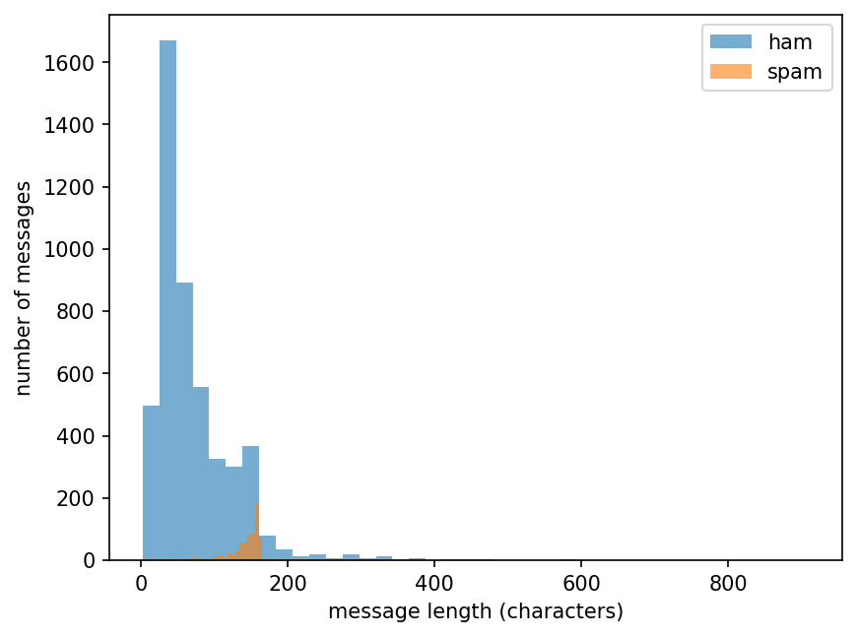
Histogram: the shape of one column
A histogram groups values into bins and counts each bin. Spam and normal messages have very different length shapes.
Code
import matplotlib.pyplot as plt
df = pd.read_csv("sms.tsv", sep="\t", header=None,
names=["label", "message"])
df["length"] = df["message"].str.len()
ham = df[df["label"] == "ham"]["length"]
spam = df[df["label"] == "spam"]["length"]
plt.hist(ham, bins=40, alpha=0.6, label="ham")
plt.hist(spam, bins=40, alpha=0.6, label="spam")
plt.xlabel("message length (characters)")
plt.ylabel("number of messages")
plt.legend()
plt.show()
Md Mahbub E Noor
Lecture 7: Seeing data
University of Barishal
6 / 20
Notes:
This is real data from Lecture 5. Normal messages pile up at short lengths; spam clusters around 140 to 160 characters, close to the old SMS length limit. alpha makes the bars see-through so both groups are visible. A chart like this tells you instantly that length is a useful feature.

Slide 7

Watch it: how a histogram is built
WATCH FOR
Each mark drops into the bin covering its value
Bar height = how many values in that bin
The shape appears as values accumulate
plt.hist does all of this in one line
Click the video to play, click again to pause. Silent: talk the class through it.
Md Mahbub E Noor
Lecture 7: Seeing data
University of Barishal
7 / 20
Notes:
Pause after the first few marks and ask which bin the next one will fall into. The point: a histogram is just counting, done for us.

Slide 8
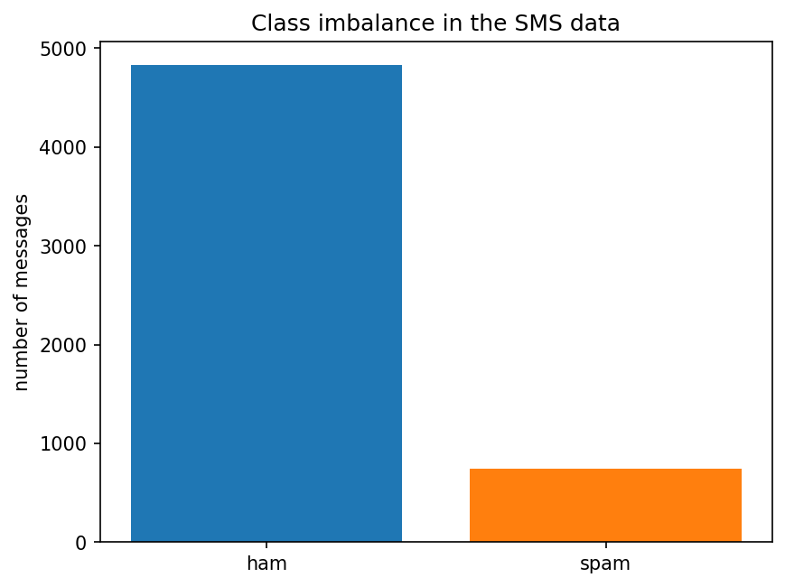
Bar chart: counts per category
Use a bar chart to compare counts of categories. Always label the axes.
Code
counts = df["label"].value_counts()
plt.bar(counts.index, counts.values,
color=["tab:blue", "tab:orange"])
plt.ylabel("number of messages")
plt.title("Class imbalance in the SMS data")
plt.show()
Md Mahbub E Noor
Lecture 7: Seeing data
University of Barishal
8 / 20
Notes:
Histograms are for numbers, bar charts for categories. This one shows the imbalance we met in Lecture 5: far more ham than spam. Imbalance will matter a lot when we evaluate models in Lecture 11.

Slide 9
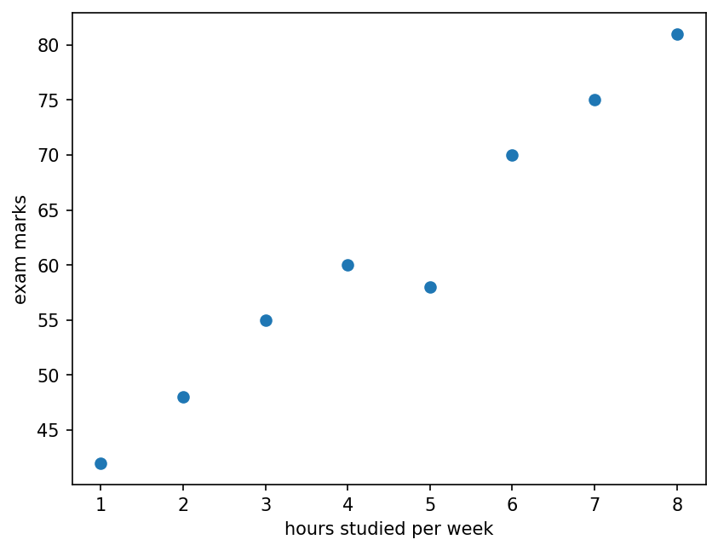
Scatter plot: two columns at once
Each dot is one student. The pattern shows how marks change with hours studied (a small invented example).
Code
hours = [1, 2, 3, 4, 5, 6, 7, 8]
marks = [42, 48, 55, 60, 58, 70, 75, 81]
plt.scatter(hours, marks)
plt.xlabel("hours studied per week")
plt.ylabel("exam marks")
plt.show()
r = pd.Series(hours).corr(pd.Series(marks))
print(round(r, 3))
Output
0.983
Md Mahbub E Noor
Lecture 7: Seeing data
University of Barishal
9 / 20
Notes:
A scatter plot is the most important chart for machine learning: it shows the relationship a model will try to learn. The dots rise to the right, so more hours tend to go with higher marks. The number printed is the correlation, explained next.

Slide 10
Correlation: how strongly two columns move together
Correlation r runs from -1 to +1. Close to +1: rise together. Close to -1: one rises as the other falls. Near 0: no straight-line pattern.
Code
import numpy as np
rng = np.random.default_rng(0)
x = rng.uniform(0, 10, 60)
ys = {"positive": 2 * x + rng.normal(0, 2, 60),
"none": rng.normal(10, 4, 60),
"negative": -2 * x + rng.normal(0, 2, 60)}
fig, axes = plt.subplots(1, 3, figsize=(10, 3))
for ax, (name, y) in zip(axes, ys.items()):
r = np.corrcoef(x, y)[0, 1]
ax.scatter(x, y, s=12)
ax.set_title(f"{name}: r = {r:.2f}")
plt.show()
Md Mahbub E Noor
Lecture 7: Seeing data
University of Barishal
10 / 20
Notes:
Three invented datasets. Point out that r only measures straight-line patterns: a perfect U-shape can have r near 0. Always look at the scatter plot, not just the number.

Slide 11
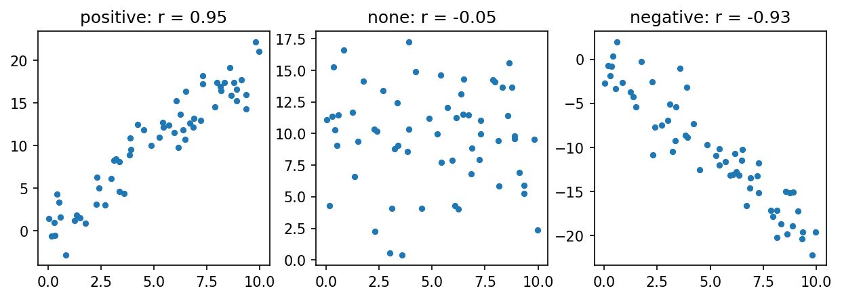
Correlation: how strongly two columns move together: the result
Md Mahbub E Noor
Lecture 7: Seeing data
University of Barishal
11 / 20
Notes:
Three invented datasets. Point out that r only measures straight-line patterns: a perfect U-shape can have r near 0. Always look at the scatter plot, not just the number.

Slide 12
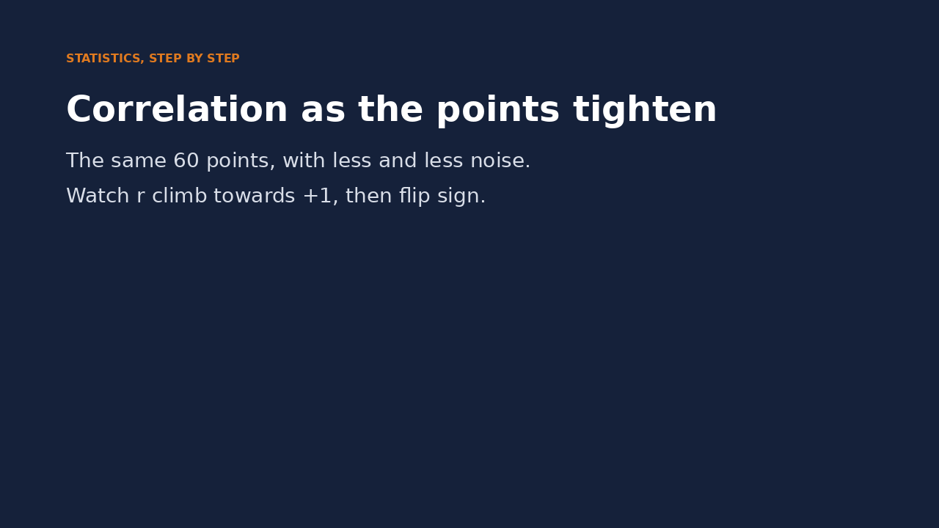
Watch it: correlation as the points tighten
WATCH FOR
Same points, less and less noise
r climbs towards +1 as the line tightens
Tilting the slope down makes r negative
Adding noise again weakens it
Click the video to play, click again to pause. Silent: talk the class through it.
Md Mahbub E Noor
Lecture 7: Seeing data
University of Barishal
12 / 20
Notes:
Pause at a few points and ask the class to guess r before reading it. Students quickly learn to estimate correlation by eye.

Slide 13
Correlation is not causation
1
2
3
Ice cream and drowning
Hidden third factor
Why it matters for ML
A correlation can come from something you did not measure. Ask: what else could explain it?
Models use correlations to predict. Prediction is useful, but it does not prove one thing causes another.
Both rise in hot weather. Ice cream does not cause drowning; heat drives both.
Md Mahbub E Noor
Lecture 7: Seeing data
University of Barishal
13 / 20
Notes:
This is one of the most important ideas in all of data science. A model that predicts well is not proof of cause. If students remember one sentence from today, make it this one.

Slide 14
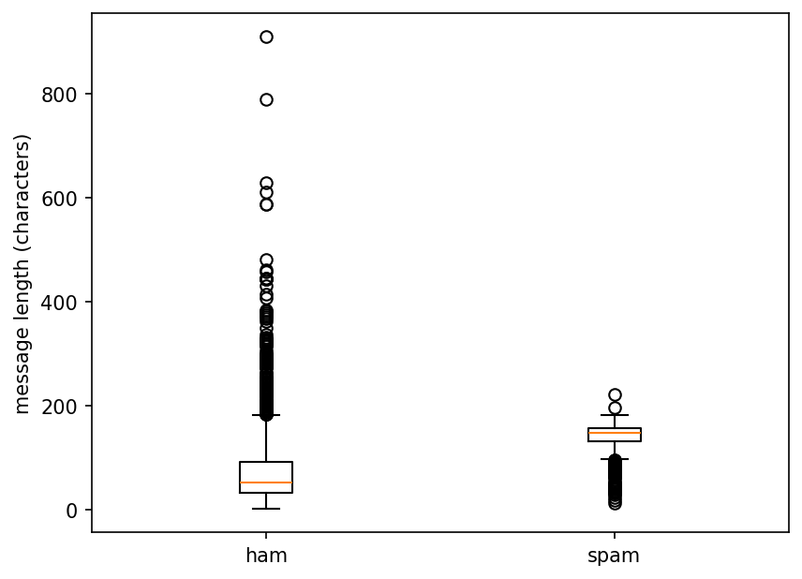
Box plot: spread and outliers at a glance
The box holds the middle 50% of values, the line is the median, and dots are unusual values (outliers).
Code
plt.boxplot([ham, spam], labels=["ham", "spam"])
plt.ylabel("message length (characters)")
plt.show()
print(ham.median(), spam.median())
Output
52.0 149.0
Md Mahbub E Noor
Lecture 7: Seeing data
University of Barishal
14 / 20
Notes:
Box plots compress a histogram into five numbers: minimum, first quartile, median, third quartile and maximum, with outliers drawn as dots. They are ideal for comparing groups side by side. The printed medians match the middle lines of the boxes.

Slide 15
Your turn
10 minutes
1
Load students.csv with pd.read_csv
Code
st = pd.read_csv("students.csv")
print(st["hours"].describe())
plt.hist(st["attendance"], bins=15)
plt.show()
...
2
Print describe() for the hours column
3
Draw a histogram of attendance
4
Draw a scatter plot of hours against prior_gpa and print the correlation
Starter code: replace the ... with your own code
Md Mahbub E Noor
Lecture 7: Seeing data
University of Barishal
15 / 20
Notes:
students.csv is an invented dataset of 150 students that we use again in Lecture 12. Correlation ignores missing values automatically. Ask two pairs to show their scatter plots and say in words what they see.

Slide 16
Common mistakes with charts and statistics
Read the last line of an error first. It names the problem.
What you typed | What Python says | What it means
plt.scatter([1, 2, 3], [4, 5]) | ValueError: x and y must be the same size | x and y must have the same number of values.
print(df["label"].mean()) | TypeError: Cannot perform reduction 'mean' with string dtype | You cannot average text. Use value_counts() for categories.
plt.hist(df["lenght"]) | KeyError: 'lenght' | Typo in the column name. Check df.columns.
Md Mahbub E Noor
Lecture 7: Seeing data
University of Barishal
16 / 20
Notes:
The second error message is long; the important part is that mean only works on numbers. For categories, count instead.

Slide 17
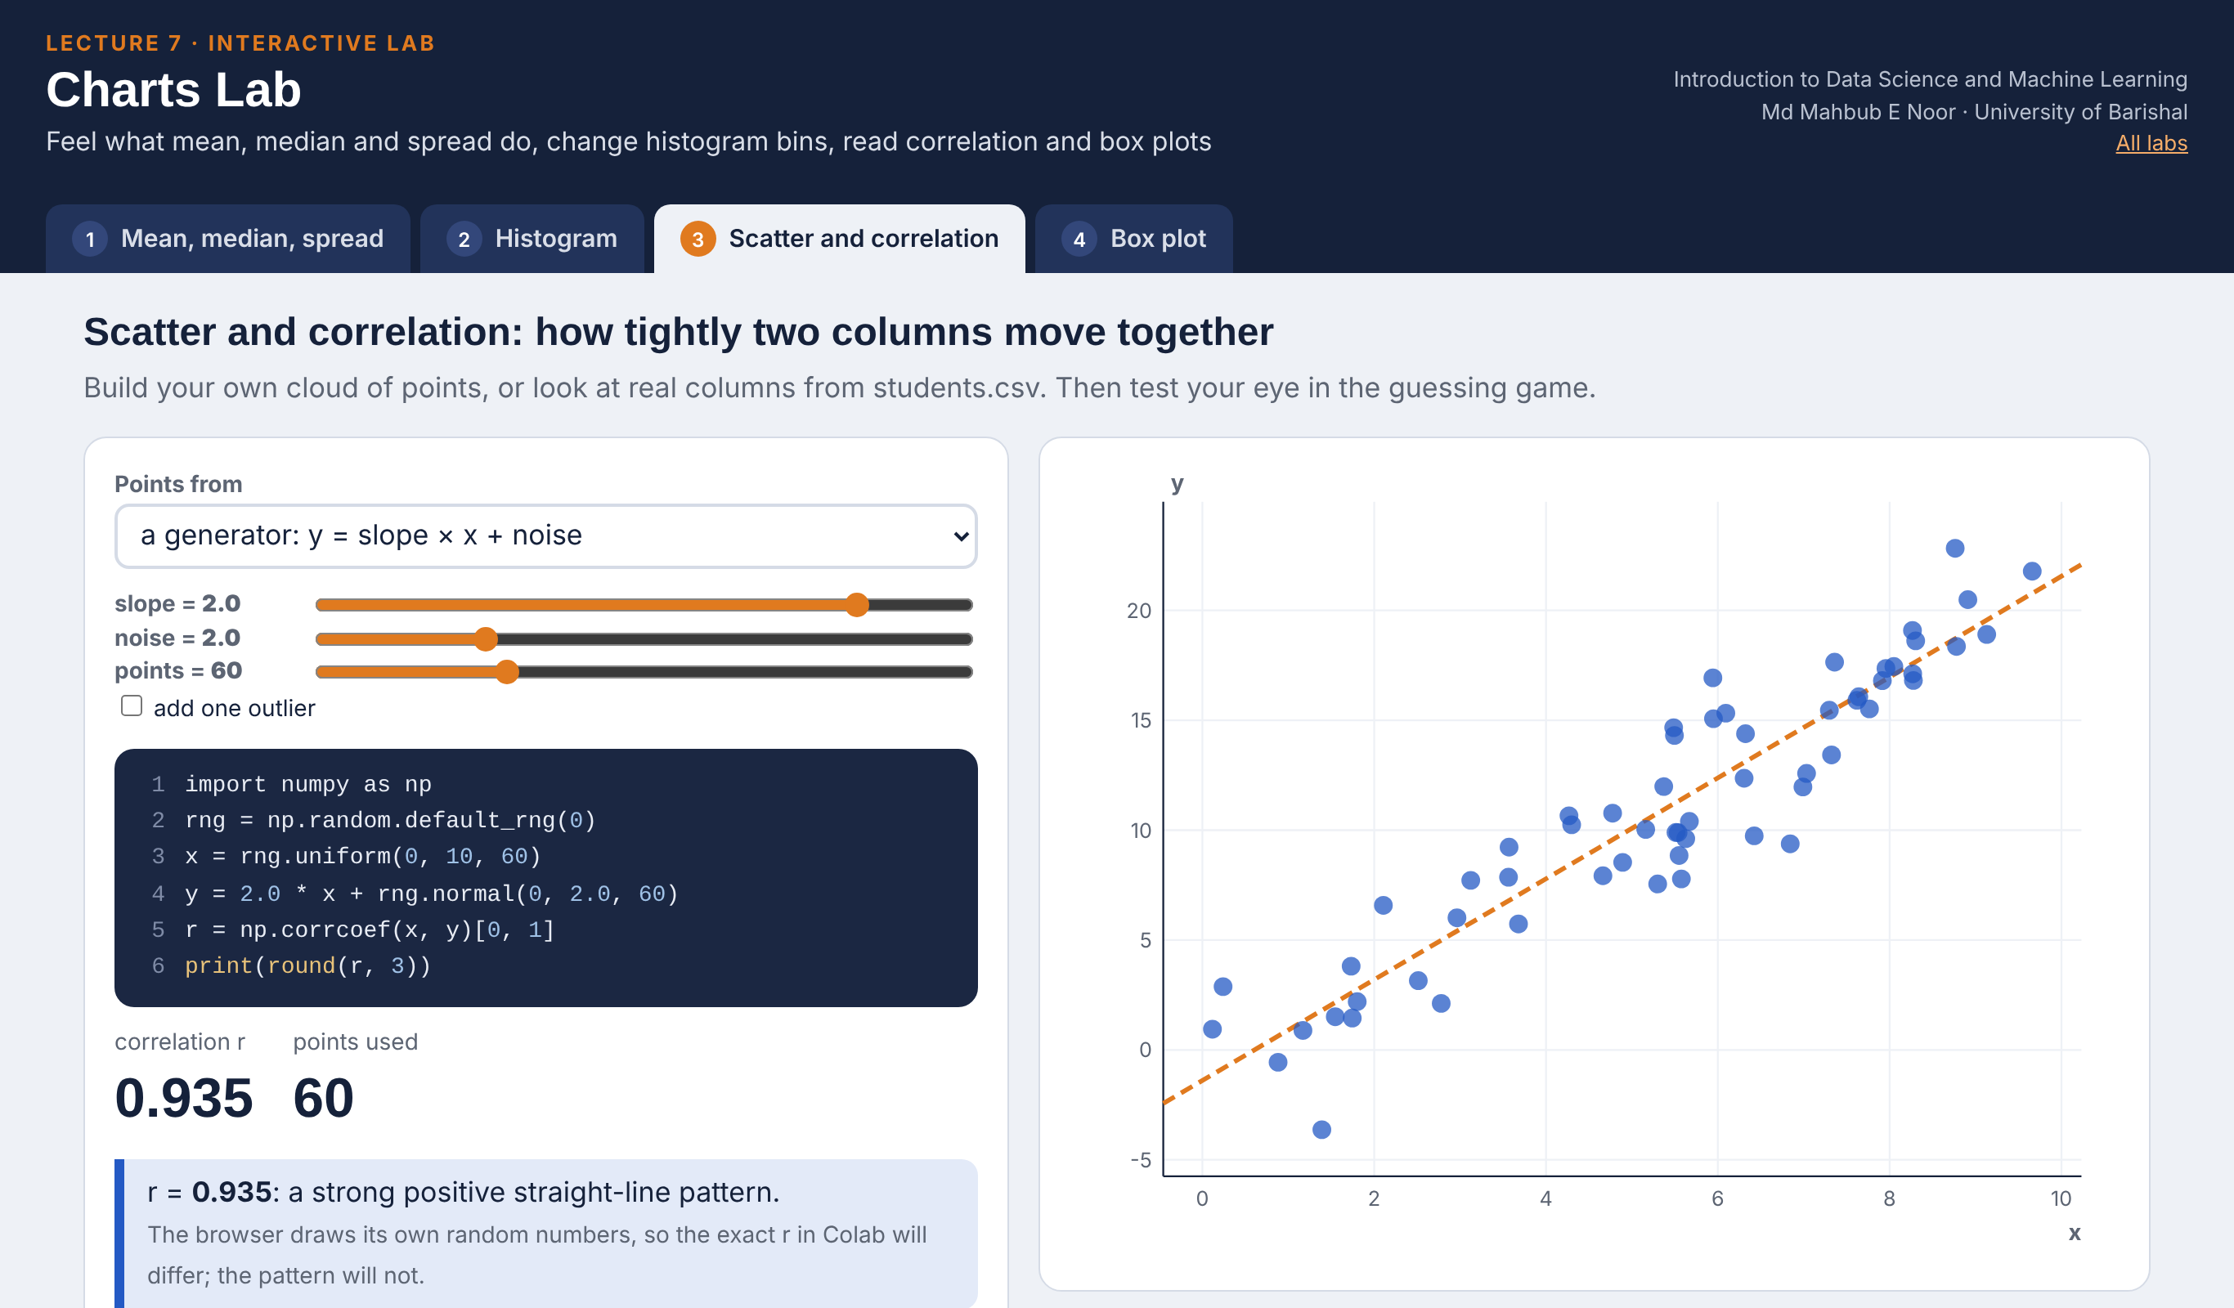
Interactive lab: Charts Lab
In the lab you can
1 Mean, median, spread
Drag one value away and watch the mean move, not the median.
2 Histogram
Change the bins and see the shape change.
3 Scatter and correlation
Build point clouds, read students.csv, guess r.
4 Box plot
Quartiles, whiskers and outliers, compared by group.
Open the lab ►
Works offline in any browser
Labs_open_in_browser/
L7_Charts_Lab.html
Md Mahbub E Noor
Lecture 7: Seeing data
University of Barishal
17 / 20
Notes:
Open the Charts Lab (double-click; works offline). Start with the slide-4 table in tab 1, then drag the largest value. In Histogram, show 5, 15 and 80 bins on the SMS lengths, and point out that two plt.hist calls use different bins. In students.csv, hours and prior_gpa are almost uncorrelated (r about 0.04), yet hours differ strongly between passed and failed students in the box plot: a good discussion of what correlation does and does not measure.

Slide 18
Today's toolkit
s.mean(), s.median() | Two kinds of average
s.std() | Typical distance from the mean
s.describe() | Full numeric summary
plt.hist(x, bins=) | Shape of one number column
plt.bar(names, counts) | Compare categories
plt.scatter(x, y) | Relationship of two columns
a.corr(b) | Strength of a straight-line pattern
plt.boxplot([a, b]) | Compare spread of groups
Md Mahbub E Noor
Lecture 7: Seeing data
University of Barishal
18 / 20
Notes:
Next lecture: what machine learning actually is, and the vocabulary we will use for the rest of the course.

Slide 19
Homework 7
Due before Lecture 8 · [date]
1
By hand
2
Median vs mean
3
Four charts
Compute the mean and standard deviation (divide by count) of 3, 5, 7, 9, 11 in a table like today's. Check with numpy: np.std(values).
Make a list of 7 prices, then replace the largest with a value 10 times bigger. Print mean and median before and after. Explain.
From students.csv: a histogram, a bar chart of dept counts, a scatter plot and a box plot of hours by passed. Label every axis.
4
Correlation table
5
Causation
Print st[["hours", "attendance", "prior_gpa"]].corr(). Which pair is most correlated?
Write one example of two things that are correlated but where one does not cause the other.
Submit on [LMS / Google Classroom]: your notebook file HW7_<your ID>.ipynb, or a Colab link set to “Anyone with the link can view”.
Md Mahbub E Noor
Lecture 7: Seeing data
University of Barishal
19 / 20
Notes:
Homework 7. Task 1 key: mean 7, squared gaps 16, 4, 0, 4, 16, sum 40, variance 8, standard deviation about 2.83. np.std uses division by count by default, unlike pandas.

Slide 20

Recap: Lecture 7 in 90 seconds
Click to play or pause. Watch it again at home to revise.
Md Mahbub E Noor
Lecture 7: Seeing data
University of Barishal
20 / 20
Notes:
Play at the end of class or leave for revision at home.

