Slide 1
LECTURE 8
What is machine learning?
Today's key line of code
model.fit(X_train, y_train)
model.predict(X_test)
Learning from examples: the ideas behind every model
Introduction to Data Science · Md Mahbub E Noor · University of Barishal
Notes:
In Lecture 6 you built a spam model by following steps. Today we step back and name the ideas behind it, so you can apply them to any problem. New notebook: Lecture8.

Slide 2
The road ahead: machine learning
Today
L7
L8
L9
L10
L11
L12
L13
L14
Charts and stats
What is ML?
Regression
Classification
Evaluation
Features
Clustering
Responsible ML
Today you will
1
Explain machine learning as learning a function from examples
2
Tell supervised from unsupervised learning
3
Tell classification from regression
4
Use the fit / predict pattern with any scikit-learn model
5
Explain why we judge a model on data it has never seen
Md Mahbub E Noor
Lecture 8: What is machine learning?
University of Barishal
2 / 19
Notes:
Today is mostly concepts with short code. Everything from here on builds on this vocabulary.

Slide 3
Machine learning in one sentence
1
2
3
Examples in
Pattern learned
New answers out
We give the computer many examples: inputs (features) and, often, the right answers (labels).
An algorithm finds a rule, called a model, that maps inputs to answers.
The model predicts answers for inputs it has never seen. That is the whole point.
Md Mahbub E Noor
Lecture 8: What is machine learning?
University of Barishal
3 / 19
Notes:
Machine learning means learning a function from examples instead of writing it by hand. Recall the Lecture 1 picture: data and answers go in, rules come out.

Slide 4
Supervised or unsupervised?
Supervised (labels given)
Unsupervised (no labels)
Every example has the right answer
Only inputs, no answers
Goal: predict the answer for new inputs
Goal: find structure, such as groups
Customer segments, topic grouping
Spam filter, price prediction, diagnosis
Lecture 13
Lectures 9 to 12
Md Mahbub E Noor
Lecture 8: What is machine learning?
University of Barishal
4 / 19
Notes:
Most practical machine learning is supervised. Unsupervised learning is useful when labels are expensive or when you do not yet know what you are looking for.

Slide 5
Classification or regression?
Ask: is the answer a category or a number?
Question | Answer looks like | Type
Is this message spam? | spam / ham | Classification
What mark will this student get? | a number, e.g. 78.5 | Regression
Which flower species is this? | one of 3 names | Classification
How many units will sell next week? | a number | Regression
Will this loan be repaid? | yes / no | Classification
Md Mahbub E Noor
Lecture 8: What is machine learning?
University of Barishal
5 / 19
Notes:
One question decides the type: is the answer a category or a number? Ask students to classify two examples of their own before moving on.

Slide 6
The machine learning workflow
1
2
3
4
5
6
7
Question
Data
Features
Split
Train
Evaluate
Use
What will we predict?
Collect and clean
Choose and prepare inputs
Hide a test set
fit()
Honest test score
predict() on new data
The same workflow as Lecture 6, for any dataset. Most of the work is before training.
Md Mahbub E Noor
Lecture 8: What is machine learning?
University of Barishal
6 / 19
Notes:
This generalises the seven steps of Lecture 6. Point out that only one step is training; deciding the question, getting data and preparing features take most of the time in real projects.

Slide 7
Meet a classic dataset: iris flowers
150 flowers, 4 measurements each (in cm), 3 species. It ships with scikit-learn, so it works offline.
sepal length | sepal width | petal length | petal width | species (label)
5.1 | 3.5 | 1.4 | 0.2 | setosa
7.0 | 3.2 | 4.7 | 1.4 | versicolor
6.3 | 3.3 | 6.0 | 2.5 | virginica
4.9 | 3.0 | 1.4 | 0.2 | setosa
6.4 | 3.2 | 4.5 | 1.5 | versicolor
Md Mahbub E Noor
Lecture 8: What is machine learning?
University of Barishal
7 / 19
Notes:
Rows are flowers, the four measurement columns are features, and species is the label. These five rows are real rows from the dataset. Features in, label out: that is supervised classification.

Slide 8
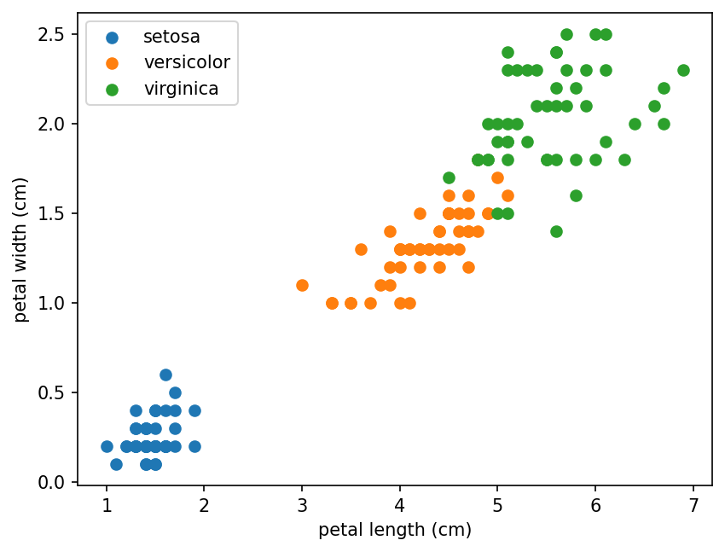
Look first: can the classes be told apart?
Two petal measurements already separate the species well. Machine learning finds such patterns automatically, in many dimensions.
Code
import matplotlib.pyplot as plt
from sklearn.datasets import load_iris
iris = load_iris(as_frame=True)
X = iris.data
y = iris.target
for k, name in enumerate(iris.target_names):
part = X[y == k]
plt.scatter(part["petal length (cm)"],
part["petal width (cm)"], label=name)
plt.xlabel("petal length (cm)")
plt.ylabel("petal width (cm)")
plt.legend()
plt.show()
Md Mahbub E Noor
Lecture 8: What is machine learning?
University of Barishal
8 / 19
Notes:
load_iris with as_frame=True gives pandas tables. One species, setosa, sits completely apart; the other two overlap a little. Overlap is where models make mistakes.

Slide 9
The same pattern for every model
Split first, with the same function as Lecture 6
Code
from sklearn.model_selection import train_test_split
from sklearn.neighbors import KNeighborsClassifier
from sklearn.tree import DecisionTreeClassifier
from sklearn.naive_bayes import GaussianNB
X_tr, X_te, y_tr, y_te = train_test_split(
X, y, test_size=0.3, random_state=42, stratify=y)
for model in [KNeighborsClassifier(),
DecisionTreeClassifier(random_state=0),
GaussianNB()]:
model.fit(X_tr, y_tr)
acc = model.score(X_te, y_te)
print(type(model).__name__, round(acc, 3))
fit learns from training data
score reports accuracy on test data
Swap the model; the code stays the same
Output
KNeighborsClassifier 0.978
DecisionTreeClassifier 0.978
GaussianNB 0.911
Md Mahbub E Noor
Lecture 8: What is machine learning?
University of Barishal
9 / 19
Notes:
This is the most useful slide of the lecture. Every scikit-learn model has fit, predict and score. Once you know the pattern, trying a new algorithm is one changed line. GaussianNB is a Naive Bayes for number features, a cousin of the spam model.

Slide 10
100% on training data: a perfect model?
Predict first
Code
?
one_nn = KNeighborsClassifier(n_neighbors=1)
one_nn.fit(X_tr, y_tr)
print(one_nn.score(X_tr, y_tr))
print(round(one_nn.score(X_te, y_te), 3))
A 1-nearest-neighbour model scores 100% on its training data. What will it score on the test data?
Md Mahbub E Noor
Lecture 8: What is machine learning?
University of Barishal
10 / 19
Notes:
Predict first.

Slide 11
Answer: 100% on training data: a perfect model?
Code
On training data it just finds each flower itself
one_nn = KNeighborsClassifier(n_neighbors=1)
one_nn.fit(X_tr, y_tr)
print(one_nn.score(X_tr, y_tr))
print(round(one_nn.score(X_te, y_te), 3))
That is memorising, not learning
Only the test score shows real skill
Output
Never report training accuracy as your result
1.0
0.933
Md Mahbub E Noor
Lecture 8: What is machine learning?
University of Barishal
11 / 19
Notes:
Training accuracy is 1.0 because every training flower's nearest neighbour is itself. The test score is lower. The gap between training and test performance is the central topic of Lecture 11.

Slide 12
Generalisation: the real goal
1
2
3
Memorising
Generalising
How we check
Learning the exact exam questions. Perfect on those, lost on new ones.
Understanding the patterns, so new questions can be answered too.
Keep a test set the model never sees, and judge it only there.
Md Mahbub E Noor
Lecture 8: What is machine learning?
University of Barishal
12 / 19
Notes:
A model that generalises has learned patterns that hold beyond the examples it saw. Everything about evaluation exists to measure generalisation honestly.

Slide 13
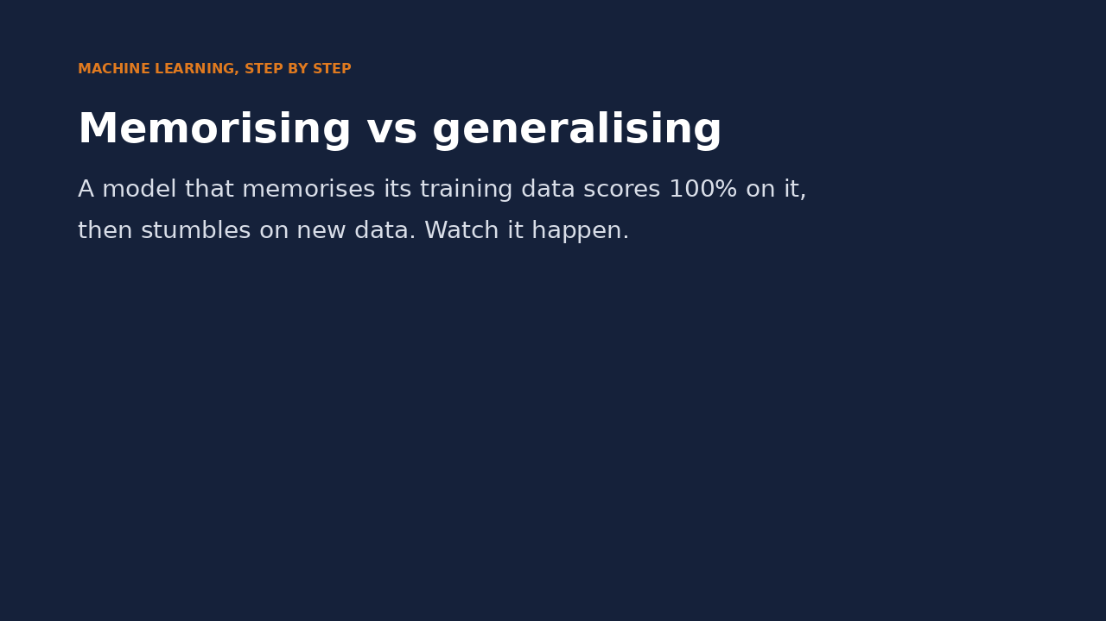
Watch it: memorising vs generalising
WATCH FOR
k = 1 wraps a border around every training point
100% on training data, 74% on new points
k = 15 is smoother: 87% on training data
But 88% on new points: it generalises better
Click the video to play, click again to pause. Silent: talk the class through it.
Md Mahbub E Noor
Lecture 8: What is machine learning?
University of Barishal
13 / 19
Notes:
Real numbers from the animation. Pause on the crosses (mistakes) and ask why the wiggly border makes them. This is the core idea behind Lecture 11.

Slide 14
Vocabulary for the rest of the course
Word | Meaning
Feature (X) | An input column the model uses
Label / target (y) | The answer we want to predict
Model | The learned rule that maps features to a label
Training (fit) | Learning the rule from examples
Prediction | The model's answer for a new example
Hyperparameter | A setting we choose, e.g. k in k-nearest neighbours
Generalisation | Doing well on data the model has never seen
Md Mahbub E Noor
Lecture 8: What is machine learning?
University of Barishal
14 / 19
Notes:
Keep this slide open for the next few weeks. Hyperparameters are new: they are settings chosen by us, not learned from data.

Slide 15
Your turn
8 minutes
1
Load the wine dataset: from sklearn.datasets import load_wine
Code
from sklearn.datasets import load_wine
wine = load_wine(as_frame=True)
X, y = wine.data, wine.target
...
2
Split it 70/30 with stratify
3
Score the same three models
4
Which model wins? Is it the same as for iris?
Starter code: replace the ... with your own code
Md Mahbub E Noor
Lecture 8: What is machine learning?
University of Barishal
15 / 19
Notes:
The wine features have very different scales, so k-nearest neighbours does much worse here than on iris. Do not explain why yet; it is the hook for Lecture 12 on scaling.

Slide 16
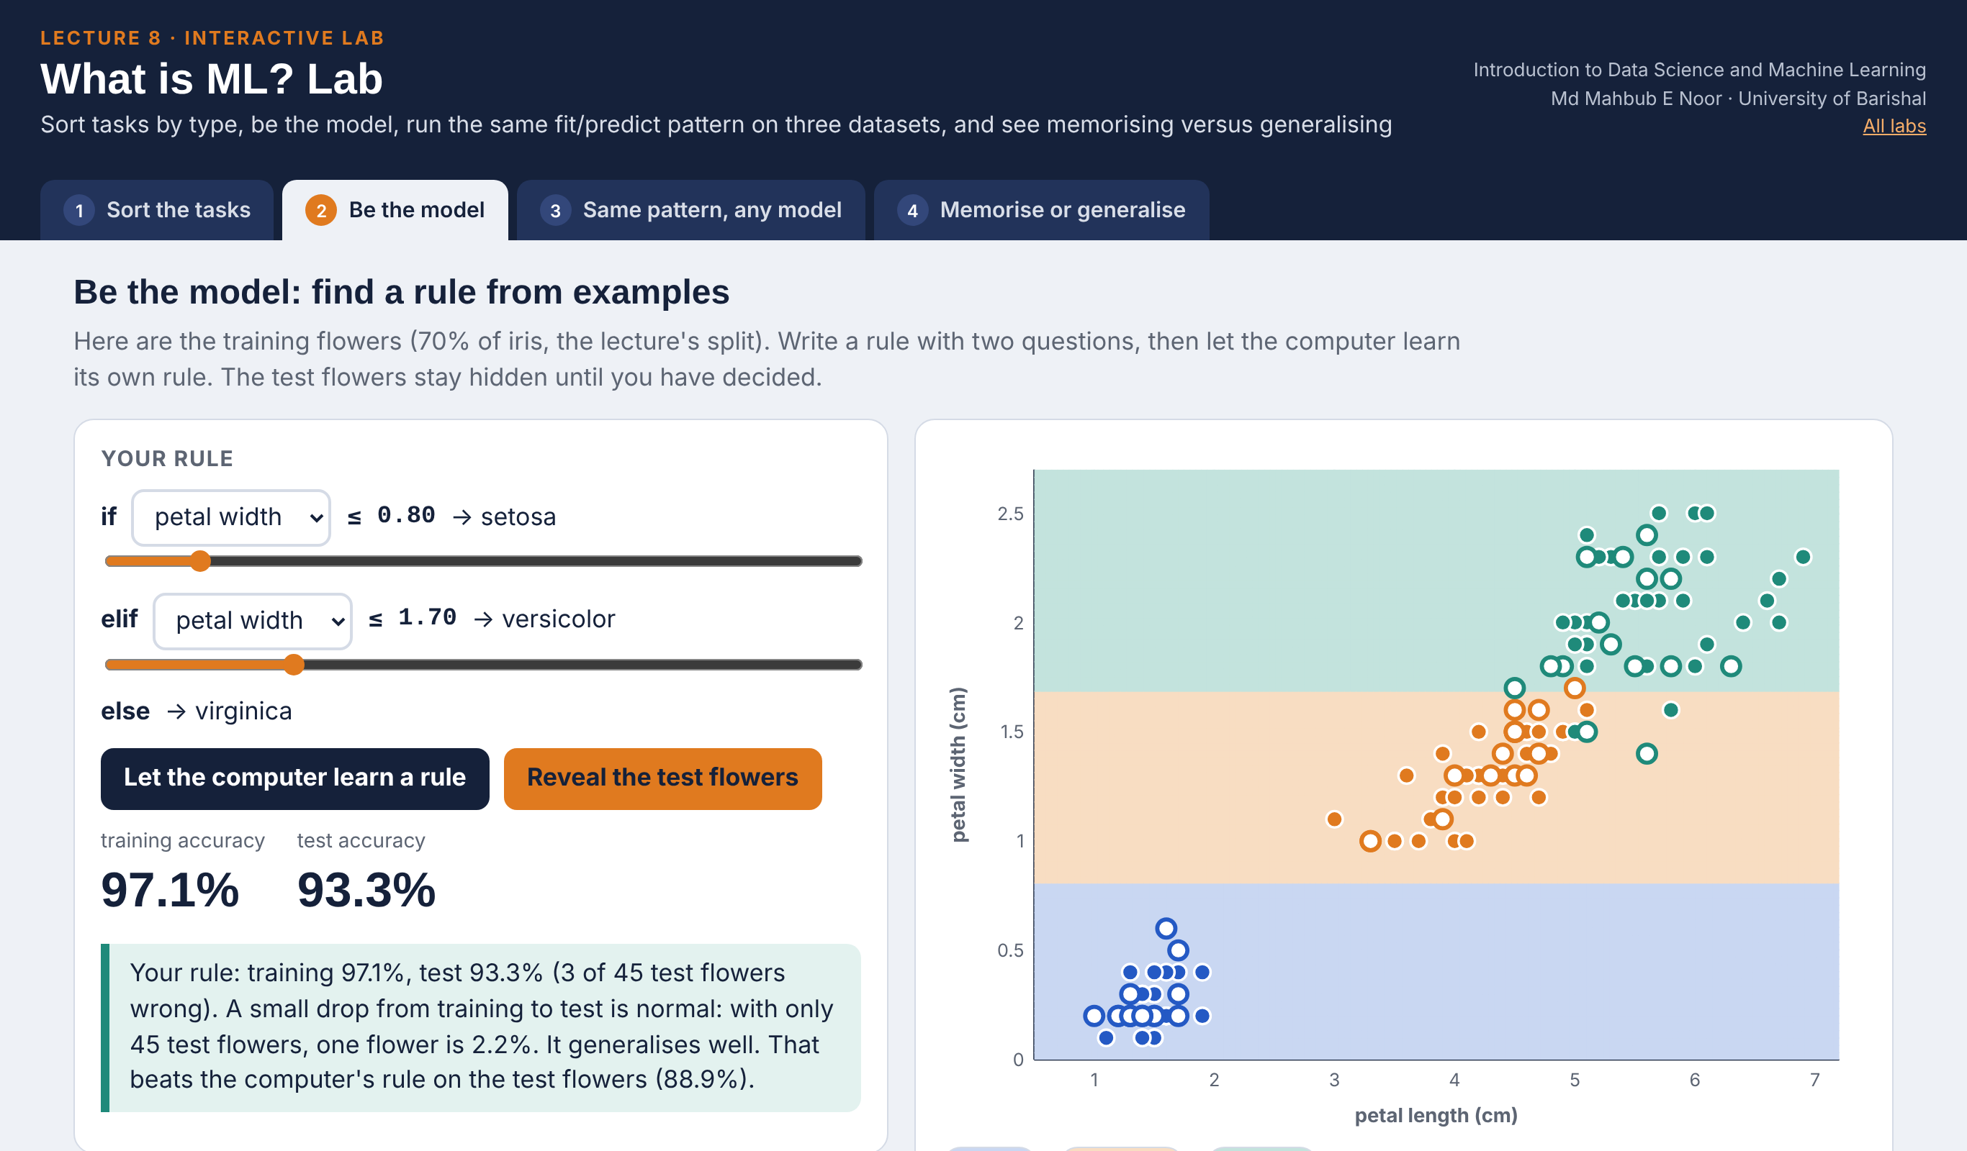
Interactive lab: What is ML? Lab
In the lab you can
1 Sort the tasks
12 questions: supervised or not, category or number.
2 Be the model
Write a two-question rule for iris, then meet the tree's.
3 Same pattern, any model
fit / score on iris, wine, breast cancer; guess the winner.
4 Memorise or generalise
k-NN from k = 1 to 101: training vs new points.
Open the lab ►
Works offline in any browser
Labs_open_in_browser/
L8_What_is_ML_Lab.html
Md Mahbub E Noor
Lecture 8: What is machine learning?
University of Barishal
16 / 19
Notes:
Open the What is ML? Lab (double-click; works offline). Sort the tasks: let pairs answer all 12 before discussing; the clustering and fraud questions are the usual mistakes. Be the model: students set thresholds on the training flowers only, then reveal the test flowers; compare with the computer's rule (petal width 0.7 / 1.55, train 97.1%, test 88.9%) - a sensible human rule can beat it on test. Same pattern: the printed lines match slide 9 exactly (0.978, 0.978, 0.911); switch to wine for the Your-turn slide. Memorise or generalise: k = 1 gives 100% training but 82.5% on new points; the table repeats slide 11 (iris 1.0 / 0.933).

Slide 17
Today's toolkit
supervised | Learn from labelled examples
unsupervised | Find structure without labels
classification | Predict a category
regression | Predict a number
model.fit(X, y) | Train
model.predict(X) | Answer for new rows
model.score(X, y) | Accuracy (classifiers)
test set | Data the model never sees in training
Md Mahbub E Noor
Lecture 8: What is machine learning?
University of Barishal
17 / 19
Notes:
Next lecture: regression, predicting numbers, starting with a line we fit by hand.

Slide 18
Homework 8
Due before Lecture 9 · [date]
1
Classify the task
2
Features and label
3
Three models
Write 6 prediction questions from daily life. Label each: classification or regression, supervised or unsupervised.
For two of your questions, list 3 useful features and the label.
Repeat the 'same pattern' slide on load_breast_cancer. Report the three test accuracies.
4
Train vs test
5
Explain
For KNeighborsClassifier(n_neighbors=1) on breast cancer, print training and test accuracy. Explain the gap.
In 3 sentences: why do we judge a model only on data it has not seen?
Submit on [LMS / Google Classroom]: your notebook file HW8_<your ID>.ipynb, or a Colab link set to “Anyone with the link can view”.
Md Mahbub E Noor
Lecture 8: What is machine learning?
University of Barishal
18 / 19
Notes:
Homework 8. For task 4 expect training accuracy 1.0 and a lower test accuracy; any explanation mentioning memorising earns full marks.

Slide 19
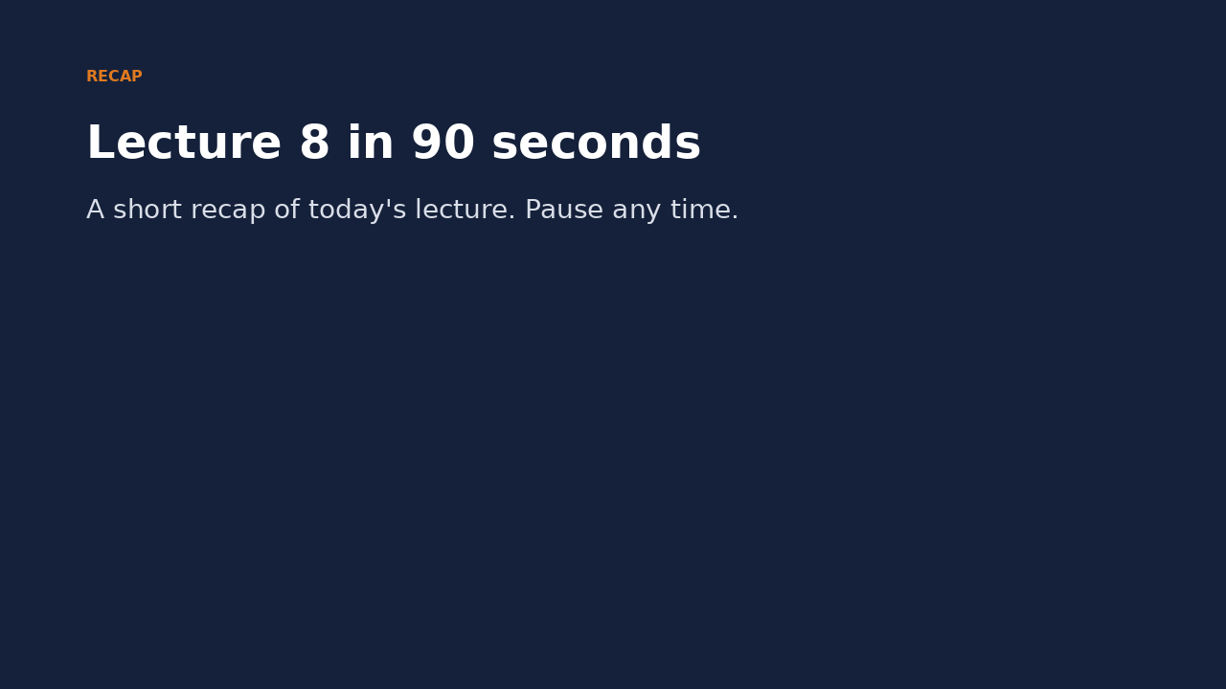
Recap: Lecture 8 in 90 seconds
Click to play or pause. Watch it again at home to revise.
Md Mahbub E Noor
Lecture 8: What is machine learning?
University of Barishal
19 / 19
Notes:
Play at the end of class or leave for revision at home.

