Slide 1
LECTURE 9
Regression
Today's key line of code
model = LinearRegression()
model.fit(X, y)
model.predict([[6]])
Predicting numbers with a straight line
Introduction to Data Science · Md Mahbub E Noor · University of Barishal
Notes:
Today: regression, predicting a number. We start with five students and a line we calculate by hand, then let scikit-learn do it, then try real medical data. New notebook: Lecture9.

Slide 2
The road ahead: machine learning
Today
L7
L8
L9
L10
L11
L12
L13
L14
Charts and stats
What is ML?
Regression
Classification
Evaluation
Features
Clustering
Responsible ML
Today you will
1
Recognise regression problems
2
Read a line: slope and intercept
3
Measure error with MAE by hand
4
Find the best line by hand, then with LinearRegression
5
Evaluate on real data with MAE and R², and know when a line misleads
Md Mahbub E Noor
Lecture 9: Regression
University of Barishal
2 / 20
Notes:
Linear regression is the oldest and still one of the most useful models. Everything about errors and evaluation that we learn today carries over to every other model.

Slide 3
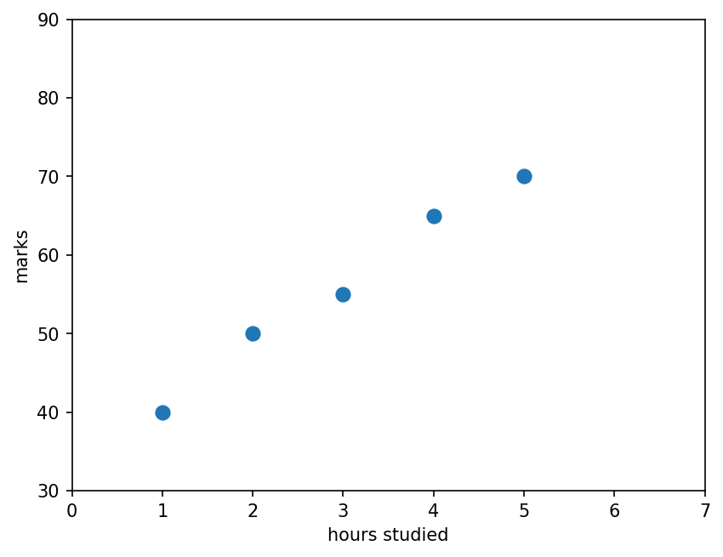
Five students, one question
Invented data: hours studied per week and exam marks. What mark would we expect for 6 hours?
Code
import matplotlib.pyplot as plt
hours = [1, 2, 3, 4, 5]
marks = [40, 50, 55, 65, 70]
plt.scatter(hours, marks, s=60)
plt.xlabel("hours studied")
plt.ylabel("marks")
plt.xlim(0, 7)
plt.ylim(30, 90)
plt.show()
Md Mahbub E Noor
Lecture 9: Regression
University of Barishal
3 / 20
Notes:
Ask the class to guess the mark for 6 hours before any maths. Most will say around 78 to 80 by extending the pattern in their heads. That mental line is exactly what regression computes.

Slide 4
Anatomy of a straight line
Code
slope = 7.5
intercept = 33.5
h = 6
predicted = slope * h + intercept
print(predicted)
Slope: marks gained per extra hour
Intercept: predicted marks at 0 hours
Slope times the input (6 hours)
plus the starting point
Output
78.5
Md Mahbub E Noor
Lecture 9: Regression
University of Barishal
4 / 20
Notes:
Every straight line is described by two numbers: the slope and the intercept. Linear regression's whole job is to choose these two numbers. Here we used the best values, which we will calculate by hand in two slides.

Slide 5
By hand: how wrong is a guessed line?
Try the line marks = 8 × hours + 30. Error = actual - predicted. MAE = average of the error sizes.
Code
hours
actual
predicted
error
|error|
# guessed line:
# 8 * hours + 30
# MAE = (2+4+1+3+0) / 5
# = 2.0 marks
1
40
38
2
2
2
50
46
4
4
3
55
54
1
1
4
65
62
3
3
5
70
70
0
0
MAE
2.0
Click to reveal the next row. Predict it first!
Md Mahbub E Noor
Lecture 9: Regression
University of Barishal
5 / 20
Notes:
Mean absolute error, MAE, is the average size of the mistakes, in the same unit as the answer: marks. Reveal each row after students compute it. A different line gives a different MAE; the best line makes the errors as small as possible.

Slide 6
By hand: the best line (least squares)
slope = sum of (h - mean h)(m - mean m) / sum of (h - mean h)². Means: hours 3, marks 56.
Code
h
m
h - 3
m - 56
product
(h - 3)²
# slope = 75 / 10 = 7.5
# intercept = 56 - 7.5 * 3
# = 33.5
# best line:
# marks = 7.5 * hours + 33.5
1
40
-2
-16
32
4
2
50
-1
-6
6
1
3
55
0
-1
0
0
4
65
1
9
9
1
5
70
2
14
28
4
sum
75
10
Click to reveal the next row. Predict it first!
Md Mahbub E Noor
Lecture 9: Regression
University of Barishal
6 / 20
Notes:
This formula gives the line with the smallest sum of squared errors, called least squares. Students only need to follow the arithmetic once; after this, the computer does it. The result, slope 7.5 and intercept 33.5, is what the next slide's code prints.

Slide 7
The same line with scikit-learn
X must be a table: one row per student, so [[1], [2], ...]
Code
from sklearn.linear_model import LinearRegression
X = [[1], [2], [3], [4], [5]]
y = [40, 50, 55, 65, 70]
model = LinearRegression()
model.fit(X, y)
print(model.coef_, model.intercept_)
print(model.predict([[6]]))
fit finds the slope (coef_) and intercept
Same numbers as our hand calculation
Output
predict answers new questions: 6 hours gives 78.5
[7.5] 33.5
[78.5]
Md Mahbub E Noor
Lecture 9: Regression
University of Barishal
7 / 20
Notes:
The double brackets matter: scikit-learn always expects a table of features, even with only one feature. The answer, 78.5, is close to the class's guess on the first slide.

Slide 8
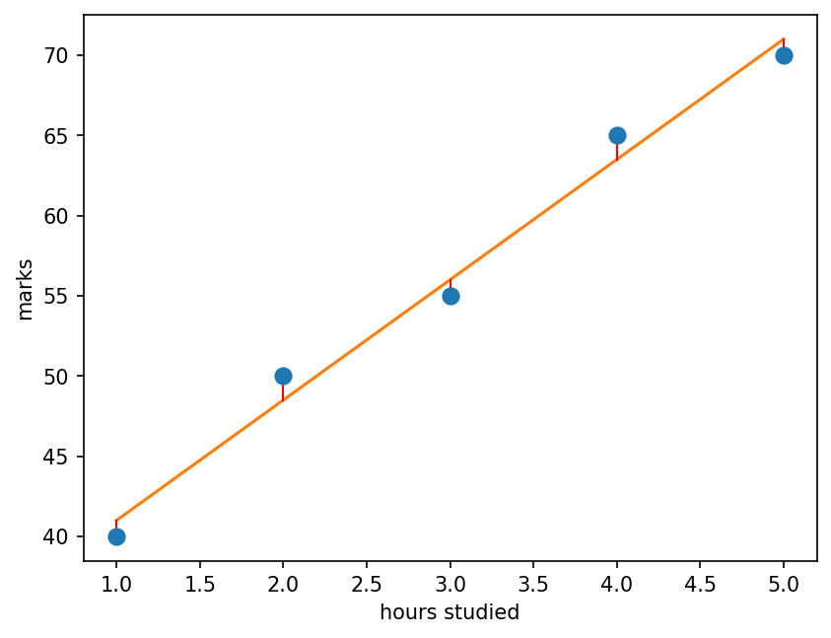
Draw the fitted line
The line passes as close as possible to all points at once. The red segments are the errors it tries to keep small.
Code
pred = model.predict(X)
plt.scatter(hours, marks, s=60, zorder=3)
plt.plot(hours, pred, color="tab:orange")
for h, m, p in zip(hours, marks, pred):
plt.plot([h, h], [m, p], color="red", lw=1)
plt.xlabel("hours studied")
plt.ylabel("marks")
plt.show()
Md Mahbub E Noor
Lecture 9: Regression
University of Barishal
8 / 20
Notes:
Each red segment is one error, the vertical gap between the actual mark and the line. Least squares minimises the sum of these gaps squared.

Slide 9
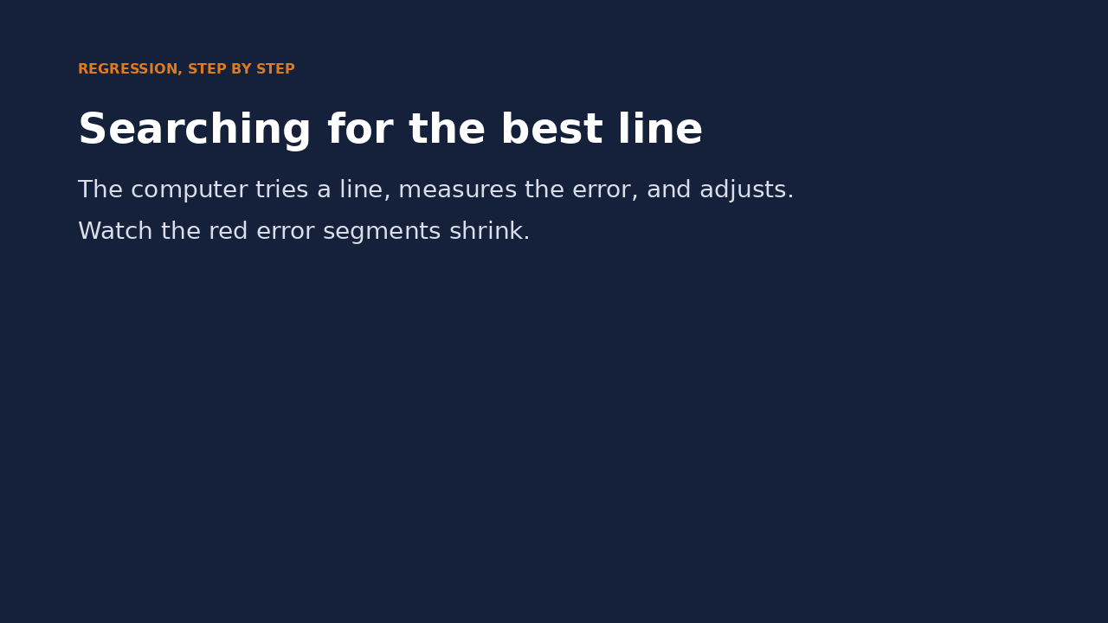
Watch it: searching for the best line
WATCH FOR
Each frame tries a different line
Red segments: the errors
MAE goes down as the line improves
The search ends at slope 7.5, intercept 33.5
Click the video to play, click again to pause. Silent: talk the class through it.
Md Mahbub E Noor
Lecture 9: Regression
University of Barishal
9 / 20
Notes:
The video shows a computer improving a line step by step, a simplified version of how many models learn: try, measure the error, adjust. Pause midway and ask whether the next adjustment should make the line steeper or flatter.

Slide 10
Real data: diabetes progression
442 patients, built into scikit-learn (offline)
Code
from sklearn.datasets import load_diabetes
from sklearn.model_selection import train_test_split
from sklearn.metrics import mean_absolute_error
data = load_diabetes(as_frame=True)
X = data.data[["bmi"]]
y = data.target
X_tr, X_te, y_tr, y_te = train_test_split(
X, y, test_size=0.25, random_state=0)
model = LinearRegression().fit(X_tr, y_tr)
pred = model.predict(X_te)
print(round(mean_absolute_error(y_te, pred), 1))
Feature: body mass index (bmi), already scaled
Target: disease progression one year later
Real data is noisy: errors are much larger
Output
53.3
Md Mahbub E Noor
Lecture 9: Regression
University of Barishal
10 / 20
Notes:
The target is a disease progression score, roughly between 25 and 350. The features in this dataset were already rescaled by its authors, which is why bmi values look small. The MAE is large: one feature explains only part of the story.

Slide 11
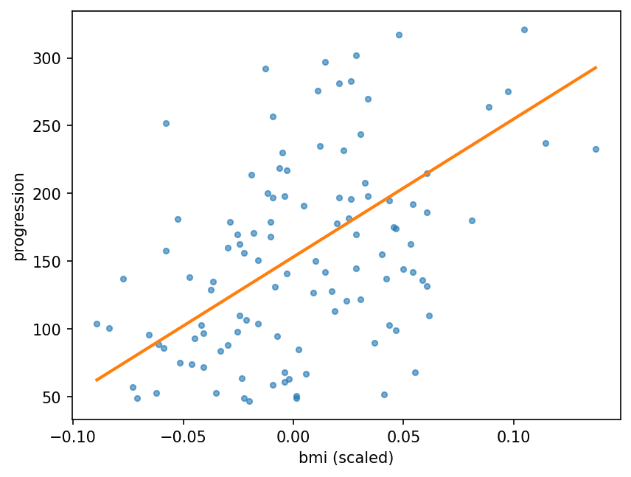
See why: one feature, lots of noise
The trend is real, but patients with the same bmi differ a lot. A line can only capture the average trend.
Code
plt.scatter(X_te["bmi"], y_te, s=12, alpha=0.6)
xs = X_te.sort_values("bmi")
plt.plot(xs["bmi"], model.predict(xs),
color="tab:orange", lw=2)
plt.xlabel("bmi (scaled)")
plt.ylabel("progression")
plt.show()
Md Mahbub E Noor
Lecture 9: Regression
University of Barishal
11 / 20
Notes:
Honest picture: the line points the right way, but most points are far from it. Adding more features usually helps, as the next slide shows.

Slide 12
All 10 features, and two more ways to score
MAE: average error size, in target units
Code
from sklearn.metrics import r2_score
for cols in [["bmi"], list(data.data.columns)]:
X = data.data[cols]
X_tr, X_te, y_tr, y_te = train_test_split(
X, y, test_size=0.25, random_state=0)
m = LinearRegression().fit(X_tr, y_tr)
p = m.predict(X_te)
print(len(cols), "features: MAE",
round(mean_absolute_error(y_te, p), 1),
"R2", round(r2_score(y_te, p), 2))
R²: share of variation explained (1 = perfect, 0 = no better than the mean)
More features: lower MAE, higher R²
Always compare on the test set
Output
1 features: MAE 53.3 R2 0.16
10 features: MAE 45.1 R2 0.36
Md Mahbub E Noor
Lecture 9: Regression
University of Barishal
12 / 20
Notes:
R squared compares the model with the simplest possible prediction, always guessing the average. Zero means no better than that; one means perfect. Neither number alone tells the whole story, so report both.

Slide 13
What if someone studies 20 hours?
Predict first
Code
?
X = [[1], [2], [3], [4], [5]]
y = [40, 50, 55, 65, 70]
small = LinearRegression().fit(X, y)
print(small.predict([[20]]))
Use our 5-student model to predict marks for 20 hours of study. Is the answer sensible?
Md Mahbub E Noor
Lecture 9: Regression
University of Barishal
13 / 20
Notes:
Predict, then reveal.

Slide 14
Answer: What if someone studies 20 hours?
Code
The line predicts 183.5 marks out of 100
X = [[1], [2], [3], [4], [5]]
y = [40, 50, 55, 65, 70]
small = LinearRegression().fit(X, y)
print(small.predict([[20]]))
Lines continue forever; real limits do not
We only had data from 1 to 5 hours
Output
Never trust predictions far outside the training data
[183.5]
Md Mahbub E Noor
Lecture 9: Regression
University of Barishal
14 / 20
Notes:
183.5 marks: impossible. Predicting outside the range of the training data is called extrapolation, and it is where models fail silently. A useful habit: check that new inputs look like the training inputs.

Slide 15
Your turn
10 minutes
1
Use the diabetes data with the feature bp (blood pressure) instead of bmi
Code
X = data.data[["bp"]]
X_tr, X_te, y_tr, y_te = train_test_split(
X, y, test_size=0.25, random_state=0)
...
2
Fit LinearRegression on the training part
3
Print MAE and R² on the test part
4
Is bp a better single feature than bmi?
Starter code: replace the ... with your own code
Md Mahbub E Noor
Lecture 9: Regression
University of Barishal
15 / 20
Notes:
On this split bp gives a slightly lower MAE (50.8 vs 53.3) but also a lower R² (0.14 vs 0.16) than bmi: the two metrics disagree. That is a good discussion point about why we report more than one number. The process is the lesson: same split, same metrics, change one thing.

Slide 16
Common regression mistakes
Read the last line of an error first. It names the problem.
What you typed | What Python says | What it means
LinearRegression().fit([1, 2, 3], [4, 5, 6]) | ValueError: Expected 2D array, got 1D array instead: | X must be 2-D: [[1], [2], [3]]. Python says so in the message.
LinearRegression().fit([[1], [2]], [4, 5, 6]) | ValueError: Found input variables with inconsistent numbers of samples: [2, 3] | X and y have different numbers of rows.
LinearRegression().predict([[6]]) | NotFittedError: This LinearRegression instance is not fitted yet. Call 'fit' with appropriate arguments before using this estimator. | The model was never fitted. Call fit first.
Md Mahbub E Noor
Lecture 9: Regression
University of Barishal
16 / 20
Notes:
The first is by far the most common: a plain list is 1-D. Wrap each value in its own list, or select columns with double brackets in pandas.

Slide 17
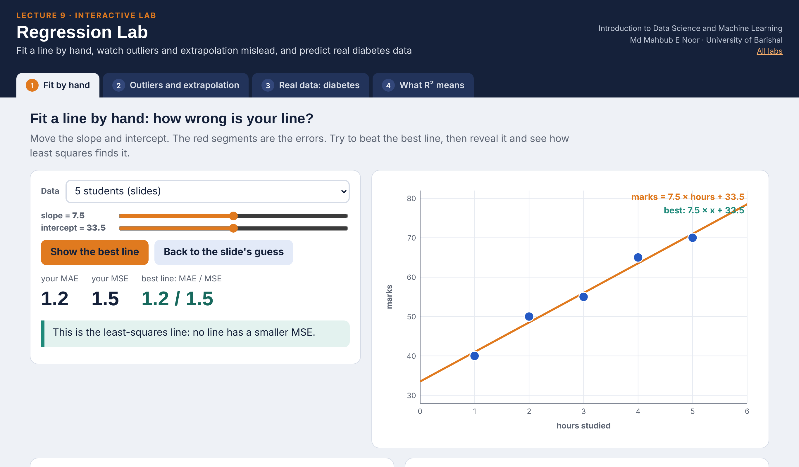
Interactive lab: Regression Lab
In the lab you can
1 Fit by hand
Move slope and intercept; watch MAE, MSE and the errors.
2 Outliers and extrapolation
One odd student swings the line; 20 hours gives 183.5.
3 Real data: diabetes
Every single feature ranked by test MAE and R².
4 What R² means
Errors drawn as squares: your line against the average.
Open the lab ►
Works offline in any browser
Labs_open_in_browser/
L9_Regression_Lab.html
Md Mahbub E Noor
Lecture 9: Regression
University of Barishal
17 / 20
Notes:
Open the Regression Lab (double-click; works offline). Fit by hand: let students race to get MAE below 2.0 before you reveal the best line and the slide-6 table. Point out that least squares minimises squared error, so a line can beat it on MAE but never on MSE. Outliers: drag the 6th student down to 20 marks and watch the slope collapse. Diabetes: the ranking table answers the 'Your turn' question about bp directly (the lab matches scikit-learn: bmi MAE 53.3, R² 0.16).

Slide 18
Today's toolkit
y = slope·x + intercept | A straight line
MAE | Average error size
R² | Share of variation explained
LinearRegression() | Fits the best line
model.coef_ | Slope(s)
model.intercept_ | Intercept
mean_absolute_error(y, p) | MAE in code
r2_score(y, p) | R² in code
Md Mahbub E Noor
Lecture 9: Regression
University of Barishal
18 / 20
Notes:
Next lecture: classification with two very intuitive models, nearest neighbours and decision trees.

Slide 19
Homework 9
Due before Lecture 10 · [date]
1
By hand
2
MAE by hand
3
Real data
For hours 2, 4, 6 and marks 50, 60, 76: compute the best slope and intercept with the table method. Check with LinearRegression.
For your line, compute the three errors and the MAE by hand.
On diabetes, try three single features of your choice. Report MAE and R² for each in a small table.
4
Extrapolation
5
Plot
Give one real-life example where a line would make an impossible prediction far outside the data.
Plot your best single feature against the target with the fitted line, as in the lecture.
Submit on [LMS / Google Classroom]: your notebook file HW9_<your ID>.ipynb, or a Colab link set to “Anyone with the link can view”.
Md Mahbub E Noor
Lecture 9: Regression
University of Barishal
19 / 20
Notes:
Homework 9. Task 1 key: means h = 4, m = 62; products (-2)(-12) + 0 + 2(14) = 52; squares 4 + 0 + 4 = 8; slope 6.5; intercept 62 - 26 = 36. Predictions 49, 62, 75; errors 1, -2, 1; MAE 4/3, about 1.33.

Slide 20

Recap: Lecture 9 in 90 seconds
Click to play or pause. Watch it again at home to revise.
Md Mahbub E Noor
Lecture 9: Regression
University of Barishal
20 / 20
Notes:
Play at the end of class or leave for revision at home.

