Slide 1
LECTURE 10
Classification
Today's key line of code
KNeighborsClassifier(n_neighbors=3)
DecisionTreeClassifier(max_depth=2)
k-nearest neighbours and decision trees
Introduction to Data Science · Md Mahbub E Noor · University of Barishal
Notes:
Today: two classification models that you can understand completely, even calculate by hand. k-nearest neighbours asks 'who are you close to?'. A decision tree plays twenty questions. New notebook: Lecture10.

Slide 2
The road ahead: machine learning
Today
L7
L8
L9
L10
L11
L12
L13
L14
Charts and stats
What is ML?
Regression
Classification
Evaluation
Features
Clustering
Responsible ML
Today you will
1
Classify a new point by hand with k-nearest neighbours
2
See how the choice of k changes the answer
3
Read the rules a decision tree learns
4
Follow a tree by hand to classify a flower
5
Compare the two models and choose sensibly
Md Mahbub E Noor
Lecture 10: Classification
University of Barishal
2 / 20
Notes:
Both models are used in practice, and both make the idea of a decision boundary visible, which helps with every later model.

Slide 3
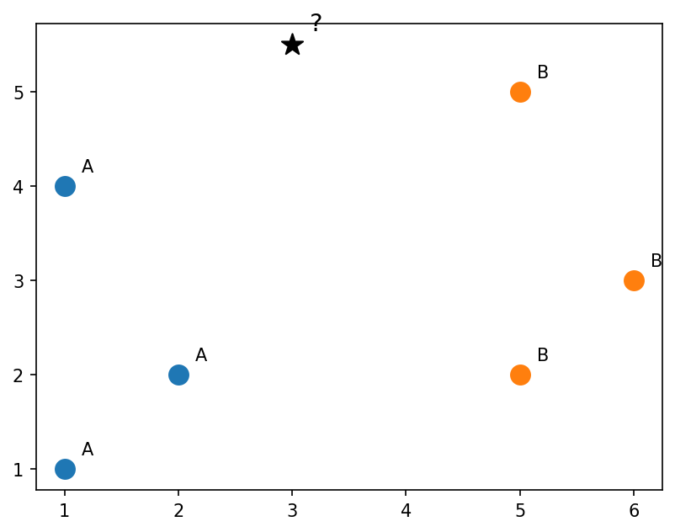
Six labelled points and one new point
Class A in blue, class B in orange. Which class should the new point (?) get?
Code
import matplotlib.pyplot as plt
pts = [(1, 1, "A"), (2, 2, "A"), (1, 4, "A"),
(5, 5, "B"), (6, 3, "B"), (5, 2, "B")]
for x, y, c in pts:
plt.scatter(x, y, s=120,
color="tab:blue" if c == "A" else "tab:orange")
plt.annotate(c, (x + 0.15, y + 0.15))
plt.scatter(3, 5.5, s=160, marker="*", color="black")
plt.annotate("?", (3.15, 5.65), fontsize=14)
plt.show()
Md Mahbub E Noor
Lecture 10: Classification
University of Barishal
3 / 20
Notes:
Let the class vote by show of hands: A or B? Usually the room splits. That disagreement is the point: it depends on how many neighbours you look at.

Slide 4
By hand: distances to the new point (3, 5.5)
Distance = √((x - 3)² + (y - 5.5)²). Sort by distance, then let the k nearest vote.
Code
rank
point
class
distance
# k = 1: nearest is B (2.06) -> B
# k = 3: B (2.06), A (2.5), A (3.64)
# A has 2 votes -> A
# Same data, different k, different answer!
1
(5, 5)
B
2.06
2
(1, 4)
A
2.50
3
(2, 2)
A
3.64
4
(6, 3)
B
3.91
5
(5, 2)
B
4.03
6
(1, 1)
A
4.92
Click to reveal the next row. Predict it first!
Md Mahbub E Noor
Lecture 10: Classification
University of Barishal
4 / 20
Notes:
Compute two or three distances together on the board, then reveal the rest. The surprise: k = 1 says B, k = 3 says A. k is a hyperparameter, a choice we make, and it matters.

Slide 5
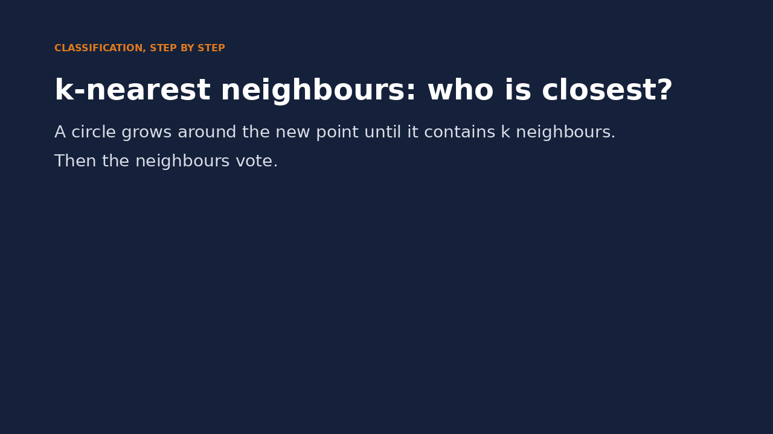
Watch it: k-nearest neighbours voting
WATCH FOR
A circle grows from the new point
It stops when it holds k neighbours
The neighbours vote; the majority wins
With k = 1 and k = 3 the answer differs
Click the video to play, click again to pause. Silent: talk the class through it.
Md Mahbub E Noor
Lecture 10: Classification
University of Barishal
5 / 20
Notes:
Pause when the circle holds one neighbour, then three. Ask what would happen with k = 5.

Slide 6
k-nearest neighbours in scikit-learn
n_neighbors is k
Code
from sklearn.datasets import load_iris
from sklearn.model_selection import train_test_split
from sklearn.neighbors import KNeighborsClassifier
X, y = load_iris(return_X_y=True)
X_tr, X_te, y_tr, y_te = train_test_split(
X, y, test_size=0.3, random_state=1, stratify=y)
for k in [1, 3, 5, 15, 50]:
knn = KNeighborsClassifier(n_neighbors=k)
knn.fit(X_tr, y_tr)
print(k, round(knn.score(X_te, y_te), 3))
Small k: follows every single point (can overfit)
Large k: smoother, but may ignore real detail
Check several k on the test set... for now
Output
1 0.978
3 0.978
5 0.978
15 0.978
50 0.867
Md Mahbub E Noor
Lecture 10: Classification
University of Barishal
6 / 20
Notes:
Choosing k by looking at the test score is actually a small cheat: we are using the exam to study. Lecture 11 shows the honest way, cross-validation. Mention it now as a teaser.

Slide 7
Decision boundaries: small k vs large k
Two sepal measurements, where the species overlap. Colours show the predicted class at every point: k = 1 draws jagged islands, k = 30 smooth regions.
Code
import numpy as np
X2 = X[:, 0:2]
xx, yy = np.meshgrid(np.linspace(4, 8.2, 300),
np.linspace(1.8, 4.6, 300))
grid = np.c_[xx.ravel(), yy.ravel()]
fig, axes = plt.subplots(1, 2, figsize=(10, 4))
for ax, k in zip(axes, [1, 30]):
m = KNeighborsClassifier(n_neighbors=k).fit(X2, y)
zz = m.predict(grid).reshape(xx.shape)
ax.contourf(xx, yy, zz, alpha=0.3, cmap="viridis")
ax.scatter(X2[:, 0], X2[:, 1], c=y, s=12, cmap="viridis")
ax.set_title(f"k = {k}")
ax.set_xlabel("sepal length")
plt.show()
Md Mahbub E Noor
Lecture 10: Classification
University of Barishal
7 / 20
Notes:
You do not need to understand every line of this plotting code. The idea: we ask the model for a prediction at every point of a fine grid and colour the grid. The border between colours is the decision boundary.

Slide 8
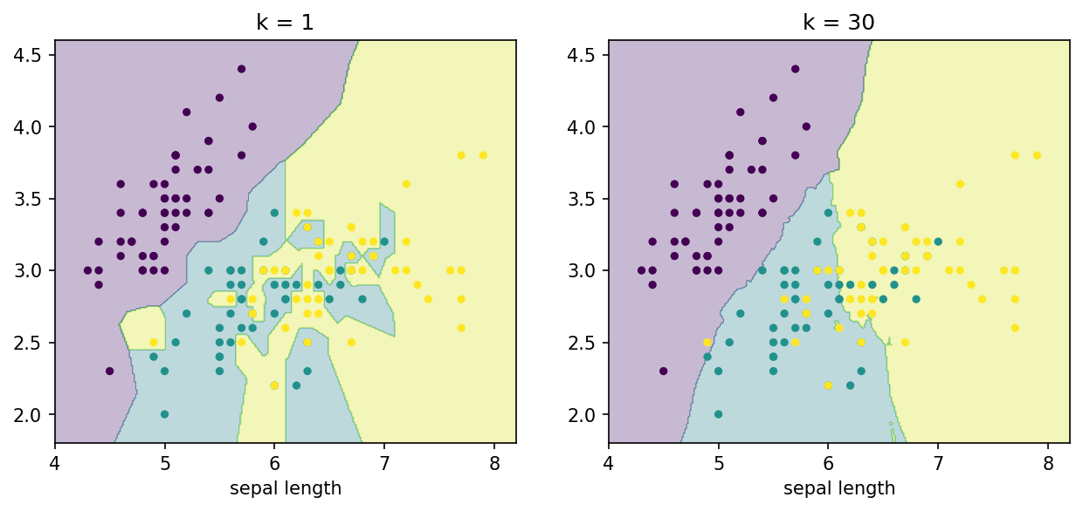
Decision boundaries: small k vs large k: the result
Md Mahbub E Noor
Lecture 10: Classification
University of Barishal
8 / 20
Notes:
You do not need to understand every line of this plotting code. The idea: we ask the model for a prediction at every point of a fine grid and colour the grid. The border between colours is the decision boundary.

Slide 9
A decision tree plays twenty questions
1
2
3
Ask a question
Pick the best question
Repeat
Is petal width at most 0.75 cm? Each question splits the data in two.
Keep asking until the groups are pure or a depth limit is reached. Leaves give the answer.
The tree chooses the question that makes each side as pure as possible.
Md Mahbub E Noor
Lecture 10: Classification
University of Barishal
9 / 20
Notes:
A decision tree is a flowchart learned from data. Unlike most models, a human can read it, which makes trees popular where decisions must be explained.

Slide 10
Train a tree and read its rules
max_depth=2: at most two questions per flower · export_text prints the learned rules · class 0 = setosa, 1 = versicolor, 2 = virginica · Nobody wrote these rules: the data did
Code
Output
from sklearn.tree import DecisionTreeClassifier, export_text
names = ["sepal len", "sepal wid", "petal len", "petal wid"]
tree = DecisionTreeClassifier(max_depth=2, random_state=0)
tree.fit(X_tr, y_tr)
print(export_text(tree, feature_names=names))
print(round(tree.score(X_te, y_te), 3))
|--- petal wid <= 0.75
| |--- class: 0
|--- petal wid > 0.75
| |--- petal len <= 4.75
| | |--- class: 1
| |--- petal len > 4.75
| | |--- class: 2
0.956
Md Mahbub E Noor
Lecture 10: Classification
University of Barishal
10 / 20
Notes:
Read the rules aloud as if/else statements, connecting back to Lecture 3.1: the tree is literally an if/elif program that wrote itself.

Slide 11
By hand: follow the tree for three flowers
Use the two rules from the previous slide. Then check: the model's own predictions are in the last column.
Code
petal len
petal wid
path
model says
if petal_wid <= 0.75:
-> setosa (0)
elif petal_len <= 4.75:
-> versicolor (1)
else:
-> virginica (2)
1.5
0.2
wid <= 0.75
0
4.7
1.2
wid > 0.75, len <= 4.75
1
5.8
2.2
wid > 0.75, len > 4.75
2
Click to reveal the next row. Predict it first!
Md Mahbub E Noor
Lecture 10: Classification
University of Barishal
11 / 20
Notes:
Students follow the path by hand, then the reveal shows the model agrees. This works only if the printed thresholds match; they come from the same trained tree, so they do.

Slide 12
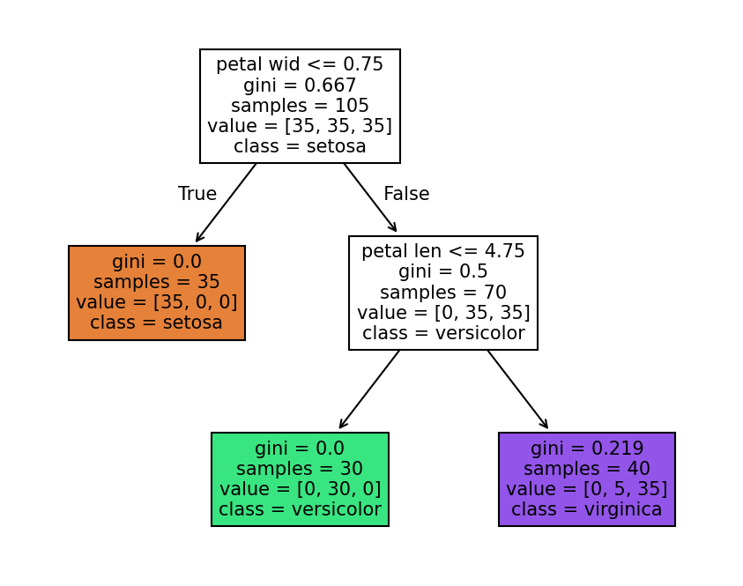
Draw the tree
Each box shows the question, how many flowers reach it, and the class counts. Leaves at the bottom give the answer.
Code
from sklearn.tree import plot_tree
plt.figure(figsize=(7, 5.5))
plot_tree(tree, feature_names=names,
class_names=["setosa", "versicolor", "virginica"],
filled=True, fontsize=10)
plt.show()
Md Mahbub E Noor
Lecture 10: Classification
University of Barishal
12 / 20
Notes:
gini is a purity score: 0 means one class only. The tree picked questions that drive gini down fastest. The colour shows the majority class in each box.

Slide 13
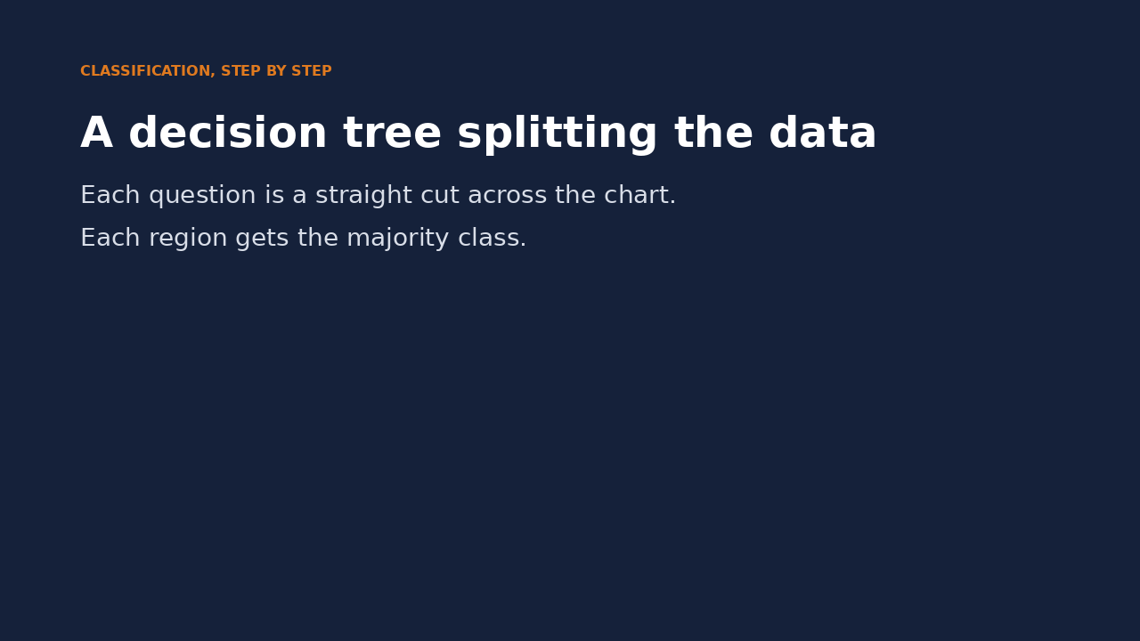
Watch it: a tree splitting the data
WATCH FOR
First question: a horizontal cut at petal width 0.75
Setosa is separated completely
Second question: a vertical cut at petal length 4.75
Each region gets the majority class
Click the video to play, click again to pause. Silent: talk the class through it.
Md Mahbub E Noor
Lecture 10: Classification
University of Barishal
13 / 20
Notes:
The video shows the same two rules as straight cuts across the scatter plot. Trees always cut parallel to the axes, which is why their boundaries look like boxes.

Slide 14
k-nearest neighbours or decision tree?
k-nearest neighbours
Decision tree
No real training: remembers all data
Learns explicit if/else rules
Slow to predict on big data
Fast to predict
Needs features on similar scales
Scale of features does not matter
Hard to explain a single answer
Deep trees overfit easily (Lecture 11)
Md Mahbub E Noor
Lecture 10: Classification
University of Barishal
14 / 20
Notes:
There is no best model in general. The habit to build: try a few, compare honestly, and prefer the simpler one when scores are close.

Slide 15
Your turn
10 minutes
1
Train DecisionTreeClassifier with max_depth 1, 2, 3, 10 on iris
Code
for d in [1, 2, 3, 10]:
t = DecisionTreeClassifier(max_depth=d, random_state=0)
t.fit(X_tr, y_tr)
print(d, t.score(X_tr, y_tr), t.score(X_te, y_te))
2
Print training and test accuracy for each
3
Which depth would you choose, and why?
4
Bonus: print export_text for depth 3
Md Mahbub E Noor
Lecture 10: Classification
University of Barishal
15 / 20
Notes:
Training accuracy rises to 1.0 with depth while test accuracy stops improving: overfitting in miniature. Lecture 11 builds on exactly this.

Slide 16
Common mistakes with classifiers
Read the last line of an error first. It names the problem.
What you typed | What Python says | What it means
KNeighborsClassifier().predict([[1, 2, 3, 4]]) | NotFittedError: This KNeighborsClassifier instance is not fitted yet. Call 'fit' with appropriate arguments before using this estimator. | Not fitted yet. Call fit before predict.
knn = KNeighborsClassifier(n_neighbors=200) knn.fit(X_tr, y_tr) knn.predict(X_te) | ValueError: Expected n_neighbors <= n_samples_fit, but n_neighbors = 200, n_samples_fit = 105, n_samples = 45 | k cannot be larger than the number of training rows (105).
tree.predict([[1.5, 0.2]]) | ValueError: X has 2 features, but DecisionTreeClassifier is expecting 4 features as input. | The model was trained on 4 features; give it 4 values.
Md Mahbub E Noor
Lecture 10: Classification
University of Barishal
16 / 20
Notes:
The third error is the classic feature-mismatch: new data must have exactly the same columns as the training data.

Slide 17
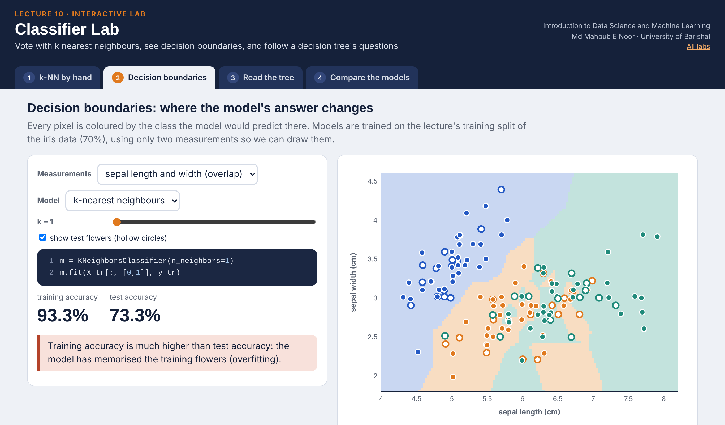
Interactive lab: Classifier Lab
In the lab you can
1 k-NN by hand
Click to move the new point; the k nearest neighbours vote.
2 Decision boundaries
k-NN and trees on two iris measurements, train and test.
3 Read the tree
Slide a flower's measurements and follow its path.
4 Compare the models
Accuracy against k and depth, and why units matter for k-NN.
Open the lab ►
Works offline in any browser
Labs_open_in_browser/
L10_Classifier_Lab.html
Md Mahbub E Noor
Lecture 10: Classification
University of Barishal
17 / 20
Notes:
Open the Classifier Lab (double-click; works offline). Start with the slide-4 point: k = 1 says B, k = 3 says A. Then click to move the point and ask the class to predict before each change. In Decision boundaries, compare k = 1 and k = 30 on the sepal measurements (slide 7), then switch to a tree. The units experiment in the last tab shows why k-NN needs scaled features (Lecture 12) while trees do not.

Slide 18
Today's toolkit
KNeighborsClassifier(n_neighbors=k) | Vote of the k nearest
distance | √(Δx² + Δy²)
DecisionTreeClassifier(max_depth=d) | Learned if/else rules
export_text(tree) | Print the rules
plot_tree(tree) | Draw the tree
decision boundary | Where predictions change
k, max_depth | Hyperparameters we choose
Md Mahbub E Noor
Lecture 10: Classification
University of Barishal
18 / 20
Notes:
Next session is Practice Class 1: regression and classification problems, by hand and in code.

Slide 19
Homework 10
Due before Lecture P1 · [date]
1
By hand
2
Choose k
3
Tree rules
For the six points and new point (4, 4), compute all distances and predict with k = 1, 3 and 5.
On the wine dataset, print test accuracy for k = 1, 3, 5, 9, 15. Which k is best?
Train a depth-2 tree on wine and write its rules as if/elif statements in a text cell.
4
Boundary
5
Explain
Adapt the boundary plot for a decision tree of depth 2 and depth 10. Describe the difference.
In 3 sentences: when would you prefer a decision tree to k-nearest neighbours?
Submit on [LMS / Google Classroom]: your notebook file HW10_<your ID>.ipynb, or a Colab link set to “Anyone with the link can view”.
Md Mahbub E Noor
Lecture 10: Classification
University of Barishal
19 / 20
Notes:
Homework 10. Task 1 key: distances from (4, 4): (5, 5) 1.41 B, (6, 3) 2.24 B, (5, 2) 2.24 B, (2, 2) 2.83 A, (1, 4) 3.0 A, (1, 1) 4.24 A. k = 1, 3: B. k = 5: B (3 to 2). Note the tie at 2.24: both are B, so it does not matter here.

Slide 20
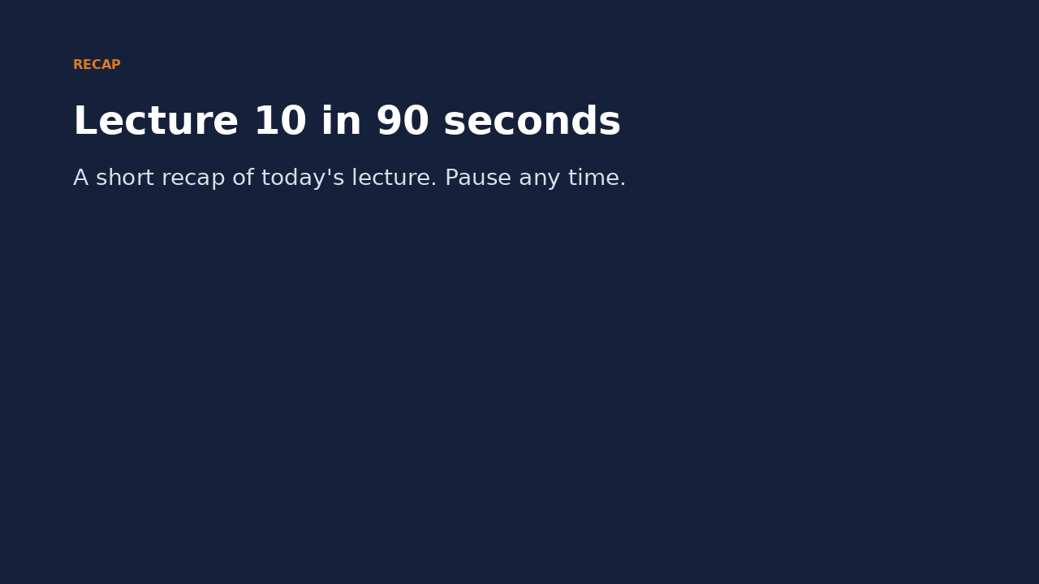
Recap: Lecture 10 in 90 seconds
Click to play or pause. Watch it again at home to revise.
Md Mahbub E Noor
Lecture 10: Classification
University of Barishal
20 / 20
Notes:
Play at the end of class or leave for revision at home.

