Slide 1
LECTURE 11
Evaluating models properly
Today's key line of code
cross_val_score(model, X, y, cv=5)
precision_score(y_te, pred)
Overfitting, cross-validation, precision and recall
Introduction to Data Science · Md Mahbub E Noor · University of Barishal
Notes:
Today is about honesty: how to know whether a model is really good. A model that looks great on the wrong test is the most common failure in machine learning projects. New notebook: Lecture11.

Slide 2
The road ahead: machine learning
Today
L7
L8
L9
L10
L11
L12
L13
L14
Charts and stats
What is ML?
Regression
Classification
Evaluation
Features
Clustering
Responsible ML
Today you will
1
Recognise underfitting and overfitting
2
Use a validation set or cross-validation to choose settings
3
Compute precision, recall and F1 by hand
4
Pick the right metric for the problem
5
Spot the accuracy trap on imbalanced data
Md Mahbub E Noor
Lecture 11: Evaluating models properly
University of Barishal
2 / 22
Notes:
Every number we report from now on should come from the methods in this lecture.

Slide 3
Too simple, just right, too complex
The same 15 noisy points (invented) fitted with curves of increasing flexibility. The right one follows the trend, not the noise.
Code
import numpy as np
import matplotlib.pyplot as plt
rng = np.random.default_rng(1)
x = np.sort(rng.uniform(0, 1, 15))
y = np.sin(2 * np.pi * x) + rng.normal(0, 0.25, 15)
grid = np.linspace(0, 1, 200)
fig, axes = plt.subplots(1, 3, figsize=(11, 3.3))
for ax, deg, name in zip(axes, [1, 3, 12],
["underfit", "good fit", "overfit"]):
coefs = np.polyfit(x, y, deg)
ax.scatter(x, y, s=18)
ax.plot(grid, np.polyval(coefs, grid), color="tab:orange")
ax.set_ylim(-2, 2)
ax.set_title(f"degree {deg}: {name}")
plt.show()
Md Mahbub E Noor
Lecture 11: Evaluating models properly
University of Barishal
3 / 22
Notes:
Left: a straight line misses the curve, underfitting. Middle: follows the trend. Right: passes through almost every point but wiggles wildly between them; it has memorised the noise. New points would be predicted badly.

Slide 4
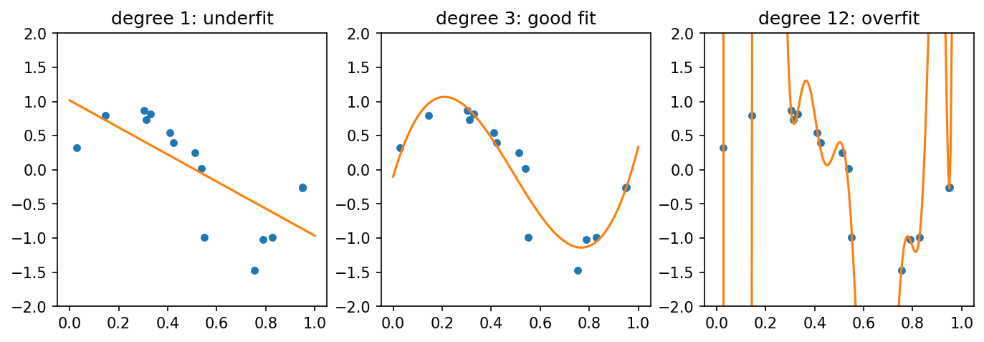
Too simple, just right, too complex: the result
Md Mahbub E Noor
Lecture 11: Evaluating models properly
University of Barishal
4 / 22
Notes:
Left: a straight line misses the curve, underfitting. Middle: follows the trend. Right: passes through almost every point but wiggles wildly between them; it has memorised the noise. New points would be predicted badly.

Slide 5
Overfitting in numbers: tree depth
Breast cancer data. As trees get deeper, training accuracy reaches 100% while test accuracy stops improving or drops.
Code
from sklearn.datasets import load_breast_cancer
from sklearn.model_selection import train_test_split
from sklearn.tree import DecisionTreeClassifier
X, y = load_breast_cancer(return_X_y=True)
X_tr, X_te, y_tr, y_te = train_test_split(
X, y, test_size=0.3, random_state=0, stratify=y)
depths = range(1, 13)
tr, te = [], []
for d in depths:
t = DecisionTreeClassifier(max_depth=d, random_state=0)
t.fit(X_tr, y_tr)
tr.append(t.score(X_tr, y_tr))
te.append(t.score(X_te, y_te))
plt.plot(list(depths), tr, marker="o", label="training")
plt.plot(list(depths), te, marker="o", label="test")
plt.xlabel("max_depth")
plt.ylabel("accuracy")
plt.legend()
plt.show()
Md Mahbub E Noor
Lecture 11: Evaluating models properly
University of Barishal
5 / 22
Notes:
The widening gap between the two lines is overfitting. The best depth is where the test line is high and the model is still simple.

Slide 6
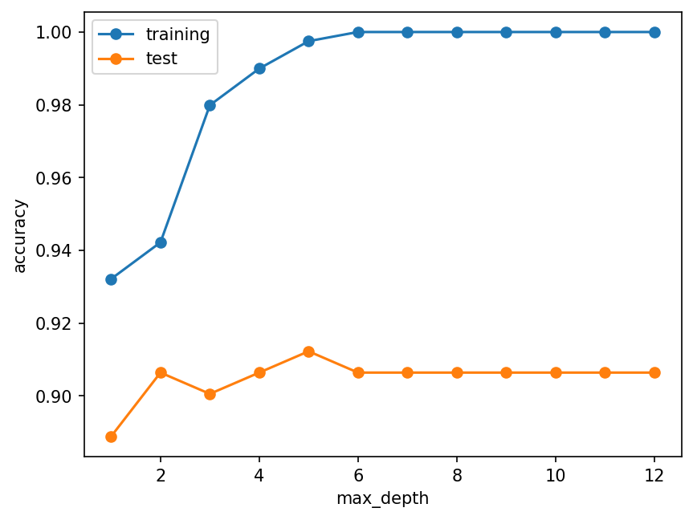
Overfitting in numbers: tree depth: the result
Md Mahbub E Noor
Lecture 11: Evaluating models properly
University of Barishal
6 / 22
Notes:
The widening gap between the two lines is overfitting. The best depth is where the test line is high and the model is still simple.

Slide 7
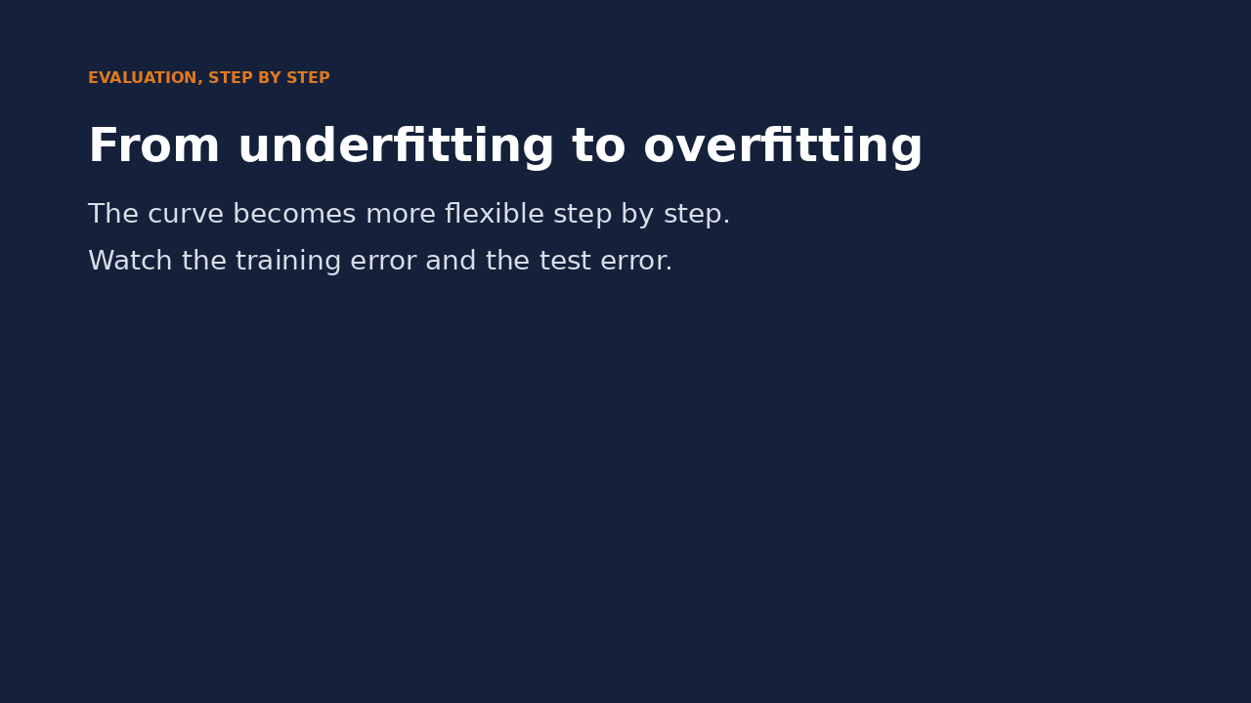
Watch it: from underfitting to overfitting
WATCH FOR
The curve gets more flexible frame by frame
Training error keeps falling
Test error falls, then rises again
The best model sits at the bottom of the test curve
Click the video to play, click again to pause. Silent: talk the class through it.
Md Mahbub E Noor
Lecture 11: Evaluating models properly
University of Barishal
7 / 22
Notes:
Pause where the test error is lowest and ask why the training error alone would have picked the wrong model.

Slide 8
Three sets, three jobs
1
2
3
Training set
Validation set
Test set
The model learns from it with fit().
We compare settings (k, depth) on it and pick the best.
Used once, at the very end, to report the final score.
Md Mahbub E Noor
Lecture 11: Evaluating models properly
University of Barishal
8 / 22
Notes:
In earlier lectures we chose k by looking at the test score. That leaks information from the exam into our choices, so the final score is too optimistic. The validation set, or cross-validation, fixes this.

Slide 9
5-fold cross-validation, pictured
Split the training data into 5 parts. Each round, one part validates and four train. Average the 5 scores.
Code
part 1
part 2
part 3
part 4
part 5
# Every row is used for validation exactly once.
# 5 scores instead of 1:
# - a more reliable average
# - and a sense of how much it varies
round 1
VALID
train
train
train
train
round 2
train
VALID
train
train
train
round 3
train
train
VALID
train
train
round 4
train
train
train
VALID
train
round 5
train
train
train
train
VALID
Click to reveal the next row. Predict it first!
Md Mahbub E Noor
Lecture 11: Evaluating models properly
University of Barishal
9 / 22
Notes:
Reveal the rounds one by one: the validation part moves along. The test set is not in this picture at all; it stays locked away.

Slide 10
Cross-validation in one line
cross_val_score runs all 5 rounds · Use only the training data · Report the mean and the spread · Choose depth by mean CV score, not by test score
Code
from sklearn.model_selection import cross_val_score
for d in [2, 3, 5, 10]:
t = DecisionTreeClassifier(max_depth=d, random_state=0)
scores = cross_val_score(t, X_tr, y_tr, cv=5)
print(d, scores.round(3), round(scores.mean(), 3))
Output
2 [0.95 0.95 0.9 0.899 0.962] 0.932
3 [0.962 0.912 0.888 0.899 0.962] 0.925
5 [0.95 0.9 0.912 0.911 0.975] 0.93
10 [0.95 0.888 0.912 0.899 0.975] 0.925
Md Mahbub E Noor
Lecture 11: Evaluating models properly
University of Barishal
10 / 22
Notes:
Look at how much the five scores vary for the same model: a single split can be lucky or unlucky. Pick the depth with the best mean, then train it on all training data and test once.

Slide 11
Then, and only then, the test set
Cross-validation picked max_depth = 2
Code
best = DecisionTreeClassifier(max_depth=2, random_state=0)
best.fit(X_tr, y_tr)
print(round(best.score(X_te, y_te), 3))
Fit it on all training data
Score the test set once
Output
0.906
That number is what you report
Md Mahbub E Noor
Lecture 11: Evaluating models properly
University of Barishal
11 / 22
Notes:
If you then change the model because of this test score, the test set has become a validation set, and you need a new test set. Discipline here is what makes results trustworthy.

Slide 12
By hand: precision, recall and F1 for our spam model
Our Lecture 6 results: TP = 117 spam caught, FP = 5 real messages flagged, FN = 14 spam missed.
Code
metric
formula
numbers
value
# precision: of the messages flagged as spam,
# how many really were spam?
# recall: of all real spam,
# how much did we catch?
# F1: one number balancing both
precision
TP / (TP + FP)
12 / 22
0.959
recall
TP / (TP + FN)
12 / 22
0.893
F1
2PR / (P + R)
2·P·R / (P + R)
0.925
Click to reveal the next row. Predict it first!
Md Mahbub E Noor
Lecture 11: Evaluating models properly
University of Barishal
12 / 22
Notes:
High precision means few false alarms; high recall means few misses. Our spam model is very precise, 0.959, but misses about one spam in nine, recall 0.893.

Slide 13
Which metric matters?
Problem | Worse mistake | Watch especially
Spam filter | Losing a real message (false positive) | Precision
Disease screening | Missing a sick patient (false negative) | Recall
Fraud alerts | Both are costly | F1, then discuss
Balanced, low-stakes task | Neither stands out | Accuracy is fine
Md Mahbub E Noor
Lecture 11: Evaluating models properly
University of Barishal
13 / 22
Notes:
There is no universally right metric: it depends on the cost of each mistake. Ask students which mistake would be worse in their own project idea.

Slide 14
The accuracy trap
Predict first
Code
?
from sklearn.metrics import accuracy_score, recall_score
y_true = [0] * 95 + [1] * 5
y_pred = [0] * 100
print(accuracy_score(y_true, y_pred))
print(recall_score(y_true, y_pred))
95 healthy people, 5 sick. A 'model' always answers healthy. What are its accuracy and recall?
Md Mahbub E Noor
Lecture 11: Evaluating models properly
University of Barishal
14 / 22
Notes:
Predict both numbers.

Slide 15
Answer: The accuracy trap
Code
Accuracy 95%: sounds excellent
from sklearn.metrics import accuracy_score, recall_score
y_true = [0] * 95 + [1] * 5
y_pred = [0] * 100
print(accuracy_score(y_true, y_pred))
print(recall_score(y_true, y_pred))
Recall 0: it finds no sick person at all
On imbalanced data, accuracy hides failure
Output
0.95
0.0
Always check recall and precision for the rare class
Md Mahbub E Noor
Lecture 11: Evaluating models properly
University of Barishal
15 / 22
Notes:
0.95 and 0.0. This is the same trap as the always-ham baseline in Lectures 5 and 6, now with a name and a metric that exposes it.

Slide 16
All the metrics at once
classification_report gives precision, recall and F1 per class
Code
from sklearn.metrics import classification_report
pred = best.predict(X_te)
print(classification_report(y_te, pred,
target_names=["malignant", "benign"], digits=3))
support = how many test rows of each class
Output
In this dataset, class 0 = malignant
precision recall f1-score support
malignant 0.843 0.922 0.881 64
benign 0.950 0.897 0.923 107
accuracy 0.906 171
macro avg 0.897 0.910 0.902 171
weighted avg 0.910 0.906 0.907 171
Read the row of the class you care most about
Md Mahbub E Noor
Lecture 11: Evaluating models properly
University of Barishal
16 / 22
Notes:
For cancer screening, the malignant row matters most, especially its recall: how many malignant tumours did the model find?

Slide 17
Your turn
10 minutes
1
Use cross_val_score to choose k for k-NN on the breast cancer training data (k = 1, 5, 15, 31)
Code
from sklearn.neighbors import KNeighborsClassifier
for k in [1, 5, 15, 31]:
s = cross_val_score(KNeighborsClassifier(n_neighbors=k),
X_tr, y_tr, cv=5)
print(k, round(s.mean(), 3))
...
2
Fit the best k on all training data
3
Print its classification_report on the test set
4
What is the recall for malignant tumours?
Starter code: replace the ... with your own code
Md Mahbub E Noor
Lecture 11: Evaluating models properly
University of Barishal
17 / 22
Notes:
This combines the whole lecture: choose with cross-validation, test once, read the right metric.

Slide 18
Common evaluation mistakes
Read the last line of an error first. It names the problem.
What you typed | What Python says | What it means
cross_val_score(best, X_tr, y_tr, scoring="acuracy") | InvalidParameterError: The 'scoring' parameter of cross_val_score must be a str among {'recall_micro', 'roc_auc', 'preci ... | Misspelt metric name. The message lists valid names.
recall_score(["a", "b"], ["a", "a"]) | ValueError: pos_label=1 is not a valid label. It should be one of ['a', 'b'] | With text labels, say which one is positive: pos_label="b".
cross_val_score(best, X_tr, y_tr[:100], cv=5) | ValueError: Found input variables with inconsistent numbers of samples: [398, 100] | X and y must have the same number of rows.
Md Mahbub E Noor
Lecture 11: Evaluating models properly
University of Barishal
18 / 22
Notes:
Plus the silent mistake no message will catch: choosing settings by looking at the test score.

Slide 19
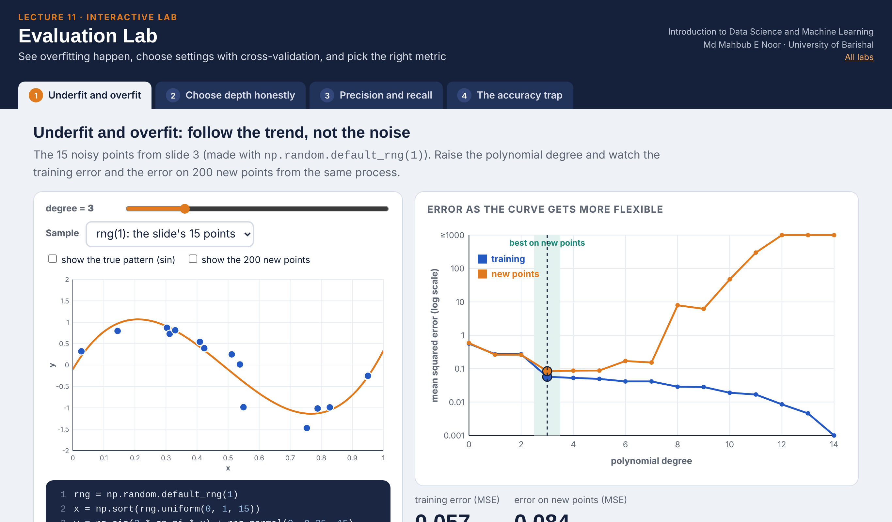
Interactive lab: Evaluation Lab
In the lab you can
1 Underfit and overfit
Raise the polynomial degree; watch error on new points.
2 Choose depth honestly
5-fold CV picks the depth; the test set is scored once.
3 Precision and recall
The spam model's threshold, matrix and PR curve.
4 The accuracy trap
Rare disease, lazy model: 95% accuracy, 0 recall.
Open the lab ►
Works offline in any browser
Labs_open_in_browser/
L11_Evaluation_Lab.html
Md Mahbub E Noor
Lecture 11: Evaluating models properly
University of Barishal
19 / 22
Notes:
Open the Evaluation Lab (double-click; works offline). Underfit and overfit uses the exact 15 points from slide 3: drag the degree from 1 to 12 and watch the orange error curve turn. In Choose depth honestly, press 'Pick the best mean CV score' (depth 2, 0.932), then score the test set once (0.906). If students reveal several depths, the lab warns that the test score is no longer honest. Precision and recall reproduces slide 12 at threshold 0.5.

Slide 20
Today's toolkit
underfit / overfit | Too simple / memorises noise
cross_val_score(m, X, y, cv=5) | 5 validation scores
precision | TP / (TP + FP)
recall | TP / (TP + FN)
F1 | Balance of precision and recall
classification_report | All metrics per class
test set | Used once, at the end
Md Mahbub E Noor
Lecture 11: Evaluating models properly
University of Barishal
20 / 22
Notes:
Next lecture: preparing features, where scaling finally explains the poor k-NN results on wine.

Slide 21
Homework 11
Due before Lecture 12 · [date]
1
By hand
2
Choose depth honestly
3
Metric choice
A model has TP = 40, FP = 10, FN = 20, TN = 130. Compute accuracy, precision, recall and F1.
On wine, choose max_depth with 5-fold cross-validation on the training data, then report the test accuracy once.
For three problems of your choice, say which mistake is worse and which metric you would watch.
4
Variation
5
Explain
Print the 5 CV scores for one model. What are the smallest and largest? Why do they differ?
In 3 sentences: why is choosing settings on the test set a form of cheating?
Submit on [LMS / Google Classroom]: your notebook file HW11_<your ID>.ipynb, or a Colab link set to “Anyone with the link can view”.
Md Mahbub E Noor
Lecture 11: Evaluating models properly
University of Barishal
21 / 22
Notes:
Homework 11. Task 1 key: accuracy 170/200 = 0.85; precision 40/50 = 0.80; recall 40/60 = 0.667; F1 = 2(0.8)(0.667)/(1.467) = 0.727.

Slide 22

Recap: Lecture 11 in 90 seconds
Click to play or pause. Watch it again at home to revise.
Md Mahbub E Noor
Lecture 11: Evaluating models properly
University of Barishal
22 / 22
Notes:
Play at the end of class or leave for revision at home.

