Slide 1
LECTURE 12
Preparing features
Today's key line of code
make_pipeline(StandardScaler(),
KNeighborsClassifier())
Missing values, categories, scaling and pipelines
Introduction to Data Science · Md Mahbub E Noor · University of Barishal
Notes:
Models are only as good as the features they are given. Today we fix the problems real data always has: missing values, text categories, and numbers on very different scales. New notebook: Lecture12. Make sure students.csv is in your folder.

Slide 2
The road ahead: machine learning
Today
L7
L8
L9
L10
L11
L12
L13
L14
Charts and stats
What is ML?
Regression
Classification
Evaluation
Features
Clustering
Responsible ML
Today you will
1
Find and handle missing values
2
Turn categories into numbers with one-hot encoding
3
See why scaling changes k-NN, by hand
4
Scale without leaking test information
5
Build a pipeline that does it all correctly
Md Mahbub E Noor
Lecture 12: Preparing features
University of Barishal
2 / 19
Notes:
In real projects, preparing data takes far longer than training models. Today shows the standard tools.

Slide 3
Meet the data: invented student records
150 invented students, made for this course
Code
import pandas as pd
st = pd.read_csv("students.csv")
print(st.head())
print(st.isna().sum())
Target: passed (yes / no)
isna().sum() counts missing values per column
Output
hours attendance prior_gpa dept passed
0 NaN 55 3.28 CSE yes
1 NaN 88 2.37 EEE yes
2 9.3 81 3.52 Math yes
3 2.7 83 3.52 EEE no
4 3.6 78 3.44 CSE no
hours 8
attendance 0
prior_gpa 6
dept 0
passed 0
dtype: int64
Some hours and GPAs are missing, as in real data
Md Mahbub E Noor
Lecture 12: Preparing features
University of Barishal
3 / 19
Notes:
students.csv is invented, so no real person's data is involved. Missing values appear as NaN, which means 'not a number'. Most scikit-learn models refuse NaN, as the mistakes slide shows.

Slide 4
Missing values: drop or fill?
dropna() removes rows with any missing value
Code
print(len(st), len(st.dropna()))
filled = st.copy()
for col in ["hours", "prior_gpa"]:
filled[col] = filled[col].fillna(filled[col].median())
print(filled.isna().sum().sum())
Fast, but throws data away
fillna(median) keeps rows, guessing a typical value
Output
150 136
0
Choose, and say which you chose in your report
Md Mahbub E Noor
Lecture 12: Preparing features
University of Barishal
4 / 19
Notes:
Dropping lost 14 of 150 rows here. Filling with the median keeps them. The median is preferred over the mean because it is not pulled by extreme values (Lecture 7). Later in the pipeline we let SimpleImputer do this for us.

Slide 5
One-hot encoding: categories become 0/1 columns
A model cannot multiply the word CSE. One-hot encoding gives each category its own yes/no column.
dept | dept_CSE | dept_EEE | dept_Math
CSE | 1 | 0 | 0
EEE | 0 | 1 | 0
Math | 0 | 0 | 1
CSE | 1 | 0 | 0
Md Mahbub E Noor
Lecture 12: Preparing features
University of Barishal
5 / 19
Notes:
Why not just number them CSE = 1, EEE = 2, Math = 3? Because then the model would think Math is three times CSE, and that EEE sits between them. One-hot avoids inventing an order.

Slide 6
One-hot encoding in pandas
pd.get_dummies creates the 0/1 columns · dtype=int shows 0 and 1 instead of False/True · Every category gets its own column · In pipelines we use OneHotEncoder instead (later)
Code
dummies = pd.get_dummies(filled["dept"], prefix="dept", dtype=int)
print(dummies.head(4))
Output
dept_CSE dept_EEE dept_Math
0 1 0 0
1 0 1 0
2 0 0 1
3 0 1 0
Md Mahbub E Noor
Lecture 12: Preparing features
University of Barishal
6 / 19
Notes:
get_dummies is perfect for exploring. Inside a model pipeline we use OneHotEncoder, which remembers the categories it saw in training.

Slide 7
By hand: why scale matters for k-nearest neighbours
Distance from student A (hours 2, attendance 90) to B (hours 10, attendance 85) and C (hours 3, attendance 60).
Code
pair
hours gap
attendance gap
distance
# Unscaled: attendance dominates.
# C looks far, B looks close, although
# B studies 8 hours more than A!
# After scaling both columns to similar ranges,
# hours matter again and C is nearer.
A to B
8
5
9.4
A to C
1
30
30.0
A to B, scaled
0.67
0.08
0.67
A to C, scaled
0.08
0.50
0.51
Click to reveal the next row. Predict it first!
Md Mahbub E Noor
Lecture 12: Preparing features
University of Barishal
7 / 19
Notes:
Here 'scaled' simply divides hours by their range of 12 and attendance by its range of 60. Before scaling, a 30-point attendance gap swamps everything; after scaling, both features count fairly. StandardScaler does a similar thing automatically.

Slide 8

Watch it: scaling changes the neighbours
WATCH FOR
14 real rows from students.csv; the star is one student
Unscaled: neighbours chosen almost only by attendance
The scaler stretches hours to a fair spread
Scaled: the three nearest neighbours change
Click the video to play, click again to pause. Silent: talk the class through it.
Md Mahbub E Noor
Lecture 12: Preparing features
University of Barishal
8 / 19
Notes:
This is the hand calculation from the previous slide, animated with real rows. Pause before the stretch and ask which neighbours will change.

Slide 9
StandardScaler: mean 0, standard deviation 1
Each column: subtract its mean, divide by its std · Every feature now has a similar range · Fit the scaler on training data only · Then transform both training and test data
Code
from sklearn.preprocessing import StandardScaler
num = filled[["hours", "attendance", "prior_gpa"]]
scaled = StandardScaler().fit_transform(num)
print(num.mean().round(1).to_dict())
print(scaled.mean(axis=0).round(2) + 0.0, scaled.std(axis=0).round(2))
Output
{'hours': 6.1, 'attendance': 70.0, 'prior_gpa': 3.0}
[0. 0. 0.] [1. 1. 1.]
Md Mahbub E Noor
Lecture 12: Preparing features
University of Barishal
9 / 19
Notes:
The same fit and transform pattern as CountVectorizer in Lecture 6. fit learns the means and standard deviations; transform applies them. Fitting on test data would leak information, the same rule as before.

Slide 10
Data leakage: the silent killer
1
2
3
What it is
Common causes
The fix
Information from the test set sneaks into training, so scores look better than reality.
Scaling or filling with statistics of ALL data; choosing settings on the test set; duplicate rows.
Split first. Fit every preparation step on training data only. Pipelines do this for you.
Md Mahbub E Noor
Lecture 12: Preparing features
University of Barishal
10 / 19
Notes:
Leakage produces no error messages, only beautiful numbers that fall apart in real use. It is the most common serious mistake in student projects, and in published papers too.

Slide 11

Watch it: leakage happening, then prevented
WATCH FOR
Wrong: the scaler learns from all rows, test included
Splitting afterwards is too late
Right: split first, lock the test set away
The pipeline fits on training rows only
Click the video to play, click again to pause. Silent: talk the class through it.
Md Mahbub E Noor
Lecture 12: Preparing features
University of Barishal
11 / 19
Notes:
Pause on step 2 of the wrong way and ask exactly which numbers came from the test set. Answer: the means and standard deviations.

Slide 12
A pipeline does every step, in the right order
Numbers: fill missing with the median, then scale · Categories: one-hot encode · Then the model · Inside cross-validation, each step is fitted on training folds only
Code
Output
from sklearn.compose import ColumnTransformer
from sklearn.impute import SimpleImputer
from sklearn.pipeline import make_pipeline
from sklearn.preprocessing import OneHotEncoder
from sklearn.neighbors import KNeighborsClassifier
from sklearn.model_selection import cross_val_score
X = st[["hours", "attendance", "prior_gpa", "dept"]]
y = st["passed"]
prep = ColumnTransformer([
("num", make_pipeline(SimpleImputer(strategy="median"),
StandardScaler()),
["hours", "attendance", "prior_gpa"]),
("cat", OneHotEncoder(), ["dept"])])
model = make_pipeline(prep, KNeighborsClassifier())
print(round(cross_val_score(model, X, y, cv=5).mean(), 3))
0.893
Md Mahbub E Noor
Lecture 12: Preparing features
University of Barishal
12 / 19
Notes:
This is the most important code of the lecture. Note that we pass the raw data with missing values and text: the pipeline handles everything, and cross-validation refits it on each training fold, so nothing leaks.

Slide 13
Does scaling really matter? Measure it.
Same pipeline, with and without the scaler
Code
def build(scale):
num_steps = [SimpleImputer(strategy="median")]
if scale:
num_steps.append(StandardScaler())
prep = ColumnTransformer([
("num", make_pipeline(*num_steps),
["hours", "attendance", "prior_gpa"]),
("cat", OneHotEncoder(), ["dept"])])
return make_pipeline(prep, KNeighborsClassifier())
for scale in [False, True]:
s = cross_val_score(build(scale), X, y, cv=5).mean()
print("scaled" if scale else "unscaled", round(s, 3))
Same data, same cross-validation
k-NN gains a lot from scaling
A decision tree would barely change (try it)
Output
unscaled 0.687
scaled 0.893
Md Mahbub E Noor
Lecture 12: Preparing features
University of Barishal
13 / 19
Notes:
The asterisk in make_pipeline(*num_steps) unpacks the list into separate arguments. The difference between the two scores is the effect we computed by hand two slides ago.

Slide 14
Your turn
10 minutes
1
Revisit Practice 1, task B2: k-NN on wine
Code
from sklearn.datasets import load_wine
Xw, yw = load_wine(return_X_y=True)
plain = KNeighborsClassifier()
scaled = make_pipeline(StandardScaler(), KNeighborsClassifier())
...
2
Put StandardScaler and KNeighborsClassifier in a pipeline
3
Compare 5-fold CV accuracy with and without scaling
4
How big is the difference?
Starter code: replace the ... with your own code
Md Mahbub E Noor
Lecture 12: Preparing features
University of Barishal
14 / 19
Notes:
On wine, scaling lifts k-NN from roughly 0.7 to above 0.95 accuracy. This finally explains the hook from Lecture 8.

Slide 15
Common feature-preparation mistakes
Read the last line of an error first. It names the problem.
What you typed | What Python says | What it means
KNeighborsClassifier().fit(filled[["hours", "dept"]], filled["passed"]) | ValueError: could not convert string to float: 'CSE' | Text column: one-hot encode dept first.
KNeighborsClassifier().fit(st[["hours"]], st["passed"]) | ValueError: Input X contains NaN. | Missing values: fill or drop them first (SimpleImputer).
OneHotEncoder().fit_transform(st["dept"]) | ValueError: Expected a 2-dimensional container but got <class 'pandas.Series'> instead. Pass a DataFrame containing a si ... | Encoders want a table: use st[["dept"]] with double brackets.
Md Mahbub E Noor
Lecture 12: Preparing features
University of Barishal
15 / 19
Notes:
All three are solved by a correctly built pipeline, which is one more reason to use one.

Slide 16
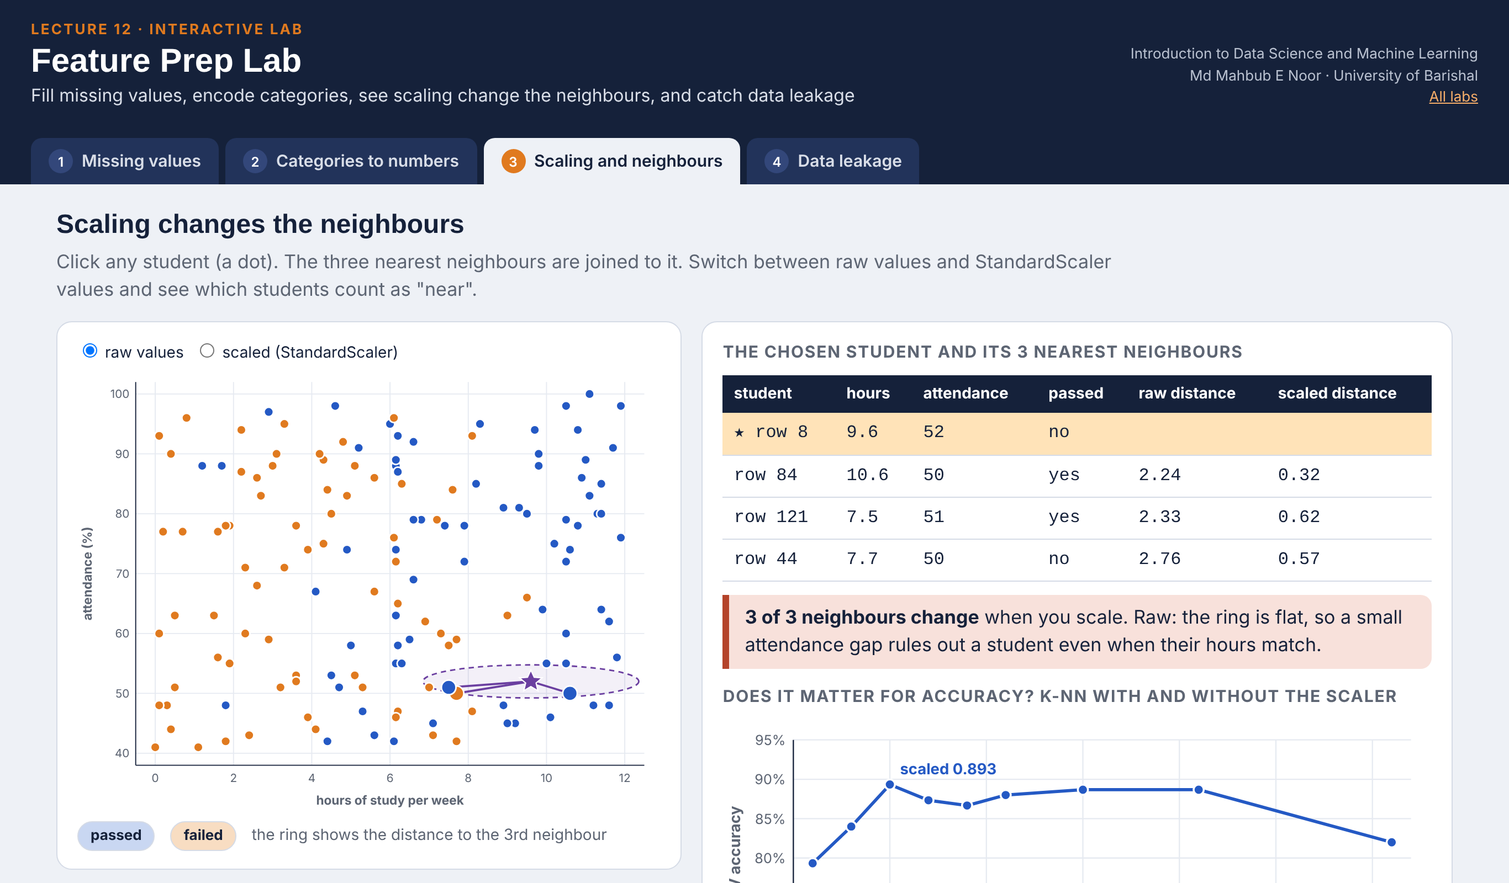
Interactive lab: Feature Prep Lab
In the lab you can
1 Missing values
Drop, median, mean or 0: see the data and the CV score.
2 Categories to numbers
One-hot versus 1, 2, 3: the distances a model sees.
3 Scaling and neighbours
Click a student; the 3 nearest change after scaling.
4 Data leakage
Over 90% on coin tosses in the wrong order; spot the leak.
Open the lab ►
Works offline in any browser
Labs_open_in_browser/
L12_Feature_Prep_Lab.html
Md Mahbub E Noor
Lecture 12: Preparing features
University of Barishal
16 / 19
Notes:
Open the Feature Prep Lab (double-click; works offline). Missing values: let students pick 'fill with 0' first and explain the orange bar at 0 hours (CV drops to 0.813). Scaling: click a student and switch raw/scaled - the flat ring shows attendance dominating; the k chart repeats slide 13 (0.687 vs 0.893 at k = 5). Leakage: with 5000 random columns and coin-toss labels, selecting features before cross-validation reports about 93%; the pipeline reports about 50%. Point out that the leaky scaler on students.csv gives the same 0.893, so leakage cannot be detected by looking at the score.

Slide 17
Today's toolkit
df.isna().sum() | Count missing values
fillna / SimpleImputer | Fill missing values
pd.get_dummies / OneHotEncoder | Categories to 0/1 columns
StandardScaler() | Mean 0, std 1
ColumnTransformer | Different steps per column
make_pipeline(...) | Chain steps and model
leakage | Test info sneaking into training
Md Mahbub E Noor
Lecture 12: Preparing features
University of Barishal
17 / 19
Notes:
Next session: Practice Class 2, an evaluation clinic where you find the mistakes in other people's experiments.

Slide 18
Homework 12
Due before Lecture P2 · [date]
1
By hand
2
Wine with scaling
3
Tree vs k-NN
Scale [2, 4, 6] with StandardScaler by hand: subtract the mean, divide by the standard deviation (divide by count). Check in code.
Choose k for a scaled k-NN pipeline on wine with cross-validation, then report test accuracy once.
On students.csv, compare the pipeline with k-NN and with a decision tree, each scaled and unscaled. Table of 4 CV scores.
4
Leakage hunt
5
Explain
Describe one way leakage could happen in a project of your choice, and how a pipeline prevents it.
Why is one-hot encoding better than numbering categories 1, 2, 3?
Submit on [LMS / Google Classroom]: your notebook file HW12_<your ID>.ipynb, or a Colab link set to “Anyone with the link can view”.
Md Mahbub E Noor
Lecture 12: Preparing features
University of Barishal
18 / 19
Notes:
Homework 12. Task 1 key: mean 4, standard deviation √(8/3) ≈ 1.633, scaled values ≈ -1.22, 0, 1.22. Task 3: trees should change very little with scaling.

Slide 19

Recap: Lecture 12 in 90 seconds
Click to play or pause. Watch it again at home to revise.
Md Mahbub E Noor
Lecture 12: Preparing features
University of Barishal
19 / 19
Notes:
Play at the end of class or leave for revision at home.

