Slide 1
LECTURE 13
Unsupervised learning
Today's key line of code
KMeans(n_clusters=3, n_init=10)
km.fit_predict(X)
Finding groups without labels: k-means clustering
Introduction to Data Science · Md Mahbub E Noor · University of Barishal
Notes:
Until now every example came with the right answer. Today there are no answers at all, and the model must find structure by itself. New notebook: Lecture13.

Slide 2
The road ahead: machine learning
Today
L7
L8
L9
L10
L11
L12
L13
L14
Charts and stats
What is ML?
Regression
Classification
Evaluation
Features
Clustering
Responsible ML
Today you will
1
Explain what clustering is for
2
Run k-means by hand on a tiny example
3
Cluster data with scikit-learn and draw the result
4
Choose k with the elbow method
5
Know the limits of k-means
Md Mahbub E Noor
Lecture 13: Unsupervised learning
University of Barishal
2 / 17
Notes:
Clustering is used for customer segments, grouping documents, finding unusual items, and exploring data before labelling it.

Slide 3
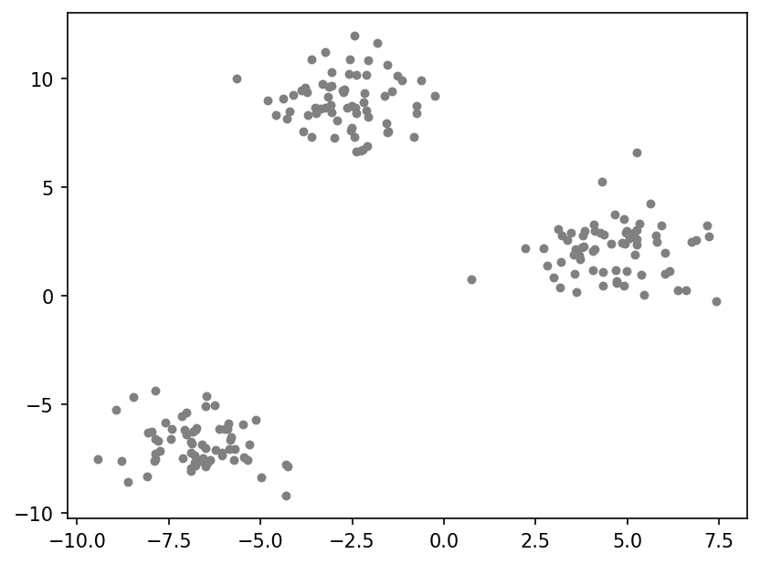
Data without labels
200 invented points. No colours, no answers. Do you see groups?
Code
import matplotlib.pyplot as plt
from sklearn.datasets import make_blobs
X, _ = make_blobs(n_samples=200, centers=3,
cluster_std=1.2, random_state=42)
plt.scatter(X[:, 0], X[:, 1], s=14, color="gray")
plt.show()
Md Mahbub E Noor
Lecture 13: Unsupervised learning
University of Barishal
3 / 17
Notes:
make_blobs generates points around a few centres; we throw away its labels with the underscore, to pretend we never had them. Humans see three groups instantly. k-means makes that precise.

Slide 4
k-means in four steps
1
2
3
1. Choose k
2. Assign
3. Move, repeat
How many groups to find. We decide this; it is a hyperparameter.
Each point joins the nearest centre. Centres start at random places.
Each centre moves to the mean of its points. Repeat steps 2 and 3 until nothing changes.
Md Mahbub E Noor
Lecture 13: Unsupervised learning
University of Barishal
4 / 17
Notes:
Only two operations, assign and move, repeated. The distance is the same one as in k-nearest neighbours.

Slide 5
By hand: k-means on six numbers
Points 1, 2, 3, 10, 11, 12. k = 2. Start the centres at 1 and 2 (a poor start, on purpose).
Code
round
centres
group 1
group 2
new centres
# Round 1: all but 1 are
# nearer to centre 2.
# New centres: 1 and 7.6
# Round 2: 2 and 3 switch.
# New centres: 2 and 11
# Round 3: no change: stop.
1
1, 2
[1]
[2, 3, 10, 11, 12]
1, 7.6
2
1, 7.6
[1, 2, 3]
[10, 11, 12]
2, 11
3
2, 11
[1, 2, 3]
[10, 11, 12]
2, 11
Click to reveal the next row. Predict it first!
Md Mahbub E Noor
Lecture 13: Unsupervised learning
University of Barishal
5 / 17
Notes:
Even from a bad start, two rounds are enough to find the natural groups. In the third round nothing changes, which is the stopping rule.

Slide 6
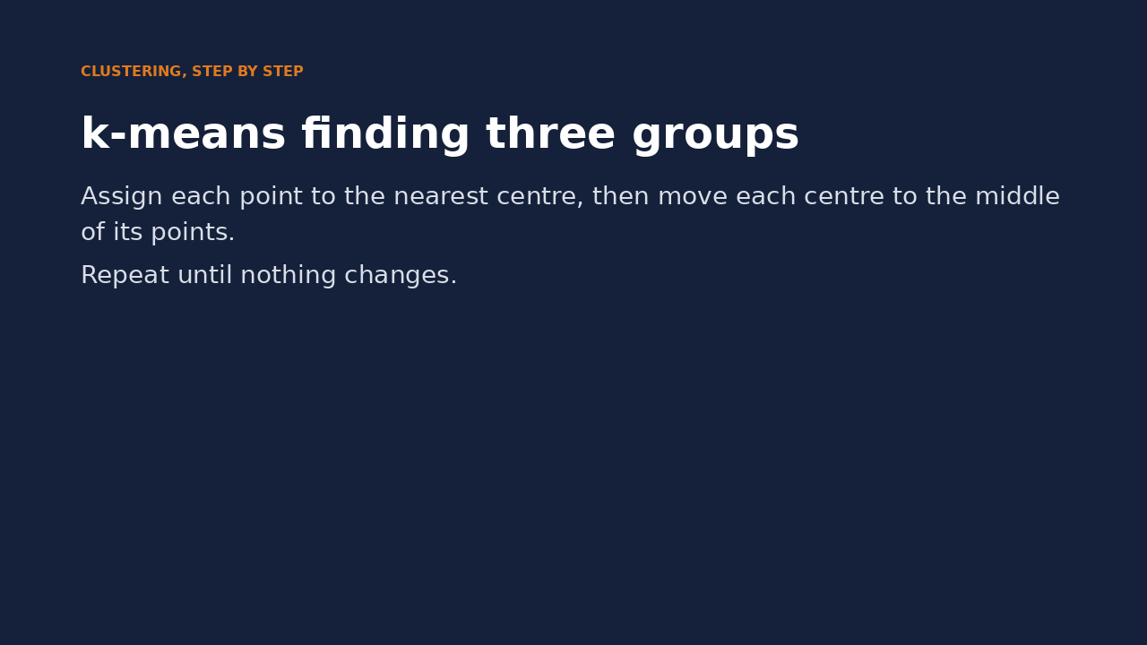
Watch it: k-means finding three groups
WATCH FOR
Three centres start at random
Points take the colour of the nearest centre
Centres move to the middle of their points
It stops when nothing changes
Click the video to play, click again to pause. Silent: talk the class through it.
Md Mahbub E Noor
Lecture 13: Unsupervised learning
University of Barishal
6 / 17
Notes:
Pause after the first move and ask where each centre will go next. The animation uses the same data as the previous slide.

Slide 7
k-means in scikit-learn
n_clusters is k
Code
import numpy as np
from sklearn.cluster import KMeans
km = KMeans(n_clusters=3, n_init=10, random_state=0)
labels = km.fit_predict(X)
print(km.cluster_centers_.round(2))
print(np.bincount(labels))
n_init=10: run 10 random starts, keep the best
fit_predict returns a cluster number per point
Output
Cluster numbers are names, not an order
[[-6.72 -6.85]
[-2.69 8.95]
[ 4.63 2.13]]
[66 67 67]
Md Mahbub E Noor
Lecture 13: Unsupervised learning
University of Barishal
7 / 17
Notes:
Several random starts protect against a bad start like the one in our hand example. bincount counts how many points fell into each cluster.

Slide 8
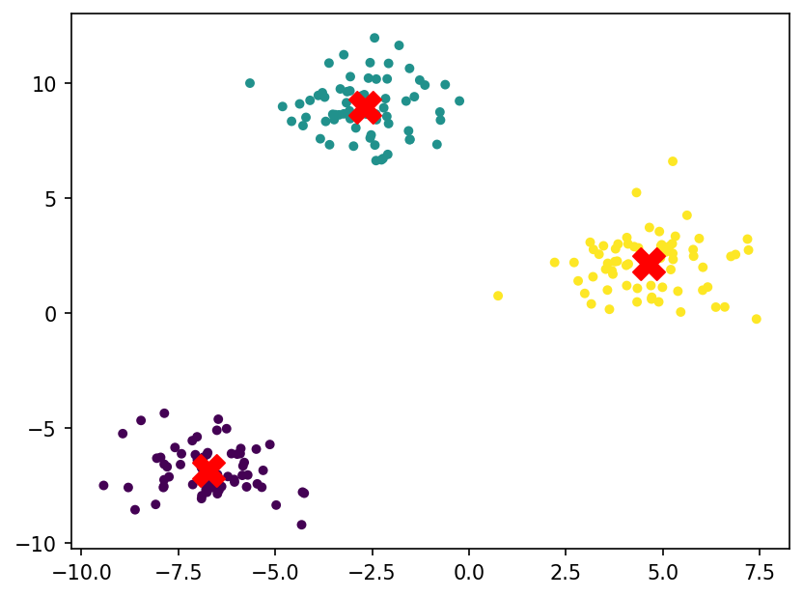
See the clusters
Colours are the clusters k-means found; crosses are the centres.
Code
plt.scatter(X[:, 0], X[:, 1], c=labels,
s=14, cmap="viridis")
c = km.cluster_centers_
plt.scatter(c[:, 0], c[:, 1], marker="X",
s=250, color="red")
plt.show()
Md Mahbub E Noor
Lecture 13: Unsupervised learning
University of Barishal
8 / 17
Notes:
The algorithm found the same three groups our eyes did, without ever seeing a label.

Slide 9
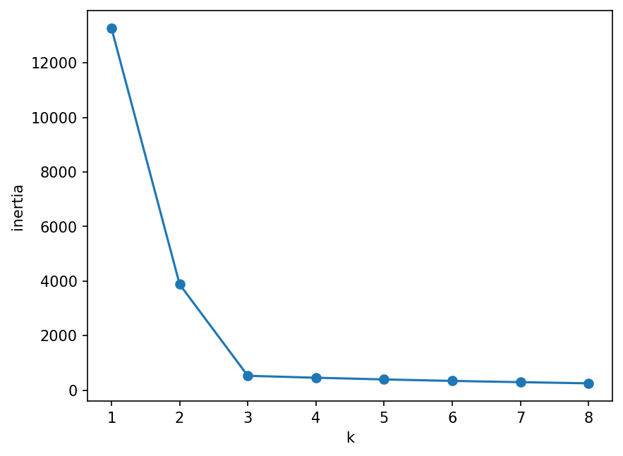
Choosing k: the elbow method
Inertia = total squared distance of points to their centre. It always falls as k grows; look for the bend.
Code
ks = range(1, 9)
inertia = []
for k in ks:
km_k = KMeans(n_clusters=k, n_init=10, random_state=0)
inertia.append(km_k.fit(X).inertia_)
plt.plot(list(ks), inertia, marker="o")
plt.xlabel("k")
plt.ylabel("inertia")
plt.show()
Md Mahbub E Noor
Lecture 13: Unsupervised learning
University of Barishal
9 / 17
Notes:
After k = 3 the curve flattens: extra clusters only split real groups. The elbow is a guide, not a law; in real data the bend is often less clear.

Slide 10
Do clusters match real classes? Iris without labels
Cluster the 4 iris measurements, ignoring species
Code
import pandas as pd
from sklearn.datasets import load_iris
iris = load_iris()
cl = KMeans(n_clusters=3, n_init=10,
random_state=0).fit_predict(iris.data)
species = [iris.target_names[t] for t in iris.target]
print(pd.crosstab(pd.Series(species, name="species"),
pd.Series(cl, name="cluster")))
Then compare clusters with the true species
Setosa forms its own cluster perfectly
Output
Versicolor and virginica get partly mixed
cluster 0 1 2
species
setosa 0 50 0
versicolor 48 0 2
virginica 14 0 36
Md Mahbub E Noor
Lecture 13: Unsupervised learning
University of Barishal
10 / 17
Notes:
crosstab counts every species and cluster combination. Clustering rediscovers most of the species structure without being told, but overlapping groups stay mixed, just as they overlapped in the Lecture 8 scatter plot.

Slide 11
Limits of k-means
1
2
3
You must choose k
Scale first
Round groups only
The elbow helps, but domain knowledge often decides.
It uses distances, so features on large scales dominate, exactly as in k-NN.
Long, curved or very uneven groups are split badly. Other methods exist.
Md Mahbub E Noor
Lecture 13: Unsupervised learning
University of Barishal
11 / 17
Notes:
Clusters are a suggestion to investigate, not a truth. Always look at what the members of each cluster have in common.

Slide 12
Your turn
10 minutes
1
Load students.csv and drop missing rows
Code
from sklearn.preprocessing import StandardScaler
st = pd.read_csv("students.csv").dropna()
cols = ["hours", "prior_gpa"]
Z = StandardScaler().fit_transform(st[cols])
km = KMeans(n_clusters=3, n_init=10)
st["cluster"] = km.fit_predict(Z)
print(st.groupby("cluster")[cols].mean())
2
Scale hours and prior_gpa with StandardScaler
3
Run k-means with k = 3 and add the cluster as a column
4
Print the mean hours and GPA of each cluster. Describe each group in words.
Md Mahbub E Noor
Lecture 13: Unsupervised learning
University of Barishal
12 / 17
Notes:
The interpretation is the exercise: students should name the groups, for example 'hard workers', in plain words. The data is invented, so no conclusions about real students.

Slide 13
Common clustering mistakes
Read the last line of an error first. It names the problem.
What you typed | What Python says | What it means
KMeans(n_clusters=3).fit(pd.read_csv("students.csv").dropna()) | ValueError: could not convert string to float: 'Math' | Text column (dept) in the data: select numeric columns only.
KMeans(n_clusters=10).fit([[1], [2], [3]]) | ValueError: n_samples=3 should be >= n_clusters=10. | Cannot make 10 clusters from 3 points.
km.predict([[1.0]]) | ValueError: X has 1 features, but KMeans is expecting 2 features as input. | km was fitted on 2 features; give it 2 values.
Md Mahbub E Noor
Lecture 13: Unsupervised learning
University of Barishal
13 / 17
Notes:
Plus the silent mistake: forgetting to scale, which gives clusters driven by one large-scale feature.

Slide 14
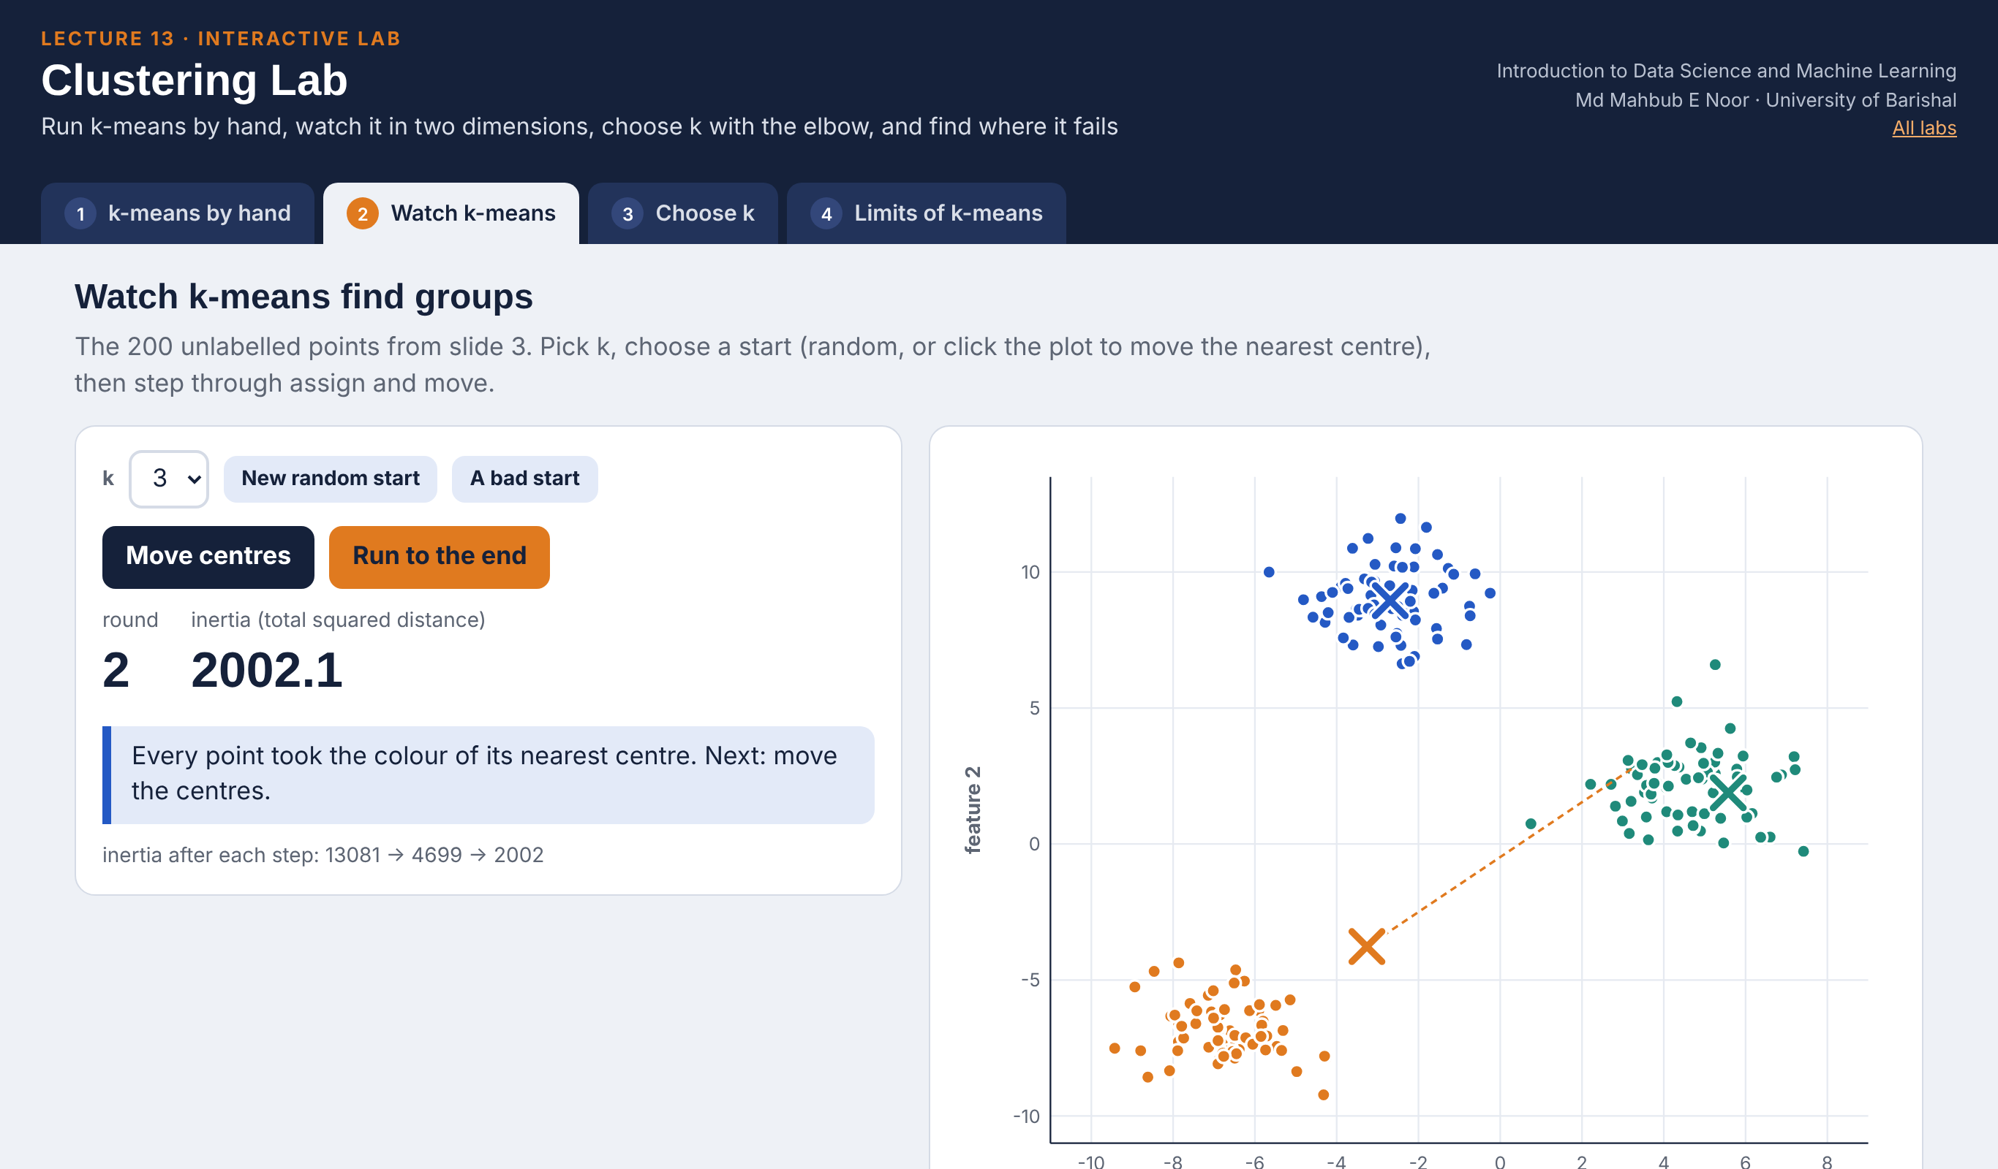
Interactive lab: Clustering Lab
In the lab you can
1 k-means by hand
Slide 5 step by step: predict, assign, move.
2 Watch k-means
200 points in 2-D; random, clicked or bad starts.
3 Choose k
The elbow, slide 7's output, and why n_init=10.
4 Limits of k-means
Curved, stretched, uneven, unscaled; iris crosstab.
Open the lab ►
Works offline in any browser
Labs_open_in_browser/
L13_Clustering_Lab.html
Md Mahbub E Noor
Lecture 13: Unsupervised learning
University of Barishal
14 / 17
Notes:
Open the Clustering Lab (double-click; works offline). By hand: students predict each row before you press the button; it reproduces slide 5 exactly. Watch: press 'A bad start' then 'Run to the end' - it stops at inertia 3830 versus 525 for the best answer, a local minimum. Choose k: the elbow is at 3; the bar chart shows 6 of 10 single random starts get stuck, which motivates n_init=10. Limits: compare 'different units, not scaled' (63.5%) with 'scaled first' (95.5%).

Slide 15
Today's toolkit
unsupervised | No labels: find structure
KMeans(n_clusters=k, n_init=10) | k-means model
km.fit_predict(X) | Cluster number per row
km.cluster_centers_ | Where the centres ended
km.inertia_ | Total squared distance
elbow method | Choose k at the bend
pd.crosstab(a, b) | Compare two labelings
Md Mahbub E Noor
Lecture 13: Unsupervised learning
University of Barishal
15 / 17
Notes:
Next session: Practice Class 3, a complete mini-project from question to report in one lab session.

Slide 16
Homework 13
Due before Lecture P3 · [date]
1
By hand
2
Elbow
3
Scaling matters
Run k-means with k = 2 on 1, 2, 6, 7, 8, 20, starting with centres 1 and 20. Show each round until it stops.
Make blobs with centers=4 and draw the elbow plot. Does the bend appear at 4?
Cluster students.csv on hours and attendance with and without scaling. Compare the group means.
4
Iris
5
Use case
Try k = 2 and k = 4 on iris and print the crosstab. What happens to setosa?
Describe one real situation where clustering would help, and what you would do with the clusters.
Submit on [LMS / Google Classroom]: your notebook file HW13_<your ID>.ipynb, or a Colab link set to “Anyone with the link can view”.
Md Mahbub E Noor
Lecture 13: Unsupervised learning
University of Barishal
16 / 17
Notes:
Homework 13. Task 1 key: round 1 groups {1, 2, 6, 7, 8} and {20}, centres 4.8 and 20; round 2 same groups, so it stops. With centres 4.8 and 20, point 8 is nearer 4.8, so the groups do not change.

Slide 17

Recap: Lecture 13 in 90 seconds
Click to play or pause. Watch it again at home to revise.
Md Mahbub E Noor
Lecture 13: Unsupervised learning
University of Barishal
17 / 17
Notes:
Play at the end of class or leave for revision at home.

