Slide 1
LECTURE 14
Responsible ML and what's next
Today's key line of code
MLPClassifier(hidden_layer_sizes=(64,))
Fairness, privacy, and a first look at neural networks
Introduction to Data Science · Md Mahbub E Noor · University of Barishal
Notes:
The final lecture. Two parts: using machine learning responsibly, and a first look at neural networks, the idea behind modern AI. New notebook: Lecture14.

Slide 2
The road ahead: machine learning
Today
L7
L8
L9
L10
L11
L12
L13
L14
Charts and stats
What is ML?
Regression
Classification
Evaluation
Features
Clustering
Responsible ML
Today you will
1
Explain how models can affect people unfairly
2
Check a model's performance per group
3
Protect privacy when collecting data
4
Compute one artificial neuron by hand
5
Train a small neural network and know where to go next
Md Mahbub E Noor
Lecture 14: Responsible ML and what's next
University of Barishal
2 / 17
Notes:
You now know enough machine learning to build models that affect real people. That brings responsibility.

Slide 3
Models make decisions about people
1
2
3
Who gets a loan
Who gets seen first
Who gets filtered out
A credit model trained on past approvals can repeat past unfairness.
A health model that works worse for one group puts that group at risk.
A spam or CV filter can hide real messages or good candidates without anyone noticing.
Md Mahbub E Noor
Lecture 14: Responsible ML and what's next
University of Barishal
3 / 17
Notes:
None of these require bad intentions. They come from data and from not checking. That is why checking is a professional duty.

Slide 4
Where unfairness comes from
1
2
3
The data
The labels
The measurement
Some groups are under-represented, so the model learns less about them. Recall our 2011 UK spam data.
Labels written by people can carry their past decisions and biases.
A feature may mean different things for different groups, or be missing more often for some.
Md Mahbub E Noor
Lecture 14: Responsible ML and what's next
University of Barishal
4 / 17
Notes:
Connect back to Lecture 6: our spam model knew only 2011 UK and Singapore messages, so it would likely work worse on Bangla or Banglish texts. That is the same problem, for a whole population of users.

Slide 5
A simple, essential check: performance per group
cross_val_predict gives an honest prediction for every row · Then compare accuracy group by group · Large gaps need explaining before any use · students.csv is invented: this shows the method only
Code
Output
import pandas as pd
from sklearn.compose import make_column_transformer
from sklearn.impute import SimpleImputer
from sklearn.model_selection import cross_val_predict
from sklearn.neighbors import KNeighborsClassifier
from sklearn.pipeline import make_pipeline
from sklearn.preprocessing import OneHotEncoder
from sklearn.preprocessing import StandardScaler
st = pd.read_csv("students.csv")
num = ["hours", "attendance", "prior_gpa"]
prep = make_column_transformer(
(make_pipeline(SimpleImputer(strategy="median"),
StandardScaler()), num),
(OneHotEncoder(), ["dept"]))
model = make_pipeline(prep, KNeighborsClassifier())
X = st[num + ["dept"]]
st["pred"] = cross_val_predict(model, X, st["passed"], cv=5)
st["correct"] = st["pred"] == st["passed"]
print(st.groupby("dept")["correct"].mean().round(3))
dept
CSE 0.911
EEE 0.900
Math 0.867
Name: correct, dtype: float64
Md Mahbub E Noor
Lecture 14: Responsible ML and what's next
University of Barishal
5 / 17
Notes:
Each prediction comes from a model that never saw that row, so the per-group numbers are honest. With only about 50 students per department, small differences are noise; with real data and real people, a large gap must be investigated before the model is used.

Slide 6
Privacy and consent
1
2
3
Collect only what you need
Remove identifiers
Ask permission
Delete names, numbers and addresses before analysis. Your SMS homework already did this.
People should know and agree when their data is used. Store it safely and delete it when done.
If a name or phone number does not help the question, do not collect it.
Md Mahbub E Noor
Lecture 14: Responsible ML and what's next
University of Barishal
6 / 17
Notes:
These rules apply directly to your projects: if you collect data from classmates, family or social media, ask, anonymise, and keep it safe.

Slide 7
A checklist before trusting any model
Check | Question to ask
Baseline | Does it clearly beat a simple guess?
Honest test | Was the test set used only once, at the end?
Right metric | Which mistake is costly, and is that metric reported?
Groups | Does it work similarly for different groups?
Data match | Does new data look like the training data (time, place, language)?
Privacy | Was the data collected with permission and anonymised?
Md Mahbub E Noor
Lecture 14: Responsible ML and what's next
University of Barishal
7 / 17
Notes:
Use this list for your project. Every row corresponds to a lecture of this course.

Slide 8
A first look at neural networks
1
2
3
A neuron
Layers
Learning
Multiplies each input by a weight, adds them up with a bias, and passes the result through a simple function.
Many neurons side by side form a layer; layers stacked together form a network.
Training adjusts the weights a little at a time to reduce the error, like the line search in Lecture 9.
Md Mahbub E Noor
Lecture 14: Responsible ML and what's next
University of Barishal
8 / 17
Notes:
Deep learning, behind image recognition, speech recognition and chatbots, is this idea at a very large scale: millions or billions of weights.

Slide 9
By hand: one neuron
Inputs: hours 6, attendance 0.9, GPA 3.2. Weights 0.5, 2.0, 1.0, bias -5. Output 1 if the total is above 0.
Code
input
value
weight
value × weight
# total = 6×0.5 + 0.9×2.0
# + 3.2×1.0 - 5
# = 3.0 + 1.8 + 3.2 - 5
# = 3.0
# 3.0 > 0, so output 1
hours
6
0.5
3.0
attendance
0.9
2.0
1.8
GPA
3.2
1.0
3.2
bias
-5
total
3.0
output
1
Click to reveal the next row. Predict it first!
Md Mahbub E Noor
Lecture 14: Responsible ML and what's next
University of Barishal
9 / 17
Notes:
That is all one neuron does. A network learns good weights from data instead of us choosing them. Ask: what weight change would make attendance matter more?

Slide 10
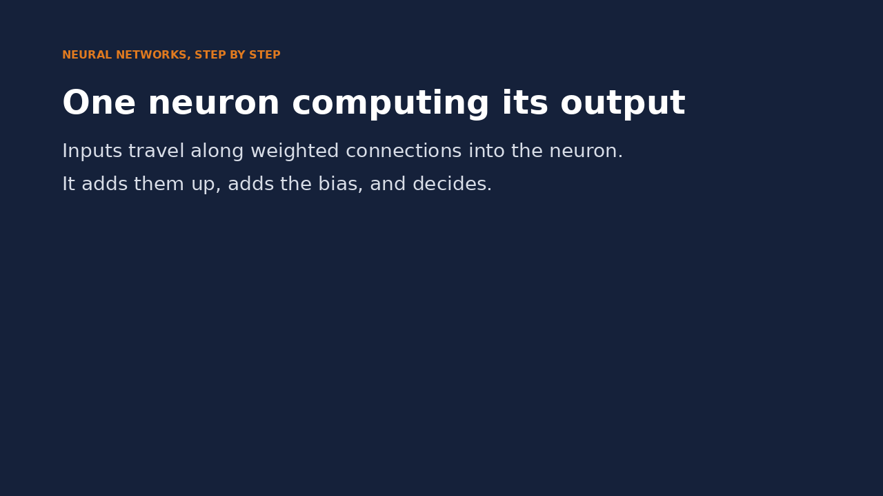
Watch it: one neuron computing its output
WATCH FOR
Each input is multiplied by its weight
The products flow into the neuron and are added
The bias is added: 8.0 - 5 = 3.0
3.0 > 0, so the output is 1
Click the video to play, click again to pause. Silent: talk the class through it.
Md Mahbub E Noor
Lecture 14: Responsible ML and what's next
University of Barishal
10 / 17
Notes:
The same numbers as the hand-calculation table. Ask: which weight would you change to make attendance matter more?

Slide 11
A small neural network on the digits
MLPClassifier: a multi-layer perceptron · One hidden layer of 64 neurons · Same fit / score pattern as every model · Compare with k-NN from Practice 3 on the same split
Code
Output
from sklearn.datasets import load_digits
from sklearn.model_selection import train_test_split
from sklearn.neural_network import MLPClassifier
X, y = load_digits(return_X_y=True)
X_tr, X_te, y_tr, y_te = train_test_split(
X, y, test_size=0.25, random_state=0, stratify=y)
knn = KNeighborsClassifier(n_neighbors=1)
net = MLPClassifier(hidden_layer_sizes=(64,),
max_iter=1000, random_state=0)
for name, m in [("kNN k=1", knn), ("neural net", net)]:
pipe = make_pipeline(StandardScaler(), m)
pipe.fit(X_tr, y_tr)
print(name, round(pipe.score(X_te, y_te), 3))
kNN k=1 0.967
neural net 0.973
Md Mahbub E Noor
Lecture 14: Responsible ML and what's next
University of Barishal
11 / 17
Notes:
Here the network is only slightly better than k-nearest neighbours (0.973 vs 0.967). On small data, simple models are often nearly as good as networks. Neural networks shine on large data such as images, sound and text, which is where deep learning comes in.

Slide 12
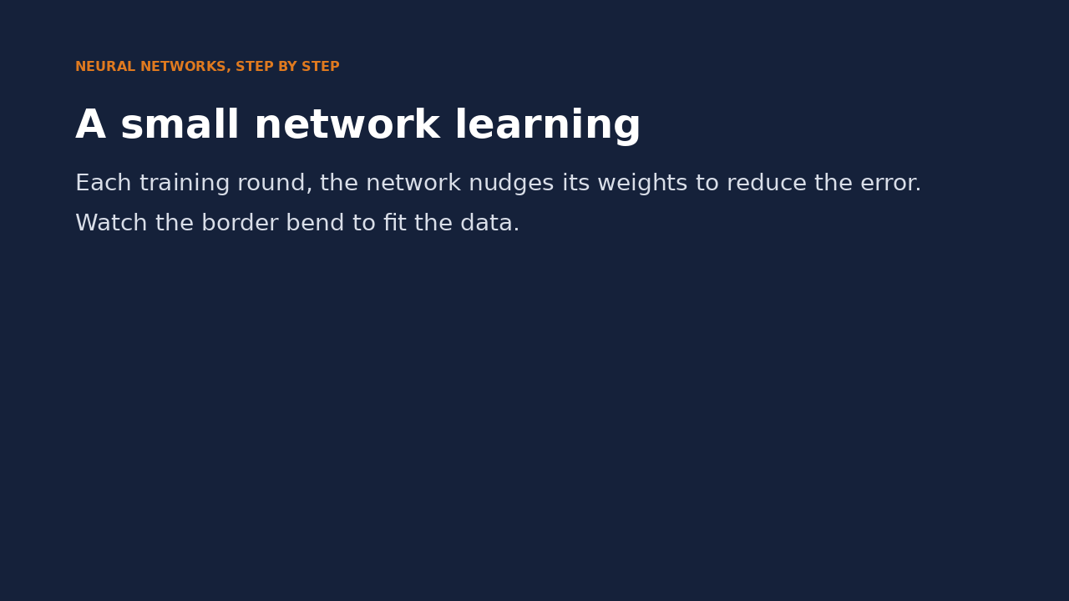
Watch it: a small network learning
WATCH FOR
The border starts almost straight
Each round nudges every weight a little
The error falls fast, then flattens
After 200 rounds: 97% on these points
Click the video to play, click again to pause. Silent: talk the class through it.
Md Mahbub E Noor
Lecture 14: Responsible ML and what's next
University of Barishal
12 / 17
Notes:
This shows training on a small two-moon dataset so the border is visible. Point out the link to Lecture 9: try, measure the error, adjust, repeat.

Slide 13
Where to go next
1
2
3
Deep learning
Language and speech
Practice
Larger networks for images, speech and text. Libraries: PyTorch, TensorFlow.
Bangla text and speech processing is an open area with real local impact.
Your project. Then public datasets and competitions, always with honest evaluation.
Md Mahbub E Noor
Lecture 14: Responsible ML and what's next
University of Barishal
13 / 17
Notes:
Encourage interested students to talk to you about thesis topics. The habits from this course, honest evaluation above all, matter more than any particular library.

Slide 14
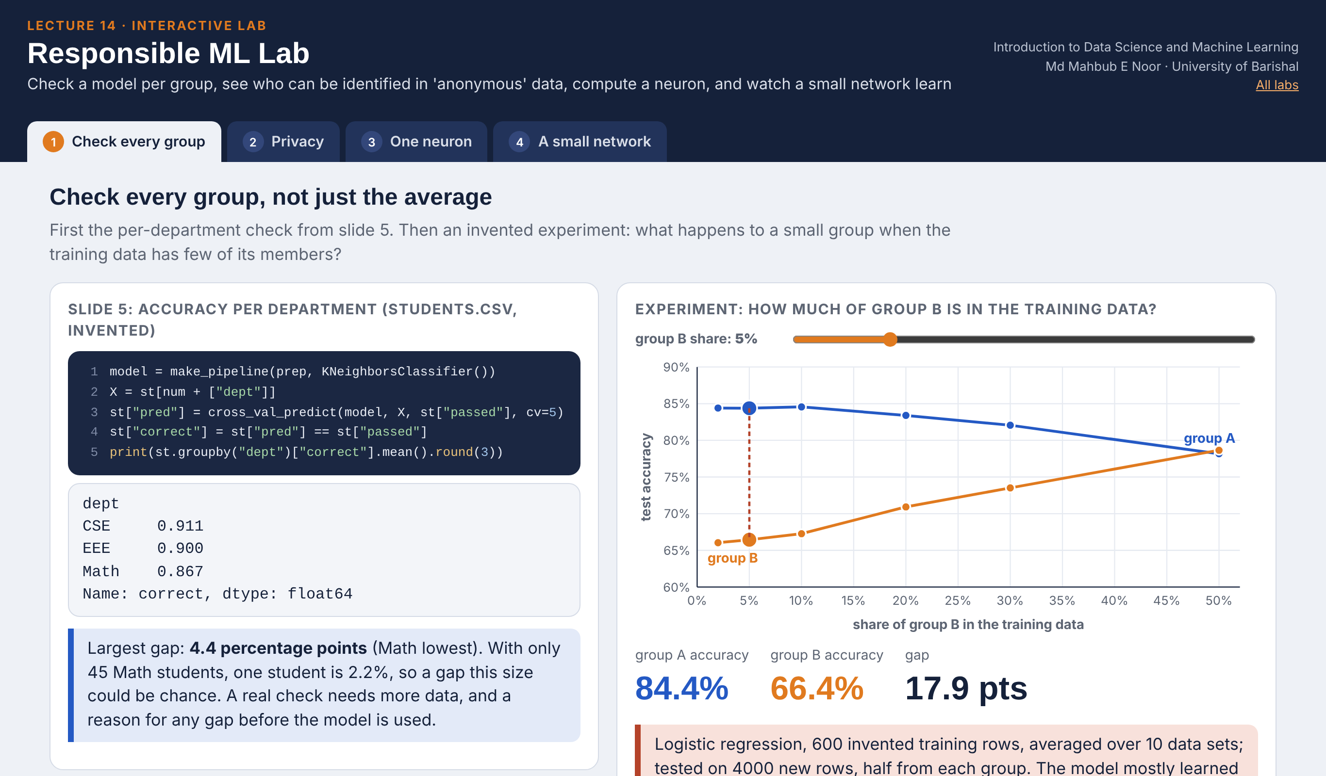
Interactive lab: Responsible ML Lab
In the lab you can
1 Check every group
Slide 5 per department; a rare group gets worse results.
2 Privacy
Remove names: how many people are still unique?
3 One neuron
Slide 9 with sliders: weights, bias, step or sigmoid.
4 A small network
Watch the border bend epoch by epoch; 1 to 16 neurons.
Open the lab ►
Works offline in any browser
Labs_open_in_browser/
L14_Responsible_ML_Lab.html
Md Mahbub E Noor
Lecture 14: Responsible ML and what's next
University of Barishal
14 / 17
Notes:
Open the Responsible ML Lab (double-click; works offline). Groups: slide 5's output, then an invented experiment where group B is 2% of the training data (66% accuracy versus 84% for group A); the gap closes only near equal shares. Privacy: untick name, phone and student ID - 144 of 150 invented students are still unique; dropping year and hall and generalising birth year and district brings it to 0. One neuron: 'Slide 9 values' gives total 3.0, output 1; homework 14.1 can be checked here. Network: on the ring, 1 hidden neuron never succeeds; 16 neurons reach 100%.

Slide 15
Today's toolkit
cross_val_predict | Honest prediction for every row
groupby(group)["correct"].mean() | Accuracy per group
anonymise | Remove names, numbers, addresses
neuron | Weighted sum + bias, then a function
MLPClassifier(...) | A small neural network
checklist | Baseline, honest test, metric, groups, data match, privacy
Md Mahbub E Noor
Lecture 14: Responsible ML and what's next
University of Barishal
15 / 17
Notes:
Next session: the project kickoff.

Slide 16
Homework 14
Due before the project kickoff · [date]
1
By hand
2
Group check
3
Network size
For the neuron on the slide, find a student (hours, attendance, GPA) for whom the output is 0. Show the total.
Repeat the per-group check with a decision tree instead of k-NN. Do the groups differ more or less?
Train MLPClassifier on the digits with hidden layers of 8, 32 and 128 neurons. Report test accuracy for each.
4
Responsible use
5
Project idea
Pick one real ML system you use. Write two ways it could treat some people unfairly.
Write one paragraph describing a project you would like to do. Bring it to the kickoff.
Submit on [LMS / Google Classroom]: your notebook file HW14_<your ID>.ipynb, or a Colab link set to “Anyone with the link can view”.
Md Mahbub E Noor
Lecture 14: Responsible ML and what's next
University of Barishal
16 / 17
Notes:
Homework 14. Task 1: any input with a total at or below 0, for example hours 2, attendance 0.5, GPA 2.0: 1 + 1 + 2 - 5 = -1, output 0.

Slide 17

Recap: Lecture 14 in 90 seconds
Click to play or pause. Watch it again at home to revise.
Md Mahbub E Noor
Lecture 14: Responsible ML and what's next
University of Barishal
17 / 17
Notes:
Play at the end of class or leave for revision at home.

