Slide 1
LECTURE 2.2
Hello, Python
Today's key line of code
print("Hello, Data Science!")
Your first lines of code: numbers, variables and text
Introduction to Data Science · Md Mahbub E Noor · University of Barishal
Notes:
Lecture 2, part 2. Last time we set up our tools: Jupyter in the lab, Colab at home. Today we write real Python: printing, arithmetic, variables, types and text. Open Jupyter and create a notebook called Lecture2_2. Rule for today: if your screen does not match mine, raise your hand immediately. Small problems are easy to fix early and painful to fix later.

Slide 2
Where we are: Lecture 2, part 2 of 3
Part 2 of 3
L2
L3
L4
L5
L6
Python basics
Decisions and loops
Counting words
Real data
Build the model
Today you will
1
Show results with print()
2
Use Python as a calculator
3
Store values in variables
4
Work with text, the raw material of spam
5
Read error messages without panic
Md Mahbub E Noor
Lecture 2.2: Hello, Python
University of Barishal
2 / 16
Notes:
Here is our journey. Five lectures from now, you will build a real spam detector that learns from more than five thousand real text messages. Every lecture adds one piece. Today is the foundation: the basic words of the Python language. Look at the goals. Notice the fourth one: text. Spam detection is about text, so from day one we practise on messages. And the last goal matters more than it looks: every programmer, including me, sees error messages every day. Today you learn to read them calmly.

Slide 3
Why Python?
1
2
3
Reads like English
Free, everywhere
Built for data
print("hello") does exactly what it says. Beginners get results on day one.
No license to buy. Runs offline in Jupyter, or online in Colab.
Tools like pandas and scikit-learn, which we use to build the spam detector, are Python libraries.
Md Mahbub E Noor
Lecture 2.2: Hello, Python
University of Barishal
3 / 16
Notes:
Why Python and not another language? Three reasons. It reads almost like English, which is why universities around the world teach it first. It is free, and with Google Colab you do not even need to install anything; it runs in a web browser, on Google's computers. And it is the main language of data science: the libraries we will use in Lectures 5 and 6 are all Python. If you learn one language for this field, this is the one.

Slide 4
print() shows a result
print() displays whatever is inside the brackets
Code
print("Hello, Data Science!")
print(2 + 3)
print("2 + 3")
Text goes inside quotes: "Hello"
Numbers do not need quotes
Output
Hello, Data Science!
5
2 + 3
Each print() starts a new line
Md Mahbub E Noor
Lecture 2.2: Hello, Python
University of Barishal
4 / 16
Notes:
Our first command is print. It shows a result below the cell. Look carefully at the second and third lines. Without quotes, Python calculates 2 plus 3 and prints 5. With quotes, it is just text, so Python prints the characters exactly as written. Quotes mean: this is text, do not calculate. Please type all three lines and run them. Ask: what do you think print of quote 10 times 2 quote shows? [Answer: the text 10 * 2.]

Slide 5
Python as a calculator
+ - * / work as you expect
Code
# Python as a calculator
print(7 + 3)
print(7 * 3)
print(7 / 2)
print(7 ** 2)
** means power: 7 ** 2 is 7 squared
/ always gives a decimal: 7 / 2 is 3.5
# starts a comment: a note Python ignores
Output
10
21
3.5
49
Md Mahbub E Noor
Lecture 2.2: Hello, Python
University of Barishal
5 / 16
Notes:
Python is a very fast calculator. Plus, minus, star for multiply, slash for divide. Two stars means power. Notice the first line starts with a hash sign: that is a comment. Python skips it completely. Comments are notes for humans: for your future self and for me when I grade your homework. Good habit from day one: write a short comment above your code saying what it does. Quick check: what does 2 star star 10 give? [1024.]

Slide 6
Variables store values
= means "store this", not "is equal to"
Code
messages_today = 12
spam_found = 3
share = spam_found / messages_today
print(share)
The name goes on the left, the value on the right
Use clear names: spam_found, not x
Output
0.25
Names use lowercase and underscores, no spaces
Md Mahbub E Noor
Lecture 2.2: Hello, Python
University of Barishal
6 / 16
Notes:
A variable is a labeled box that stores a value. messages_today equals 12 means: make a box called messages_today and put 12 in it. The equals sign here does NOT mean equal in the maths sense; read it as 'store'. Once stored, we can use the name instead of the number, as in the third line. Why bother? Because in real data work, values come from data and change; names keep your code readable. Choose names that explain themselves. spam_found tells a reader far more than x.

Slide 7
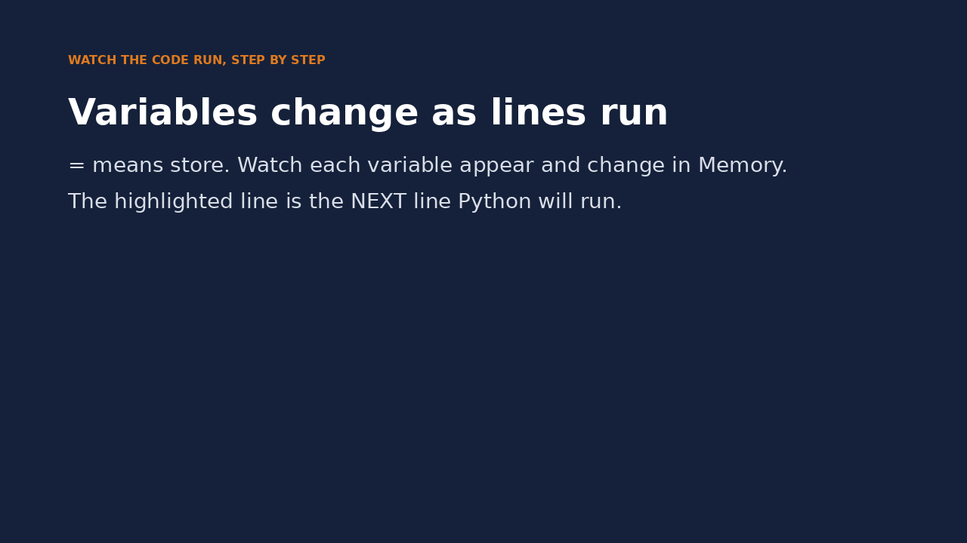
Watch it run: variables changing
WATCH FOR
Each variable appears in Memory when it is first stored
x = x + 1 uses the old value
share does not update by itself
The highlighted line is the next one to run
Click the video to play, click again to pause. Silent: talk the class through it.
Md Mahbub E Noor
Lecture 2.2: Hello, Python
University of Barishal
7 / 16
Notes:
Pause after line 4 and ask: what is share now? Many students expect it to update automatically. It does not: it keeps the value computed earlier until line 5 recomputes it.

Slide 8
Every value has a type
int: whole numbers like 12
Code
print(type(12))
print(type(0.25))
print(type("free prize"))
print(type(True))
float: decimals like 0.25
str (string): text like "free prize"
bool: True or False, answers to yes/no questions
Output
<class 'int'>
<class 'float'>
<class 'str'>
<class 'bool'>
Md Mahbub E Noor
Lecture 2.2: Hello, Python
University of Barishal
8 / 16
Notes:
Python keeps track of what kind of value is in each box. That kind is called a type, and type() tells you which one. Four types matter for us: int for whole numbers, float for decimals, str, short for string, for text, and bool for True or False. Why care? Because what you can do depends on the type: you can divide numbers but not text. Remember bool: the spam detector will ultimately answer a True or False question, is this spam?

Slide 9
Text is data too
len() counts characters, spaces included
Code
message = "Claim your FREE prize now"
print(len(message))
print(message.lower())
print("free" in message)
print("free" in message.lower())
.lower() makes all letters small, so FREE and free match
in asks: does this text appear inside?
Output
This is the first building block of a spam filter
25
claim your free prize now
False
True
Md Mahbub E Noor
Lecture 2.2: Hello, Python
University of Barishal
9 / 16
Notes:
Spam detection is all about text, so let's play with a message. len counts characters, including spaces. dot lower converts everything to small letters. Now the interesting part: the word 'in' asks whether some text appears inside another. Look at the last two lines. 'free' in message is False! Why? Because the message says FREE in capitals, and Python treats capital and small letters as different. After lower(), it becomes True. This tiny detail is why real spam filters clean text before looking at it. We will meet this again.

Slide 10
f-strings mix text and values
Put f before the quotes
Code
spam_found = 3
total = 12
print(f"{spam_found} of {total} messages were spam")
share = spam_found / total
print(f"That is {share:.0%} of the inbox")
Anything inside { } is calculated and inserted
{share:.0%} shows a number as a percentage
Output
3 of 12 messages were spam
That is 25% of the inbox
Perfect for clear, readable reports
Md Mahbub E Noor
Lecture 2.2: Hello, Python
University of Barishal
10 / 16
Notes:
Data scientists do not just compute numbers, they report them. An f-string lets you drop values into a sentence. Put the letter f before the opening quote, and write variable names inside curly braces. Python replaces them with the values. The colon dot zero percent part is a formatting instruction: show this number as a percentage with no decimals. You do not need to memorise that; you need to know that it exists and where to look it up.

Slide 11
Your turn
5 minutes
1
Store your first name in a variable called name
Code
name = "..."
message = "..."
print(f"...")
print(...)
2
Store any text message in message
3
Print a sentence like: Nadia's message has 42 characters
4
Print whether the message contains "offer" (ignore capitals)
Starter code: replace the ... with your own code
Md Mahbub E Noor
Lecture 2.2: Hello, Python
University of Barishal
11 / 16
Notes:
Five minutes, work with your neighbour. [Walk around.] Solution: name = 'Nadia'; message = 'Special OFFER on recharge'; print(f"{name}'s message has {len(message)} characters"); print('offer' in message.lower()). Common slips to watch for: forgetting the f, putting len(message) outside the braces, and forgetting lower() so capital OFFER gives False. If someone gets False, ask them why before telling them.

Slide 12
A first look at errors (more in Lecture 2.3)
Read the last line of an error first. It names the problem.
What you typed | What Python says | What it means
total = 12 print(totl) | NameError: name 'totl' is not defined | Typo in a name. Python only knows names you created. Check spelling.
print("hello) | SyntaxError: unterminated string literal (detected at line 1) | A quote or bracket was opened but not closed. Close it.
print("Total: " + 12) | TypeError: can only concatenate str (not "int") to str | Cannot glue text and a number with +. Use an f-string.
Md Mahbub E Noor
Lecture 2.2: Hello, Python
University of Barishal
12 / 16
Notes:
Errors are completely normal. Professional programmers see them all day. What matters is reading them. Always look at the LAST line of an error first: it names the problem. NameError means you used a name Python has never seen, usually a typo. SyntaxError means the grammar is broken, often a missing quote or bracket; Colab even points to the spot. TypeError means you combined types that do not fit, like text plus a number. Fix: use an f-string. Please do not be afraid to break things in Colab. Nothing can be damaged.

Slide 13
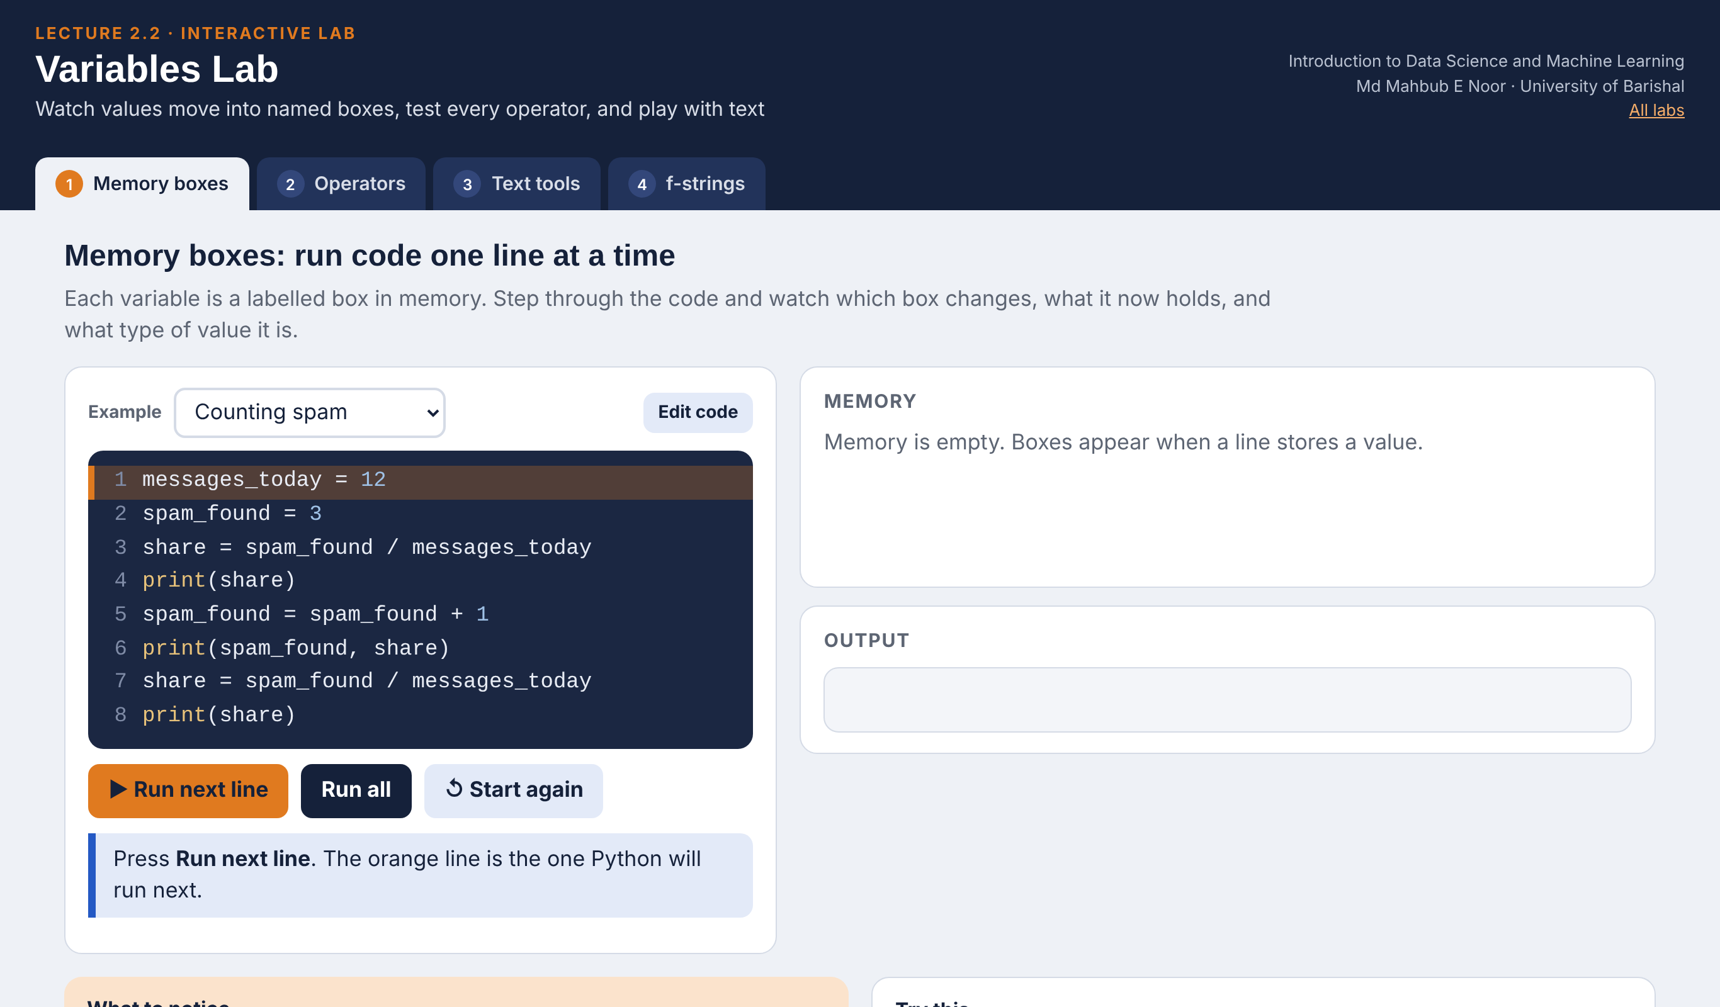
Interactive lab: Variables Lab
In the lab you can
1 Memory boxes
Run code line by line and watch each box change.
2 Operators
Change a and b: every result and type updates live.
3 Text tools
Type a message: indexes, len, in and .lower() update.
4 f-strings
Move sliders and format numbers with :.2f and :.0%.
Open the lab ►
Works offline in any browser
Labs_open_in_browser/
L2.2_Variables_Lab.html
Md Mahbub E Noor
Lecture 2.2: Hello, Python
University of Barishal
13 / 16
Notes:
Open the Variables Lab from the Labs_open_in_browser folder (double-click; no internet needed). Suggested 10-minute flow: Memory boxes with 'Counting spam' (ask the class to predict line 6 before running it); Operators with a = -7, b = 2 to discuss // rounding down; Text tools with the FR33 g1ft preset. Students can repeat everything at home: the same file works on any laptop or phone browser.

Slide 14
Today's toolkit
print(x) | Show a value
# note | Comment, ignored by Python
name = value | Store a value in a variable
+ - * / ** | Arithmetic, ** is power
type(x) | Which kind of value is this?
len(text) | Number of characters
text.lower() | All letters to lowercase
"a" in text | Does the text contain "a"? True/False
f"{x} items" | Insert values into text
Md Mahbub E Noor
Lecture 2.2: Hello, Python
University of Barishal
14 / 16
Notes:
Here is everything from today on one slide. Take a photo, or better, copy it into a text cell at the top of your notebook. Next lecture we build on every one of these: variables, text, and True or False will become decisions and loops, and we will write our first spam rule.

Slide 15
Homework 2.2
Due before Lecture 2.3 · [date]
1
Set up
2
About me
3
Predict, then run
Create a notebook (Jupyter or Colab) named HW2_2_<your ID>. Put your name in a text cell at the top.
Store your name, department and favourite number in variables. Print one f-string sentence using all three.
For each line, write your prediction as a comment first, then run it: print(10 / 4), print(10 // 4), print("ab" * 3), print(len("data science")).
4
Message inspector
5
Break it on purpose
Store a real SMS you received (remove names and numbers). Print its length, its lowercase version, and whether it contains "free".
Create one error deliberately. Keep the error message and explain in one sentence what it means.
Submit on [LMS / Google Classroom]: your notebook file HW2_2_<your ID>.ipynb, or a Colab link set to “Anyone with the link can view”.
Md Mahbub E Noor
Lecture 2.2: Hello, Python
University of Barishal
15 / 16
Notes:
Homework for next class. Why homework? Because programming is learned with the fingers, not the eyes. Watching me type is not enough. Task 3 is the most important: write your prediction BEFORE running. Being wrong is fine and expected, 10 double-slash 4 will surprise most of you. That surprise is where learning happens, and it tells me what to re-teach. Instructor key: 10/4 gives 2.5; 10//4 gives 2 (floor division, whole part only); 'ab'*3 gives ababab; len('data science') gives 12, the space counts. For task 5, accept any genuine error with a correct one-sentence explanation. Grade on effort and honest predictions, not correctness of predictions.

Slide 16

Recap: Lecture 2.2 in 90 seconds
Click to play or pause. Watch it again at home to revise.
Md Mahbub E Noor
Lecture 2.2: Hello, Python
University of Barishal
16 / 16
Notes:
Play this at the end of class, or leave it for students to revise at home. It is silent: pause on each card and ask the class for an example.

