Slide 1
LECTURE 2.3
Finding and fixing mistakes
Today's key line of code
print("Total: " + 5)
# TypeError: can only concatenate
# str (not "int") to str
Reading error messages and debugging, step by step
Introduction to Data Science · Md Mahbub E Noor · University of Barishal
Notes:
Lecture 2, part 3. Every programmer, at every level, spends a large part of their time finding and fixing mistakes. It is a skill, and like any skill it can be taught. Today you learn to read error messages calmly, to recognise the common ones, and to follow a routine when something goes wrong. New notebook: Lecture2_3.

Slide 2
Where we are: Lecture 2, part 3 of 3
Part 3 of 3
L2
L3
L4
L5
L6
Python basics
Decisions and loops
Counting words
Real data
Build the model
Today you will
1
Tell apart syntax, runtime and logic errors
2
Read an error message from the bottom up
3
Recognise the ten errors you will meet most
4
Find logic errors by printing values
5
Follow a debugging routine, and ask for help well
Md Mahbub E Noor
Lecture 2.3: Finding and fixing mistakes
University of Barishal
2 / 26
Notes:
After today you should never again feel that an error message is an insult. It is Python telling you, as precisely as it can, where it got stuck.

Slide 3
Three kinds of mistakes
1
2
3
Syntax error
Runtime error
Logic error
Python cannot read the code: a missing colon, bracket or quote. Nothing in the cell runs.
The code starts, then crashes at one line: a wrong name, a wrong type, a missing file.
No message at all, but the answer is wrong. The hardest kind, because Python is happy.
Md Mahbub E Noor
Lecture 2.3: Finding and fixing mistakes
University of Barishal
3 / 26
Notes:
Syntax errors are grammar mistakes: Python refuses to start. Runtime errors happen while running: the lines before the crash have already run. Logic errors are the dangerous ones: the program runs and gives a wrong result, and only testing with an answer you already know will reveal it.

Slide 4
Anatomy of an error message
Error message (traceback)
Traceback: the path Python took. Read it from the bottom up
Traceback (most recent call last):
File "shop.py", line 6, in <module>
print("Average: " + average)
~~~~~~~~~~~~^~~~~~~~~
TypeError: can only concatenate str (not "float") to str
Where: file name and line number
The exact line that failed
Markers point at the failing part
Error type: the kind of problem
Message: what went wrong, in words
Md Mahbub E Noor
Lecture 2.3: Finding and fixing mistakes
University of Barishal
4 / 26
Notes:
This is a real error message from a small script. Read it from the bottom: the last line gives the type, TypeError, and the message: you cannot join text and a decimal number with plus. The line above shows the failing line, and the line number tells you where it is. In Jupyter and Colab the same parts appear with colours and an arrow pointing at the line; the file path will show your own folder.

Slide 5
A debugging routine you can always follow
1
2
Read the last line
Find the line
Error type and message. Say in your own words what Python is complaining about.
Go to the line number. Check that line and the one just above it.
3
4
Make one change
Still stuck?
Change one thing only, then run again. Several changes at once hide what fixed it.
Print the values involved, shrink the problem, then ask for help with the full error.
Md Mahbub E Noor
Lecture 2.3: Finding and fixing mistakes
University of Barishal
5 / 26
Notes:
Four steps, in this order, every time. Students who skip step 1 and start changing code at random take much longer. The line above matters because a missing bracket on one line often shows up as an error on the next.

Slide 6
The errors you will meet most
Error | Usually means | Typical fix
SyntaxError | Missing colon, bracket or quote | Look at the marked spot and the line above
IndentationError | Block not indented, or mixed spacing | Indent the block by 4 spaces
NameError | Name misspelled or never created | Check spelling; run the cell that creates it
TypeError | Wrong type for the operation | Convert: int(), str(), or an f-string
ValueError | Right type, impossible value | Check the value: int("ten") cannot work
IndexError | Position past the end of a list | Positions run from 0 to len - 1
KeyError | Dictionary key does not exist | Use d.get(key, 0) or check the key
ZeroDivisionError | Dividing by zero | Check the divisor first, for example empty lists
FileNotFoundError | File not where Python looks | Put the file next to the notebook
ModuleNotFoundError | Library not installed | Lab: use Anaconda. Home: pip install
Md Mahbub E Noor
Lecture 2.3: Finding and fixing mistakes
University of Barishal
6 / 26
Notes:
You do not need to memorise this table; you need to recognise the names. Keep it open during the first weeks. Notice how many of these are fixed by checking a spelling or a position.

Slide 7
Bug hunt 1: find the mistake
Predict first
Code
?
age = "20"
next_year = age + 1
print(next_year)
This cell fails. Which line, and why? Decide before you run it.
Md Mahbub E Noor
Lecture 2.3: Finding and fixing mistakes
University of Barishal
7 / 26
Notes:
Give the class 30 seconds.

Slide 8
Answer: Bug hunt 1: find the mistake
Code
"20" in quotes is text, not a number
age = "20"
next_year = age + 1
print(next_year)
Text + number is a TypeError
Fix: age = 20, or convert with int(age)
Output
Data read from files and input() often arrives as text
TypeError: can only concatenate str (not "int") to str
Md Mahbub E Noor
Lecture 2.3: Finding and fixing mistakes
University of Barishal
8 / 26
Notes:
The quotes make age a string. Python will not add 1 to text. This exact bug appears constantly with real data, because values read from files or typed by users arrive as text. int(age) converts it.

Slide 9
Bug hunt 2: find the mistake
Predict first
Code
?
scores = [70, 85, 90]
total = 0
for s in scores:
total = total + s
average = total / len(score)
This cell fails. Which line, and why? Decide before you run it.
Md Mahbub E Noor
Lecture 2.3: Finding and fixing mistakes
University of Barishal
9 / 26
Notes:
Look closely at the last line.

Slide 10
Answer: Bug hunt 2: find the mistake
Code
score was never created: the list is scores
scores = [70, 85, 90]
total = 0
for s in scores:
total = total + s
average = total / len(score)
NameError points to the line with the typo
Recent Python versions may add: Did you mean: 'scores'?
Output
Fix: len(scores)
NameError: name 'score' is not defined
Md Mahbub E Noor
Lecture 2.3: Finding and fixing mistakes
University of Barishal
10 / 26
Notes:
A one-letter typo, score instead of scores. The error names the unknown name exactly, which makes it quick to find once you read the message.

Slide 11
Bug hunt 3: find the mistake
Predict first
Code
?
marks = []
average = sum(marks) / len(marks)
print(average)
This cell fails. Which line, and why? Decide before you run it.
Md Mahbub E Noor
Lecture 2.3: Finding and fixing mistakes
University of Barishal
11 / 26
Notes:
The code is correct for normal lists. What is special here?

Slide 12
Answer: Bug hunt 3: find the mistake
Code
An empty list has length 0
marks = []
average = sum(marks) / len(marks)
print(average)
Dividing by 0 is impossible: ZeroDivisionError
Fix: check first, if len(marks) > 0:
Output
Real data often has empty groups
ZeroDivisionError: division by zero
Md Mahbub E Noor
Lecture 2.3: Finding and fixing mistakes
University of Barishal
12 / 26
Notes:
The list is empty, so len is 0 and Python cannot divide. Code that works on your test data can still fail on real data. Checking for empty data before dividing is a professional habit.

Slide 13
Logic error: no message, wrong answer
Predict first
Code
?
a = 70
b = 90
average = a + b / 2
print(average)
Expected average of 70 and 90: 80. What does it print?
Md Mahbub E Noor
Lecture 2.3: Finding and fixing mistakes
University of Barishal
13 / 26
Notes:
No error message this time. Predict the number.

Slide 14
Answer: Logic error: no message, wrong answer
Code
Division happens before addition
a = 70
b = 90
average = a + b / 2
print(average)
So Python computes 70 + 45 = 115.0
Fix: (a + b) / 2
Always test with a case where you know the answer
Output
115.0
Md Mahbub E Noor
Lecture 2.3: Finding and fixing mistakes
University of Barishal
14 / 26
Notes:
115.0. Python follows maths rules: division before addition. The program ran perfectly and gave a wrong answer. That is a logic error, and the only defence is to test with an example whose correct answer you already know.

Slide 15
Find logic errors by printing values
Goal: count the vowels in "banana" (expected 3)
Code
word = "banana"
count = 0
for ch in word:
if ch in "aeiou":
count = 1
print(count)
The loop runs, but the answer is 1
Next step: print the values inside the loop
Look for the round where the value goes wrong
Output
1
Md Mahbub E Noor
Lecture 2.3: Finding and fixing mistakes
University of Barishal
15 / 26
Notes:
Here is a logic error. The code runs without complaint and prints 1. Before reading the code line by line looking for the problem, let's make the program show us what it is doing.

Slide 16
Add a print inside the loop
Each round now shows ch and count
Code
word = "banana"
count = 0
for ch in word:
if ch in "aeiou":
count = 1
print("ch =", ch, "count =", count)
print(count)
count never goes above 1
The line count = 1 sets instead of adds
Fix: count = count + 1, then delete the debug print
Output
ch = b count = 0
ch = a count = 1
ch = n count = 1
ch = a count = 1
ch = n count = 1
ch = a count = 1
1
Md Mahbub E Noor
Lecture 2.3: Finding and fixing mistakes
University of Barishal
16 / 26
Notes:
One extra print line turns the invisible into the visible. Now you can watch count: it jumps to 1 at the first a and stays there. That points straight at count = 1, which should be count = count + 1. Remove debug prints once the bug is fixed.

Slide 17
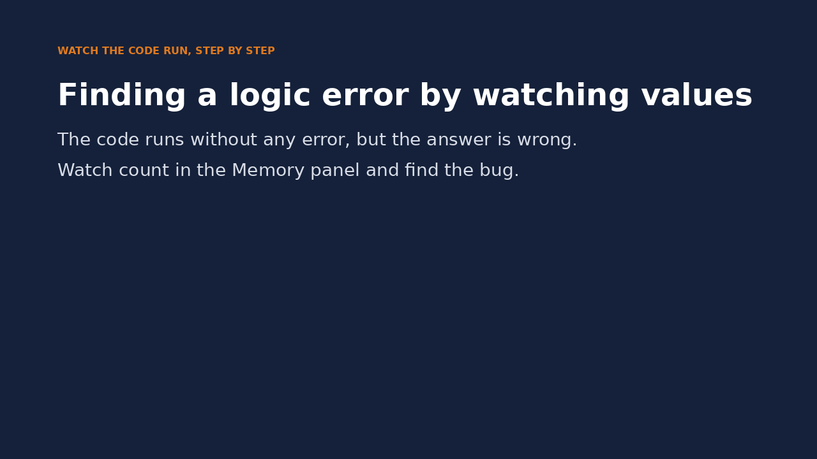
Watch it run: hunting the logic error
WATCH FOR
No error message, but the answer is 1
Watch count in Memory after each vowel
It never goes above 1
That points straight at count = 1
Click the video to play, click again to pause. Silent: talk the class through it.
Md Mahbub E Noor
Lecture 2.3: Finding and fixing mistakes
University of Barishal
17 / 26
Notes:
This is the same bug as the previous two slides, seen from the inside. Pause each time count is set and ask the class what count should be now.

Slide 18
More tactics when you are stuck
1
2
3
Shrink it
Comment out
Restart and run all
Copy the failing part into a new cell with a tiny input. Small problems are easy to see.
Put # before lines to switch them off, and find which line breaks things.
Rules out the execution-order trap from Lecture 2.1 before you search any further.
Md Mahbub E Noor
Lecture 2.3: Finding and fixing mistakes
University of Barishal
18 / 26
Notes:
Three extra tools. Shrinking the problem is the most powerful: professional programmers do it all the time. And whenever a result seems impossible in a notebook, restart and run all before you do anything else.

Slide 19
Asking for help, including AI tools
1
2
3
Try for 10 minutes
Share the right things
AI: explain, not write
Follow the routine first. Struggling a little is where the learning happens.
The code, the full error message, what you expected, and what you already tried.
Ask it to explain the error. Run and check anything it suggests. You must be able to explain every line you submit. [Course AI policy]
Md Mahbub E Noor
Lecture 2.3: Finding and fixing mistakes
University of Barishal
19 / 26
Notes:
When you ask a classmate, me, or an AI tool, include the full error, not 'it doesn't work'. On AI tools: they are good at explaining error messages, and often wrong about the fix. Use them to understand, never paste code you cannot explain. Replace the bracketed placeholder with your course's official AI policy.

Slide 20
Bug hunt: fix all five
Each numbered part has exactly one bug. Parts 4 and 5 run without errors but give wrong answers. 15 minutes, in pairs.
Code
# 1
print("Total: " + 5)
# 2
name = "Nadia"
if name == "Nadia"
print("Hi")
# 3
marks = [70, 85, 90]
print(marks[3])
# 4 should print the sum 15, once
total = 0
for i in range(1, 6):
total = total + i
print(total)
# 5 30 Celsius should give 86.0
celsius = 30
print(celsius * 9 / 5 + 23)
Md Mahbub E Noor
Lecture 2.3: Finding and fixing mistakes
University of Barishal
20 / 26
Notes:
Students should type each part into its own cell and run it. Parts 1 to 3 produce error messages; parts 4 and 5 run and give wrong answers. Solutions on the next slides.

Slide 21
Solutions
Show these after students have tried the bug hunt.
Md Mahbub E Noor
Lecture 2.3: Finding and fixing mistakes
University of Barishal
21 / 26
Notes:
Solutions.

Slide 22
Solutions: the five fixes
1: use an f-string. 2: add the colon. 3: last position is 2. 4: print after the loop, not inside. 5: the constant is 32.
Code
Output
print(f"Total: {5}")
name = "Nadia"
if name == "Nadia":
print("Hi")
marks = [70, 85, 90]
print(marks[2])
total = 0
for i in range(1, 6):
total = total + i
print(total)
celsius = 30
print(celsius * 9 / 5 + 32)
Total: 5
Hi
90
15
86.0
Md Mahbub E Noor
Lecture 2.3: Finding and fixing mistakes
University of Barishal
22 / 26
Notes:
Ask pairs which bugs they found by reading the error and which they found by testing. Part 4 is the indentation logic bug: the print was inside the loop, so it printed every partial sum. Part 5 is a wrong constant that only a known test case, 30 Celsius is 86 Fahrenheit, can reveal.

Slide 23
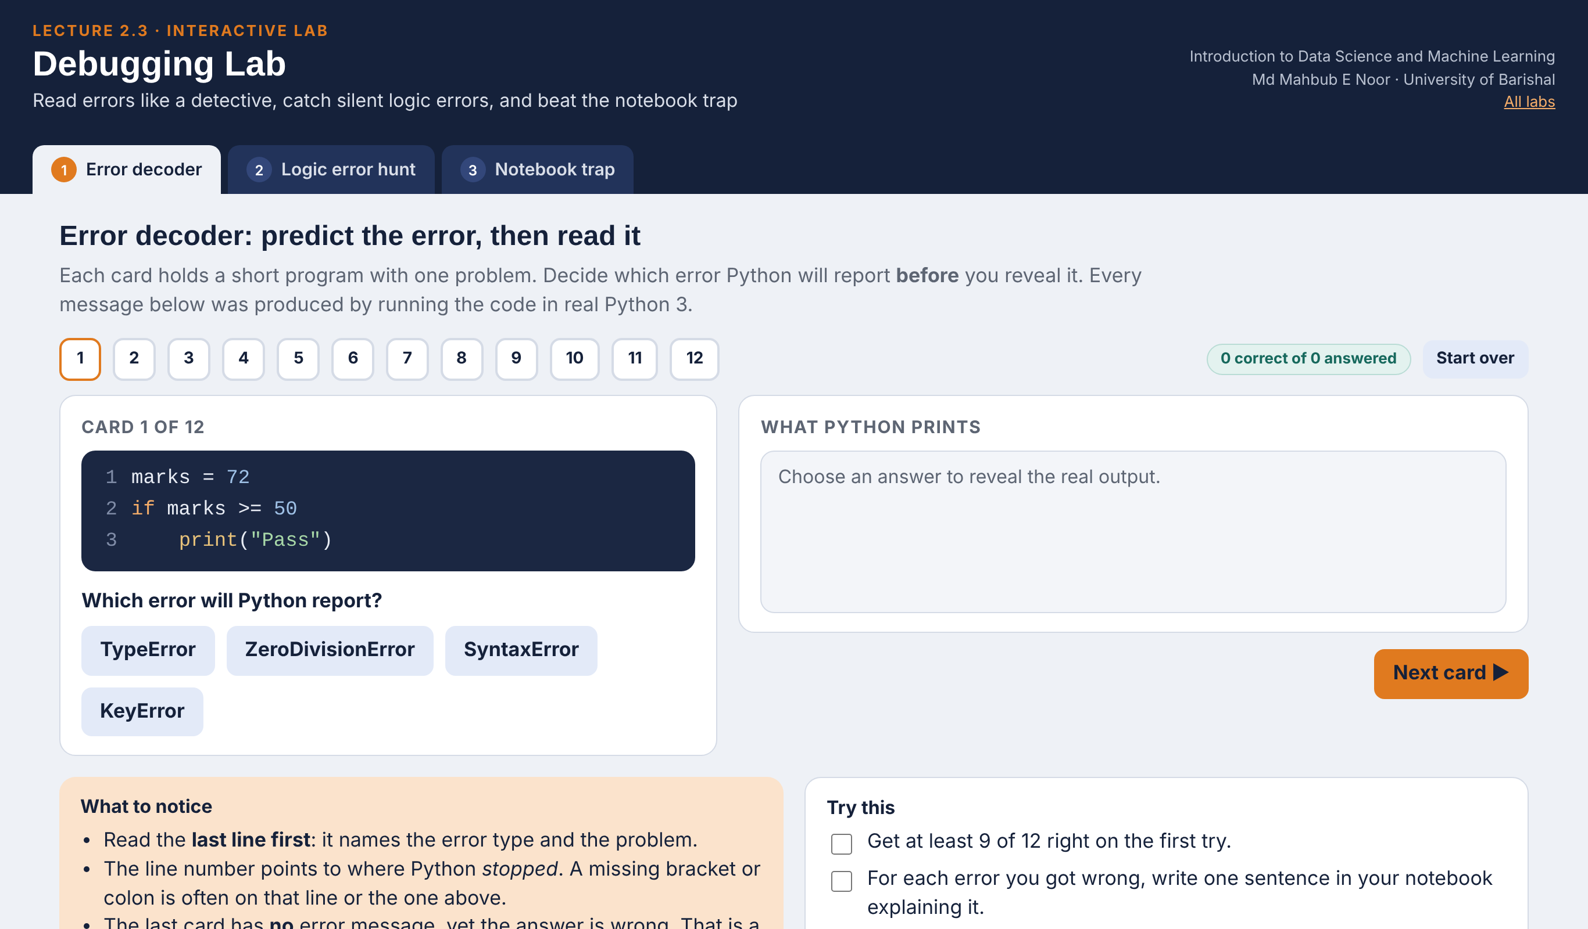
Interactive lab: Debugging Lab
In the lab you can
1 Error decoder
12 broken programs: predict the error, then read the real Python message.
2 Logic error hunt
Trace a vowel counter round by round and see why a + b / 2 is wrong.
3 Notebook trap
Run cells out of order, edit, restart, and see what the kernel remembers.
Open the lab ►
Works offline in any browser
Labs_open_in_browser/
L2.3_Debugging_Lab.html
Md Mahbub E Noor
Lecture 2.3: Finding and fixing mistakes
University of Barishal
23 / 26
Notes:
Open the Debugging Lab (double-click; works offline). Run the Error decoder as a class quiz: show the card, let students vote with fingers for an option, then reveal. Every traceback was produced by real Python 3. In the Notebook trap, run A then B, change A to x = 7 without running it, run B again and ask why it still prints 10. Finish with Restart and run all.

Slide 24
Today's toolkit
Last line first | Error type + message
Line number | Where it failed; check the line above
Syntax / runtime / logic | Can't read / crashes / wrong answer
print("x =", x) | Show values while debugging
# line | Switch a line off to test
Tiny input | Shrink the problem
Restart + Run all | Rule out execution-order bugs
Known answer | The only way to catch logic errors
Md Mahbub E Noor
Lecture 2.3: Finding and fixing mistakes
University of Barishal
24 / 26
Notes:
This routine applies to every remaining lecture. Next: Lecture 3.1, making decisions with if.

Slide 25
Homework 2.3
Due before Lecture 3.1 · [date]
1
Error diary
2
Read, don't run
3
Debug with print
Create 5 different errors on purpose. For each: the code, the last line of the error, and one sentence explaining it.
For the three bug-hunt slides, write the error type you expect before running. How many did you get right?
This should count words longer than 3 letters in "we love data science" but prints 0. Fix it using prints: count = 0; for w in text.split(): if len(w) > 3: count + 1.
4
Logic test
5
Explain
Write code for the average of 3 numbers. Test it with a case you can check in your head. Show the test.
In 3 sentences: why are logic errors harder to find than syntax errors?
Submit on [LMS / Google Classroom]: your notebook file HW2_3_<your ID>.ipynb, or a Colab link set to “Anyone with the link can view”.
Md Mahbub E Noor
Lecture 2.3: Finding and fixing mistakes
University of Barishal
25 / 26
Notes:
Homework 2.3. Task 3 key: count + 1 computes a value and throws it away; it should be count = count + 1. Printing count inside the loop reveals that it never changes. Task 4: the point is the test itself, for example 3, 6, 9 should give 6. Grade the error diary on the quality of the explanations.

Slide 26

Recap: Lecture 2.3 in 90 seconds
Click to play or pause. Watch it again at home to revise.
Md Mahbub E Noor
Lecture 2.3: Finding and fixing mistakes
University of Barishal
26 / 26
Notes:
Play this at the end of class, or leave it for students to revise at home. It is silent: pause on each card and ask the class for an example.

