Slide 1
LECTURE 3.1
Making decisions
Today's key line of code
if marks >= 50:
print("Pass")
else:
print("Try again")
if, elif, else, and match: teaching Python to choose
Introduction to Data Science · Md Mahbub E Noor · University of Barishal
Notes:
Welcome to Lecture 3, part 1. Lecture 3 is split into three parts because it contains the three ideas beginners find hardest: decisions today, lists and tuples in part 2, and loops in part 3. Today we go slowly and look at every piece of an if statement. New Colab notebook: Lecture3_1.

Slide 2
Where we are: Lecture 3, part 1 of 3
Part 1 of 3
L2
L3
L4
L5
L6
Python basics
Decisions and loops
Counting words
Real data
Build the model
Today you will
1
Ask True/False questions with comparison operators
2
Read every part of an if statement
3
Choose between paths with else and elif, and see why order matters
4
Combine conditions with and, or, not
5
Use match-case when one value has many fixed options
Md Mahbub E Noor
Lecture 3.1: Making decisions
University of Barishal
2 / 28
Notes:
Here is where we are. Programs so far ran every line from top to bottom. Today they start choosing which lines to run. That is the first step towards a spam filter: a filter is just a program that decides.

Slide 3
Comparison operators give True or False
Every decision starts with a question. Python answers with True or False (a bool).
You type | Python gives | Meaning
7 == 7 | True | equal to (two = signs)
7 != 5 | True | not equal to
3 > 8 | False | greater than
3 < 8 | True | less than
5 >= 5 | True | greater than or equal to
4 <= 2 | False | less than or equal to
"free" == "Free" | False | text comparison is case-sensitive
Md Mahbub E Noor
Lecture 3.1: Making decisions
University of Barishal
3 / 28
Notes:
Six comparison operators. Read each row aloud with the class. The last row surprises people: 'free' and 'Free' are different, because a small f and a capital F are different characters. Remember this for spam filtering.

Slide 4
= stores, == compares
Predict first
Code
?
x = 5
print(x == 5)
x = 10
print(x == 5)
What will this print? Write your prediction as a comment before you run the cell.
Md Mahbub E Noor
Lecture 3.1: Making decisions
University of Barishal
4 / 28
Notes:
Ask everyone to write down both outputs before I reveal. [Pause.] Most people get the first one. The second: after x = 10, the question 'is x equal to 5?' is False.

Slide 5
Answer: = stores, == compares
Code
x = 10 stores a new value in x
x = 5
print(x == 5)
x = 10
print(x == 5)
x == 5 only asks a question; it changes nothing
Mixing up = and == is the most common beginner bug
Output
True
False
Md Mahbub E Noor
Lecture 3.1: Making decisions
University of Barishal
5 / 28
Notes:
True, then False. One equals sign stores; two equals signs ask. If you remember one thing from today, remember this.

Slide 6
Anatomy of an if statement
Code
marks = 72
if marks >= 50:
print("You passed!")
print("Result checked")
Keyword if starts a decision
Condition: a question that is True or False
Colon: the block starts on the next line
Output
4 spaces: this line belongs to the if and runs only when True
You passed!
Result checked
No indent: outside the if, runs every time
Md Mahbub E Noor
Lecture 3.1: Making decisions
University of Barishal
6 / 28
Notes:
Let's name every part, because students who can name the parts can debug them. The keyword if. The condition, a True or False question. The colon, which Python requires. The indentation, four spaces, which tells Python which lines belong to the if. And the last line, not indented, is outside the if: it always runs.

Slide 7
When the condition is False, the block is skipped
35 >= 50 is False, so the indented line is skipped
Code
marks = 35
if marks >= 50:
print("You passed!")
print("Result checked")
The unindented line still runs
An if does not need an else
Try it: change marks to 72 and run again
Output
Result checked
Md Mahbub E Noor
Lecture 3.1: Making decisions
University of Barishal
7 / 28
Notes:
Same code, different marks. Only one line prints, because the condition is False and Python jumps over the indented block. Ask students to change the value and re-run; they should see two lines again.

Slide 8
if / else: exactly one of two paths
Code
marks >= 50
True
print("Pass")
marks = 35
if marks >= 50:
print("Pass")
else:
print("Try again")
False
else
print("Try again")
Output
Try again
Md Mahbub E Noor
Lecture 3.1: Making decisions
University of Barishal
8 / 28
Notes:
The flowchart on the right is the same program as a picture. Python checks the condition in the diamond. True goes right, False goes down to else. Exactly one of the two prints will run, never both, never neither. Note: else has no condition of its own, and it also needs a colon.

Slide 9
elif: more than two paths
Code
score >= 80
True
print("A")
score = 72
if score >= 80:
print("A")
elif score >= 65:
print("B")
elif score >= 50:
print("C")
else:
print("F")
False
score >= 65
True
print("B")
False
score >= 50
True
print("C")
False
Output
else
print("F")
B
Md Mahbub E Noor
Lecture 3.1: Making decisions
University of Barishal
9 / 28
Notes:
elif is short for 'else if'. Follow the flowchart for 72: is it at least 80? False, go down. At least 65? True, go right, print B, and we are done. Python never looks at the remaining conditions once one is True.

Slide 10
Tracing the elif chain
Python checks from the top and stops at the first True. Later conditions are not even checked.
Code
score
>= 80
>= 65
>= 50
prints
if score >= 80:
print("A")
elif score >= 65:
print("B")
elif score >= 50:
print("C")
else:
print("F")
95
True
not checked
not checked
A
72
False
True
not checked
B
55
False
False
True
C
20
False
False
False
F
Click to reveal the next row. Predict it first!
Md Mahbub E Noor
Lecture 3.1: Making decisions
University of Barishal
10 / 28
Notes:
A trace table follows the program by hand. Each row is one score. For 95, the first check is True, so the other checks say 'not checked'. For 20, every check is False, so else prints F. Ask students to add a row for 65 exactly. [Answer: False, True, not checked, prints B.] Boundary values like 65 are where bugs hide.

Slide 11
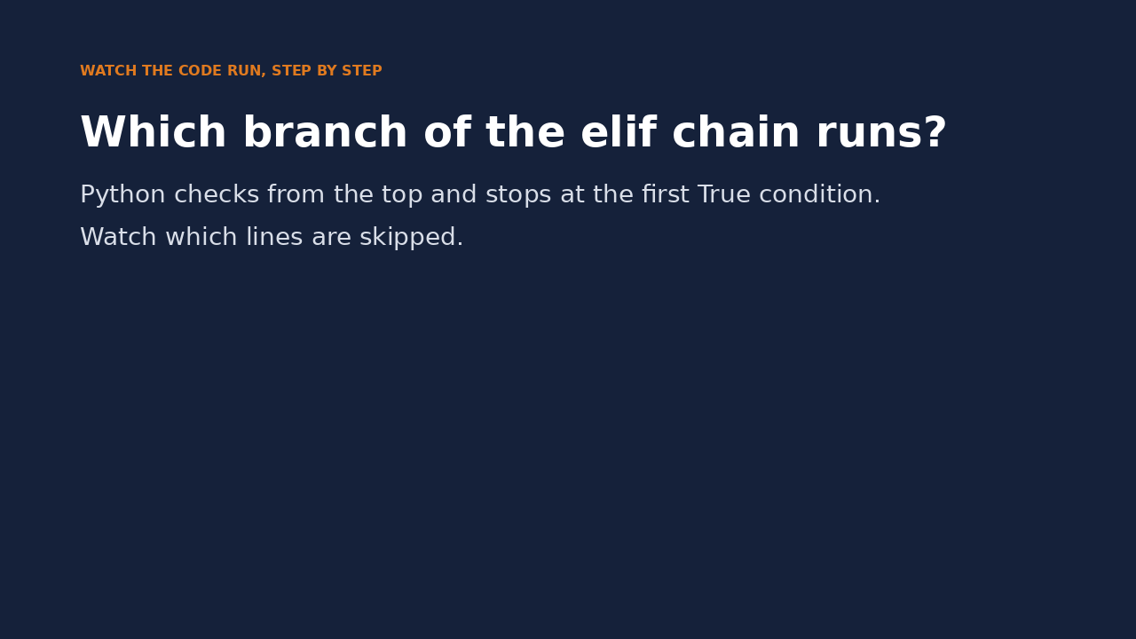
Watch it run: the elif chain
WATCH FOR
score = 72 is checked against each condition
72 >= 80 is False: skip
72 >= 65 is True: print B
Everything below is skipped
Click the video to play, click again to pause. Silent: talk the class through it.
Md Mahbub E Noor
Lecture 3.1: Making decisions
University of Barishal
11 / 28
Notes:
Short video. After it, ask: what would change if score were 85? Then 40? Students should be able to say which lines would be highlighted.

Slide 12
Does the order of elif matter?
Predict first
Code
?
score = 92
if score >= 50:
print("C")
elif score >= 65:
print("B")
elif score >= 80:
print("A")
What will this print? Write your prediction as a comment before you run the cell.
Md Mahbub E Noor
Lecture 3.1: Making decisions
University of Barishal
12 / 28
Notes:
Same conditions, different order. Predict the output for 92. [Pause.]

Slide 13
Answer: Does the order of elif matter?
Code
92 >= 50 is True, so Python stops at the first branch
score = 92
if score >= 50:
print("C")
elif score >= 65:
print("B")
elif score >= 80:
print("A")
The A and B branches can never run for any score
Rule: put the strictest condition first
Output
C
Md Mahbub E Noor
Lecture 3.1: Making decisions
University of Barishal
13 / 28
Notes:
It prints C for a student who scored 92. There is no error message: this is a silent bug, and silent bugs are the dangerous ones. Always put the most specific or strictest condition first.

Slide 14
and, or, not: combining conditions
and needs both. or needs at least one. not flips True and False.
You type | Python gives | Meaning
True and True | True | both True, so True
True and False | False | one False is enough to make and False
False or True | True | one True is enough to make or True
False or False | False | nothing True, so False
not True | False | not flips the value
5 > 3 and "a" in "cat" | True | real conditions combine the same way
Md Mahbub E Noor
Lecture 3.1: Making decisions
University of Barishal
14 / 28
Notes:
This is the whole truth table you need. A trick for remembering: and is strict, it needs everyone to agree; or is generous, one yes is enough.

Slide 15
Combining conditions in an if
Both parts must be True for and
Code
age = 20
has_id = True
if age >= 18 and has_id:
print("Can enter")
else:
print("Cannot enter")
Each side of and is a full condition
Write age >= 18 and age <= 60, not age >= 18 and <= 60
Try it: set has_id to False
Output
Can enter
Md Mahbub E Noor
Lecture 3.1: Making decisions
University of Barishal
15 / 28
Notes:
A common mistake is writing half a condition after and. Python needs a full question on each side. Also note has_id is already True or False, so we do not need to write has_id == True.

Slide 16
An if inside an if (nesting)
Each level indents 4 more spaces
Code
marks = 72
attendance = 60
if marks >= 50:
if attendance >= 75:
print("Pass")
else:
print("Pass marks, low attendance")
else:
print("Fail")
The inner question is asked only if the outer one is True
Use nesting when the second question only makes sense after the first
Otherwise and keeps the code flatter
Output
Pass marks, low attendance
Md Mahbub E Noor
Lecture 3.1: Making decisions
University of Barishal
16 / 28
Notes:
Nested ifs are just ifs inside ifs. The indentation tells you which else belongs to which if: each else lines up with its own if. Ask: what prints if marks is 40? [Fail: the inner if is never reached.]

Slide 17
Decisions about text: the first spam rule
in checks whether text appears inside other text
Code
message = "Claim your FREE prize"
text = message.lower()
if "free" in text or "prize" in text:
print("Suspicious")
else:
print("Looks normal")
.lower() first, so FREE and free both match
or: any one suspicious word is enough
Lecture 3.3 turns this into a filter for a whole inbox
Output
Suspicious
Md Mahbub E Noor
Lecture 3.1: Making decisions
University of Barishal
17 / 28
Notes:
Here is our spam-detection thread again. One message, one decision. In part 3 we will run the same decision over every message in an inbox using a loop.

Slide 18
match-case: one value, many fixed options
match compares one value with several patterns
Code
number = "01711111111"
match number[:3]:
case "017" | "013":
print("Grameenphone")
case "019" | "014":
print("Banglalink")
case "018":
print("Robi")
case _:
print("Unknown operator")
| means or inside a case
case _: catches everything else, like else
number[:3] = first 3 characters (Lecture 3.2)
Needs Python 3.10+; Colab has it
Output
Grameenphone
Md Mahbub E Noor
Lecture 3.1: Making decisions
University of Barishal
18 / 28
Notes:
When you compare one value against many exact options, match-case is tidier than a long elif chain. Each case is tried from the top; the underscore case catches anything else. You could write the same with if and elif, and it would be just as correct. Note: match cannot check ranges like score >= 80 in this simple form; for ranges, use if and elif.

Slide 19
Common mistakes with decisions
Read the last line of an error first. It names the problem.
What you typed | What Python says | What it means
if marks >= 50 print("ok") | SyntaxError: expected ':' | Missing colon at the end of the if line.
if marks = 50: print("ok") | SyntaxError: invalid syntax. Maybe you meant '==' or ':=' instead of '='? | One = stores. To compare, use ==.
if marks >= 50: print("ok") | IndentationError: expected an indented block after 'if' statement on line 1 | The block must be indented under the if.
if "5" > 3: print("ok") | TypeError: '>' not supported between instances of 'str' and 'int' | Text and numbers cannot be compared. Convert with int("5").
Md Mahbub E Noor
Lecture 3.1: Making decisions
University of Barishal
19 / 28
Notes:
Four errors you will meet this week. Notice that Python's message for the second one even suggests the fix: maybe you meant ==. Read the last line of the error first.

Slide 20
In-class exercises
Work in pairs. 15 minutes. n % 2 is the remainder after dividing n by 2.
1
Even or odd
2
Largest of three
Given n, print Even or Odd. Test: 7 gives Odd, 10 gives Even.
Given a, b, c, print the largest using if/elif/else, without max(). Test: 4, 9, 2 gives 9.
3
Leap year
4
Operator check
Leap if divisible by 4 and not by 100, or divisible by 400. Test: 2024 Leap, 1900 Not leap, 2000 Leap.
Extend the match example with Teletalk (015) and Airtel (016). Print INV if the number is not exactly 11 characters.
Md Mahbub E Noor
Lecture 3.1: Making decisions
University of Barishal
20 / 28
Notes:
Fifteen minutes in pairs. Walk around. For the largest-of-three task, watch for students writing a >= b only and forgetting c. For leap year, the brackets matter: test 1900 and 2000 specifically. Solutions follow on the next slides; show them only after the attempt.

Slide 21
Solutions
Show these after students have tried the exercises.
Md Mahbub E Noor
Lecture 3.1: Making decisions
University of Barishal
21 / 28
Notes:
Solutions. Ask one pair to present their answer first, then compare with these.

Slide 22
Solutions 1 and 2
Test every branch: try values that should give each possible answer.
Code
Output
n = 7
if n % 2 == 0:
print("Even")
else:
print("Odd")
a = 4
b = 9
c = 2
if a >= b and a >= c:
print(a)
elif b >= c:
print(b)
else:
print(c)
Odd
9
Md Mahbub E Noor
Lecture 3.1: Making decisions
University of Barishal
22 / 28
Notes:
Why does the elif only compare b and c? Because if we reach it, we already know a is not the largest. That reasoning, what do I already know at this point, is how you design elif chains.

Slide 23
Solution 3: leap year
The brackets group the first two conditions. Test the tricky years: 1900 and 2000.
Code
year = 1900
if (year % 4 == 0 and year % 100 != 0) or year % 400 == 0:
print("Leap")
else:
print("Not leap")
Output
Not leap
Md Mahbub E Noor
Lecture 3.1: Making decisions
University of Barishal
23 / 28
Notes:
1900 is divisible by 4 but also by 100, and not by 400, so it is not a leap year. 2000 is divisible by 400, so it is. Have students change the year to 2000 and 2024 and re-run.

Slide 24
Solution 4: operator check
The else matters: without it, a wrong-length number would print INV and then also an operator name.
Code
Output
number = "0151234567"
if len(number) != 11:
print("INV")
else:
match number[:3]:
case "017" | "013":
print("Grameenphone")
case "019" | "014":
print("Banglalink")
case "015":
print("Teletalk")
case "016":
print("Airtel")
case "018":
print("Robi")
case _:
print("INV")
INV
Md Mahbub E Noor
Lecture 3.1: Making decisions
University of Barishal
24 / 28
Notes:
The test number has only 10 digits, so it prints INV. Point out the design: we check the length first and only look at the prefix when the length is valid. A version without else would print two answers for a wrong-length number that starts with a valid prefix. A stricter version would also check that every character is a digit; we will meet the tools for that later.

Slide 25
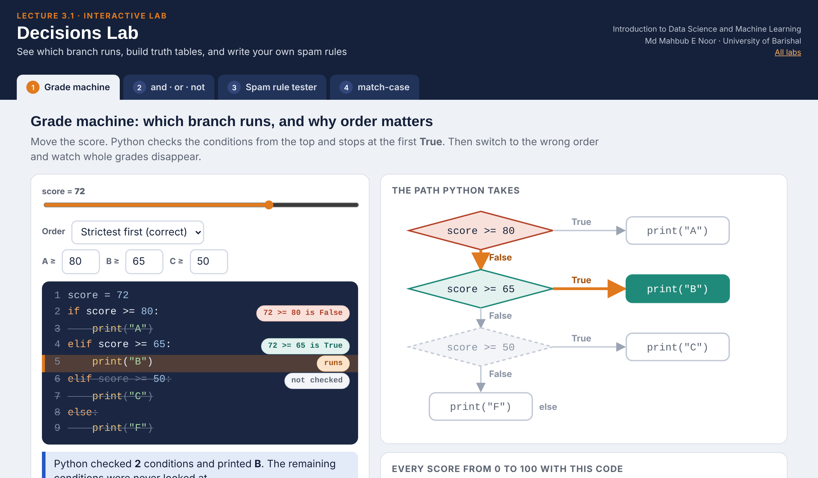
Interactive lab: Decisions Lab
In the lab you can
1 Grade machine
Move the score, follow the path, then break it with the wrong elif order.
2 and · or · not
Flip p and q, build truth tables, and test the entry rule.
3 Spam rule tester
Pick words, test the rule on 12 messages, count misses and false alarms.
4 match-case
Type a phone number and watch which case matches.
Open the lab ►
Works offline in any browser
Labs_open_in_browser/
L3.1_Decisions_Lab.html
Md Mahbub E Noor
Lecture 3.1: Making decisions
University of Barishal
25 / 28
Notes:
Open the Decisions Lab (double-click; works offline). Grade machine: drag the score to 65 and 64, then switch to 'Loosest first' and point at the colour strip: A and B vanish. Spam rule tester: start with free and prize, add words one by one and ask what happens to false alarms. This previews Lecture 6, where the model learns the rule from data instead of us choosing words.

Slide 26
Today's toolkit
== != > < >= <= | Compare, gives True/False
if condition: | Run the block only if True
else: | Run when nothing above was True
elif condition: | Another check, only if earlier failed
and / or / not | Combine or flip conditions
"x" in text | Does text contain x?
match value: | Compare one value with many options
case "a" | "b": | Matches a or b
case _: | Anything else
Md Mahbub E Noor
Lecture 3.1: Making decisions
University of Barishal
26 / 28
Notes:
Today's toolkit on one slide. Next part: lists and tuples, so we can store a whole inbox instead of one message.

Slide 27
Homework 3.1
Due before Lecture 3.2 · [date]
1
Predict, then run
2
Weather advice
3
Ticket price
Write predictions as comments first: print(10 != 10), print(not (3 > 5)), print("a" in "Data" and 2 < 1).
Store a temperature. Print Cold (below 15), Pleasant (15 to 27) or Hot (above 27). Test 14, 15, 27, 28.
Price is 50 for age under 12 or students, 100 otherwise. Store age and is_student and print the price.
4
Spam level
5
Find the bug
Store a message. Print High if it contains both "win" and "cash", Medium if either, otherwise Low. Ignore capitals.
The "Does the order matter" slide prints C for 92. Fix the code and explain the bug in one sentence.
Submit on [LMS / Google Classroom]: your notebook file HW3_1_<your ID>.ipynb, or a Colab link set to “Anyone with the link can view”.
Md Mahbub E Noor
Lecture 3.1: Making decisions
University of Barishal
27 / 28
Notes:
Homework 3.1. Key for task 1: False; True; False ('a' is in 'Data', but 2 < 1 is False). Task 2 is about boundaries: 15 and 27 must print Pleasant, so the conditions are temp < 15, then temp <= 27. Task 3: if age < 12 or is_student: 50, else 100. Task 5: reorder to >= 80, >= 65, >= 50.

Slide 28

Recap: Lecture 3.1 in 90 seconds
Click to play or pause. Watch it again at home to revise.
Md Mahbub E Noor
Lecture 3.1: Making decisions
University of Barishal
28 / 28
Notes:
Play this at the end of class, or leave it for students to revise at home. It is silent: pause on each card and ask the class for an example.

