Slide 1
LECTURE 3.2
Lists and tuples
Today's key line of code
inbox = ["Hi", "Win cash", "Class at 10"]
print(inbox[1])
Storing many values: a whole inbox in one variable
Introduction to Data Science · Md Mahbub E Noor · University of Barishal
Notes:
Lecture 3, part 2. Last time Python learned to decide about one message. But an inbox has thousands. Today we learn how to store many values in one variable: lists, and their read-only cousin, tuples. New notebook: Lecture3_2.

Slide 2
Where we are: Lecture 3, part 2 of 3
Part 2 of 3
L2
L3
L4
L5
L6
Python basics
Decisions and loops
Counting words
Real data
Build the model
Today you will
1
Create lists and read items by position
2
Slice out parts of a list
3
Add, change and remove items
4
Use tuples for fixed records, and unpack them
5
Avoid the two-names-one-list trap
Md Mahbub E Noor
Lecture 3.2: Lists and tuples
University of Barishal
2 / 29
Notes:
Lists are everywhere in data science. The pandas tables we use in Lecture 5 are, underneath, columns of values much like lists. Everything today transfers directly.

Slide 3
Why lists?
One variable per message does not scale to 5,000 messages
Code
msg1 = "Win a free phone"
msg2 = "Class moved to 305"
msg3 = "Claim your prize"
inbox = [msg1, msg2, msg3]
print(inbox)
print(len(inbox))
A list keeps many values, in order, under one name
len() counts the items
Lists are written with square brackets
Output
['Win a free phone', 'Class moved to 305', 'Claim your prize']
3
Md Mahbub E Noor
Lecture 3.2: Lists and tuples
University of Barishal
3 / 29
Notes:
Imagine the SMS dataset from Lecture 5 with a separate variable for each of 5,572 messages. Impossible. A list is one name for many values, kept in order.

Slide 4
Anatomy of a list
Code
scores = [72, 85, 90]
print(scores)
The name of the list
[ opens the list
Items: any values, here numbers
Output
Commas separate the items
[72, 85, 90]
] closes the list
Md Mahbub E Noor
Lecture 3.2: Lists and tuples
University of Barishal
4 / 29
Notes:
Name, equals, square bracket, items separated by commas, closing bracket. Items can be numbers, text, True/False, even other lists. An empty list is just two brackets: [].

Slide 5
Positions start at 0
index from the start
0
1
2
3
"Win cash"
"Class 305"
"Claim prize"
"See you"
-4
-3
-2
-1
index from the end
Code
Output
inbox = ["Win cash", "Class 305",
"Claim prize", "See you"]
print(inbox[0])
print(inbox[2])
print(inbox[-1])
print(inbox[-2])
Win cash
Claim prize
See you
Claim prize
Md Mahbub E Noor
Lecture 3.2: Lists and tuples
University of Barishal
5 / 29
Notes:
Every item has two addresses. From the front, counting starts at 0, so the first item is inbox[0] and the last of four is inbox[3]. From the back, -1 is the last item, -2 the one before. Why start at 0? Think of it as 'how many steps from the start': the first item is zero steps away.

Slide 6
Slicing: take a part of a list
index from the start
inbox[1:3]
0
1
2
3
"Win cash"
"Class 305"
"Claim prize"
"See you"
-4
-3
-2
-1
index from the end
Code
Output
print(inbox[1:3])
print(inbox[:2])
print(inbox[2:])
['Class 305', 'Claim prize']
['Win cash', 'Class 305']
['Claim prize', 'See you']
Md Mahbub E Noor
Lecture 3.2: Lists and tuples
University of Barishal
6 / 29
Notes:
inbox[1:3] means: start at position 1, stop BEFORE position 3. So we get items 1 and 2, highlighted. Leave out the start and Python starts at the beginning; leave out the end and it goes to the end. The stop-before rule feels odd at first, but it has a nice property: inbox[:2] plus inbox[2:] gives the whole list back, with nothing lost or repeated.

Slide 7
Predict the slices
Predict first
Code
?
nums = [10, 20, 30, 40, 50]
print(nums[1:4])
print(nums[-3:])
print(len(nums[2:]))
What will this print? Write your prediction as a comment before you run the cell.
Md Mahbub E Noor
Lecture 3.2: Lists and tuples
University of Barishal
7 / 29
Notes:
Write down all three lines before the reveal.

Slide 8
Answer: Predict the slices
Code
[1:4] takes positions 1, 2, 3: stop before 4
nums = [10, 20, 30, 40, 50]
print(nums[1:4])
print(nums[-3:])
print(len(nums[2:]))
[-3:] means the last three items
A slice is itself a list, so len() works on it
Output
[20, 30, 40]
[30, 40, 50]
3
Md Mahbub E Noor
Lecture 3.2: Lists and tuples
University of Barishal
8 / 29
Notes:
20, 30, 40; then 30, 40, 50; then 3. If someone wrote 20 to 50 for the first, remind them: stop BEFORE the end position.

Slide 9
Changing a list
append(x) adds to the end
Code
tasks = ["read", "code"]
tasks.append("sleep")
tasks.insert(0, "eat")
tasks[1] = "study"
tasks.remove("code")
last = tasks.pop()
print(tasks)
print(last)
insert(i, x) adds at position i
list[i] = x replaces an item
remove(x) deletes the first x
pop() removes and returns the last item
Output
['eat', 'study']
sleep
Md Mahbub E Noor
Lecture 3.2: Lists and tuples
University of Barishal
9 / 29
Notes:
Lists can change after they are created; we say they are mutable. These five operations cover almost everything you will need. The next slide traces each step so you can see the list evolve.

Slide 10
Watching the list change, step by step
Each row runs one line. Follow how the list looks after it.
Code
step
operation
tasks after this line
tasks = ["read", "code"]
tasks.append("sleep")
tasks.insert(0, "eat")
tasks[1] = "study"
tasks.remove("code")
last = tasks.pop()
1
create
['read', 'code']
2
append
['read', 'code', 'sleep']
3
insert
['eat', 'read', 'code', 'sleep']
4
replace [1]
['eat', 'study', 'code', 'sleep']
5
remove
['eat', 'study', 'sleep']
6
pop -> 'sleep'
['eat', 'study']
Click to reveal the next row. Predict it first!
Md Mahbub E Noor
Lecture 3.2: Lists and tuples
University of Barishal
10 / 29
Notes:
Trace tables are the best debugging tool for beginners. Step 4 is where people slip: after insert, position 1 holds 'read', so tasks[1] = 'study' replaces 'read', not 'code'. Ask the class to predict each row before revealing the table.

Slide 11
Asking questions about a list
len, max, min, sum work on whole lists
Code
nums = [5, 3, 8, 3, 1]
print(len(nums), max(nums), min(nums), sum(nums))
print(8 in nums)
print(nums.count(3))
print(nums.index(8))
print(sorted(nums))
print(nums)
x in list checks membership
count(x) and index(x) find items
sorted(list) gives a new sorted list; the original stays
Output
5 8 1 20
True
2
2
[1, 3, 3, 5, 8]
[5, 3, 8, 3, 1]
Md Mahbub E Noor
Lecture 3.2: Lists and tuples
University of Barishal
11 / 29
Notes:
These answer the everyday questions: how many, biggest, smallest, total, is it there, how often, where. Notice the last line: sorted gave us a sorted copy, and nums is unchanged.

Slide 12
sort() versus sorted()
Predict first
Code
?
nums = [5, 3, 8]
result = nums.sort()
print(nums)
print(result)
What will this print? Write your prediction as a comment before you run the cell.
Md Mahbub E Noor
Lecture 3.2: Lists and tuples
University of Barishal
12 / 29
Notes:
A classic trap. Predict both lines.

Slide 13
Answer: sort() versus sorted()
Code
.sort() sorts the list itself, in place
nums = [5, 3, 8]
result = nums.sort()
print(nums)
print(result)
It returns nothing, which Python shows as None
sorted(nums) returns a new sorted list instead
Output
[3, 5, 8]
None
Never write nums = nums.sort(): you lose the list
Md Mahbub E Noor
Lecture 3.2: Lists and tuples
University of Barishal
13 / 29
Notes:
The list is sorted, [3, 5, 8], but result is None. .sort() changes the list and hands back nothing. We will see why in Lecture 4.1 when we talk about return values.

Slide 14
Strings behave like lists, almost
Strings have positions and slices too
Code
word = "PYTHON"
print(word[0], word[-1])
print(word[1:4])
print(len(word))
len() counts characters
But strings cannot be changed in place
Output
P N
YTH
6
word[0] = "J" gives an error (see the mistakes slide)
Md Mahbub E Noor
Lecture 3.2: Lists and tuples
University of Barishal
14 / 29
Notes:
Everything you learned about positions and slicing works on text. That is how number[:3] worked in the match-case example last lecture: the first three characters. The difference: strings are immutable, you cannot change one character in place.

Slide 15
Anatomy of a tuple
Code
student = ("Nadia", 21, "CSE")
print(student[0])
print(len(student))
Round brackets make a tuple
Items, read with positions like a list
Commas separate items
Indexing works the same as lists
Output
Nadia
3
Md Mahbub E Noor
Lecture 3.2: Lists and tuples
University of Barishal
15 / 29
Notes:
A tuple looks like a list with round brackets. You read it exactly like a list. The difference is on the next slide: it cannot be changed.

Slide 16
Tuples cannot be changed
Reading works; changing gives a TypeError
Code
student = ("Nadia", 21, "CSE")
print(student[1])
student[1] = 22
Use tuples for fixed records: a student, a date, a coordinate
Fixed means safe: no code can change it by accident
Output
21
TypeError: 'tuple' object does not support item assignment
Functions use tuples to return several values (Lecture 4.1)
Md Mahbub E Noor
Lecture 3.2: Lists and tuples
University of Barishal
16 / 29
Notes:
Here the error is the lesson. Tuples are immutable. That is a feature: when data should not change, a tuple protects it.

Slide 17
Unpacking: one tuple, several names
name, age, dept = student gives each item a name
Code
name, age, dept = student
print(name)
print(age)
a, b = 1, 2
a, b = b, a
print(a, b)
The number of names must match the number of items
a, b = b, a swaps two values in one line
You will use this constantly with functions
Output
Nadia
21
2 1
Md Mahbub E Noor
Lecture 3.2: Lists and tuples
University of Barishal
17 / 29
Notes:
Unpacking is a very Pythonic feature. The swap line is a favourite exam question: in most languages swapping needs a temporary variable; in Python one line does it.

Slide 18
List or tuple?
List [ ]
Tuple ( )
Square brackets
Round brackets
Can change: append, remove, replace
Fixed once created
For collections that grow: messages, scores
For records: a student, a coordinate
Example: several values returned by a function
Example: an inbox
Md Mahbub E Noor
Lecture 3.2: Lists and tuples
University of Barishal
18 / 29
Notes:
The simple rule: if the data will grow or change, use a list. If it describes one fixed thing, use a tuple.

Slide 19
Careful: two names, one list
b = a does not copy the list
Code
a = [1, 2, 3]
b = a
b.append(4)
print(a)
c = a.copy()
c.append(5)
print(a)
print(c)
Both names point to the same list
Change it through b, and a sees the change
Use a.copy() for a real copy
Output
[1, 2, 3, 4]
[1, 2, 3, 4]
[1, 2, 3, 4, 5]
Md Mahbub E Noor
Lecture 3.2: Lists and tuples
University of Barishal
19 / 29
Notes:
This surprises everyone. b = a does not create a second list; it gives the same list a second name. So appending through b changes what a shows. With copy, c is a separate list. Remember this picture: names point to objects. It is exactly what explains how functions receive lists in Lecture 4.1.

Slide 20
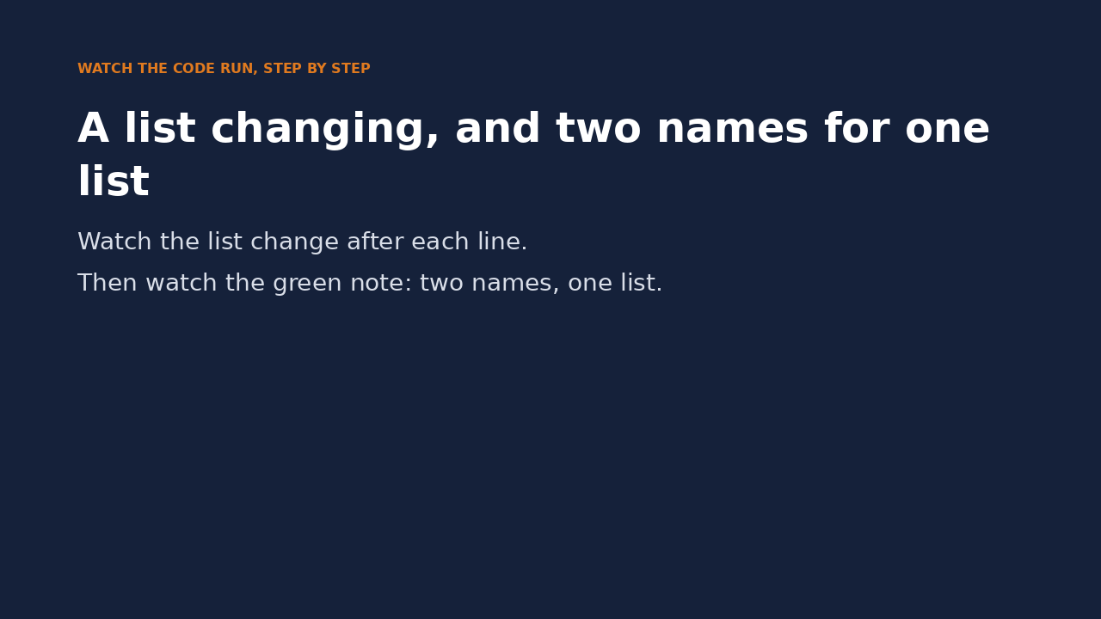
Watch it run: changing a list, and two names
WATCH FOR
append, replace and pop change the list
pop hands the removed item back
b = tasks: the note says 'same object'
b.append changes what tasks shows too
Click the video to play, click again to pause. Silent: talk the class through it.
Md Mahbub E Noor
Lecture 3.2: Lists and tuples
University of Barishal
20 / 29
Notes:
Pause at b = tasks and ask: will tasks change if we append through b? This prepares the function lecture, where a parameter is exactly such a second name.

Slide 21
Common mistakes with lists and tuples
Read the last line of an error first. It names the problem.
What you typed | What Python says | What it means
print(inbox[10]) | IndexError: list index out of range | No position 10. Valid positions: 0 to len(inbox) - 1.
student[1] = 22 | TypeError: 'tuple' object does not support item assignment | Tuples cannot be changed. Use a list, or build a new tuple.
nums.remove(99) | ValueError: list.remove(x): x not in list | 99 is not in the list. Check with 99 in nums first.
word[0] = "J" | TypeError: 'str' object does not support item assignment | Strings cannot be changed. Build a new one: "J" + word[1:].
Md Mahbub E Noor
Lecture 3.2: Lists and tuples
University of Barishal
21 / 29
Notes:
IndexError, TypeError twice, ValueError. Each message tells you exactly what went wrong if you read the last line.

Slide 22
In-class exercises
Work in pairs. 15 minutes. No loops yet: use indexing, slicing and list functions.
1
Second largest
2
Ends of the inbox
Use sorted() to print the second largest of [4, 9, 2, 7]. Expected: 7. Bonus: what goes wrong with [4, 9, 9, 2]?
Print the first two and the last two messages of a 6-message list, using slices.
3
Swap ends
4
Student record
Swap the first and last items of a list. Test: [1, 2, 3, 4] becomes [4, 2, 3, 1].
Store (name, roll, cgpa) as a tuple, unpack it, and print one f-string sentence.
Md Mahbub E Noor
Lecture 3.2: Lists and tuples
University of Barishal
22 / 29
Notes:
The bonus in task 1 is the interesting part: with a repeated maximum, sorted(nums)[-2] gives 9 again, not 7. That motivates a loop-based solution in Lecture 3.3.

Slide 23
Solutions
Show these after students have tried the exercises.
Md Mahbub E Noor
Lecture 3.2: Lists and tuples
University of Barishal
23 / 29
Notes:
Solutions.

Slide 24
Solutions 1 and 2
The bonus shows a real limitation: with a repeated maximum, [-2] returns the maximum again.
Code
Output
nums = [4, 9, 2, 7]
print(sorted(nums)[-2])
print(sorted([4, 9, 9, 2])[-2])
inbox = ["m1", "m2", "m3", "m4", "m5", "m6"]
print(inbox[:2])
print(inbox[-2:])
7
9
['m1', 'm2']
['m5', 'm6']
Md Mahbub E Noor
Lecture 3.2: Lists and tuples
University of Barishal
24 / 29
Notes:
sorted(nums)[-2] reads as: sort, then take the second from the end. With duplicates it breaks. Ask: how would you fix it? We will do it properly with a loop in 3.3.

Slide 25
Solutions 3 and 4
Swapping uses tuple unpacking. Unpacking gives each field of a record its own name.
Code
items = [1, 2, 3, 4]
items[0], items[-1] = items[-1], items[0]
print(items)
record = ("Nadia", 1042, 3.71)
name, roll, cgpa = record
print(f"{name} (roll {roll}) has CGPA {cgpa}")
Output
[4, 2, 3, 1]
Nadia (roll 1042) has CGPA 3.71
Md Mahbub E Noor
Lecture 3.2: Lists and tuples
University of Barishal
25 / 29
Notes:
The swap uses the same one-line trick as a, b = b, a, with list positions instead of names.

Slide 26
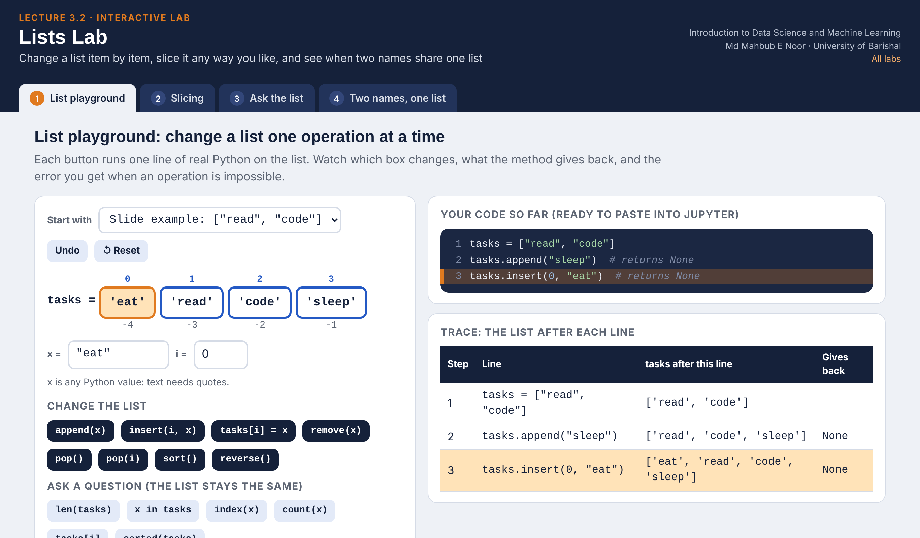
Interactive lab: Lists Lab
In the lab you can
1 List playground
Append, insert, remove and pop: see each box change.
2 Slicing
Drag start, stop and step and watch which items are taken.
3 Ask the list
Edit marks: len, max, sum, sorted and a live chart.
4 Two names, one list
Arrows show when b = a shares one list.
Open the lab ►
Works offline in any browser
Labs_open_in_browser/
L3.2_Lists_Lab.html
Md Mahbub E Noor
Lecture 3.2: Lists and tuples
University of Barishal
26 / 29
Notes:
Open the Lists Lab (double-click; works offline). Playground: rebuild the slide-10 example live (append sleep, insert eat at 0, replace position 1, remove code, pop) and ask the class to predict each box before you click. Slicing: use the presets [1:3], [-3:] and [::-1]. Finish with Two names, one list: ask what print(a) shows on line 4 before running it.

Slide 27
Today's toolkit
[a, b, c] | Make a list
x[0], x[-1] | First item, last item
x[1:3] | Items 1 and 2 (stop before 3)
append / insert | Add items
remove / pop | Delete items
sorted(x) / x.sort() | New sorted list / sort in place
(a, b, c) | Make a tuple (fixed)
n, a, d = t | Unpack a tuple
x.copy() | A real, separate copy
Md Mahbub E Noor
Lecture 3.2: Lists and tuples
University of Barishal
27 / 29
Notes:
Next part: loops. With loops, everything we can do to one item, we can do to every item in a list.

Slide 28
Homework 3.2
Due before Lecture 3.3 · [date]
1
Predict, then run
2
Grade book
3
Inbox editor
Predict first: x = [3, 1, 2]; print(x[::-1]); print(x[5:]); print(sorted(x) == x).
Make a list of 5 marks. Print the highest, lowest, average (sum / len) and the marks sorted.
Start with 3 messages. Add 2, replace the second, remove one by value, and print the list after each step.
4
Trace it
5
Explain
Draw a trace table (step, list after) for the Inbox editor code by hand, then check it by printing.
In 2 sentences: why does b = a followed by b.append(4) change a?
Submit on [LMS / Google Classroom]: your notebook file HW3_2_<your ID>.ipynb, or a Colab link set to “Anyone with the link can view”.
Md Mahbub E Noor
Lecture 3.2: Lists and tuples
University of Barishal
28 / 29
Notes:
Homework 3.2. Task 1 key: [2, 1, 3] (step -1 reverses; not taught, so it is a discovery question); [] (slicing past the end gives an empty list, no error); False (sorted(x) is [1, 2, 3], x is [3, 1, 2]). Task 5: both names point to the same list object.

Slide 29

Recap: Lecture 3.2 in 90 seconds
Click to play or pause. Watch it again at home to revise.
Md Mahbub E Noor
Lecture 3.2: Lists and tuples
University of Barishal
29 / 29
Notes:
Play this at the end of class, or leave it for students to revise at home. It is silent: pause on each card and ask the class for an example.

