Slide 1
LECTURE 3.3
Loops
Today's key line of code
for msg in inbox:
if "free" in msg.lower():
print("SPAM?", msg)
for, while, range, break: judging a whole inbox
Introduction to Data Science · Md Mahbub E Noor · University of Barishal
Notes:
Lecture 3, part 3, the last part of Lecture 3. Decisions from part 1, lists from part 2, and today loops, which let us apply a decision to every item in a list. By the end we rebuild the rule-based spam filter from the Lecture 1 demo. New notebook: Lecture3_3.

Slide 2
Where we are: Lecture 3, part 3 of 3
Part 3 of 3
L2
L3
L4
L5
L6
Python basics
Decisions and loops
Counting words
Real data
Build the model
Today you will
1
Read every part of a for loop and trace it by hand
2
Count with range()
3
Add up and count with the accumulator pattern
4
Repeat until a condition changes, with while
5
Stop early with break, skip with continue, and nest loops to build a spam filter
Md Mahbub E Noor
Lecture 3.3: Loops
University of Barishal
2 / 35
Notes:
Loops are where programming starts to feel powerful. After today, the size of the data stops mattering: four messages or four million, the code is the same.

Slide 3
Why loops?
Writing print five times does not scale
Code
for i in range(1, 6):
print(f"Message {i} checked")
A loop repeats the indented block for you
Output
Message 1 checked
Message 2 checked
Message 3 checked
Message 4 checked
Message 5 checked
Same two lines for 5 items or 5 million
The loop variable i changes each round
Md Mahbub E Noor
Lecture 3.3: Loops
University of Barishal
3 / 35
Notes:
Without a loop we would write five print lines, or 5,572 for our dataset. The loop writes them for us.

Slide 4
Anatomy of a for loop
Code
inbox = ["Hi", "Win cash", "Bye"]
for msg in inbox:
print(msg)
Keyword for starts the loop
Loop variable: holds the current item, a new one each round
Output
The collection to walk through
Hi
Win cash
Bye
Colon, as with if
Body: runs once for every item
Md Mahbub E Noor
Lecture 3.3: Loops
University of Barishal
4 / 35
Notes:
Read it as English: for each msg in inbox, print msg. The loop variable name is your choice; msg is a good name because it describes what it holds. The body is indented, exactly like an if block.

Slide 5
Tracing a for loop, round by round
Each round, msg takes the next item. The body runs once per round.
Code
round
msg
len(msg)
prints
inbox = ["Hi", "Win cash", "Bye"]
for msg in inbox:
print(len(msg), msg)
1
'Hi'
2
2 Hi
2
'Win cash'
8
8 Win cash
3
'Bye'
3
3 Bye
Output
Click to reveal the next row. Predict it first!
2 Hi
8 Win cash
3 Bye
Md Mahbub E Noor
Lecture 3.3: Loops
University of Barishal
5 / 35
Notes:
Three items, three rounds. After the third round there is nothing left, so the loop ends and Python continues below it. Tracing by hand like this is slow, and that is the point: it builds the mental model you need to debug loops.

Slide 6
range(): a sequence of numbers
list() is only here so we can see the numbers. In a for loop you write range(...) directly.
You type | Python gives | Meaning
list(range(5)) | [0, 1, 2, 3, 4] | 0 up to 5, stop not included
list(range(1, 6)) | [1, 2, 3, 4, 5] | start at 1, stop before 6
list(range(0, 11, 2)) | [0, 2, 4, 6, 8, 10] | third number = step
list(range(5, 0, -1)) | [5, 4, 3, 2, 1] | negative step counts down
len(range(1, 10)) | 9 | how many numbers: 9
Md Mahbub E Noor
Lecture 3.3: Loops
University of Barishal
6 / 35
Notes:
range follows the same stop-before rule as slicing. range(1, 6) gives 1 to 5. This is the source of the classic off-by-one bug: to include N, write range(1, N + 1).

Slide 7
Predict the range
Predict first
Code
?
for i in range(2, 11, 3):
print(i)
What will this print? Write your prediction as a comment before you run the cell.
Md Mahbub E Noor
Lecture 3.3: Loops
University of Barishal
7 / 35
Notes:
Predict every number printed.

Slide 8
Answer: Predict the range
Code
Start at 2, add 3 each time
for i in range(2, 11, 3):
print(i)
2, 5, 8 are below 11
The next value, 11, is not included
Output
2
5
8
Md Mahbub E Noor
Lecture 3.3: Loops
University of Barishal
8 / 35
Notes:
2, 5, 8. The next would be 11, but stop is not included.

Slide 9
The accumulator: adding up as you go
Start with 0 before the loop, then add each item inside the loop.
Code
round
n
total before
total after
nums = [4, 7, 1, 8]
total = 0
for n in nums:
total = total + n
print(total)
1
4
0
4
2
7
4
11
3
1
11
12
4
8
12
20
Output
Click to reveal the next row. Predict it first!
20
Md Mahbub E Noor
Lecture 3.3: Loops
University of Barishal
9 / 35
Notes:
This is the accumulator pattern and it is everywhere: totals, counts, building lists. The key detail: total = 0 goes BEFORE the loop. Put it inside and it resets every round; students do this a lot. Ask: what prints if total = 0 is moved inside the loop? [8, the last number only.]

Slide 10
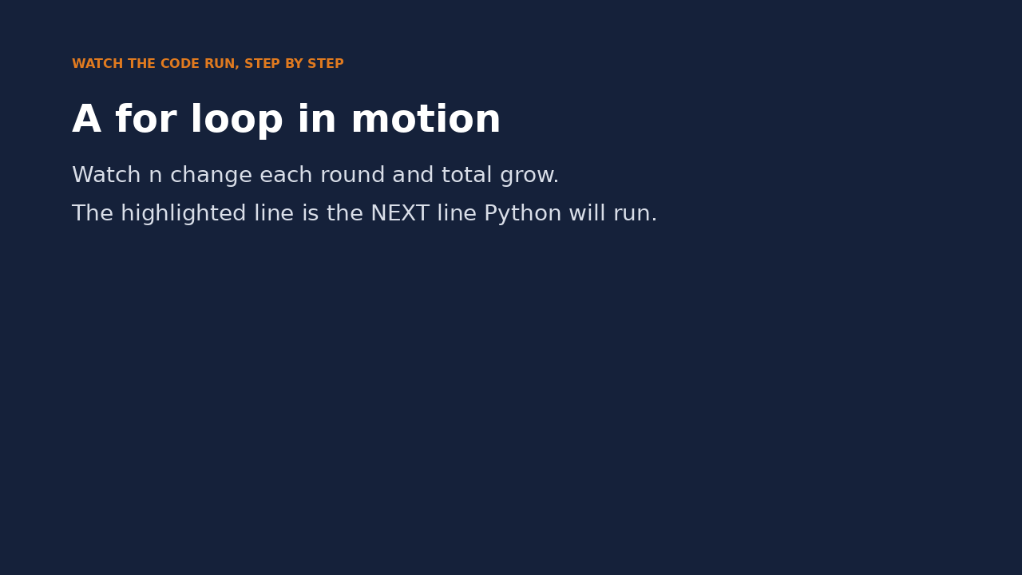
Watch it run: a for loop
WATCH FOR
The highlighted line is the next one Python runs
n takes a new value each round
total grows by n each round
total = 0 runs only once, before the loop
Click the video to play, click again to pause. Silent: talk the class through it.
Md Mahbub E Noor
Lecture 3.3: Loops
University of Barishal
10 / 35
Notes:
Play the video and narrate. Pause on round 2 and ask: what will total be after this line? Students who can predict the next value understand the loop. The memory panel on the right is the same information as our trace table, but moving.

Slide 11
Counting: an if inside a loop
The count goes up only in rounds where the condition is True.
Code
i
i % 2
even?
count
count = 0
for i in range(1, 8):
if i % 2 == 0:
count = count + 1
print(count)
1
1
False
0
2
0
True
1
3
1
False
1
4
0
True
2
Output
5
1
False
2
3
6
0
True
3
7
1
False
3
Click to reveal the next row. Predict it first!
Md Mahbub E Noor
Lecture 3.3: Loops
University of Barishal
11 / 35
Notes:
Loops and decisions combined. For each i, check if it is even; if so, add one. The count column only moves in True rows. This is exactly how we will count spam messages.

Slide 12
Anatomy of a while loop
Code
n = 3
while n > 0:
print(n)
n = n - 1
print("Go!")
Keyword while: repeat as long as the condition is True
Condition, checked before every round
Body: runs while the condition is True
Update: moves towards the end. Without it, the loop never stops
Output
3
2
1
Go!
After the loop, when the condition becomes False
Md Mahbub E Noor
Lecture 3.3: Loops
University of Barishal
12 / 35
Notes:
A while loop is an if that repeats. It checks the condition, runs the body, checks again, and so on. The update line is essential: it changes n so that the condition eventually becomes False.

Slide 13
Tracing the while loop
The condition is checked before each round. The loop ends the first time it is False.
Code
n
n > 0
what happens
n = 3
while n > 0:
print(n)
n = n - 1
print("Go!")
3
True
print 3, then n = 2
2
True
print 2, then n = 1
1
True
print 1, then n = 0
0
False
leave loop, print Go!
Output
Click to reveal the next row. Predict it first!
3
2
1
Go!
Md Mahbub E Noor
Lecture 3.3: Loops
University of Barishal
13 / 35
Notes:
Four checks for three rounds: the last check is the one that is False and ends the loop.

Slide 14
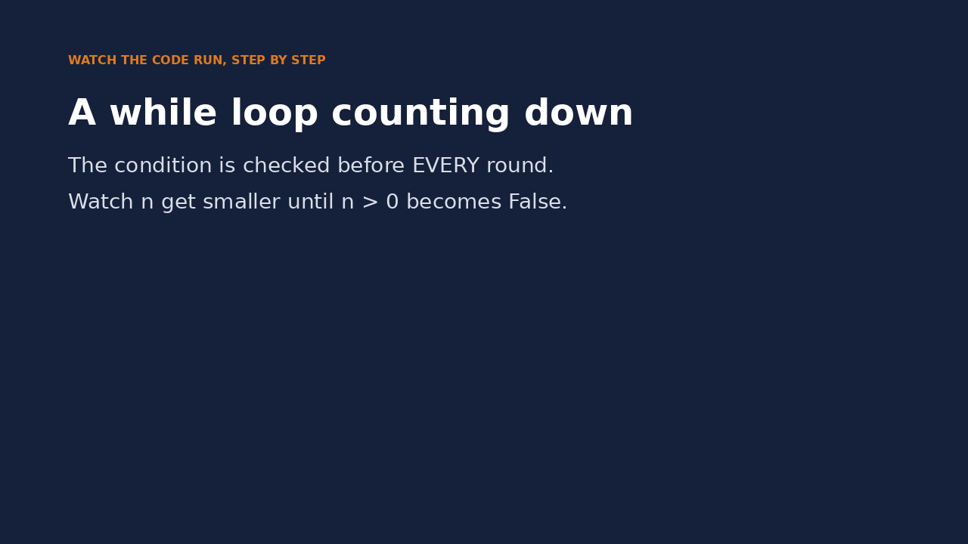
Watch it run: a while loop
WATCH FOR
The condition is checked before every round
n goes 3, 2, 1, 0
When n > 0 is False, Python jumps past the loop
Without n = n - 1 it would never end
Click the video to play, click again to pause. Silent: talk the class through it.
Md Mahbub E Noor
Lecture 3.3: Loops
University of Barishal
14 / 35
Notes:
Pause just before the last check and ask: will the loop run again? The key moment is the final check, where the condition is False and Python skips to the line after the loop.

Slide 15
for or while?
for
while
You know what to walk through
Repeat until something changes
Each item of a list, or a range of numbers
You do not know how many rounds
You must update the condition yourself
Ends by itself
Example: check every message
Example: ask again until the password is right
Md Mahbub E Noor
Lecture 3.3: Loops
University of Barishal
15 / 35
Notes:
Default to for. It is safer because it cannot run forever. Use while when the number of rounds depends on something that happens inside the loop.

Slide 16
Infinite loops, and how to stop one
Without n = n - 1, n stays 3 and n > 0 is always True. In Colab, click the stop square next to the cell, or Runtime > Interrupt execution.
Code
n = 3
while n > 0:
print(n)
# forgot: n = n - 1 -> prints 3 forever
Md Mahbub E Noor
Lecture 3.3: Loops
University of Barishal
16 / 35
Notes:
Do not run this one in class unless you want to demonstrate stopping it. Everyone writes an infinite loop at some point; it is not a disaster, you just stop the cell.

Slide 17
break: stop the loop early
break leaves the loop immediately
Code
inbox = ["Hi", "See you", "WIN cash", "Bye"]
for msg in inbox:
if "win" in msg.lower():
print("First spam:", msg)
break
print("OK:", msg)
Useful when you have found what you were looking for
Messages after the break are never checked
It usually sits inside an if
Output
OK: Hi
OK: See you
First spam: WIN cash
Md Mahbub E Noor
Lecture 3.3: Loops
University of Barishal
17 / 35
Notes:
The loop checks messages one by one. When it finds 'WIN cash', it prints and breaks out. 'Bye' is never checked.

Slide 18
continue: skip to the next round
continue skips the rest of this round only
Code
for msg in ["Hi", "", "Bye", ""]:
if msg == "":
continue
print("Checking:", msg)
The loop carries on with the next item
Useful for skipping empty or invalid data
Output
Checking: Hi
Checking: Bye
Real data always has some
Md Mahbub E Noor
Lecture 3.3: Loops
University of Barishal
18 / 35
Notes:
break ends the whole loop; continue ends just this round. Here empty messages are skipped. Cleaning bad data like this is daily work in data science.

Slide 19
enumerate(): position and item together
enumerate gives (position, item) pairs
Code
inbox = ["Hi", "Win cash", "Bye"]
for i, msg in enumerate(inbox):
print(i, msg)
Unpack them into two names, as with tuples
Handy for numbered reports
Output
0 Hi
1 Win cash
2 Bye
Positions start at 0, like indexing
Md Mahbub E Noor
Lecture 3.3: Loops
University of Barishal
19 / 35
Notes:
enumerate is a small convenience that uses tuple unpacking from part 2. Each round it hands over a pair: the position and the item.

Slide 20
Nested loops: a loop inside a loop
The inner loop runs completely for each round of the outer loop
Code
spam_words = ["free", "win"]
inbox = ["Win cash", "Class at 10",
"Free gift"]
for msg in inbox:
found = False
for word in spam_words:
if word in msg.lower():
found = True
print(found, msg)
Here: every message is checked against every spam word
found resets to False for each new message
3 messages x 2 words = 6 checks
Output
True Win cash
False Class at 10
True Free gift
Md Mahbub E Noor
Lecture 3.3: Loops
University of Barishal
20 / 35
Notes:
This is the hardest slide of Lecture 3, so the next slide traces it. The outer loop picks a message; the inner loop tries every spam word on it. found starts False for each message and becomes True if any word matches.

Slide 21
Tracing the nested loop
Outer loop: one message at a time. Inner loop: every word for that message.
Code
msg
word
word in msg?
found
for msg in inbox:
found = False
for word in spam_words:
if word in msg.lower():
found = True
print(found, msg)
'Win cash'
'free'
False
False
'Win cash'
'win'
True
True
'Class at 10'
'free'
False
False
'Class at 10'
'win'
False
False
'Free gift'
'free'
True
True
'Free gift'
'win'
False
True
Click to reveal the next row. Predict it first!
Md Mahbub E Noor
Lecture 3.3: Loops
University of Barishal
21 / 35
Notes:
Six rows: three messages times two words. Watch found: for 'Win cash' it becomes True at the second word; for 'Class at 10' it stays False; for 'Free gift' it becomes True immediately and stays True. Question: would break after found = True change the result? [No, only the number of checks; it would skip checking remaining words.]

Slide 22
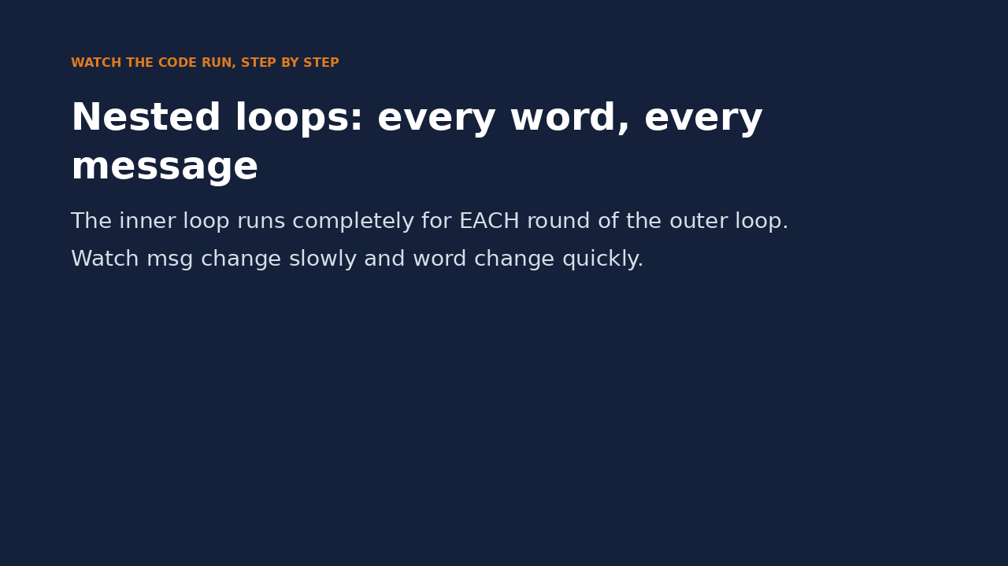
Watch it run: nested loops
WATCH FOR
Outer loop: msg changes slowly
Inner loop: word changes quickly
found resets for each new message
4 checks in total: 2 messages x 2 words
Click the video to play, click again to pause. Silent: talk the class through it.
Md Mahbub E Noor
Lecture 3.3: Loops
University of Barishal
22 / 35
Notes:
This is the hardest idea of Lecture 3, so it gets a video as well as the trace table. Pause when the second message starts and point out found going back to False.

Slide 23
Build it: a rule-based spam filter
Loops + decisions + a list of suspicious words: the filter from Lecture 1's demo, in real code.
Code
Output
spam_words = ["free", "win", "prize", "cash"]
inbox = ["Win a free phone",
"Class moved to room 305",
"Claim your cash prize",
"See you at the library"]
spam_count = 0
for msg in inbox:
is_spam = False
for word in spam_words:
if word in msg.lower():
is_spam = True
if is_spam:
spam_count = spam_count + 1
print("SPAM ", msg)
else:
print("OK ", msg)
print(f"Flagged {spam_count} of {len(inbox)}")
SPAM Win a free phone
OK Class moved to room 305
SPAM Claim your cash prize
OK See you at the library
Flagged 2 of 4
Md Mahbub E Noor
Lecture 3.3: Loops
University of Barishal
23 / 35
Notes:
Everything from Lecture 3 in one program: a list, a nested loop, decisions, and the counting accumulator. Type it carefully.

Slide 24
Where rules break
Same rules, two trickier messages. Predict the labels before you run it.
Code
tricky = ["Claim your FR33 g1ft now",
"Free lunch after the seminar"]
for msg in tricky:
is_spam = False
for word in spam_words:
if word in msg.lower():
is_spam = True
print(is_spam, msg)
Output
False Claim your FR33 g1ft now
True Free lunch after the seminar
Md Mahbub E Noor
Lecture 3.3: Loops
University of Barishal
24 / 35
Notes:
The obvious spam is missed because FR33 and g1ft are not in our list, and the department message is flagged because it says free. This is the whack-a-mole problem. Notice also that we copied the checking code twice; in Lecture 4.1 we put it in a function, and in Lecture 4 we start learning the words from data instead of typing them.

Slide 25
Common mistakes with loops
Read the last line of an error first. It names the problem.
What you typed | What Python says | What it means
for i in range(5) print(i) | SyntaxError: expected ':' | Missing colon after the for line.
for i in range(5): print(i) | IndentationError: expected an indented block after 'for' statement on line 1 | The body must be indented.
for x in 5: print(x) | TypeError: 'int' object is not iterable | A number is not a collection. Use range(5).
for i in range(3): totl = totl + i | NameError: name 'totl' is not defined | totl was never created. Create it before the loop, and check spelling.
Md Mahbub E Noor
Lecture 3.3: Loops
University of Barishal
25 / 35
Notes:
Plus one silent bug with no error at all: range(1, N) stops at N - 1. When the last number is missing, check the stop value.

Slide 26
In-class exercises
Each task uses a loop. Test with N = 20 unless stated.
1
Even numbers
2
Skip fives
3
3 or 4, not 5
Print all even numbers from 1 to N.
Print 1 to N except numbers divisible by 5.
Print numbers from 1 to N divisible by 3 or 4 but not by 5.
4
Primes
5
Second largest
6
Sum of digits
Print all primes up to N. Expected for 20: 2 3 5 7 11 13 17 19.
Find the second largest distinct value of [4, 9, 2, 9, 7] with a loop, no sort. Expected: 7.
Given n = 4721, add its digits with a while loop. Hint: n % 10 and n // 10. Expected: 14.
Md Mahbub E Noor
Lecture 3.3: Loops
University of Barishal
26 / 35
Notes:
Tasks 1 to 3 are warm-ups. Task 4 needs a nested loop and task 6 a while loop. Let fast pairs attempt 5 and 6; others finish 1 to 4 as homework.

Slide 27
Solutions
Show these after students have tried the exercises.
Md Mahbub E Noor
Lecture 3.3: Loops
University of Barishal
27 / 35
Notes:
Solutions.

Slide 28
Solutions 1 and 2
range(1, N + 1) includes N. end=" " prints on one line instead of a new line each time.
Code
N = 20
for i in range(1, N + 1):
if i % 2 == 0:
print(i, end=" ")
print()
for i in range(1, N + 1):
if i % 5 != 0:
print(i, end=" ")
Output
2 4 6 8 10 12 14 16 18 20
1 2 3 4 6 7 8 9 11 12 13 14 16 17 18 19
Md Mahbub E Noor
Lecture 3.3: Loops
University of Barishal
28 / 35
Notes:
Note range(1, N + 1) to include N itself. The empty print() just ends the line between the two outputs.

Slide 29
Solution 3: brackets matter
and is evaluated before or. Without brackets, 15 would wrongly be printed.
Code
N = 20
for i in range(1, N + 1):
if (i % 3 == 0 or i % 4 == 0) and i % 5 != 0:
print(i, end=" ")
Output
3 4 6 8 9 12 16 18
Md Mahbub E Noor
Lecture 3.3: Loops
University of Barishal
29 / 35
Notes:
Without brackets Python reads the condition as i % 3 == 0 or (i % 4 == 0 and i % 5 != 0), so 15 would print. Let students remove the brackets and watch 15 appear.

Slide 30
Solution 4: primes with a nested loop
A prime has no divisor between 2 and itself. break stops checking as soon as one divisor is found.
Code
Output
N = 20
for n in range(2, N + 1):
is_prime = True
for d in range(2, n):
if n % d == 0:
is_prime = False
break
if is_prime:
print(n, end=" ")
2 3 5 7 11 13 17 19
Md Mahbub E Noor
Lecture 3.3: Loops
University of Barishal
30 / 35
Notes:
Same shape as the spam filter: an outer loop over candidates, an inner loop over checks, and a True/False flag. For speed, d only needs to go up to the square root of n, but clarity first.

Slide 31
Solutions 5 and 6
Second largest: skip the maximum, then track the largest of the rest. Digits: take the last digit, then drop it.
Code
Output
nums = [4, 9, 2, 9, 7]
largest = max(nums)
second = None
for x in nums:
if x != largest:
if second == None or x > second:
second = x
print(second)
n = 4721
total = 0
while n > 0:
total = total + n % 10
n = n // 10
print(total)
7
14
Md Mahbub E Noor
Lecture 3.3: Loops
University of Barishal
31 / 35
Notes:
None means 'no value yet'. Experienced programmers write 'second is None'; == works here too and is easier for beginners. The digit sum: 4721 % 10 is 1, 4721 // 10 is 472, and so on until n is 0.

Slide 32
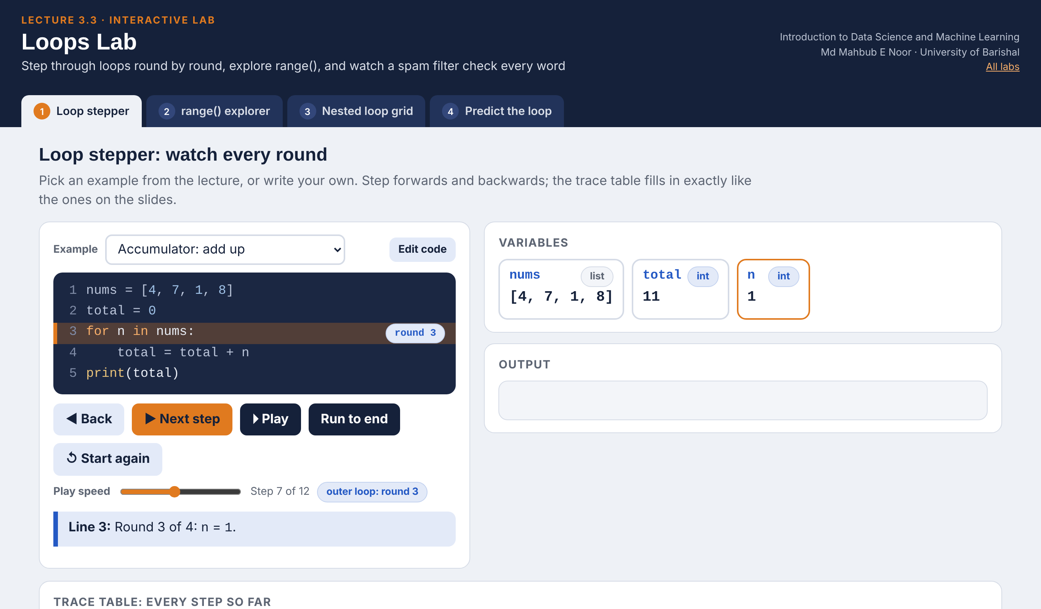
Interactive lab: Loops Lab
In the lab you can
1 Loop stepper
Step any loop round by round; the trace table fills itself.
2 range() explorer
Move start, stop and step and see the numbers on a line.
3 Nested loop grid
Watch every message checked against every spam word.
4 Predict the loop
8 short loops: choose the output, then see why.
Open the lab ►
Works offline in any browser
Labs_open_in_browser/
L3.3_Loops_Lab.html
Md Mahbub E Noor
Lecture 3.3: Loops
University of Barishal
32 / 35
Notes:
Open the Loops Lab (double-click; works offline). Loop stepper: run Accumulator with Back and Next so students predict total each round; then show the Infinite loop example and how the lab stops it after 600 steps. Nested loop grid: press Play, then tick break and compare the number of checks. Predict the loop works well as a 5-minute end-of-class quiz.

Slide 33
Today's toolkit
for x in items: | Repeat for each item
range(a, b, step) | Numbers from a, stop before b
total = 0 ... total += x | Accumulator pattern
while condition: | Repeat while True
break | Leave the loop now
continue | Skip to the next round
for i, x in enumerate(items): | Position and item
loop inside a loop | Every pair of items
Md Mahbub E Noor
Lecture 3.3: Loops
University of Barishal
33 / 35
Notes:
Lecture 3 is complete: decisions, collections and repetition. Next, Lecture 4.1: functions, so we can package the spam check and reuse it anywhere.

Slide 34
Homework 3.3
Due before Lecture 4.1 · [date]
1
Predict, then run
2
Multiplication table
3
Trace it
Predict first: the output of for i in range(10, 0, -3): print(i), and print(len(range(0, 100, 10))).
Ask for no input: store n = 7 and print n x 1 up to n x 10 in the form 7 x 3 = 21.
Draw a trace table by hand for the accumulator slide with nums = [2, 5, 3]. Then check by running.
4
Spam counter
5
Guessing game
Make 8 invented messages. Count how many contain any word from your spam_words list, using nested loops.
Store secret = 7 and a list of guesses [3, 9, 7, 5]. Loop over guesses, print Too low / Too high, and break when correct.
Submit on [LMS / Google Classroom]: your notebook file HW3_3_<your ID>.ipynb, or a Colab link set to “Anyone with the link can view”.
Md Mahbub E Noor
Lecture 3.3: Loops
University of Barishal
34 / 35
Notes:
Homework 3.3. Key for task 1: 10, 7, 4, 1; and 10. Task 5 combines if/elif/else, a for loop and break; the 5 should never be checked. Check that task 3 tables show total before and after each round.

Slide 35

Recap: Lecture 3.3 in 90 seconds
Click to play or pause. Watch it again at home to revise.
Md Mahbub E Noor
Lecture 3.3: Loops
University of Barishal
35 / 35
Notes:
Play this at the end of class, or leave it for students to revise at home. It is a silent summary: pause on each card and ask the class for an example.

