Slide 1
LECTURE 4.1
Functions
Today's key line of code
def add(a, b):
return a + b
print(add(5, 6))
Write once, use everywhere, and how Python passes arguments
Introduction to Data Science · Md Mahbub E Noor · University of Barishal
Notes:
Lecture 4, part 1: functions. Functions are how programmers stop repeating themselves. Today we build them piece by piece, then look carefully at a question that confuses many textbooks: what happens to a variable when you pass it into a function. New notebook: Lecture4_1.

Slide 2
Where we are: Lecture 4, part 1
Part 1
L2
L3
L4
L5
L6
Python basics
Decisions and loops
Counting words
Real data
Build the model
Today you will
1
Name every part of a function definition and call
2
Send values in with parameters, get values out with return
3
Use keyword and default arguments
4
Know which variables a function can see
5
Predict what a function can and cannot change in the caller
Md Mahbub E Noor
Lecture 4.1: Functions
University of Barishal
2 / 39
Notes:
Lecture 4 has two parts. This part is functions in depth. Part 2 uses functions and dictionaries to count words, which is the core idea of the real spam model.

Slide 3
The problem: the same lines, again and again
Without a function
With a function
Code
Code
account = 20
balance = 100
balance = balance + 100
print("Account:", account)
print("Balance:", balance)
balance = balance - 50
print("Account:", account)
print("Balance:", balance)
balance = balance - 10
print("Account:", account)
print("Balance:", balance)
def show(account, balance):
print("Account:", account)
print("Balance:", balance)
account = 20
balance = 100
balance = balance + 100
show(account, balance)
balance = balance - 50
show(account, balance)
balance = balance - 10
show(account, balance)
Change the report format once, inside show, and every call uses the new format.
Md Mahbub E Noor
Lecture 4.1: Functions
University of Barishal
3 / 39
Notes:
Left: the two print lines appear three times. If the bank wants the format changed, we must edit it in three places and hope we do not miss one. Right: the lines live in one function, called three times. This is the same idea as structured programming in C, in Python syntax.

Slide 4
You already use functions
1
2
3
Built-in
From modules
Your own
print(), len(), type(), input(), max(): written by Python's developers, ready to use.
math.sqrt(), pd.read_csv(): written by others, loaded with import.
Written with def. Today's topic.
Md Mahbub E Noor
Lecture 4.1: Functions
University of Barishal
4 / 39
Notes:
A function is a mini program inside your program: it has a name, it may take inputs, it does a job, and it may hand back a result. You have been calling functions since Lecture 2.

Slide 5
Anatomy of a function
Code
def hello():
print("Hello World!")
hello()
Keyword def defines a function
Function name: you choose it
Brackets: inputs go here (none yet)
Body: indented, runs only when the function is called
Output
Call: runs the body. Brackets are required
Hello World!
Md Mahbub E Noor
Lecture 4.1: Functions
University of Barishal
5 / 39
Notes:
Defining a function does not run it. It only teaches Python a new command. The body runs when you call it, by writing its name with brackets. Ask: what happens if you write hello without brackets? [Nothing is called; Colab just shows that hello is a function.]

Slide 6
Parameters and arguments
Code
def hello(name):
print(f"Hello {name}!")
hello("Joy")
hello("Rini")
Parameter: a name for the input, used inside the function
The parameter is used like a normal variable
Argument: the actual value sent in
Another call, another argument, same code
Output
Hello Joy!
Hello Rini!
Md Mahbub E Noor
Lecture 4.1: Functions
University of Barishal
6 / 39
Notes:
Two words people mix up. The parameter is the placeholder name in the definition. The argument is the real value in the call. When hello('Joy') runs, name holds 'Joy'.

Slide 7
What if we forget the argument?
Predict first
Code
?
def printme(text):
print(text)
printme()
What will this print? Write your prediction as a comment before you run the cell.
Md Mahbub E Noor
Lecture 4.1: Functions
University of Barishal
7 / 39
Notes:
What is the output of this code? Many students guess it prints nothing or an empty line.

Slide 8
Answer: What if we forget the argument?
Code
printme has one required parameter
def printme(text):
print(text)
printme()
The call sends nothing, so Python stops with a TypeError
The message names the missing parameter: text
Output
Fix: printme("Hello")
TypeError: printme() missing 1 required positional argument: 'text'
Md Mahbub E Noor
Lecture 4.1: Functions
University of Barishal
8 / 39
Notes:
It is an error. A parameter without a default value is required. Read the last line: it tells you exactly which argument is missing.

Slide 9
return: hand a value back
Code
def add(a, b):
s = a + b
return s
x = add(5, 6)
print(x)
Two parameters, separated by a comma
return sends the value back and ends the function
The returned value is stored in x
5 goes to a, 6 goes to b, by position
Output
11
Md Mahbub E Noor
Lecture 4.1: Functions
University of Barishal
9 / 39
Notes:
Note the name add, not sum. sum is a built-in function; if we define our own sum, we hide Python's sum for the rest of the notebook. More on that on the mistakes slide.

Slide 10
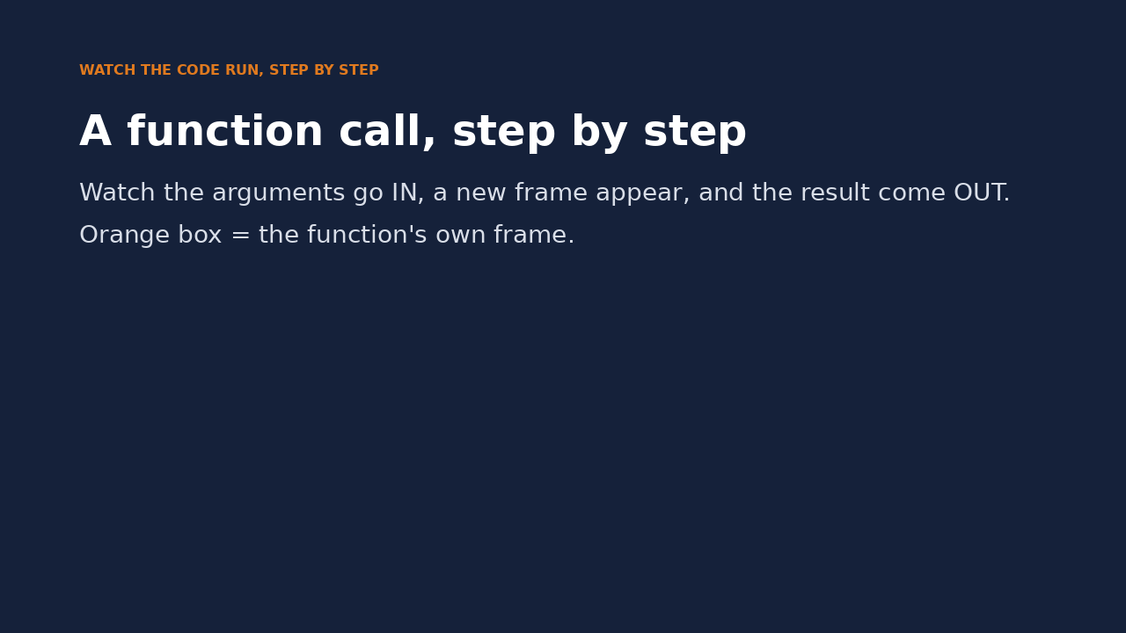
Watch it run: a function call
WATCH FOR
Defining a function does not run it
At the call, a new orange frame appears
Parameters a and b get the argument values
return sends 11 back, and the frame disappears
Click the video to play, click again to pause. Silent: talk the class through it.
Md Mahbub E Noor
Lecture 4.1: Functions
University of Barishal
10 / 39
Notes:
Play and narrate. Pause when the orange frame appears and ask: where did a = 5 come from? Pause again on the return pill: where does 11 go next? The grey 'waiting' line shows that the main program is paused at the call until the function returns.

Slide 11
print or return?
Predict first
Code
?
def double_print(x):
print(x * 2)
def double_return(x):
return x * 2
a = double_print(4)
b = double_return(4)
print(a, b)
What will this print? Write your prediction as a comment before you run the cell.
Md Mahbub E Noor
Lecture 4.1: Functions
University of Barishal
11 / 39
Notes:
Predict every line of output. This is the single most important distinction today.

Slide 12
Answer: print or return?
Code
double_print shows 8, but gives nothing back
def double_print(x):
print(x * 2)
def double_return(x):
return x * 2
a = double_print(4)
b = double_return(4)
print(a, b)
A function without return gives back None
double_return gives back 8, stored in b
To use a result later, return it
Output
8
None 8
Md Mahbub E Noor
Lecture 4.1: Functions
University of Barishal
12 / 39
Notes:
8, then None 8. print shows a value to a human and it is gone. return gives the value to the program, which can store it and use it. This also explains last lecture's puzzle: nums.sort() returns None.

Slide 13
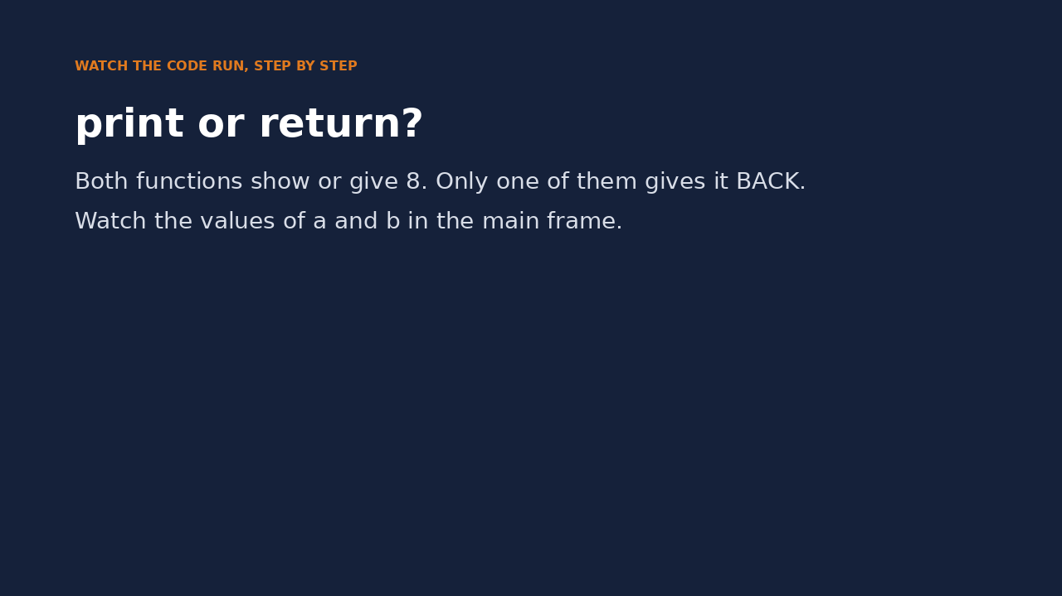
Watch it run: print versus return
WATCH FOR
Both functions produce 8
Only double_return hands it back
Watch a become None, b become 8
Shown on screen is not the same as returned
Click the video to play, click again to pause. Silent: talk the class through it.
Md Mahbub E Noor
Lecture 4.1: Functions
University of Barishal
13 / 39
Notes:
Show this after the answer slide. Pause after double_print returns and ask: why is a None even though 8 appeared on the screen?

Slide 14
Returning several values
return a, b, c packs the values into a tuple
Code
def check():
return "ok", 10, 3.14
result = check()
print(result)
print(type(result))
status, num1, num2 = check()
print(status, num1, num2)
Unpack them into separate names (Lecture 3.2)
The number of names must match
Avoid names like str and sum: they hide built-ins
Output
('ok', 10, 3.14)
<class 'tuple'>
ok 10 3.14
Md Mahbub E Noor
Lecture 4.1: Functions
University of Barishal
14 / 39
Notes:
Python functions return one object; with commas, that object is a tuple. Unpacking then gives each value its own name. We use status instead of str, because str is the name of Python's text type and a built-in function.

Slide 15
Keyword arguments: pass by name
Name the parameter in the call: age=50
Code
def printinfo(name, age):
print("Name:", name)
print("Age:", age)
printinfo(age=50, name="Miki")
Then order does not matter
Makes calls with many inputs easier to read
Lecture 6 uses this a lot: test_size=0.2
Output
Name: Miki
Age: 50
Md Mahbub E Noor
Lecture 4.1: Functions
University of Barishal
15 / 39
Notes:
Keyword arguments make calls self-explanatory. Data science libraries use them heavily; in Lecture 6 we call train_test_split with test_size, random_state and stratify, all keyword arguments.

Slide 16
Default arguments: a value if none is given
age=35 in the definition is a default
Code
def printinfo(name, age=35):
print("Name:", name, "| Age:", age)
printinfo("Miki")
printinfo("Miki", 50)
printinfo(name="Joy", age=20)
Leave it out and 35 is used
Pass a value and it replaces the default
Parameters with defaults must come after those without
Output
Name: Miki | Age: 35
Name: Miki | Age: 50
Name: Joy | Age: 20
Md Mahbub E Noor
Lecture 4.1: Functions
University of Barishal
16 / 39
Notes:
Defaults make a function easy for the common case and flexible for the rest. CountVectorizer() in Lecture 6 works with no arguments because every parameter has a default.

Slide 17
The rules for arguments
Read the last line of an error first. It names the problem.
What you typed | What Python says | What it means
def f(age=35, name): pass | SyntaxError: parameter without a default follows parameter with a default | Parameters with defaults must come after required ones.
printinfo(name="Miki", 50) | SyntaxError: positional argument follows keyword argument | Positional arguments must come before keyword arguments.
printinfo("Miki", name="Joy") | TypeError: printinfo() got multiple values for argument 'name' | name got two values: one by position, one by keyword.
Md Mahbub E Noor
Lecture 4.1: Functions
University of Barishal
17 / 39
Notes:
Three rules, each enforced by Python with a clear message. You do not need to memorise them; you need to read the message.

Slide 18
Variables inside a function stay inside
greeting is a local variable: it exists only while the function runs
Code
def make_greeting():
greeting = "Hi"
return greeting
print(make_greeting())
print(greeting)
Outside, Python has never heard of it
Inputs come in through parameters
Results go out through return
Output
Hi
NameError: name 'greeting' is not defined
Md Mahbub E Noor
Lecture 4.1: Functions
University of Barishal
18 / 39
Notes:
The function runs, returns 'Hi', and its local variable disappears. The second print fails with a NameError. This is a feature: functions do not leak their working variables into the rest of your program.

Slide 19
How arguments are passed: names point to objects
A variable is a name that points to an object
name outside the function
nums
Passing an argument does not copy the object
The parameter becomes a second name for the same object
[10, 20, 30]
Python's rule is called pass by object reference (or pass by assignment)
inside add_item()
one object in memory
lst
It is neither classic call by value nor call by reference
Md Mahbub E Noor
Lecture 4.1: Functions
University of Barishal
19 / 39
Notes:
This is the part many slides and websites get wrong, so let's be precise. In Python, a variable is a name tag attached to an object. When you call add_item(nums), the parameter lst becomes a second tag on the same list. Nothing is copied. Whether the caller then sees a change depends on what the function does: change the object, or move the tag. The next four slides test this with real code.

Slide 20
Evidence: the same object inside and outside
id() gives an object's identity number
Code
def show_id(arg):
print("inside: ", id(arg))
var = "Hello"
print("outside:", id(var))
show_id(var)
Same number means same object
So the function received the object itself, not a copy
Your numbers will differ; they only need to match
Output
outside: 140601564316704
inside: 140601564316704
Md Mahbub E Noor
Lecture 4.1: Functions
University of Barishal
20 / 39
Notes:
The two numbers match, so var and arg name the same object. This shows that no copy was made. It does not by itself prove call by reference, as the next slides show.

Slide 21
Changing a list inside a function changes it outside
lst.append(100) changes the list object itself
Code
def add_item(lst):
lst.append(100)
nums = [10, 20, 30]
add_item(nums)
print(nums)
nums names that same object
So the caller sees the change
Lists and dictionaries are mutable: they can be changed
Output
[10, 20, 30, 100]
Md Mahbub E Noor
Lecture 4.1: Functions
University of Barishal
21 / 39
Notes:
The function did not return anything, yet nums changed. Because both names point to one list, and append modified that list. This is useful, and it can surprise you: always know whether a function you call modifies its inputs.

Slide 22
But reassigning inside a function does not
lst = [99] points the local name at a new list
Code
def replace(lst):
lst = [99]
print("inside: ", lst)
nums = [10, 20, 30]
replace(nums)
print("outside:", nums)
The caller's name still points to the old list
Under true call by reference, nums would now be [99]
So Python is not call by reference
Output
inside: [99]
outside: [10, 20, 30]
Md Mahbub E Noor
Lecture 4.1: Functions
University of Barishal
22 / 39
Notes:
This is the test that separates the two ideas. With genuine call by reference, as with reference parameters in C++, assigning to the parameter would change the caller's variable. In Python it does not: the assignment only moves the local name tag.

Slide 23
Numbers and strings can only be replaced
Integers and strings are immutable: no operation changes them
Code
def add_one(n):
n = n + 1
return n
x = 10
add_one(x)
print(x)
x = add_one(x)
print(x)
n = n + 1 makes a new object and moves the local name
The caller's x is untouched
To get a new value out, return it: x = add_one(x)
Output
10
11
Md Mahbub E Noor
Lecture 4.1: Functions
University of Barishal
23 / 39
Notes:
With an integer, there is no way to modify the object, so a function can only create new ones. Calling add_one(x) without storing the result changes nothing. Storing it, x = add_one(x), is the normal Python pattern.

Slide 24
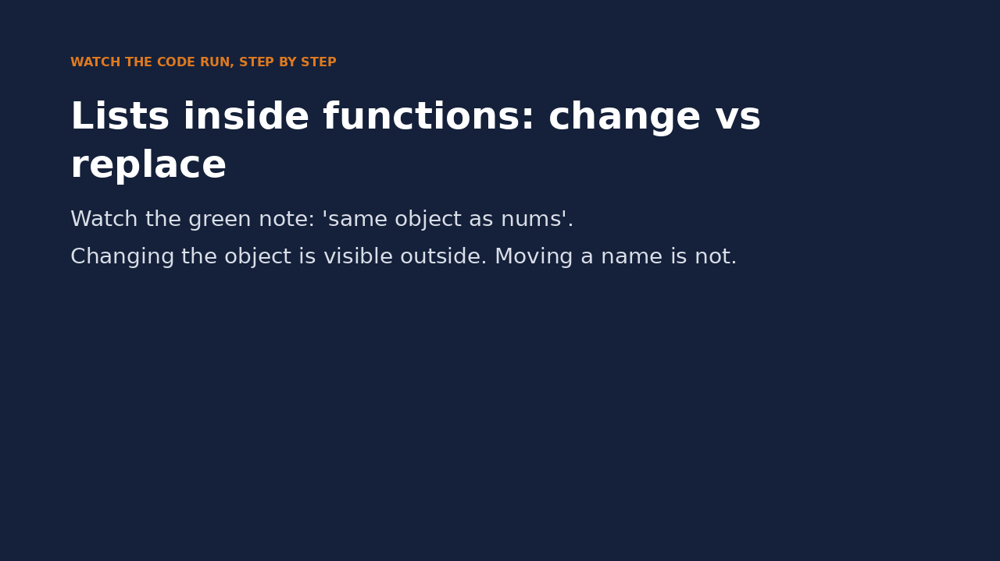
Watch it run: change the object, or move the name
WATCH FOR
Green note: lst and nums name the same list
append changes that list, so nums changes too
lst = [99] moves only the local name
After replace, nums is unchanged
Click the video to play, click again to pause. Silent: talk the class through it.
Md Mahbub E Noor
Lecture 4.1: Functions
University of Barishal
24 / 39
Notes:
This video shows the whole argument-passing story in one minute. Pause on 'same object as nums' and ask what will happen to nums after append. Pause again after lst = [99] and ask whether nums will change. This replaces the long call-by-value versus call-by-reference debate with something students can see.

Slide 25
The one rule to remember
lst.append(x) | Changes the object: caller sees it
lst[0] = x | Changes the object: caller sees it
d[key] = x | Changes the object: caller sees it
lst = [...] | Moves the local name: caller does not
n = n + 1 | New object: caller does not see it
return value | The reliable way to send results out
Md Mahbub E Noor
Lecture 4.1: Functions
University of Barishal
25 / 39
Notes:
One rule replaces the whole value-versus-reference debate: if the function changes the object, the caller sees it; if the function only reassigns its parameter, the caller does not. When in doubt, return the result.

Slide 26
Built-in math functions
You type | Python gives | Meaning
abs(-5) | 5 | distance from zero
max(5, 9) | 9 | largest of the arguments
max([4, 9, 2]) | 9 | or largest item of a list
min(5, 9) | 5 | smallest
pow(2, 3) | 8 | 2 ** 3
pow(2, 3, 5) | 3 | (2 ** 3) % 5
round(5.8) | 6 | nearest whole number
round(3.14159, 2) | 3.14 | round to 2 decimal places
round(2.5) | 2 | halves go to the even number
sum([5, 6]) | 11 | sum needs a list, not sum(5, 6)
Md Mahbub E Noor
Lecture 4.1: Functions
University of Barishal
26 / 39
Notes:
Two corrections to watch. round(2.5) gives 2 and round(3.5) gives 4: Python rounds exact halves to the nearest even number, which avoids bias in large datasets. And sum takes a list: sum(5, 6) is an error, shown on the next slide.

Slide 27
Mistakes to avoid
Read the last line of an error first. It names the problem.
What you typed | What Python says | What it means
sum(5, 6) | TypeError: 'int' object is not iterable | sum needs one list: sum([5, 6]).
sum = 10 print(sum([1, 2])) | TypeError: 'int' object is not callable | sum = 10 hid the built-in sum. Never use built-in names for variables.
nums = [1, 2] nums = nums.append(3) print(nums) | None | No error, but None: append returns nothing, and nums lost its list.
Md Mahbub E Noor
Lecture 4.1: Functions
University of Barishal
27 / 39
Notes:
The second row explains why we never call our own function sum or our variable str: after sum = 10, the name sum points to the number 10, and calling it fails. If this happens in Colab, restart the runtime or run del sum. The third is a silent bug: append changes the list and returns None, and assigning that None back throws the list away.

Slide 28
Modules: borrowing more functions
A module is a file of ready-made functions
Code
import math
print(math.sqrt(16))
print(math.gcd(8, 12))
print(math.pi)
from math import lcm
print(lcm(8, 12))
import math loads it; use math.name
from math import lcm imports one name directly
Use math.gcd to check your exercise answers
Output
4.0
4
3.141592653589793
24
Md Mahbub E Noor
Lecture 4.1: Functions
University of Barishal
28 / 39
Notes:
Modules extend Python. pandas and scikit-learn, which we use in Lectures 5 and 6, are modules too, just much bigger. Before writing a function, it is worth asking whether one already exists.

Slide 29
In-class exercises: write functions
Each task is a function that RETURNS its answer. Test it with the examples.
1
evens(n)
2
gcd(a, b)
3
lcm(a, b)
Return a list of even numbers from 1 to n. evens(10) gives [2, 4, 6, 8, 10].
Greatest common divisor, with a loop. gcd(8, 12) gives 4.
Use your gcd: a * b // gcd(a, b). lcm(8, 12) gives 24.
4
mex(lst)
5
find_operator(number)
6
second_largest(lst)
Smallest non-negative integer not in the list. mex([2, 1, 4, 0, 5]) gives 3.
Return the operator name, or "INV" if not 11 characters or unknown prefix.
Largest value smaller than the maximum. second_largest([4, 9, 2, 9, 7]) gives 7.
Md Mahbub E Noor
Lecture 4.1: Functions
University of Barishal
29 / 39
Notes:
These are the earlier exercises rewritten so that each one practises writing a function that returns. Check answers against math.gcd and math.lcm.

Slide 30
Solutions
Show these after students have tried the exercises.
Md Mahbub E Noor
Lecture 4.1: Functions
University of Barishal
30 / 39
Notes:
Solutions.

Slide 31
Solution: evens
Build the answer in a list, return it at the end. The caller decides whether to print it.
Code
Output
def evens(n):
result = []
for i in range(1, n + 1):
if i % 2 == 0:
result.append(i)
return result
print(evens(10))
[2, 4, 6, 8, 10]
Md Mahbub E Noor
Lecture 4.1: Functions
University of Barishal
31 / 39
Notes:
The function returns a list rather than printing numbers. That makes it reusable: another function could sum the evens, count them, and so on.

Slide 32
Solutions: gcd and lcm
lcm reuses gcd: functions calling functions is how bigger programs are built.
Code
Output
def gcd(a, b):
result = 1
for i in range(1, min(a, b) + 1):
if a % i == 0 and b % i == 0:
result = i
return result
def lcm(a, b):
return a * b // gcd(a, b)
print(gcd(8, 12), gcd(86, 44), lcm(8, 12))
4 2 24
Md Mahbub E Noor
Lecture 4.1: Functions
University of Barishal
32 / 39
Notes:
gcd keeps the largest common divisor found so far. lcm uses the identity a times b equals gcd times lcm, so it needs no loop at all once gcd exists. Compare with math.gcd and math.lcm.

Slide 33
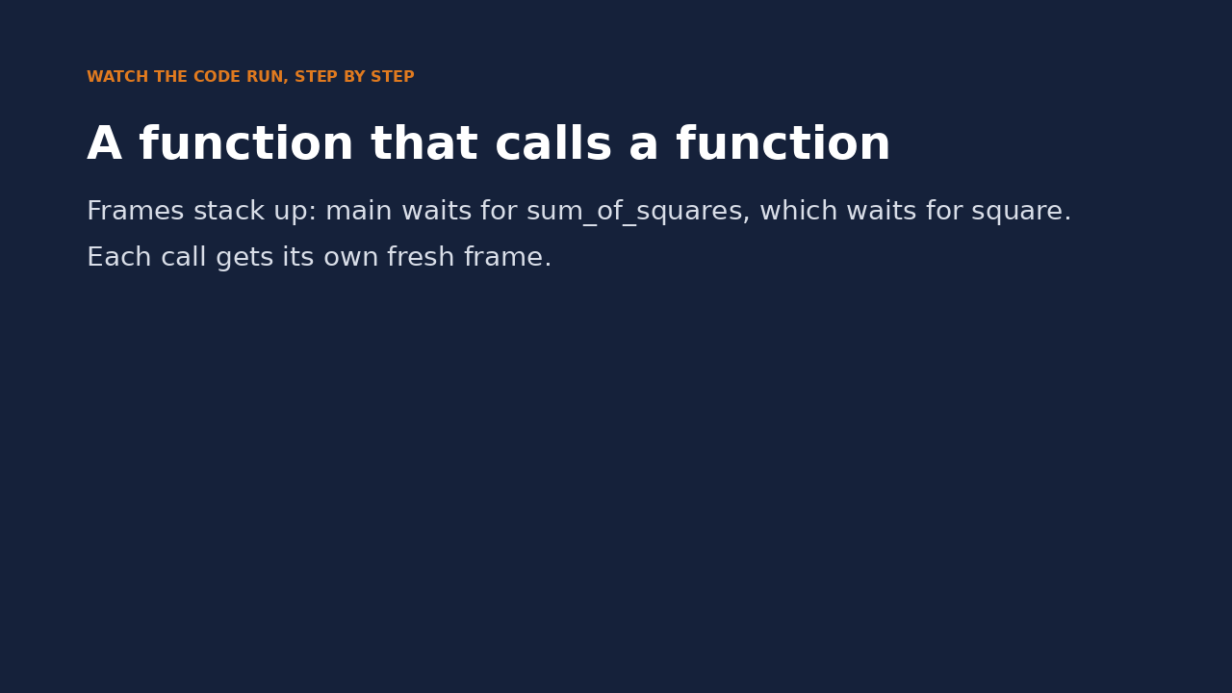
Watch it run: a function that calls a function
WATCH FOR
Frames stack up: main, sum_of_squares, square
Each caller waits until its call returns
square runs twice, each time with a fresh frame
Like lcm calling gcd in the solution
Click the video to play, click again to pause. Silent: talk the class through it.
Md Mahbub E Noor
Lecture 4.1: Functions
University of Barishal
33 / 39
Notes:
lcm calls gcd, so this is a good moment to show the call stack. Pause when three frames are visible and ask which function is running right now. Answer: only the bottom, orange-bordered one; the others are waiting.

Slide 34
Solutions: mex and second_largest
while m in lst keeps counting up until it finds a number that is missing.
Code
Output
def mex(lst):
m = 0
while m in lst:
m = m + 1
return m
def second_largest(lst):
largest = max(lst)
others = []
for x in lst:
if x != largest:
others.append(x)
return max(others)
print(mex([2, 1, 4, 0, 5]), mex([2, 1, 4, 0, 5, 3]))
print(second_largest([4, 9, 2, 9, 7]))
3 6
7
Md Mahbub E Noor
Lecture 4.1: Functions
University of Barishal
34 / 39
Notes:
The mex solution needs no sorting and works with duplicates. second_largest removes every copy of the maximum first, which fixes the duplicate problem from Lecture 3.2.

Slide 35
Solution: find_operator
return ends the function at once, so an invalid number can never also print an operator name.
Code
Output
def find_operator(number):
if len(number) != 11:
return "INV"
match number[:3]:
case "017" | "013": return "Grameenphone"
case "014" | "019": return "Banglalink"
case "015": return "Teletalk"
case "016": return "Airtel"
case "018": return "Robi"
case _: return "INV"
print(find_operator("01411111111"))
print(find_operator("0131234567890"))
Banglalink
INV
Md Mahbub E Noor
Lecture 4.1: Functions
University of Barishal
35 / 39
Notes:
The second test has 13 digits and a valid prefix. A version that prints INV and then continues to the match would print two answers; the early return prevents that. A stricter version would also check number.isdigit().

Slide 36
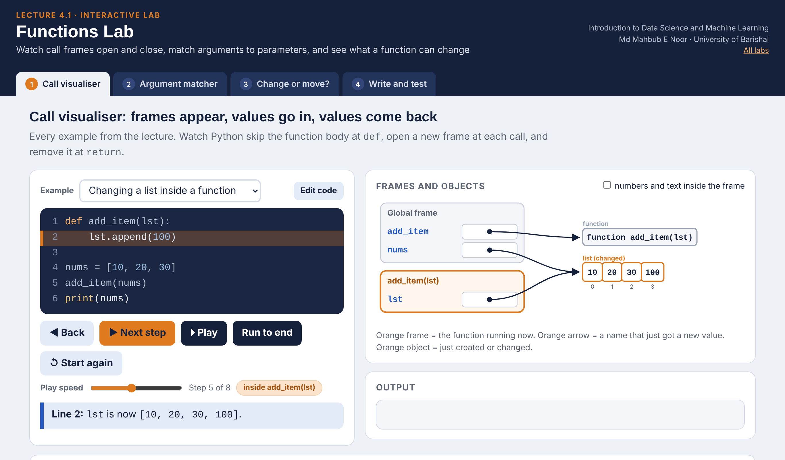
Interactive lab: Functions Lab
In the lab you can
1 Call visualiser
Step through calls: frames open, values go in, return comes back.
2 Argument matcher
See which argument fills which parameter, or why it fails.
3 Change or move?
Predict whether a function changes the caller's list.
4 Write and test
9 exercises with automatic tests checked against Python.
Open the lab ►
Works offline in any browser
Labs_open_in_browser/
L4.1_Functions_Lab.html
Md Mahbub E Noor
Lecture 4.1: Functions
University of Barishal
36 / 39
Notes:
Open the Functions Lab (double-click; works offline). Call visualiser: run 'print or return?' and ask for a and b before stepping. Then untick 'numbers and text inside the frame' on 'Reassigning inside does not' to show names pointing to objects. Change or move? is the best 10 minutes of this lecture: students must predict before each reveal. Write and test can be the in-class exercise session: the tests check returned values, not printed ones.

Slide 37
Today's toolkit
def name(p1, p2): | Define a function
return value | Send a result back
name(a1, a2) | Call it with arguments
name(p2=x, p1=y) | Keyword arguments
def f(p, q=35): | Default value for q
a, b = f() | Unpack several return values
import math | Load a module
math.sqrt(x) | Use a module's function
Md Mahbub E Noor
Lecture 4.1: Functions
University of Barishal
37 / 39
Notes:
Next, Lecture 4 part 2: dictionaries and word counting, where these functions start learning from data.

Slide 38
Homework 4.1
Due before Lecture 4.2 · [date]
1
Predict, then run
2
Temperature
3
Grade function
Predict first: def f(x): x.append(1); then a = [0]; f(a); print(a). And def g(x): x = x + [1]; with the same test.
Write c_to_f(c) that returns c * 9 / 5 + 32. Print a table for 0, 25, 37, 100 using a loop.
Turn the Lecture 3.1 grade code into grade(score) that returns A, B, C or F. Test all four.
4
Spam check
5
Explain
Write is_spam(message, words) that returns True or False. Default words: ["free", "win", "prize"].
In 3 sentences: why does f change a but g does not? Use the words object and name.
Submit on [LMS / Google Classroom]: your notebook file HW4_1_<your ID>.ipynb, or a Colab link set to “Anyone with the link can view”.
Md Mahbub E Noor
Lecture 4.1: Functions
University of Barishal
38 / 39
Notes:
Homework 4.1. Task 1 key: after f, a is [0, 1] because append changes the object; after g, a stays [0] because x + [1] builds a new list and x = ... only moves the local name. Task 4 practises default arguments; check that students return rather than print. Task 5 is the concept check for today.

Slide 39

Recap: Lecture 4.1 in 90 seconds
Click to play or pause. Watch it again at home to revise.
Md Mahbub E Noor
Lecture 4.1: Functions
University of Barishal
39 / 39
Notes:
Play this at the end of class, or leave it for students to revise at home. It is a silent summary: pause on each card and ask the class for an example.

