Slide 1
LECTURE 4.2
Counting words with dictionaries
Today's key line of code
counts[word] = counts.get(word, 0) + 1
The idea behind real spam filters
Introduction to Data Science · Md Mahbub E Noor · University of Barishal
Notes:
Lecture 4, part 2. In part 1 we learned to write functions. Today we use them for the key idea of the whole course: instead of typing spam rules ourselves, we count which words actually appear in spam and in normal messages. That idea, counting from examples, is the heart of the real model in Lecture 6. New notebook: Lecture4_2.

Slide 2
Where we are: Lecture 4, part 2
Part 2
L2
L3
L4
L5
L6
Python basics
Decisions and loops
Counting words
Real data
Build the model
Today you will
1
Recap: package the spam check as a function
2
Split a message into words
3
Store word counts in a dictionary
4
Count words across many messages
5
Build a spam score learned from examples, not typed rules
Md Mahbub E Noor
Lecture 4.2: Counting words with dictionaries
University of Barishal
2 / 17
Notes:
We are past the halfway point. Today is the conceptual turning point of the whole series. By the end of the class, our program will make decisions based on counts it learned from example messages, not on a rule list we typed. That is the step from traditional software to data science that we discussed in Lecture 1.

Slide 3
Recap from 4.1: a spam check as a function
def defines a function: a named, reusable block
Code
def is_spam(message):
text = message.lower()
for word in ["free", "win", "prize"]:
if word in text:
return True
return False
print(is_spam("Win a phone today"))
print(is_spam("See you at 5"))
message is the input (a parameter)
return hands back the answer and stops
Call it by name: is_spam("...")
Output
True
False
Md Mahbub E Noor
Lecture 4.2: Counting words with dictionaries
University of Barishal
3 / 17
Notes:
Remember we wrote the checking loop twice last lecture? A function packages that logic under a name. def is_spam, bracket, message: this function takes one input called message. Inside, we do our usual check. return True hands the answer back immediately and leaves the function. If the loop finishes without finding a word, we return False. Now checking any message is one short line. You have been using functions since Lecture 2: print, len and type are functions somebody else wrote.

Slide 4
Split a message into words
.split() cuts text at spaces into a list
Code
message = "Win a FREE prize, win now"
words = message.lower().split()
print(words)
print(len(words))
Combine with .lower() so WIN and win match
Punctuation stays stuck: prize, is not prize
Output
['win', 'a', 'free', 'prize,', 'win', 'now']
6
Cleaning text matters; scikit-learn will help in Lecture 6
Md Mahbub E Noor
Lecture 4.2: Counting words with dictionaries
University of Barishal
4 / 17
Notes:
To count words, we first need words. split cuts the text at every space and gives a list. Look closely at the output: 'prize,' still has its comma attached. For Python, 'prize,' and 'prize' are different words. This is a real problem in text data. In Lecture 6 the scikit-learn library will handle punctuation for us, but now you know why that step exists.

Slide 5
Dictionaries: look up a value by name
Curly braces: {key: value}
Code
counts = {"win": 2, "free": 1}
print(counts["win"])
counts["prize"] = 1
counts["win"] = counts["win"] + 1
print(counts)
Look up with counts["win"]
Add or change: counts["prize"] = 1
Like a word book: word → how many times we saw it
Output
2
{'win': 3, 'free': 1, 'prize': 1}
Md Mahbub E Noor
Lecture 4.2: Counting words with dictionaries
University of Barishal
5 / 17
Notes:
A list finds items by position: item 0, item 1. A dictionary finds values by a name, called a key. Think of a real dictionary: you look up a word and find its meaning. Here we look up a word and find a count. You can add new keys and update old ones. Notice the counting pattern from last lecture again: take the old value, add one, store it back.

Slide 6
Count every word in many messages
counts.get(word, 0) means: the current count, or 0 if we have never seen this word.
Code
def count_words(messages):
counts = {}
for msg in messages:
for word in msg.lower().split():
counts[word] = counts.get(word, 0) + 1
return counts
spam_msgs = ["Win a free prize", "Free cash win now",
"Claim your free gift"]
spam_counts = count_words(spam_msgs)
print(spam_counts)
Output
{'win': 2, 'a': 1, 'free': 3, 'prize': 1, 'cash': 1,
'now': 1, 'claim': 1, 'your': 1, 'gift': 1}
Md Mahbub E Noor
Lecture 4.2: Counting words with dictionaries
University of Barishal
6 / 17
Notes:
This is the most important function of the week. For every message, for every word, add one to that word's count. The get method solves a small problem: the first time we see a word, it is not in the dictionary yet, so counts[word] would crash. get with a default of zero says 'give me the count, or zero if it is new'. Look at the output: 'free' appears 3 times across our spam, 'win' twice. We did not type these as rules. The data told us.

Slide 7
Tracing count_words, word by word
The first two spam messages. counts.get(word, 0) is the count before this word; the dictionary then stores one more.
Code
message
word
count before
count after
counts = {}
for msg in messages:
for word in msg.lower().split():
counts[word] = counts.get(word, 0) + 1
'Win a free prize'
'win'
0
1
'Win a free prize'
'a'
0
1
'Win a free prize'
'free'
0
1
'Win a free prize'
'prize'
0
1
'Free cash win now'
'free'
1
2
'Free cash win now'
'cash'
0
1
'Free cash win now'
'win'
1
2
'Free cash win now'
'now'
0
1
Click to reveal the next row. Predict it first!
Md Mahbub E Noor
Lecture 4.2: Counting words with dictionaries
University of Barishal
7 / 17
Notes:
This is the slide to go slowly on. For the very first word, 'win', the dictionary is empty, so get returns the default 0 and we store 1. Watch 'free' in the second message: its count before is 1, because it appeared in the first message, so it becomes 2. The same happens to 'win'. Ask students to continue the table for the third message, 'Claim your free gift', by hand. [claim 0 to 1, your 0 to 1, free 2 to 3, gift 0 to 1.]

Slide 8
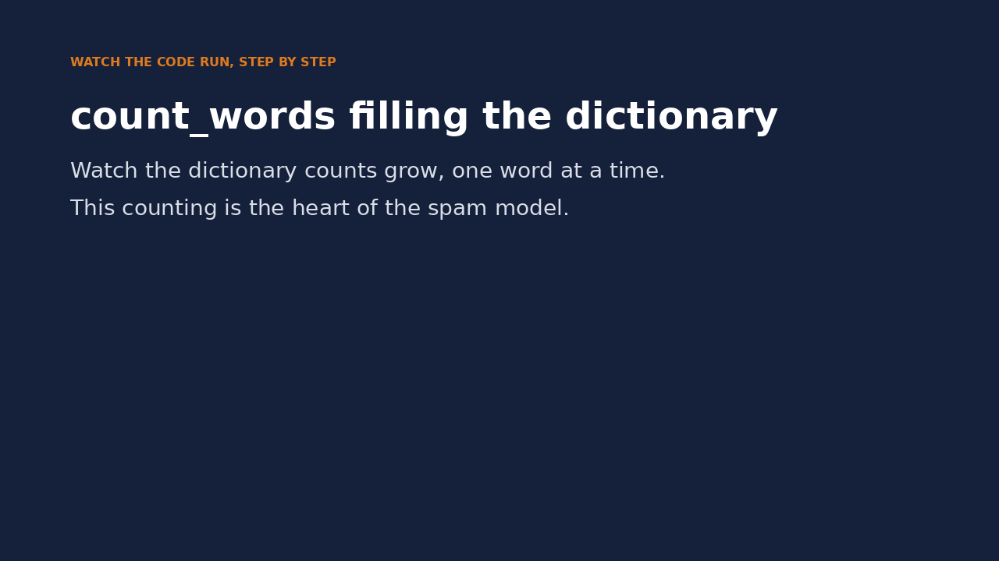
Watch it run: count_words
WATCH FOR
messages is a second name for the list spam
counts grows by one word at a time
'cash' appears twice, so its count reaches 2
return hands the whole dictionary back
Click the video to play, click again to pause. Silent: talk the class through it.
Md Mahbub E Noor
Lecture 4.2: Counting words with dictionaries
University of Barishal
8 / 17
Notes:
The video continues the trace table: the table shows the counts, the video shows the loops running. Pause when 'cash' is seen the second time and ask what get will return.

Slide 9
Now count normal messages too
Same function, different examples
Code
ham_msgs = ["See you at the library",
"Is class at 10 now",
"Can you send the notes"]
ham_counts = count_words(ham_msgs)
for w in ["free", "now", "you"]:
print(w, spam_counts.get(w, 0),
ham_counts.get(w, 0))
Compare: how often is a word in spam vs. normal?
"free": 3 in spam, 0 in normal
"now" appears in both, so it is a weaker clue
Output
free 3 0
now 1 1
you 0 2
Md Mahbub E Noor
Lecture 4.2: Counting words with dictionaries
University of Barishal
9 / 17
Notes:
Data scientists call normal messages 'ham', the opposite of spam. We reuse the same function on ham messages, which is exactly why we wrote a function. Now compare. 'free' shows up 3 times in spam and never in ham: a strong clue. 'now' appears once in each: a weak clue. 'you' appears only in ham. This comparison, how common is a word in spam versus ham, is precisely what the Naive Bayes model computes, but over thousands of messages and with proper probabilities.

Slide 10
A spam score learned from examples
Add a point for each word seen in spam, subtract one for each word seen in normal messages.
Code
Output
def spam_score(message):
score = 0
for word in message.lower().split():
score = score + spam_counts.get(word, 0)
score = score - ham_counts.get(word, 0)
return score
for msg in ["Free prize for you", "See you in class",
"Claim cash now"]:
print(spam_score(msg), msg)
2 Free prize for you
-4 See you in class
2 Claim cash now
Md Mahbub E Noor
Lecture 4.2: Counting words with dictionaries
University of Barishal
10 / 17
Notes:
Here is our home-made learning filter. For every word in a new message, add its spam count and subtract its ham count. Positive score: spam-like. Negative: normal. Look: 'Claim cash now' scores positive even though we never wrote a rule about 'claim' or 'cash'; it learned them from the examples. Honest limits: it only knows 6 training messages, and it would be unfair if we had many more spam than ham examples. Ask the class to think about that; it is in the homework.

Slide 11
From typed rules to learned counts
Lecture 3: rules we typed
Lecture 4: counts we learned
A person picks the words
Examples pick the words
Every new trick needs a new rule
More examples, better counts
Yes or no, no sense of strength
A score: stronger or weaker evidence
Knows nothing we did not tell it
Finds clues we never thought of
Md Mahbub E Noor
Lecture 4.2: Counting words with dictionaries
University of Barishal
11 / 17
Notes:
Let's name what just happened. On the left, last week's approach: a person writes the rules. On the right, today's: the program counts patterns in labeled examples. That is the paradigm shift from Lecture 1, now in your own code. What is still missing? Lots of real data, which comes next lecture, and a proper mathematical way to turn counts into probabilities, which scikit-learn gives us in Lecture 6.

Slide 12
Your turn
7 minutes
1
Write word_count(message) that returns how many words a message has
Code
def word_count(message):
...
return ...
print(word_count("Win a free prize")) # expect 4
2
Test it on two messages
3
Add 2 spam and 2 normal messages of your own to the lists
4
Recount, then test spam_score on a new message
Starter code: replace the ... with your own code
Md Mahbub E Noor
Lecture 4.2: Counting words with dictionaries
University of Barishal
12 / 17
Notes:
Seven minutes. Solution: def word_count(message): return len(message.split()). For the second part, students must re-run spam_counts = count_words(spam_msgs) after appending, or the counts will not change. That is a great mistake to catch: in a notebook, changing a list does not update results computed earlier. You must re-run the cell.

Slide 13
Common mistakes with functions and dictionaries
Read the last line of an error first. It names the problem.
What you typed | What Python says | What it means
print(spam_counts["hello"]) | KeyError: 'hello' | The key does not exist. Use spam_counts.get("hello", 0).
def double(x): x * 2 print(double(4)) | None | No error, but None: the function forgot to return.
print(spam_score()) | TypeError: spam_score() missing 1 required positional argument: 'message' | The function needs an input. Pass a message.
Md Mahbub E Noor
Lecture 4.2: Counting words with dictionaries
University of Barishal
13 / 17
Notes:
KeyError: you looked up a key that is not in the dictionary. That is exactly why we use get. The second row shows no error at all, just None. This is a silent bug: the function calculated x times 2 and threw it away because there was no return. Silent bugs are worse than loud errors, so always test your functions on an example where you know the answer. Third: calling a function without the input it needs.

Slide 14
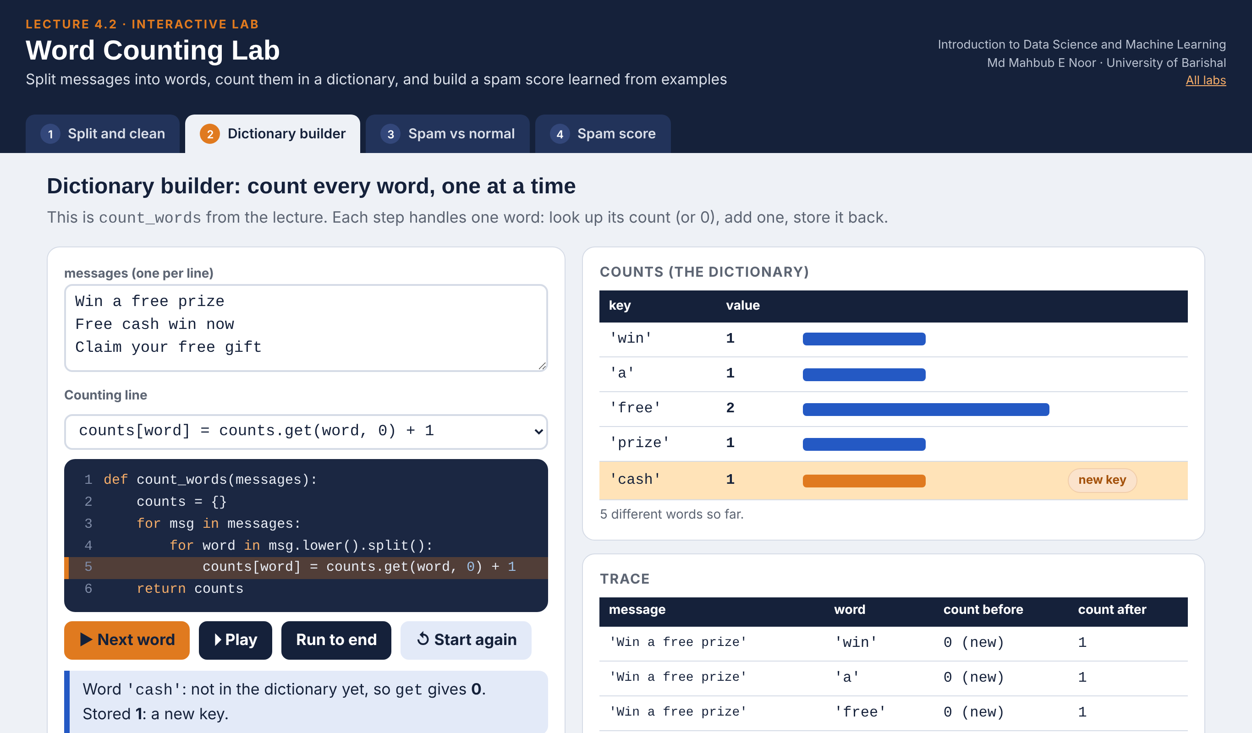
Interactive lab: Word Counting Lab
In the lab you can
1 Split and clean
See .lower() and .split() turn a message into words.
2 Dictionary builder
Watch counts.get(word, 0) + 1 fill the dictionary.
3 Spam vs normal
Compare word counts in spam and normal examples.
4 Spam score
Score new messages, then teach the filter more examples.
Open the lab ►
Works offline in any browser
Labs_open_in_browser/
L4.2_Word_Counting_Lab.html
Md Mahbub E Noor
Lecture 4.2: Counting words with dictionaries
University of Barishal
14 / 17
Notes:
Open the Word Counting Lab (double-click; works offline). Dictionary builder: press Play, then switch the counting line to counts[word] + 1 to show the KeyError live. Spam score: find the best threshold together, then teach five spam examples and no normal ones to show how unbalanced data creates false alarms. If a student teaches a test message, the lab flags it as unfair: a first look at leakage (Lecture 12).

Slide 15
Today's toolkit
def f(x): | Define a function with input x
return value | Hand back the answer
text.split() | Cut text into a list of words
d = {"a": 1} | A dictionary: key → value
d["a"] | Look up a key (error if missing)
d.get("a", 0) | Look up, or 0 if missing
d["a"] = 5 | Add or change a key
d.get(k, 0) + 1 | The word-counting pattern
Md Mahbub E Noor
Lecture 4.2: Counting words with dictionaries
University of Barishal
15 / 17
Notes:
Today's toolkit. Next lecture we leave toy examples behind: we load more than five thousand real SMS messages with a library called pandas. Everything you learned today, counting, comparing spam and ham, still applies; pandas just does it at scale.

Slide 16
Homework 4.2
Due before Lecture 5 · [date]
1
From memory
2
Longest word
3
Bigger training set
Without looking, write count_words() again and test it on 3 sentences. Then compare with the slide.
Write longest_word(message) that returns the longest word. Test: "Claim your fantastic prize" should give "fantastic".
Add 5 spam and 5 normal messages of your own. Recount, then print the spam and ham counts for 5 words you choose.
4
Test the score
5
Think ahead
Run spam_score on 6 new messages. How many does it get right? Explain one mistake.
What would happen to spam_score if we had 1,000 spam examples but only 10 normal ones? Answer in 3 sentences.
Submit on [LMS / Google Classroom]: your notebook file HW4_2_<your ID>.ipynb, or a Colab link set to “Anyone with the link can view”.
Md Mahbub E Noor
Lecture 4.2: Counting words with dictionaries
University of Barishal
16 / 17
Notes:
Homework 4. Task 1 is retrieval practice: writing from memory is harder than copying, and much better for learning. Task 2 solution: def longest_word(message): best = ''; for word in message.split(): if len(word) > len(best): best = word; return best. Task 5 prepares Lecture 5 and 6: with 1,000 spam and 10 ham examples, raw spam counts would dwarf ham counts, so almost everything scores as spam. The fix is to compare proportions, not raw counts, which is what Naive Bayes does. Give full credit for any answer that notices the unfairness.

Slide 17

Recap: Lecture 4.2 in 90 seconds
Click to play or pause. Watch it again at home to revise.
Md Mahbub E Noor
Lecture 4.2: Counting words with dictionaries
University of Barishal
17 / 17
Notes:
Play this at the end of class, or leave it for students to revise at home. It is silent: pause on each card and ask the class for an example.

