Slide 1
PRACTICE CLASS 1
Practice: regression and classification
Today's key line of code
mean_absolute_error(y_te, pred)
model.score(X_te, y_te)
Hand calculations first, then code
Introduction to Data Science · Md Mahbub E Noor · University of Barishal
Notes:
Practice class 1. No new theory today: students work through problems on Lectures 9 and 10. Part A is on paper, Part B in Jupyter. Solutions are after the divider; show them only after attempts.

Slide 2
How today works
1
2
3
Part A: by hand (30 min)
Part B: in code (40 min)
Check (20 min)
We compare answers together. Being wrong and finding out why is the point of today.
Four small calculations on paper. They make sure you know what the code is doing.
Four tasks in a new notebook, Practice1. Work in pairs, one keyboard, switch every task.
Md Mahbub E Noor
Practice 1: Regression and classification
University of Barishal
2 / 14
Notes:
Set a visible timer. Walk around during Part A; most errors are arithmetic, not concepts. For Part B, pairs should switch typist after every task.

Slide 3
Part A: by hand
Write every step. A calculator is fine; Python is not, yet.
1
A1: MAE
2
A2: best line
Actual: 10, 12, 15, 20. Predicted: 11, 12, 13, 22. Compute every error and the MAE.
x: 1, 2, 3 and y: 3, 5, 10. Find the least-squares slope and intercept with the table method.
3
A3: k-nearest neighbours
4
A4: follow the tree
Points A (1,1), (2,2), (1,4) and B (5,5), (6,3), (5,2). New point (4, 3.5). Predict with k = 1, 3 and 5.
Rules: petal width ≤ 0.75: setosa; else petal length ≤ 4.75: versicolor; else virginica. Classify (1.4, 0.2), (4.9, 1.5), (4.5, 1.3), given as (length, width).
Md Mahbub E Noor
Practice 1: Regression and classification
University of Barishal
3 / 14
Notes:
A4 has a deliberate near-boundary case: 4.9 is just above 4.75, so virginica, even though such a flower may really be versicolor. Good for discussing that rules have sharp edges.

Slide 4
Part B: in code
Use only built-in datasets, so everything works offline. Fix random_state=0 so we can compare answers.
1
B1: best single feature
2
B2: choose k
Diabetes data: for each of the 10 features alone, fit LinearRegression and print test MAE. Which feature is best?
Wine data: test accuracy of k-NN for k = 1 to 15. Plot accuracy against k.
3
B3: tree depth
4
B4: three models
Wine data: training and test accuracy of trees with max_depth 1 to 6. Where does test accuracy stop improving?
Breast cancer data: compare k-NN, a depth-3 tree and GaussianNB on the same split. Report a small table.
Md Mahbub E Noor
Practice 1: Regression and classification
University of Barishal
4 / 14
Notes:
Expected time is about ten minutes per task. If a pair finishes early, ask them to repeat B2 with a different random_state and see whether the best k changes.

Slide 5
Solutions
Show after students have attempted Part A and Part B.
Md Mahbub E Noor
Practice 1: Regression and classification
University of Barishal
5 / 14
Notes:
Solutions.

Slide 6
A1 solution: MAE
Error = actual - predicted. MAE = average size of the errors = 5 / 4 = 1.25.
Code
actual
predicted
error
|error|
# MAE = (1 + 0 + 2 + 2) / 4
# = 5 / 4 = 1.25
10
11
-1
1
12
12
0
0
15
13
2
2
20
22
-2
2
MAE
1.25
Click to reveal the next row. Predict it first!
Md Mahbub E Noor
Practice 1: Regression and classification
University of Barishal
6 / 14
Notes:
Common slip: averaging the signed errors, which gives 0.25 because positive and negative errors cancel. That is exactly why MAE uses the size of each error.

Slide 7
A2 solution: best line
Means: x = 2, y = 6. slope = 7 / 2 = 3.5. intercept = 6 - 3.5 × 2 = -1. Line: y = 3.5x - 1.
Code
x
y
x - 2
y - 6
product
(x - 2)²
from sklearn.linear_model import LinearRegression
m = LinearRegression().fit([[1], [2], [3]], [3, 5, 10])
print(m.coef_.round(2), round(m.intercept_, 2))
1
3
-1
-3
3
1
2
5
0
-1
0
0
Output
3
10
1
4
4
1
[3.5] -1.0
sum
7
2
Click to reveal the next row. Predict it first!
Md Mahbub E Noor
Practice 1: Regression and classification
University of Barishal
7 / 14
Notes:
The code confirms the hand result. A negative intercept is fine: it only says where the line crosses zero, which may be outside the useful range.

Slide 8
A3 solution: k-nearest neighbours from (4, 3.5)
k = 1: B. k = 3: B, B, B, so B. k = 5: three B and two A, so B. Ties in distance do not matter here: both tied points are B.
Code
rank
point
class
distance
from sklearn.neighbors import KNeighborsClassifier
X = [[1, 1], [2, 2], [1, 4], [5, 5], [6, 3], [5, 2]]
y = ["A", "A", "A", "B", "B", "B"]
for k in [1, 3, 5]:
knn = KNeighborsClassifier(n_neighbors=k).fit(X, y)
print(k, knn.predict([[4, 3.5]]))
1
(5, 2)
B
1.80
2
(5, 5)
B
1.80
3
(6, 3)
B
2.06
4
(2, 2)
A
2.50
Output
1 ['B']
3 ['B']
5 ['B']
5
(1, 4)
A
3.04
6
(1, 1)
A
3.91
Click to reveal the next row. Predict it first!
Md Mahbub E Noor
Practice 1: Regression and classification
University of Barishal
8 / 14
Notes:
Compare with the lecture example at (3, 5.5), where k changed the answer. Here all three k agree because the new point sits clearly in B territory.

Slide 9
A4 solution: follow the tree
Flower (length, width) | Question 1: width ≤ 0.75? | Question 2: length ≤ 4.75? | Answer
(1.4, 0.2) | yes | not asked | setosa
(4.9, 1.5) | no | no (4.9 > 4.75) | virginica
(4.5, 1.3) | no | yes | versicolor
Md Mahbub E Noor
Practice 1: Regression and classification
University of Barishal
9 / 14
Notes:
The middle flower is the interesting one: 4.9 is just over the threshold. Real flowers near a boundary are where trees, and all models, make most of their mistakes.

Slide 10
B1 solution: best single feature
Loop over the columns, keep everything else the same. A fair comparison changes one thing at a time.
Code
from sklearn.datasets import load_diabetes
from sklearn.model_selection import train_test_split
from sklearn.metrics import mean_absolute_error
data = load_diabetes(as_frame=True)
results = {}
for col in data.data.columns:
X_tr, X_te, y_tr, y_te = train_test_split(
data.data[[col]], data.target, test_size=0.25, random_state=0)
pred = LinearRegression().fit(X_tr, y_tr).predict(X_te)
results[col] = round(mean_absolute_error(y_te, pred), 1)
print(sorted(results.items(), key=lambda kv: kv[1]))
Output
[('s5', 49.8), ('bp', 50.8), ('s6', 52.7), ('s4', 52.9),
('bmi', 53.3), ('s1', 55.9), ('s3', 56.0), ('s2', 56.3),
('age', 56.8), ('sex', 58.0)]
Md Mahbub E Noor
Practice 1: Regression and classification
University of Barishal
10 / 14
Notes:
The key with lambda sorts the pairs by their second value, the MAE. Students who did not know this can simply read the printed dictionary and find the smallest value by eye.

Slide 11
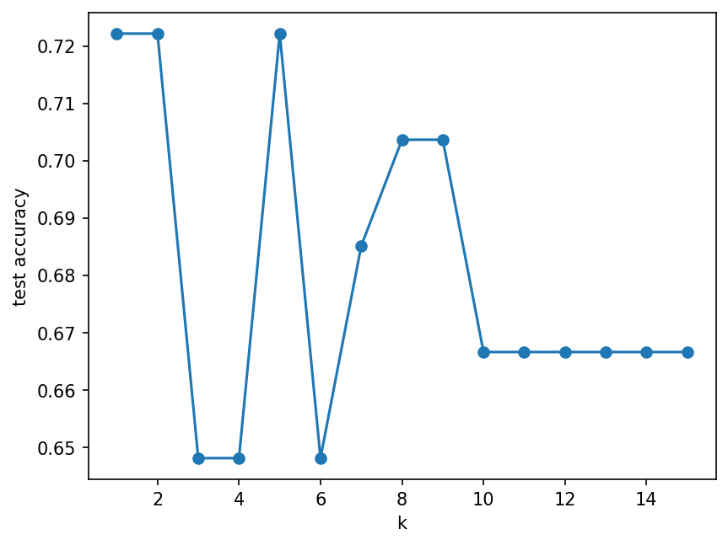
B2 solution: choosing k on the wine data
Accuracy depends strongly on k here, and it is low overall. Lecture 12 shows why: the wine features have very different scales.
Code
import matplotlib.pyplot as plt
from sklearn.datasets import load_wine
Xw, yw = load_wine(return_X_y=True)
Xw_tr, Xw_te, yw_tr, yw_te = train_test_split(
Xw, yw, test_size=0.3, random_state=0, stratify=yw)
ks = range(1, 16)
accs = [KNeighborsClassifier(n_neighbors=k).fit(Xw_tr, yw_tr)
.score(Xw_te, yw_te) for k in ks]
plt.plot(list(ks), accs, marker="o")
plt.xlabel("k")
plt.ylabel("test accuracy")
plt.show()
Md Mahbub E Noor
Practice 1: Regression and classification
University of Barishal
11 / 14
Notes:
Keep this plot in mind: after scaling in Lecture 12, the same experiment gives much higher accuracy. Choosing k on the test set is still a small cheat; Lecture 11 fixes it.

Slide 12
B3 solution: tree depth on wine
Training accuracy keeps rising to 1.0 · Test accuracy stops improving early · The gap is overfitting · Prefer the shallowest tree with near-best test accuracy
Code
from sklearn.tree import DecisionTreeClassifier
for d in range(1, 7):
t = DecisionTreeClassifier(max_depth=d, random_state=0)
t.fit(Xw_tr, yw_tr)
print(d, round(t.score(Xw_tr, yw_tr), 3),
round(t.score(Xw_te, yw_te), 3))
Output
1 0.702 0.667
2 0.927 0.852
3 0.984 0.963
4 1.0 0.944
5 1.0 0.944
6 1.0 0.944
Md Mahbub E Noor
Practice 1: Regression and classification
University of Barishal
12 / 14
Notes:
Columns: depth, training accuracy, test accuracy. This is the overfitting story of Lecture 11 in numbers.

Slide 13
B4 solution: three models on breast cancer
Same split for every model: fair comparison · Scores are close: no single winner by far · Next lectures: test more reliably (11), prepare features (12) · Write results as a small table in your report
Code
from sklearn.datasets import load_breast_cancer
from sklearn.naive_bayes import GaussianNB
Xb, yb = load_breast_cancer(return_X_y=True)
Xb_tr, Xb_te, yb_tr, yb_te = train_test_split(
Xb, yb, test_size=0.3, random_state=0, stratify=yb)
for name, m in [("kNN", KNeighborsClassifier()),
("tree d=3", DecisionTreeClassifier(max_depth=3,
random_state=0)),
("GaussianNB", GaussianNB())]:
m.fit(Xb_tr, yb_tr)
print(name, round(m.score(Xb_te, yb_te), 3))
Output
kNN 0.912
tree d=3 0.901
GaussianNB 0.924
Md Mahbub E Noor
Practice 1: Regression and classification
University of Barishal
13 / 14
Notes:
Ask: with scores this close, would you trust a single split to choose? This question motivates cross-validation in the next lecture.

Slide 14
Homework P1
Due before Lecture 11 · [date]
1
Finish
2
Reflect
3
One change
Complete any task from Part A or B you did not finish, in your Practice1 notebook.
In a text cell: which hand calculation helped you understand the code most, and why?
Repeat B4 with random_state=1. Did the ranking of the three models change? What does that tell you?
Submit on [LMS / Google Classroom]: your notebook file HWP1_<your ID>.ipynb, or a Colab link set to “Anyone with the link can view”.
Md Mahbub E Noor
Practice 1: Regression and classification
University of Barishal
14 / 14
Notes:
Short homework: the practice class itself is the main work. Task 3 sets up cross-validation.

