Slide 1
PRACTICE CLASS 3
Practice: a complete mini-project
Today's key line of code
baseline -> candidates -> CV -> test once
Recognising handwritten digits, from question to report
Introduction to Data Science · Md Mahbub E Noor · University of Barishal
Notes:
Practice class 3 is a rehearsal for the final project: one small, complete project in a single lab session. Students type along step by step; every step is a cell in their notebook.

Slide 2
Today's project brief
1
2
3
Question
Data
Deliverable
Can a model recognise handwritten digits 0 to 9 from small 8×8 pixel images?
1,797 images, built into scikit-learn, so it works offline in the lab.
A clean notebook (restart and run all) and a one-page report.
Md Mahbub E Noor
Practice 3: An end-to-end mini-project
University of Barishal
2 / 14
Notes:
Read the brief aloud. Ask: is this classification or regression? Supervised or unsupervised? (Classification, supervised.)

Slide 3
The plan for today
1
2
3
4
5
6
7
Look
Split
Baseline
Candidates
Tune
Test once
Report
10 min
5 min
5 min
15 min
15 min
10 min
20 min
This order never changes. Write a text cell above every step explaining what and why.
Md Mahbub E Noor
Practice 3: An end-to-end mini-project
University of Barishal
3 / 14
Notes:
The time boxes keep the session moving. If a step overruns, use the code on the slide and continue.

Slide 4
Step 1: look at the data
Each image is 8×8 pixels, stored as 64 numbers from 0 (white) to 16 (black). The label is the digit.
Code
import matplotlib.pyplot as plt
from sklearn.datasets import load_digits
digits = load_digits()
X, y = digits.data, digits.target
print(X.shape)
fig, axes = plt.subplots(2, 5, figsize=(8, 3.6))
for ax, img, label in zip(axes.ravel(), digits.images, y):
ax.imshow(img, cmap="gray_r")
ax.set_title(label)
ax.axis("off")
plt.show()
Output
(1797, 64)
Md Mahbub E Noor
Practice 3: An end-to-end mini-project
University of Barishal
4 / 14
Notes:
64 features per image: every pixel is a feature. Looking at a few examples first is never wasted time; here it shows how coarse the images are.

Slide 5
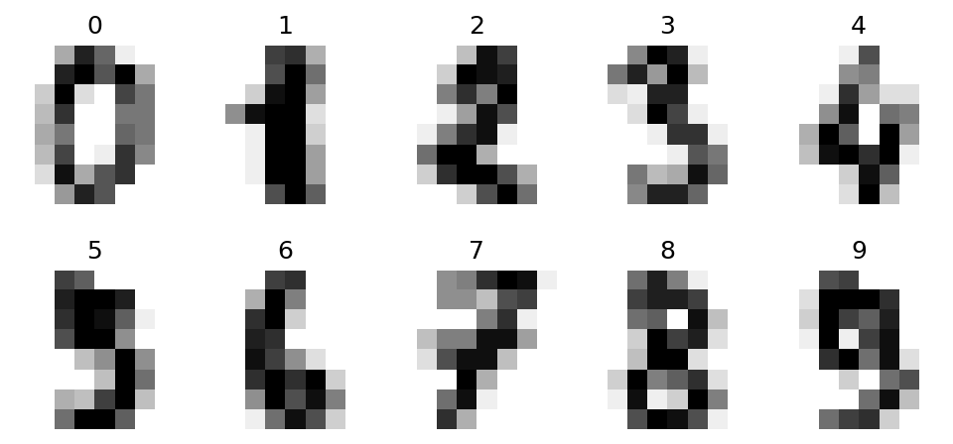
Step 1: look at the data: the result
Md Mahbub E Noor
Practice 3: An end-to-end mini-project
University of Barishal
5 / 14
Notes:
64 features per image: every pixel is a feature. Looking at a few examples first is never wasted time; here it shows how coarse the images are.

Slide 6
Step 1 (continued): are the classes balanced?
bincount counts each digit
Code
import numpy as np
print(np.bincount(y))
About 180 of each: balanced
So accuracy is a fair main metric
Output
[178 182 177 183 181 182 181 179 174 180]
Still check per-digit results at the end
Md Mahbub E Noor
Practice 3: An end-to-end mini-project
University of Barishal
6 / 14
Notes:
Compare with the spam data, which was very imbalanced. Because the classes here are balanced, accuracy is meaningful.

Slide 7
Step 2 and 3: split, then a baseline
Split once, with stratify, and put the test set away · Baseline: always guess the most common digit · About 10%: the score to beat · Every result in the report is compared with this
Code
from sklearn.model_selection import train_test_split
from sklearn.dummy import DummyClassifier
X_tr, X_te, y_tr, y_te = train_test_split(
X, y, test_size=0.25, random_state=0, stratify=y)
base = DummyClassifier(strategy="most_frequent").fit(X_tr, y_tr)
print(round(base.score(X_te, y_te), 3))
Output
0.102
Md Mahbub E Noor
Practice 3: An end-to-end mini-project
University of Barishal
7 / 14
Notes:
With ten balanced classes, a guesser gets about one in ten right. Any real model must clearly beat that.

Slide 8
Step 4: compare candidate models with cross-validation
Three models, same folds, training data only · k-NN inside a scaling pipeline · A tree and Naive Bayes for comparison · Pick the best mean for tuning
Code
Output
from sklearn.model_selection import cross_val_score
from sklearn.pipeline import make_pipeline
from sklearn.preprocessing import StandardScaler
from sklearn.neighbors import KNeighborsClassifier
from sklearn.tree import DecisionTreeClassifier
from sklearn.naive_bayes import GaussianNB
knn = make_pipeline(StandardScaler(),
KNeighborsClassifier())
tree = DecisionTreeClassifier(random_state=0)
cands = {"kNN": knn, "tree": tree,
"GaussianNB": GaussianNB()}
for name, m in cands.items():
s = cross_val_score(m, X_tr, y_tr, cv=5)
print(name, round(s.mean(), 3), round(s.std(), 3))
kNN 0.969 0.004
tree 0.837 0.024
GaussianNB 0.834 0.018
Md Mahbub E Noor
Practice 3: An end-to-end mini-project
University of Barishal
8 / 14
Notes:
Printing the standard deviation of the five fold scores shows how stable each model is. The test set has still not been touched.

Slide 9
Step 5: tune the best candidate
Try several k, judged by cross-validation · k = 1 has the best mean here · But all values are within about 0.004 · Such small differences are mostly noise
Code
for k in [1, 3, 5, 7, 9]:
m = make_pipeline(StandardScaler(),
KNeighborsClassifier(n_neighbors=k))
print(k, round(cross_val_score(m, X_tr, y_tr, cv=5).mean(), 3))
Output
1 0.973
3 0.969
5 0.969
7 0.97
9 0.971
Md Mahbub E Noor
Practice 3: An end-to-end mini-project
University of Barishal
9 / 14
Notes:
Discuss what to choose when two values of k are within a few thousandths: such differences are smaller than the fold-to-fold variation from the previous slide.

Slide 10
Step 6: test once
Fit the chosen model on all training data
Code
from sklearn.metrics import recall_score
final = make_pipeline(StandardScaler(),
KNeighborsClassifier(n_neighbors=1))
final.fit(X_tr, y_tr)
pred = final.predict(X_te)
print(round(final.score(X_te, y_te), 3))
rec = recall_score(y_te, pred, average=None)
print(rec.round(2))
One test score, compared with the 10% baseline
Per-digit recall shows which digits are hard
Output
This is the number for your report
0.967
[1. 0.98 0.98 0.93 0.98 0.98 1. 1. 0.95 0.87]
Md Mahbub E Noor
Practice 3: An end-to-end mini-project
University of Barishal
10 / 14
Notes:
We use k = 1, the best cross-validation mean; students who picked another k should use their own choice. average=None gives one recall value per digit, from 0 to 9. Honest surprise for discussion: on this particular test set, k = 3 would have scored a little higher, but we could only know that by peeking. Choosing by cross-validation is still the right method; small differences like this are noise.

Slide 11
Step 6 (continued): look at the mistakes
Looking at errors often teaches more than the score. Would you have read these correctly?
Code
wrong = np.where(pred != y_te)[0][:6]
imgs = X_te.reshape(-1, 8, 8)
fig, axes = plt.subplots(1, 6, figsize=(9, 2.2))
for ax, i in zip(axes, wrong):
ax.imshow(imgs[i], cmap="gray_r")
ax.set_title(f"true {y_te[i]}, said {pred[i]}")
ax.axis("off")
plt.show()
Md Mahbub E Noor
Practice 3: An end-to-end mini-project
University of Barishal
11 / 14
Notes:
Many misread digits are genuinely ambiguous even to people. Error analysis like this belongs in every project report.

Slide 12
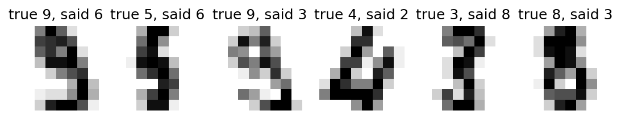
Step 6 (continued): look at the mistakes: the result
Md Mahbub E Noor
Practice 3: An end-to-end mini-project
University of Barishal
12 / 14
Notes:
Many misread digits are genuinely ambiguous even to people. Error analysis like this belongs in every project report.

Slide 13
Step 7: the one-page report
Section | What to write
Question | What you predict, and why it matters
Data | Source, size, features, label, class balance
Method | Split, baseline, candidate models, how you chose (cross-validation)
Results | Baseline vs final test score; per-class recall; a small table
Errors | 2 or 3 examples of mistakes and a guess why
Limits | What could make the result misleading; what you would try next
Md Mahbub E Noor
Practice 3: An end-to-end mini-project
University of Barishal
13 / 14
Notes:
This template is also the structure for the final project report. Keep it to one page: clarity matters more than length.

Slide 14
Homework P3
Due before Lecture 14 · [date]
1
Clean notebook
2
One-page report
3
One improvement
Restart and run all. Every step has a text cell explaining it.
Write the report using the template, with your own numbers.
Try one idea to beat your score (another model, another k, a different setting). Report it honestly, even if it fails.
Submit on [LMS / Google Classroom]: your notebook file HWP3_<your ID>.ipynb, or a Colab link set to “Anyone with the link can view”.
Md Mahbub E Noor
Practice 3: An end-to-end mini-project
University of Barishal
14 / 14
Notes:
Grade the report on honesty and clarity: a clearly reported failed idea is worth more than an unexplained high score.

