Slide 1



Sunset Vacation
This Photo by Unknown author is licensed under CC BY.
Group 2 (A2)
1705040
1705042
1705043
1705048
1705060
1605051

Slide 2
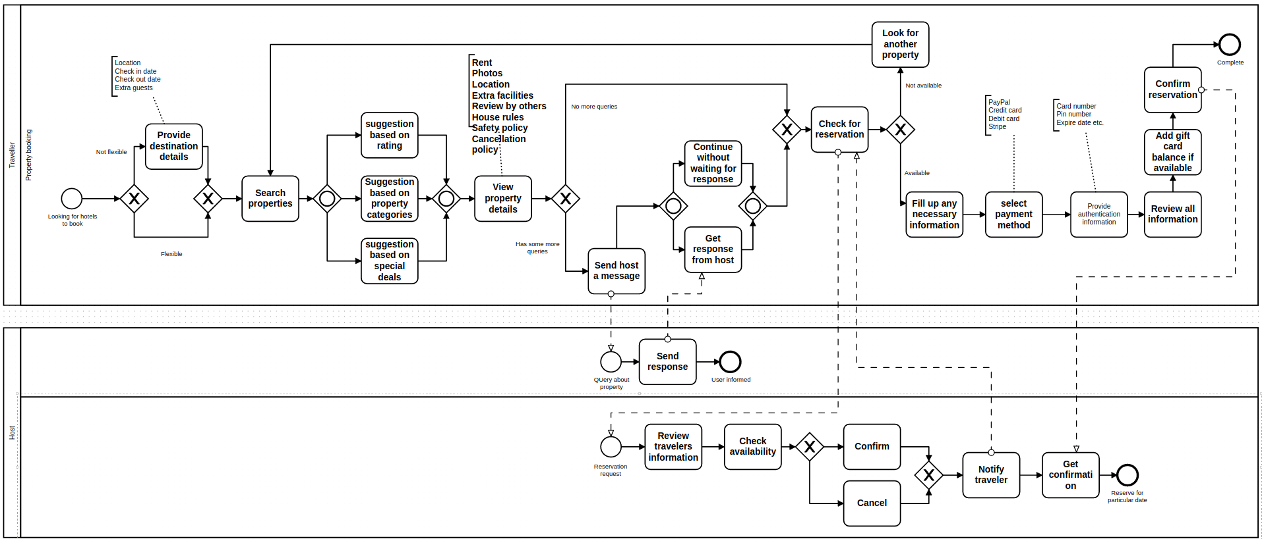
BOOKING MODULE
Hotel/Resort Booking

Slide 3
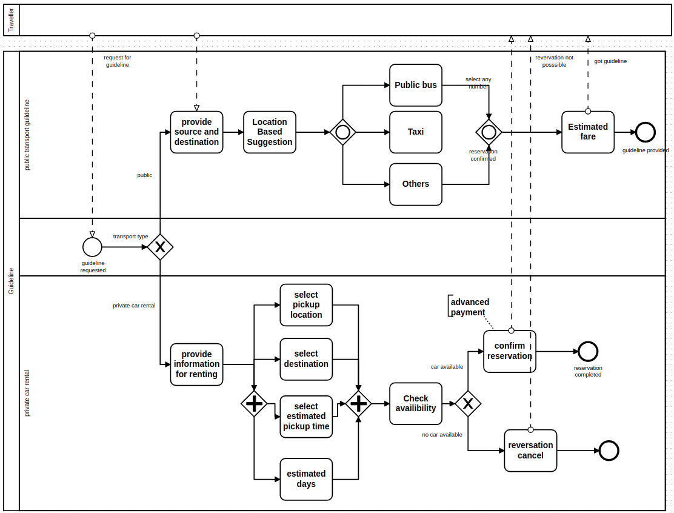
BOOKING MODULE
Transport Guideline

Slide 4
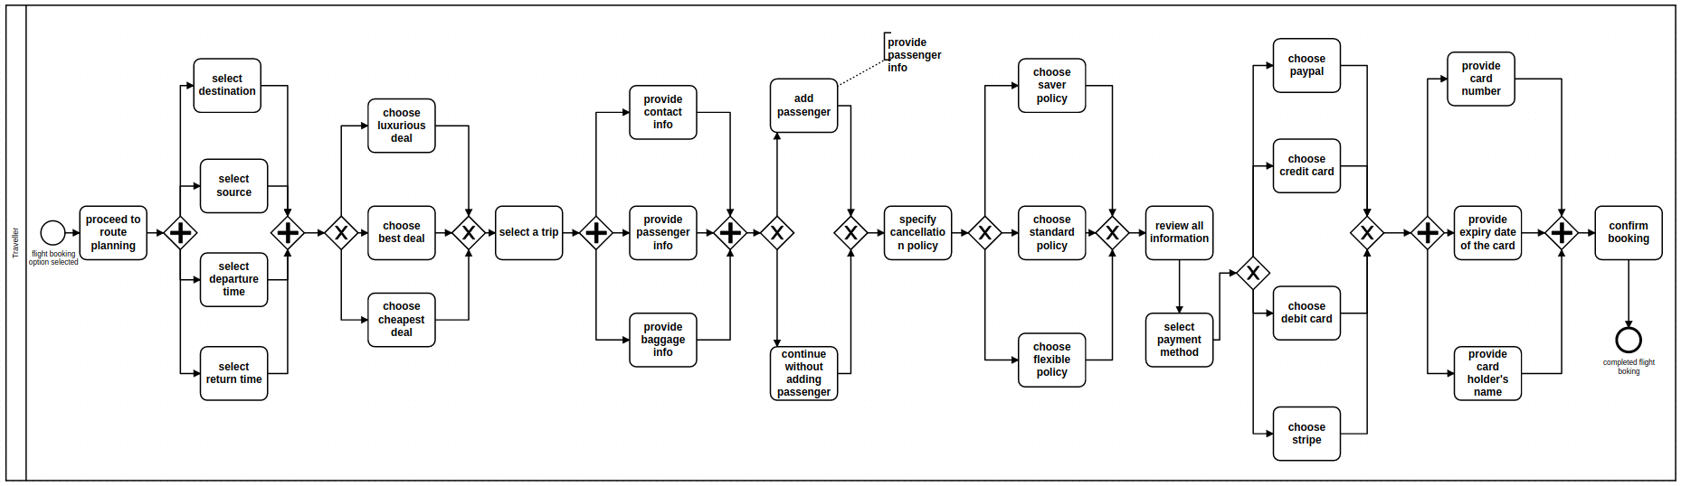
BOOKING MODULE
Flight Booking

Slide 5
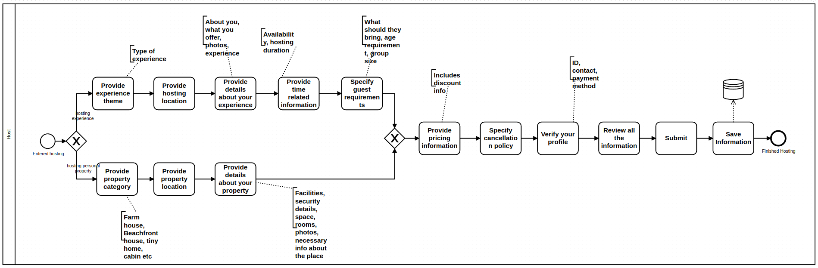
HOSTING MODULE
Hosting Property/Experience

Slide 6
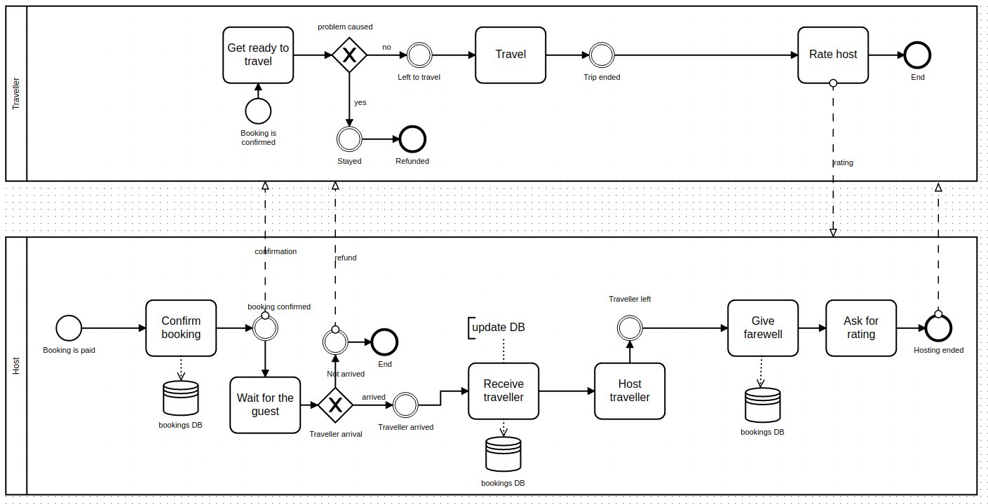
HOSTING MODULE
Management Dashboard

Slide 7
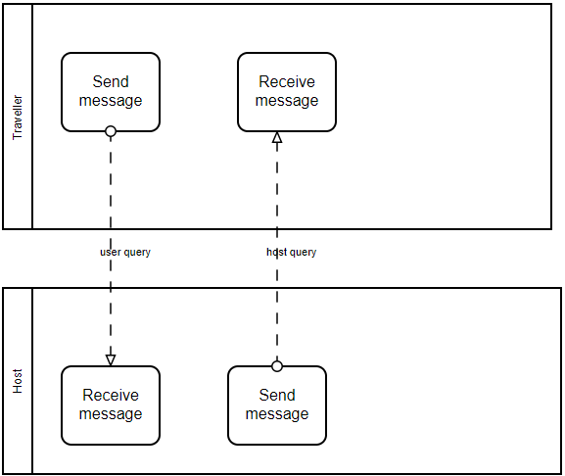
COMMUNICATION MODULE
Communication Between
Host and Travellers

Slide 8
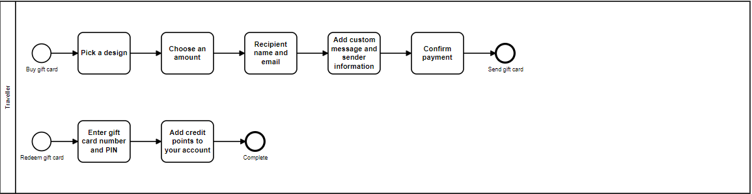
COMMUNICATION MODULE
Sending Gift Cards

Slide 9
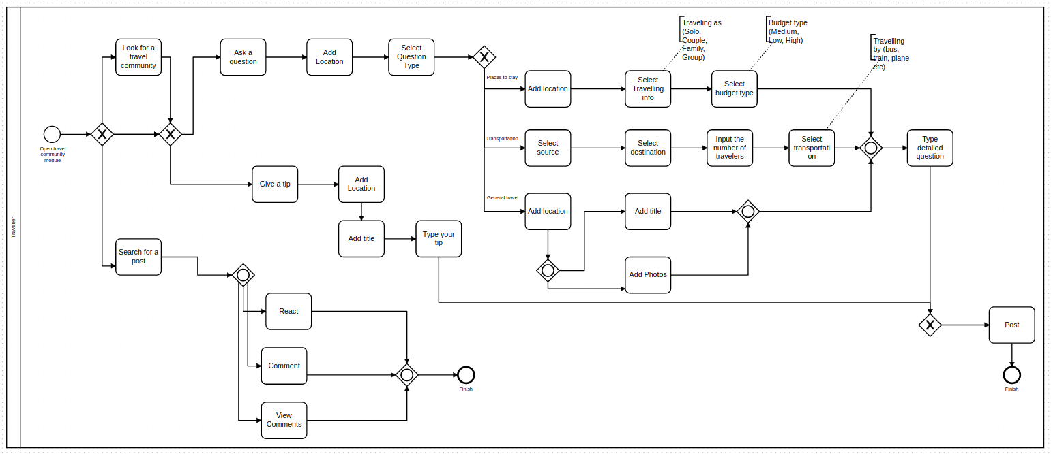
Communication Module
Communication between travelers

Slide 10
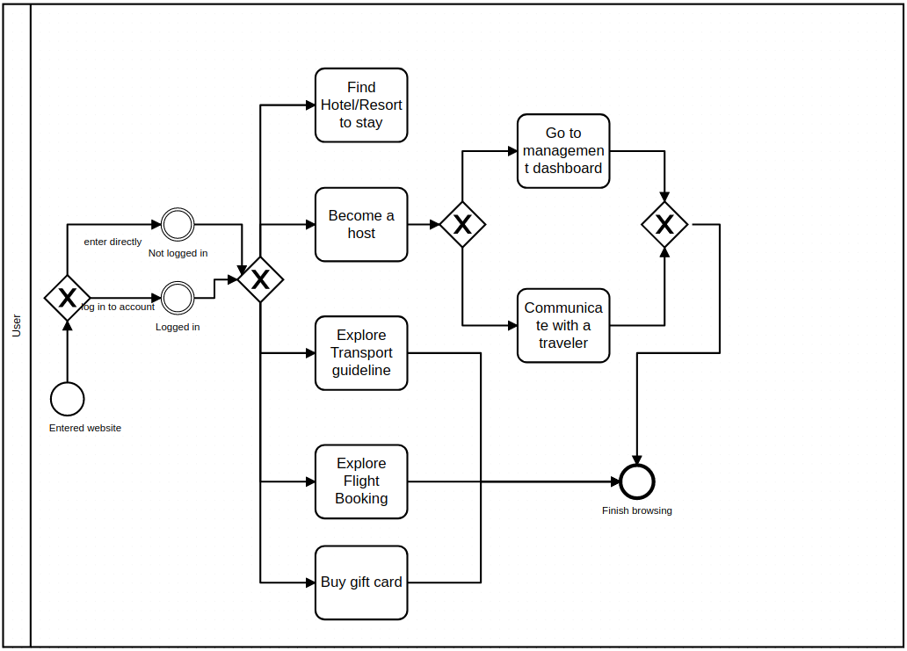
Overview

