Slide 2

Control Flow in Python
Maliheh Mahdavi Sefat
June 2024
https://www.youtube.com/@csinternship8859

Slide 3
print(‘Welcome!’)
#cs_internship
#machine_learning
#step2
Collections, Control Flows,
and Linear Algebra

Slide 4
Agenda
01
What is control flow?
Controlling the runtime execution flow
02
How does control flow work?
The interpreter decides which line gets executed depending on the structure
03
Control flow structures
Sequential, Loops, Conditional, Exception, Function,…
04
Code examples
Let’s go over to Sublime Text

Slide 5
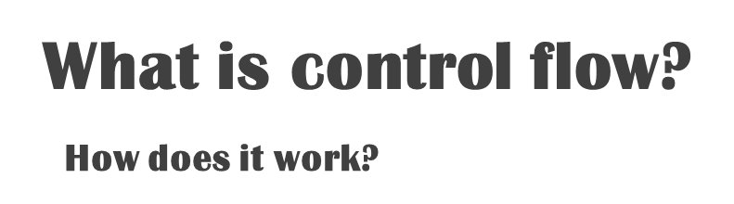

Controlling the flow of
the runtime execution
The control flow in Python occurs during runtime when the Python interpreter processes the bytecode generated by the compiler.
The interpreter sequentially executes the bytecode, making decisions based on conditions, iterating through loops, handling function calls, and managing exceptions
to control the flow of the program.
This process can be compared to a virtual cursor
moving through the code, executing instructions
based on the defined control flow structures.
When and how does it happen?

Slide 6








Control flow structures
()
Function
Exception handling
Class
Jump statement
Conditional statement
Loops
Switch statements
Sequential execution
Nested

Slide 7


Sequential Execution:
In sequential execution, statements are executed in the order they appear in the code, from top to bottom.
. …
line n - 2
line n - 1
line n
line n + 1
line n + 2
. …
The control flow is always sequential, unless it has another specific structure.
1

Slide 8

Conditional Statements:
2
Conditional statements allow the program to make decisions based on certain conditions.
These statements evaluate a condition and execute different blocks of code based on whether the condition evaluates to true or false.
if condition 1:
body 1
elif condition 2:
body 2
…
else:
body n

Slide 9

Loops:
3
Loops allow the control flow to repeat a block of code multiple times.
The most common types of loops are
for and while loops.
while condition1:
body 1
for item in …:
body 2
While loops can provide indefinite (uncounted) iteration.
For loops can provide definite, (counted) iteration.
These loops continue executing as long as a specified condition is met.
Loops have the potential to iterate over objects that are a member of an iterable.

Slide 10


4
Function Calls:
Functions are reusable blocks of code that can be called from different parts of a program to do some operations.
When a function is called, the program jumps to the function's code, executes it, and then returns to the point where it was called.
def function(arguments):
body
return …
…
…
function(arguments)

Slide 11
Exception Handling:
try:
# might be error
except Exception1:
# handle1
raise <error1>
…
finally:
# code
Exception handling allows you to handle errors or exceptional situations that may occur during program execution.
This includes
try
,
catch
, and
Finally
blocks to manage exceptions gracefully.
5

Slide 12
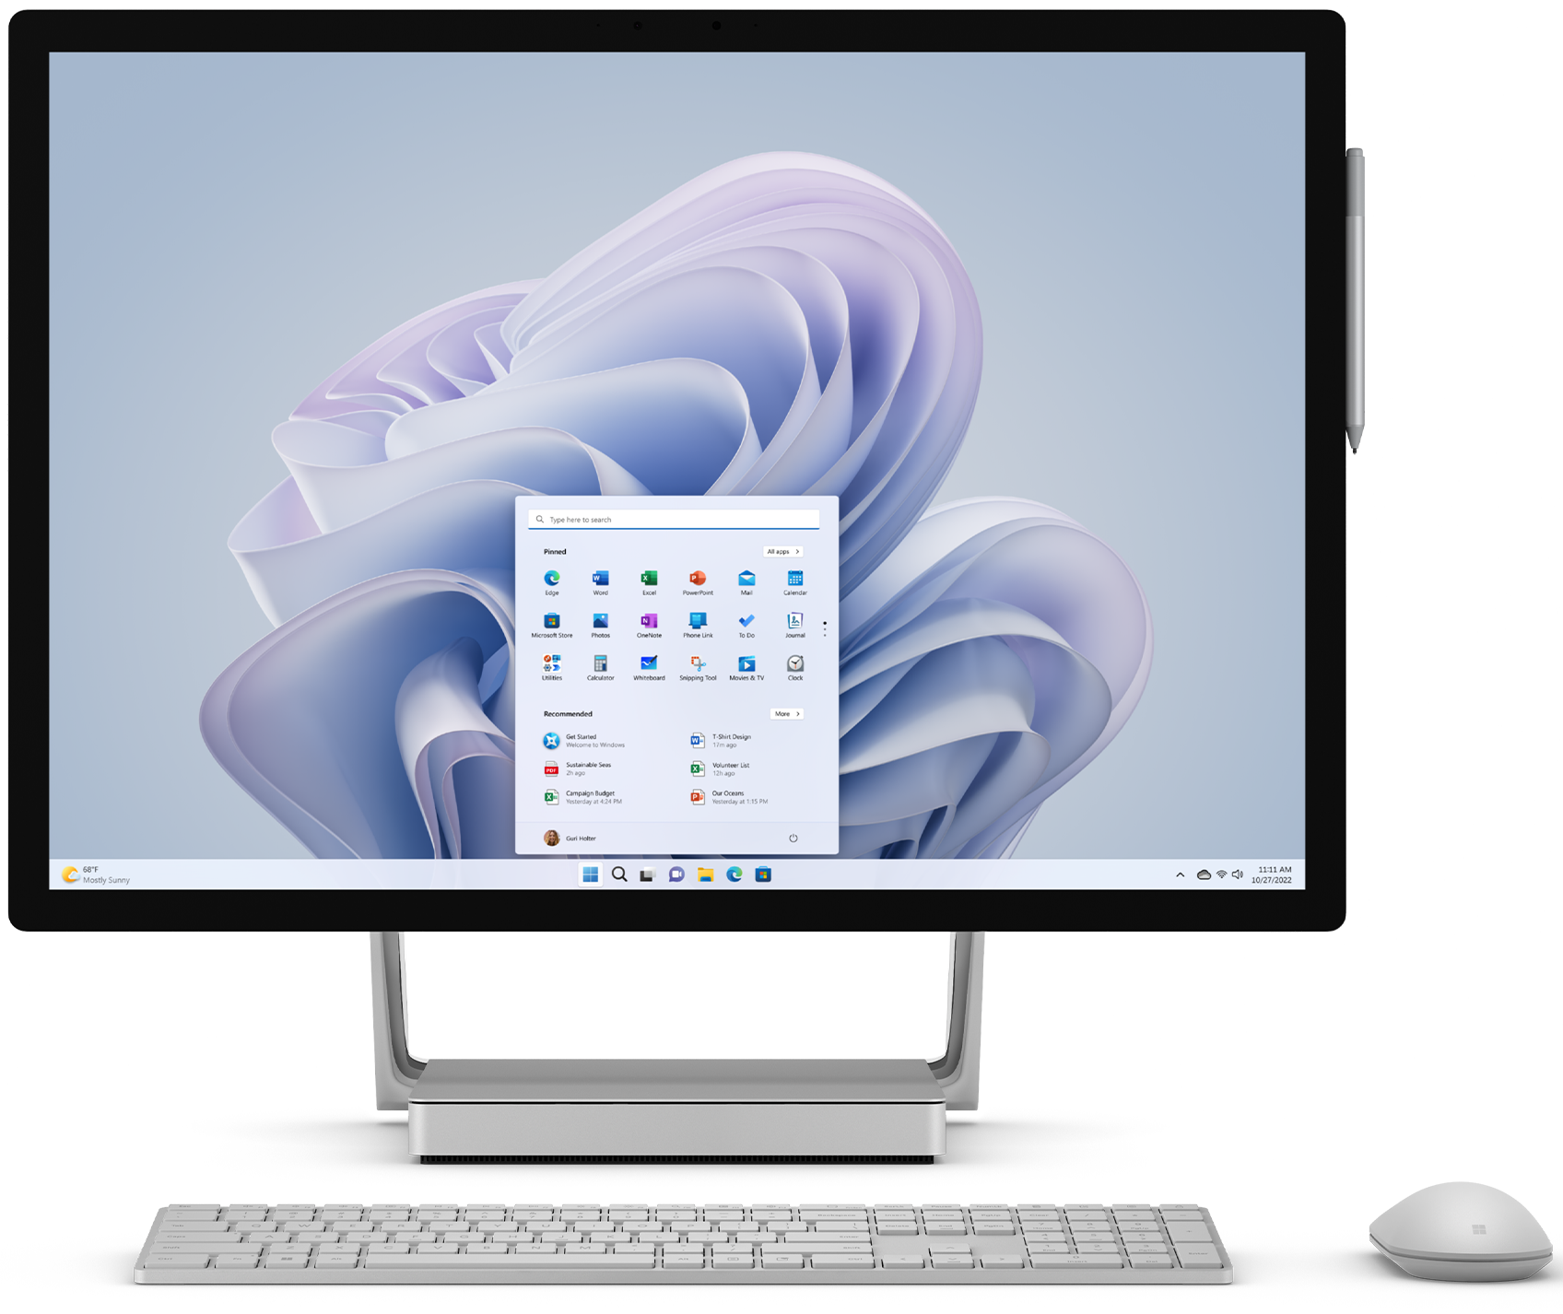
6
def switch_example(value):
switcher = {
'a': "first",
'b': "second",
'c': "third",
}
return switcher.get(value, "Invalid")
print(switch_example('b’))
# Output: second
Switch
statement:
Switch statements provide an alternative way to make decisions based on multiple possible values of a variable.
They allow you to compare a variable against multiple values and execute different blocks of code based on the matching value.

Slide 13

7
Class
A class is a blueprint for creating objects of certain species, defining the properties and behaviors that the created objects (instances) will have.
A class instance is an individual object created using the class blueprint, with its own unique set of data attributes and methods as defined by the class.
class MyClass:
class_attribute = <default value>
def __init__(self, arg1, …):
self.instance_attr1 = arg1
…
def method1(self):
body
…
my_instance = MyClass(args)

Slide 14
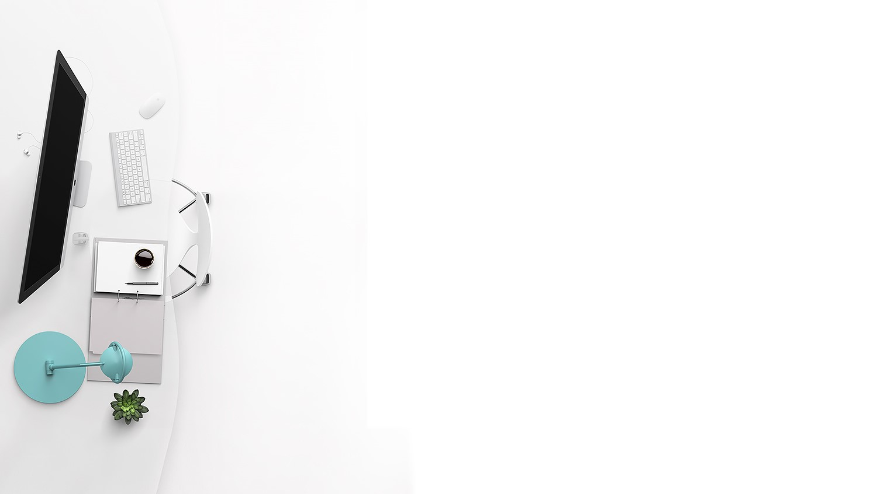
Jump statements
These statements allow a program to transfer
control to a different part of the code, skipping
or jumping over certain sections.
break
…
continue
…
return
8

Slide 15

Thank you
For watching my presentation

