Slide 1







Hi..! Nice to meet you
I'm Takehiro Kanegi
Check the next slide to learn more

Slide 2

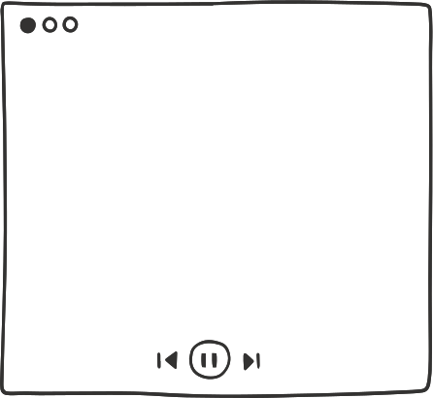
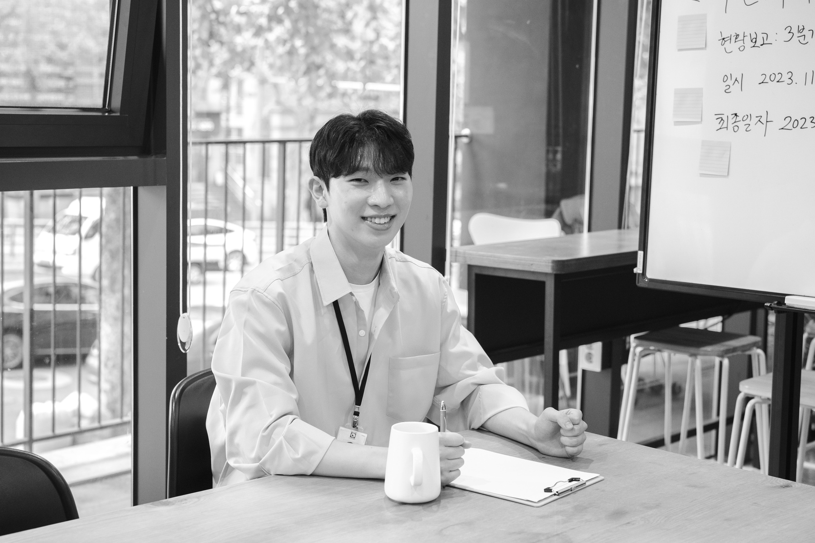

Call Me Hiro
Hi everyone, welcome to my self-introduction presentation. My name is Takehiro Kanegi, but you can call me Hiro..

Slide 3



Get to Know Me Better
I am 25 years old, born and living in Anywhere St. This beloved city has created many memories for me.

Slide 4







Things I Like
I like automotive
I like challenging sports
I like... you

Slide 5




My Hobbies
I love traveling around the world to photograph landscapes and beautiful moments.

Slide 6
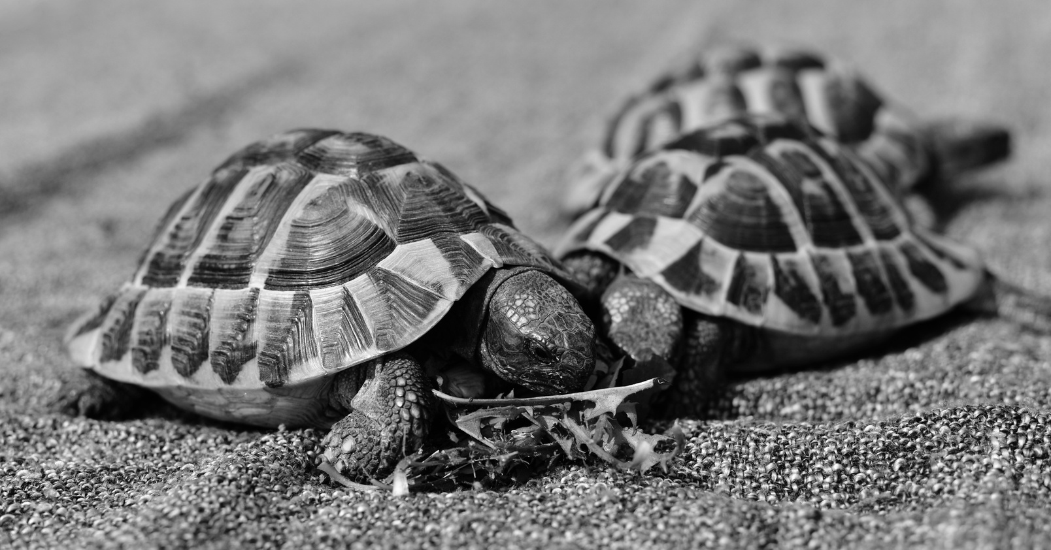
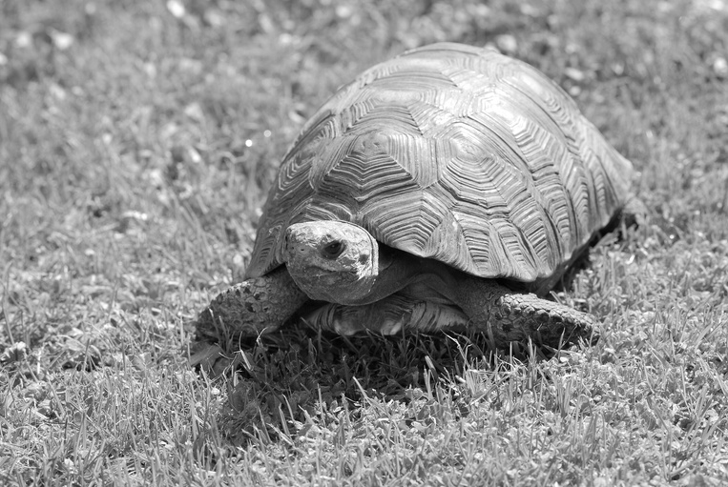


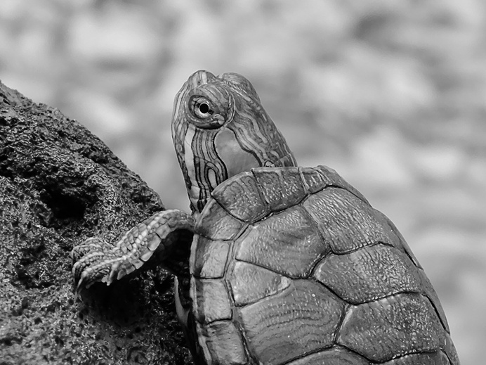
My Pet
Turtle

Slide 7
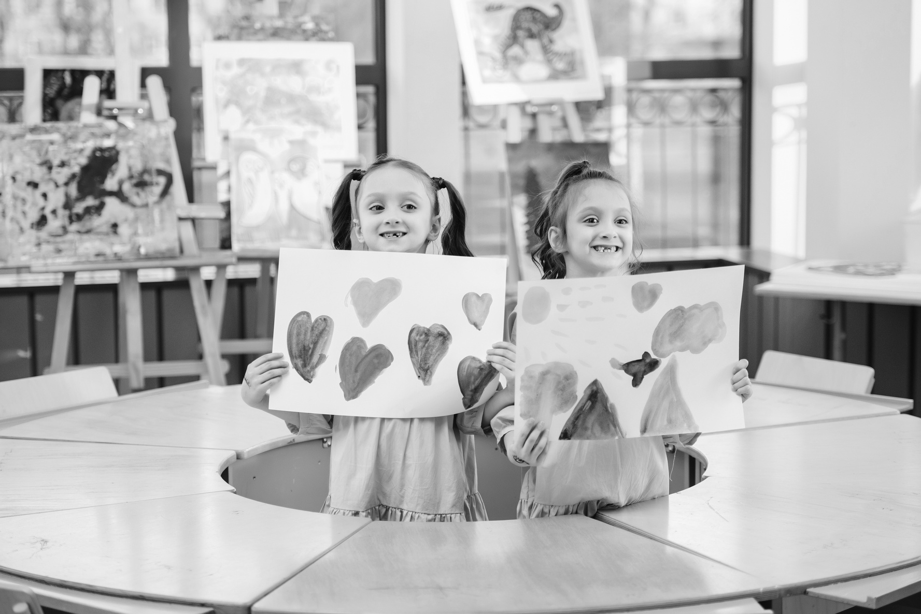

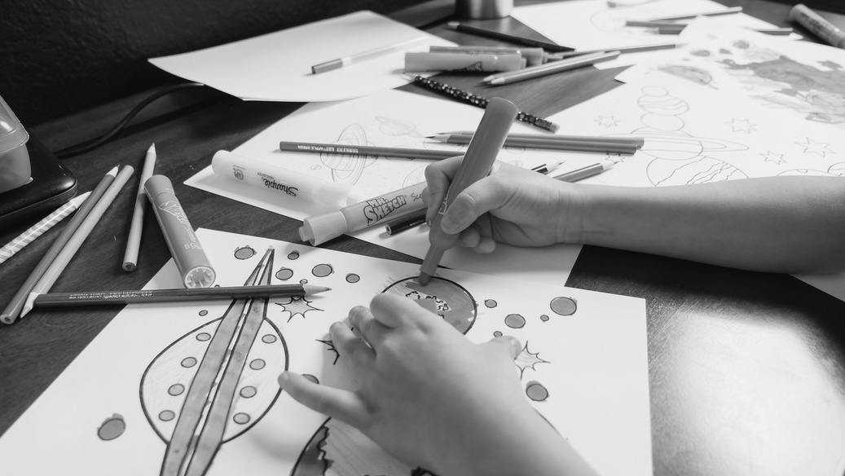
My Dream
My dream is to build an art school for underprivileged children.

Slide 8
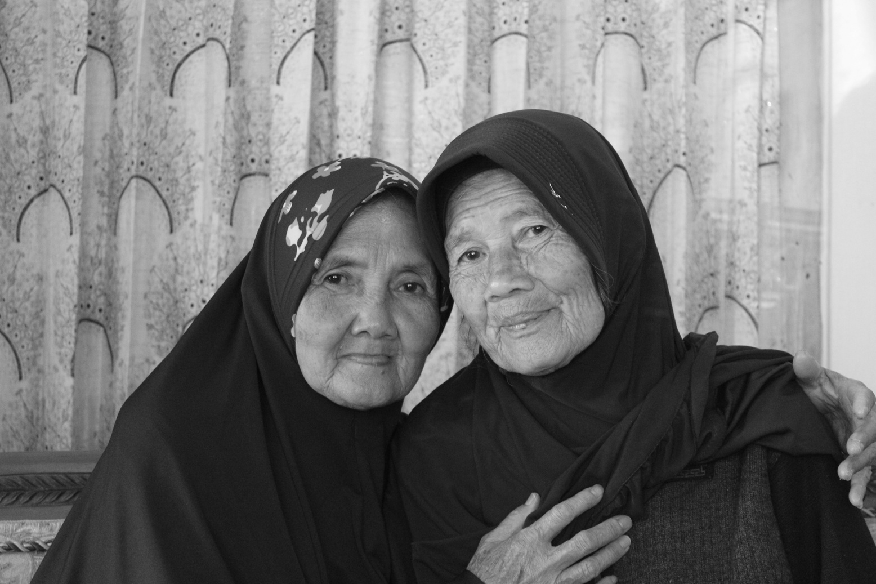



My Family Portrait
They are my source of strength and the center of love.

Slide 9

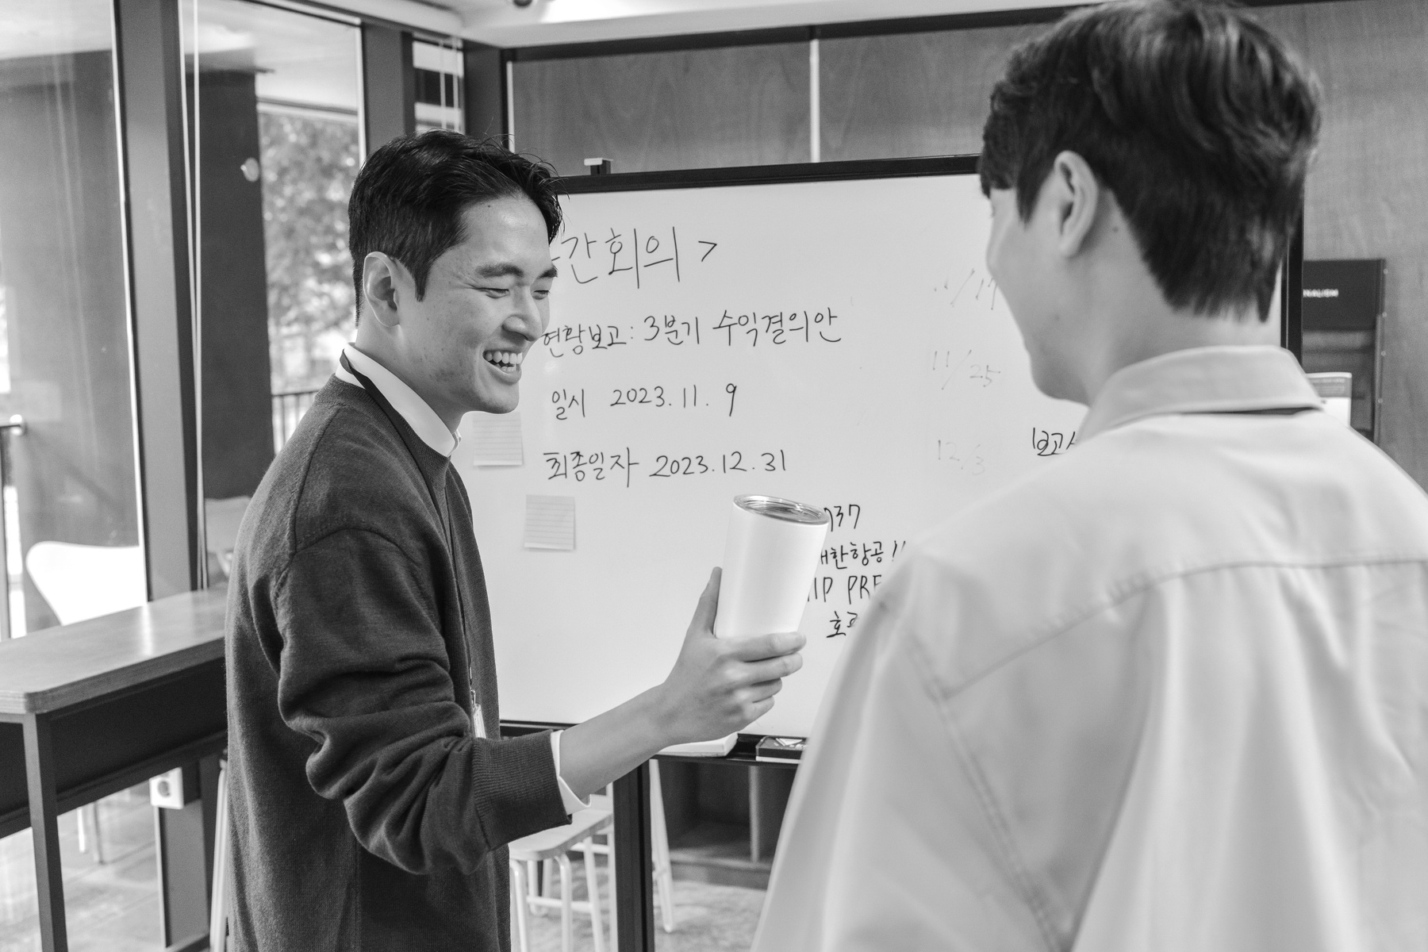

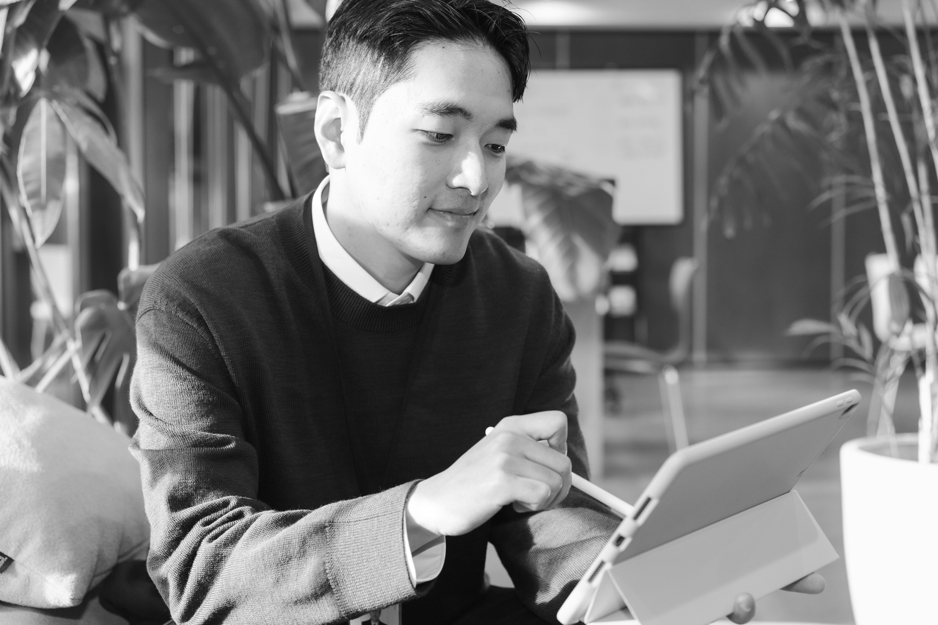
My Friends Portrait
Friends for doing fun things and a place to share joys and sorrows.

Slide 10
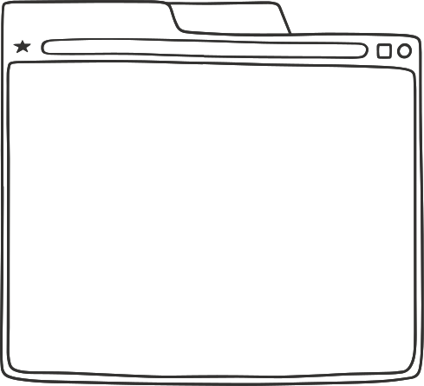
Thank you, everyone. It was nice to meet you all.

