Slide 1

alonda
THE ESSENTIAL APP- TAP THE BUTTON

Slide 2
Which tech company made the app?
It was made by a malawian social enterprise named IMOSYS (intelligence monitoring system).
It launched the app at 2023.

Slide 3
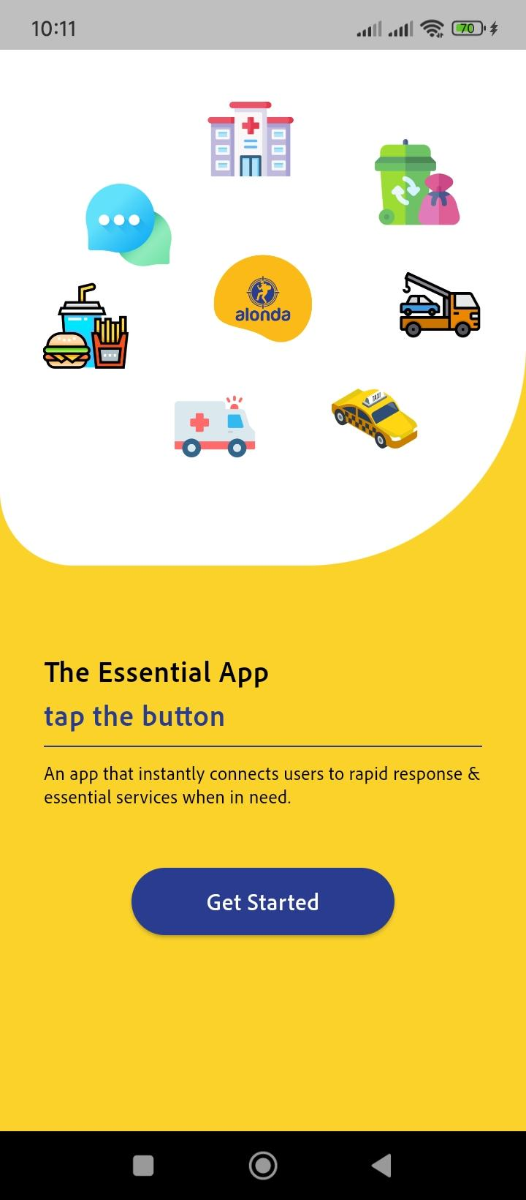
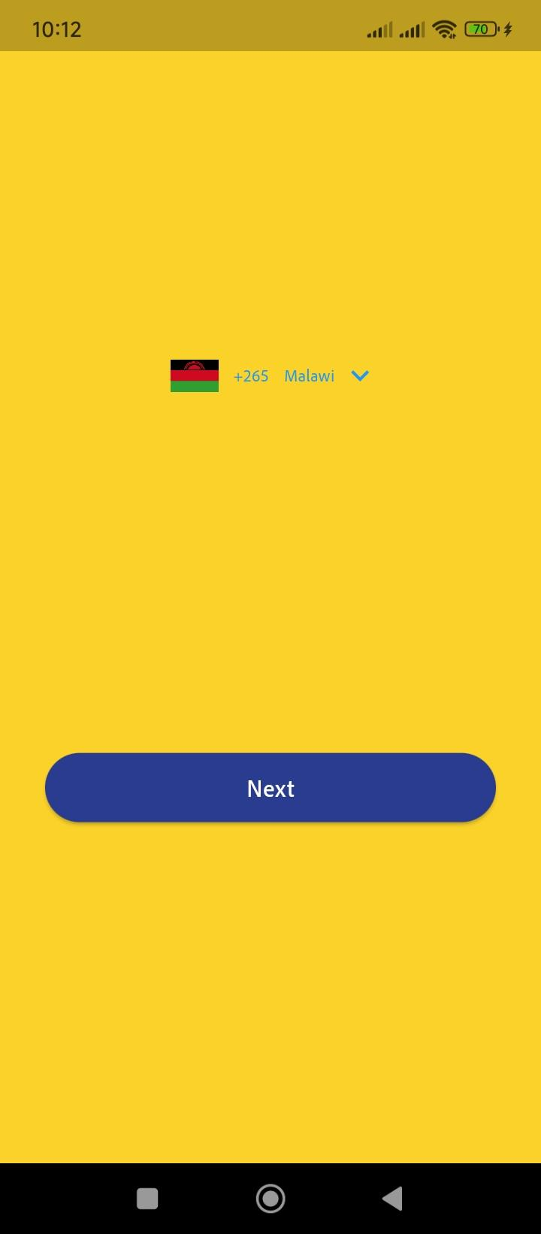
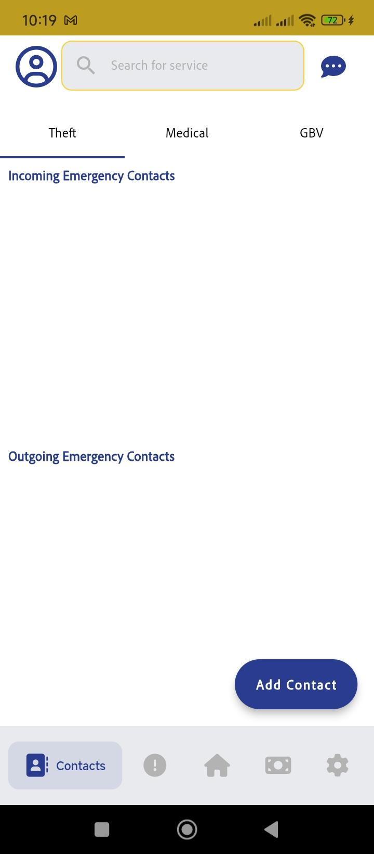

Slide 4
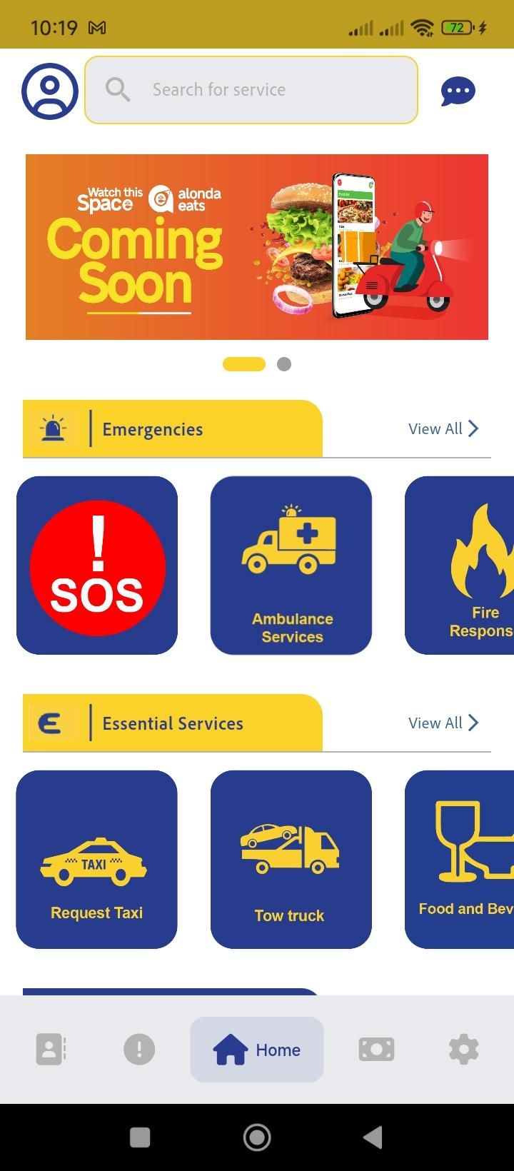
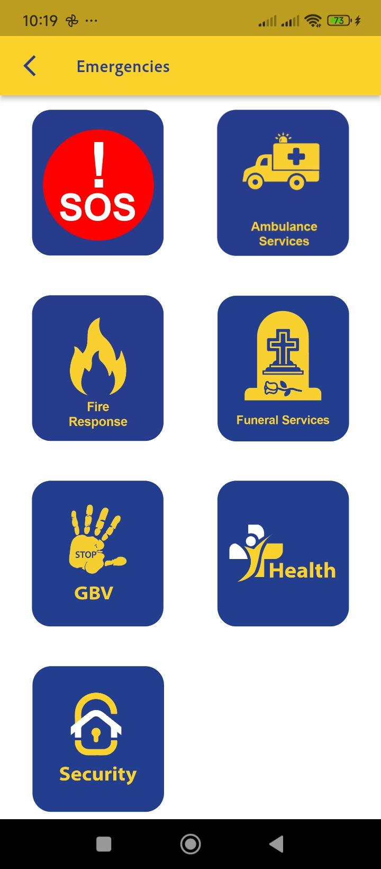
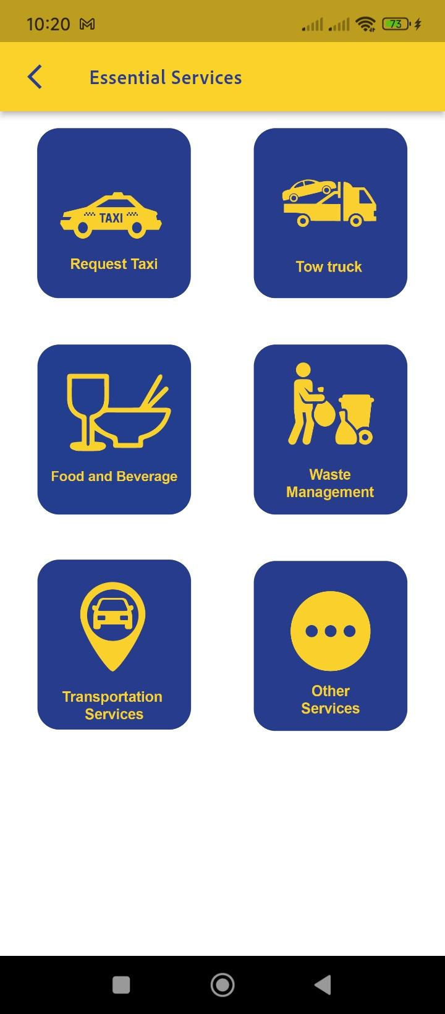

Slide 5
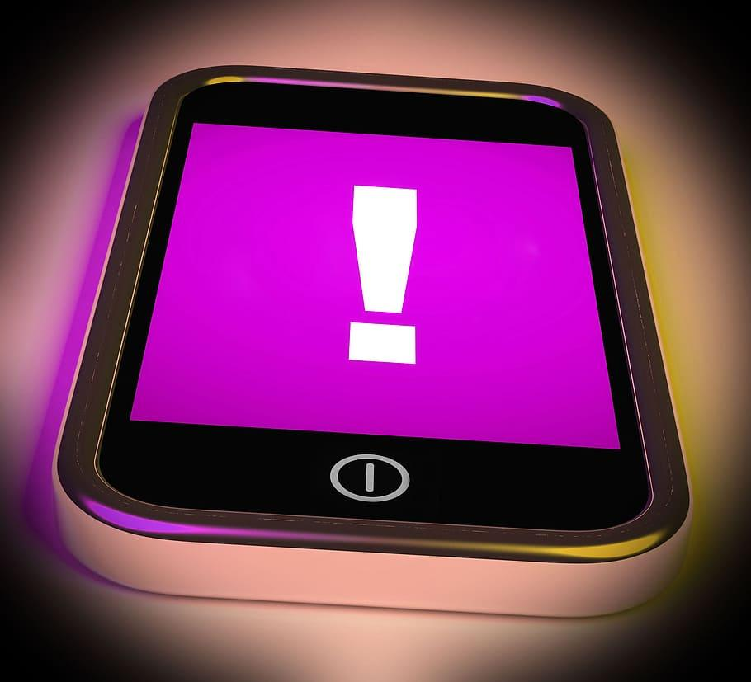
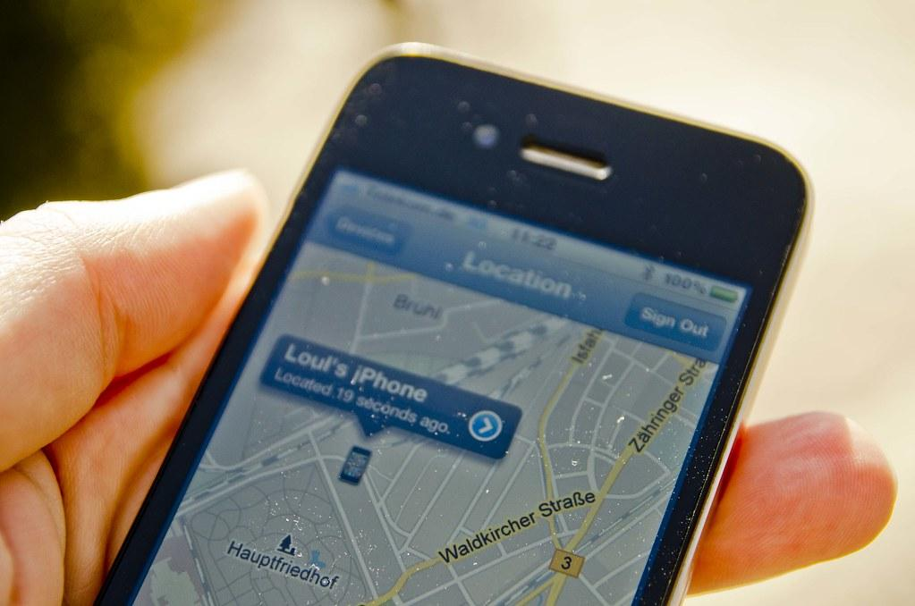

How Does Alonda App Work?
Uses key features like
Automated emergency alerts
Real-Time tracking
Essential service directory
Data driven insights

Slide 6
GROWTH TRAJECTORY OF THE APP
Emergency app
Essential Services
Alonda Eats
Alonda Chat
Alonda Pay
Emergency App
Emergency app
Essential Services

Slide 7
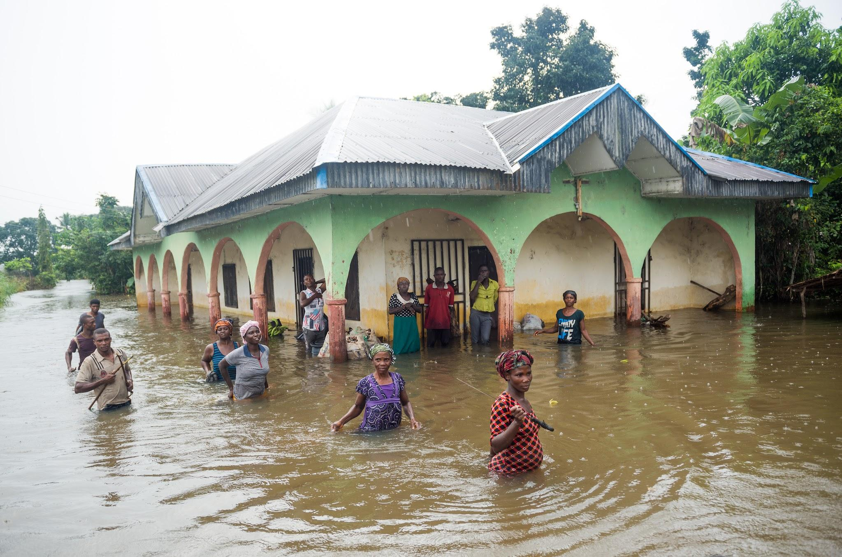
Why was Alonda App Created?

Slide 8
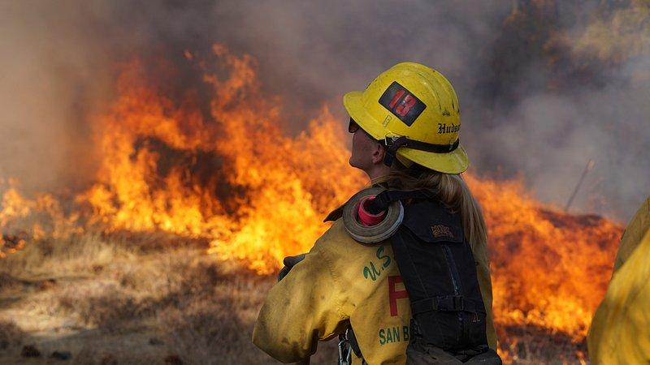
Problem Statement.
In Malawi,emergency response and personal safety remains critical challenges, leaving many vulnerable in times of crisis.
Challenges such as theft ,medical emergencies ,gender based violence are on the rise.
The country experiences frequent fires and earthquakes,natural disasters,droughts and landslides.
For instance in 2013, there were 4,375 recorded fire incidents.
Despite, these recurring incidents, emergency response systems are often slow, no automated triggering of emergency alerts ,uncoordinated, or difficult to access due to lack of real time tracking ,making it hard for victims to get timely assistance.

Slide 9

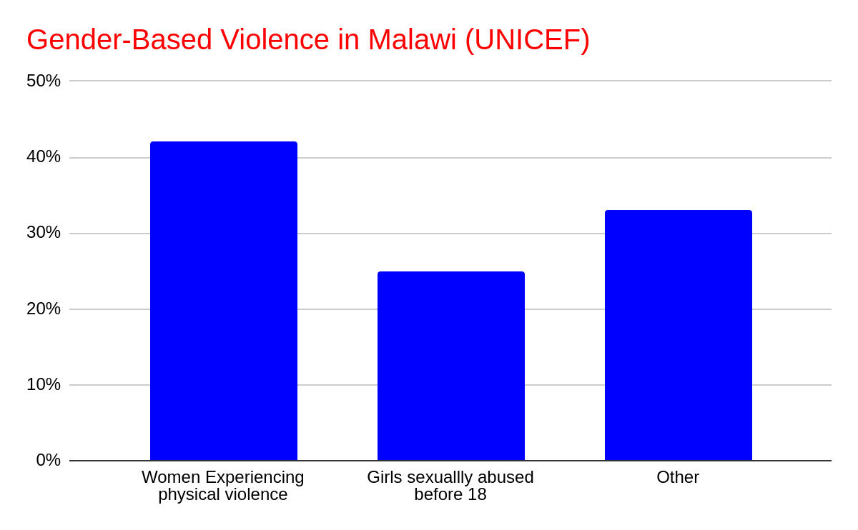
Additionally, Gender-Based Violence is a major concern.
42% of women have experienced GBV.
1 in 4 girls (25%) are sexually abused before turning 18.
This highlights the urgent need for accessible safely solutions.
The most recent is cyclone freddy in March 2023 which poured 6 months rainfall in 6 days killing over 1200 people.

Slide 10
RESEARCH
Define the problem-natural disasters
Floods
Earthquakes
Landslides
Analyze solutions.
Consult with experts.
Experiment with different approaches.
Gather data from users or systems

Slide 11
Most victims of GBV and other emergencies struggle to seek help due to fear, stigma, or lack of a reliable platform to alert trusted contacts and responders.
The alonda app was created to bridge this gap by providing a real-time emergency response platform that allows users to quickly send alerts, request help and connect with emergency responders or personal contacts at the touch of a button.
Alonda empowers individuals to take care of their safety, ensuring that help is always within reach when they need it most.

Slide 12
UI/UX DESIGN

Slide 13
UI/UX DESIGN is more about what are we developing,who we are developing it for and how easily can they access the product.
User Experience refers to the overall experience the user have when using the product.It's more like how the user feels withe the product like is the user confused, does the user understand how to use the product, was it easy or hard etc..
User interface: refers to the visual and interactive elements of a product. ex: pages,buttons,typography,colors etc..
UI DESIGN
UX DESIGN

Slide 16
USER INTERFACE (UI DESIGN)
1.Understand user & their needs
2.Plan the structure
3.Design Visuals
-Research:people,other products,
Competitors.
-User personas: create personas.
-Information Architecture:
organize structure.
-Wireframing:create sketches or
Wireframes.
-Style guide:colour, font,anything
reflecting the brand and easy to use.
-High fidelity mockups:add colors,icons,images to wireframes.
6.Handoff to developers
5.Test and refine
4.Prototype Alonda
-Interactive prototype: create
clickable prototype.
-Test the prototype:share with users
to get feedbacks.
-User testing:observe users’
interaction.
-Iteration: make improvements.
-Collaborate with developers
7.Monitor and improve
-User feedback
-Iterate

Slide 17
USER EXPERIENCE (UX DESIGN)
1.Understand user & their needs
2.Define the problem
3.Plan the user’s journey
-Research:who,why and how
-User personas: create personas.
-Pain points.
-Set goals.
-Map the user flow.
-Wireframes.
6.Collaborate with developers
5.Iterate and improve
4.Design the experience
-Make changes based on
feedback.
-Re-test.
-Collaborate with developers
-User testing.
-Collect feedback.
7.Launch the app
-Introduce the final
product.

Slide 18
FRONT-END DEVELOPMENT

Slide 19
MOBILE APP DEVELOPMENT
iOs
Android
Swift
kotlin
Swift
Cross-functional framework (React Native or Flutter)

Slide 20
API INTEGRATIONS
USER INTERFACE (UI)
Handles data fetching and user authentication
Fetching incident reports
Connecting to third party services e.g google maps
Sending new reports
Authenticating users
Directories
Buttons e.g emergency services buttons
Alerts e.g emergency alerts,SOS
Map views
Push Notifications

Slide 21
HOW API INTEGRATION WORK
Front-end sends an API request to back-end server
Back-end processes the request (validate data, stores data)
User submits data (report fire incident)
Front-end updates UI based on the response
Back-end sends a response back to front end “report submitted successfully.”

Slide 22
API Integration
CLOSED SOURCE

Slide 23
BACK-END DEVELOPMENT
User Authentication
Data Storage and retrieval
Real time alerts & notifications
Communication between users
Security and data protection
Integration with third party services
What is happening here?

Slide 24
Authentication service
Client App
API Gateway
Database
Incident Processing service
PostgreSQL-Structured data)
Firebase Firestore-Real-time data
Notification Service
External APIs (e.g google maps)

Slide 25
Third party APIs
Google Maps API
Twilio API & Firebase Cloud Messaging-sending sms alerts and making voice calls to emergency contacts and responders and delivering push notifications within the app, ensuring timely alerts.
Firebase Authentication
Payment processing (Stripe or paypal)
Data analytics API
Local Service APIs- Integrate databases of local emergency services, hospitals and other essential service providers.

Slide 26
QUALITY ASSURANCE

Slide 27
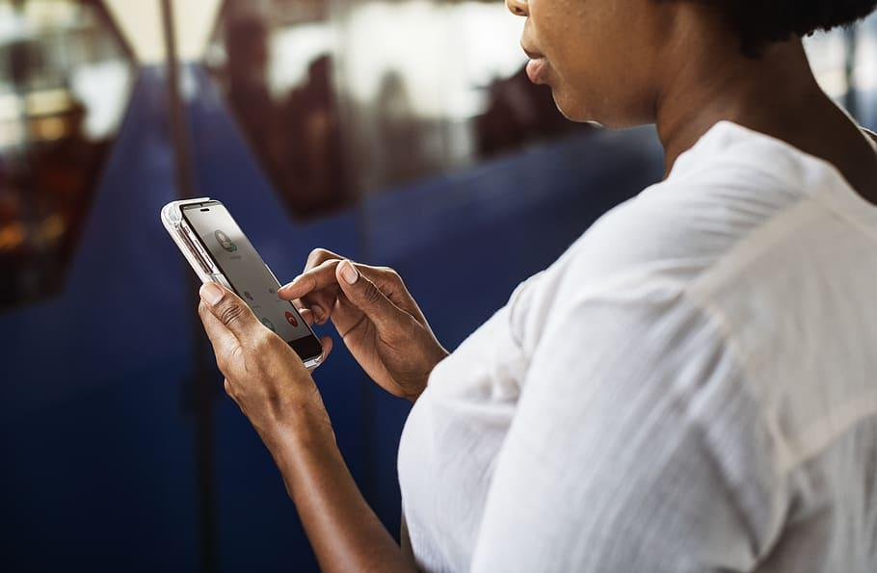
USER-EXPERIENCES
Functionality(answer if it's easy to login?,can request for services is the responders get notified?
Usability(is the app easy to navigate?can user find important button like medical, fire emergencies?).

Slide 28
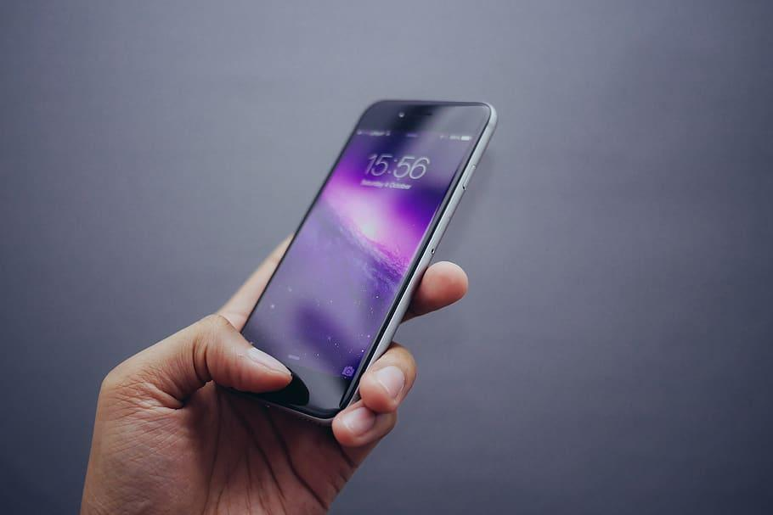

SECURITY
Data protection _is user data safe?

Slide 29


RELIABILITY
Reliable anytime
Can be downloaded from both android and ios versions

Slide 30
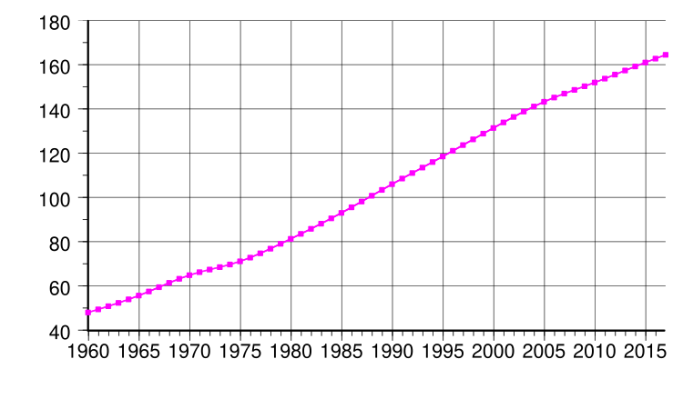
SCALABILITY/PERFORMANCE
Progress of the outcome
Can the app handles multiple requests of the services?
Does the app load quickly?
Does it crash when many users are online?

Slide 31
Problem
Malawi is prone to disaster like flooding and fire.
Lack of easy access to emergency and other essential services
Research
Problem solving
User-centered design
Market analysis
Technical feasibility
UI/UX design
User friendly and intuitive interactions
The button size ,shape,color.
Back end development
Cross platform native(like react native or Flutter)
Apis to connect to payment systems, to notification and location tracking systems, to verification of phones and sending OTP
ALONDA
Quality assurance
Ensure reliability
User experience
Functionality
Usability
Security
performance
Front end development
Only a mobile app (both IOS and Android)
UI implementation
Yellow and white background and big blue buttons
Api integrations-Gps accessibility
-payment is made
-verify phones
Feed back
Regular updates
Deployment
Get permission from google play and App store.
Monitoring

Slide 32
References
IMoSyS. (n.d.). Innovative Monitoring Systems. Retrieved February 13, 2025, https://www.imosys.mw

Slide 33
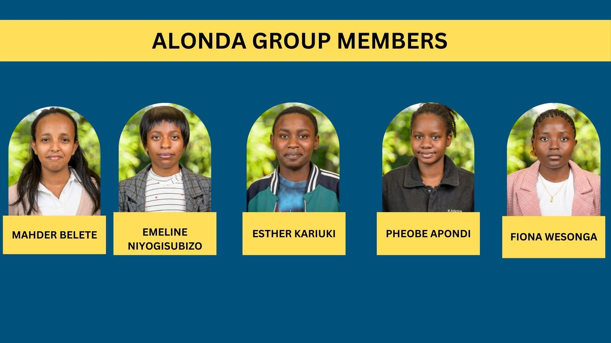

Slide 34
Thank you

