Slide 1
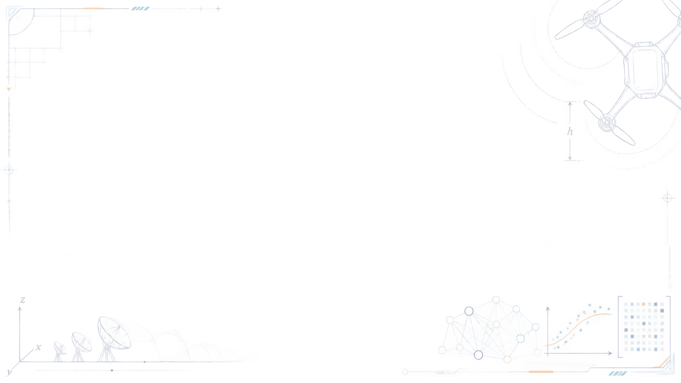

A Supervised Learning Surrogate for Joint Waveform and Altitude Optimization
UAV-enabled integrated sensing and wireless power transfer
UAV
Machine Learning Course Project
OPTIMIZATION
Mahdi Aslani · Student ID 40301904
Instructor: Dr. Aliyari · August 2026
×
MACHINE LEARNING
K. N. Toosi University of Technology
Notes:
[Sources]
- Project report and verified project outputs; KNTU logo supplied by the student.
[/Sources]

Slide 2

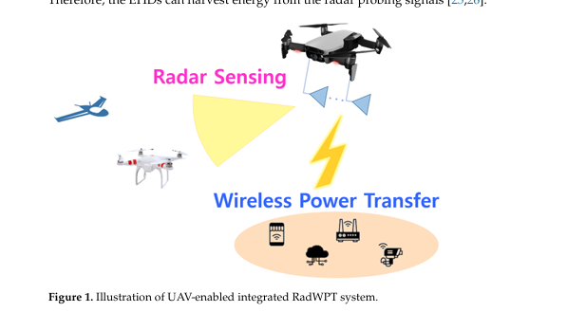
PROBLEM CONTEXT
One airborne platform must serve two competing tasks
The same transmit waveform supports radar sensing and wireless power transfer.
Radar sensing favors a desired beampattern around target directions.
Wireless power transfer favors energy delivery toward ground devices.
UAV altitude changes both path loss and array geometry, so the two decisions are coupled.
Design question
Can previous optimized scenarios predict a useful altitude without discarding waveform constraints?
Source: Kang et al. (2024), Fig. 1
K. N. Toosi University of Technology
02
Notes:
[Sources]
- Kang et al., Electronics 2024, 13, 4237, Figure 1.
[/Sources]

Slide 3
MATHEMATICAL MODEL
The objective balances radar and power fidelity
P1
min ρ · Lrad(X, γ) + (1 − ρ) · Lwpt(X, h)
decision variables
waveform covariance X · scaling γ · UAV altitude h
physical constraints
X ⪰ 0 — positive semidefinite covariance
Why P1 is difficult
diag(X) = PT / N — fixed per-antenna power
For a fixed altitude, P2|h is convex. Across altitude, the propagation-dependent objective is nonlinear and non-convex.
Hmin ≤ h ≤ Hmax
K. N. Toosi University of Technology
03
Notes:
[Sources]
- Kang et al., Electronics 2024, Sections 2–3 and problem P1/P2.
- Project report, mathematical formulation chapter.
[/Sources]

Slide 4
REFERENCE SOLUTION
Kang searches altitude outside the exact SDP
Candidate altitude h
Solve P2 | h
Evaluate P1
Update search
outer search
convex SDP
radar + WPT
PSO / scan
Algorithm 1
Algorithm 2
Accurate joint design
Exact P2 at every outer evaluation
Restricted waveform structure
Lower complexity, near-optimal result
73 exact P2 solves
≈ 0.15–3.08% gap
K. N. Toosi University of Technology
04
Notes:
[Sources]
- Kang et al., Electronics 2024, Algorithms 1–2.
- Project paper-grid benchmark: exact_alg1_pso_sweep.json and gap1_results(1).json.
[/Sources]

Slide 5
OUR CONTRIBUTION
We learn altitude but keep exact waveform design
ML replaces only the outer search; one exact P2 solve preserves feasibility.
Scenario
Canonicalize
RBF-SVR
Clip h
Exact P2 | ĥ
8 input features
sort EHD pairs
predict altitude ĥ
[Hmin, Hmax]
return feasible X and γ
ML output
Physics-constrained output
1
1
PSD + fixed diagonal
altitude prediction
exact P2 solve
feasibility retained by construction
K. N. Toosi University of Technology
05
Notes:
The novelty is deliberately narrow: the RBF-SVR predicts only the altitude. The covariance matrix X and the trade-off variable gamma are still obtained by solving the exact convex P2 subproblem at the predicted altitude. This is why I describe the method as a hybrid surrogate, not an end-to-end replacement.
[Sources]
- Project implementation: 02_Complete_ML_Analysis.ipynb, reference_solver.py, and benchmark_gap1.py.
[/Sources]

Slide 6
DATA AND EVALUATION
Reproducible data supports two levels of evaluation
1,000
8
800 / 200
5
simulated scenarios
geometric + control features
train / held-out test
independent test splits
Input representation
Evaluation protocol
ρ, target angles, and two EHD positions
Regression: MAE, RMSE, and R² on held-out data
EHDs sorted by distance while preserving each (r, φ) pair
Engineering: P1 objective gap after one exact P2 solve
Hyperparameters were selected by cross-validation on the training partition only; the test set remained untouched until final evaluation.
K. N. Toosi University of Technology
06
Notes:
[Sources]
- Project outputs: ml_corrected_results.json and repeated_split_metrics.json.
- Dataset generation: 01_Dataset_Generation.ipynb and ds3.npz.
[/Sources]

Slide 7
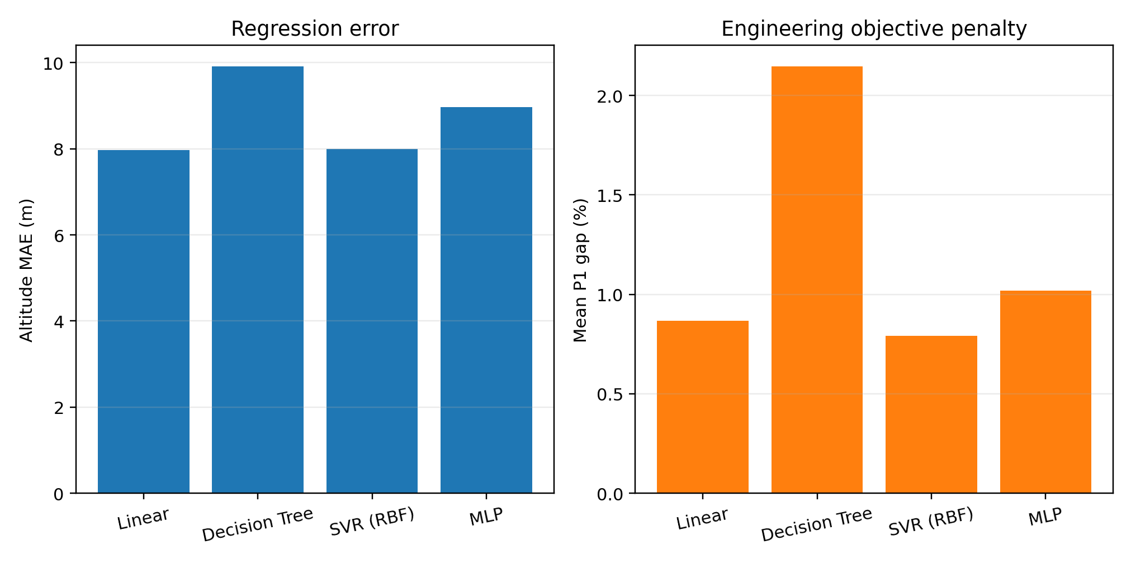
MODEL COMPARISON
Altitude error alone does not select the best surrogate
Selected model
RBF-SVR
7.99 m
seed-42 test MAE
0.793%
mean P1 gap on 200 cases
Key point: a few metres of altitude error can have little objective cost when P1 is locally flat.
K. N. Toosi University of Technology
07
Notes:
[Sources]
- Project figure mae_vs_gap(1).png generated from ml_corrected_results.json.
[/Sources]

Slide 8
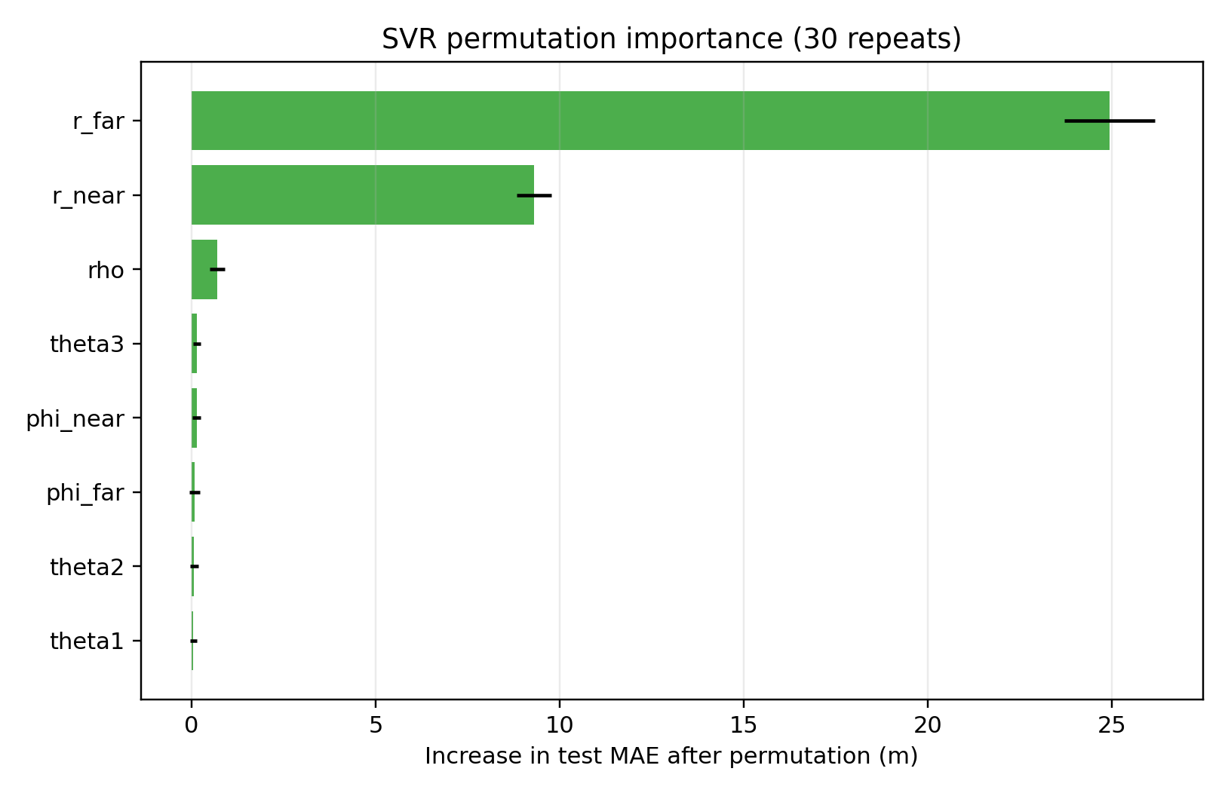
ROBUSTNESS AND INTERPRETABILITY
SVR is stable across splits; distance dominates
Mean MAE across five held-out splits
Permutation importance of the final SVR
7.88 ± 0.67 m
Horizontal distance dominates; angular features contribute much less in this sampled scenario space.
SVR mean ± standard deviation
K. N. Toosi University of Technology
08
Notes:
[Sources]
- Project outputs: repeated_split_metrics.json and svr_permutation_importance(1).png.
[/Sources]

Slide 9
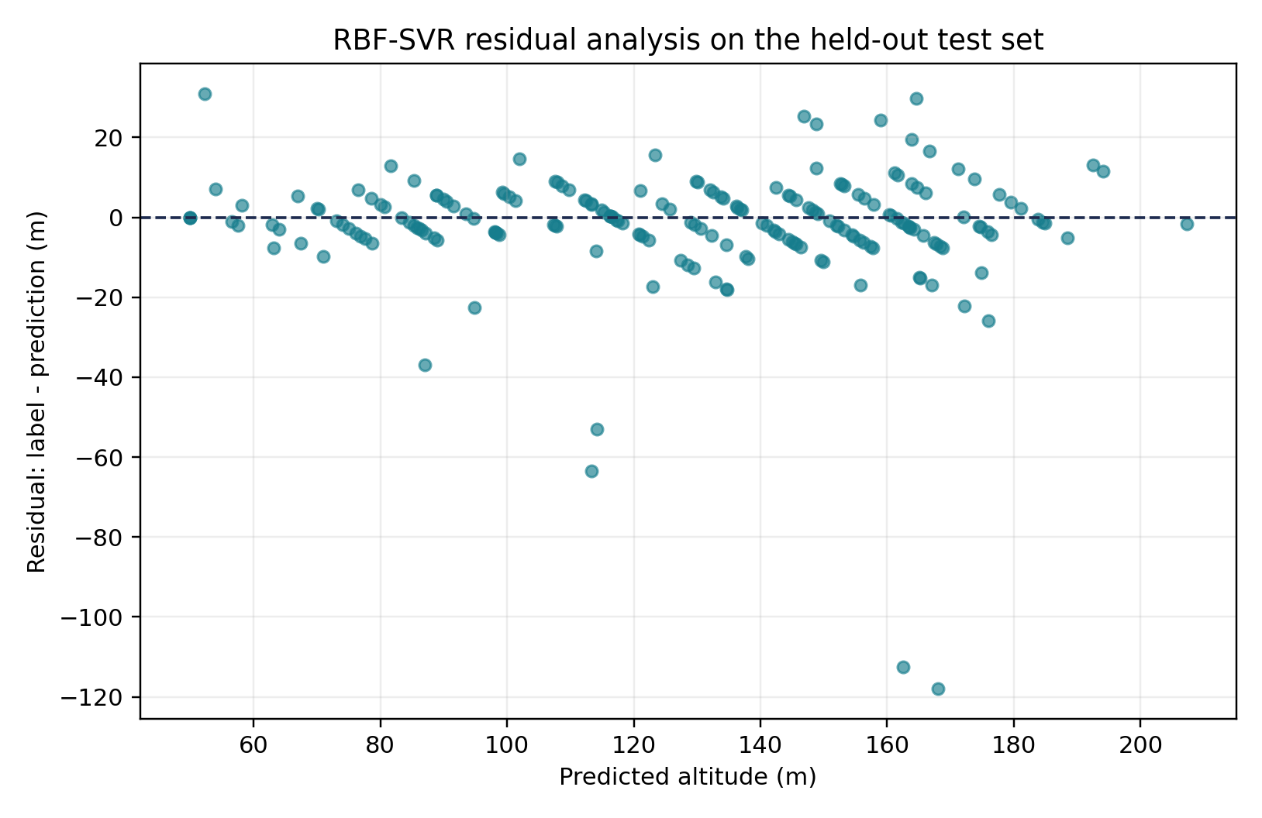
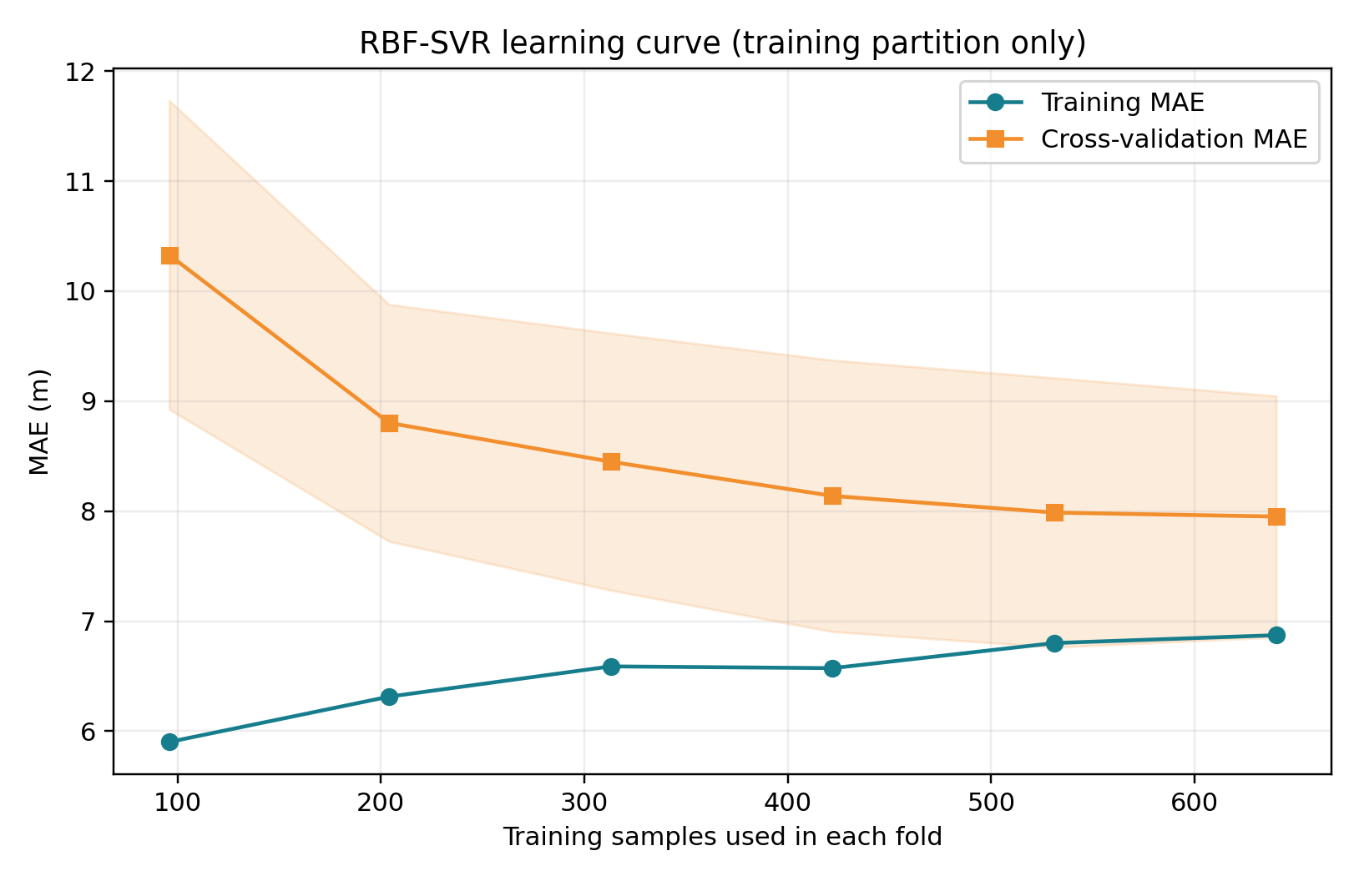
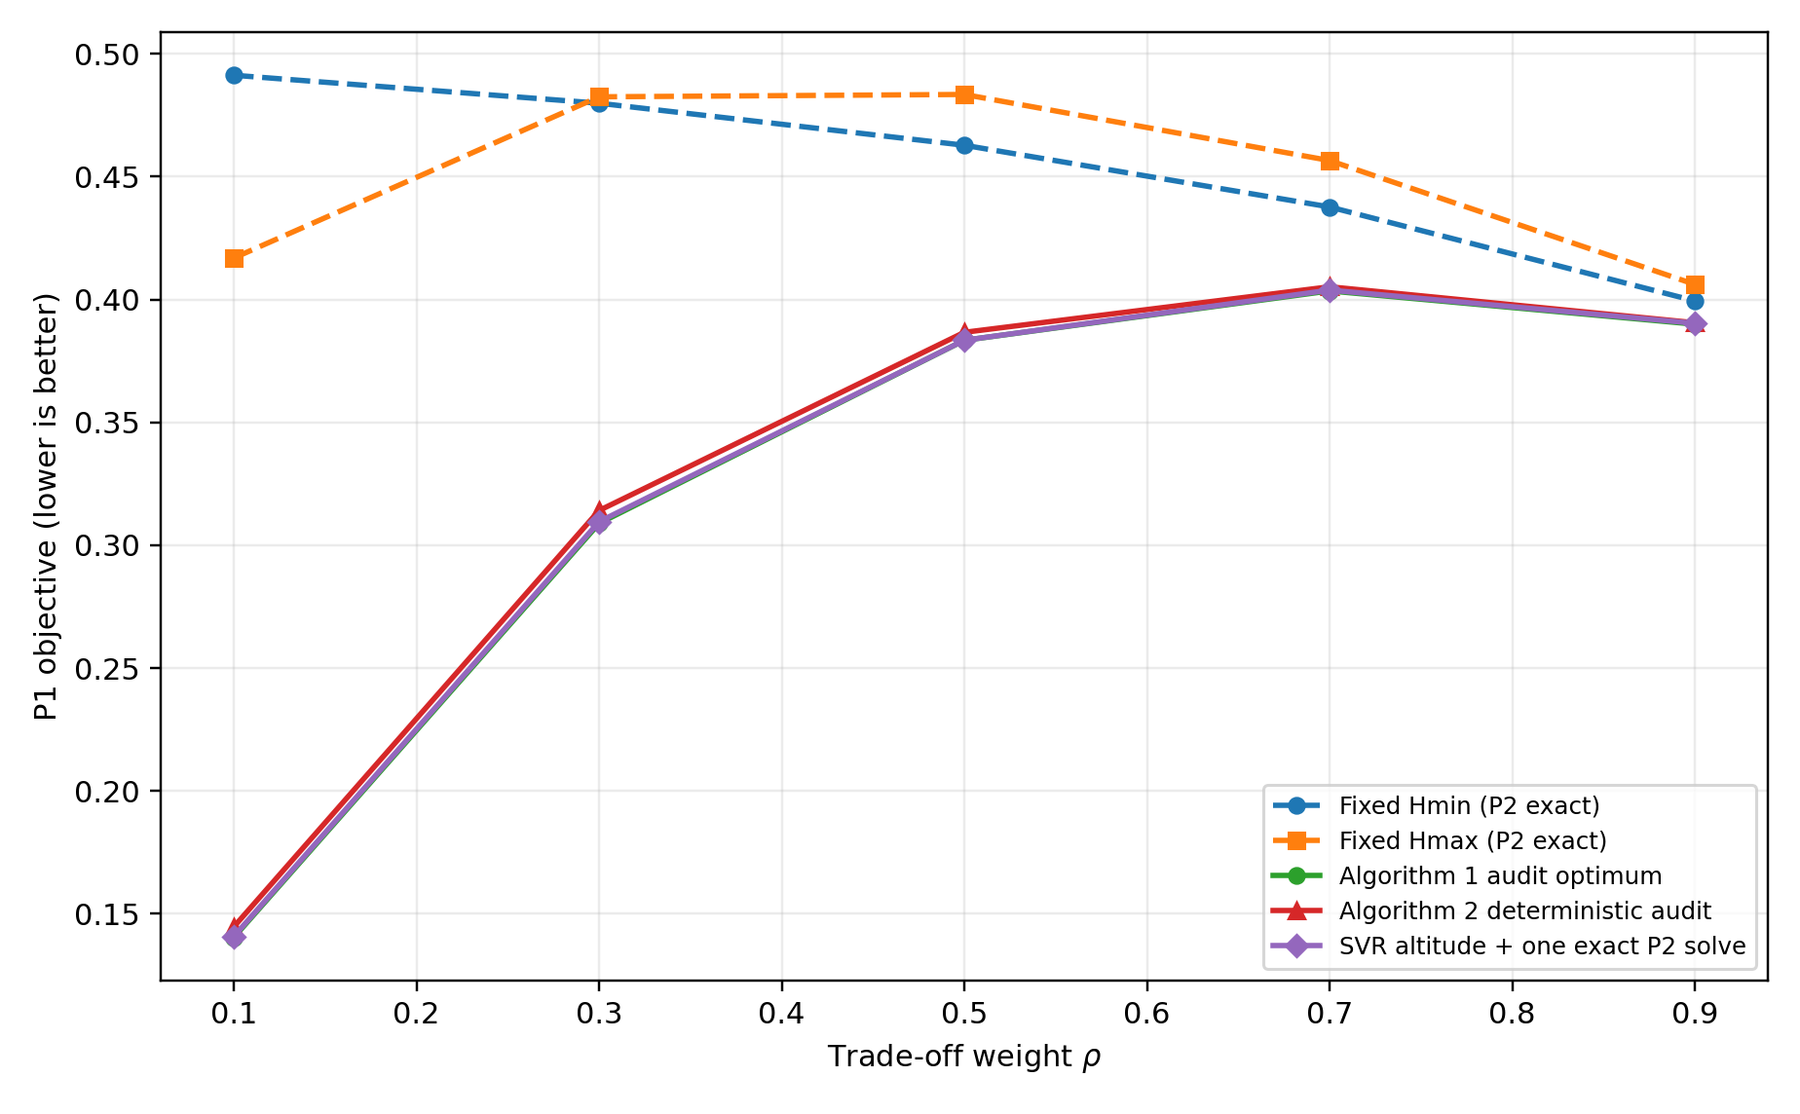
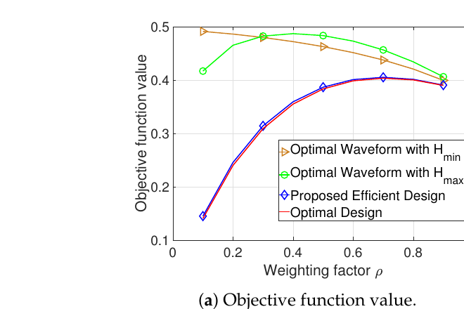
PAPER REPRODUCTION AND EXTENSION
We reproduce Kang before adding the ML alternative
Scenario 1 · target angles [−40°, 0°, 40°] · EHD angles [−20°, 20°] · 0.1° grid
Kang et al. — Figure 3(a)
Our verified extension
Across ρ ∈ {0.1, 0.3, 0.5, 0.7, 0.9}, SVR + one exact P2 solve stays within 0.31% of the audit reference.
Left: Kang et al. (2024), Fig. 3(a) · Right: benchmark_gap1.py → gap1_results(1).json
K. N. Toosi University of Technology
09
Notes:
[Sources]
- Kang et al., Electronics 2024, Figure 3(a).
- Project outputs: gap1_objective_comparison(1).png and gap1_results(1).json.
[/Sources]

Slide 10
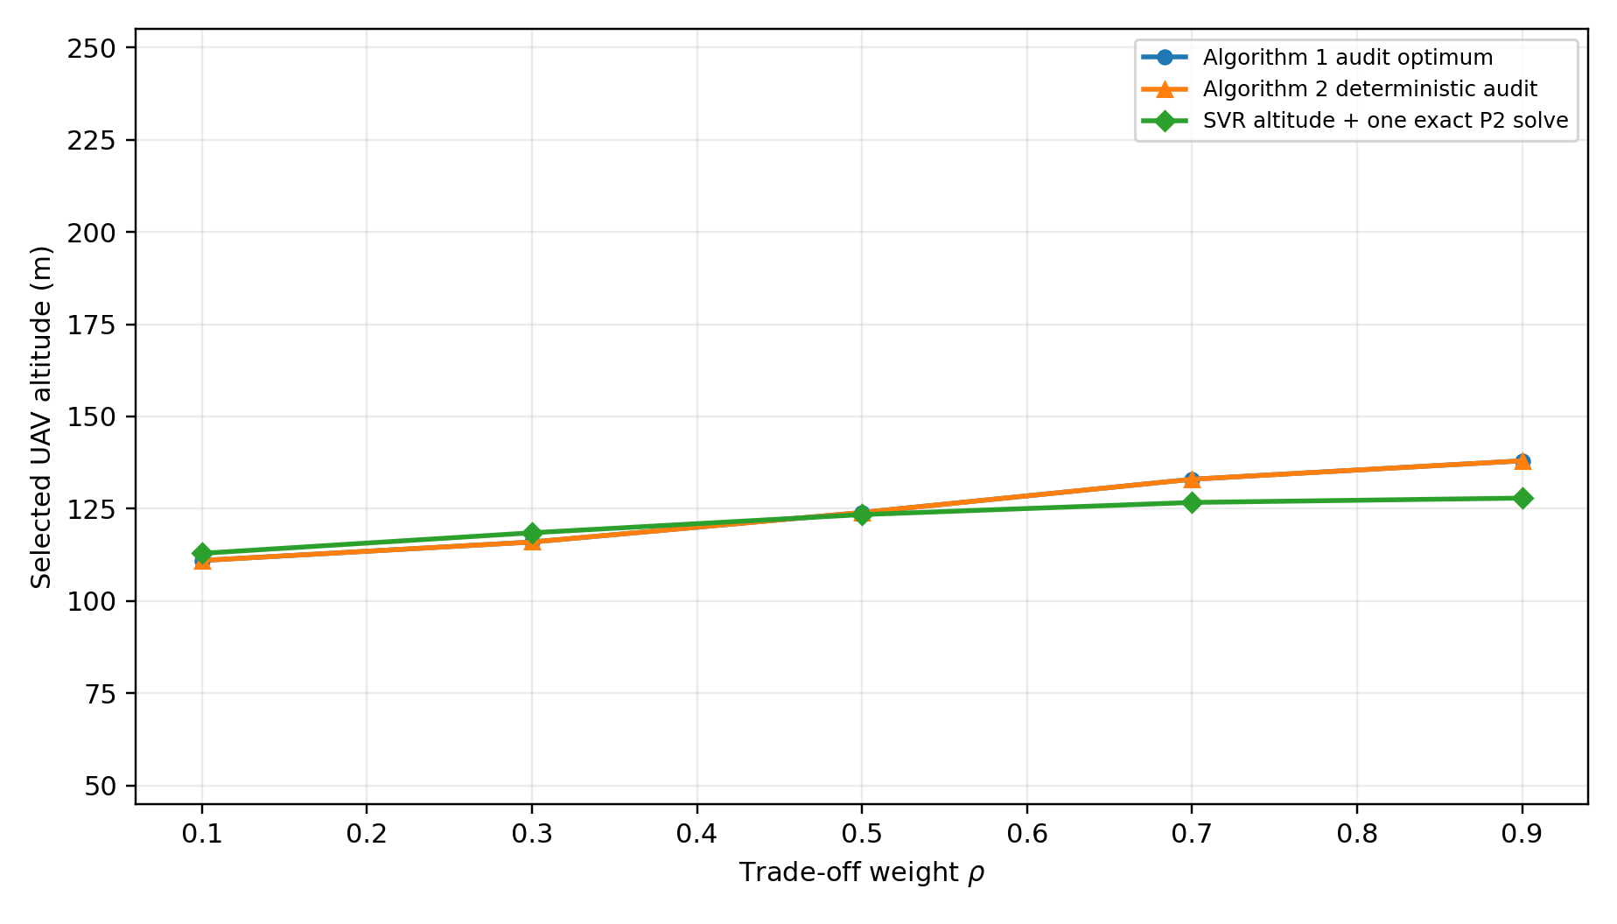
ALTITUDE SELECTION
SVR follows the reference altitude trend
Reference altitude
111 → 136 m
as ρ increases
SVR altitude
113 → 128 m
same direction, flatter response
The engineering result remains strong because the optimized objective is relatively flat around the best altitude.
K. N. Toosi University of Technology
10
Notes:
[Sources]
- Project output gap1_altitude_comparison(1).png from the 0.1-degree paper-grid benchmark.
[/Sources]

Slide 11
VERIFICATION
Audits confirm numerical quality and physical feasibility
0.025%
0.063%
0
median fast-vs-exact objective error
mean label objective gap on 12 exact audits
maximum fixed-diagonal violation
Fast waveform solver
Feasibility checks
FISTA/Dykstra used for bulk candidate evaluation
minimum eigenvalue remained non-negative
Exact CVXPY P2 retained for audits and final inference
per-antenna power diagonal matched exactly
The ML model proposes h; the optimization layer guarantees a valid waveform X.
K. N. Toosi University of Technology
11
Notes:
[Sources]
- Project outputs: fast_solver_audit.json and label_quality_audit.json.
[/Sources]

Slide 12
CONCLUSION
Hybrid ML reduces search while preserving constraints
01
Learn the altitude
RBF-SVR replaces the repeated outer search over h.
73 → 1
paper Algorithm 1 PSO budget
→ one exact P2 solve at inference
02
Keep the waveform optimization
One exact P2 solve retains PSD and fixed-power constraints.
03
Evaluate the engineering objective
The selected SVR achieves a 0.793% mean gap on 200 held-out cases and ≤0.31% in the Kang Scenario 1 sweep.
Scope: 73 is the paper PSO budget; the hybrid keeps exact P2 feasibility but does not claim continuous global optimality.
K. N. Toosi University of Technology
12
Notes:
The headline speed comparison refers to the paper's stated PSO configuration of 73 exact inner solves for Algorithm 1 versus one exact P2 solve after the SVR prediction. Our independent deterministic audit used scan and refinement, so I do not present 73 as a universal count. The result is a verified engineering comparison on the evaluated grid, not a proof of continuous global optimality.
[Sources]
- Kang et al., Electronics 2024, Algorithm 1.
- Project evidence: exact_alg1_pso_sweep.json, gap1_results(1).json, and verification_log.txt.
[/Sources]

Slide 13
SELECTED REFERENCES
Selected references
[1]
J. Kang et al., “Joint Design of Transmit Waveform and Altitude for UAV-Enabled Integrated Sensing and Wireless Power Transfer Systems,” Electronics, vol. 13, no. 21, 4237, 2024.
[2]
H. Sun et al., “Learning to Optimize: Training Deep Neural Networks for Wireless Resource Management,” IEEE Transactions on Signal Processing, vol. 66, no. 20, pp. 5438–5453, 2018.
[3]
S. Diamond and S. Boyd, "CVXPY: A Python-Embedded Modeling Language for Convex Optimization," Journal of Machine Learning Research, vol. 17, no. 83, pp. 1–5, 2016.
[4]
F. Pedregosa et al., "Scikit-learn: Machine Learning in Python," Journal of Machine Learning Research, vol. 12, pp. 2825–2830, 2011.
K. N. Toosi University of Technology
13
Notes:
[Sources]
- [1] Kang et al., Electronics 2024, 13, 4237.
- [2] Sun et al., IEEE Transactions on Signal Processing, 2018.
- [3] Diamond and Boyd, Journal of Machine Learning Research, 2016.
- [4] Pedregosa et al., Journal of Machine Learning Research, 2011.
- The project additionally uses FISTA/Dykstra-style projections in the fast candidate solver; see audit_fast_solver.py.
[/Sources]

Slide 14
APPENDIX · SVR DIAGNOSTICS
SVR diagnostics separate data sufficiency from outliers
Locked RBF-SVR · 800/200 split · seed 42 · training-only cross-validation
Learning curve
Held-out residuals
CV MAE falls 10.33 → 7.95 m; mean residual is −1.97 m. Engineering impact is evaluated separately with P1.
Source: render_svr_diagnostics.py → svr_diagnostics.json
K. N. Toosi University of Technology
A1
Notes:
Use this slide only if asked about overfitting, data sufficiency, or outliers. The learning curve uses five-fold cross-validation on the 800-sample training partition only; the StandardScaler remains inside the Pipeline, so each fold fits preprocessing without leakage. Validation MAE decreases from 10.33 m at 96 training cases to 7.95 m at 640 cases. On the untouched 200-sample test set, the mean residual (label minus prediction) is -1.97 m, the residual standard deviation is 15.53 m, the median absolute residual is 4.68 m, and the 95th percentile absolute residual is 23.51 m. A larger altitude residual is not automatically a large engineering penalty because P1 is recomputed after the exact P2 solve.
[Sources]
- Project-generated diagnostics: render_svr_diagnostics.py, ds3.npz, and svr_diagnostics.json.
[/Sources]

