Slide 1
Open Source Software
Philip Johnson
Collaborative Software Development Laboratory
Information and Computer Sciences
University of Hawaii
Honolulu HI 96822

Slide 2
History

Slide 3
Pre-history: Software is Free!
1960’s: Companies (IBM, Honeywell, etc.) sold the hardware, and provided software for free
  source available
  no restrictions on use, changes, distribution
1970’s: IBM software unbundled from hardware, “proprietary” software invented.
  Binaries only, no source.
  Restrictions on distribution.
  Software recognized as valuable “intellectual property”

Slide 4
Next stage: Software is IP!
Software is valuable “intellectual property”.
Ways to protect this intellectual property:
  Software Licenses: specify contract between owner and user that defines legal uses of software.
  Trade secret: do not redistribute source code; obfuscate binaries, prohibit reverse engineering
  Patents: protect “idea” behind software.
  Nondisclosure/employment contracts: require employees to sign over rights to all software they create while employed.

Slide 5
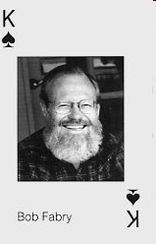
Beginnings of OSS: West Coast
1970’s: The Computer Science Research Group at UC-Berkeley, headed by Bob Fabry was improving Unix and building applications known as “BSD Unix”.
  Originally distributed only if you already had a Unix AT&T license
  Late 1980’s: distributed under
  the “BSD License” (but you still
  needed an AT&T license for key
  parts of kernel).

Slide 6
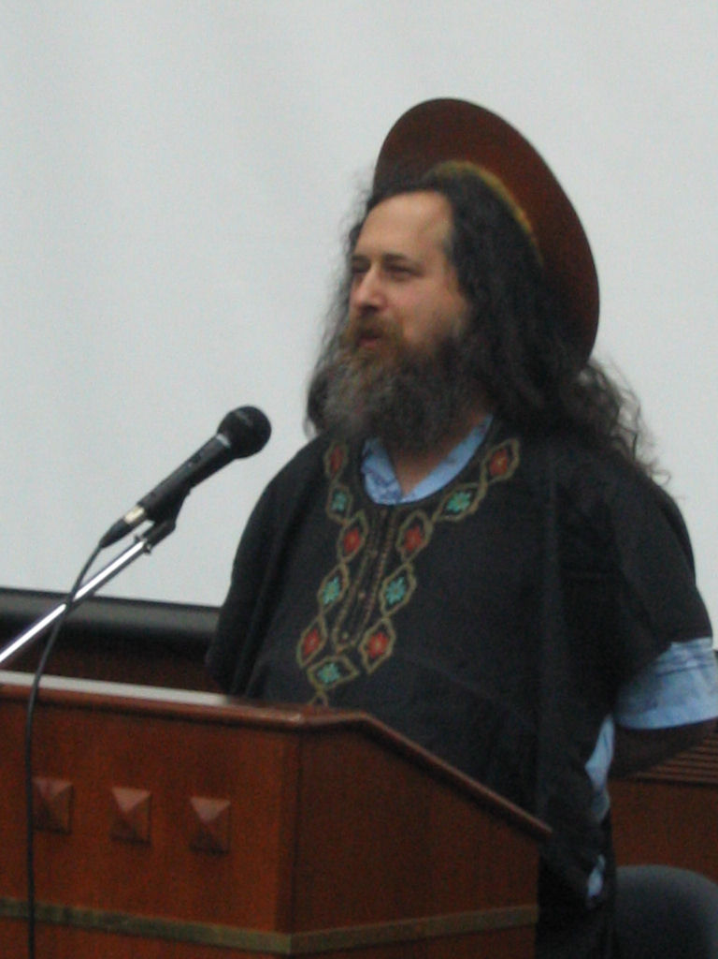
Beginnings of OSS: East Coast
1980’s: Richard Stallman was a programmer in the MIT AI Lab. He decided to quit to launch the GNU Project and the Free Software Foundation.
GNU Project goals:
  Create a complete operating
  system following the principles
  of the “GNU Manifesto”.
Free Software Foundation:
  Build a community of people to
  support development and use of
  free software

Slide 7
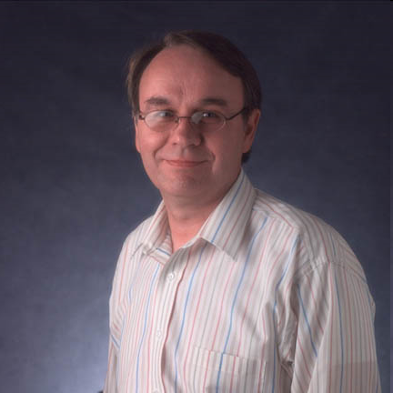
Tipping Point #1: West Coast
Early 1990’s: Bill Jolitz finished re-implementing proprietary components of BSD Unix to create a version free of AT&T code. Called “386BSD” because it ran on i386 machines.
Covered under the BSD license,
but also included free code under
other licenses.
386BSD evolves into NetBSD,
FreeBSD, OpenBSD, etc.

Slide 8
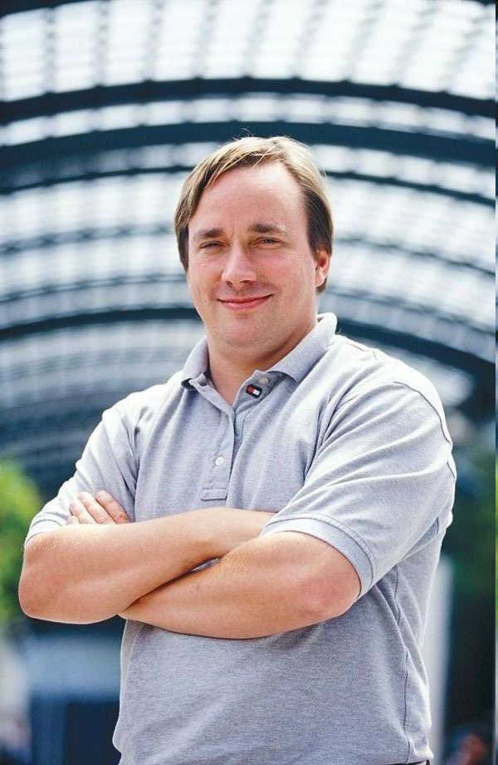
Tipping Point #2: Finland
Early 1990’s: Linus Torvalds, a CS student, was creating a Unix kernel called Linux.
GNU Project had working versions
of many OS applications, but the
kernel (called “Herd”) was not
yet finished.
Linux + GNU Project apps
created a complete, open
source operating system.

Slide 9
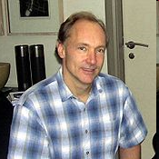
Tipping Point #3: WWW
Early 1990’s: Tim Berners-Lee invents the http protocol and WWW, making the Internet more easily accessible and useful.
  Important components (Apache, SendMail, BIND) are open source.
By the mid-1990’s, the situation was:
  Internet/WWW makes software
  distribution essentially free.
  Internet is no longer required to be
  non-commercial
  BSD, GNU, and other licenses make source code available over internet
  The worldwide community of programmers is connected.

Slide 10

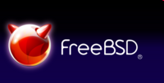
Take off and Collision
By mid-1990’s, there is a critical mass of free software, and a critical mass of interested users and developers.
Two principal groups:
  GNU: Free software is a philosophical issue.
  BSD/others: Free software is a pragmatic issue.

Slide 11
The GNU Manifesto
Software should be “free” as in “freedom” (not price). This includes the following FOUR FREEDOMS:
  run the program for any purpose
  modify the program to suit your needs
  redistribute copies (perhaps for a fee)
  distribute modified versions with your changes and improvements.
This is a philosophical stance about the best way for software to serve society.
Problem: how to prevent people from taking “free” software and effectively making it proprietary (as was happening with the X Windows system)

Slide 12


Copyright and Copyleft
A copyright is the exclusive legal right of a creator to reproduce, prepare derivative works, distribute, perform, display, sell, lend, or rent their creations.
Copyleft is a general method for making a program or other work free, and requiring all modified and extended versions of the program to be free as well.

Slide 13
Licenses

Slide 14
The GNU "General Public License" (GPL)
Terms include:
  User freedom to distribute and/or modify;
  Requirement that original and modified source code be always made available to the world under the terms of the original license;
  Must retain copyright notices and warranty disclaimers;
  Does not include grant of patent licenses.
Key (and most controversial) feature:
  License is VIRAL. If you modify GPL software, your modifications must be distributed under GPL.

Slide 15
The Fear of Freedom
By the late 1990's, a backlash was starting against the FSF and the GPL license.
Objections raised:
  The viral nature of GPL makes free software risky for businesses to work with.
  How can a business make money from "free" software?
  Some people don't see software as a philosophical crusade, or proprietary software as "evil".

Slide 16

“Open”, not “Free”
In 1998, a group of individuals coined a new term (and type of license) called “Open Source” as more “business friendly” than free software.
Lobbying group: Open Source Initiative
Licenses claiming to be “open
source” must satisfy the 10
principles of the
“Open Source Definition”

Slide 17
The Open Source Definition
1. Free redistribution
  No royalties allowed.
2. Source code available
  No binary-only
3. Derivations ok
  You can hack on it.
4. Integrity of author’s source code.
  Distribution of modifications may require patch files.
5. No discrimination against people
6. No discrimination against fields of endeavor.
  Business use is OK.
7. Distribution of license
  Can’t require non-disclosure
8. License not specific to product.
  Can extract the program
9. License cannot restrict other software distributed with this one.
10. License is technology neutral
  No “click-wrap”, etc.

Slide 18
Free vs. Open Source
The open source definition allows greater liberties with licensing than the GPL.
Open source allows for the possibility of mixing proprietary and open source code in a single package.
From RMS: “We disagree on the basic principles, but agree more or less on the practical recommendations. So we can and do work together on many specific projects. We don't think of the Open Source movement as the enemy.“
“FLOSS”: Free/Libre/Open-Source software. An attempt to bridge the gap between “free” and “open source” terms.
  “Libre” (no entanglements) vs. “Gratis” (no charge)

Slide 19
Example:
The MIT License
Permission is hereby granted, free of charge, to any person obtaining a copy of this software and associated documentation files (the “Software”), to deal in the Software without restriction, including without limitation the rights to use, copy, modify, merge, publish, distribute, sublicense, and/or sell copies of the Software, and to permit persons to whom the Software is furnished to do so, subject to the following conditions:
The above copyright notice and this permission notice shall be included in all copies or substantial portions of the Software.
This is the most permissive popular open source license. You can do anything, as long as you include the license.

Slide 20
Example:
The Apache Software License
Governs the Apache web-server software.
Terms include:
  User freedom to distribute and/or modify;
  No requirement for source code to be made available to the world in downstream distribution;
  Must retain all copyright notices and warranty disclaimers;
  Not a viral license.

Slide 21
Example: Creative Commons
Licenses similar to open source, but for other kinds of artifacts (images, reports, videos, etc.)
Four basic parts that can be combined:
  Attribution: must attribute authorship
  Share Alike: must preserve licence
  Non-Commercial: share only if non-commercial
  No Derivative: can copy, but not modify
Example: Attribution, Non-Commercial

Slide 22
Development Process

Slide 23
The Cathedral and the Bazaar
Also in 1998, Eric Raymond wrote a paper called “The Cathedral and the Bazaar” which contrasted two styles of open source development:
  Cathedral: careful architecture, changes controlled. (example: GNU software)
  Bazaar: rapid releases, all changes available, survival of fittest (example: Linux)
Raymond experimented with “Bazaar” approach with success.
Impact: Netscape execs read paper, decided to open source their browser (Mozilla) under a “bazaar” model.

Slide 24
The Bazaar model
1. Users should be treated as co-developers
  Access to source, report bugs, etc.
  “Given enough eyeballs, all bugs are shallow”
2. Release early.
  Increases chances of finding co-developers
3. Frequent integration.
  Finds integration problems quickly
4. Several Versions
  Stable vs. Development (with more features)
5. High modularization
  Support parallel development
6. Dynamic decision making structure
  Some structure required

Slide 25
Open Source Development:
Strengths and Weaknesses
Strengths:
  Freely available source code
  Right to redistribute modifications and improvements
  No single entity decides the future of software
  High motivation for developers
  Product is released when it is ready
Weaknesses:
  No guarantee on development goals
  Code contamination
  It is difficult to know if a project exists and its current status
  Many third party software packages are not compatible with open source

Slide 26
Project Management
OS projects self-organize as a pyramid meritocracy via virtual project management
  Meritocracies embrace incremental mutations over radical innovations
  VPM requires people to act in leadership roles based on skill, availability, and belief in project community
OS developers want to have fun, exercise their technical skill, try out new kinds of systems to develop, and/or interconnect multiple OS projects (freedom of choice and expression).

Slide 27
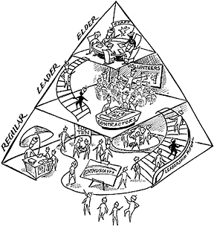
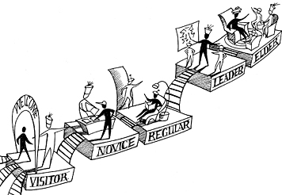
A pyramid meritocracy
(images from A.J. Kim, Community Building on the Web, 2000)

Slide 28
Business Models

Slide 29
The case of MySQL
Owned by Oracle
  Gives away software under open source license.
  Sells software support and maintenance.
  Currently around 8,000 customers who pay around 1-10% of amount they would pay for a proprietary version (i.e. Oracle).
For every paying customer, MySQL estimates there are 1,000 free users. However,
  Free users are potential paying customers
  Free users are potential future employees
Code rarely accepted from outside developers.
  Company employs 60 developers, from 25 countries, of whom 70% work at home.

Slide 30
Open Source beyond software
Wikipedia
  Open source approach to encyclopedia writing
CAMBIA:
  Open source approach to biotechnology
Creative Commons:
  Open source approach to copyright outside of software (books, music, etc.)
OpenCola
  Open source recipe for a soft drink.
Public Library of Science (PLoS)
  Open source approach to scientific journal publication

Slide 31
What does this mean for you?
As a student:
  Open source projects are a way for you to establish visibility and proficiency in software development.
As a developer:
  The license that you choose for your software matters. All “free” software is “open”, but not vice-versa!
As an entrepreneur:
  Consider both use and development of open source software.

Slide 33
Module Overview

