Slide 1
Data science
Part1: introduction

Slide 2
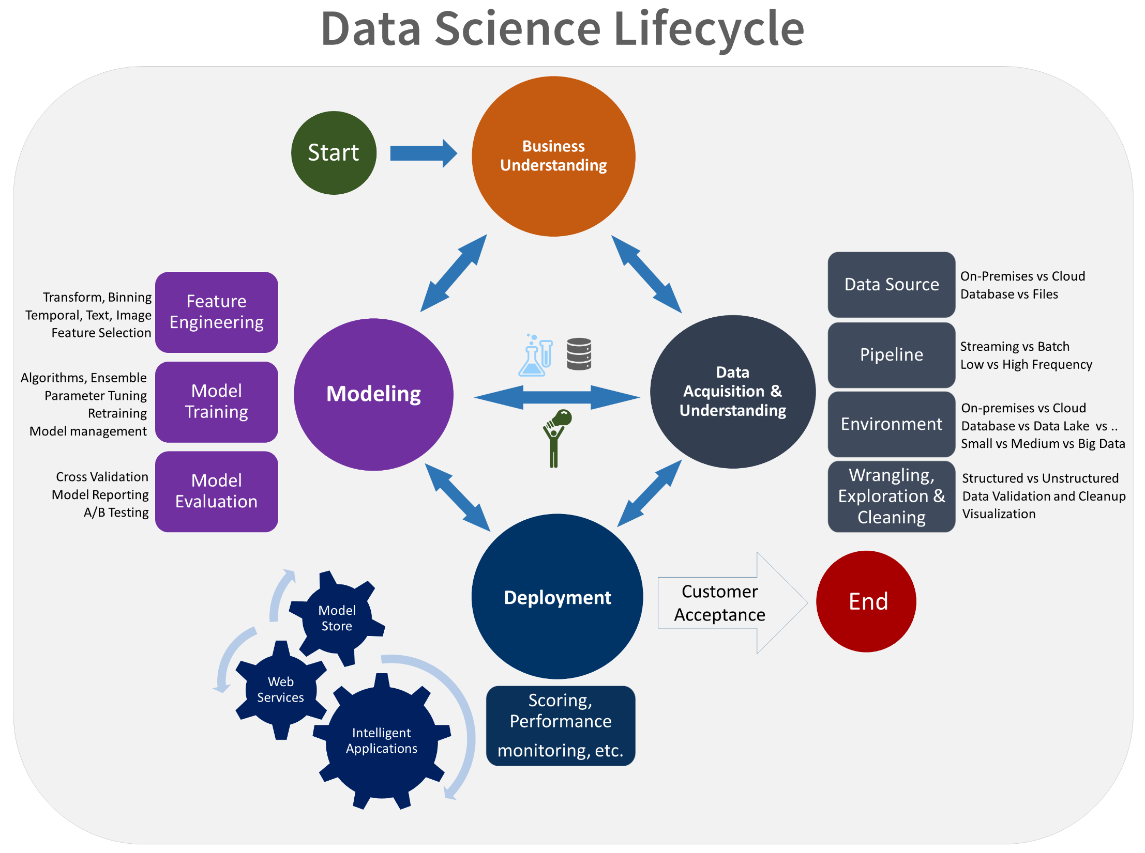

Slide 3
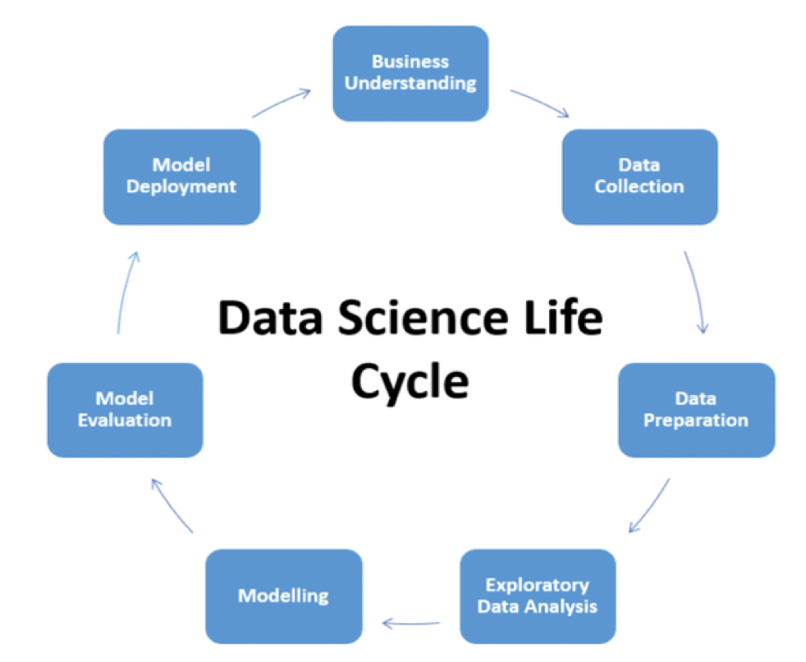

Slide 4
Data science Lifecycle/Business Understanding
Business Understanding
Business Understanding plays a key role during success of any project. Every domain and internet business work with a pair of rules as well as goals. In order to acquire the correct data, we should become able to be aware of business. Begging questions about dataset will help in narrowing as a result of correct files acquisition.

Slide 5
Data science Lifecycle/Data Collection
2. Data Collection
As it is a prominent reality there is no Data Science without Data . So, data serves important element for making any Data Scientific discipline project. Now the question happens where to get the files from. Data could be from different sources:
logs from webservers,
data coming from online repositories,
data from sources, social media data
data for excel sheet,
so in short data can come from any kind of source. Everywhere data is presently there. Newspaper, journals, online, websites, every part is made up of data files only. sources.

Slide 6
Data science Lifecycle/Data Collection
A major struggle faced by data professionals through data acquisition step is in order to understand where the data arrives from and whether it is undoubtedly the latest data or not really. It makes it a vital step to keep a trail all through the project lifespan cycle as data might to be re-acquired to do analytics and reach to conclusions.

Slide 7
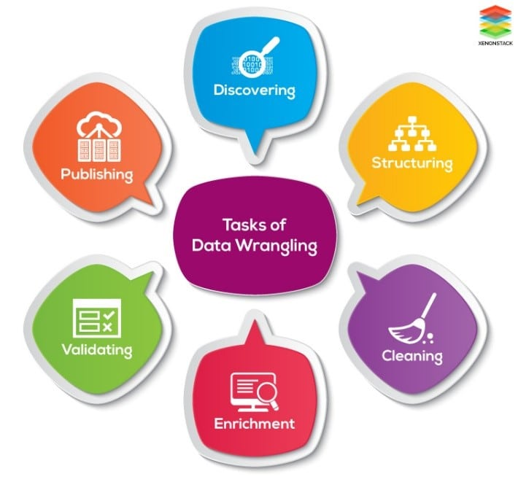
Data Preparation
Data Preparation
Data Cleaning
Data Wrangling

Slide 8
Data science Lifecycle/ Exploratory Data Analysis
Data acquired in previous step will probably not give clear analytical image or patterns in the info. So, to understand this info ought to be structured and cleaned. Might possibly be data is obtained right from different sources except for analysis files need to be clubbed mutually from different sources. This is without question also referred as structuring the particular data. Apart from this information might have missing values which usually will cause obstruction in research and model building. There are really various methods to do missing out on value and duplicate value treatment.
Exploratory Data Analysis (EDA) plays an important job at this stage as summarization of clean data helps through identifying the structure, outliers, flaws and patterns in the information.

Slide 9
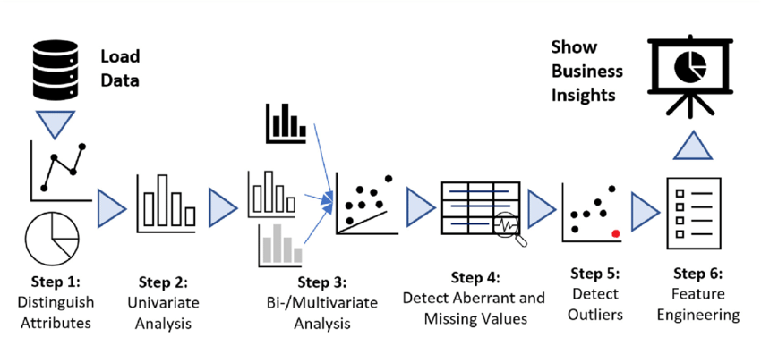
EDA(Exploratory Data Analysis )

Slide 10
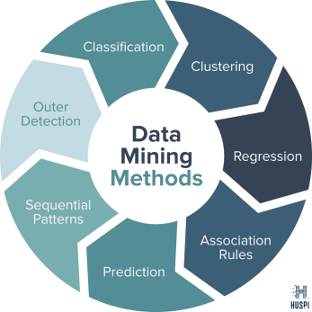
Data science Lifecycle/Modeling
Modeling
Classification
Regression
Clustering
…

Slide 11
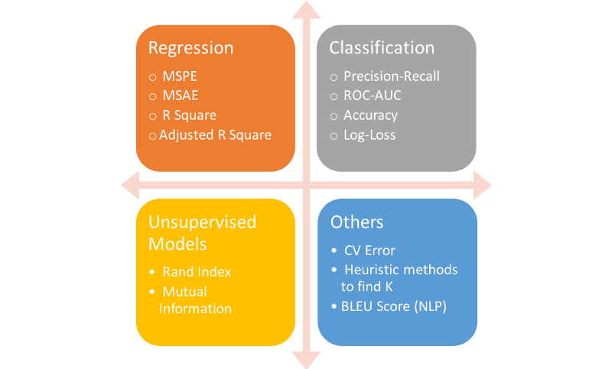
Data science Lifecycle/Model Evaluation
Model Evaluation

Slide 12
Data science Lifecycle/Model Deployment
TensorFlow Serving
MLflow
Kubeflow
Cortex
Seldon.io
BentoML
AWS SageMaker
Torchserve

Slide 13
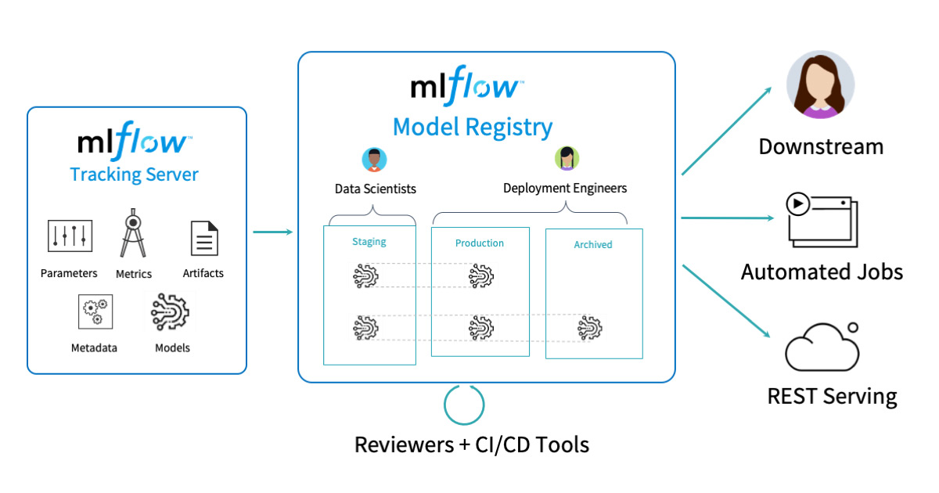

Slide 14
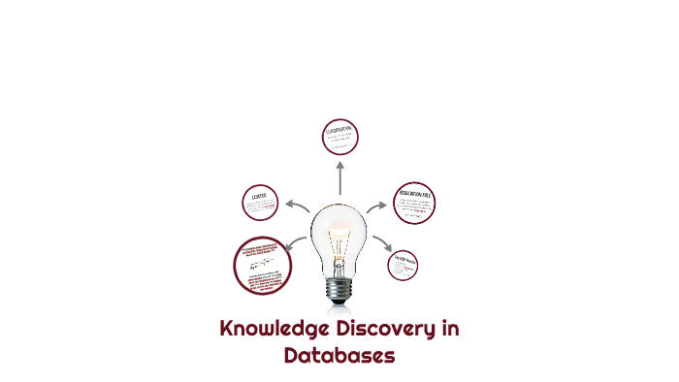
Knowledge Discovery in Databases (KDD)

Slide 15
What is the KDD Process?
The term Knowledge Discovery in Databases, or KDD for short, refers to the broad process of finding knowledge in data, and emphasizes the "high-level" application of particular data mining methods. It is of interest to researchers in machine learning, pattern recognition, databases, statistics, artificial intelligence, knowledge acquisition for expert systems, and data visualization.

Slide 16
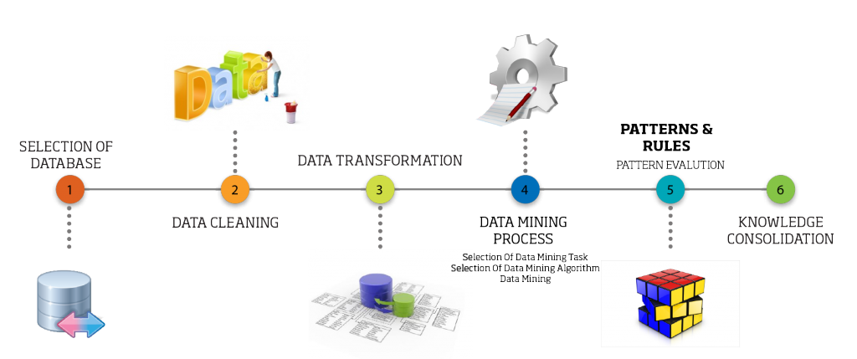
KDD

Slide 17
KDD
The overall process of finding and interpreting patterns from data involves the repeated application of the following steps:
Goal-Setting and Application Understanding
Developing an understanding of
the application domain
the relevant prior knowledge
the goals of the end-user

Slide 18
KDD
Data Selection and Integration
Creating a target data set:
selecting a data set, or focusing on a subset of variables, or data samples, on which discovery is to be performed.
Data integration is defined as heterogeneous data from multiple sources combined in a common source(DataWarehouse).
Data integration using Data Migration tools.
Data integration using Data Synchronization tools.
Data integration using ETL(Extract-Load-Transformation) process.

Slide 19
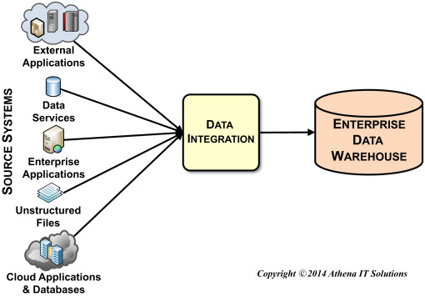
Data integration

Slide 20
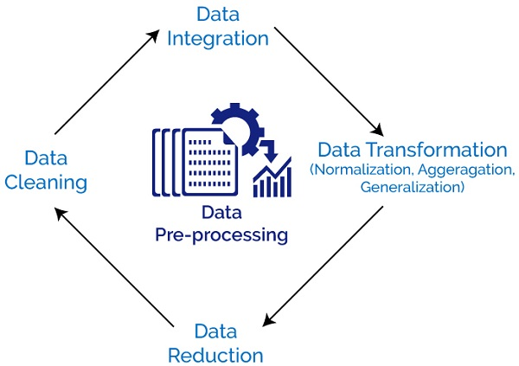
KDD
3. Preprocessing Data
Data cleaning
Data Transformation
Data Reduction

Slide 21
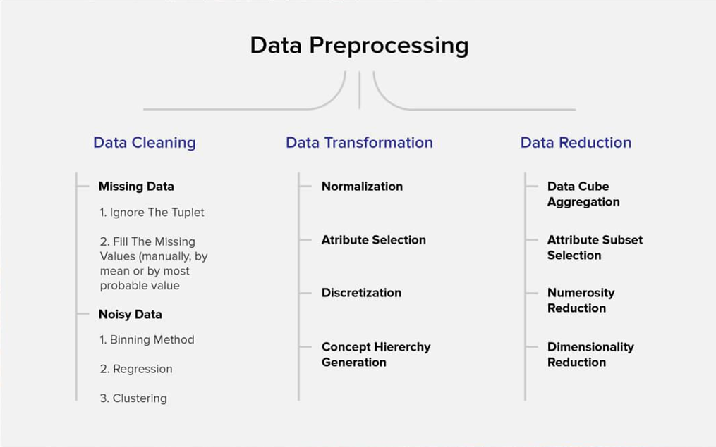

Slide 22
KDD
4. Data mining.
Choosing the data mining task.
Deciding whether the goal of the KDD process is classification, regression, clustering, etc.
Choosing the data mining algorithm(s).
Selecting method(s) to be used for searching for patterns in the data.
Deciding which models and parameters may be appropriate.
Matching a particular data mining method with the overall criteria of the KDD process.
Searching for patterns of interest in a particular representational form or a set of such representations as classification rules or trees, regression, clustering, and so forth.

Slide 23
KDD
5. Interpreting mined patterns:
Pattern Evaluation is defined as identifying strictly increasing patterns representing knowledge based on given measures.
Find interestingness score of each pattern.
Uses summarization and Visualization to make data understandable by user.

Slide 24
KDD
Consolidating discovered knowledge (Knowledge representation):
Knowledge representation is defined as technique which utilizes visualization tools to represent data mining results.
Generate reports.
Generate tables.
Generate discriminant rules, classification rules, characterization rules, etc.

Slide 25
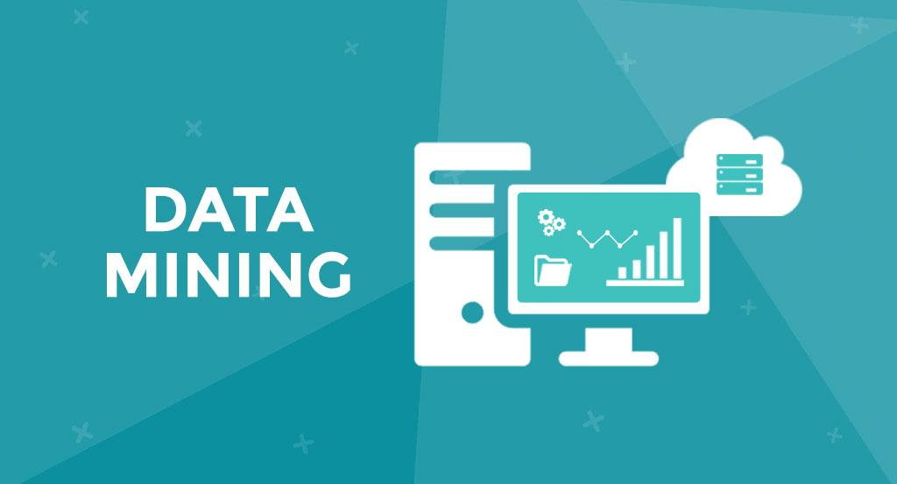

Slide 26
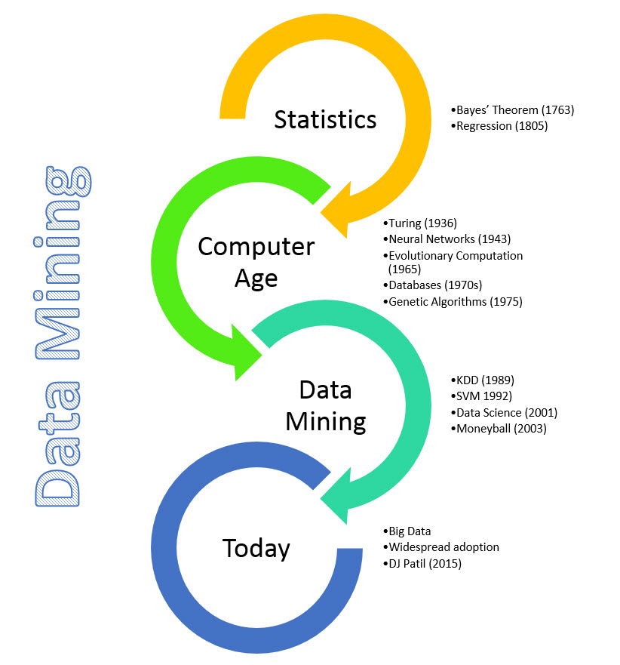

Slide 27
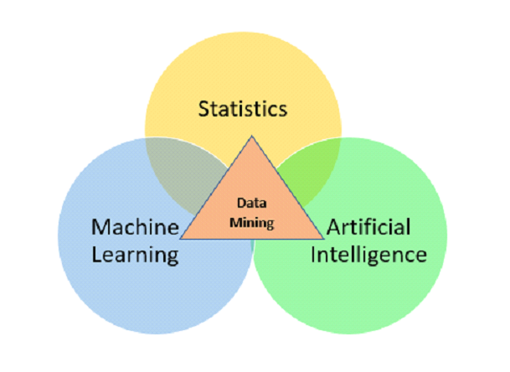
What is data Mining?
Data mining is a process of extracting and discovering patterns in large data sets involving methods at the intersection of machine learning, statistics, and database systems.
Data mining is one of the Step from KDD process.

Slide 28
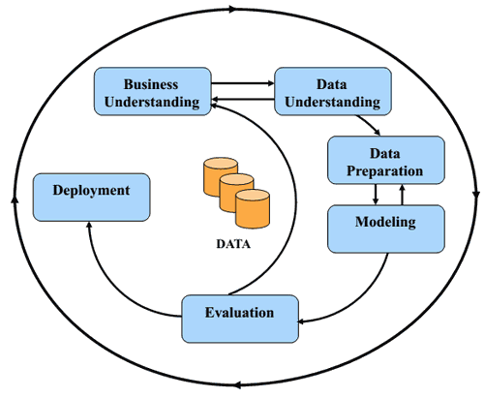
CRISP-DM (Cross-Industry Standard Process for Data Mining)

Slide 29
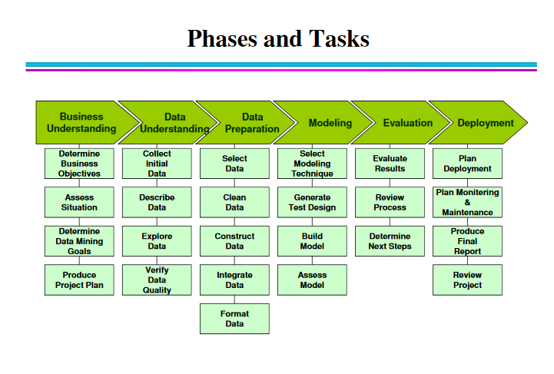

Slide 30
