Slide 1
Data science
Part 3: Data Collection & Preparation

Slide 2
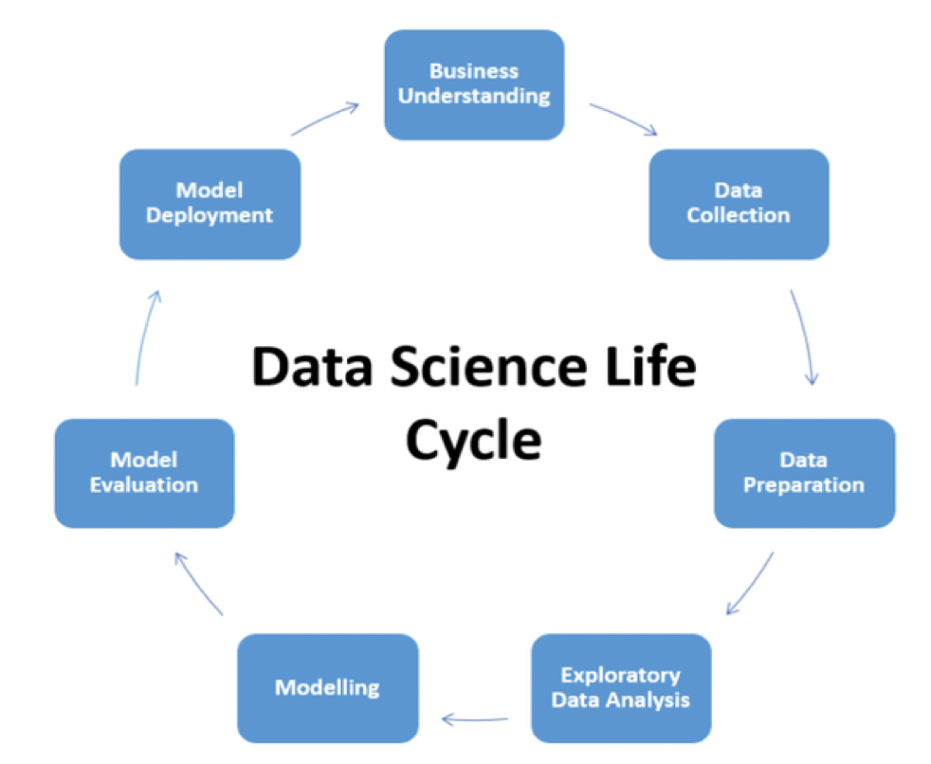

Slide 3
What are the Different Types of Data Collection?
Primary Data Collection
Qualitative Research Method
non – calculable elements like the emotions, opinions and feelings
2. Quantitative Method
quantitative method depends on numbers and mathematical calculations to help you arrive at a conclusion
mean, median, mode
Secondary Data Collection
online portals, books and journals

Slide 4
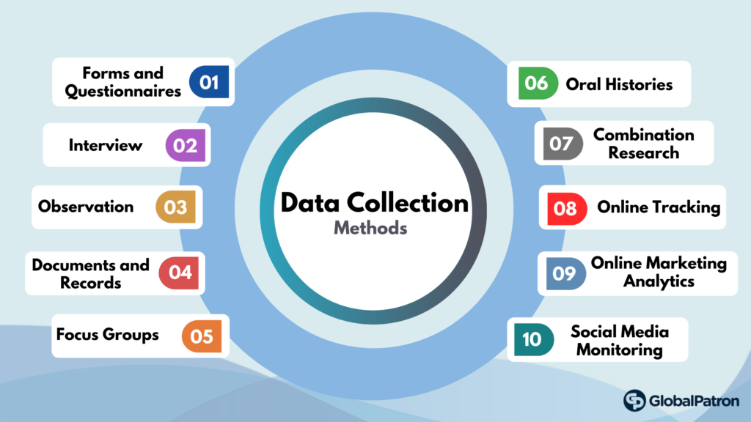
Data Collection

Slide 5
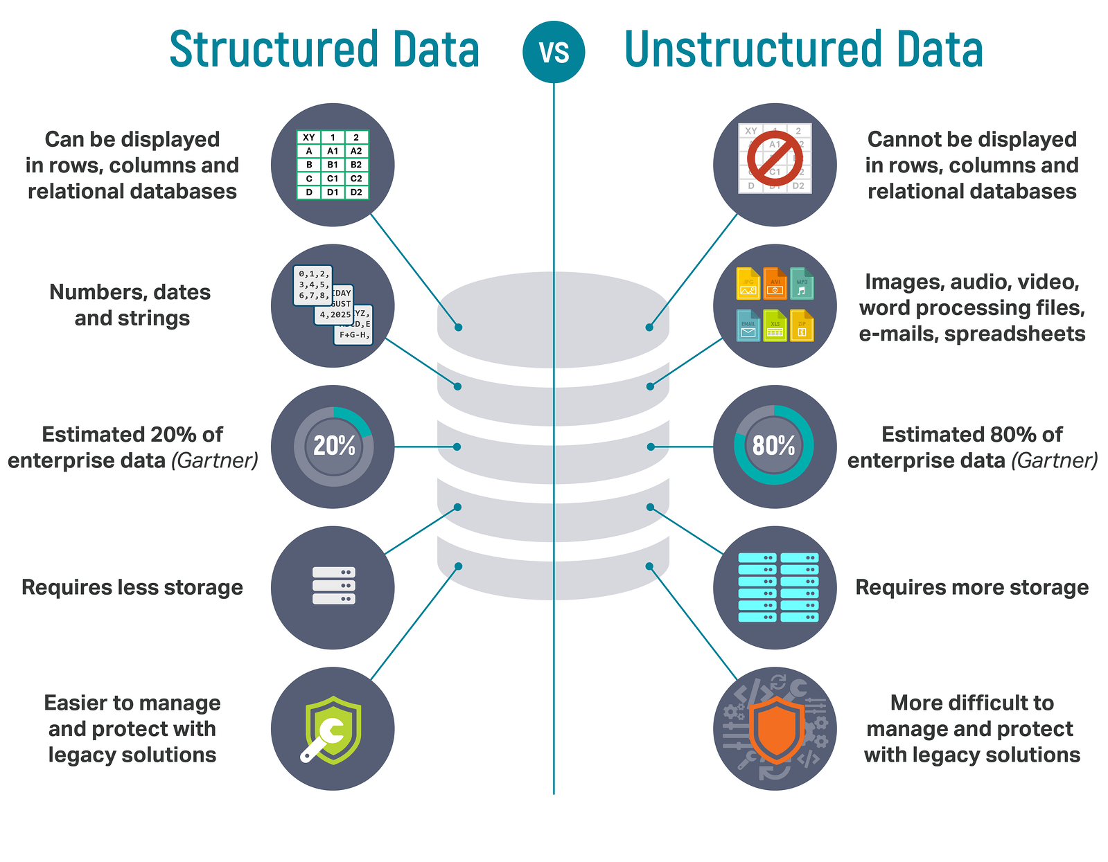

Slide 6
Hair Color
Salary
Age
Purchase
continuous
types of structured data
numerical
discrete
the number of people in a class
test questions answered correctly
Categorical
Hair Color
categorical
Binary data
Man or Women
education level
(“high school”,”BS”,”MS”,”PhD”)
ordinal data

Slide 7
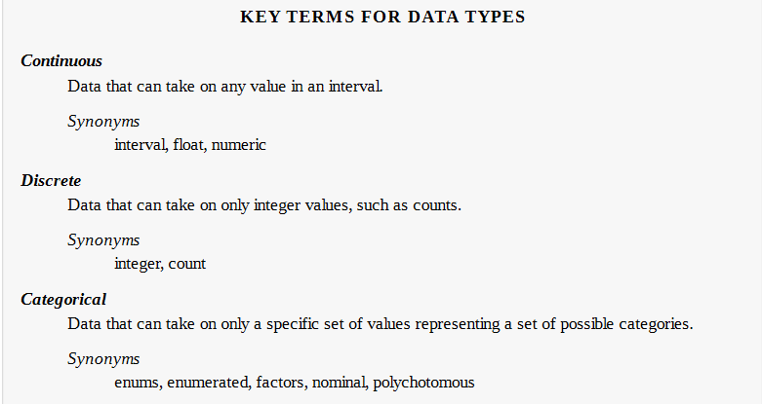

Slide 8
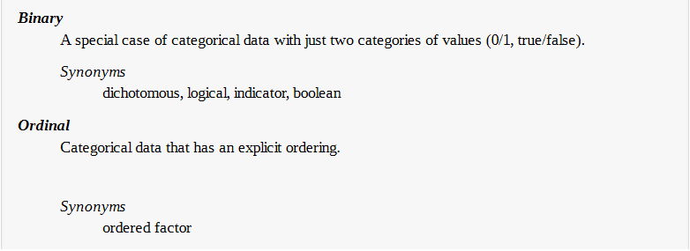

Slide 9
Rectangular Data Structures
Rectangular Data Structures :
unstructured data (e.g., text) must be processed and manipulated so that it can be represented as a set of features in the rectangular data.
Data in relational databases must be extracted and put into a single table.
Database table

Slide 10
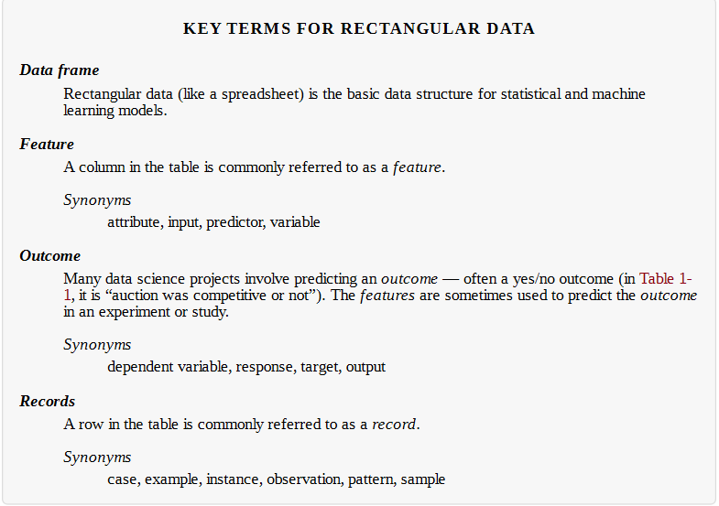

Slide 11
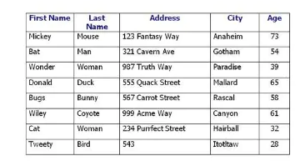
Rectangular Data Structures/ example

Slide 12
Nonrectangular Data Structures
Time series data records
records successive measurements of the same variable
Spatial data structures
which are used in mapping and location analytics, are more complex and varied than rectangular data structures. In the object representation, the focus of the data is an object (e.g., a house) and its spatial coordinates. The field view, by contrast, focuses on small units of space and the value of a relevant metric (pixel brightness, for example)
Graph (or network) data structures
These data structure are used to represent physical, social, and abstract relationships. For example, a graph of a social network, such as Facebook or LinkedIn, may represent connections between people on the network.

Slide 13
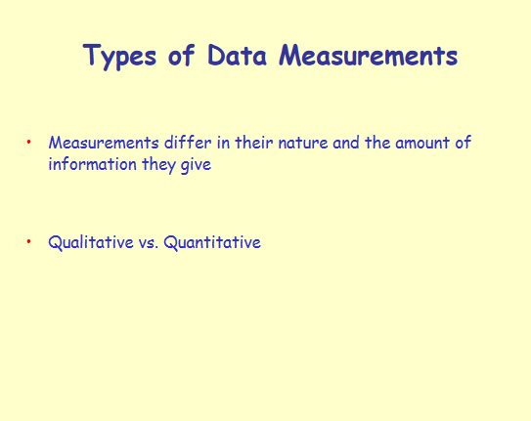

Slide 14
Types of Measurements
Nominal scale
Gives unique names to objects - no other information deducible
Names of people
Ordinal scale
Measured values can be ordered naturally
Transitivity: (A > B) and (B > C) ⇒(A > C)
Classifying students as: Very, Good, Good Sufficient,...
Temperature: Cool, Mild, Hot
Qualitative

Slide 15
Types of Measurements
Interval scale
The scale has a means to indicate the distance that separates measured values
Temperature
Ratio scale
measurement values can be used to determine a meaningful ratio between them
Bank account balance
Weight
Salary
Quantitative

Slide 16
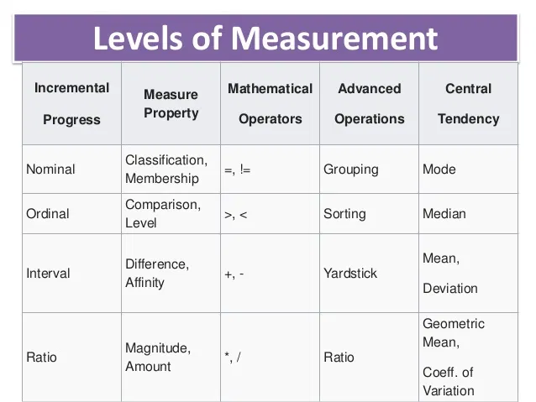

Slide 18
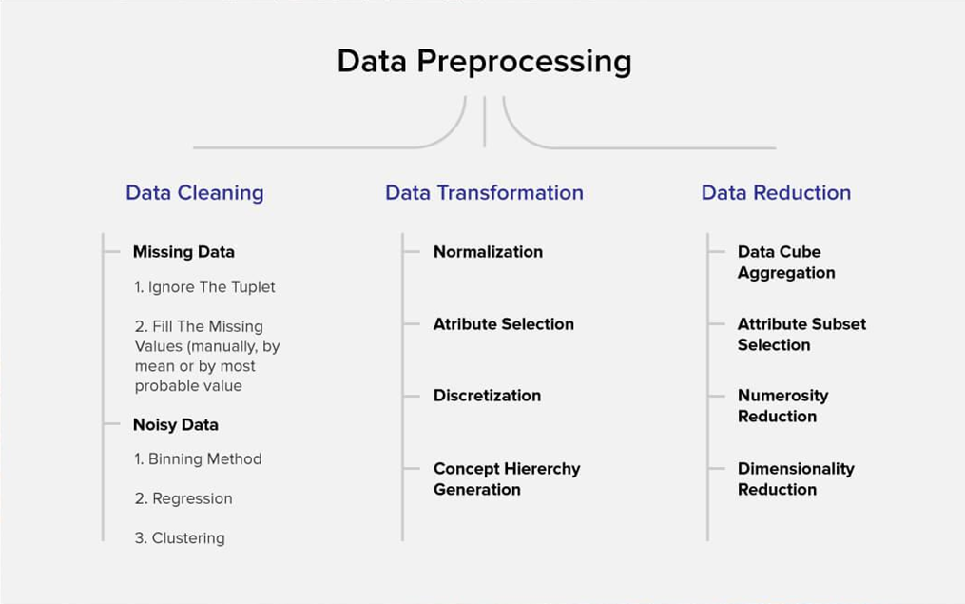

Slide 19
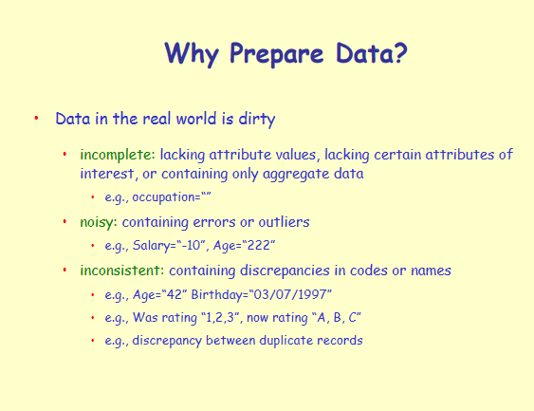

Slide 20
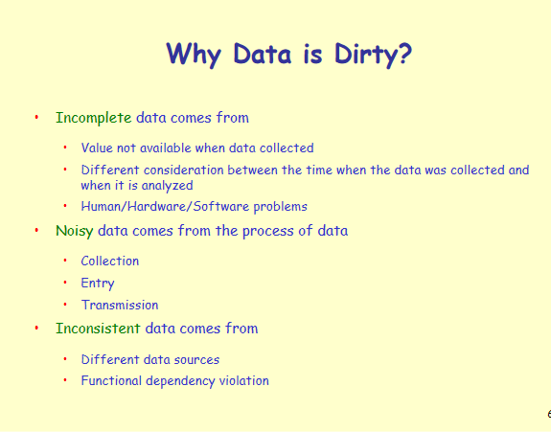

Slide 21
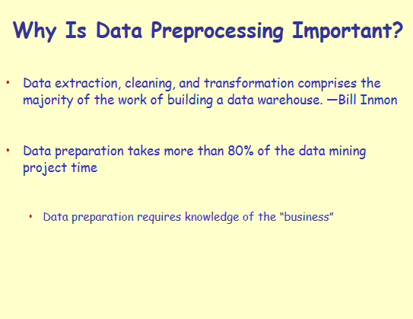

Slide 22
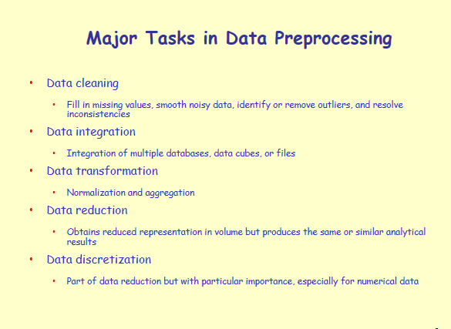

Slide 23
Data Preprocessing
Data Cleaning
Missing Data
Missing at Random (MAR)
Missing Completely at Random (MCAR)
Missing Not at Random (MNAR)
Noisy Data
Binning method
Regression
Clustring

Slide 24
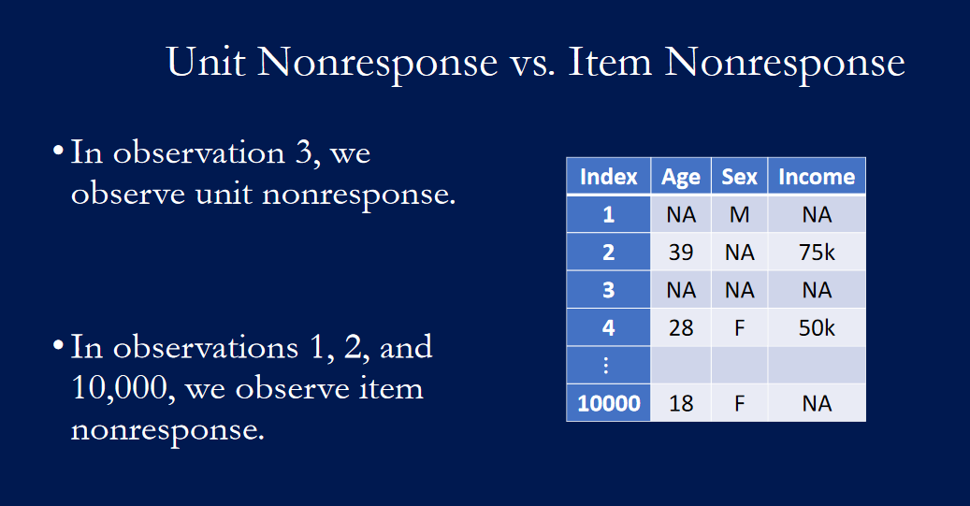

Slide 25
Data Cleaning/Missing Data
Missing at Random (MAR)
If the probability of being missing is the same only within groups defined by the observed data
When data are MAR, the fact that the data are missing is systematically related to the observed but not the unobserved data
Consider the following example.
men are more likely to tell you their age than women
men are more likely to tell you their weight than women.
men are more likely to dropout in clinical trials than women.
men are less likely to fill in a depression survey but this has nothing to do with their level of depression, after accounting for maleness.

Slide 26
Data Cleaning/Missing Data
Missing Completely at Random (MCAR)
If the probability of being missing is the same for all cases
In other words, no systematic differences exist between participants with missing data and those with complete data.
Missing Not at Random (MNAR)
If the probability of being missing varies for reasons that are unknown to us.
The fact that the data is missing is related to the unobserved data, that is, the missingness is related to events or factors which are not measured by the researcher.
Example: the depression registry may encounter data that are MNAR if participants with severe depression are more likely to refuse to complete the survey about depression severity.

Slide 27
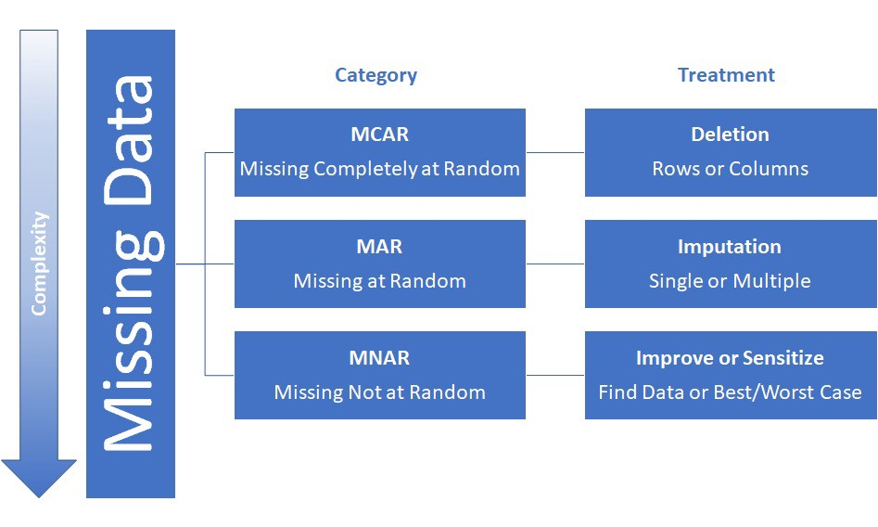
Missing Data/Solution

Slide 28
Missing Data/Solution/Removing Data
Removing Data
Listwise deletion → Drop missing entries
Missing data → MCAR
number of missing values is not very high
Dropping variable
Missing data → MCAR
variable has a lot of missing values → missing on 60–70 percent of the variable.
variable is not a very important predictor for the target variable.

Slide 29
Missing Data/Solution/Data Imputation
Data Imputation
Encoding missing variables in continuous features(Numerical Data).
When the variable is positive in nature, encoding missing entries as -1 works well for tree-based models
Encoding missing entry as another level of a categorical variable.
This method also works best with tree-based models. Here, we modify the missing entries in a categorical variable as another level

Slide 30
Missing Data/Solution/Data Imputation
Mean/Median/Mode imputation.
Numerical Data → Mean, Median
Categorical Data → Mode
Pros: Easy to implement and comprehend. Seems reasonable.
Cons: Significantly distorts histogram, underestimates variance, mean and median imputation will give very different results for asymmetric data, invalid method.

Slide 31
Mean/Median/Mode imputation
# Replace using mean df.fillna(df.median())
# Replace using mean
df.fillna(df.mean())
#Replace using mod or most frequent value
df.fillna(df.mode())
#Replace using mod or most frequent value
df.fillna(df[‘Coulmn1'].value_counts().index[0])

Slide 32
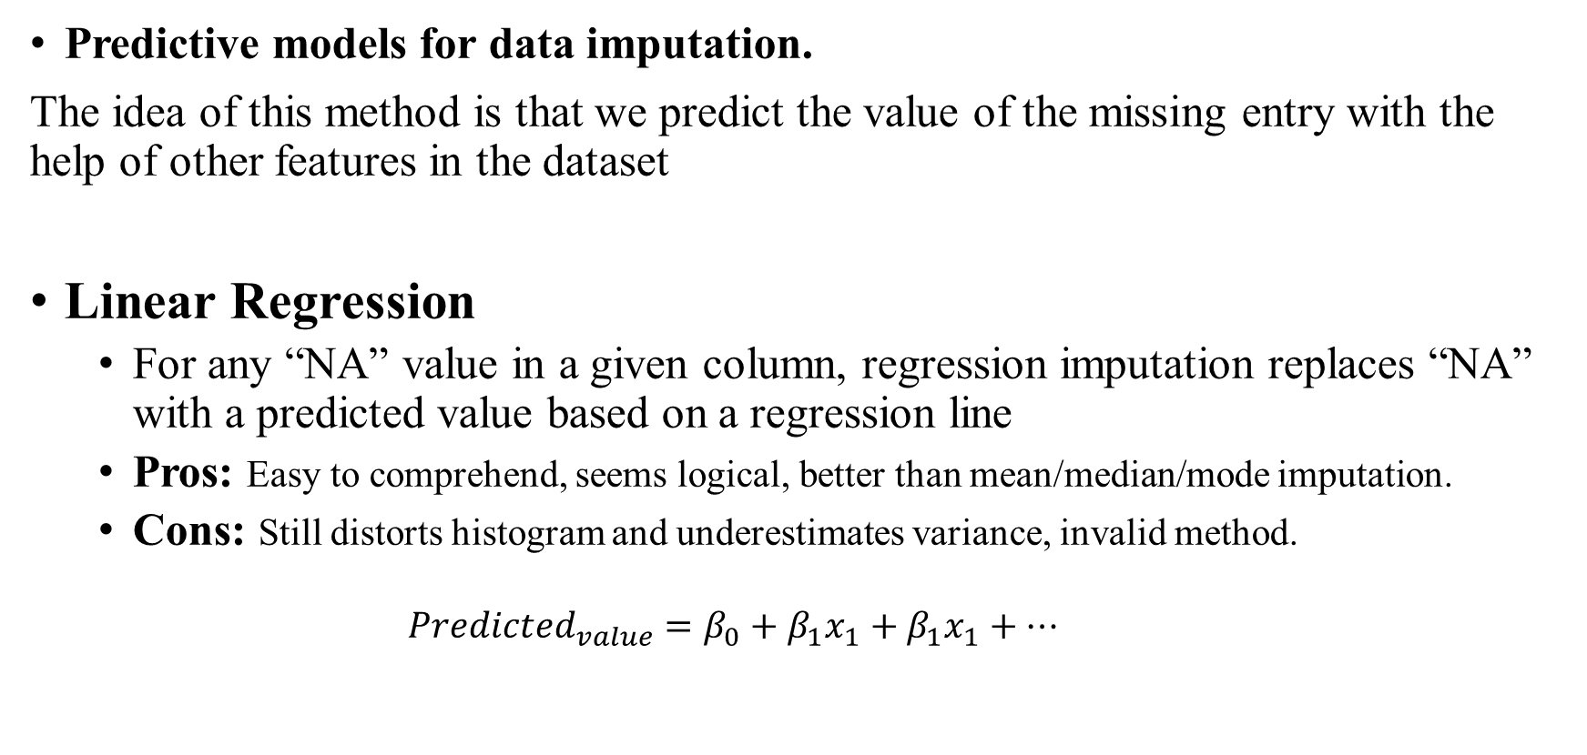
Missing Data/Solution/Data Imputation
Predictive models for data imputation.
The idea of this method is that we predict the value of the missing entry with the help of other features in the dataset
Linear Regression
For any “NA” value in a given column, regression imputation replaces “NA” with a predicted value based on a regression line
Pros: Easy to comprehend, seems logical, better than mean/median/mode imputation.
Cons: Still distorts histogram and underestimates variance, invalid method.
$${Predicted_{value}=β}_{0}+β_{1}x_{1}+β_{1}x_{1}+…$$

Slide 33
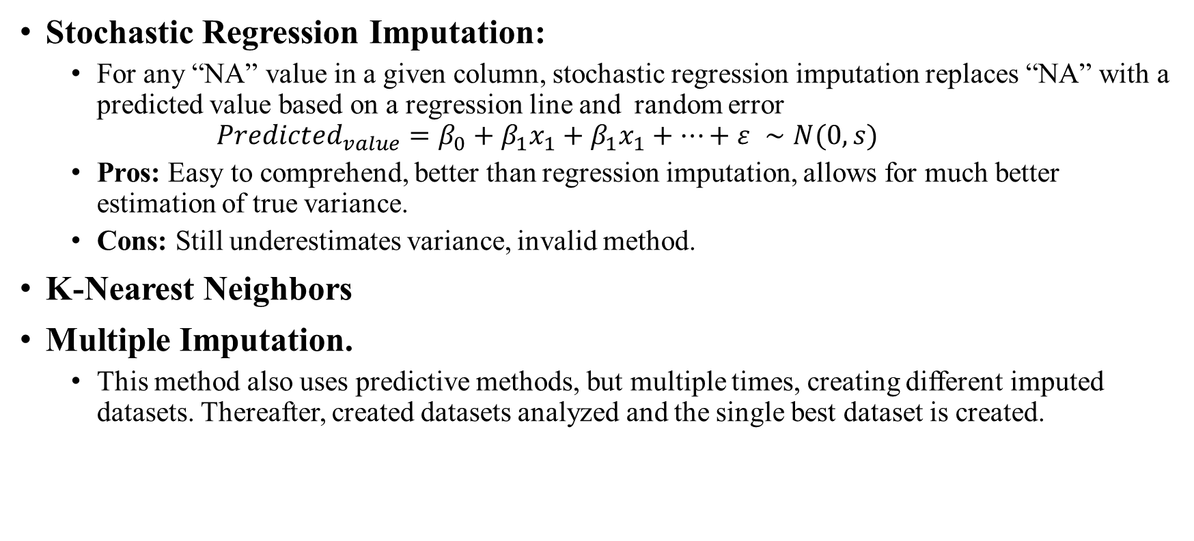
Missing Data/Solution/Data Imputation/Predictive models
Stochastic Regression Imputation:
For any “NA” value in a given column, stochastic regression imputation replaces “NA” with a predicted value based on a regression line and random error
$${Predicted_{value}=β}_{0}+β_{1}x_{1}+β_{1}x_{1}+…+ε ∼N(0,s)$$
Pros: Easy to comprehend, better than regression imputation, allows for much better estimation of true variance.
Cons: Still underestimates variance, invalid method.
K-Nearest Neighbors
Multiple Imputation.
This method also uses predictive methods, but multiple times, creating different imputed datasets. Thereafter, created datasets analyzed and the single best dataset is created.

Slide 34
Missing Data/Solution/Data Imputation
Hot-Deck Imputation:
Divide sample units into classes (i.e. based on age and sex). For any “NA” value in a given class, randomly select the value of one of the observed values in that class and impute that value for the missing value.
i.e. Among 18-34 year old women, there are 20 observed values and 3 missing values. For each missing value, pick one observed value at random and fill in the missing value with that observed value. You will select three observed values with replacement.
Pros: You’re using existing data.
Cons: If columns are imputed separately, multivariate relationships are not preserved. Invalid method

Slide 35
Data Cleaning/Noisy Data
Noise: - Random error or variance in a measured variable or we can say meaningless data
Incorrect attribute values may due to:
•Faulty data collection •Data entry problems •Data transmission problems •Technology limitation •Inconsistency in naming convention

Slide 36
How to Handle Noisy Data?
•Binning method
• First sort data and partition • Then one can smooth by bin mean, median and boundaries.
Clustering
Outliers may be detected by clustering, where similar values are organized into group of cluster
•Regression
• Here data can be smoothed by fitting the data to a function.
Combined computer and human inspection

Slide 37
Binning method
Equal-width (distance) partitioning: • It divides the range into N intervals of equal size: uniform grid • If A and B are the lowest and highest values of the attribute, the width of intervals will be: W = (B-A)/N. • The most straightforward • Skewed data is not handled well
Disadvantage
Where does N come from?
Sensitive to outliers
Advantage
simple and easy to implement
produce a reasonable abstraction of data
Equal-depth (frequency) partitioning: • It divides the range into N intervals, each containing approximately same number of samples • Good data scaling • Managing categorical attributes can be tricky.

Slide 38
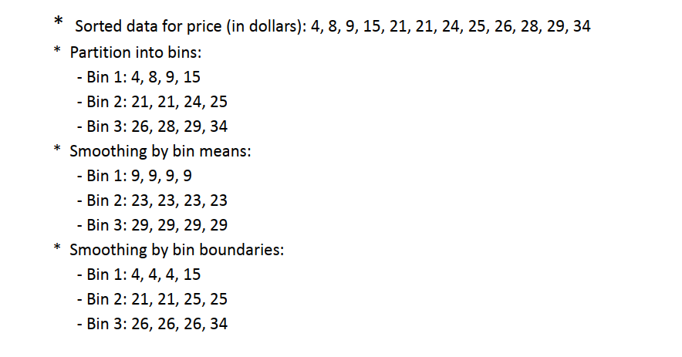
Binning method/Example1(Equal-width)

Slide 39
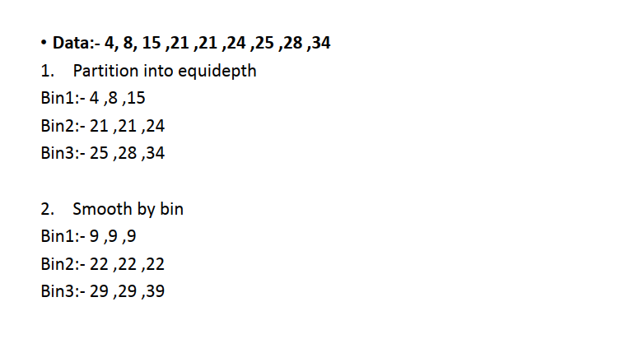
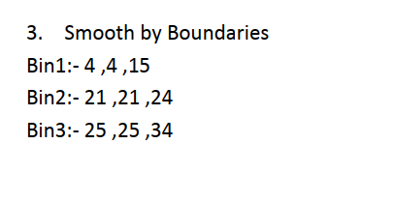
Binning method/Example2(Equal-depth)

Slide 40
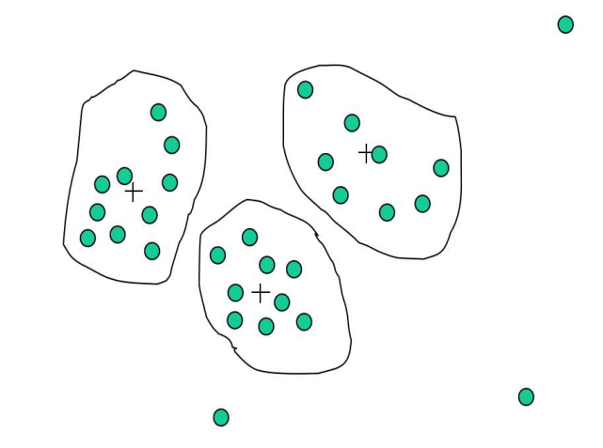
Cluster Analysis

Slide 41
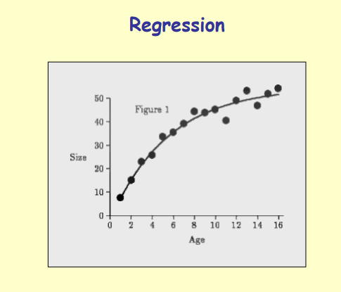
Regression

Slide 42
Data integration and transformation
Detecting and resolving data value conflicts
For the same real world entity, attribute values from different sources may be different
Which source is more reliable ?
Is it possible to induce the correct value?
Possible reasons: different representations, different scales, e.g., metric vs. British units
Careful integration of the data from multiple sources may help reduce/avoid redundancies and inconsistencies and improve mining speed and quality
Note : Data integration requires knowledge of the “business”

Slide 43
Issues in Data Integration
Schema Integration:
Metadata (i.e. the schema) from different sources may not be compatible.
Example : Consider two data sources R and S. Customer id in R is represented as cust_id and in S is represented is c_id
Data value conflicts:
The values or metrics or representations of the same data maybe different in for the same real world entity in different data sources.
Kilograms, grams

Slide 44
Issues in Data Integration
Redundant data:
Duplicate attributes or tuples may occur as a result of integrating data from various sources. This may also lead to inconsistencies
The same attribute may have different names in different databases
One attribute may be a “derived” attribute in another table, e.g., annual revenue

Slide 45
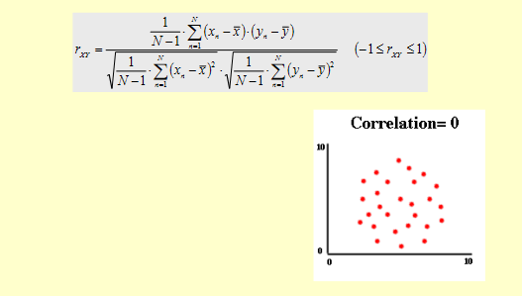
Handling Redundancy in Data Integration
Redundant data may be detected by correlation analysis

