Slide 1
CAD/USD Outlook
Borderland Co-op
Mahdi Ghafarian
Oct 2025

Slide 2
1. Introduction

Slide 3
Forecasting Approaches
Technical Analysis: Discretionary price and volume analysis
Quantitative Analysis: Applying statistics and machine learning
Sentiment Analysis: General sentiment of market participants
Fundamental Analysis: Economics and finance theories on value, equilibrium levels, and supply and demand

Slide 4
2. Key Drivers of the CAD/USD Exchange Rate

Slide 5
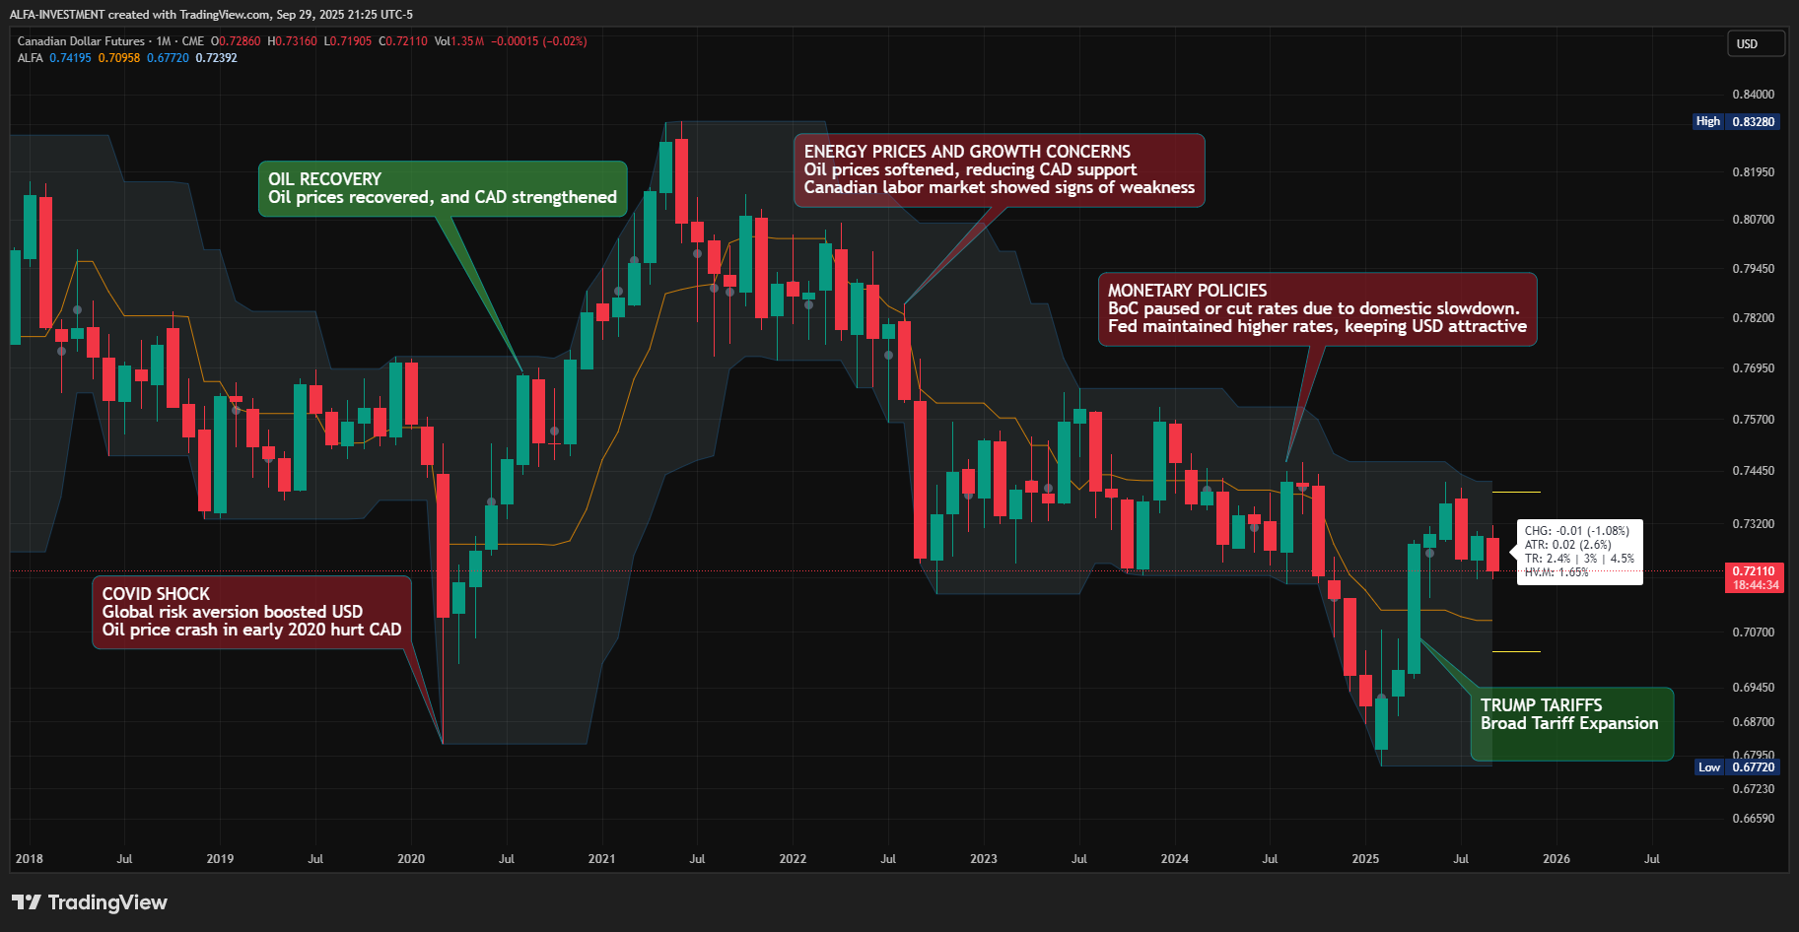
CAD/USD: 2020 – 2025

Slide 6
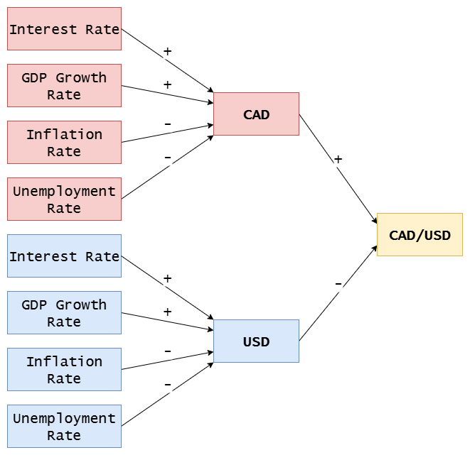
Exchange Rate Models in Economics
Purchasing Power Parity
Interest Rate Parity
Relative Economic Strength

Slide 7
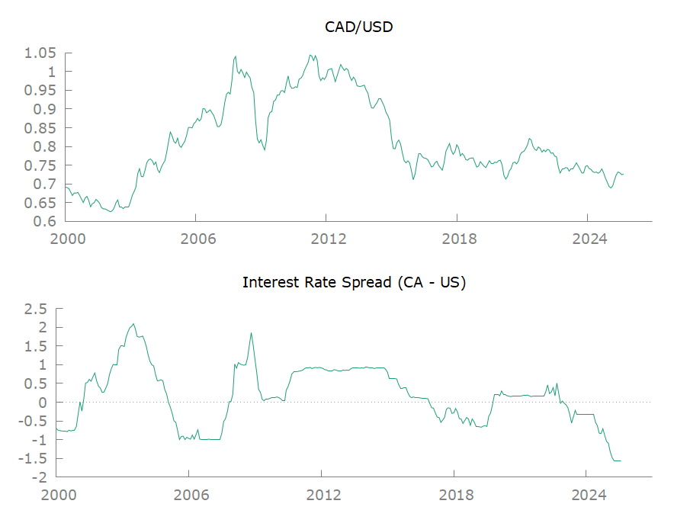
Interest Rate Parity

Slide 8
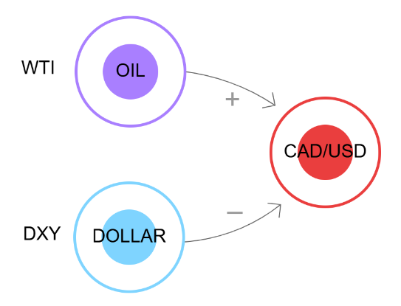
Conceptual Model

Slide 9
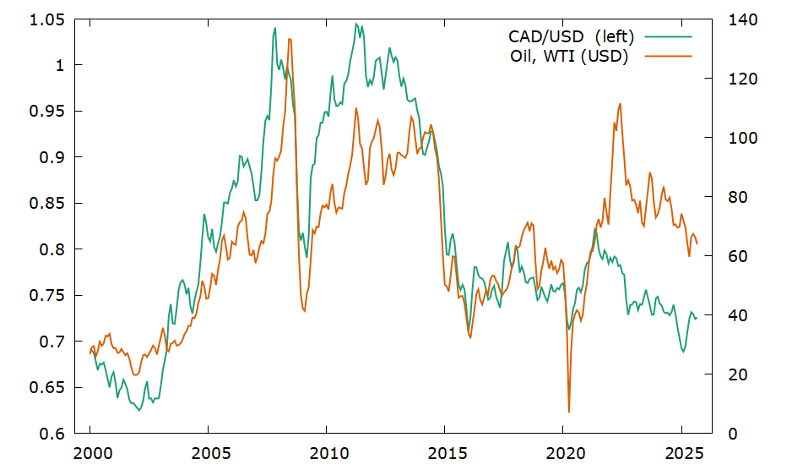
Crude Oil (WTI)

Slide 10
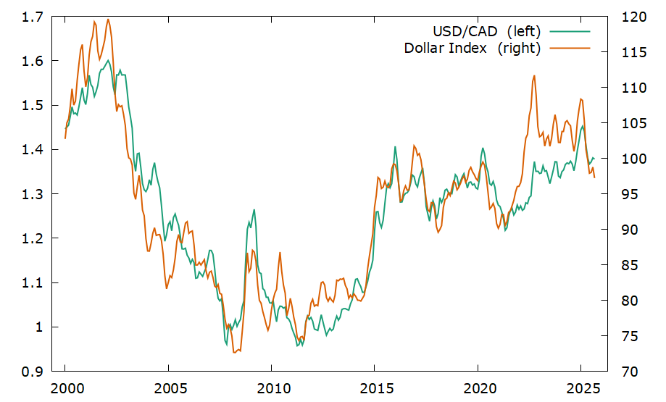
Dollar Index (DXY)

Slide 11
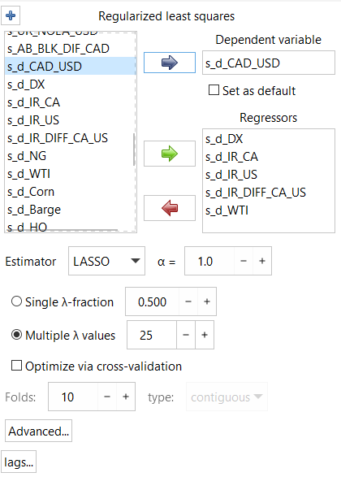
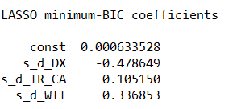
Lasso (L1) Regularized Regression

Slide 12
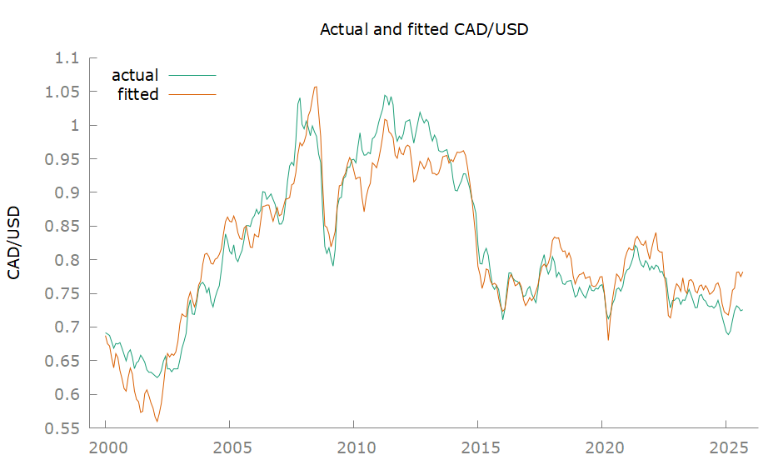
CAD/USD: Simple Linear Regression of Oil and Dollar Index
Notes:
Model 3: OLS, using observations 2000:01-2025:09 (T = 309)
Dependent variable: CAD_USD
coefficient std. error t-ratio p-value
----------------------------------------------------------
const 1.36524 0.0250267 54.55 1.07e-159 ***
WTI 0.00151539 0.000100173 15.13 5.46e-039 ***
DX −0.00699391 0.000221306 −31.60 2.27e-098 ***
Mean dependent var 0.812704 S.D. dependent var 0.111882
Sum squared resid 0.370919 S.E. of regression 0.034816
R-squared 0.903792 Adjusted R-squared 0.903164
F(2, 306) 1437.309 P-value(F) 2.7e-156
Log-likelihood 600.5780 Akaike criterion −1195.156
Schwarz criterion −1183.956 Hannan-Quinn −1190.678
rho 0.944612 Durbin-Watson 0.118346

Slide 13
3. Global Economy

Slide 14
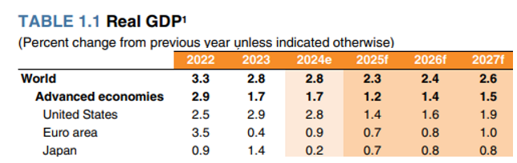
Global Growth is Slowing
2025 – Uncertainty in Global Policy
Global growth is slowing due to a substantial rise in trade barriers and the pervasive effects of an uncertain global policy environment.
Growth is expected to weaken to 2.3 percent in 2025, with deceleration in most economies relative to last year. This would mark the slowest rate of global growth since 2008, aside from outright global recessions.
2026-2027 – Moderate Growth
In 2026-27, a tepid recovery is expected.
The outlook largely hinges on the evolution of trade policy globally.
Reference: World Bank (June 2025), Global Economic Prospects

Slide 15
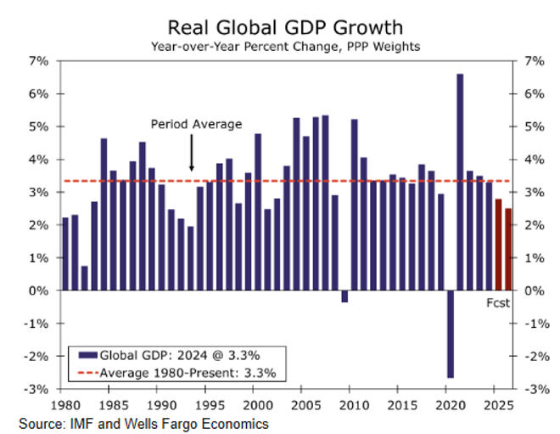
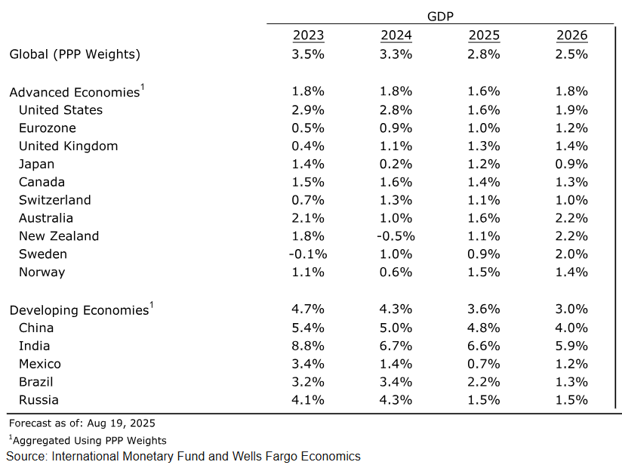
Slowing Economy in 2025-2026
Reference: Wells Fargo, International Economic Outlook: August 2025

Slide 16
4. Crude Oil

Slide 17
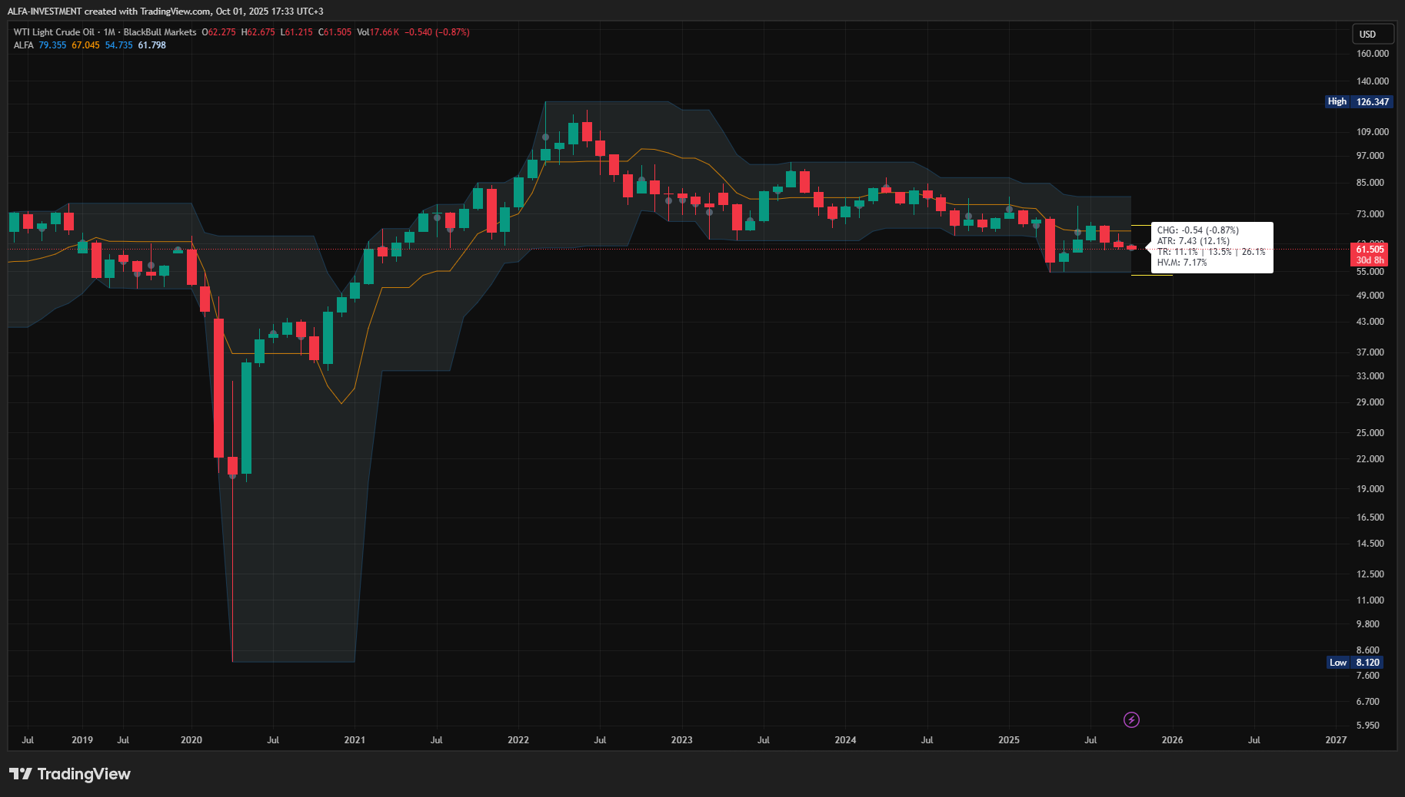
Crude Oil is in a downtrend since 2023

Slide 18
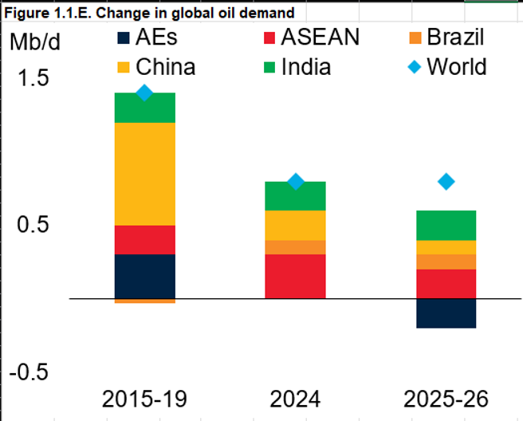
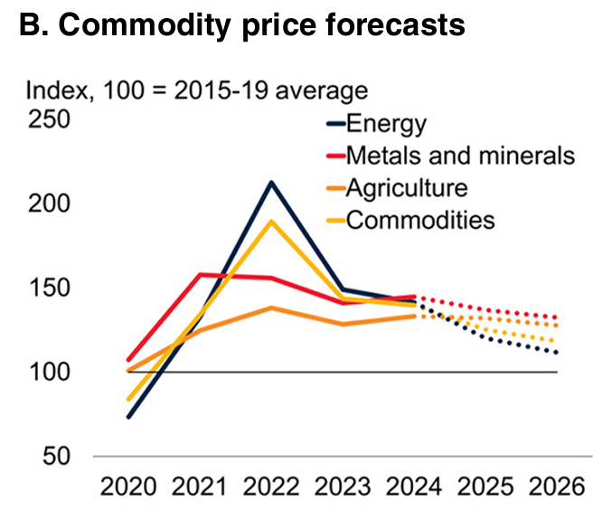
Oil Demand Falls as Global Economy Slows (2025–2026)
Reference: World Bank (June 2025), Global Economic Prospects

Slide 19
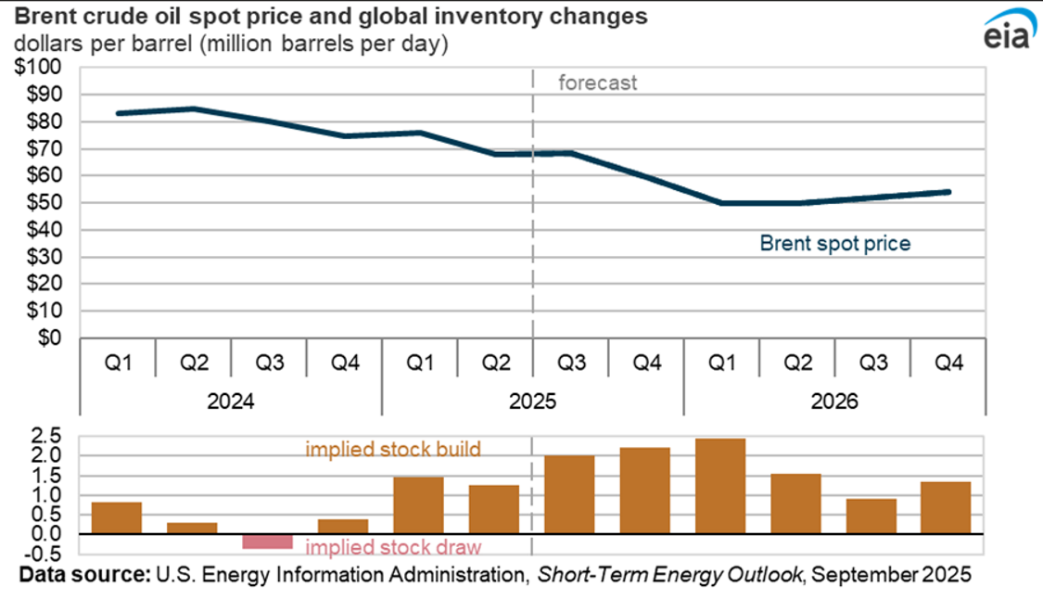
Increasing Oil Inventories
Reference: U.S. Energy Information Administration (EIA), Short-Term Energy Outlook
Notes:
EIA

Slide 20
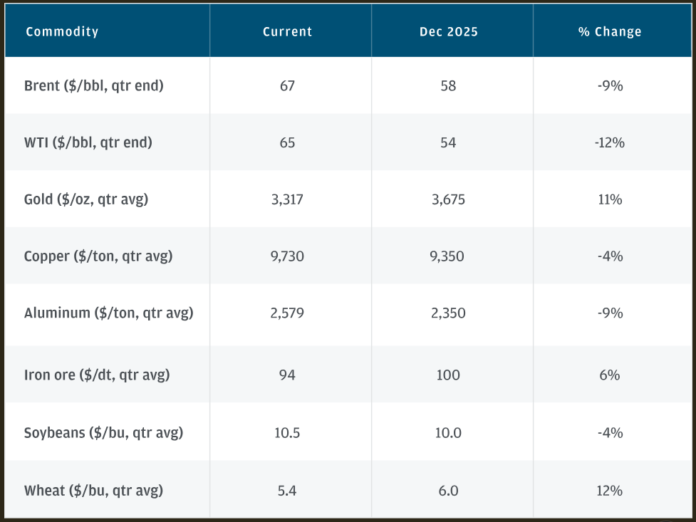
Bearish Oil Outlook for 2025-2026
J.P. Morgan’s base case for oil remains anchored by the supply-demand balance. Since February, global oil inventories have increased by almost 240 million barrels, indicating that supply is abundant.
Based on our forward physical oil balances, which show a market in a 2.2–2.4 mbd surplus over the second half of 2025, oil is anticipated to trade in the low- to mid-$60/bbl range for the remainder of 2025 and settle at $60/bbl in 2026.
Reference: J.P. Morgan Research, Mid-year market outlook 2025

Slide 21
5. U.S. Dollar

Slide 22
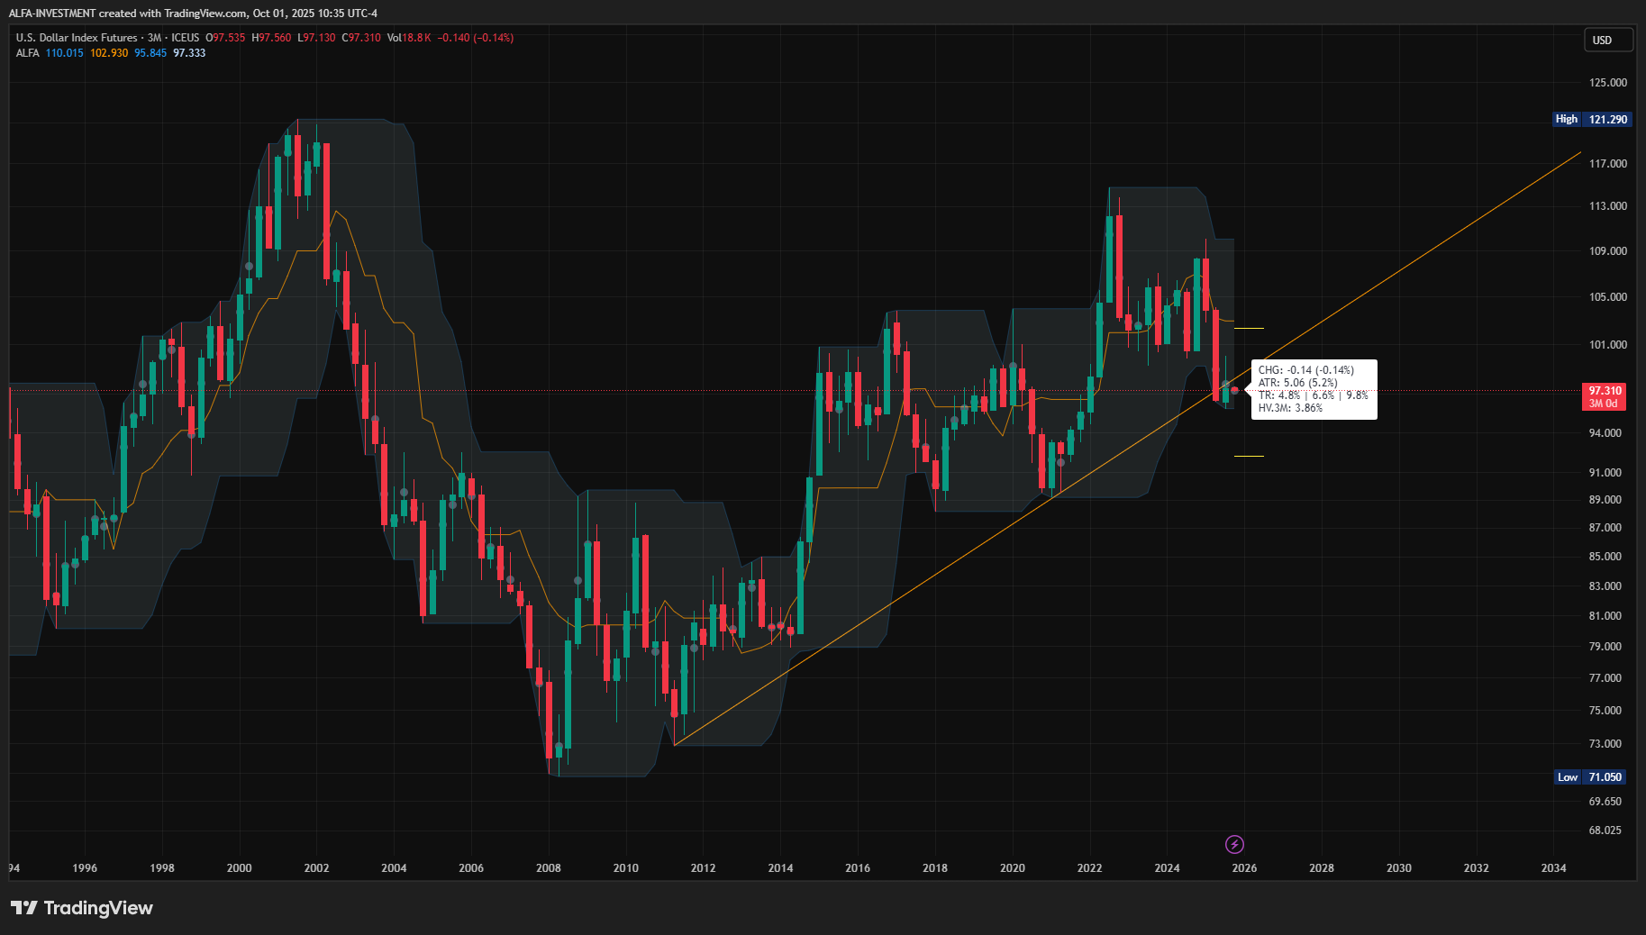
Dollar is in an uptrend since 2014

Slide 23
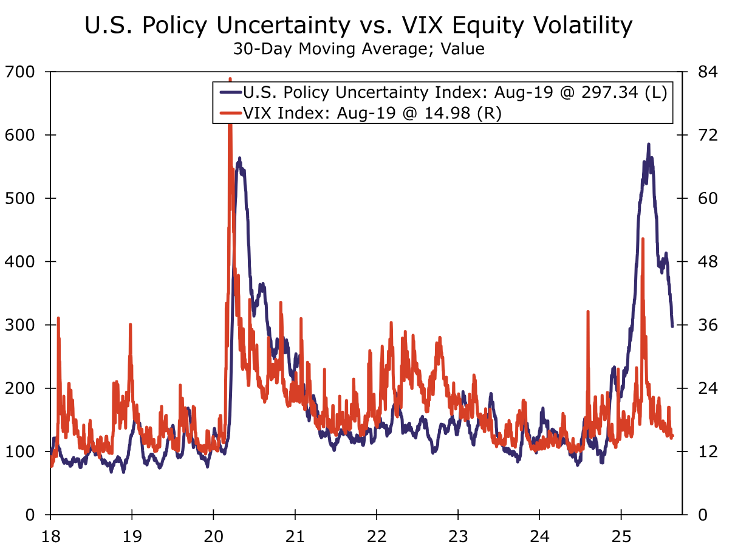
U.S. Policy Uncertainty

Slide 24
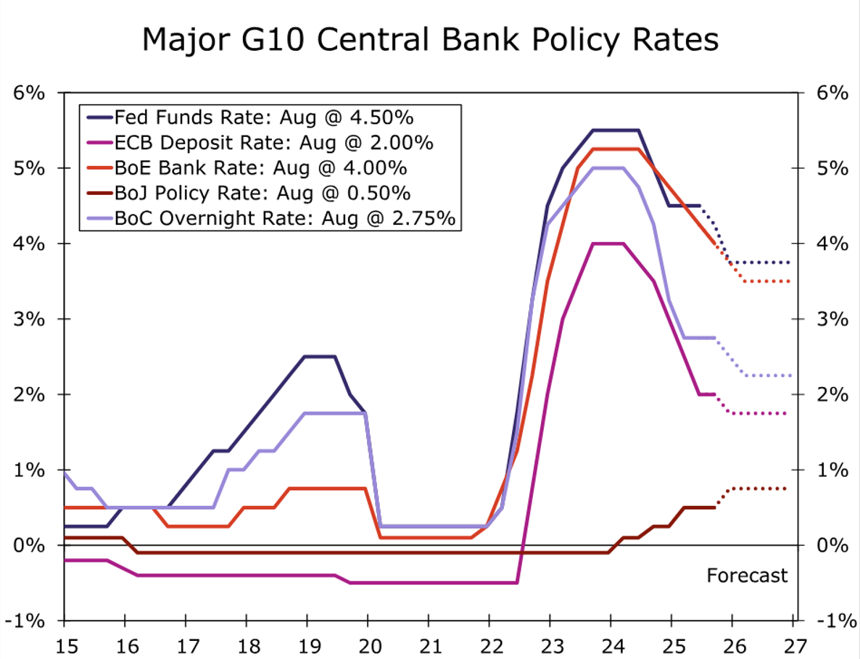
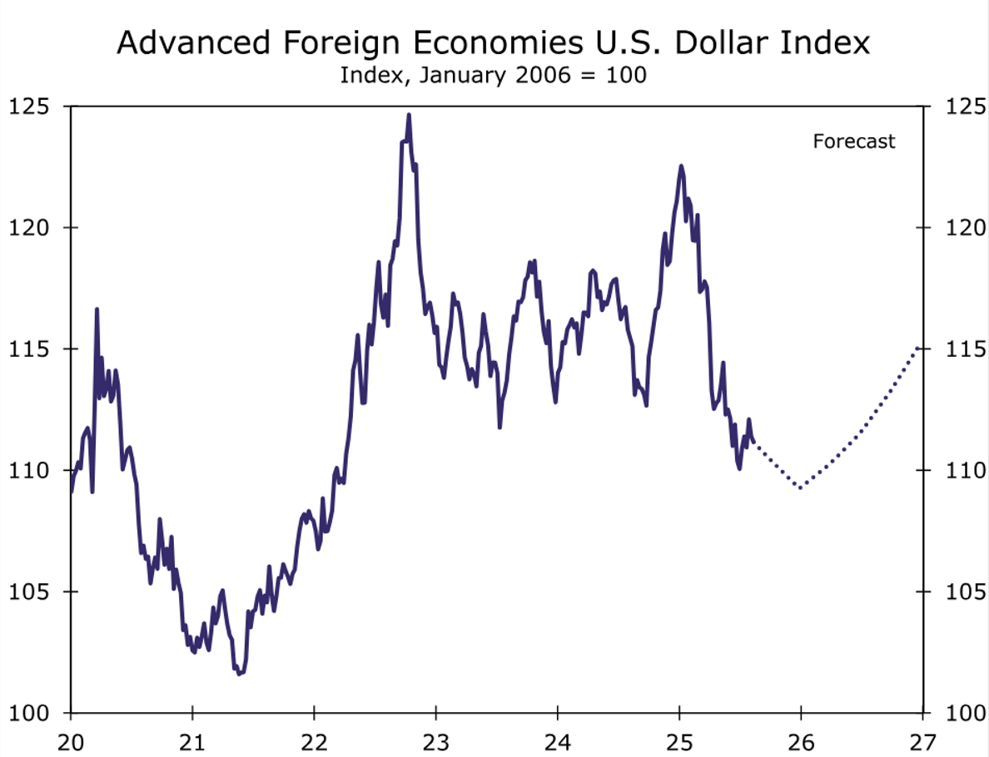
U.S. Dollar Recovers in 2026
Reference: Wells Fargo, International Economic Outlook: August 2025

Slide 25
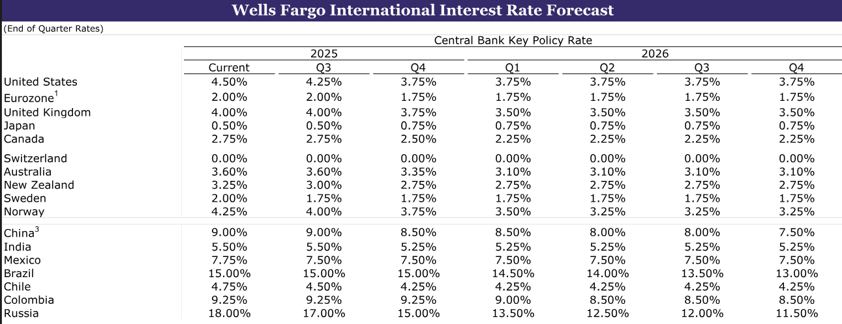
Interest Rate Forecast
Reference: Wells Fargo, International Economic Outlook: August 2025

Slide 26
6. Forecast

Slide 27
Forecasting Exchange Rates is Very Difficult
It is well known that exchange rate fluctuations are very difficult to predict using economic models, and that a random walk forecasts exchange rates better than any economic model. Exchange Rate Predictability - American Economic Association
The view that exchange rates are largely disconnected from economic fundamentals at short horizons has mainly predominated since the seminal paper by Meese and Rogoff (1983), which showed that exchange rate models were unable to deliver more accurate nominal exchange rate forecasts than the simple prediction of “no change” associated with the random walk (RW) model. The predictive power of equilibrium exchange rate models

Slide 28
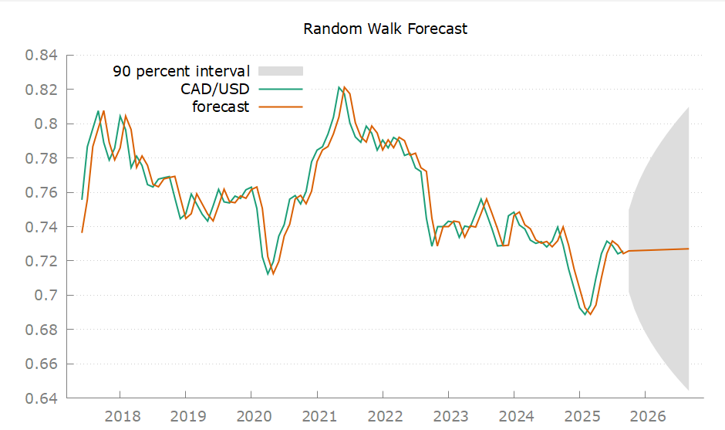
Scenario Planning – Random Walk Model
Price (Sep 2026) | Std Error | Lower Band (5%) | Upper Band (95%)
0.7270 (+0.2%) | 0.05 | 0.6440 (-11%) | 0.8099 (+12%)
Notes:
2025:09 0.7257
2026:09 0.7270 0.0504 0.6441 - 0.8099

Slide 29
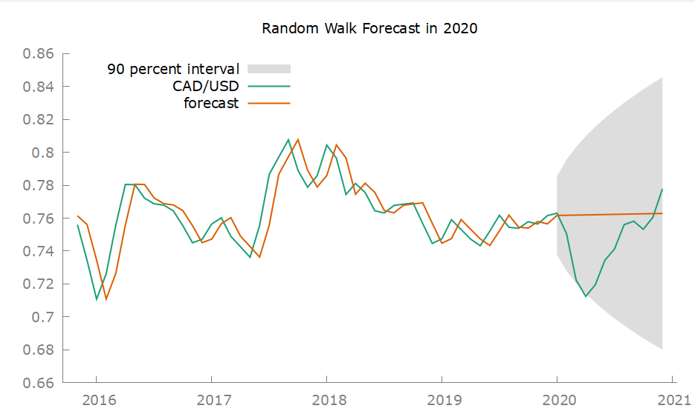
Prediction Intervals and Risk Management

Slide 30
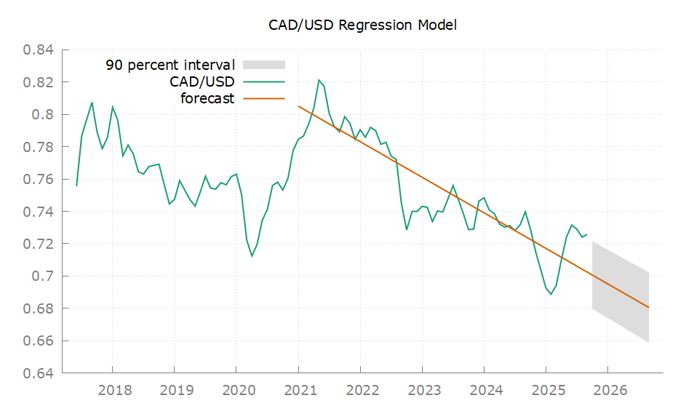
Regression Model (2021-Present)
Price (Sep 2026) | Std Error | Lower Band (5%) | Upper Band (95%)
0.6804 (-6%) | 0.01 | 0.6585 (-9%) | 0.7022 (-3%)
Notes:
2025:09 0.7257
2026:09 0.6804 0.0130 0.6586 - 0.7022

Slide 31
7. Conclusion
CAD/USD: Bearish Outlook for 2026

Slide 32
Recap
Economic growth projected to slow in 2026
Oil demand declines while inventories rise, signaling oversupply
After a period of weakness due to Tariffs, the U.S. dollar rebounds in 2026
CAD/USD is positively correlated with oil prices and negatively correlated with the dollar index
The CAD/USD downtrend persists into 2026, continuing the decline initiated in 2022.

