Slide 1
Urea Outlook for 2026
Borderland Co-op
Mahdi Ghafarian
Sep 2025

Slide 2
1. Introduction

Slide 3
Process
Forecast FOB prices for general direction and possible range of moves
Use the difference between Alberta and FOB prices for timing the purchase.

Slide 4
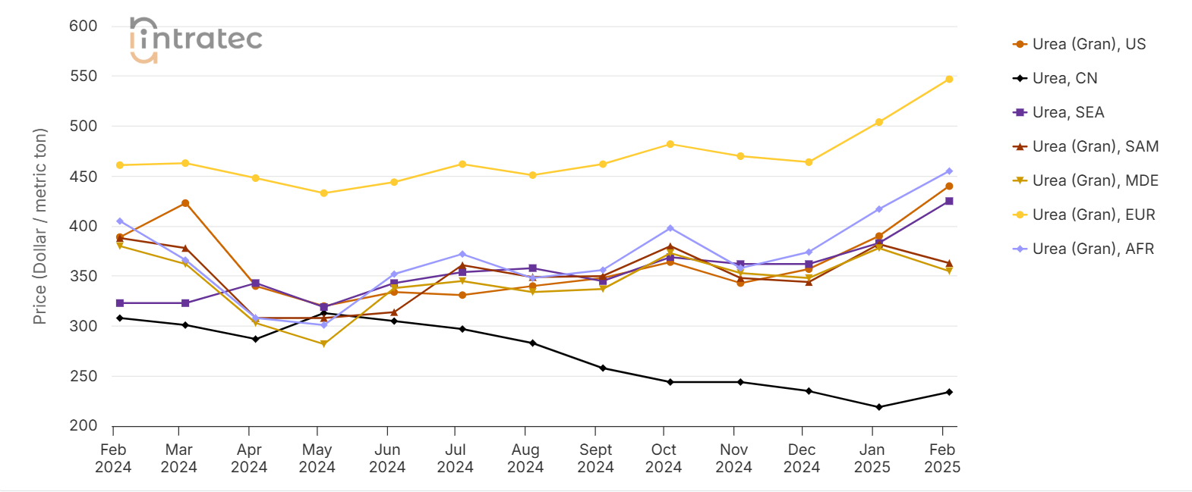
Urea – A Fragmented Market
Reference: Urea Price - Current & Forecasts | Intratec.us
Notes:
The chart above is a sample of historical data taken from Intratec Primary Commodity Prices. It presents price assessments for Urea, in USA Dollar per metric ton (USD/mt), across 7 key locations, as follows:
Urea (Gran), US (United States): Urea (granular), export spot price, fob, US Gulf
Urea, CN (China): Urea, domestic spot price, exw, China
Urea, SEA (Southeast Asia): Urea, import contract price, cfr, India
Urea (Gran), SAM (South America): Urea (granular), import spot price, cfr, Brazil
Urea (Gran), MDE (Middle East): Urea (granular), export spot price, fob, Arab Gulf
Urea (Gran), EUR (Europe): Urea (granular), domestic spot price, ddp, United Kingdom
Urea (Gran), AFR (Africa): Urea (granular), export spot price, fob, Egypt

Slide 5
2. Conceptual Model

Slide 6
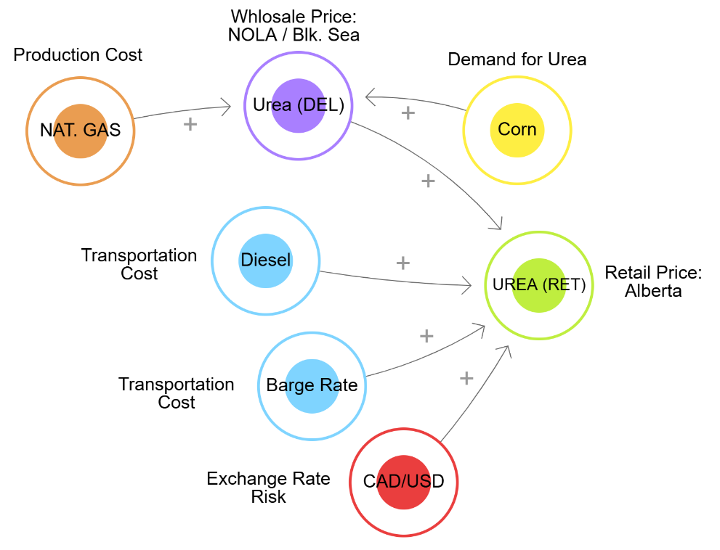
Conceptual Model

Slide 7
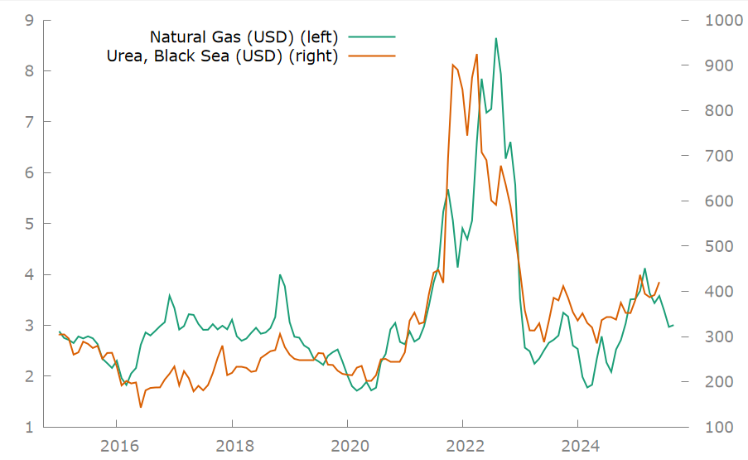
Natural Gas accounts for 70-90% of urea variable production costs
Reference: FarmProgress, Urea, Natural Gas, and Corn Price Correlations

Slide 8
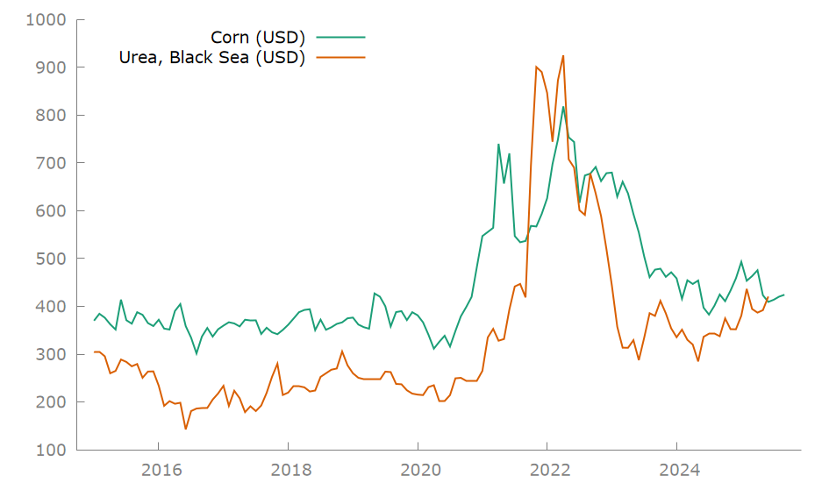
Corn price is a proxy for agriculture / urea demand
Reference: What Are the Drivers of Fertilizer Prices in Canada? - Pouliot economics

Slide 9
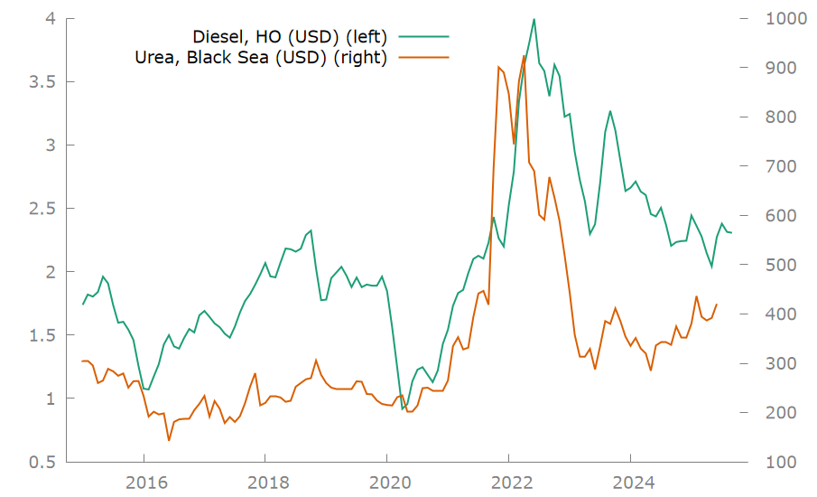
Diesel – transportation costs by trucks, rail, or ship

Slide 10
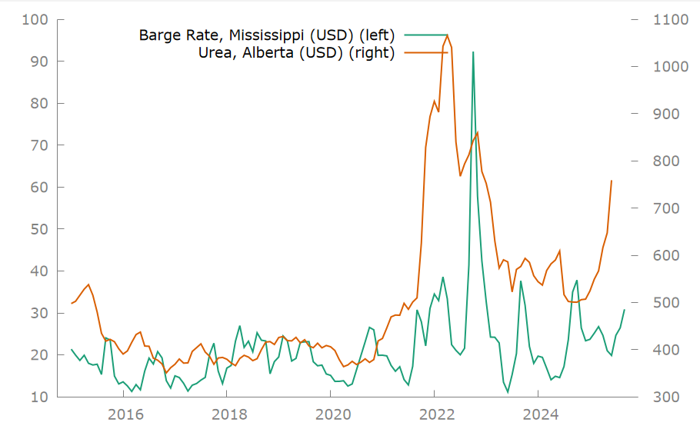
Barge Rate (Mississippi), transportation cost from US
Reference: United States Department of Agriculture (USDA), Downbound Grain Barge Rates

Slide 11
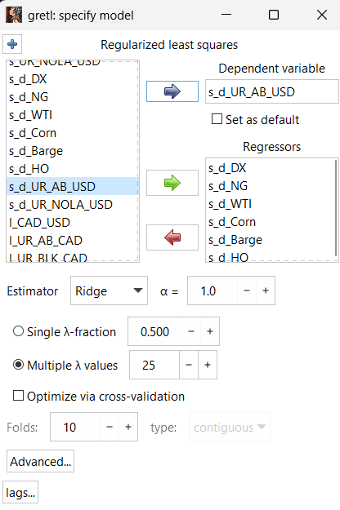
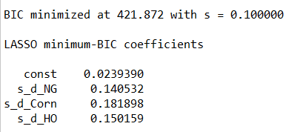
Lasso (L1) Regularized Regression

Slide 12
3. Urea Price Drivers

Slide 13
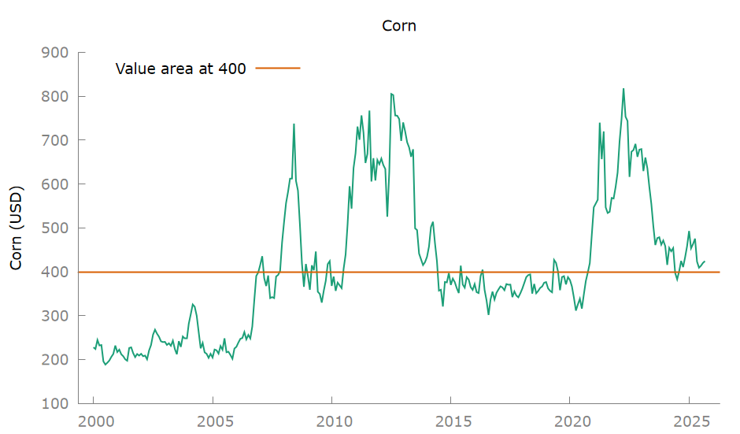
Corn is trading at 2010 levels ($400) and is undervalued

Slide 14
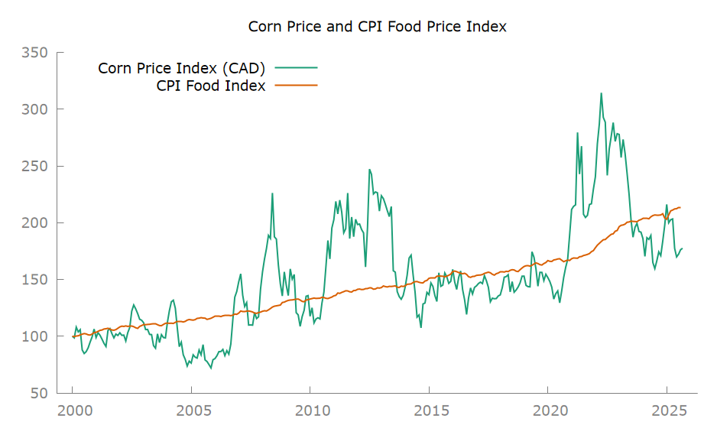
Corn price is below CPI Food Index (Annual Growth Rate = 3%)

Slide 15
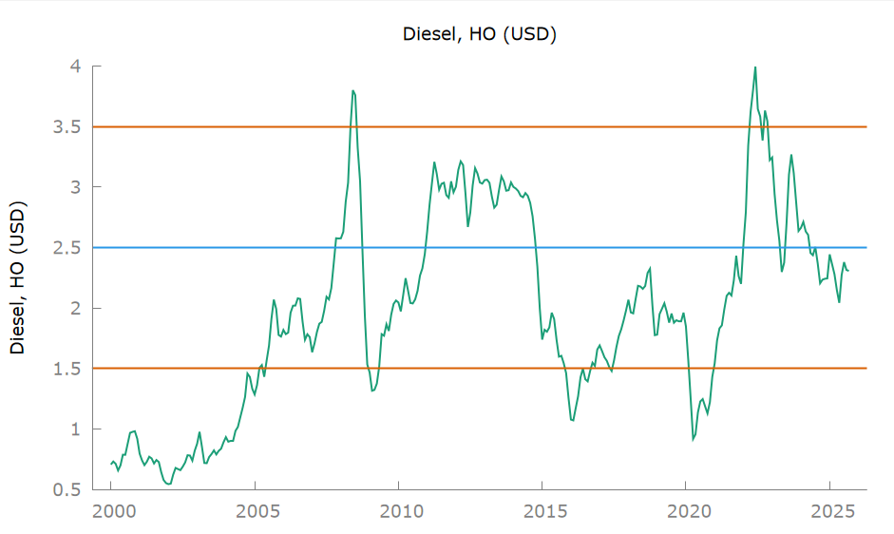
Diesel: near value, bearish outlook

Slide 16
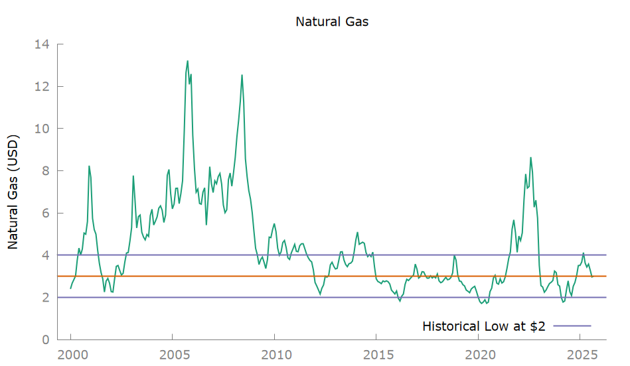
Natural Gas near historical low, trading in 2-4 range

Slide 17
4. Urea Long-Term Trend

Slide 18
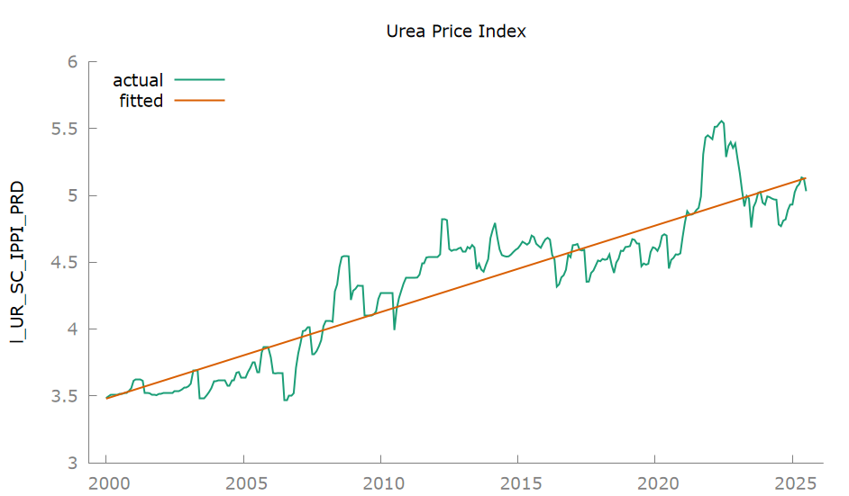
Urea Price Index – Statistics Canada (PPI), 6% annual growth rate since 2000

Slide 19
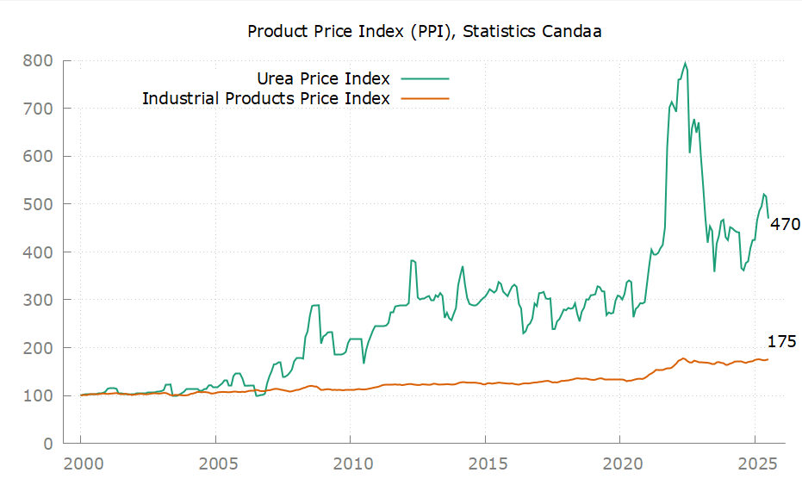
Urea Price Index vs. Industrial Product Price Index (IPPI)
Notes:
IPPI, CAGR = 2.2%
Urea Price Index, CAGR = 6.0%

Slide 20
5. Forecast
12-month ahead

Slide 21
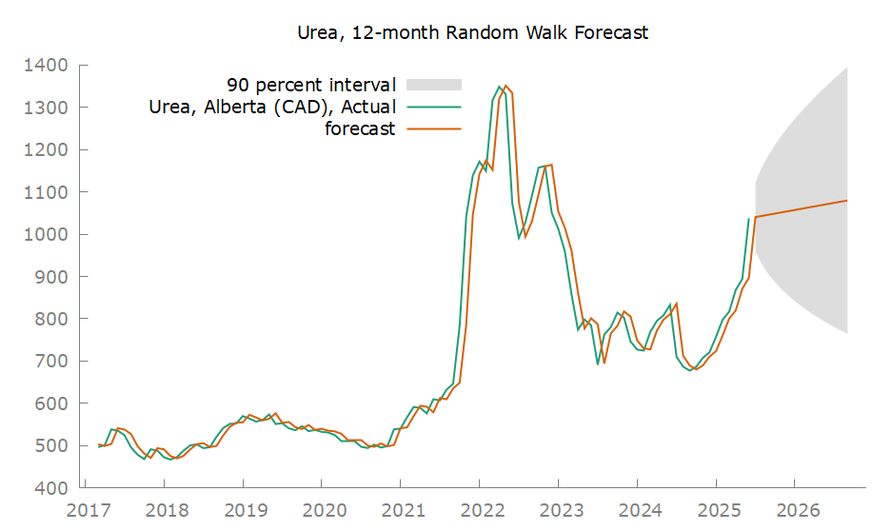
Random Walk Model – Scenario Panning
Price (Sep 2026) | Std Error | Lower Band (5%) | Upper Band (95%)
$1,102 (+3.9%) | $207 | $761 (-27%) | $1443 (+39%)
Notes:
Sample: 2016-Present
Last Price (2025-06): $1038
2026:09 1102.20 207.196 761.39 - 1443.01

Slide 22
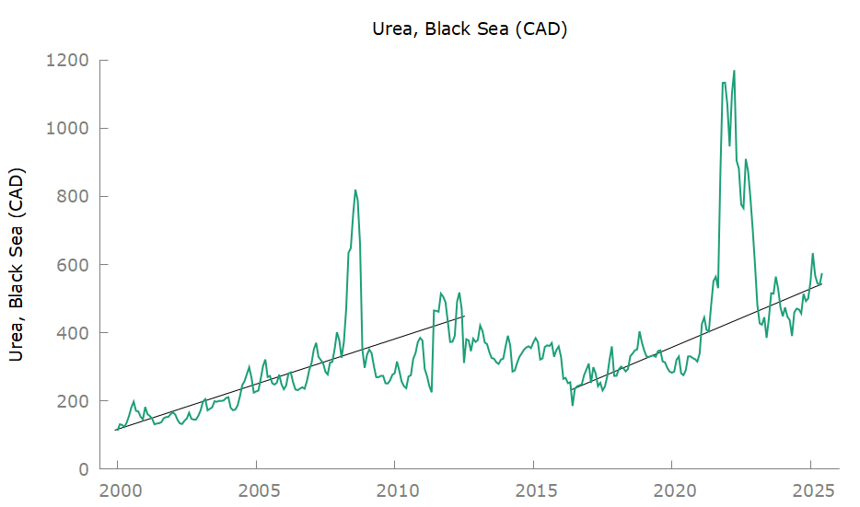
Regression Model – Price reverts to the mean after shocks

Slide 23
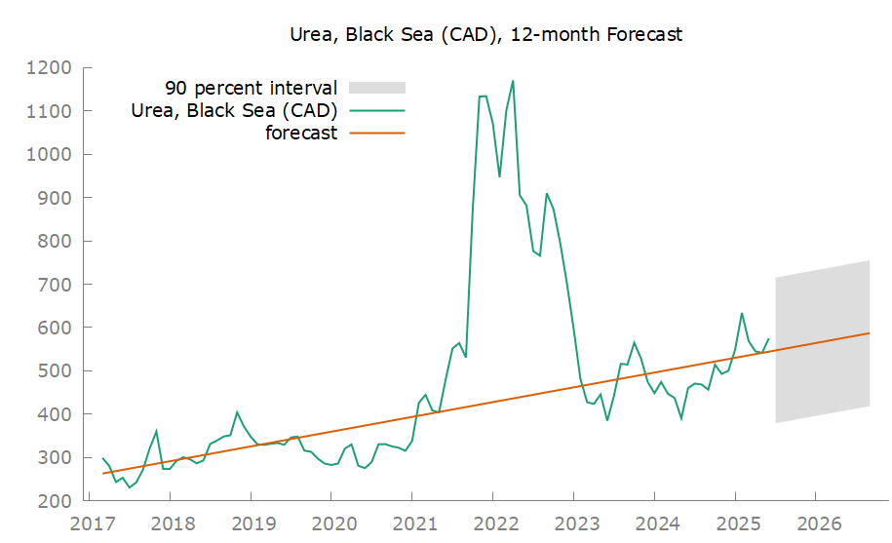
Urea, FOB Black Sea – Forecast
Price (Sep 2026) | Std Error | Lower Band (5%) | Upper Band (95%)
$587 (+2%) | $102 | 418 (-27%) | 755 (+31%)
Notes:
Sample: 2016-PRESENT
Quantile Regression
Last Price (2025-06): 575 CAD
2026:09 586.791829 101.607085 418.269100 - 755.314559

Slide 24
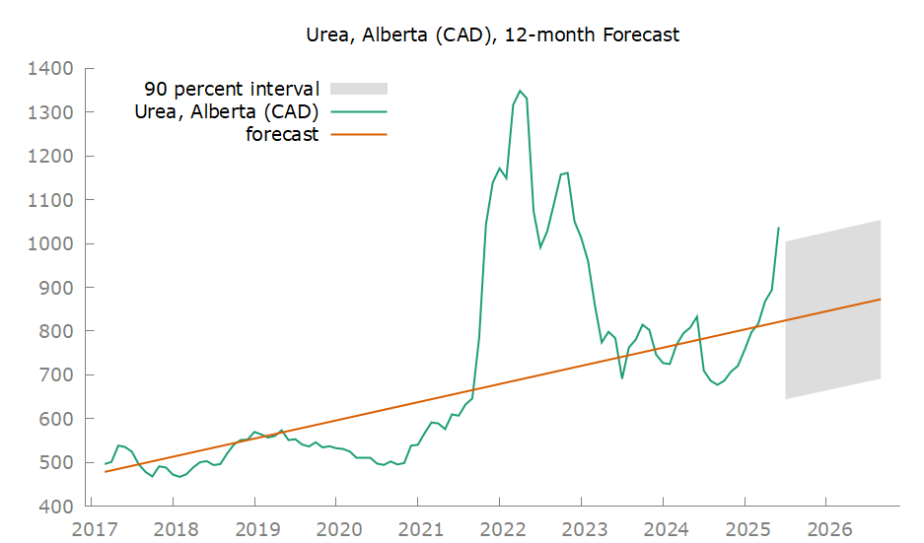
Urea, Alberta – Forecast
Price (Sep 2026) | Std Error | Lower Band (5%) | Upper Band (5%)
$872 (-16%) | $109 | $691 (-33%) | $1054 (2%)
Notes:
Sample: 2016-PRESENT
Quantile Regression
Last Price (2025-06): $1038
2026:09 872.70 109.441 691.19 - 1054.22

Slide 25
6. Market Timing

Slide 26
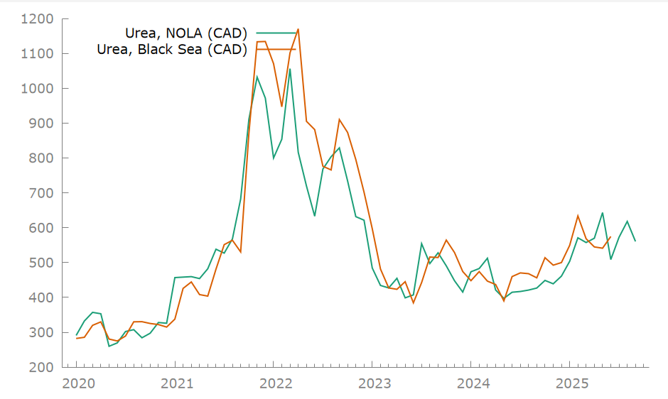
NOLA vs. Black Sea FOB prices (in CAD)

Slide 27
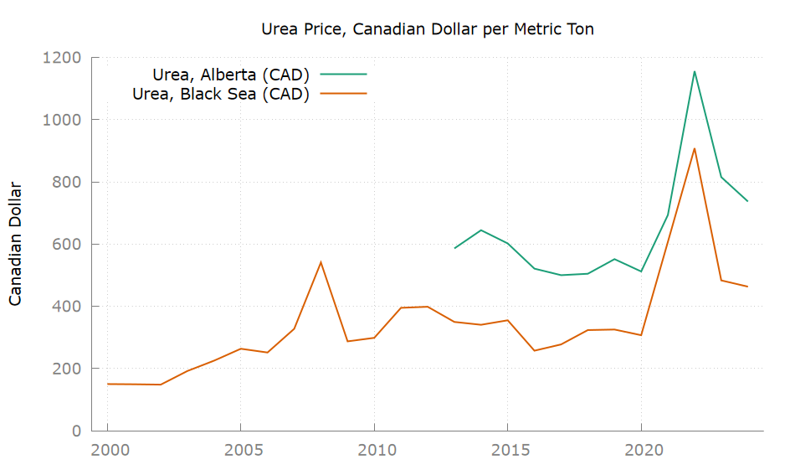
Urea, Annual Chart

Slide 28
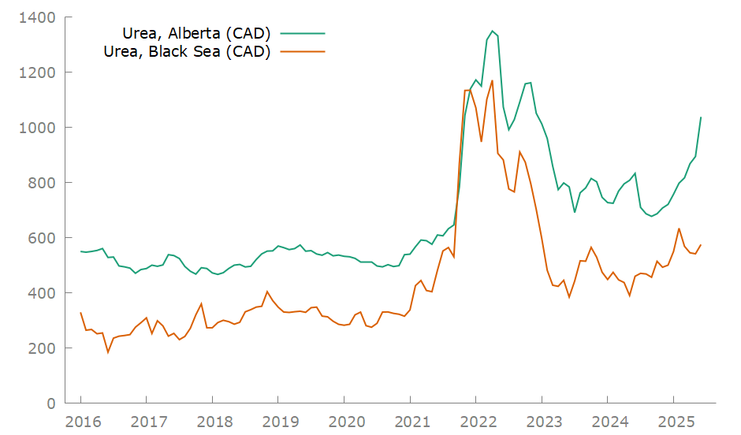
Alberta and Black Sea Spread (in CAD)

Slide 29
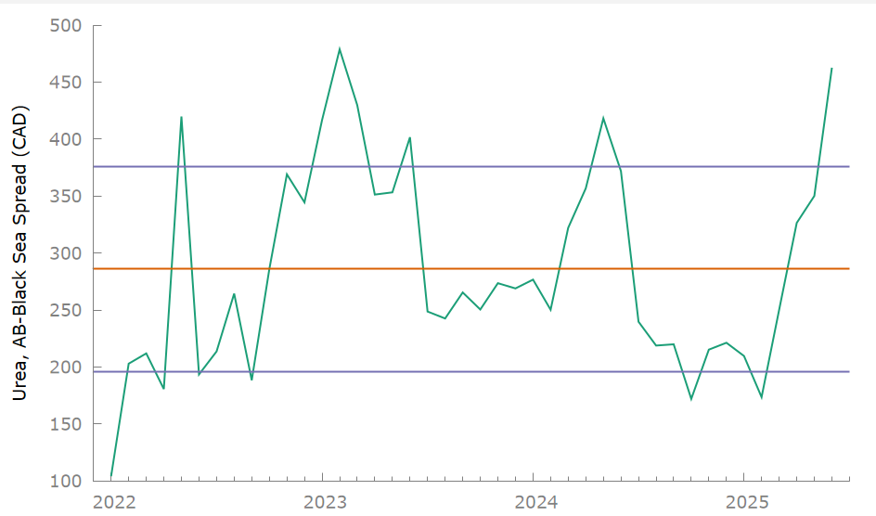
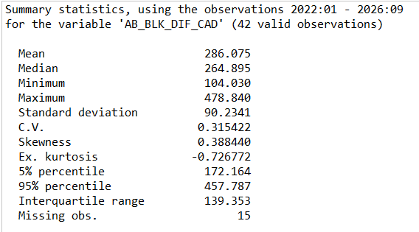
Alberta and Black Sea Spread, Retail prices are highly overvalued (as of 2025-06)

Slide 30
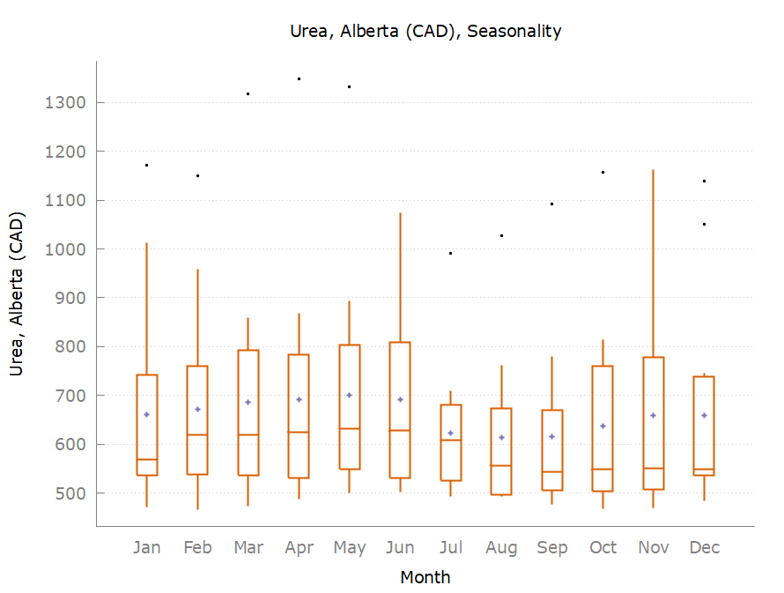
Seasonality

Slide 31
7. Conclusion

Slide 32
Conclusion
Urea has an established uptrend with 6% annual growth rate, and price of urea will increase in the following years.
The current spread between urea in Alberta and FOB prices ($462) means overvalued urea prices now.
Recommendation: Wait for the spread of less than $300 to buy.

Slide 33
Risks
The end of the Russia-Ukraine conflict and the resumption of Russian exports to global markets, along with the termination of China's zero-export policy and the return of Chinese urea to international trade, can increase supply and cause further price declines in the short term.

Slide 34
Future Research
Interprovincial trade dynamics and the price relationship between Eastern and Western Canada.
Analysis of global supply and demand of urea and crops.
Calculation of CIF prices to estimate wholesale price in Canada
Analysis of agriculture data from Statistics Canada, including:
Farm Product Price Index
Farm Input Price Index
Canadian Fertilizer Production
Canadian Fertilizer Inventories
Fertilizers Shipments to Canadian Agriculture
Analyzing the CFTC Commitment of Traders (COT) report for the futures market to gain insights into market sentiment and shifts in positions held by major hedge funds and producers.
Notes:
(1) Import + Production = Export + Consumption + Change in Inventory
(2) Supply = Demand + Change in Inventory
Therefore:
Increasing Inventory: Supply > Demand
Decreasing Inventory: Supply < Demand

