Slide 1
Urea Outlook for 2026
Borderland Co-op
Mahdi Ghafarian
Sep 2025

Slide 2
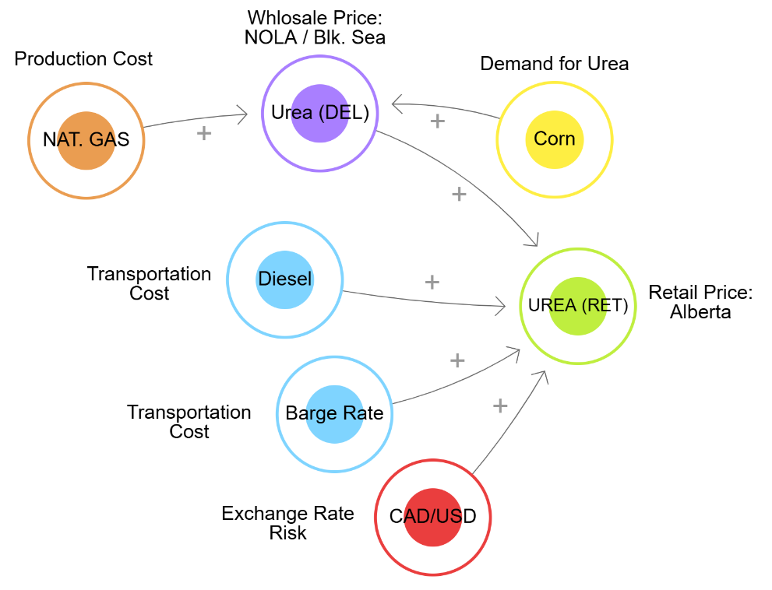
Conceptual Model

Slide 3
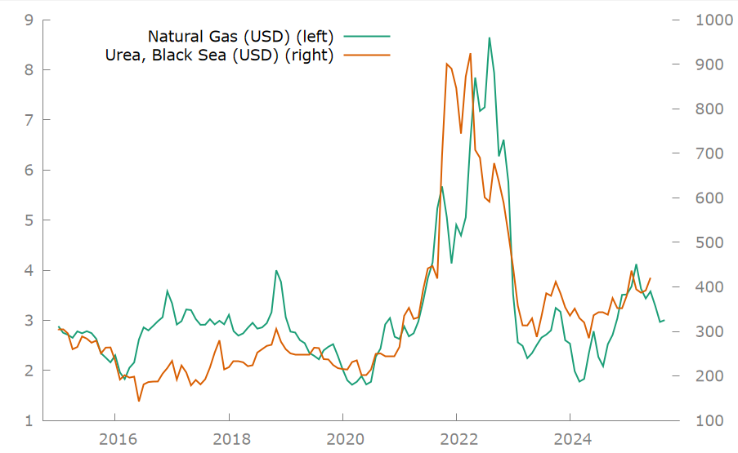
Natural Gas accounts for 70-90% of urea variable production costs

Slide 4
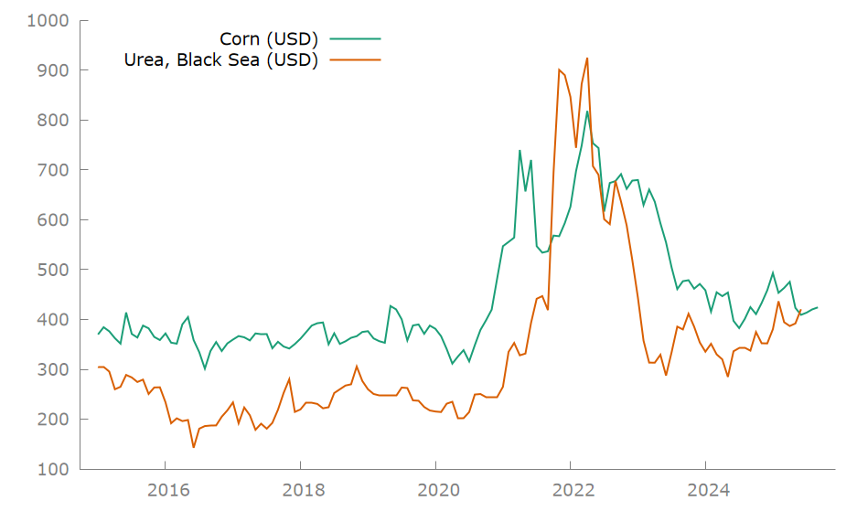
Corn price is a proxy for agriculture / urea demand

Slide 5
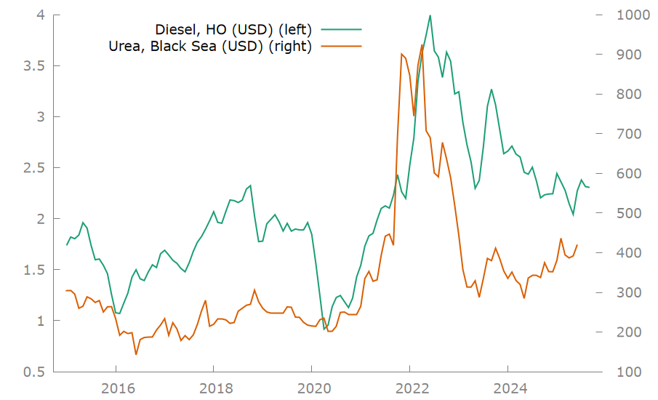
Diesel, transportation costs by trucks, rail, or ship

Slide 6
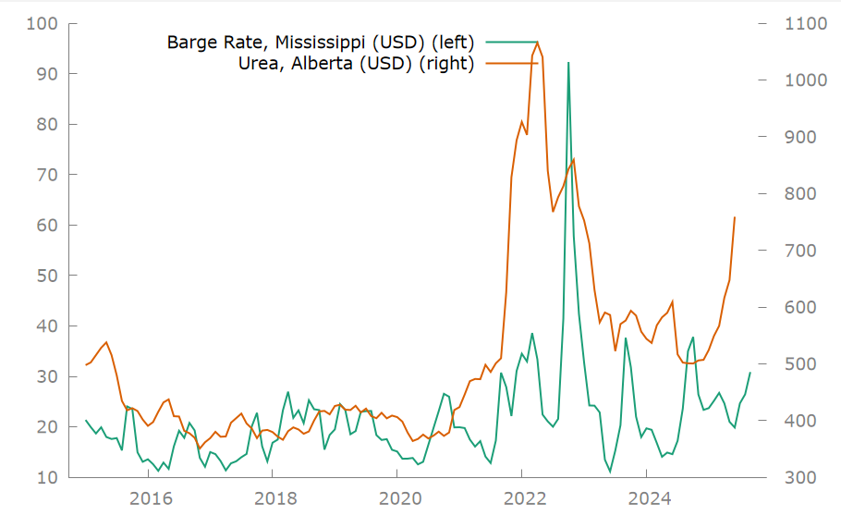
Barge Rate (Mississippi), transportation cost from US

Slide 7
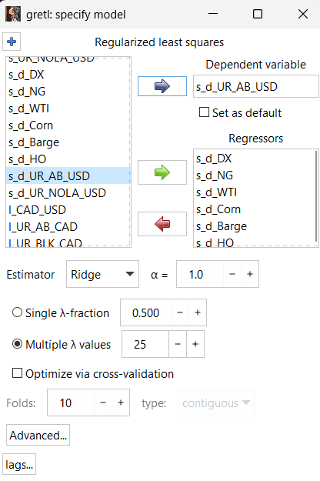
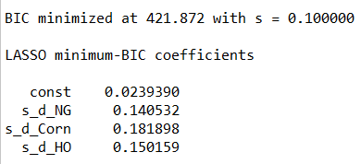
Lasso (L1) Regularized Regression

Slide 8
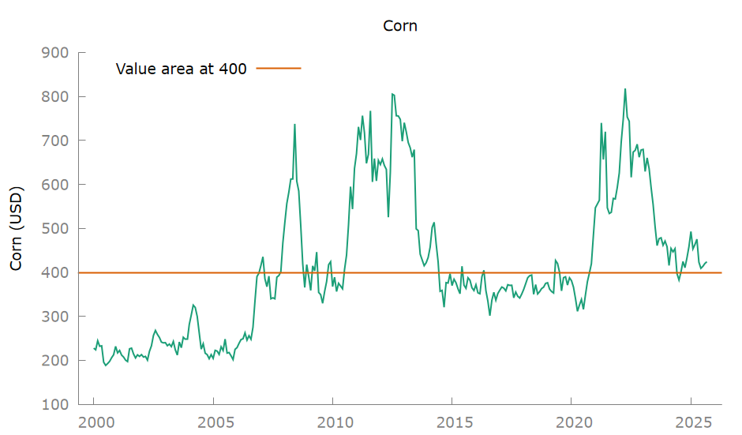
Corn is trading at 2010 levels and is undervalued

Slide 9
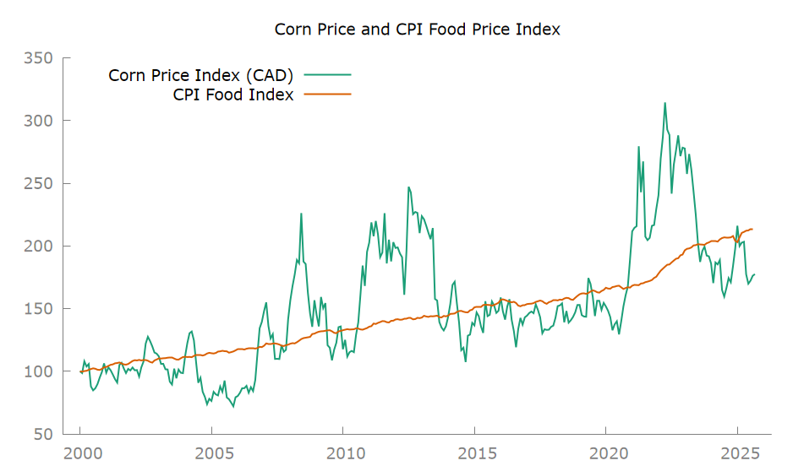
Corn price is below CPI Food Index (Annual Growth Rate = 3%)

Slide 10
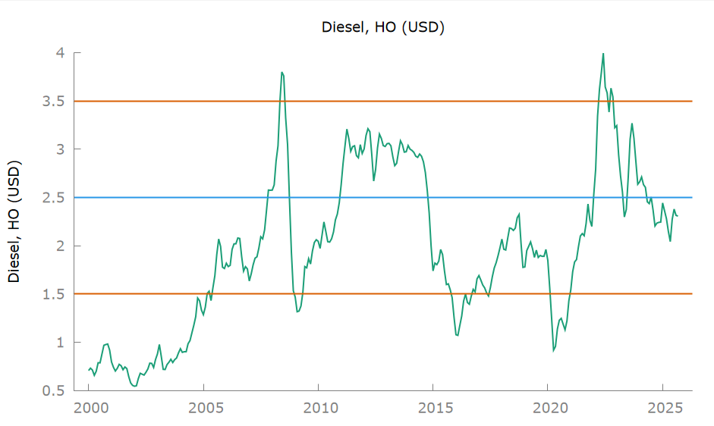
Diesel: near value, bearish outlook

Slide 11
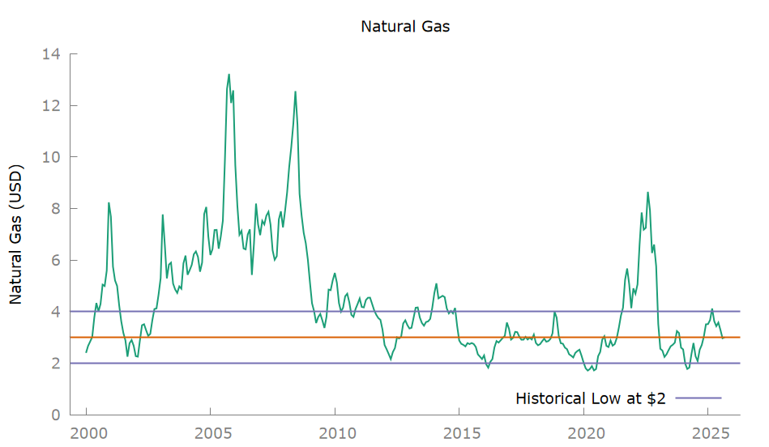
Natural Gas near historical low, trading in 2-4 range

Slide 12
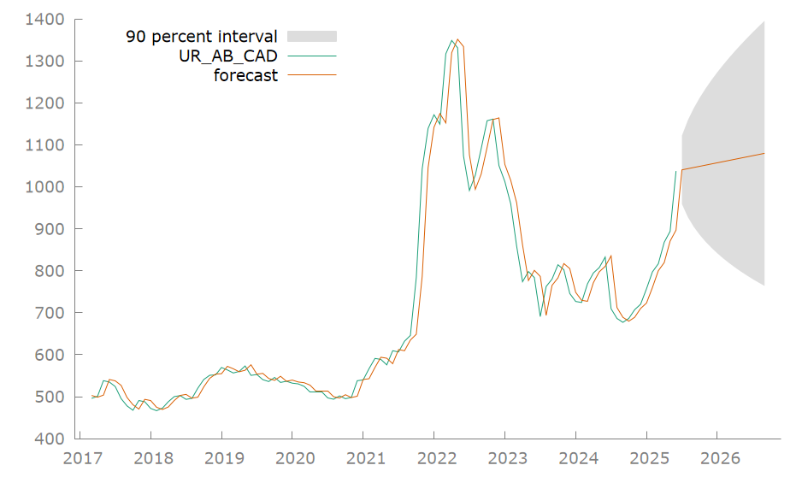
Random Walk Model – Scenario Panning

Slide 13
Random Walk Model – Scenario Panning
Forecast for Sep 2025, 90% Prediction Interval
Price | Std Error | Upper Band (95%) | Lower Band (5%) | Upper Band (% chg.) | Lower Band (% chg.)
$1,079 | $192 | $1396 | $764 | +29% | -26%

Slide 14
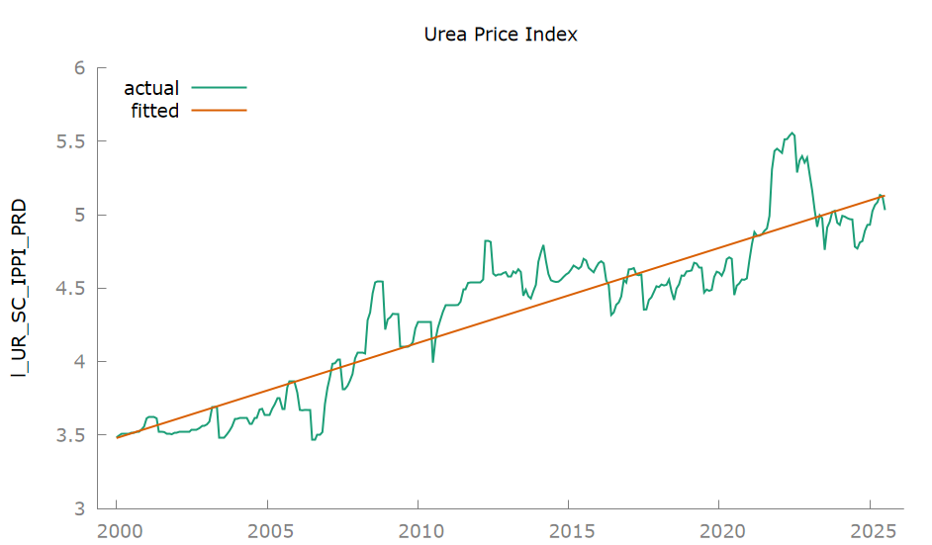
Urea Price Index – Statistics Canada (PPI), 6% annual growth rate since 2000

Slide 15
FOB Black Sea – Regression Model

Slide 16
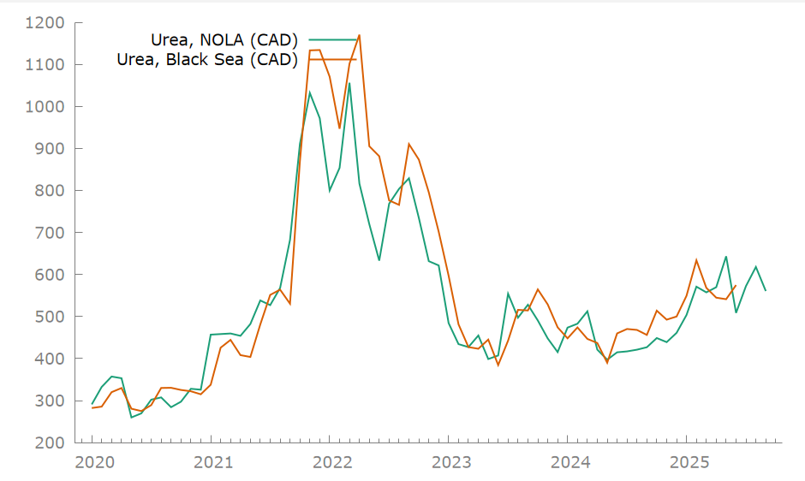
NOLA vs. Black Sea FOB prices (in CAD)

Slide 17
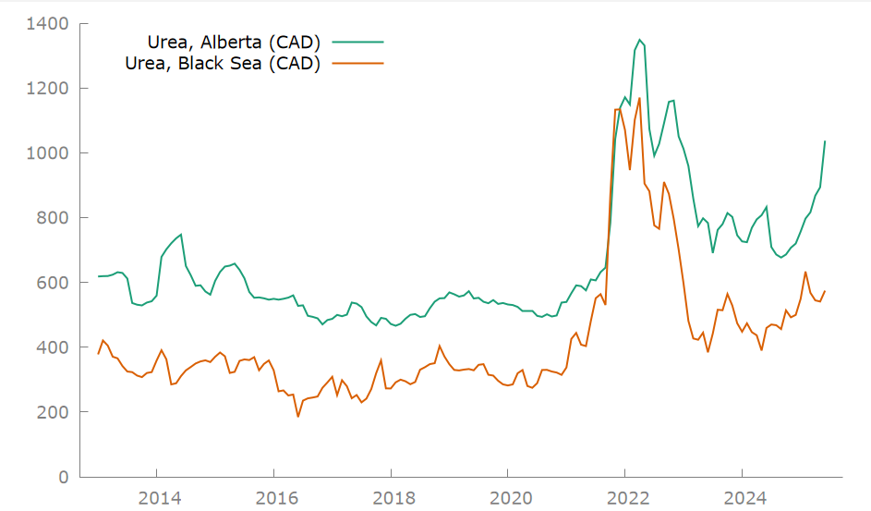
Alberta and Black Sea Spread (in CAD)

Slide 18
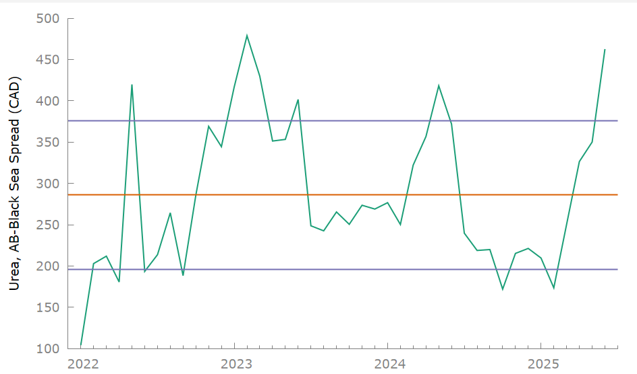
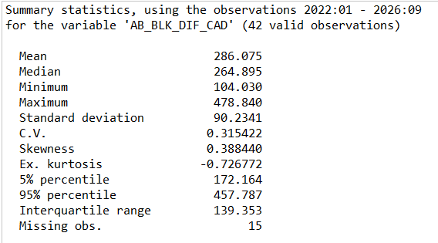
Alberta and Black Sea Spread, Retail prices are highly overvalued (as of 2025-06)

Slide 19
Conclusion
Urea has an established uptrend with 6% annual growth rate, and price of urea will increase in the following years.
The current spread between urea in Alberta and FOB prices ($462) means overvalued urea prices now.
Recommendation: Wait for the spread of less than $300 to buy.

Slide 20
Risks
The end of the Russia-Ukraine conflict and the resumption of Russian exports to global markets, along with the termination of China's zero-export policy and the return of Chinese urea to international trade, can increase supply and cause further price declines in the short term.

Slide 21
Future Research
Interprovincial trade dynamics and the price relationship between Eastern and Western Canada.
Analysis of global supply and demand of urea and crops.
Calculation of CIF prices to estimate wholesale price in Canada
Analysis of agriculture data from Statistics Canada, including:
Farm Product Price Index
Farm Input Price Index
Canadian Fertilizer Production
Canadian Fertilizer Inventories
Fertilizers Shipments

