Slide 1
Software Reuse and Component-Based Software Engineering
CIS 376
Bruce R. Maxim
UM-Dearborn

Slide 2
Software Reuse
In most engineering disciplines, systems are designed by composition (building system out of components that have been used in other systems)
Software engineering has focused on custom development of components
To achieve better software quality, more quickly, at lower costs, software engineers are beginning to adopt systematic reuse as a design process

Slide 3
Types of Software Reuse
Application System Reuse
  reusing an entire application by incorporation of one application inside another (COTS reuse)
  development of application families (e.g. MS Office)
Component Reuse
  components (e.g. subsystems or single objects) of one application reused in another application
Function Reuse
  reusing software components that implement a single well-defined function

Slide 4
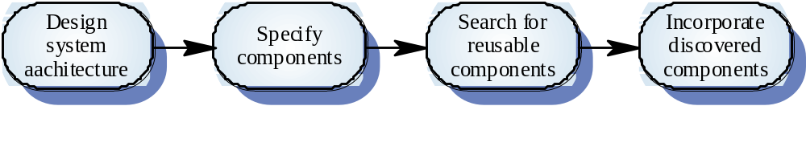
Opportunistic Reuse

Slide 5
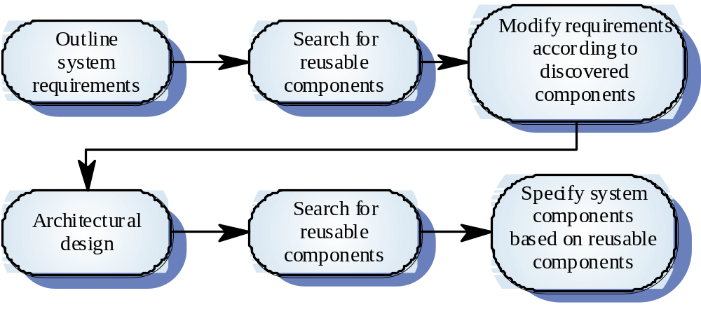
Development Reuse as a Goal

Slide 6
Benefits of Reuse
Increased Reliability
  components already exercised in working systems
Reduced Process Risk
  less uncertainty in development costs
Effective Use of Specialists
  reuse components instead of people
Standards Compliance
  embed standards in reusable components
Accelerated Development
  avoid custom development and speed up delivery

Slide 7
Requirements for Design with Reuse
You need to be able to find appropriate reusable components
You must be confident that that component you plan to reuse is reliable and will behave as expected
The components to be reused must be documented to allow them to be understood and modified (if necessary)

Slide 8
Reuse Problems
Increased maintenance costs
Lack of tool support
Pervasiveness of the “not invented here” syndrome
Need to create and maintain a component library
Finding and adapting reusable components

Slide 9
Economics of Reuse - part 1
Quality
  with each reuse additional component defects are identified and removed which improves quality.
Productivity
  since less time is spent on creating plans, models, documents, code, and data the same level of functionality can be delivered with less effort so productivity improves.

Slide 10
Economics of Reuse - part 2
Cost
  savings projected by estimating the cost of building the system from scratch and subtracting the costs associated with reuse and the actual cost of the software as delivered.
Cost analysis using structure points
  can be computed based on historical data regarding the costs of maintaining, qualification, adaptation, and integrating each structure point.

Slide 11
Generator-Based Reuse
Program generators reuse standard patterns and algorithms
Programs are automatically generated to conform to user defined parameters
Possible when it is possible to identify the domain abstractions and their mappings to executable code
Domain specific language is required to compose and control these abstractions

Slide 12
Types of Program Generators
Applications generators for business data processing
Parser and lexical analyzers generators for language processing
Code generators in CASE tools
User interface design tools

Slide 13
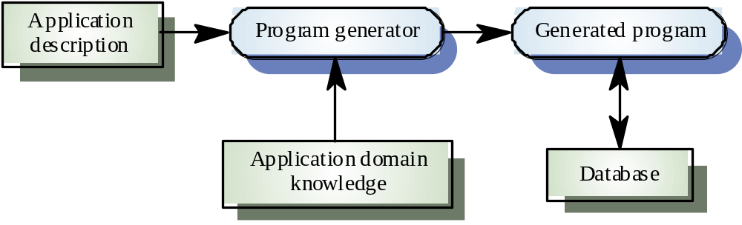
Program Generation

Slide 14
Assessing Program Generator Reuse
Advantages
  Generator reuse is cost effective
  It is easier for end-users to develop programs using generators than other CBSE techniques
Disadvantages
  The applicability of generator reuse is limited to a small number of application domains

Slide 15
Component-Based Software Engineering
CBSE is an approach to software development that relies on reuse
CBSE emerged from the failure of object-oriented development to support reuse effectively
Objects (classes) are too specific and too detailed to support design for reuse work
Components are more abstract than classes and can be considered to be stand-alone service providers

Slide 16
Component Abstractions
Functional Abstractions
  component implements a single function (e.g. ln)
Casual Groupings
  component is part of a loosely related entities like declarations and functions
Data Abstractions
  abstract data types or objects
Cluster Abstractions
  component from group of cooperating objects
System Abstraction
  component is a self-contained system

Slide 17
Engineering of Component-Based Systems - part 1
Software team elicits system requirements
Architectural design is established
Team determines requirements are amenable to composition rather than construction
  Are commercial off-the-shelf (COTS) components available to implement the requirement?
  Are internally developed reusable components available to implement the requirement?
  Are the interfaces for available components compatible within in the proposed system architecture?
Team attempts to remove or modify requirements that cannot be implemented with COTS or in-house components

Slide 18
Engineering of Component-Based Systems - part 2
For those requirements that can be addressed with available components the following activities take place:
  component qualification
  component adaptation
  component composition
  component update
Detailed design activities commence for remainder of the system

Slide 19
Definition of Terms
Component Qualification
  candidate components are identified based on services provided and means by which consumers access them
Component Adaptation
  candidate components are modified to meet the needs of the architecture or discarded
Component Composition
  architecture dictates the composition of the end product from the nature of the connections and coordination mechanisms
Component Update
  updating systems that include COTS is made more complicated by the fact that a COTS developer must be involved

Slide 20
Commercial Off-the-Shelf Software
COTS systems are usually complete applications library the off an applications programming interface (API)
Building large systems by integrating COTS components is a viable development strategy for some types of systems (e.g. E-commerce or video games)

Slide 21
COTS Integration Problems
Lack of developer control over functionality and performance
Problems with component interoperability as COTS vendors make different user assumptions
COTS vendors may not offer users any control over the evolutions of its components
Vendors may not offer support over the lifetime of a product built with COTS components

Slide 22
Developing Components for Reuse
Components may constructed with the explicit goal to allow them to be generalized and reused
Component reusability should strive to
  reflect stable domain abstractions
  hide state representations
  be independent (low coupling)
  propagate exceptions via the component interface

Slide 23
Reusable Components
Tradeoff between reusability and usability
  generic components can be highly reusable
  reusable components are likely to be more complex and harder to use
Development costs are higher for reusable components than application specific components
Generic components may be less space-efficient and have longer execution times than their application specific analogs

Slide 24
Domain Engineering - part 1
Domain analysis
  define application domain to be investigated
  categorize items extracted from domain
  collect representative applications from the domain
  analyze each application from sample
  develop an analysis model for objects
Domain model
Software architecture development

Slide 25
Domain Engineering - part 2
Structural model
  consists of small number of structural elements manifesting clear patterns of interaction
  architectural style that can be reused across applications in the domain
  structure points are distinct constructs within the structural model (e.g. interface, control mechanism, response mechanism)
Reusable component development
Repository of reusable components is created

Slide 26
Structure Point Characteristics
Abstractions with limited number of instances within an application and recurs in applications in the domain
Rules governing the use of a structure point should be easily understood and structure point interface should be simple
Structure points should implement information hiding by isolating all complexity contained within the structure point itself

Slide 27
Component-Based Development
Analysis
Architectural design
  component qualification
  component adaptation
  component decomposition
Component engineering
Testing
Iterative component update

Slide 28
Component Adaptation Techniques
White-box Wrapping
  integration conflicts removed by making code-level modifications to the code
Grey-box Wrapping
  used when component library provides a component extension language or API that allows conflicts to be removed or masked
Black-box Wrapping
  requires the introduction of pre- and post-processing at the component interface to remove or mask conflicts

Slide 29
Enhancing Reliability
Name generalization
  names modified to use domain independent language
Operation generalization
  operations added to provide extra functionality
  domain specific operations may be removed
Exception generalization
  application specific exceptions removed
  exception management added to increase robustness
Component certification
  component warranted correct and reliable for reuse

Slide 30
Component Composition Infrastructure Elements - part 1
Data exchange model
  similar to drag and drop type mechanisms should be defined for all reusable components
  allow human-to-software and component-to-component transfer
Automation
  tools, macros, scripts should be implemented to facilitate interaction between reusable components

Slide 31
Component Composition Infrastructure Elements - part 2
Structured storage
  heterogeneous data should be organized and contained in a single data structure rather several separate files
Underlying object model
  ensures that components developed in different languages are interoperable across computing platforms

Slide 32
Application Frameworks
Frameworks are sub-system design containing a collection of abstract and concrete classes along with interfaces between each class
A sub-system is implemented by adding components to fill in missing design elements and by instantiating the abstract classes
Frameworks are reusable entities

Slide 33
Framework Classes
System infrastructure frameworks
  support development of systems infrastructure elements like user interfaces or compilers
Middleware integration frameworks
  standards and classes that support component communication and information exchange
Enterprise application frameworks
  support development of particular applications like telecommunications or financial systems

Slide 34
Extending Frameworks
Generic frameworks need to be extended to create specific applications or sub-systems
Frameworks can be extend by
  defining concrete classes that inherit operations from abstract class ancestors
  adding methods that will be called in response to events recognized by the framework
Frameworks are extremely complex and it takes time to learn to use them (e.g. DirectX or MFC)

Slide 35
Representative Component Standards
Object Management Group (OMG) CORBA
  common object request broker architecture
Microsoft COM
  component object model
Sun JavaBeans Component System

Slide 36
Application Families
Set of related applications that has a common core or domain specific architecture
The common core is reused each time a new application is created
Each member of the family is specialized
  platform specialization
  configuration specialization
  function specialization (based on differences in customer requirements)

Slide 37
Application Family Architectures
Architectures must be structured into loosely coupled sub-systems to allow easy modification
Architectures should separate entities from their descriptions
Access to entities must come through their descriptions (interfaces) rather than by direct access

Slide 38
Family Member Development
Elicit stakeholder requirements
  use existing family member as prototype
Choose closest-fit family member
  search for member that best matches requirements
Re-negotiate requirements
  adapt requirements as needed to software capabilities
Adapt existing system
  develop new modules needed
Deliver new family member
  document key features for further development

Slide 39
Classifying and Retrieving Components - part 1
Describing reusable components
  concept
    what the component does
  content
    how the concept is realized
  context
    specifies conceptual, operational, and implementation features of the software component within its domain of application

Slide 40
Classifying and Retrieving Components - part 2
Library indexing methods
  uncontrolled indexing vocabularies
    syntax free, no restrictions)
  enumerated classification
    hierarchical listing of the domain objects grouped by class relations
  faceted classification
    based on 1 to 8 basic descriptive application domain features
  attribute-value classification
    similar to faceted classification using unlimited number of fixed terms

Slide 41
Classifying and Retrieving Components - part 3
Reuse environment elements
  component database capable of storing software components and classification information to allow their retrieval
  library management system to allow access to database
  software component retrieval system that enables client software to retrieve components and services from library server
CBSE tools that support integration of reused components into a new design or implementation

Slide 42
Design Patterns
A pattern provides a description of a problem and the essence of its solution
Provide a means of reusing abstract knowledge about a problem and its solution
Patterns should be sufficiently abstract to allow its reuse in different settings
Patterns often rely on object characteristics like inheritance and polymorphism

Slide 43
Pattern Elements
Name
  some meaningful identifier
Description
  similar to any module description
Solution
  template for a design solution which can be instantiated in different ways
Consequences
  results and tradeoffs from applying the pattern

Slide 44
Example from
Sommerville 6th Edition
Chapter 14

Slide 45
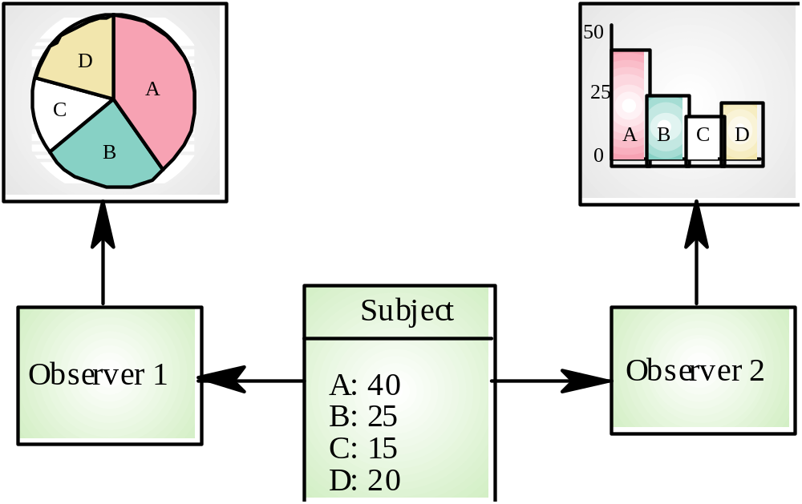
Multiple Data Displays

Slide 46
Observer Pattern
Name
  Observer
Description
  Separates the display of object state from the object itself
Problem description
  Used when multiple displays of state are needed
Solution description
  See next slide with UML description
Consequences
  Optimisation to enhance display performance are impractical

Slide 47
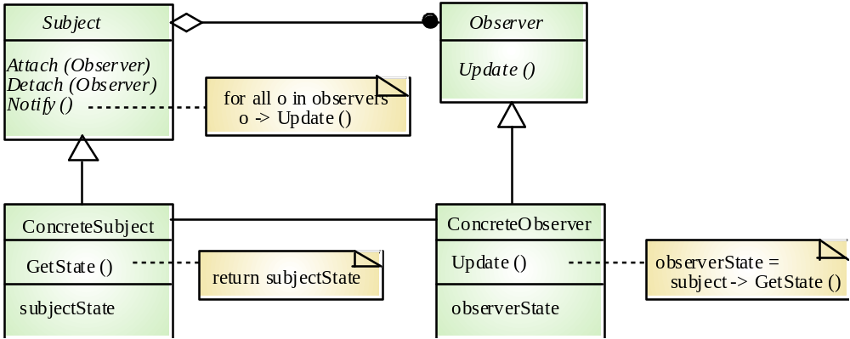
Observer Pattern - UML

