Slide 1
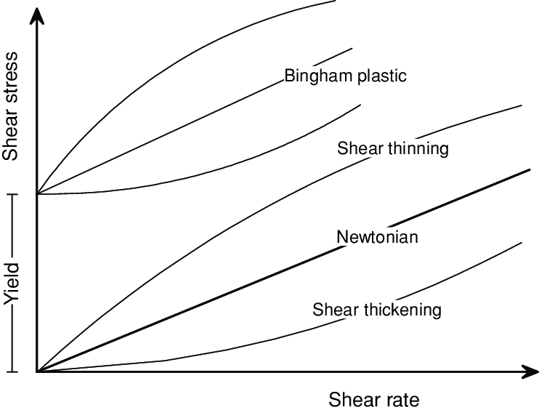
Rheology Study
Acceleration Consortium
SDL-5

Slide 2
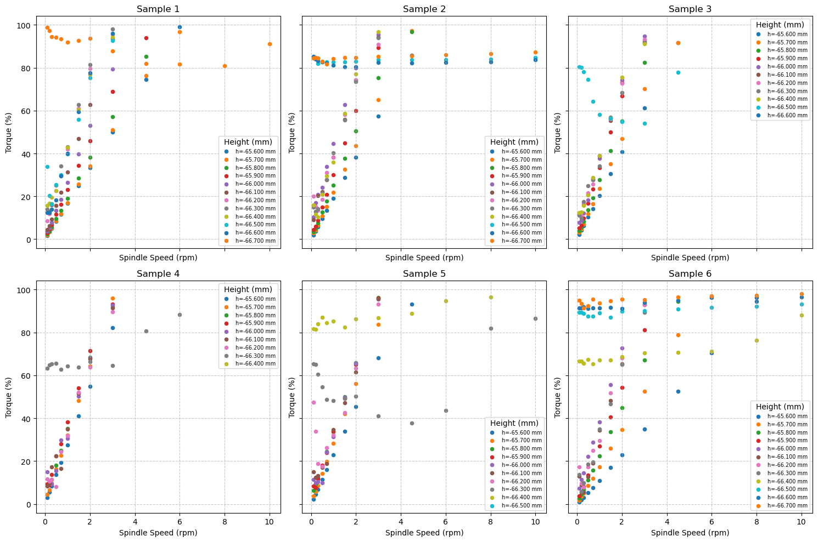
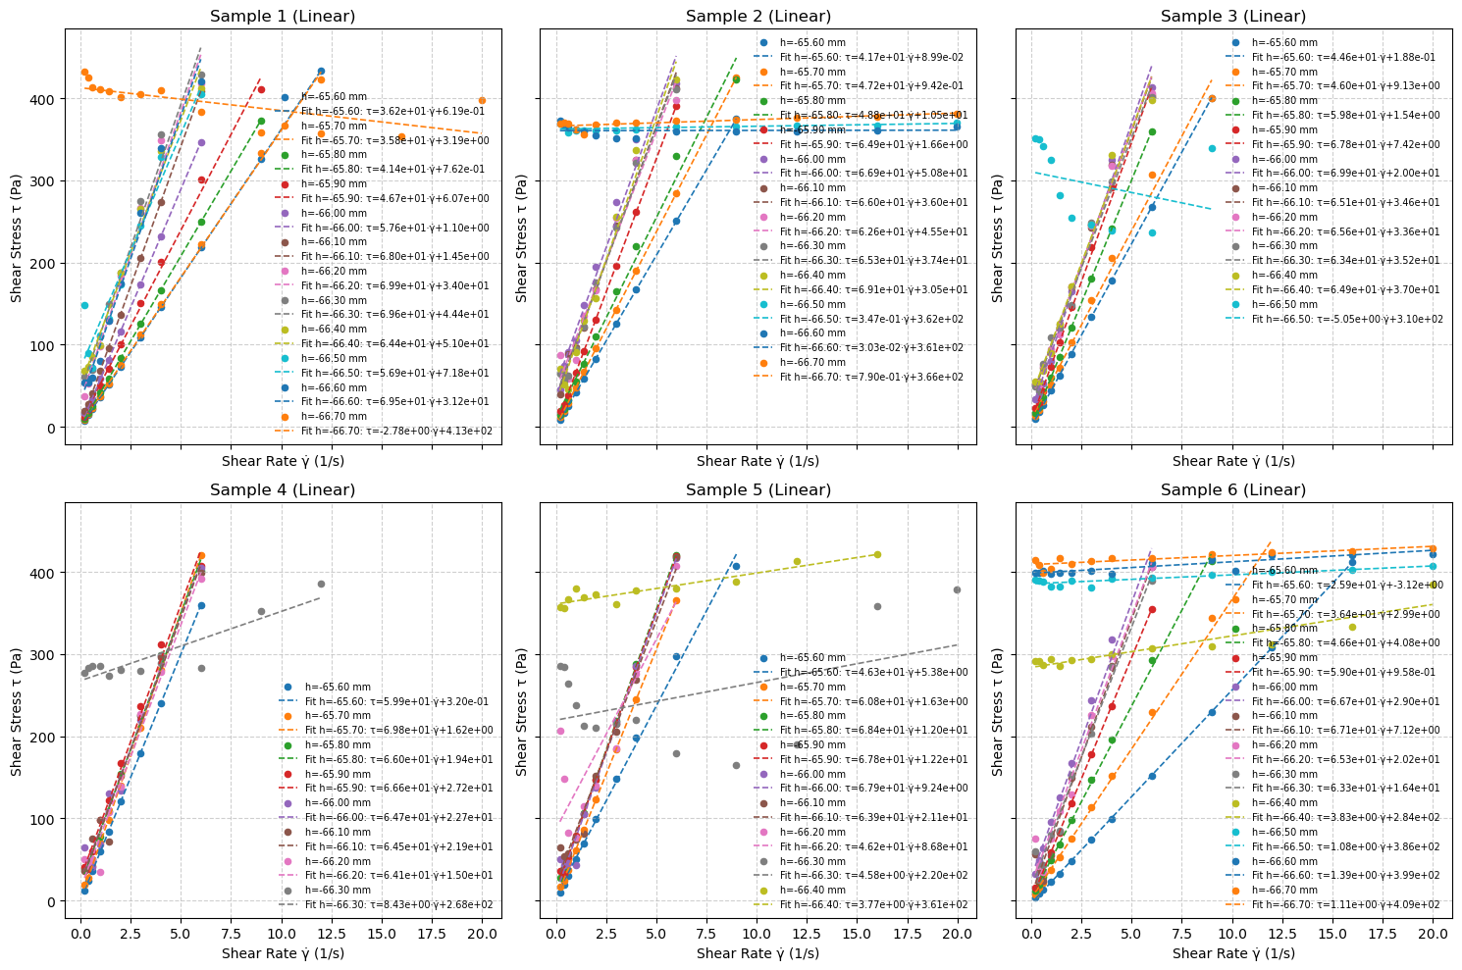
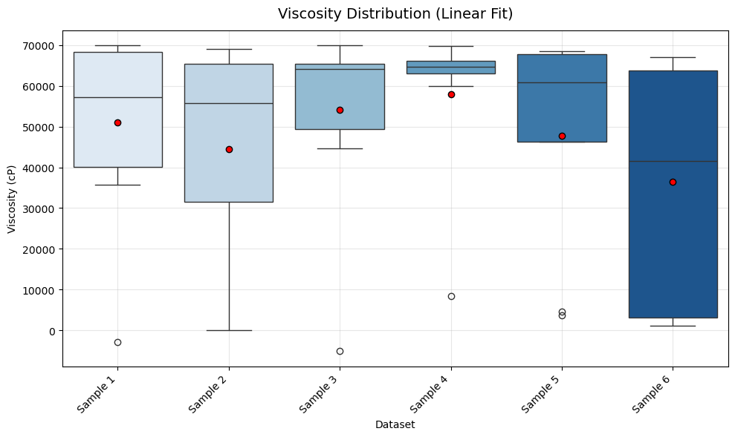
Silicon – Newtonian – 30,000 cP
Raw Data of Torque(%)-Spees (rpm) | Fitted Curve on Stress-Strain | Calculated Viscosity (cP)

Slide 3
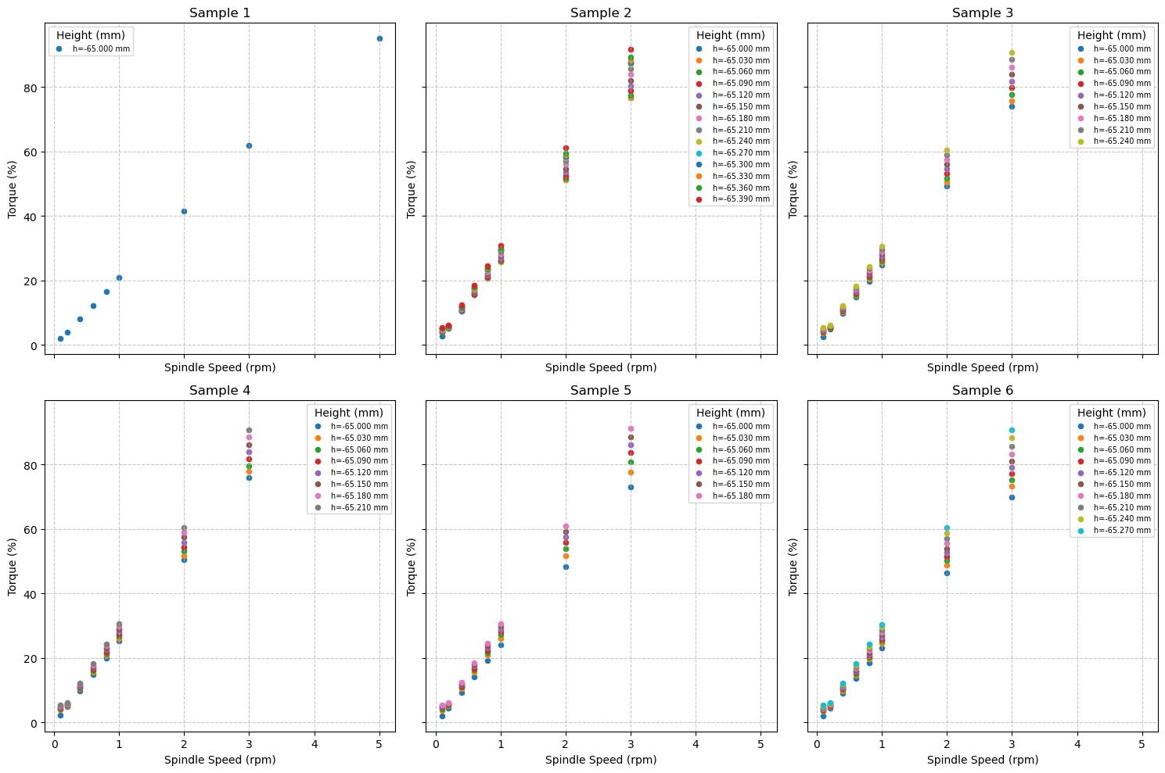
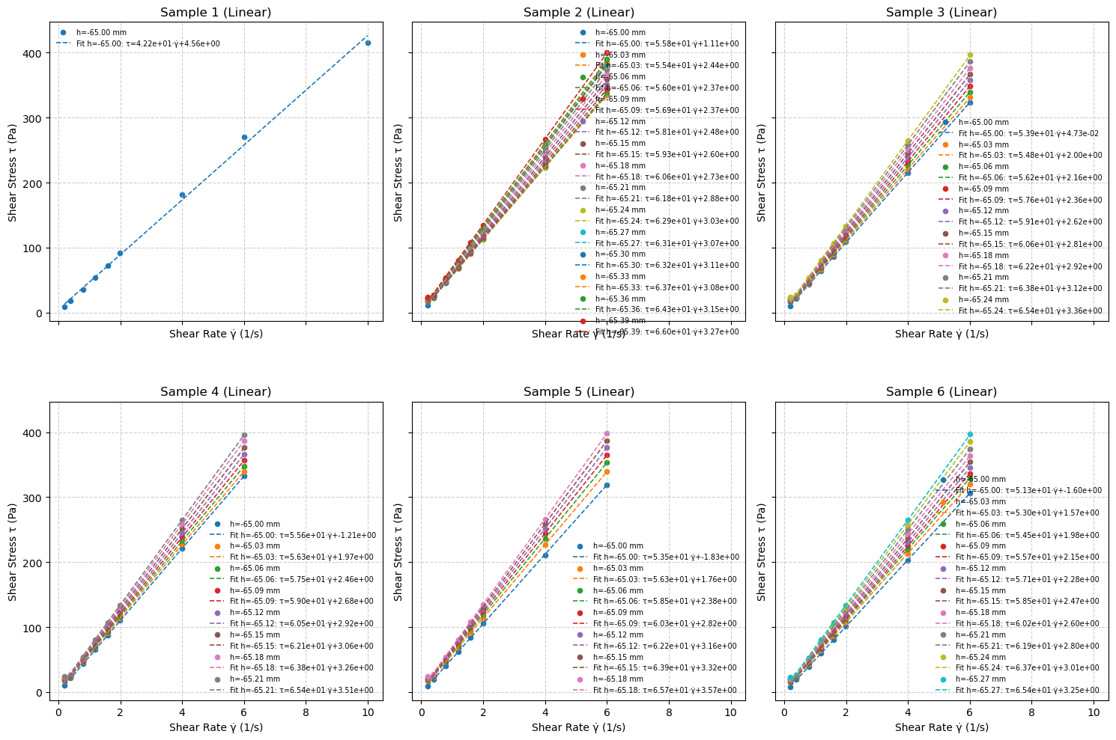
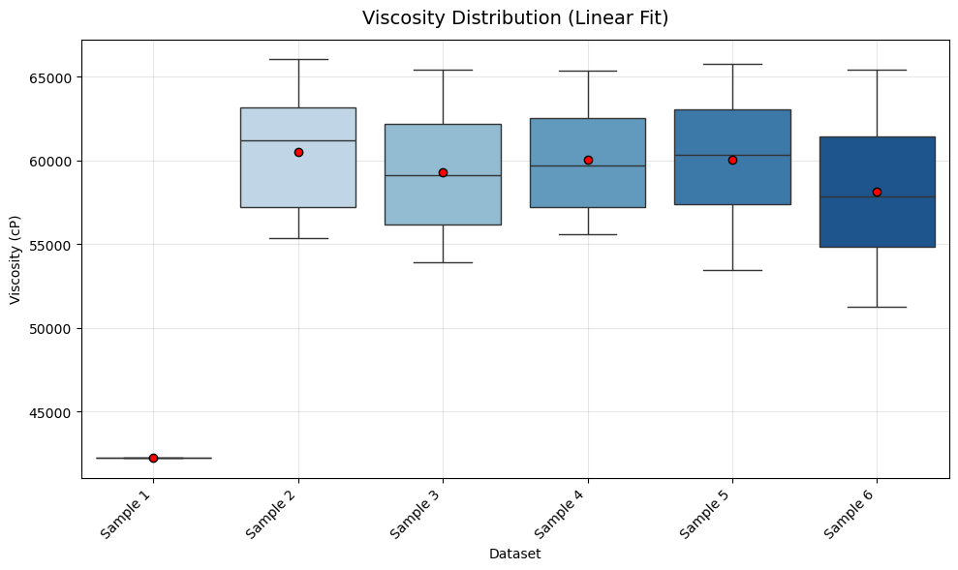
Silicon – Newtonian – 60,000 cP
Raw Data of Torque(%)-Spees (rpm) | Fitted Curve on Stress-Strain | Calculated Viscosity (cP)

Slide 4
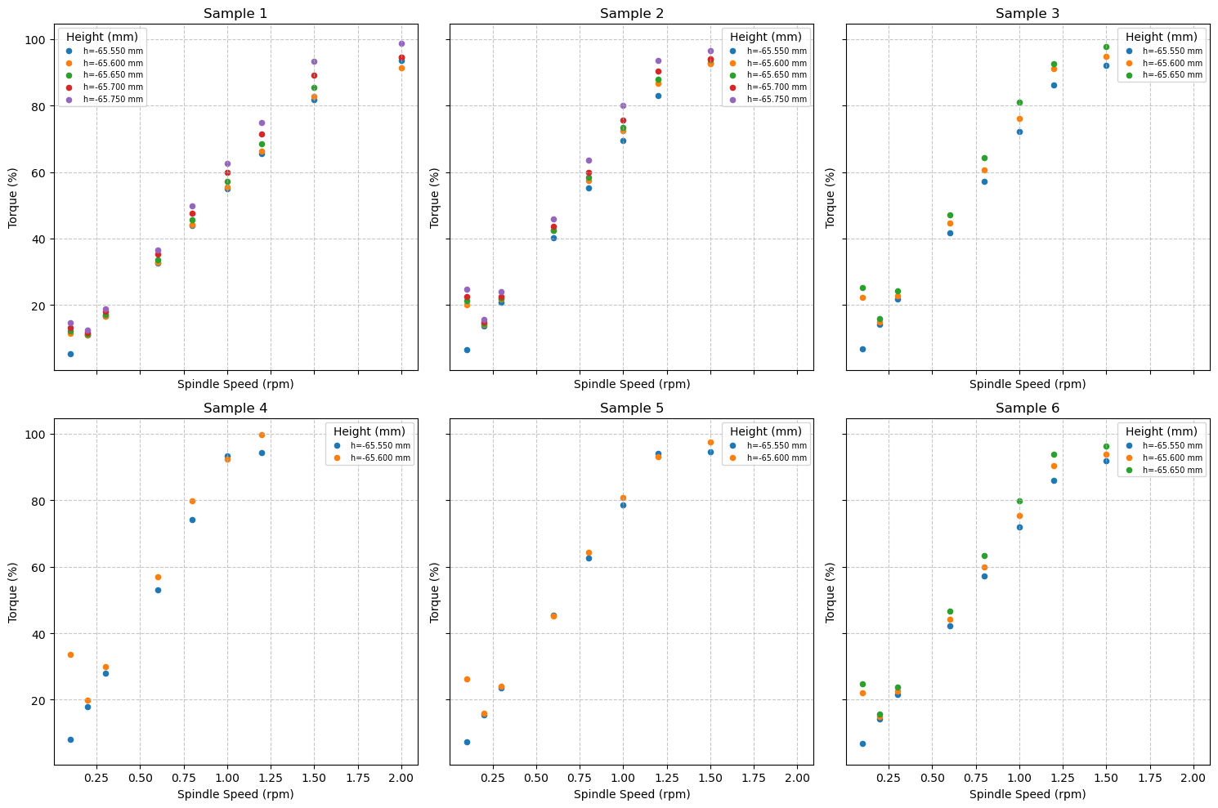
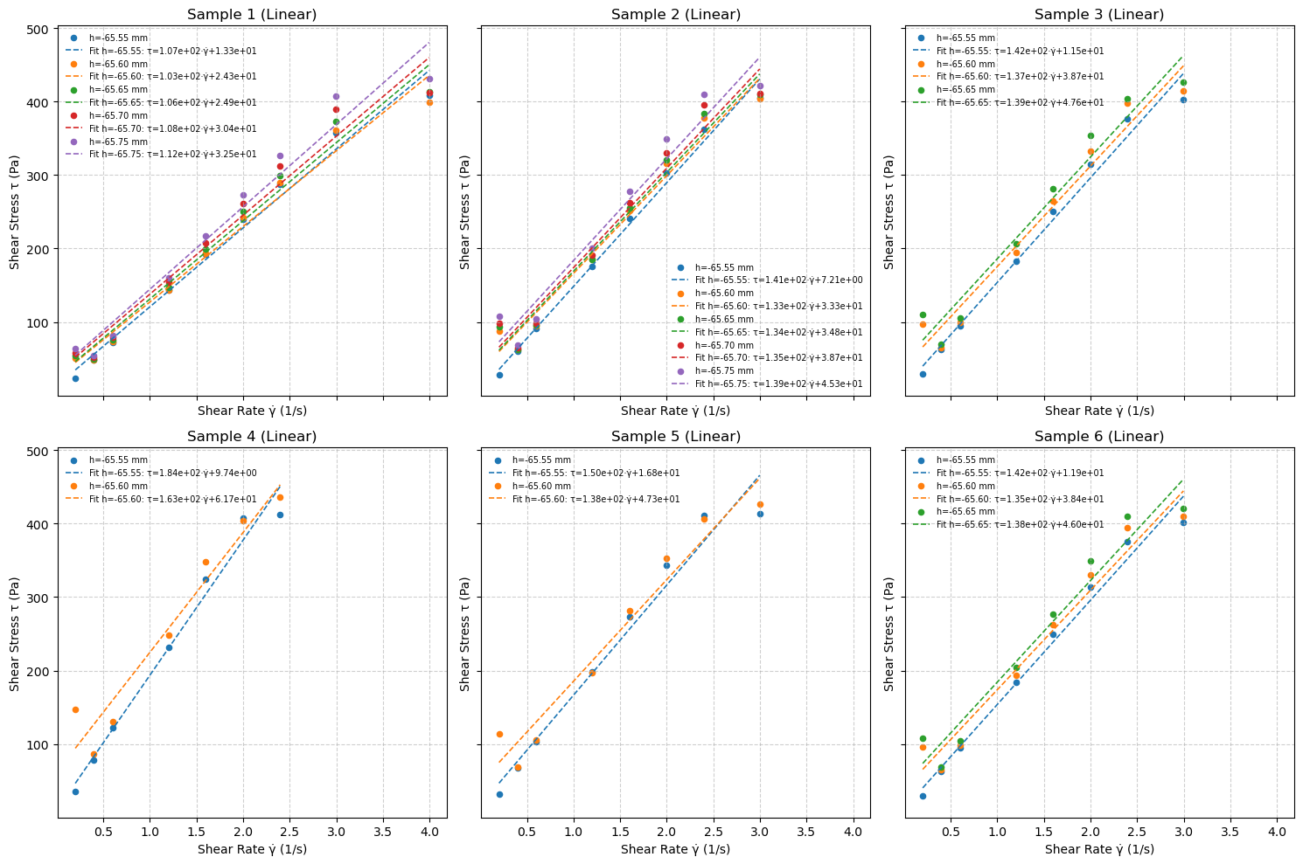
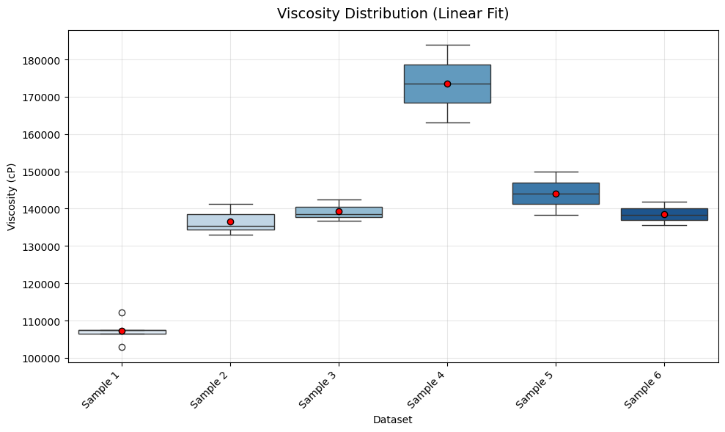
Silicon – Newtonian – 100,000 cP
Raw Data of Torque(%)-Spees (rpm) | Fitted Curve on Stress-Strain | Calculated Viscosity (cP)

Slide 5
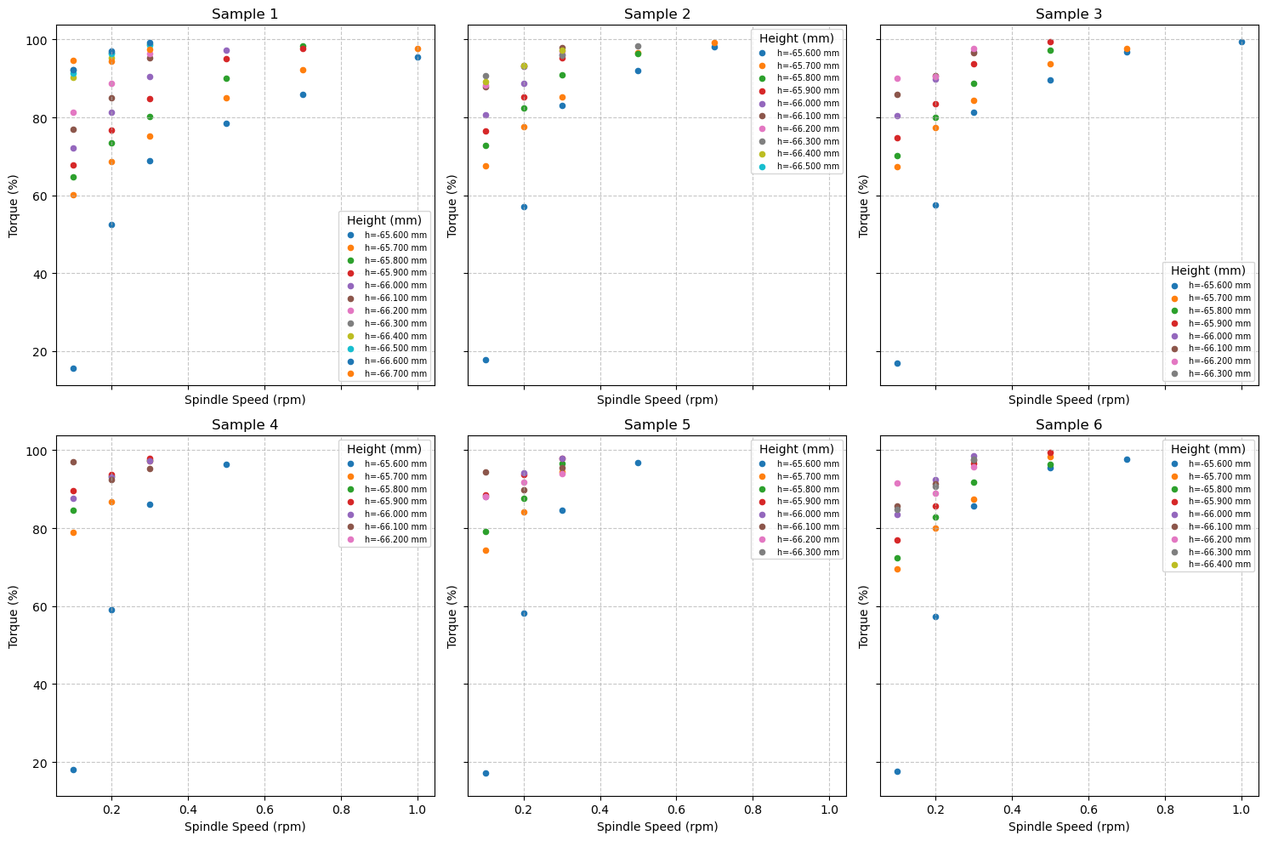
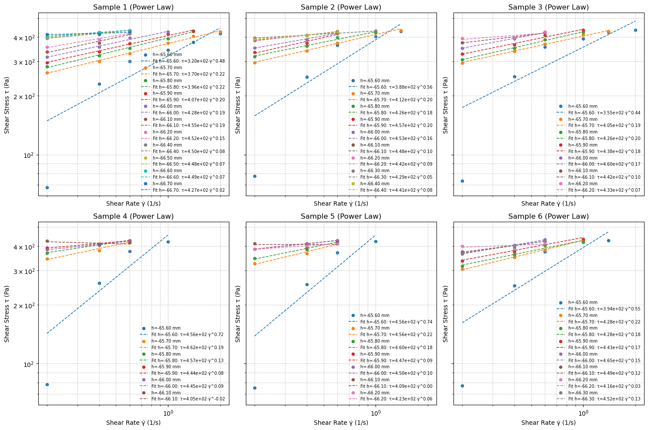
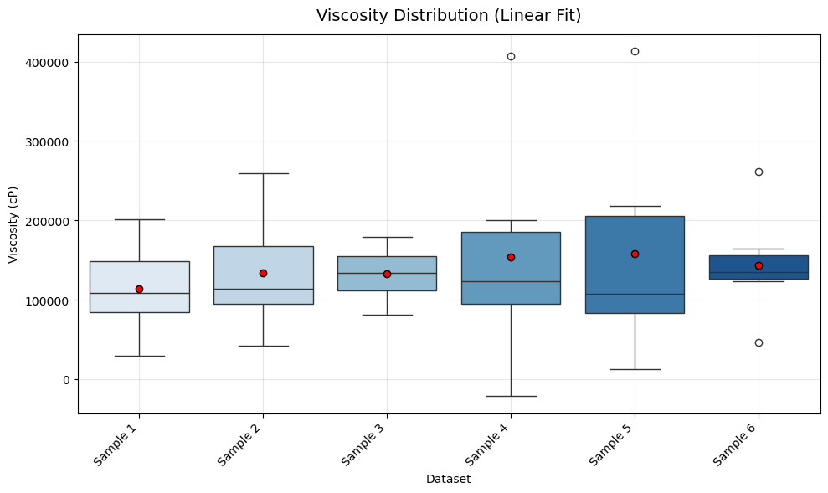
HY500
Raw Data of Torque(%)-Spees (rpm) | Fitted Curve on Stress-Strain | Calculated Viscosity (cP)

Slide 6
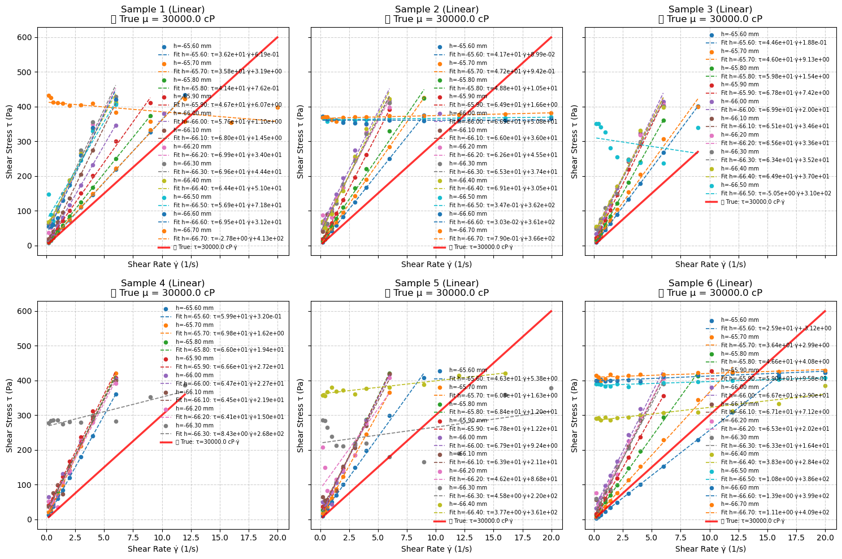

Slide 7
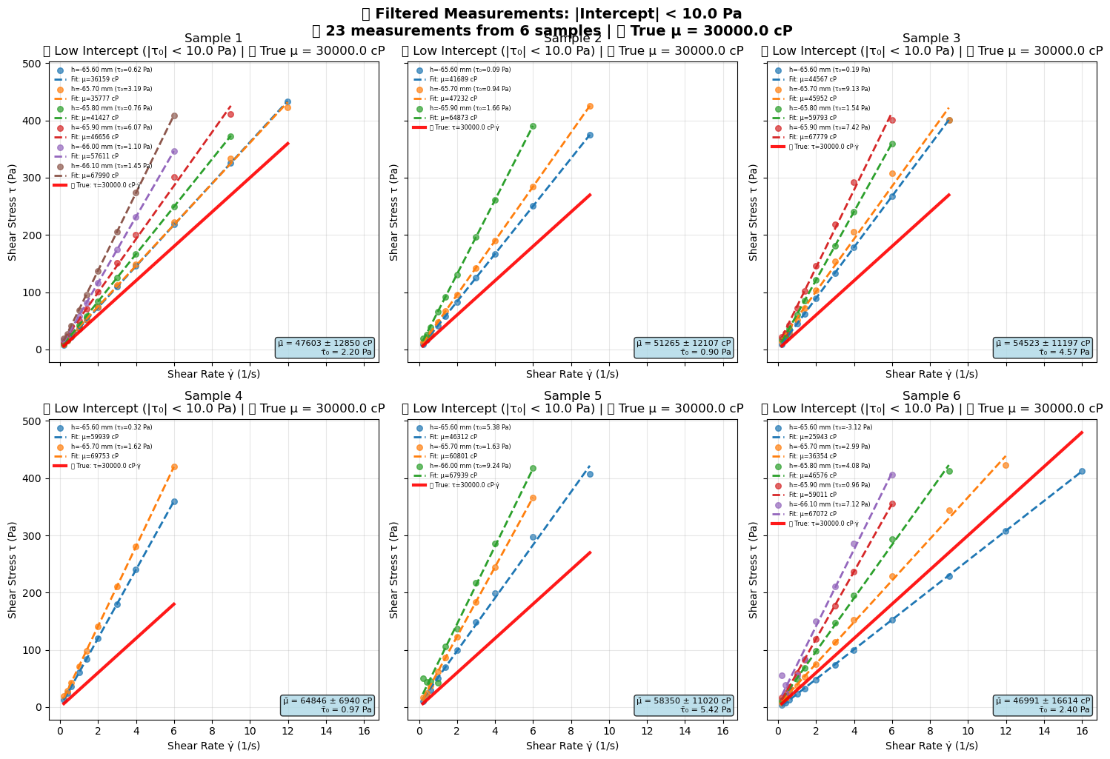

Slide 8
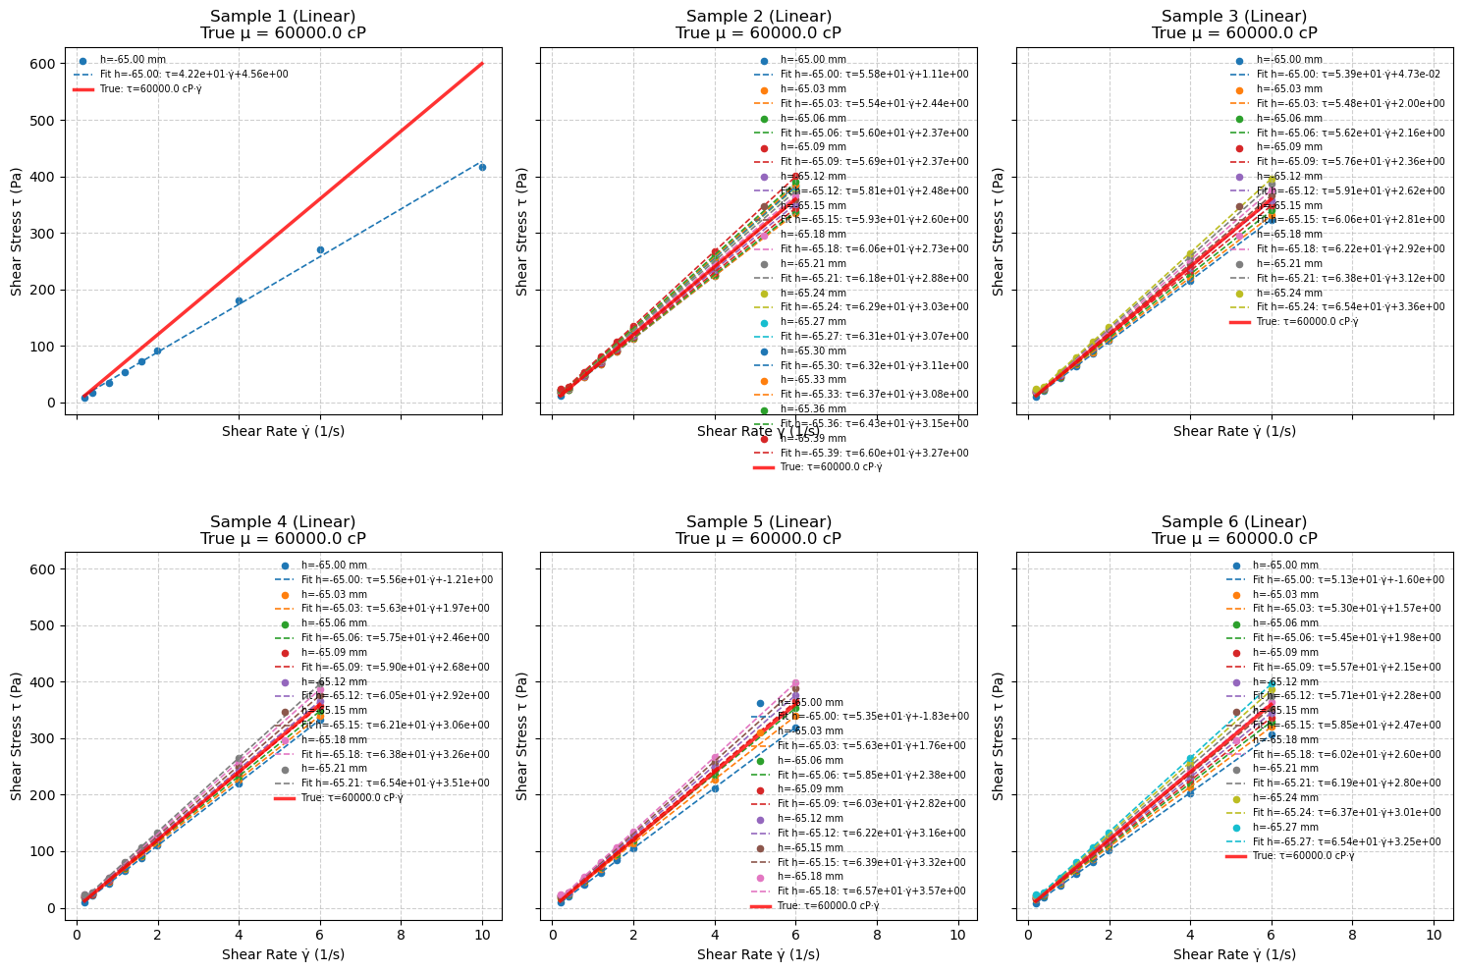

Slide 9
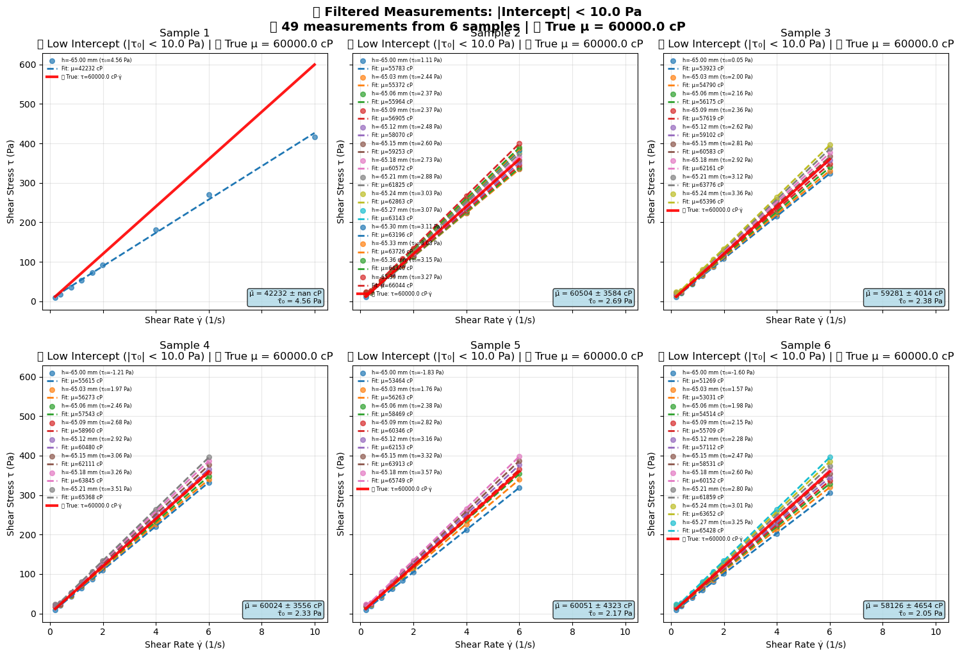

Slide 10
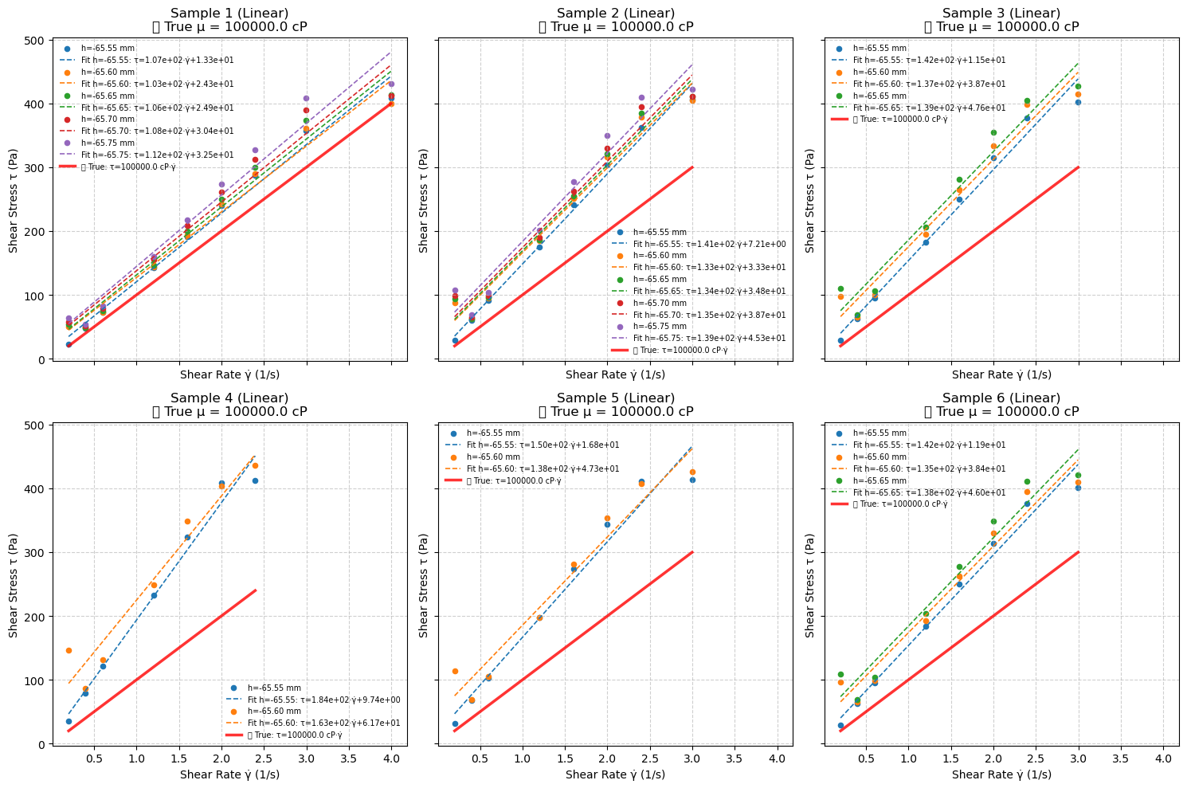

Slide 11
