Slide 1




End of Studies Project Presentation
Presented to obtain the bachelor's degree in
Business Computing : Business Intelligence Specialty
Design and development of a Web-Based Project Management and Business Intelligence Application
Under the direction of:
Mr. Trigui Omar
Mr. Jawhar Letaief
Presented By:
Mahdi Mlika
Academic Year: 2025 - 2026

Slide 2
TABLE OF CONTENTS
01
General Project Context
02
Analysis & Requirements
03
03
Design & Architecture
04
Implementation
05
Conclusion & Perspectives
2

Slide 3
01
General Project Context
3

Slide 4
General Project Context
Host Organization | Problem Statement | Existing System Analysis | Proposed Solution
Creative Media
Sector
Digital Technology & Multimedia Agency — Sousse, Tunisia
Founded
2002 · Legal form: SARL
Expertise
Web & mobile development · UX/UI design · AI integration · Digital branding · CGI
Methodology
Agile & Scrum
Team
Full-stack developers · UX/UI designers · AI integrators · Multimedia specialists
4
Notes:
In order to obtain the bachelor's degree in Business Computing: Business Intelligence Specialty, I have realized an internship at Pixelium to design and develop a skills management and technical evaluation platform, which we called “StackSkill”.

Slide 5
General Project Context
Host Organization | Problem Statement | Existing System Analysis | Proposed Solution
No systematic time logging against project budgets
Scope creep undetected & revision cycles untracked
Scope creep undetected & revision cycles untracked
No real-time budget consumption visibility
Inability to identify unprofitable clients
Inability to identify unprofitable clients
No structured client feedback channel
5
5
Notes:
Pixelium is an information technology services, solution, and software development firm
Founded in 2017, located at Sahloul, Sousse
Its expertise is mainly in the fields of mobile and web applications, giving solutions for current technology needs

Slide 6


General Project Context
Host Organization | Problem Statement | Existing System Analysis | Proposed Solution
Tools
Strengths
Gaps for Creative Media
✓ Time tracking
✓ Invoicing
✗ No scope creep tracking
✗ Requires external PM tool
✗ No client profitability
Harvest
✓ Excellent timer UX
✗ No project budget management
✗ No client portal
✗ No BI metrics
Toggl Track
✓ Mature task management
✗ No native time tracking
✗ No budget tracking
✗ No client portal
Asana
6

Slide 7

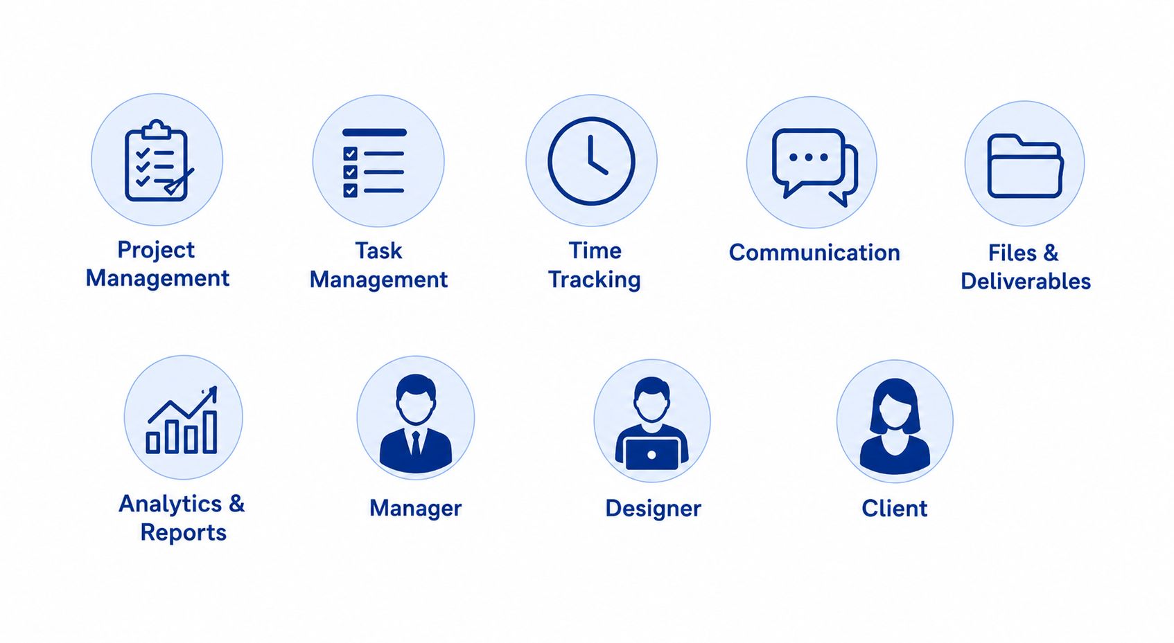
General Project Context
Host Organization | Problem Statement | Existing System Analysis | Proposed Solution
7
Notes:
Many developers are more accustomed to coding with the aid of an IDE and online resources.
Leading to performance anxiety and potentially impacting their ability to solve problems effectively

Slide 8
02
Analysis & Requirements
8
Notes:
HackerRank: cons: Can be intimidating for candidates who might excel in a work environment but not in timed tests
Codility: cons: Can be costly for small companies or startups
CodinGame: cons: Focus on games can overshadow the assessment of practical coding skills

Slide 9

Analysis & Requirements
Actors | Specification of Requirements | Use Case Diagram
Actors
Manager
Designer
Client
9
Notes:
A candidate is an individual seeking employment who interacts with the platform primarily for the purpose of self-skill evaluation
A recruiter is responsible for managing the interview process within the platform.
A super administrator is the highest-level user with overarching control over the platform.

Slide 10
Analysis & Requirements
Actors | Specification of Requirements | Use Case Diagram
Functional
Functional
Non-Functional
Authentication
Project & task CRUD
Time Tracking
Kanban drag-and-drop
Client portal & structured feedback
Project messaging board
BI dashboards
PDF & Excel exports
Security
Performance
Scalability
Maintainability
Usability
10

Slide 11
Analysis & Requirements
Actors | Specification of Requirements | Use Case Diagram
Descriptive
KPI Cards
Budget Utilization
Designer Utilization
Knowledge
“What happened?”
2. Diagnostic
Decisional
Scope Creep Index
Budget Variance
Revision-to-Approval
Understanding
“Why did it happen?”
3. Prescriptive
AI Health Narrative
Profitability Ranking
Action
“What should we do?”
11

Slide 12
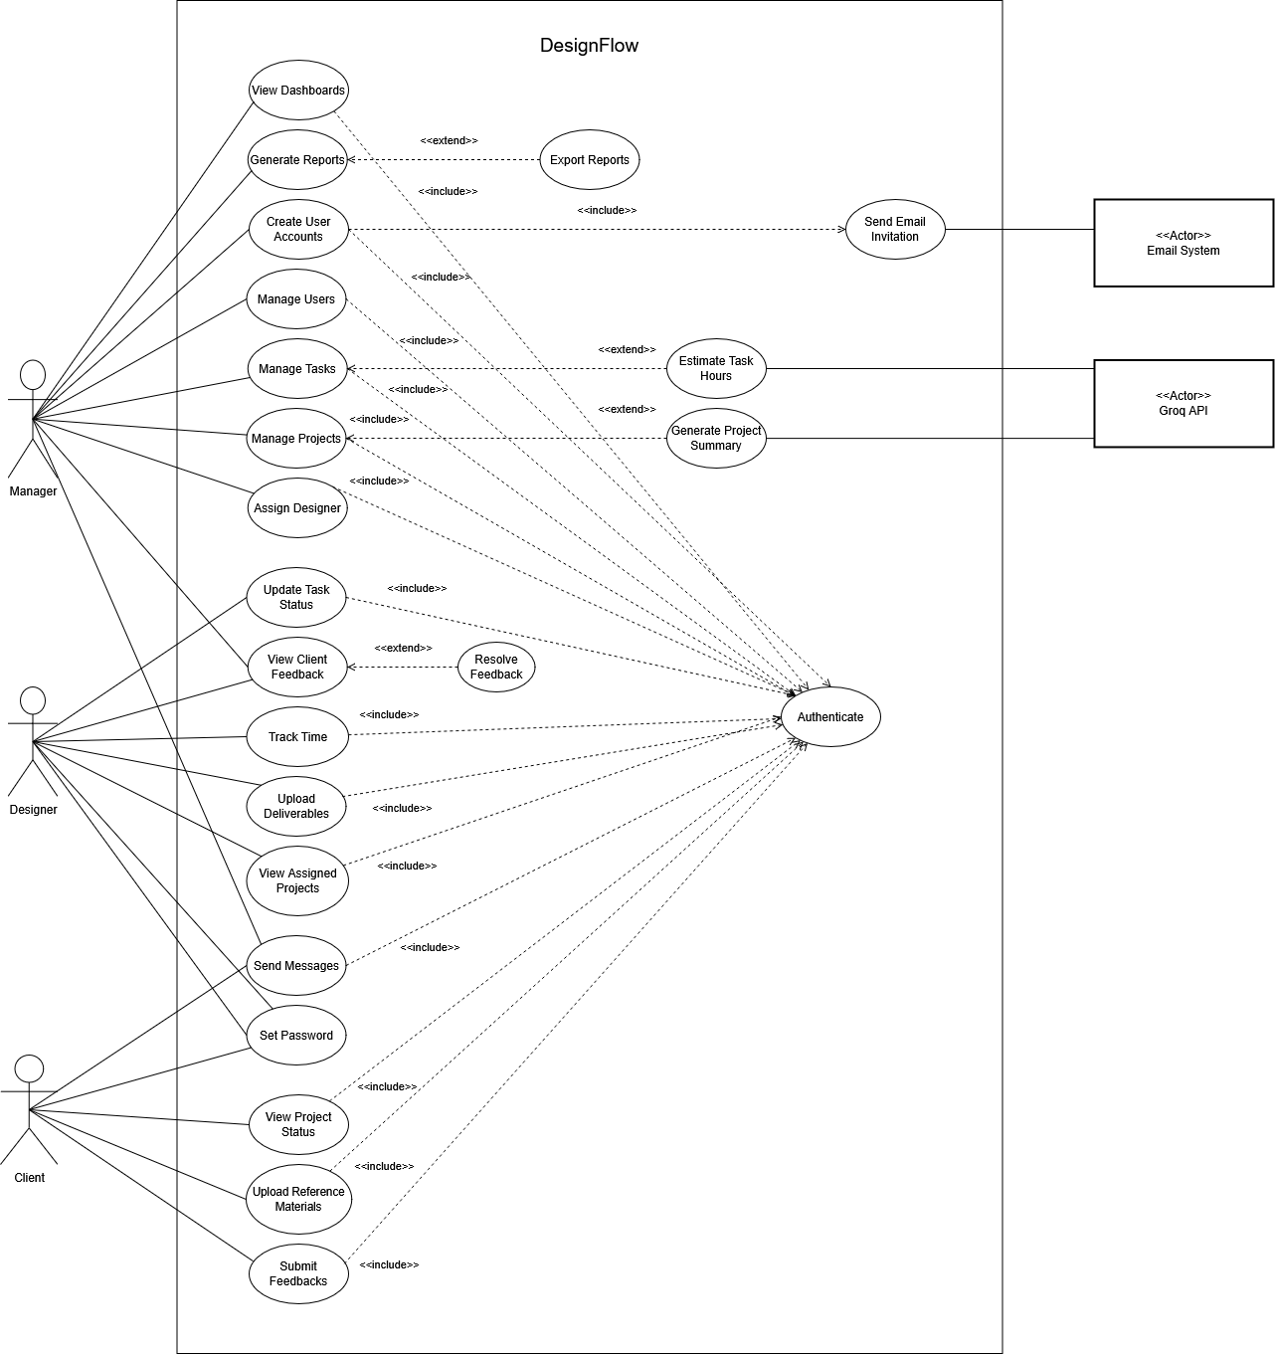
Analysis & Requirements
Actors | Specification of Requirements | Use Case Diagram
12

Slide 13
03
Design & Architecture
13

Slide 14


Design & Architecture
Design & Architecture
Technologies | Architecture | Class Diagram
Development Tools
Tech Stack
Development Tools
Tech Stack
15
14

Slide 15
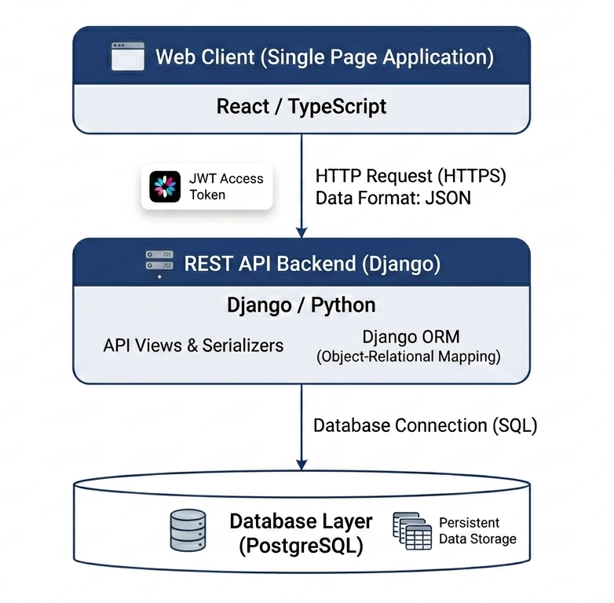
Design & Architecture
Technologies | Architecture | Class Diagram
3-Tier Architecture
15

Slide 16
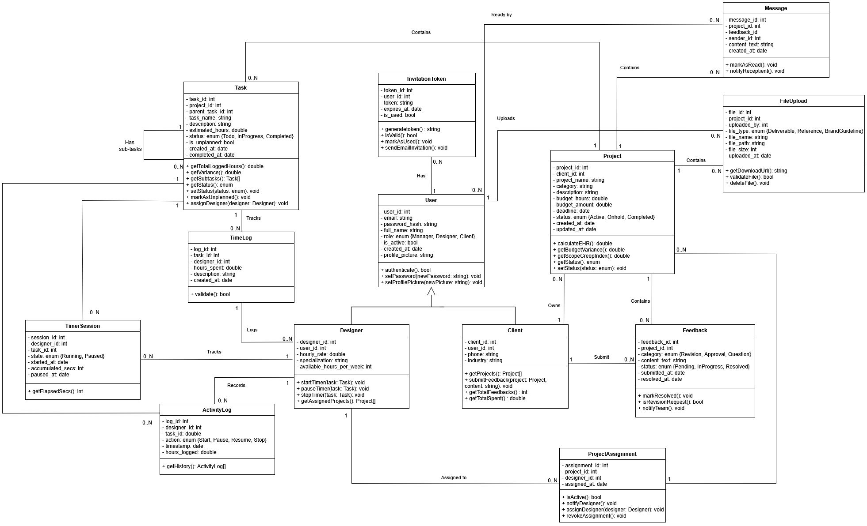
Design & Architecture
Technologies | Architecture | Class Diagram
16

Slide 17
04
Implementation
17

Slide 18
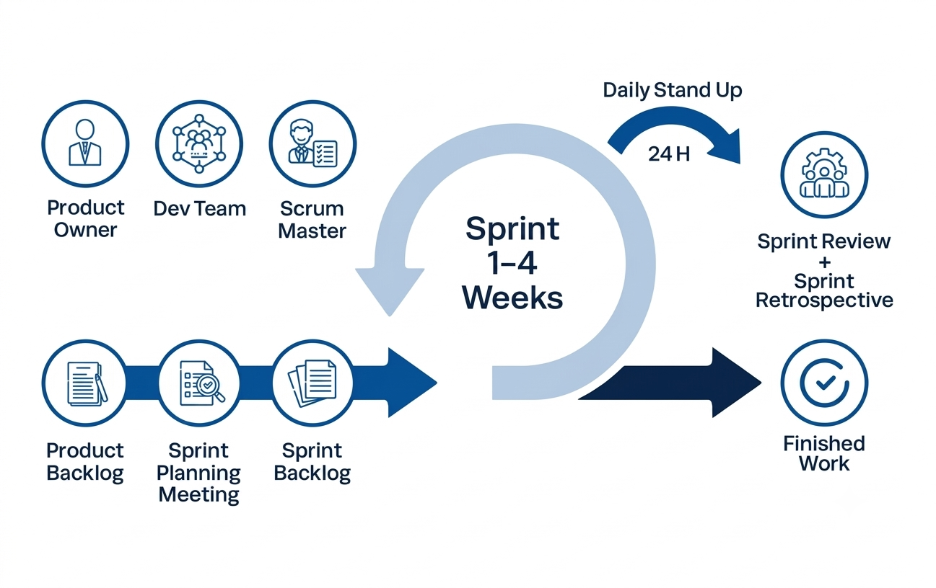
Implementation
Methodology | Sprint Planning | Sprint 3 | Sprint 5
18
Notes:
StackSkill emerges as a paramount solution, offering a pivotal feature essential for real-time interviews.

Slide 19
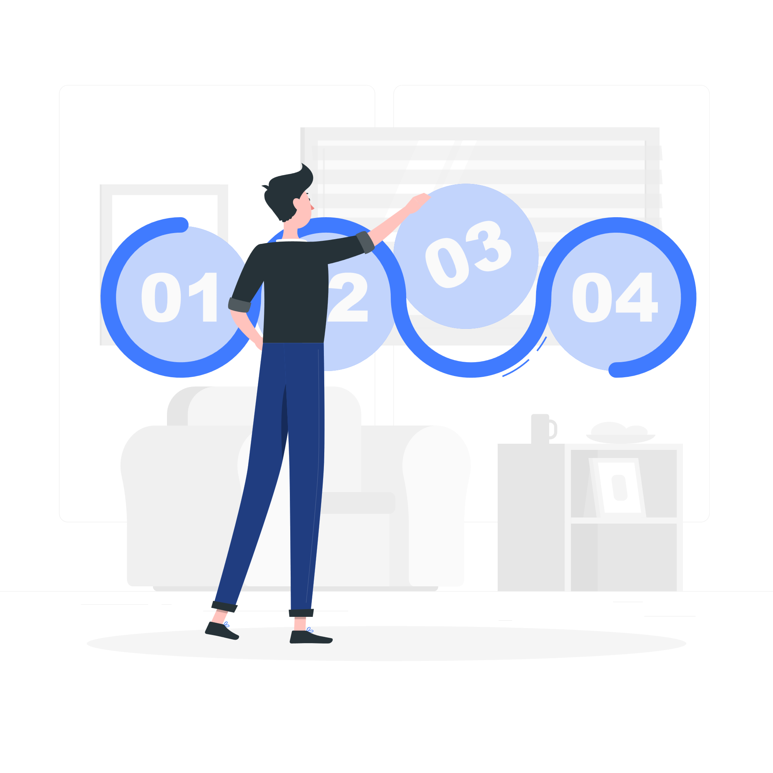
Implementation
Methodology | Sprint Planning | Sprint 3 | Sprint 5
Sprint Planning
S1
S2
S3
S4
S5
Foundation
& Auth
Projects
& Tasks
Time
Tracking
Client
Portal
BI &
Reports
19

Slide 20
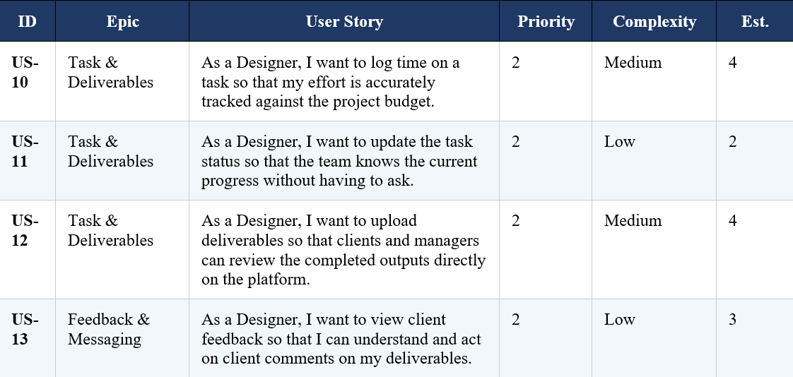
Implementation
Methodology | Sprint Planning | Sprint 3 | Sprint 5
Sprint 3 Backlog
20

Slide 21
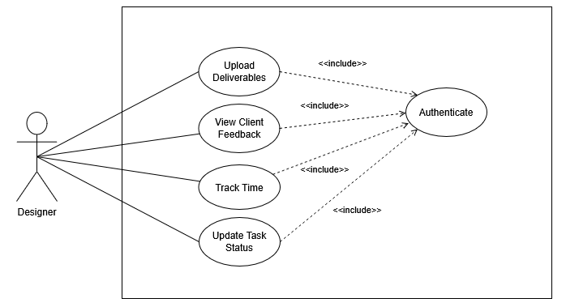
Implementation
Methodology | Sprint Planning | Sprint 3 | Sprint 5
Sprint 3 Use Case Diagram
21

Slide 22
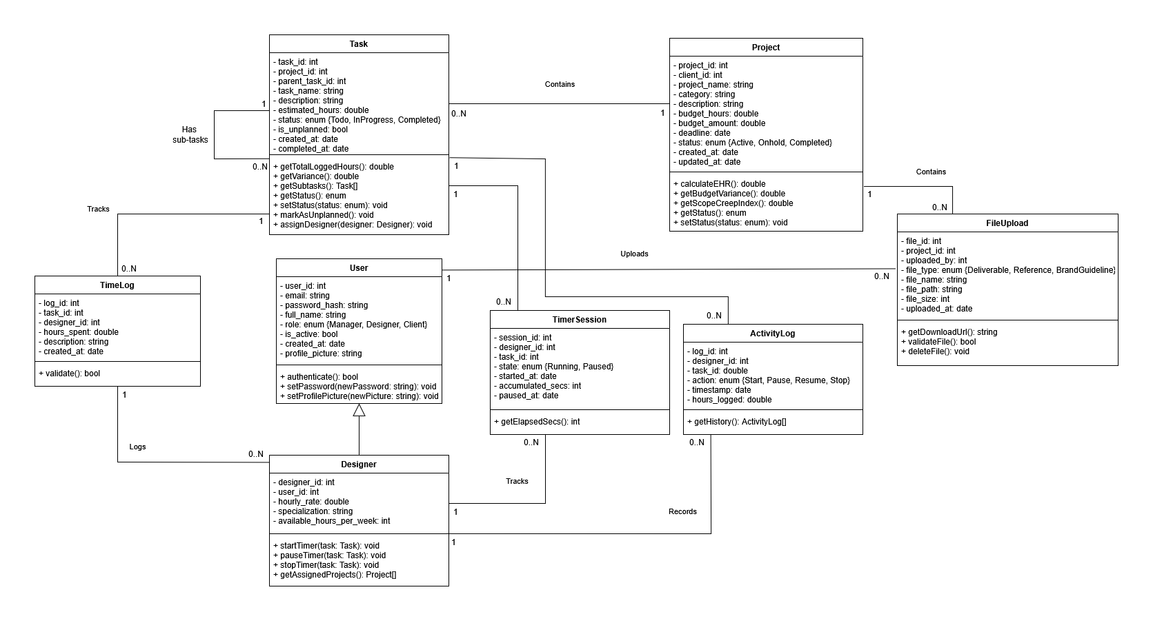
Implementation
Methodology | Sprint Planning | Sprint 3 | Sprint 5
Sprint 3 Class Diagram
22

Slide 23
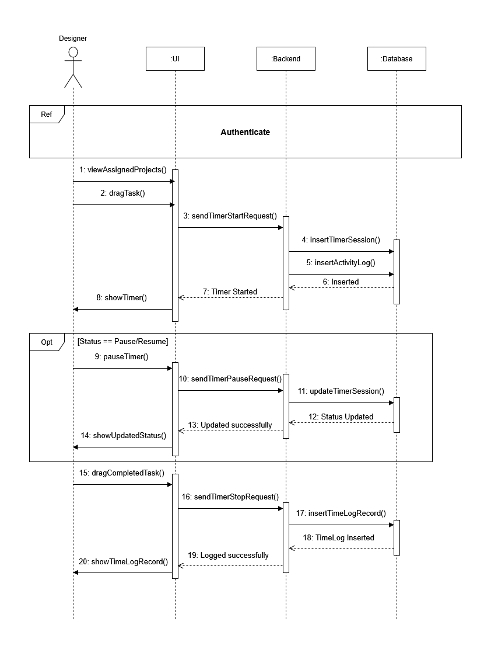
Implementation
Methodology | Sprint Planning | Sprint 3 | Sprint 5
Sequence Diagram — Track Time
23

Slide 24
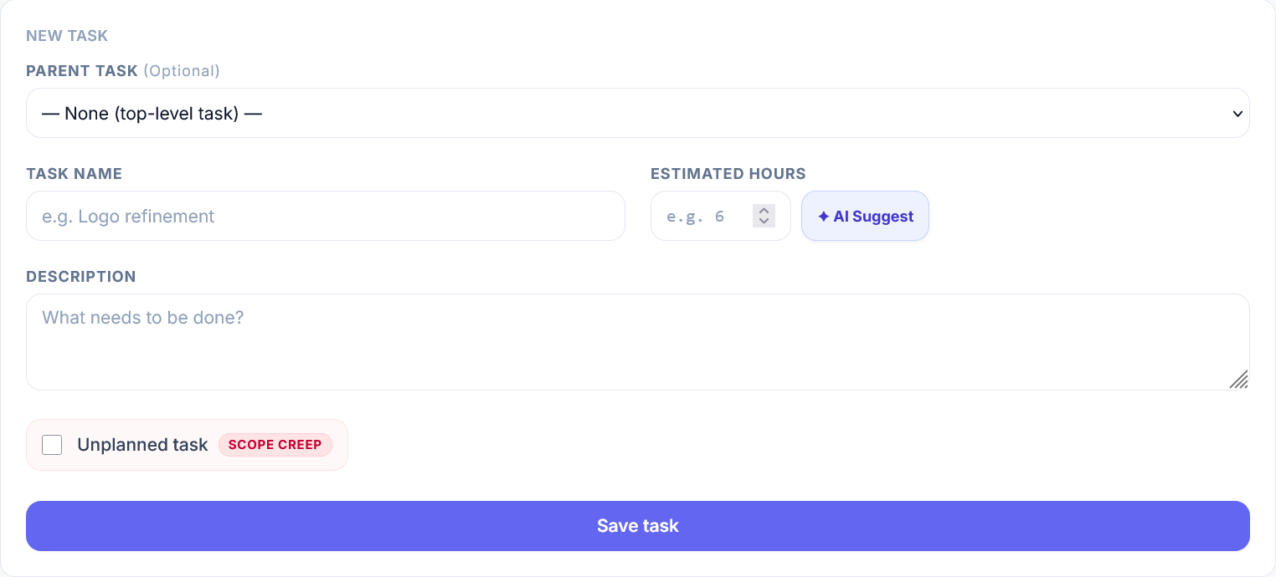
Implementation
Methodology | Sprint Planning | Sprint 3 | Sprint 5
24

Slide 25
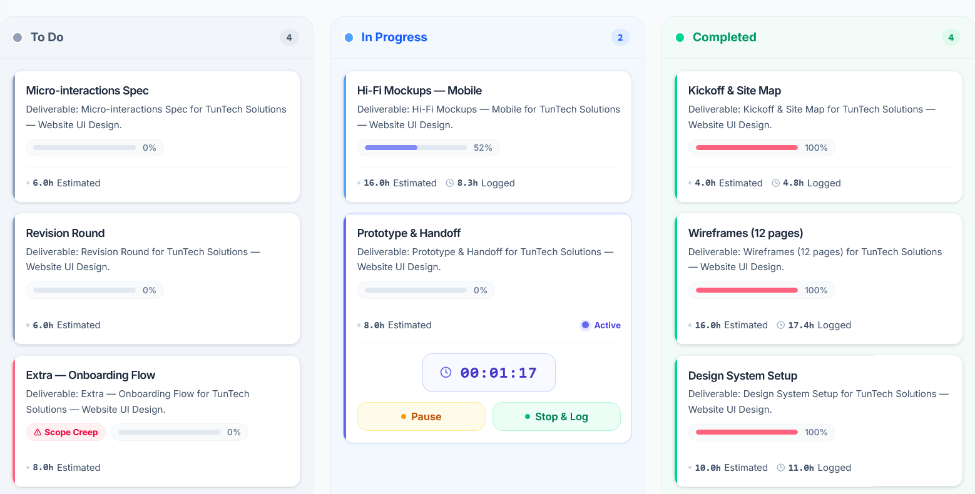
Implementation
Methodology | Sprint Planning | Sprint 3 | Sprint 5
25

Slide 26
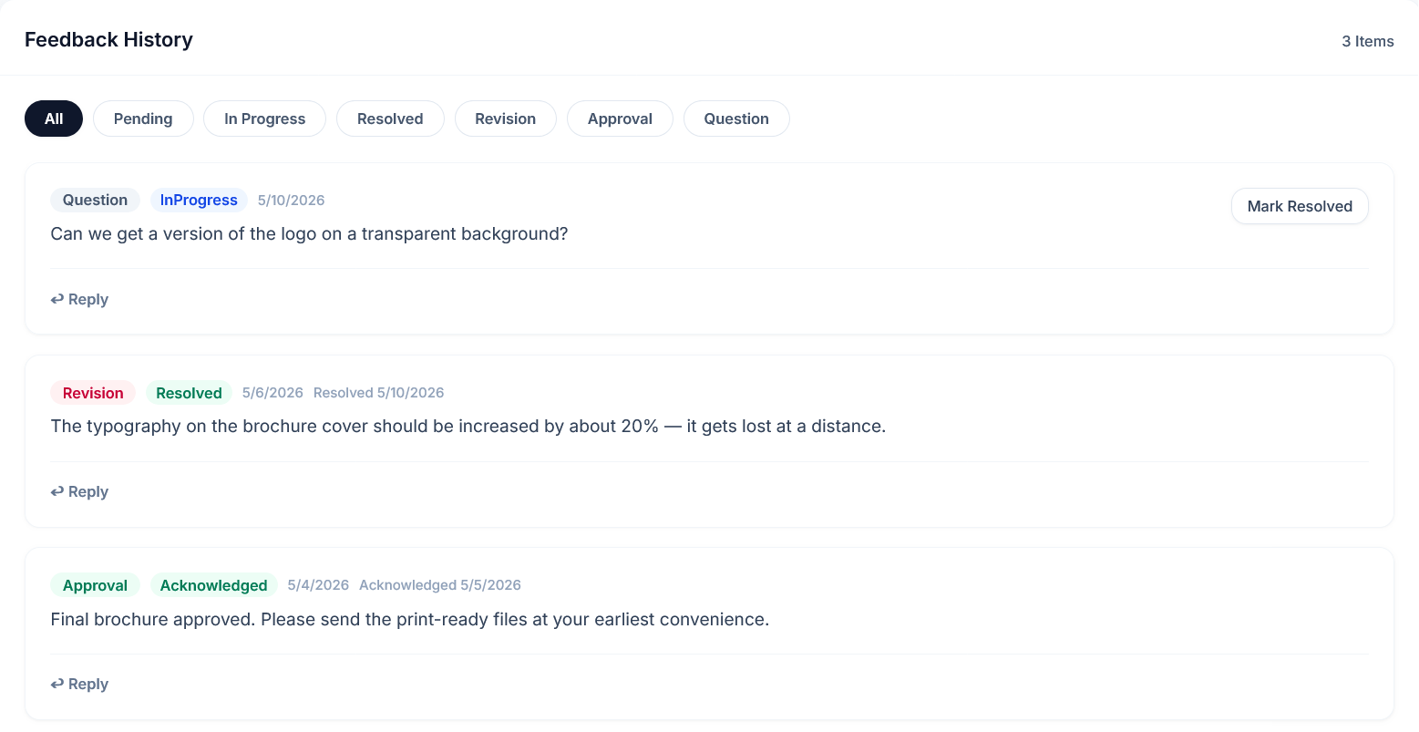
Implementation
Methodology | Sprint Planning | Sprint 3 | Sprint 5
26

Slide 27
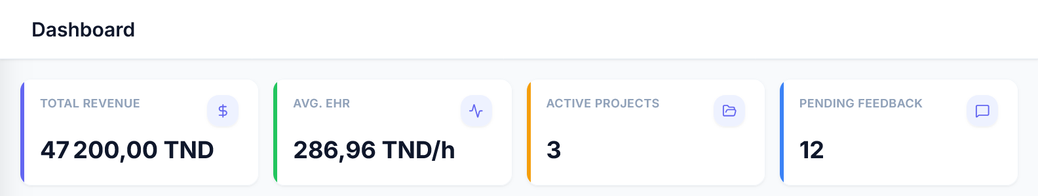
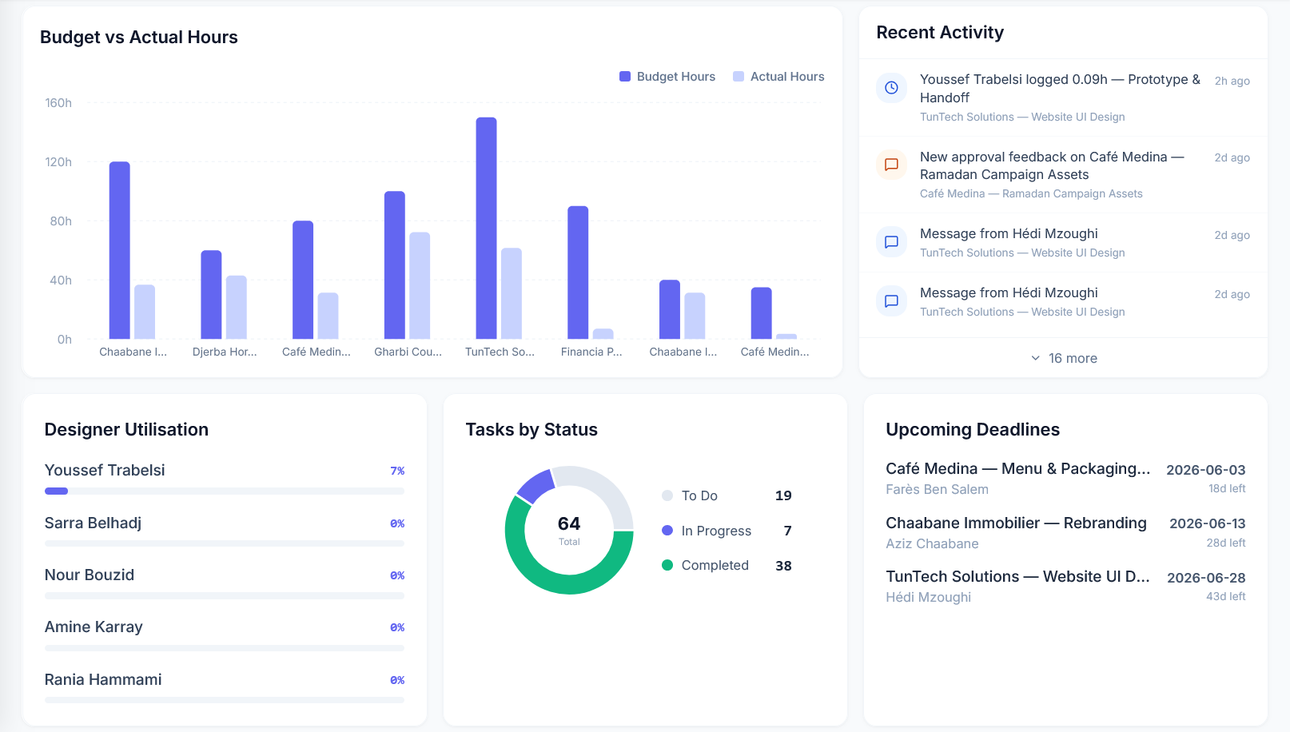
Implementation
Methodology | Sprint Planning | Sprint 3 | Sprint 5
27

Slide 28
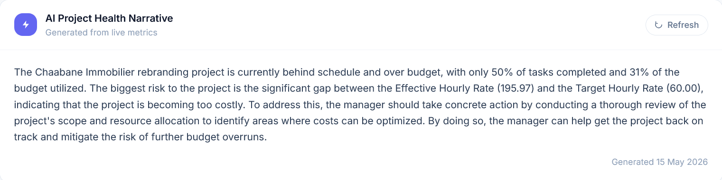
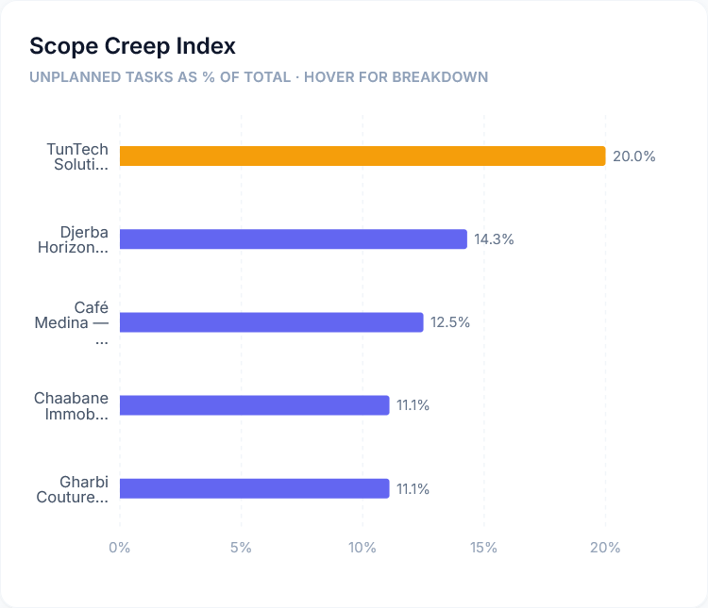
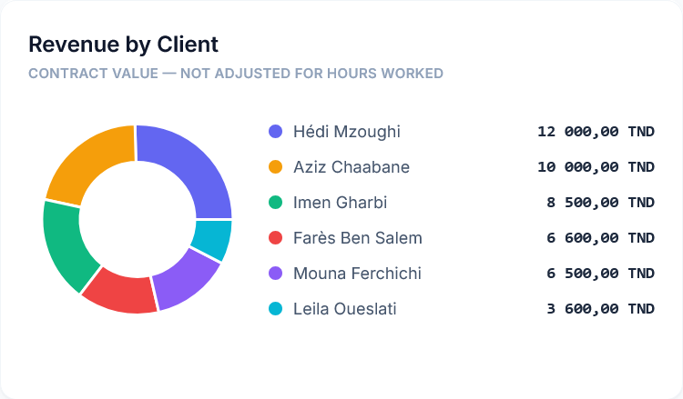
Implementation
Methodology | Sprint Planning | Sprint 3 | Sprint 5
28

Slide 29
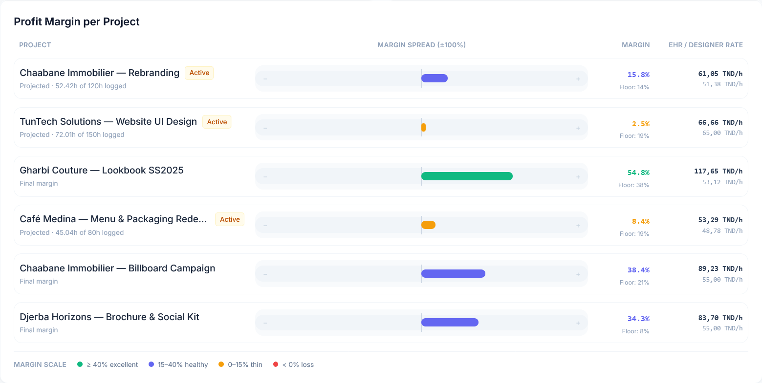
Implementation
Methodology | Sprint Planning | Sprint 3 | Sprint 5
29

Slide 30
05
Conclusion & Perspectives
30

Slide 31

Conclusion
Conclusion | Perspectives
1
1
Rigorous methodology
2
Modern tech stack
3
Operational BI metrics
4
Integrated AI features
5
Security & quality
31

Slide 32


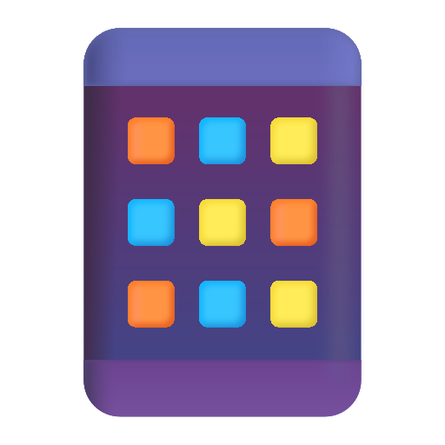
Perspectives
Conclusion | Perspectives
Multi-tenant SaaS Architecture
Isolated data for each agency
Real-time notifications
Django Channels WebSockets for messaging & timer alerts
Mobile app
React Native version for timer tracking on the go
32

Slide 33
Thank you for your attention

