Slide 1
Presentation Tips
Keep slides simple and visual
Explain WHY steps were performed
Focus on understanding, not complexity
Use readable figures and plots
Be prepared to answer questions
If any of the slide content is not performed in your project and you can not inlcude, please explain/justify, why?
Note: this slide is hidden, please keep it as it is and do not present this slide.

Slide 2

Predicting Vehicle Fuel Efficiency (MPG)
Students group No: [Group number]
Mahdi Mosavi & [Partner name]
TAM400 – Introduction to Applied AI & ML
June 2026
Notes:
Exempelsidorna som följer visa hur layouten är tänkt med bilder och layoutflöde.
Under ”Ny bild”¹ finns fler layoutmallar² än de som ligger på exempelsidorna nedan.
1.
2.

Slide 3
Problem & Objective
Problem: predict vehicle fuel efficiency in MPG from car attributes.
Why: fuel efficiency is important for cost, environment and comparing vehicles.
Objective: build a simple ML regression workflow and compare models.
Final goal: choose a model that predicts MPG accurately and is easy to explain.
Project question
Can we estimate MPG using features such as weight, horsepower, cylinders and model year?
TAM400 – Applied AI & Machine Learning
(1)

Slide 4
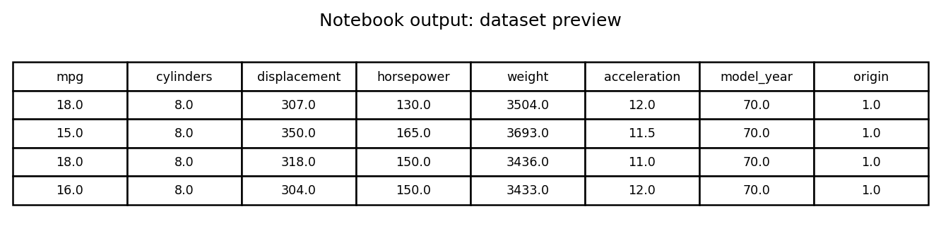
Dataset & Data Collection
Feature → Target
Vehicle attributes ↓ ML regression model ↓ Predicted MPG
Dataset: UCI Auto MPG dataset.
Size: 398 cars, historical vehicle data.
Target variable: mpg.
Input features: cylinders, displacement, horsepower, weight, acceleration, model_year, origin.
car_name was removed because it is mostly a text identifier.
Table from the notebook output: first rows after loading the dataset.
TAM400 – Applied AI & Machine Learning
(2)

Slide 5
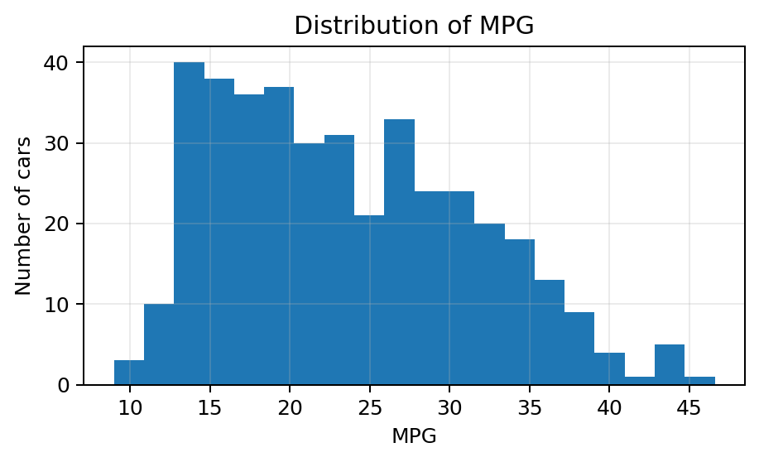
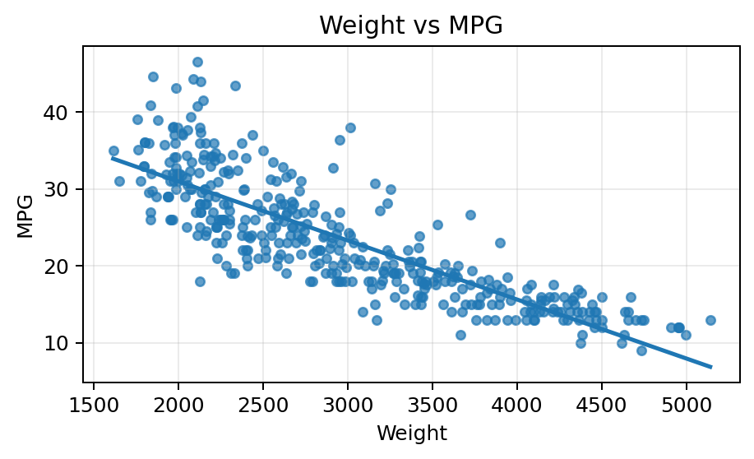
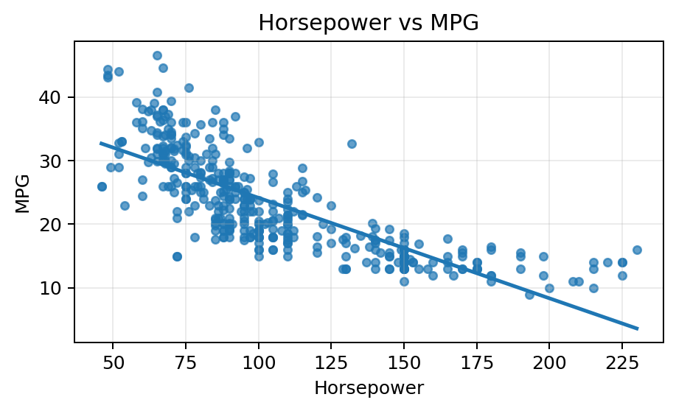
Exploratory Data Analysis (EDA)
Notebook EDA outputs
EDA was used to understand the dataset before training.
MPG distribution shows that cars have different fuel-efficiency levels.
Weight vs MPG: heavier cars usually have lower MPG.
Horsepower vs MPG: stronger engines often have lower MPG.
These patterns make regression suitable for this problem.
TAM400 – Applied AI & Machine Learning
(3)

Slide 6
Data Preprocessing Pipeline
Raw data
Impute + Encode
Evaluate
Split data before preprocessing to avoid data leakage.
Missing horsepower values were handled with median imputation.
origin was treated as categorical and encoded with OneHotEncoder.
StandardScaler was used for Linear Regression.
All steps were combined in sklearn Pipelines/ColumnTransformer.
Train/Test split
Train model
TAM400 – Applied AI & Machine Learning
(4)

Slide 7
Selected Machine Learning Model
Why not only Linear Regression?
Linear Regression is easy to explain, but it can miss non-linear patterns. Random Forest can capture more complex relationships while still being understandable.
This is a regression problem because the target, MPG, is a numeric value.
Models compared: DummyRegressor, Linear Regression, Decision Tree, Random Forest.
Selected model: RandomForestRegressor.
Reason: it gave the best test score and is more stable than one Decision Tree.
Simple explanation: Random Forest combines many decision trees and averages their predictions.
TAM400 – Applied AI & Machine Learning
(5)

Slide 8
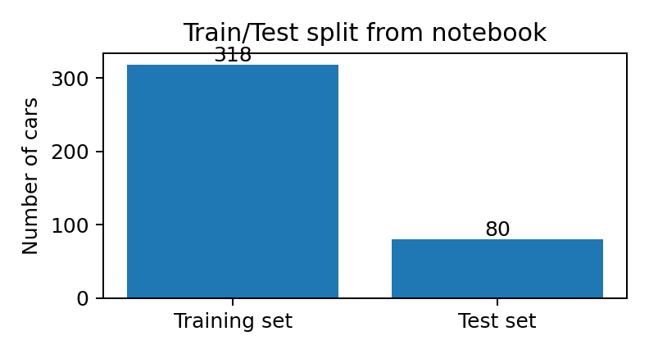
Model Training & Fine-Tuning
Important idea
The test set was kept separate so the final result is a fair estimate of how the model performs on unseen data.
Train/test split: 80% training, 20% testing.
Cross-validation: 5-fold CV on the training set.
Fine-tuning: GridSearchCV with a small parameter grid.
Tuned parameters included n_estimators, max_depth, min_samples_leaf and max_features.
The final model was evaluated once on the test set.
TAM400 – Applied AI & Machine Learning
(6)

Slide 9
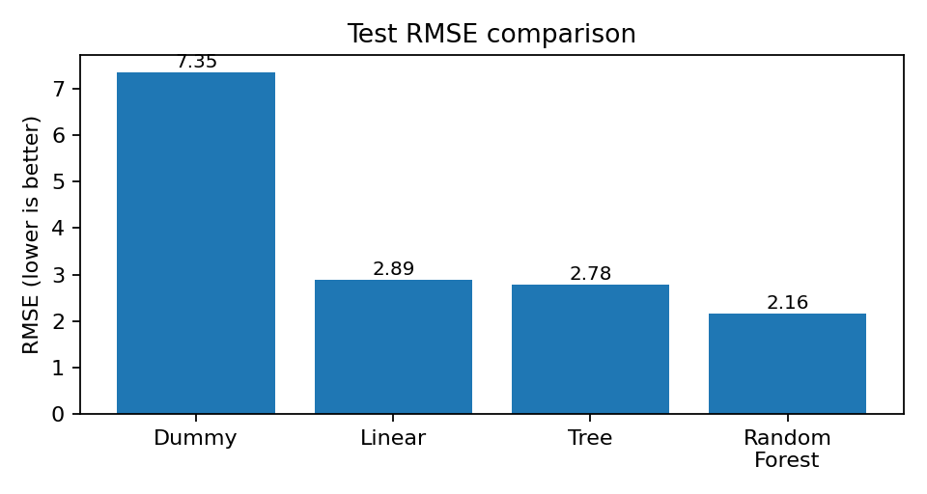
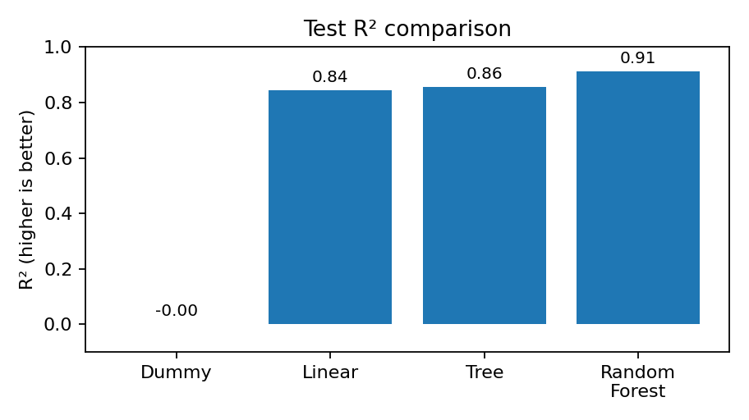
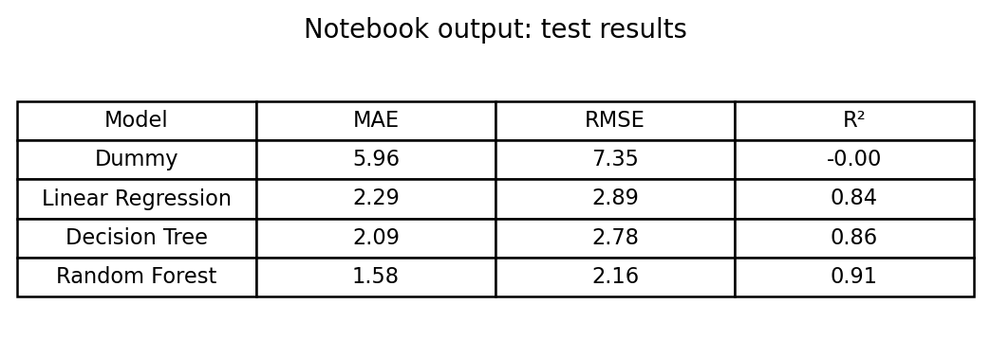
Results & Evaluation
Random Forest performed best on the test set.
Final Random Forest result: MAE ≈ 1.58, RMSE ≈ 2.16, R² ≈ 0.91.
R² ≈ 0.91 means the model explains about 91% of the variation in MPG on the test set.
Lower RMSE/MAE means predictions are closer to the true MPG values.
TAM400 – Applied AI & Machine Learning
(7)

Slide 10
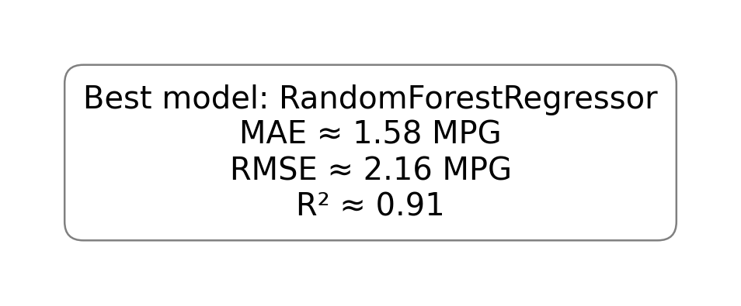
Conclusion & Future Work
What worked well: a complete ML workflow with preprocessing, pipelines, training and evaluation.
Main finding: weight, horsepower and related engine features are useful for predicting MPG.
Best model: Random Forest, because it had the lowest error and highest R².
Limitations: dataset is old and small; modern cars may have different patterns.
Future work: use newer data, add more vehicle features, and test deployment with an API/app.
Final conclusion
A simple and well-explained ML project is enough: the focus is understanding the workflow, not using advanced algorithms.
TAM400 – Applied AI & Machine Learning
(8)

Slide 11
AI Acknowledgment & References
Generative AI acknowledgment: ChatGPT was used for understanding concepts, debugging help, improving explanations and preparing presentation text.
All code and results were reviewed and must be explainable by the students.
Dataset reference: UCI Machine Learning Repository – Auto MPG dataset.
Tools: Python, pandas, NumPy, scikit-learn, matplotlib, joblib.
Code reference: project GitHub repository / notebook.
TAM400 – Applied AI & Machine Learning
(9)

Slide 12
Thank you!
Any questions?
Key message
We predicted MPG using a complete, simple and understandable ML workflow.

Slide 13
Backup slide: Important notebook outputs
Use this only if the teacher asks about exact outputs. You can say: The notebook printed train/test sizes, model scores and the comparison table. Random Forest had the lowest RMSE and highest R², so I selected it.

