Slide 1
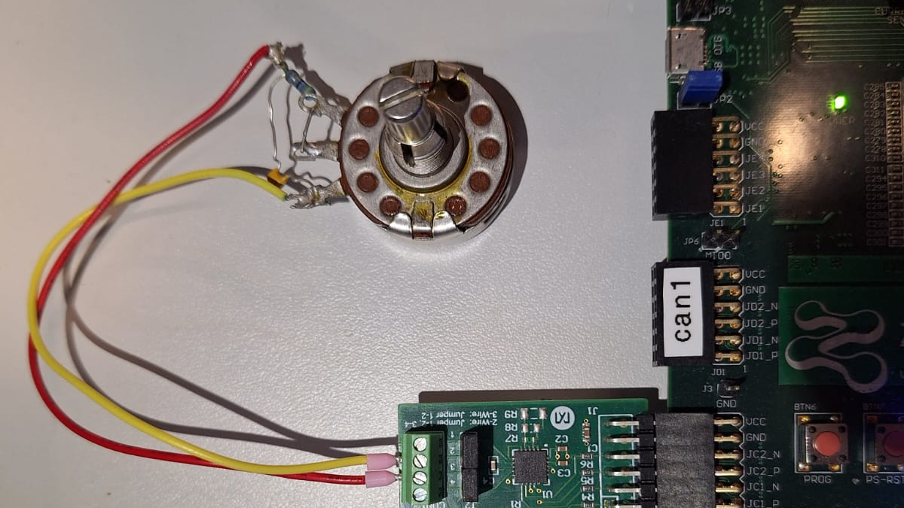
Measurement Network Gateway
ALIN RAJ RAJAGOPALAN NAIR
Matr No: 41520

Slide 2
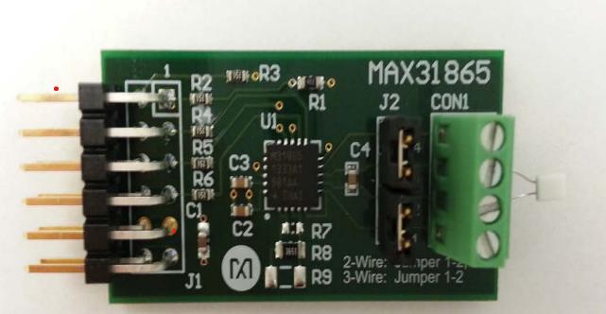
Introduction to MAX31865
Developed by Maxim Integrated, the MAX31865 is a high-performance RTD-to-digital converter purpose-built for precision temperature sensing.
It features a 15-bit delta-sigma ADC that digitizes the ratio of RTD resistance to a reference resistance with exceptional accuracy.
Its tailored signal conditioning circuitry is engineered for seamless operation with PT100 to PT1000 platinum RTD sensors, delivering reliable readings across a wide temperature range.
Notes:
Let's start with an introduction. The MAX31865 is a high-performance RTD-to-digital converter purpose-built for precision temperature sensing. At its core is a 15-bit delta-sigma ADC that digitises the ratio of RTD resistance to a reference resistance. This ratiometric approach is key — it means that any drift in the excitation current source cancels out, giving us inherently stable measurements. The device's signal conditioning circuitry is specifically engineered for PT100 to PT1000 platinum RTD sensors. Platinum is the material of choice for precision temperature measurement because of its excellent linearity and long-term stability. What makes the MAX31865 especially convenient for embedded designers is its integration. It packs input protection, a digital controller, and a full SPI-compatible interface into a single chip. This drastically reduces the external component count and simplifies the design process — you don't need to build a discrete amplifier chain or worry about noise filtering at the analogue level.

Slide 3
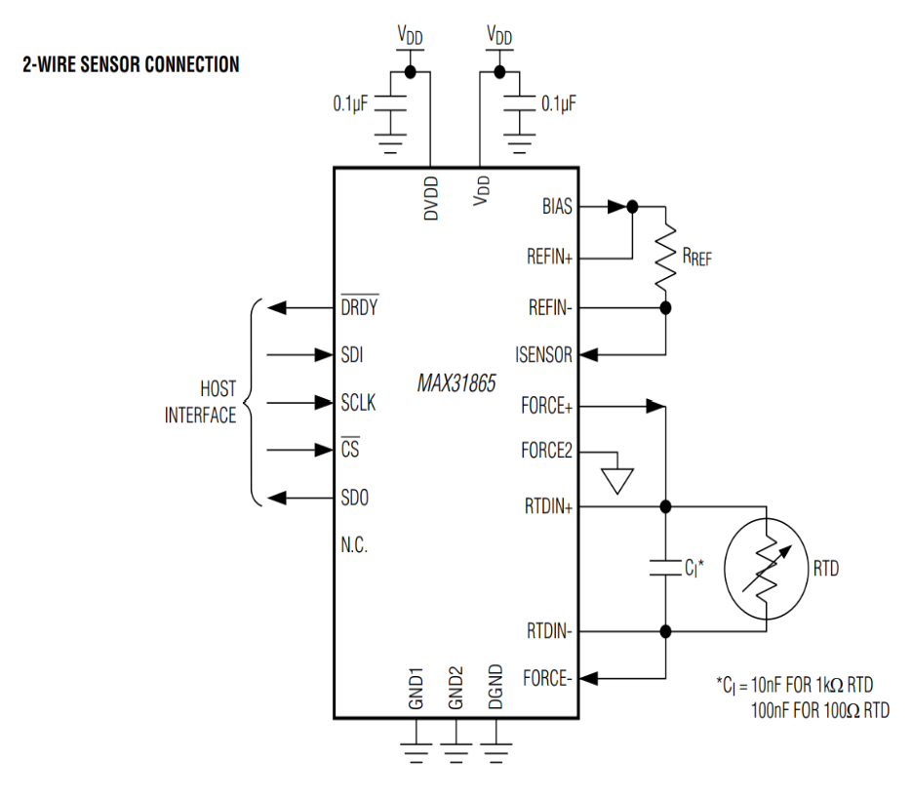
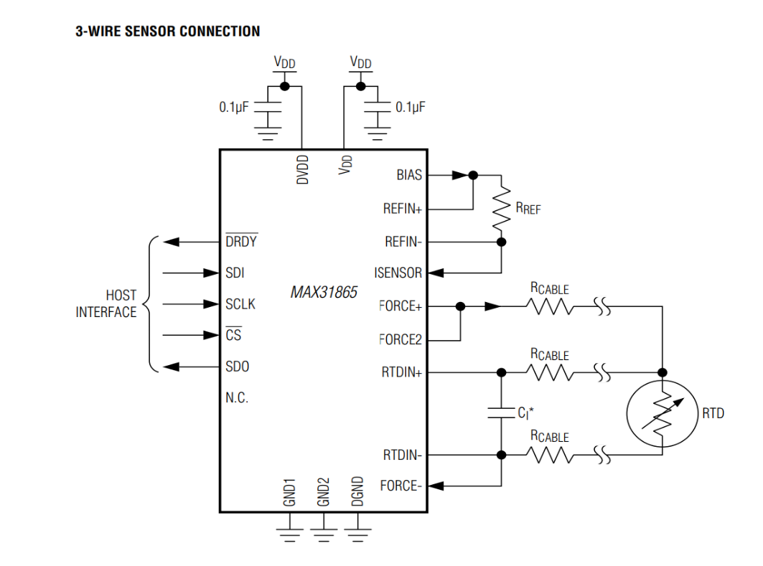
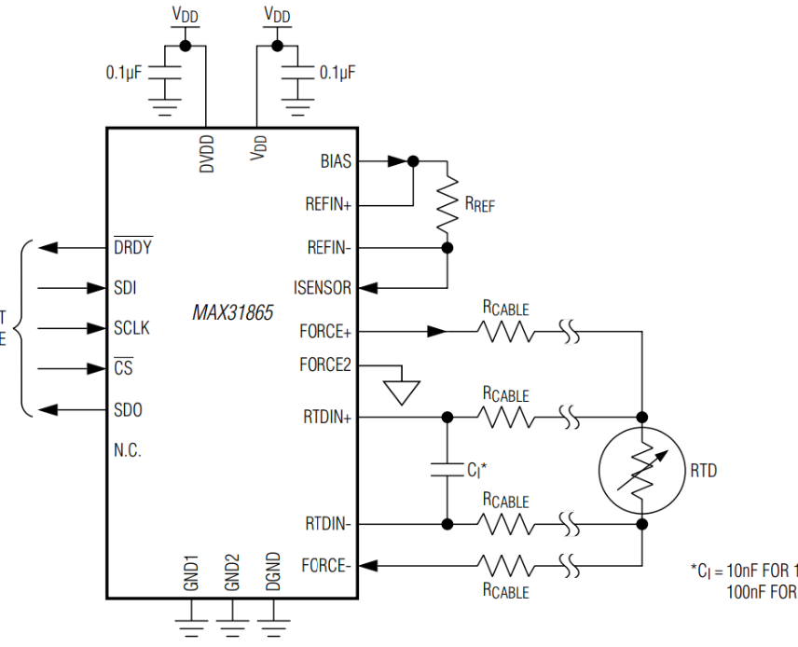
TYPICAL APPLICATION CIRCUITS
Three types of application Circuits
2 wire has the largest lead resistance error.
4 wire is more accurate.
3-Wire
4-Wire

Slide 4
Internal Registers Overview
The MAX31865 integrates a precision bias current source, 15-bit sigma-delta ADC, fault detection circuitry, and digital filtering. Registers are accessed via SPI using 0Xh (read) and 8Xh (write) addresses, MSB first.
Register Name | Read Address | READ/WRITE | Purpose
Configuration | 0x00 | R/W | Controls how chip works
RTD MSBs | 0x01 | R | Upper 8 bit of measurement result
RTD LSBs | 0x02 | R | Lower 7 bit of measurement result + Fault flag bit
High fault threshold MSB | 0x03 | R/W | If resistance goes above this – Fault
High fault threshold LSB | 0x04 | R/W | Lower byte of high limit
Low fault threshold MSB | 0x05 | R/W | If resistance goes below this – Fault
Low fault threshold LSB | 0x06 | R/W | Lower byte of low limit
Fault Status | 0x07 | R | Tells us exactly what went wrong
Notes:
Now let's dive into the internal register architecture of the MAX31865. The device integrates a precision bias current source, 15-bit sigma-delta ADC, fault detection circuitry, and digital filtering — all accessible through a set of internal registers. These registers are accessed via SPI using a straightforward addressing scheme: read addresses use the 0X-hex prefix, while write addresses use the 8X-hex prefix. All data is transferred MSB first. As you can see in the register map image, the device has registers for configuration at address 00h, RTD resistance data at 01h-02h, fault threshold limits at 03h-06h, and fault status at 07h. This is a well-designed, compact register set that gives you complete control over the measurement process, fault detection, and noise filtering — all through simple SPI transactions. Let me walk through the most important registers individually, starting with the configuration register.

Slide 5
Configuration Register (0x00)
This is the control panel of MAX31865
D7 | D6 | D5 | D4 | D3 | D2 | D1 | D0
V-Bias | CONV | 1shot | 3-Wire | Fault 1 | Fault2 | F-CLR | FILT
0= OFF 1=ON The power switch for Measurement | Continuous = 1 One Shot =0 | Write bit =1 Chip suddenly starts conversion. Clears itself | 3-Wire =1 2/4 wire =0 | Normally 0 These are self tests, the chip tests its own connection to ensure if there is any fault |  | Normally 0 When all faults flag cleared =1 | filter turned to 50Hz =1 filter turned to 60Hz =0
Bit 7 | Bit 6 | Bit 5 | Bit 4 | Bit 3 | Bit 2 | Bit 1 | Bit 0

Slide 6
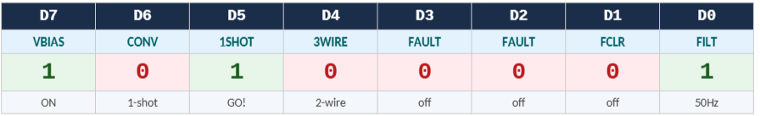
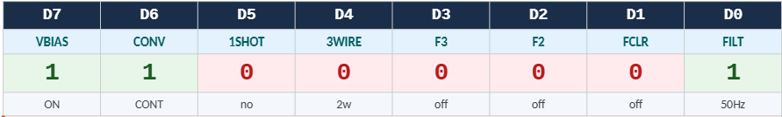
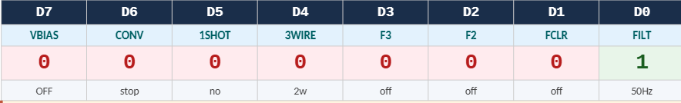
The three config values used
MAX_31865_CNV_START
Value: 0xA1
Used for each Measurement
MAX_31865_CFG_50HZ
Value: 0x81
Used once at startup
MAX_31865_CFG_SHUTDOWN
Value: 0x01
Used at shutdown

Slide 7
Complete temperature measurement cycle
PART 1 — WRITE
PART 2 — READ
START
readMAXSpiInterface(fd, 0x01)
Reads RTD MSB Register — upper 8 bits of result
getTempSnsrVal(fd, &tempsnsr_val)
Thread.c — called when deadline reached
rnum=1, rvalue=0x0100
SPI read command for register 0x01 → write(fd,...)
writeMAXSpiInterface(fd, 0x00, 0xA1)
Write to Config Register → VBIAS ON, 1-SHOT, 50Hz
Bit Check + retrieve: rvalue=2
rnum=0xFF, rvalue=2 → get result → mask 0xFF
KERNEL
MODULE
/dev/meascdd
rnum=1, rvalue=0x80A1
SPI frame into tf_obj_snd, calls write(fd,...)
readMAXSpiInterface(fd, 0x02)
Reads RTD LSB Register — lower 7 bits + fault flag
Bit check loop: xdata & 0x01 == 1?
0xFF, rvalue=1 → write() + read() until done
rtd = ((uint16_t)msb<<8) | lsb
Merge MSB + LSB into 16-bit value
usleep(1000)
1ms — ADC conversion in progress on chip
rtd & 0x01 == 1?
Fault flag check
rtd >>= 1 → *regVal = rtd
Remove fault bit → store raw ADC code 0-32767

Slide 8
writeMAXSpiInterface() — SPI Write Overview
The 5-step process to write a configuration value to the MAX31865 via SPI
Step 1
Set Write Bit
mreg |= 0x080 Set bit 7 to indicate a write operation
Step 2
Build SPI Frame
transm_data = (mreg<<8) | (msend&0xFF) Combine addr + data
Step 3
Send via Kernel
Load struct, call write(fd, ...) to cross into kernel space
Step 4
Status Check
Read status register in a do-while loop until SPI completes
Step 5
Confirm / Timeout
bit0=1 → done k≥1000 → timeout Return success/error
utils.c — Function Call
// utils.c — Function call that starts the write process
writeMAXSpiInterface(fd, 0x00, 0xA1);
// fd=3: file descriptor mreg=0x00: Config Register msend=0xA1: value (VBIAS+1SHOT+50Hz)
Each step is detailed on the following slides (Slides 17–21)

Slide 9
Step 1 of 5 — Set the Write Bit on the Register Address
STEP 1: Set Write Bit
Bitwise OR Operation
BEFORE
0
0
0
0
0
0
0
0
mreg |= 0x080
OR |
1
0
0
0
0
0
0
0
mreg becomes 0x80
bit 7 = 1 tells MAX31865: this is a WRITE
AFTER
1
0
0
0
0
0
0
0
↑ WRITE BIT
Proceed to Step 2: Build the 16-bit SPI Frame →
utils.c — Line 82
// Set the write bit (bit 7) so MAX31865 knows this is a write command
mreg |= 0x080;
// Without this: MAX31865 would treat it as READ — WRONG!
// mreg starts as 0x00 → 0x00 | 0x80 = 0x80

Slide 10
Step 2 of 5 — Build the 16-bit SPI Frame
STEP 2: Build SPI Frame
16-bit SPI Frame Layout
Upper: 0x80
Write address
Lower: 0xA1
Data (VBIAS+1SHOT+50Hz)
Part A: Shift address left 8 bits
mreg << 8 → 0x8000
Combined: 0x80A1 → This IS the SPI frame
Part B: OR with masked data
0x8000 | (0xA1 & 0xFF) = 0x80A1
Bits 15–8 = register address (0x80)
Bits 7–0 = data payload (0xA1)
Sent as single 16-bit SPI transaction
transm_data = 0x80A1
utils.c — Line 85
unsigned int transm_data;
transm_data = (mreg << 8) | (msend & 0x0FF);
// (0x80 << 8) = 0x8000 | (0xA1 & 0xFF) = 0xA1 → 0x80A1

Slide 11
Step 3 of 5 — Send Data via Kernel Module
USER SPACE (utils.c)
readTempSnsrVal() calls writeMAXSpiInterface (fd=3, mreg=0x00, msend=0xA1)
Load tf_obj_snd struct with transm_data = 0x80A1
write(fd, &tf_obj_snd, MEASOBJ_SIZE) → Cross into kernel
SYSTEM CALL BOUNDARY
KERNEL SPACE (/dev/meascdd)
Kernel module receives data Executes SPI Write Transaction Sends 0x80A1 on SPI bus
MAX31865 receives command Writes 0xA1 to Config Register ADC conversion starts!
HARDWARE (MAX31865 SPI)
MOSI sends 0x80 (write address byte)
MOSI sends 0xA1 (data payload byte)
Config register updated ADC conversion starts
// utils.c lines 86-88 — Load struct and send to kernel
tf_obj_snd.rvalue = transm_data; write(fd, &tf_obj_snd, MEASOBJ_SIZE);

Slide 12
Steps 4 & 5 — Poll Status Register & Confirm Completion
STEP 4: Initialize poll variables
xdata = 0 k = 0
utils.c — Lines 91-99
// STEP 4: Init poll vars
xdata = 0; k = 0;
// STEP 5: Poll loop
do {
tf_obj_snd.rnum = 0xFF;
write(fd, &tf_obj_snd,
MEASOBJ_SIZE);
read(fd, &tf_obj_rcv,
MEASOBJ_SIZE);
xdata = tf_obj_rcv.rvalue;
k++;
} while((xdata & 0x01)==0
&& k < 1000);
// if k < 1000: confirmed
// if k >= 1000: timeout!
do-while Poll Loop
1. Set rnum = 0xFF (query mode)
2. write(fd) + read(fd) → get xdata
3. Increment k
STEP 5: Check exit conditions
(xdata & 0x01)==0 AND k<1000 ?
✓ SPI Done
bit0 = 1 → complete
✗ Timeout
k ≥ 1000 → error
Key Insight: The poll loop is identical for both write and read operations — only the initial setup differs. The loop checks bit 0 of the status register to detect SPI completion.

Slide 13
Config Register Bits & Poll Verification
Configuration Value 0xA1 = 1010 0001 (binary)
1
VBIAS
0
CONV
1
1SHOT
0
3WIRE
0
Fault D1:D0
0
Fault D1:D0
0
FILT CLR
1
50Hz
How the Poll Check Works: xdata & 0x01
Iteration 1 (SPI still busy)
xdata = 0xC0000000 0xC0000000 & 0x01 = 0 → bit0=0 → loop again
Iteration 2 (SPI complete)
xdata = 0xC0000001 0xC0000001 & 0x01 = 1 → bit0=1 → done!
Result: SPI write confirmed complete. Config register now holds 0xA1 — VBIAS enabled, 1-shot conversion triggered, 50Hz filter active. ADC conversion has started!

Slide 14
readMAXSpiInterface() — SPI Read Overview
Why is READ a two-phase protocol? Phase 1 tells the chip WHICH register to read. Phase 2 retrieves the actual data.
PHASE 1: Request Register + Poll
PHASE 2: Retrieve Data
Step 1
Shift Address
mreg <<= 8 Shift register addr into upper byte
Step 2
Send Request
rvalue=1, write(fd) Send read request via kernel module
Step 3 (Poll)
Poll Status
do-while loop Poll until SPI complete or timeout
Step 4
Request Data
rvalue=2, write(fd) read(fd) to get captured data
Step 5
Mask & Return
xdata &= 0xFF Return lower 8 bits as the register value
utils.c — Function
unsigned int readMAXSpiInterface(int fd, unsigned int mreg)
// Called as: readMAXSpiInterface(fd, 0x01) → read register 0x01
Each step is detailed on the following slides

Slide 15
Read Step 1 — Shift Register Address & Build rvalue
FUNCTION CALLED
readMAXSpiInterface(fd=3, mreg=0x01)
16-bit rvalue Layout (After Shift)
0x01
Upper: register addr
0x00
Lower: don’t care
Step 1: Shift address left 8 bits
mreg <<= 8 → 0x0100
Example Trace
mreg starts as 0x01
mreg <<= 8 → 0x0100
rvalue = 0x0100 (Phase 1 request)
SPI sends 0x01 on MOSI (read addr)
0x00 on second byte (don’t care)
Set rvalue = 1 (Phase 1 mode)
rvalue = mreg | 0x01 = 0x0100
Why SHIFT (<<) not OR (|)?
Read has no write bit — address goes to upper byte. Bit 7 stays 0 (no write flag).
// utils.c — readMAXSpiInterface() lines 41-45
mreg <<= 8; // 0x01 → 0x0100 (addr in upper byte)
tf_obj_snd.rnum = 1;
tf_obj_snd.rvalue = mreg;

Slide 16
Read Step 2 — Send Request via Kernel (Phase 1 Architecture)
USER SPACE (utils.c)
readMAXSpiInterface(fd, 0x01) Shifts addr: mreg = 0x0100 Sets rnum=1, rvalue=mreg
write(fd, &tf_obj_snd, MEASOBJ_SIZE) → Sends Phase 1 request
SYSTEM CALL BOUNDARY
KERNEL SPACE (/dev/meascdd)
Kernel receives rnum=1 Executes SPI read transaction Sends 0x01 on MOSI pin
MAX31865 captures register Data stored internally
HARDWARE (MAX31865 SPI)
MOSI: 0x01 (read reg 0x01)
Register 0x01 selected Data captured for next read
// Phase 1: rnum=1 tells kernel “perform SPI read transaction for this register”
write(fd, &tf_obj_snd, MEASOBJ_SIZE); read(fd, &tf_obj_rcv, MEASOBJ_SIZE);

Slide 17
Read Step 3 — Poll Status (Identical to Write Poll)
Key: The poll loop for read is IDENTICAL to the write poll (same rnum=0xFF query, same do-while, same exit conditions)
utils.c — Lines 47-55
After write(fd): SPI read running in hardware Set rnum = 0xFF (query mode)
// Poll — Wait for SPI read to finish
tf_obj_snd.rnum = 0xFF;
do {
write(fd, &tf_obj_snd, ...);
read(fd, &tf_obj_rcv, ...);
xdata = tf_obj_rcv.rvalue;
k++;
} while((xdata & 0x01)==0
&& k < 1000);
// Same loop as writeMAXSpi...
// Exits when SPI read done
do-while Poll Loop 1. write(fd) — send query 2. read(fd) — get xdata 3. k++
Exit Condition (xdata & 0x01)==0 AND k<1000 ?
✓ Done (bit0=1)
→ Proceed to Phase 2
✗ Timeout (k≥1000)
→ Error returned
Note: writeMAXSpiInterface() lines 91–99 and readMAXSpiInterface() identical poll logic. Code reuse is intentional — both operations need to confirm SPI bus completion.

Slide 18
Phase 2-Read Step 4 of 5 — Request Captured Data & Mask to 8 bits | rvalue=2 → xdata &= 0xFF
Key: rvalue=2 is the KEY difference that makes READ a two-phase protocol. writeMAXSpiInterface() NEVER uses rvalue=2. readMAXSpiInterface() uses rvalue=2 ONLY AFTER the poll confirms the SPI read is done. rvalue=1 asks 'are you done?' | rvalue=2 asks 'give me the data you captured'.
Poll loop exited (bit0=1 → SPI read done)
Kernel buffer holds 0x40 (captured from MAX31865)
utils.c lines 65-76 — Phase 2: Retrieve captured data
rvalue = 1 → 'Are you done yet?' Kernel checks SPI completion flag Response: bit0=0 (no) or bit0=1 (yes) Used in: BOTH write AND read (poll loop) rvalue = 2 → 'Give me the captured SPI data!' Kernel fetches 0x40 from its internal data register
else // (k < 1000 = SPI read succeeded)
{
// ── PHASE 2 STEP 1: REQUEST DATA ─────────
tf_obj_snd.rnum = REGNUM_ID; // 0xFF
tf_obj_snd.rvalue = 2; // 'give me data!'
// ↑ This line is WHY READ is 2-phase!
// writeMAXSpiInterface() NEVER has rvalue=2
write(fd, &tf_obj_snd, MEASOBJ_SIZE);
// ── PHASE 2 STEP 2: COLLECT RESPONSE ────
read(fd, &tf_obj_rcv, MEASOBJ_SIZE);
xdata = tf_obj_rcv.rvalue; // = 0x00000040
// ── PHASE 2 STEP 3: MASK TO 8 BITS ──────
xdata &= 0x0ff; // keep only 8 bits
// 0x00000040 & 0xFF = 0x40 = 64
}
return xdata; // returns 0x40 = 64
}
Phase2-Step 1:Request the captured data
tf_obj_snd.rnum = REGNUM_ID (0xFF)
tf_obj_snd.rvalue = 2 ← 'give me the data!'
write(fd, &tf_obj_snd, MEASOBJ_SIZE)
Phase2-Step 2:Collect the response
read(fd, &tf_obj_rcv, MEASOBJ_SIZE) xdata = tf_obj_rcv.rvalue → 0x00000040
Phase2-Step 3:Collect the response
xdata &= 0x0FF 0x00000040 & 0xFF = 0x40 = 64
return xdata → returns 0x40 = 64 to caller
msb = readMAXSpiInterface(fd, 0x01) = 64

Slide 19
Step 5 of 5 — Full Iteration Trace with Numbers + Final MSB Result + Complete Function
xdata & 0x01 — How bit 0 is isolated
Complete poll trace — readMAXSpiInterface(fd=3, mreg=0x01)
Iteration 1: xdata = 0x00000000 0x00000000 & 0x00000001 = 0 → bit0=0 → still running (0==0) TRUE → keep looping Iteration 2: xdata = 0x00000001 0x00000001 & 0x00000001 = 1 → bit0=1 → DONE! (1==0) FALSE → EXIT loop → go to Phase 2
P2-1 | 0xFF | 2 | ‘give me data’ | 0x00000040 | - | returns captured SPI
MASK | - | - | xdata &= 0xFF | 0x00000040 → 0x40 | - | 0x40 = 64 = msb ✓
Phase 2 data retrieval trace
Iter | Rnum | rvalue | write(fd) sends | read() xdata | Bit0 | Action
INIT | - | - | k=0, xdata=0xC0000000 | - | - | ENTER loop (bit0=0)
1 | 0xFF | 1 | 'done?' → kernel checks | 0x00000000 |  | YES, loop again
2 | 0xFF | 1 | 'done?' → SPI complete | 0x00000001 |  | EXIT loop ✓
Final: return xdata = 0x40 = 64 → msb = 64
In readTempSnsrVal(): msb = readMAXSpiInterface(fd, 0x01) = 0x40 = 64 lsb = readMAXSpiInterface(fd, 0x02) = 0x00 = 0 rtd = ((uint16_t)0x40 << 8) | 0x00 = 0x4000 → >>1 = 8192

Slide 20
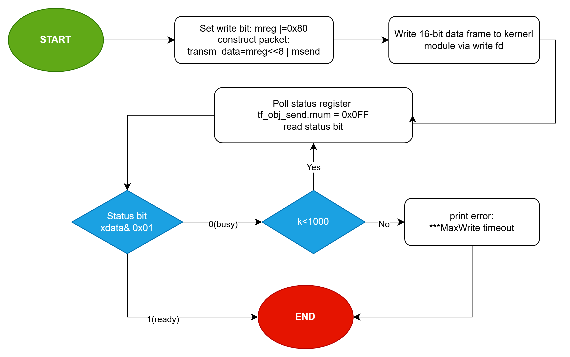
SPI Operations: Writing to MAX31865
Notes:
This slide shows the SPI write timing diagram visually. You can see how the chip select line goes low, the clock toggles, and the 16-bit frame is shifted out on the data line — first the 8-bit write address, then the 8-bit data value. This is a standard SPI Mode 1 or Mode 3 transaction that any microcontroller or FPGA SPI peripheral can generate. Take a moment to study this diagram as it clarifies exactly what happens on the wire during a write operation.

Slide 21
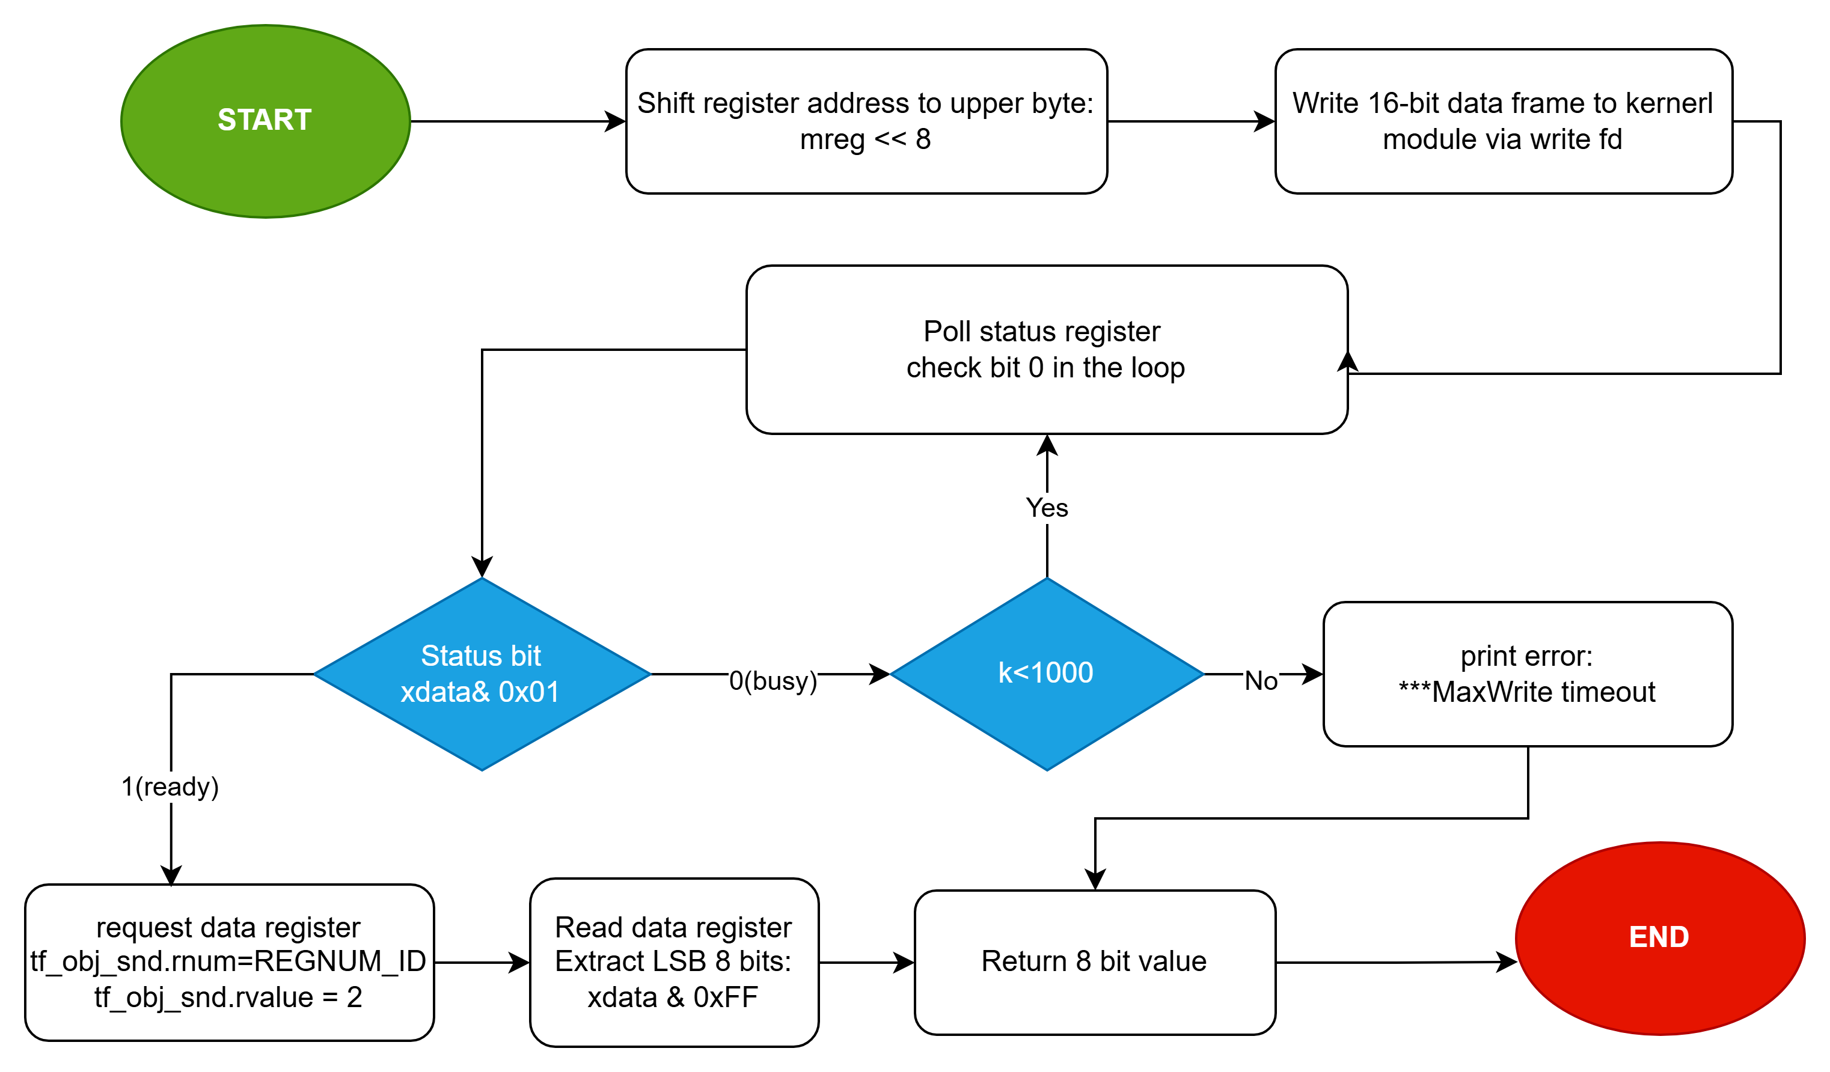
SPI Operations: Reading from MAX31865
Notes:
This slide shows the SPI read timing diagram. You can see the two-phase nature of the read — first the register address is clocked out on the SDI line, then on the very next set of clock cycles, the device responds with the register data on the SDO line. Again, this is standard SPI protocol behaviour. The chip select remains low throughout the entire transaction to keep the device selected.

Slide 22

Hardware Button Overview
Zedboard Button Layout
Five momentary push buttons in a cross pattern for directional navigation.
BTNC (Bit 0): Centre / OK
BTND (Bit 1): Down / Decrease
BTNL (Bit 2): Left / Previous
BTNR (Bit 3): Right / Next
BTNU (Bit 4): Up / Increase
5-bit encoding: 0x00 to 0x1F
BTNU
Bit 4
BTNL
Bit 2
BTNC
Bit 0
BTNR
Bit 3
BTND
Bit 1
Notes:
Now let's shift to the hardware button interface. Our system uses five momentary push buttons arranged in a cross pattern for directional navigation — similar to a D-pad on a game controller. BTNC at bit 0 is the centre or OK button. BTND at bit 1 is down or decrease. BTNL at bit 2 is left or previous. BTNR at bit 3 is right or next. And BTNU at bit 4 is up or increase. These five buttons are encoded as a 5-bit value, giving us a range from 0x00 to 0x1F — that's 0 to 31 in decimal. As shown in the diagram on the right, the cross-shaped layout makes the button functions intuitive for the user. This encoding scheme allows us to detect multiple simultaneous button presses, which I'll explain on the next slide.

Slide 23
Button State Encoding System
Each button maps to a bit in a 5-bit value (Bit4=BTNU, Bit3=BTNR, Bit2=BTNL, Bit1=BTND, Bit0=BTNC). Multiple simultaneous presses are naturally represented:
Encoding Examples:
No buttons pressed: 00000 = 0x00 (decimal 0)
BTNC only: 00001 = 0x01 (decimal 1)
BTNU only: 10000 = 0x10 (decimal 16)
BTNC + BTNU: 10001 = 0x11 (decimal 17)
All 5 buttons: 11111 = 0x1F (decimal 31)
Extracting Individual States (Bitwise):
is_btnc = (value >> 0) & 0x01; // Bit 0
is_btnu = (value >> 4) & 0x01; // Bit 4
Right-shift the value by the bit position, then AND with 0x01 to isolate the bit.
Notes:
Here's the button state encoding system in detail. Each button maps to a specific bit position in a 5-bit value. Bit 4 is BTNU, bit 3 is BTNR, bit 2 is BTNL, bit 1 is BTND, and bit 0 is BTNC. The beauty of this approach is that multiple simultaneous presses are naturally represented. For example, no buttons pressed gives us binary 00000 or 0x00. BTNC alone is 00001 or 0x01. BTNU alone is 10000 or 0x10 which is decimal 16. If both BTNC and BTNU are pressed simultaneously, we get 10001 or 0x11 — decimal 17. And if all five buttons are pressed, that's 11111 or 0x1F — decimal 31. To extract individual button states in code, we use simple bitwise operations. For the centre button: right-shift the value by 0 and AND with 0x01. For the up button: right-shift by 4 and AND with 0x01. This isolates each bit cleanly. This is a very efficient encoding that requires no lookup tables or complex parsing — just shift and mask.

Slide 24
Reading Button Data (readButtons)
The readButtons(fd) function communicates with the kernel module to read the current state of all five buttons from the FPGA hardware:
Step-by-Step Process:
Prepare Request: Set rnum = REGNUM_ID (0x0FF), rvalue = 7 (button selector code)
Send to Kernel: write(fd, &tf_obj_snd, MEASOBJ_SIZE) crosses user-kernel boundary
Read Response: read(fd, &tf_obj_rcv, MEASOBJ_SIZE) retrieves GPIO register data
Mask to 5 bits: button_data = tf_obj_rcv.rvalue & 0x1F (keeps only bits 0-4)
Return Value: Range 0x00 (none pressed) to 0x1F (all pressed)
Key Points:
rvalue = 7 differentiates buttons from switches (rvalue = 0)
Typical execution time: 5-8 microseconds per read
Notes:
The readButtons function shows how we actually communicate with the FPGA hardware to read the current state of all five buttons. The process goes through our kernel module, just like the SPI operations. First, we prepare the request: set rnum to REGNUM_ID — that's 0x0FF — and rvalue to 7, which is the button selector code. The value 7 specifically tells the kernel module we want to read buttons rather than switches, which use rvalue 0. Next, we send this request to the kernel module using the standard write system call — this crosses the user-kernel boundary. Then we read the response using the read system call, which retrieves the GPIO register data from the FPGA. Finally, we mask the result to 5 bits using AND 0x1F, which keeps only bits 0 through 4 — our five button states. The return value ranges from 0x00 for no buttons pressed to 0x1F for all five pressed simultaneously. A key point: the typical execution time is just 5 to 8 microseconds per read, making this fast enough for responsive user interaction even at high polling rates.

Slide 25





GUI Commands
Connect
Start
Stop
STOP
Configure
Disconnect
Shutdown

Slide 26
References
"MAX31865PMB1 Peripheral Module," Analog Devices. Available: https://www.analog.com/media/en/technical-documentation/data-sheets/max31865pmb1.pdf
"MAX31865 Datasheet," Analog Devices. Available: https://www.analog.com/media/en/technical-documentation/data-sheets/MAX31865.pdf
Makerguides - MAX31865 RTD Sensor and Arduino. Available: https://www.makerguides.com/max31865-rtd-sensor-and-arduino-uno/
Notes:
And finally, here are the references that informed this presentation. The primary source is the MAX31865 datasheet from Analog Devices, which provides the complete register specifications, timing diagrams, and application circuit recommendations. We also referenced the MAX31865PMB1 peripheral module documentation for the evaluation board design. And the Makerguides tutorial provided useful practical guidance for Arduino-based implementations. To summarise what we've covered today: we started with the fundamentals of the MAX31865 — what it is, its specifications, and where it's used. We explored the three RTD wiring configurations and the temperature conversion mathematics. Then we dived deep into the register architecture, SPI read and write operations, and the kernel module interface. We covered the complete temperature measurement process and flow, the shutdown procedures, the hardware button interface, and finally the GUI client commands. Thank you for your attention. I'm happy to take any questions you might have about the MAX31865, the system architecture, or any specific implementation details.

