Slide 1
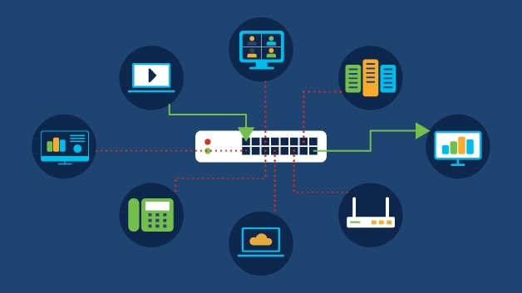
Measurement Network Gateway Server Acquisition & GUI Client

Slide 2
Scope of the Section
Sensor Thread Lifecycle
Switch Handling
Timing and Determinism
GUI Architecture & Threading Model
Address Validation
Buffer Handling
ADC Acquisition
Utility Layer Analysis
Design Alternatives & Validations
Socket Creation
State Machine Design
Network Interaction & Utility Layer

Slide 3
Sensor Thread
Central execution component responsible for continuous hardware acquisition.
Acquires: ADC channels (ADC0, ADC1) & digital slide switches.
Outputs: Timestamped sensor samples and publishes to shared ring buffer.
Autonomous execution independent of TCP clients, network traffic and command activity.
Notes:
The sensor thread continuously interacts with measurement hardware and generates sensor samples.
Unlike the network thread, which is event-driven, the sensor thread runs autonomously to maintain temporal consistency of measurements.

Slide 4
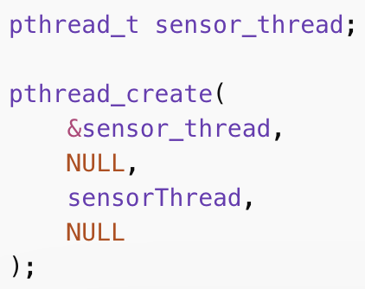
Sensor Thread Lifecycle
Sensor thread creation occurs after initialization of shared buffers, synchronization primitives and global control flags.
Sensor acquisition starts before network connections.
Notes:
Thread exists for entire server runtime.

Slide 5
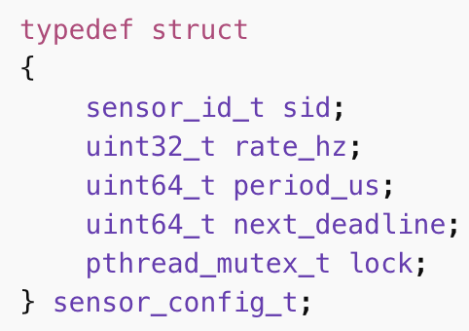
Sensor Configuration Model
Each sensor is defined by sensor id, sampling rate, sampling period and next acquisition deadline.
Sensor thread iterates over sensors and supports multiple heterogeneous sensors within one thread.

Slide 6
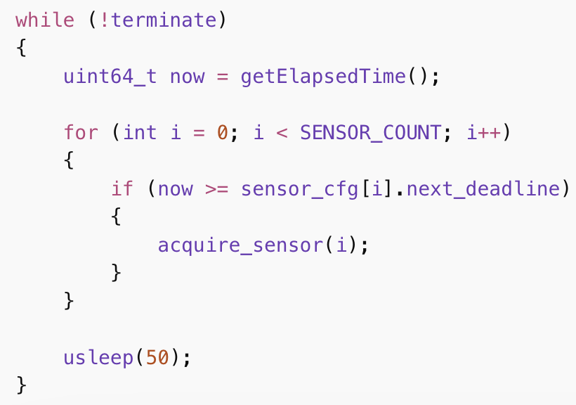
Execution Loop
In each iteration, the sequence is as follows: Read ADC values, read switch states, assemble measurement record & insert into ring buffer.
Notes:
Each iteration is one sampling cycle.

Slide 7
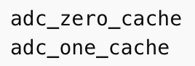
Local Sensor State
Local variables store intermediate results.
Advantages: No inter-thread access, no locking required and minimal synchronization overhead
Synchronization occurs only during ring buffer insertion.

Slide 8
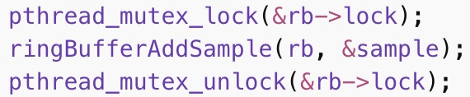
Shared Resources
Sensor thread acts as producer and publishes the samples to shared buffer.
Example:
Critical section are protected by mutex.
Notes:
Interaction with Ring Buffer. Guarantees atomic sample publication.

Slide 9
Sampling Rate Control
Sampling rate is controlled by sensor deadline and execution loop delay.
This avoids busy waiting, reduce CPU load, maintain periodic sampling and importantly provides soft real-time behavior on Linux.

Slide 10
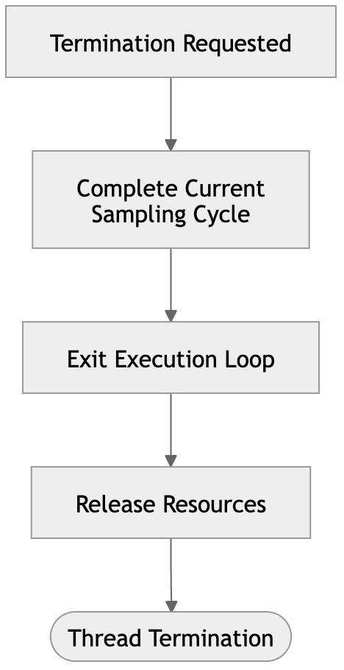
Thread Shutdown
Termination initiated by server shutdown, the mechanism being global termination flag.
Shutdown steps: Finish current cycle, exit the loop, release resources and terminate thread.

Slide 11
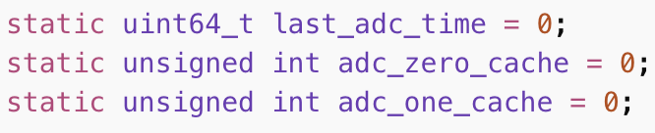
ADC Acquisition
ADC acquisition is executed directly inside the sensor thread loop.
Key design choices include: No separate ADC thread, no external interrupt handling and integrated into deadline-driven scheduling.
ADC acquisition uses persistent state variables.
These plays the role of storing timestamp of last ADC read, cached ADC0 value and cached ADC1 value.
Being static allows state persistence across loop iterations.

Slide 12
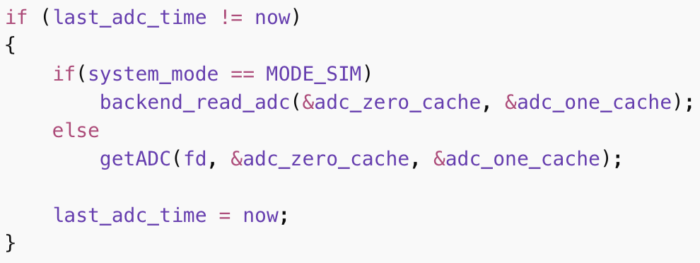
ADC Handling
ADC is handled inside the sensor switch block, and is read only once per sampling cycle.

Slide 13
Simulation Mode
When system runs in simulation, it generates synthetic ADC signals, writes both channels simultaneously and provides identical interface to hardware mode.
Advantages: Scheduling logic, caching logic, and buffering pipeline without requiring real hardware.

Slide 14
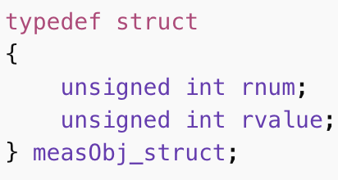
Measurement Device Interface
Device interface: /dev/meascdd
Architecture: Sensor Thread - Linux Character Device - Kernel Module - FPGA Logic
Both ADC channels are sampled in one hardware conversion cycle.

Slide 15
Conversion and Extraction
Conversion procedure: Trigger conversion, poll conversion status and read result register.
Both channels are stored in one register and acquired from a single hardware read.
The lower 12 bits are for ADC0 and the upper bits are for ADC1.

Slide 16
Switch Inputs
ZedBoard slide switches provide persistent digital input states.
These have binary states, maintain state until manually changed and are treated as digital sensors.
Handled in the sensor thread switch-case block.
Trigger condition: if (now >= sensor_cfg[i].next_deadline)
Polling strategy is used as switch states change infrequently, hence interrupt-driven approach is not favoured.
ADC acquisition remains unaffected because switch read time << ADC acquisition time.

Slide 17
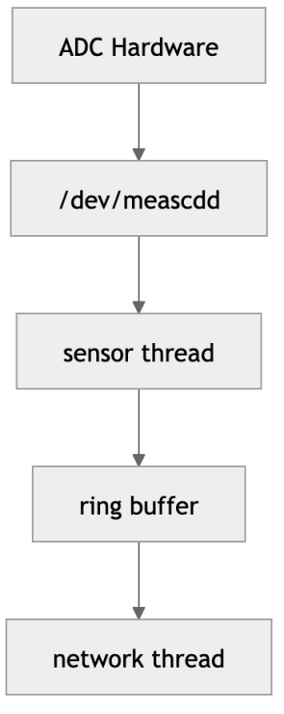
Encoding & Data Flow
Stored as 8-bit bitfield.
Switch Index | Bit Position | Description
SW0 | Bit 0 | Slide switch 0
SW1 | Bit 1 | Slide switch 1
SW2 | Bit 2 | Slide switch 2
SW3 | Bit 3 | Slide switch 3
SW4 | Bit 4 | Slide switch 4
SW5 | Bit 5 | Slide switch 5
SW6 | Bit 6 | Slide switch 6
SW7 | Bit 7 | Slide switch 7

Slide 18

Utility Layer
It provides hardware abstraction, timing functions and low-level device communication.
Hardware interactions occurs through utility functions.
It also handles register numbers, device communication and kernel interface.
It provides centralized monotonic timing functions, thereby providing system clock adjustments, avoiding timestamp drift and inconsistent timing. All sensors share the same timestamp reference.
it gives design benefits such as modular architecture, easy addition of new sensors and reusable hardware interface.
Notes:
Separate hardware access from application logic.

Slide 19
Deterministic Timing
The server runs in Linux user space, which does not provide hard real-time guarantees.
As the sensor acquisition requires predictable sampling intervals, consistent timestamps and bounded execution time, soft real-time deterministic sampling is required.
The system achieves deterministic sampling without real-time Linux extensions through deadline scheduling in sensor thread and monotonic timing in utility layer.
The advantages are it is portable across Linux systems and no PREEMPT_RT is required.

Slide 20
Design Alternatives & Testing
Sensor scheduling - timer-driven vs deadline scheduling
Timing model - relative delay vs absolute deadline
Threading - single thread vs multi-thread
Hardware access - user-space vs kernel-space
Time source - wall-clock vs monotonic
OS behavior - real-time Linux vs soft real-time
Testing: Verify correct sensor acquisition, validate timing consistency, detect system faults, confirm robustness under load
Notes:
Timing drift, *, synchronization complexity, complex development, * Testing scope: Hardware interface, sensor thread scheduling, ring buffer integration, network transmission

Slide 21
GUI Client Architecture
Acts as the client interface of the Measurement Network Gateway.
Responsibilities includes establishing TCP connection to server, send control commands, receive sensor data streams, and visualize measurements in real time.
Technologies used:
GTK - window & UI
POSIX sockets - TCP communication
pthreads - background networking
Cairo - real-time plotting
Notes:
All GTK widget operations must run in the main thread so that the graphical interface never gets blocked.

Slide 22
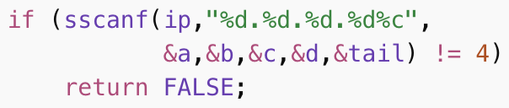
TCP Connection
Connection initiated by user input of server IPv4 address.
User input is validated before opening a socket.
Example invalid input rejected: 192.168.1, 192.168.1.1abc
Notes:
Timeout after 3 seconds.

Slide 23
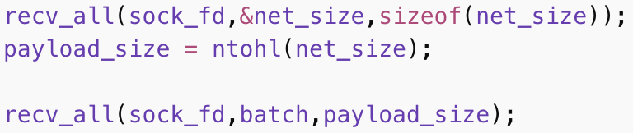
State Machine & Data Reception
GUI maintains its own client-side state machine.
DISCONNECTED - no TCP connection
CONNECTED - socket established
RUNNING - streaming active
Sensor data arrives as length-prefixed packets.

Slide 24
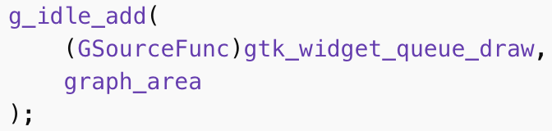
Thread-Safe GUI Updates
Network thread never accesses GTK widgets directly, instead it schedules updates.
This prevents race conditions, ensures GTK thread safe and keeps GUI responsive.

Slide 25
Conclusion
Implemented a deterministic sensor acquisition framework in Linux user space.
Deadline based scheduling with monotonic timestamps ensures predictable sampling.
Hardware abstraction via utility layer and register based device interface.
Robust acquisition pipeline for ADC channels and digital switches.
Provides real-time monitoring and control interface.
Uses thread-safe architecture separating GTK UI and network communication.
Client-side state machine and input validation ensures safe operation.
Notes:
Together they form a modular measurement network gateway architecture suitable for monitoring systems.

