Slide 1
Measurement Network Gateway
Haizon Helet Cruz (42708)

Slide 2
Overview
PetaLinux basics and build process
Application Layer
Ring buffer implementation
Network thread implementation
GUI
GUI Plot rendering and values text box
Help command line

Slide 3
Introduction
Create a Linux based software platform on Zynq
Access AXI registers implemented
Expose the hardware to C user space via character device
Enable real-time sensor data acquisition
Software Stack
User-Space App (mngivp.c)
Character Device /dev/meascdd
meascdd.ko Kernel Module
Linux Kernel + Device Tree
AXI IP Core (PL – Vivado)
Physical Sensors (ADC, Temp, GPIO)

Slide 4
Image Build Process
STEP 1 – Create Project
STEP 2 – Import XSA
STEP 3 – Verify DTS
STEP 4 – Build
petalinux-create
--type project
--template zynq
--name meas_gateway
petalinux-config
--get-hw-description
=<file_path>
system-top.dts
pl.dtsi
Kernel config frags
petalinux-build
Yocto-based Linux build environment for ARM Cortex-A9
Auto-generates DTS, DTSI, kernel config fragments
AXI base address & interrupt ID must match Vivado
Generates full Linux image aligned with Zynq-7000 hardware

Slide 5
Image Build Process - Hardware and Device tree
We have a custom FPGA board with any number of sensors, the question is how do we make it accessible.
In FPGA, we have custom IP core "measdif"
Device tree entry has "compatible", "reg", "interrupt". Auto generated from .xsa
Shared header - Communication contract between kernel and user space
typedef struct {
unsigned int rnum; // which register
unsigned int rvalue; // its value
} MeasObj_struct;

Slide 6
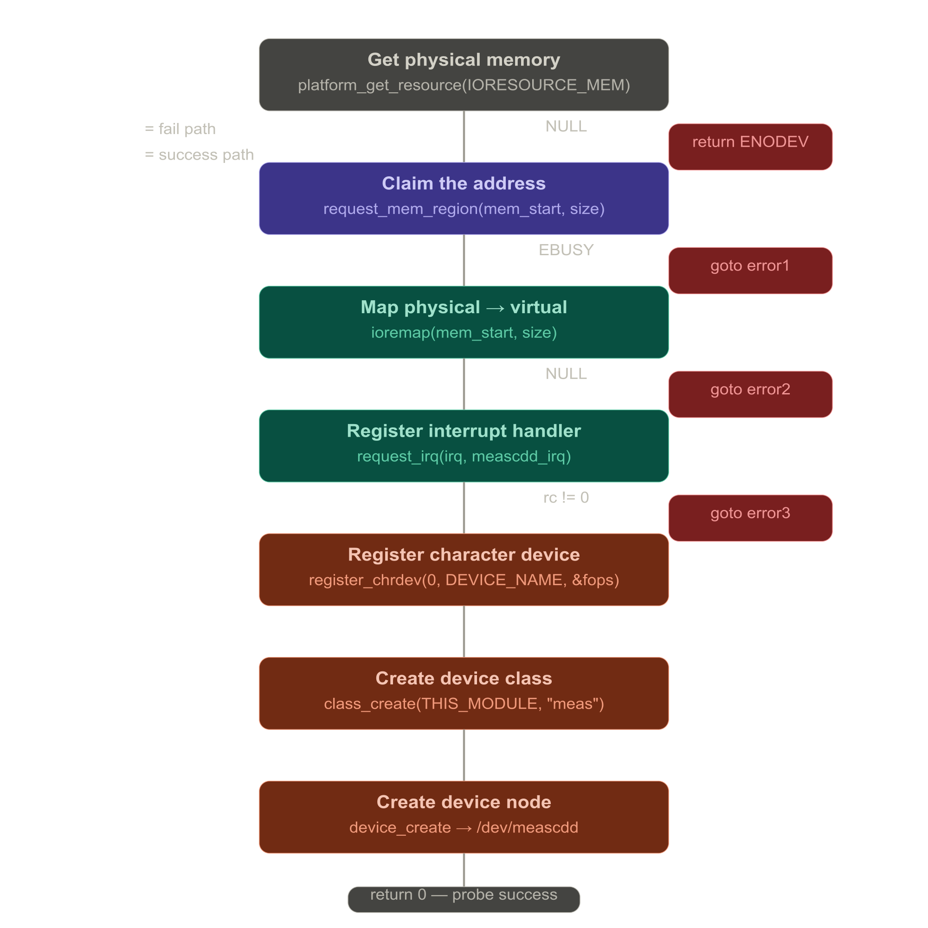
Image Build Process - Kernel
Once the "compatible" string is matched, the probe function is called.
This is accessible using methods dev_open, dev_write, dev_read, dev_release

Slide 7
Image Build Process - Read and Write
Read process
write({rnum = 0xFF, rvalue = N}), selects register N
read(), get register N‘s value
Write process
write({rNum = N, rValue = value}), write value to register N
petalinux-build : compiles kernel + driver + rootfs + u-boot
petalinux-package --boot : Creates BOOT.BIN + image.ub + rootfs.ext4
Flash to SD card and boot the board

Slide 8
Application - Network Layer
Haizon Helet Cruz (42708)

Slide 9
Application Layer Overview
01
Ring Buffer — Fundamentals
02
Ring Buffer — Concurrency
Fixed-memory FIFO, producer–consumer model, O(1) complexity
Mutex protection, condition variables, overflow policy
03
Ring Buffer — Operations
04
TCP Network Thread
Insert (O1), batch extraction, complexity analysis
Socket creation, Berkeley Sockets API, server lifecycle
05
State Machine
06
Configuration Commands
IDLE → RUNNING → DISCONNECT states and transitions
CONNECT, START, CONFIGURE, STOP, DISCONNECT, SHUTDOWN

Slide 10
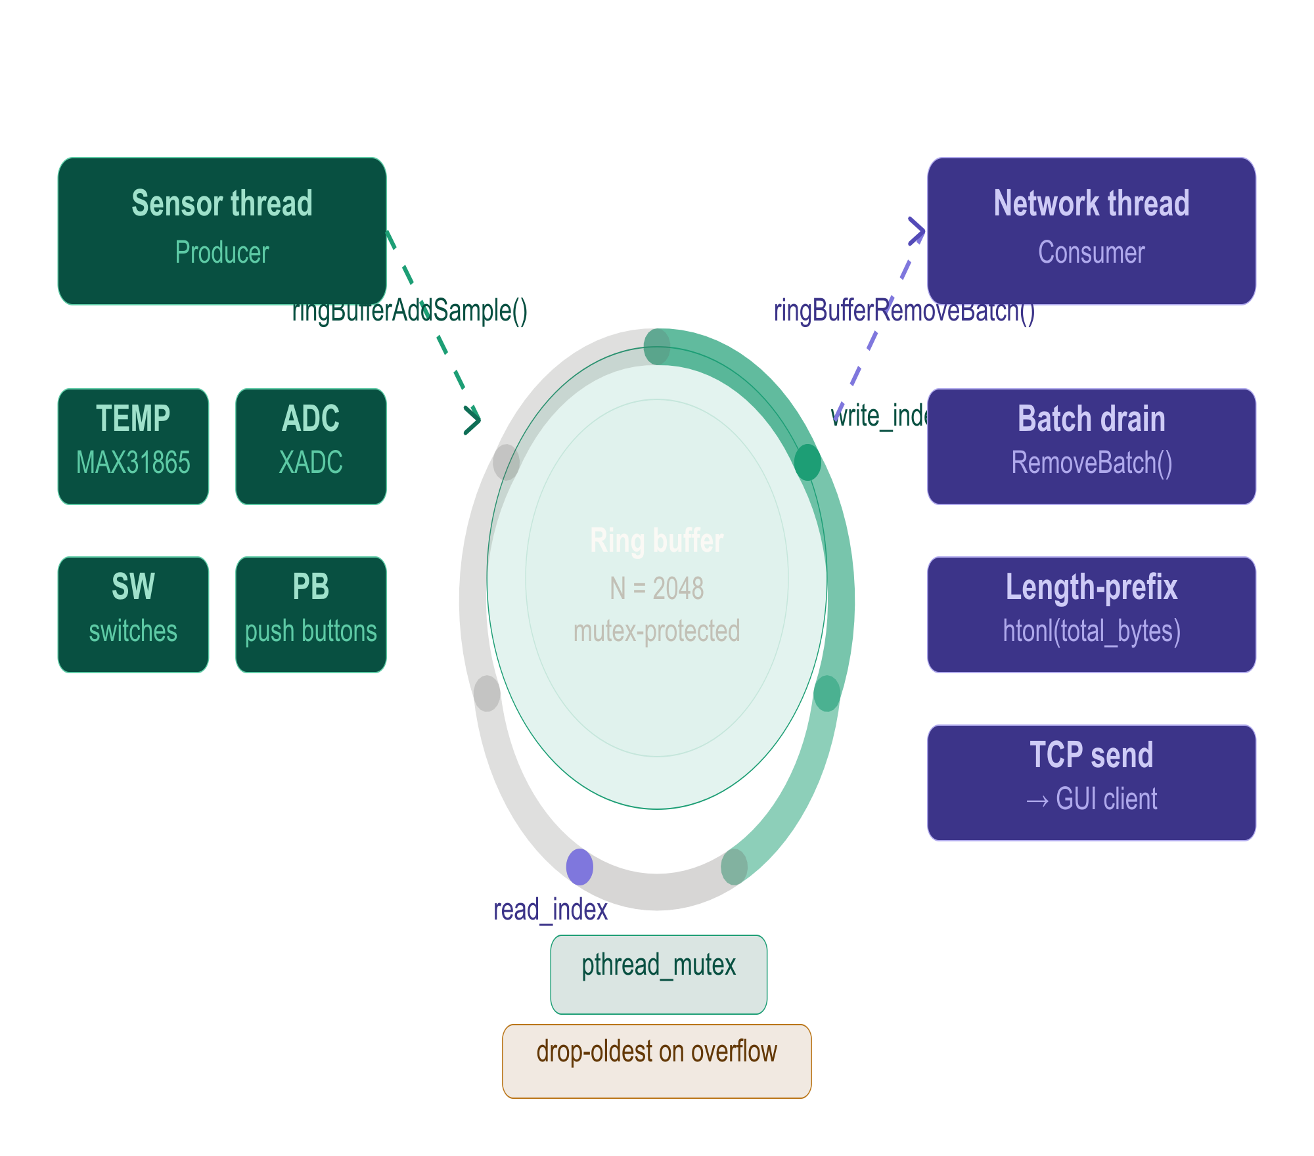
Ring Buffer Role in MNG
Ring Buffer is a common data storage method used in embedded systems.
This data structure enables in active communication between the two threads
Sensor thread can "fire and forget"
Network thread focuses on retrieving data and send to the GUI

Slide 11
Ring Buffer Operations
Ring Buffer Init - ring_buffer_t *ringBufferInit()
Ring Buffer add sample - void ringBufferAddSample(ring_buffer_t *rb, const sensor_data_t *sample)
Ring Buffer batched data extraction - size_t ringBufferRemoveBatch(ring_buffer_t *rb, sensor_data_t *dest, size_t max_samples)
Free memory allocation - free(rb)
Ring Buffer structure
typedef struct {
pthread_mutex_t rbMutex;
sensor_data_t sampleArray[RING_BUF_SIZE];
size_t write_index;
size_t read_index;
uint16_t count;
} ring_buffer_t;

Slide 12
TCP Network Thread - Configuration Commands
CONNECT <ip_address> : Connect to device using IPv4 address
START : Start to send data to the GUI. IDLE to RUNNING state
CONFIGURE : configure <sensor_identifier> <sampling_frequency>
STOP : Stop sending data to the client. RUNNING to IDLE state
DISCONNECT : Disconnects from client. IDLE to DISCONNECT state
SHUTDOWN : Shuts down the server

Slide 13
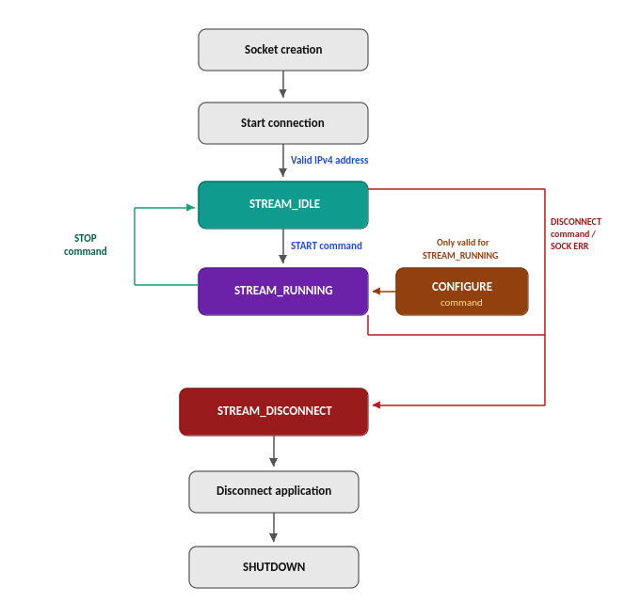
TCP Network Thread - Workflow

Slide 14
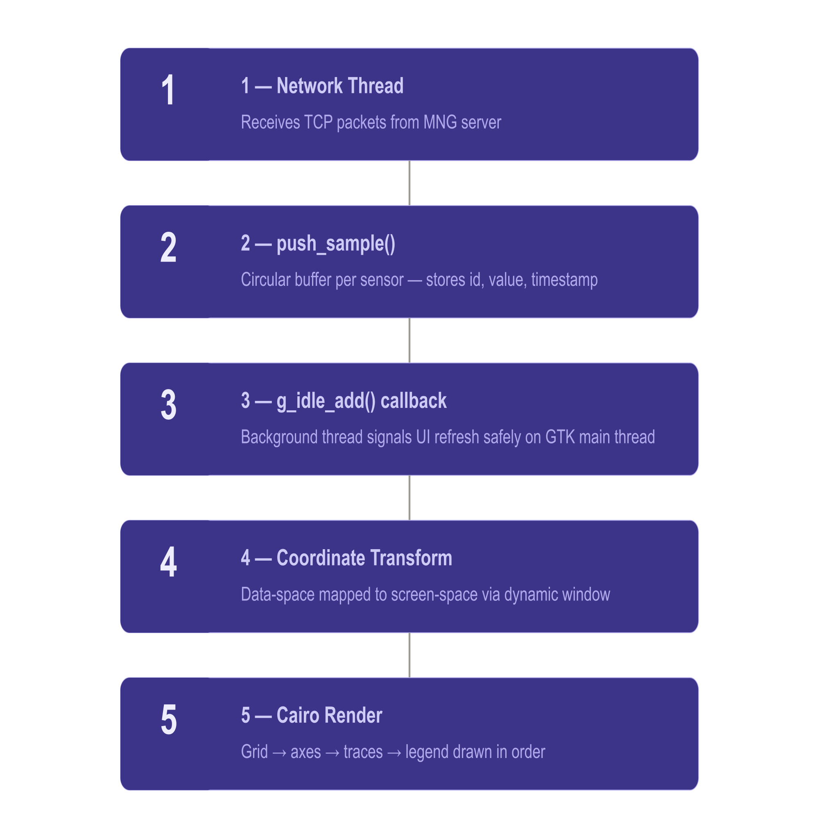
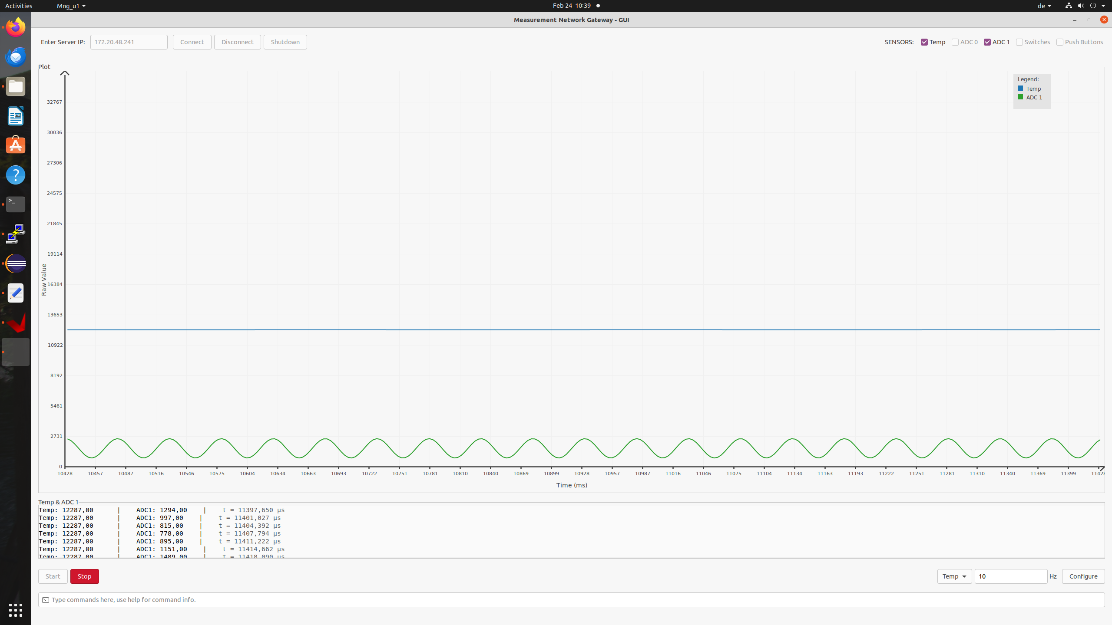
GUI Render Flow Pipeline

Slide 15
Tasks Completed
Theoretical study on PetaLinux implementation
Ring Buffer Implementation
Network Thread Implementation
GUI rendering, value text box and help command line
Adding suggested improvements and debugging bugs

