Slide 1


MEASUREMENT NETWORK GATEWAY
Software Development
by Mert Ali Türk

Slide 2
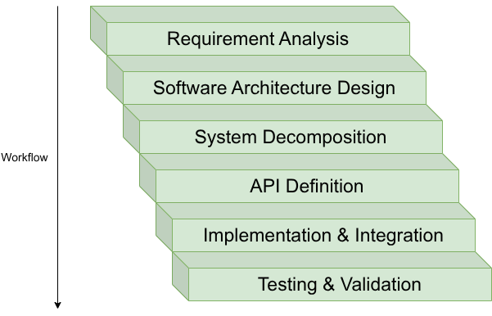
Development Workflow

Slide 3
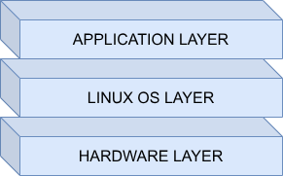
Software Architecture

Slide 4
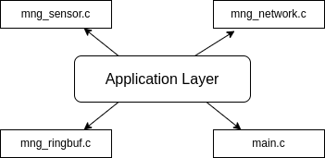
Application Layer
The application layer coordinates system functionality through different modules.
The goal is to create a modular, scalable, and manageable application layer.

Slide 5




How to divide to modules?
Divide the system into independent components.
Each module should have a single responsibility.
• easier development
• easier debugging
• code reuse
• parallel development
Divide and Conquer

Slide 6

Configuration File in Application
Contains system configuration parameters.
System behaviour changes without touching core logic.
Why is it beneficial?
/* Length of the Ring Buffer*/
#define MNG_RBUF_LENGTH 104U
/* Base frequency is maximum frequency that sensor can sampled. */
#define MNG_BASE_FREQ_HZ 1000U
/* 1 ms sensor loop sleep value. (microsec) */
#define MNG_SENSOR_LOOP_INTERVAL_US 1000
No need to modify multiple files
Improves portability
Centralized management

Slide 7
Main Implementation File
The main function should be simple and clean.
It is responsible for coordinating system modules.
MIt interacts with modules through abstracted APIs.
Pseudo code for main function as follows:
main
sensor_init
ring_buffer_init
threads_init
wait for threads to exit
return

Slide 8
Threads in Application
The sensor thread is responsible for sampling sensors at their desired frequencies.
The network thread is responsible for receiving and parsing commands and sending buffered data.
Sensor Thread
open file
loop until shutdown cmd
sample sensors
write to ring buffer
exit loop
return
Network Thread
network_init
loop until shutdown cmd
receive
parse_cmd
send(buffer)
exit loop
return

Slide 9

Demo
If you want to see demo video of MNG, please scan the QR code.

Slide 10
THANK YOU
FOR YOUR ATTENTION

