Slide 1
Measurement Network Gateway (MNG) Embedded Linux Server and GUI Application
Name: Saeed Omidvari - 41490 Course: Embedded Systems Project University: Hochschule Bremerhaven Supervisor: Prof. Dr.-Ing. Kai Mueller and Prof. Dr.-Ing. Karsten Peter Date : 17/03/2026
Notes:
Hello, my name is Saeed Omidvari and this presentation introduces my Embedded Systems Project, the Measurement Network Gateway. The goal of this project was to design and implement a system that acquires sensor data from embedded hardware and makes it available for monitoring on a control computer.

Slide 2
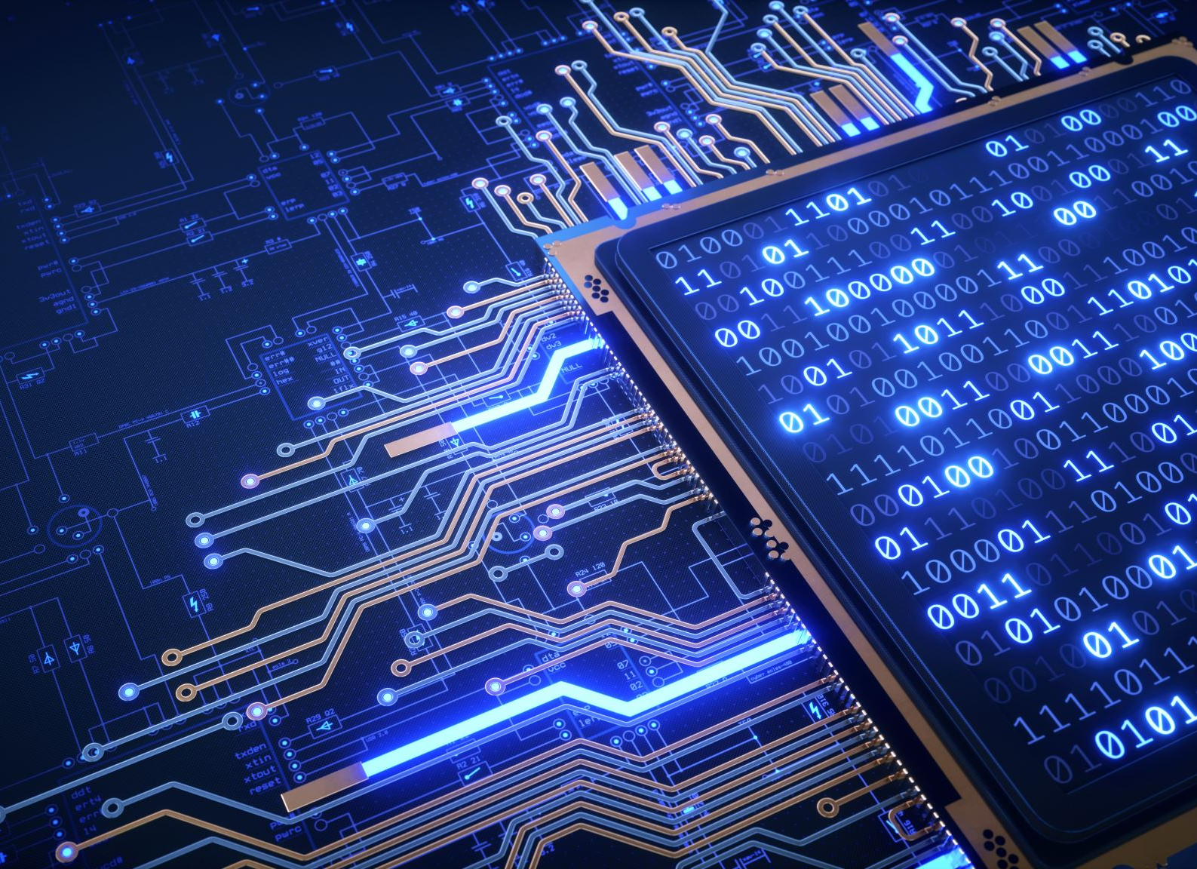
Motivation and Problem Statement
Embedded measurement systems often face several challenges:
Sensor data must be acquired with stable timing
Measurements must be accessible remotely
Efficient network transmission is required
Real-time monitoring and visualization are necessary
Goal: Create a gateway system that reliably transfers measurement data from embedded hardware to a control computer
Notes:
Embedded measurement systems must acquire sensor data reliably while also allowing remote monitoring and visualization. However, achieving stable sampling, efficient data transmission, and real-time visualization simultaneously can be challenging. Therefore, the motivation of this project was to develop a gateway system that reliably transfers measurement data from embedded hardware to a monitoring application.

Slide 3
Project Objectives
Develop an Embedded Linux server for sensor acquisition
Transmit measurements via TCP/IP network communication
Support multiple sensor sources (temperature, ADC, GPIO)
GUI client for visualization and control
Notes:
The main objective of the project was to design a complete measurement gateway system. This includes implementing a reliable data acquisition mechanism, designing a TCP-based communication interface, and creating a graphical user interface for real-time monitoring and control.

Slide 4
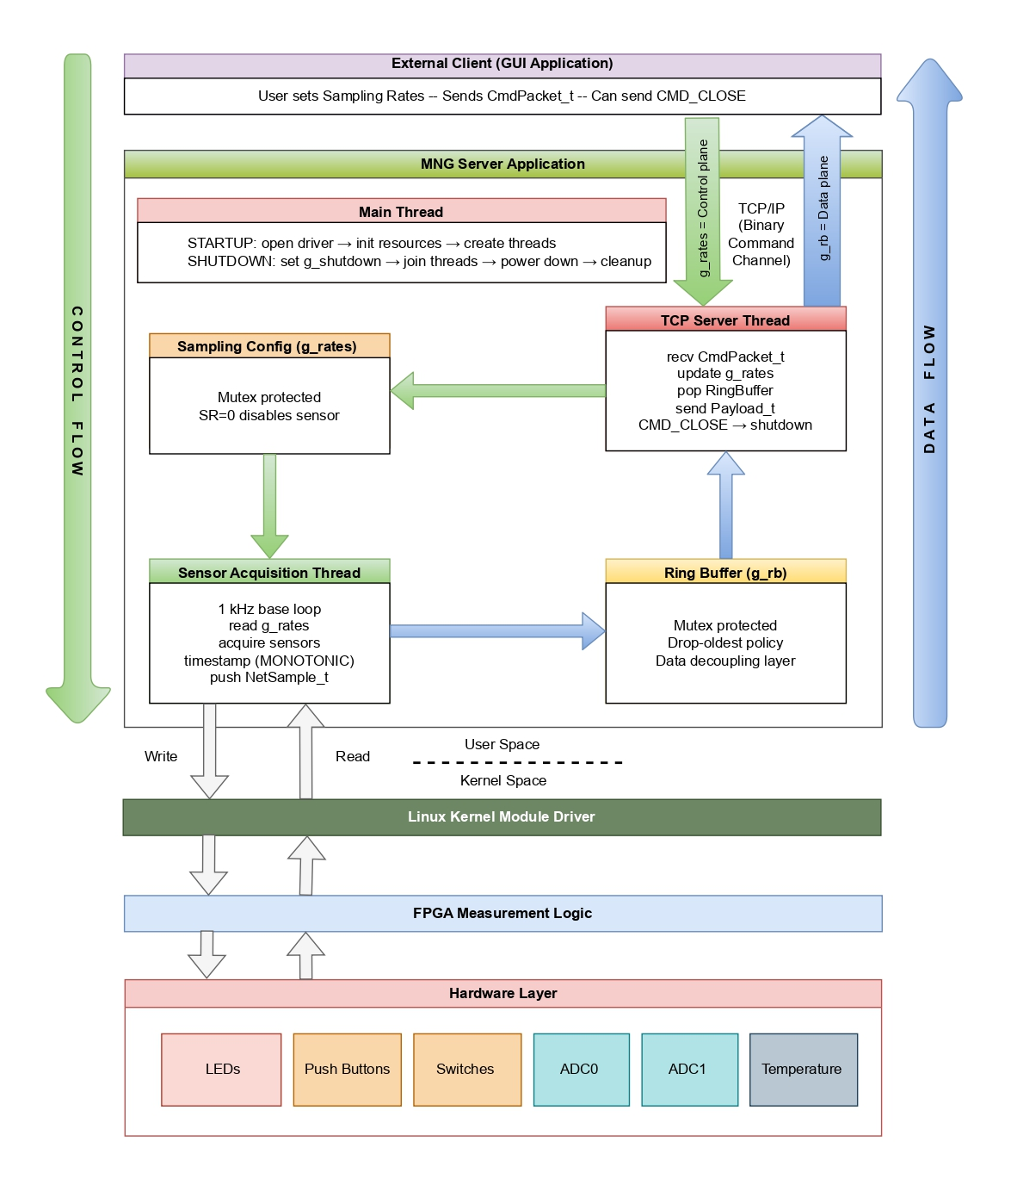
System Architecture Overview
FPGA hardware for sensor acquisition
Embedded Linux server for data processing and communication
GUI client for visualization and control
Notes:
The system consists of three main components. First, an embedded Linux server running on the hardware platform acquires sensor data. Second, the server transmits the data through a TCP communication interface. Third, a graphical user interface on the client side visualizes the measurement data and allows configuration of sampling parameters.

Slide 5
Hardware Platform
FPGA board for data acquisition
Temperature sensor (MAX31865)
Analog-to-Digital Converter channels (ADC)
Digital inputs (push buttons / switches)
Ethernet interface for network communication
Notes:
The hardware platform provides the physical interface to sensors and the processing environment for the server application. The embedded system collects measurement signals and forwards them to the Linux server software for further processing and transmission.

Slide 6
System Software Architecture
Hardware layer: Sensors and FPGA acquisition logic
Linux driver layer: Provides access to FPGA hardware
MNG server application: Handles sampling and TCP communication
GUI client: Provides visualization and user interaction
Notes:
The software architecture separates the system into acquisition, communication, and visualization layers. This modular design improves maintainability and ensures that sensor acquisition and network communication can operate independently.

Slide 7
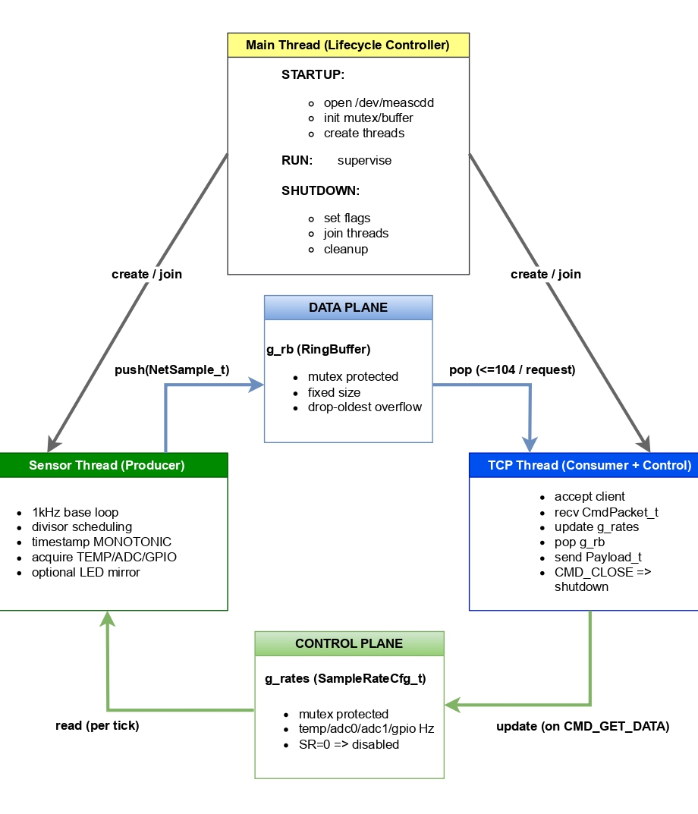
Server Architecture
Sensor thread – acquires measurement data from sensors
TCP thread – handles communication with the client
Main thread – manages initialization and system control
A shared ring buffer is used to store measurement samples between the sensor acquisition thread and the network transmission thread.
Notes:
The server is implemented as a multithreaded application. The sensor thread continuously acquires measurement samples from sensors. The TCP thread handles communication with the client. Between these threads, a shared ring buffer is used to store measurement samples. This architecture allows deterministic acquisition while still supporting asynchronous network communication.

Slide 8
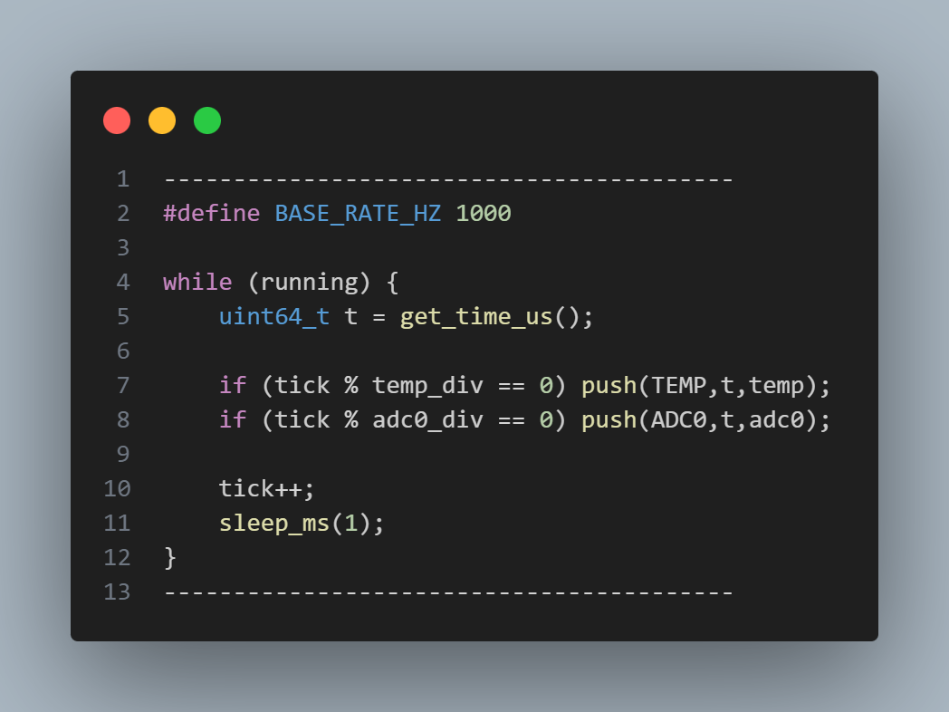
Sensor Sampling and Timing Model
The MNG server uses a periodic timing model for sensor acquisition.
Key concepts:
• Base timing loop running at 1 kHz • Individual sensors use configurable sampling divisors • Each measurement sample receives a precise timestamp • The timing system is based on the Linux CLOCK_MONOTONIC timer
This approach enables stable sampling frequencies while supporting multiple sensors with different update rates.
Notes:
Sensor acquisition is based on a periodic timing model. A base timing loop runs at one kilohertz, and individual sensors use configurable sampling divisors to derive lower sampling rates. Each measurement sample receives a timestamp generated from the Linux CLOCK_MONOTONIC timer. This approach ensures stable sampling frequencies while supporting sensors with different update rates.

Slide 9
TCP Server and Communication Protocol
A client connects to the server over the Ethernet network
The client sends command packets to request measurements
The server responds with binary data packets containing sensor samples
The server creates a TCP socket and waits for client connections

Slide 10
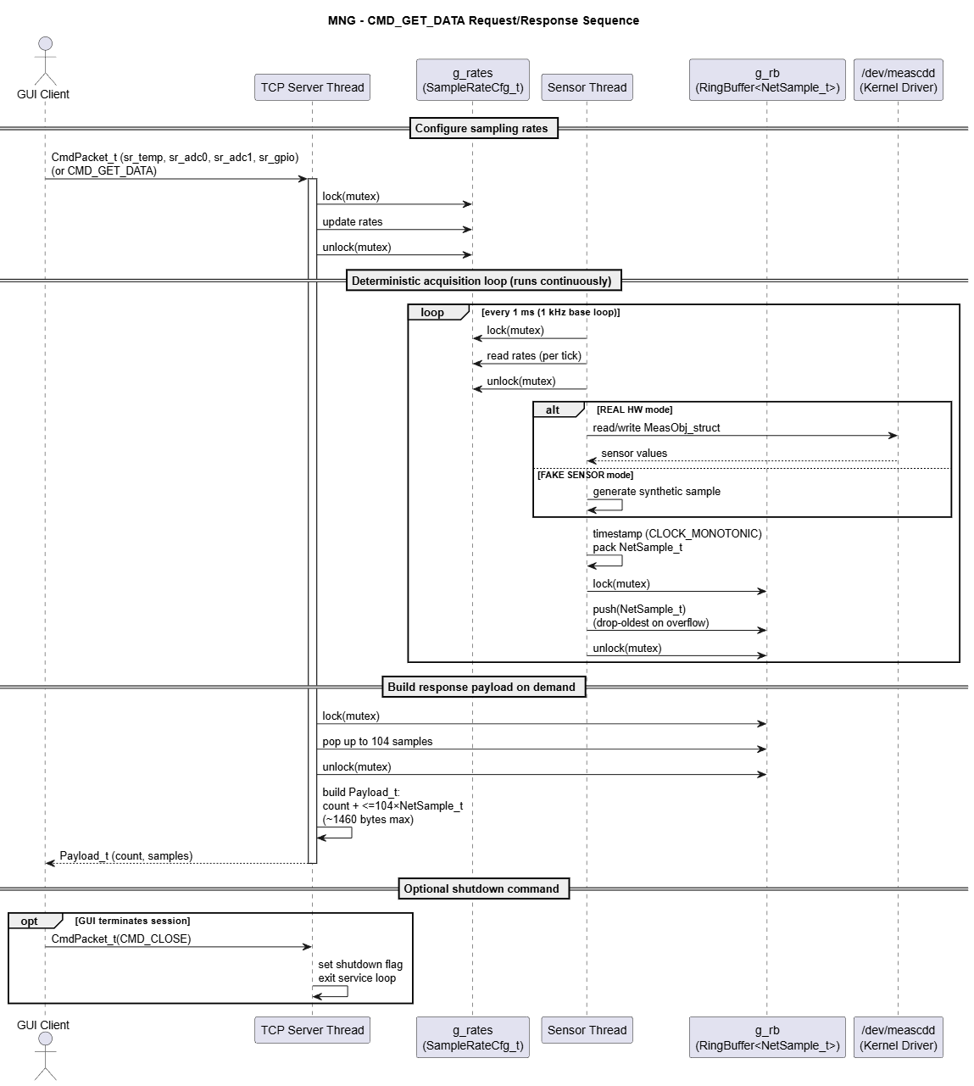
Request–Response Sequence
This sequence diagram illustrates how the GUI client requests measurement data using the CMD_GET_DATA command. The TCP server updates sampling rates, while the sensor thread continuously acquires data using a deterministic 1 kHz loop. Samples are stored in a ring buffer and the TCP thread builds a response payload of up to 104 samples.
Notes:
Communication between the GUI client and the server follows a request–response model. The client sends a command requesting measurement data, and the server responds with a packet containing a sequence of samples. The sensor thread continuously fills the ring buffer while the TCP thread builds response packets from available samples.

Slide 11
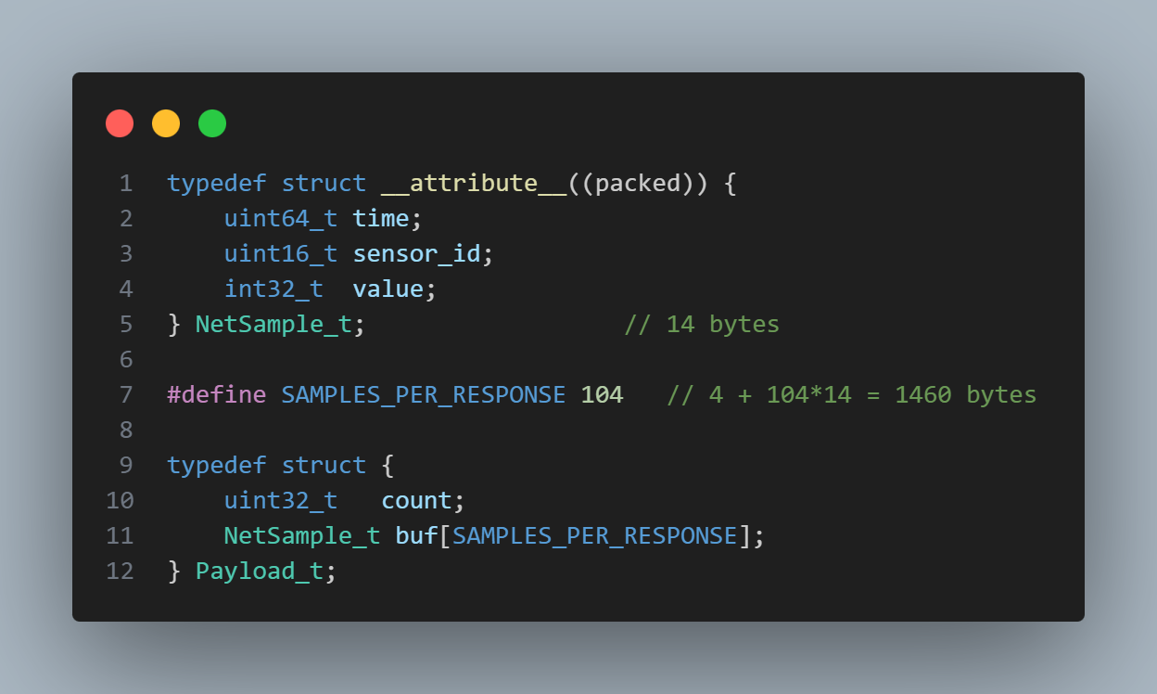
Packet Structure and Payload Optimization
Measurement data is transmitted using compact binary packets.
Packet structure:
• Header information (sample count) • Sequence of measurement samples • Each sample contains timestamp, sensor identifier, and measured value
To improve network efficiency, the packet size is optimized to remain within the Ethernet Maximum Transmission Unit (MTU).
This ensures that each response packet can be transmitted in a single TCP segment without IP fragmentation.
Notes:
Measurement data is transmitted using compact binary packets. Each packet contains a sample count followed by a sequence of measurement samples, where each sample includes a timestamp, sensor identifier, and value. The payload size is optimized to remain within the Ethernet MTU, allowing each response to be transmitted in a single TCP segment without fragmentation.

Slide 12

Graphical User Interface (GUI) Overview
A graphical user interface was developed to provide real-time monitoring and control of the Measurement Network Gateway system.
Main GUI features:
• Real-time visualization of sensor data • Interactive plots for multiple sensor channels • Command interface for controlling the server • Configuration options for sampling parameters
The GUI communicates with the MNG server through the TCP protocol and displays incoming measurement data in real time.
Notes:
A graphical user interface was developed to monitor the system in real time. The GUI communicates with the server over TCP and displays incoming measurement data using interactive plots. It also provides commands for controlling the server and configuring system parameters.

Slide 13
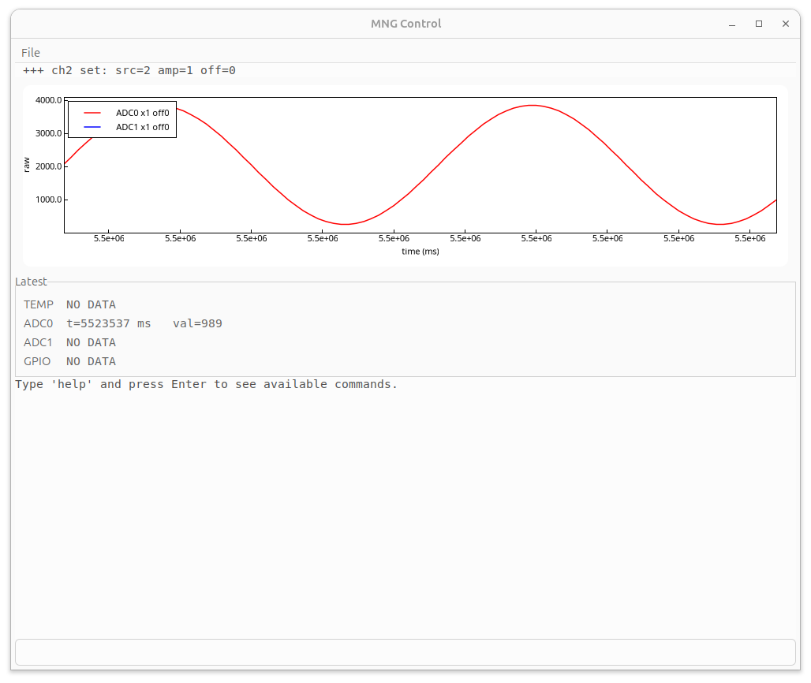
Graphical User Interface – Main Window
Real-time visualization of sensor data
Multi-channel plotting using Slope rendering
Latest sensor values displayed in dashboard
Integrated command console for system control
Notes:
The main window displays sensor data in real time. Multiple sensor channels can be plotted simultaneously, and the latest measurement values are shown in the dashboard. A command console is also integrated for direct interaction with the server.

Slide 14
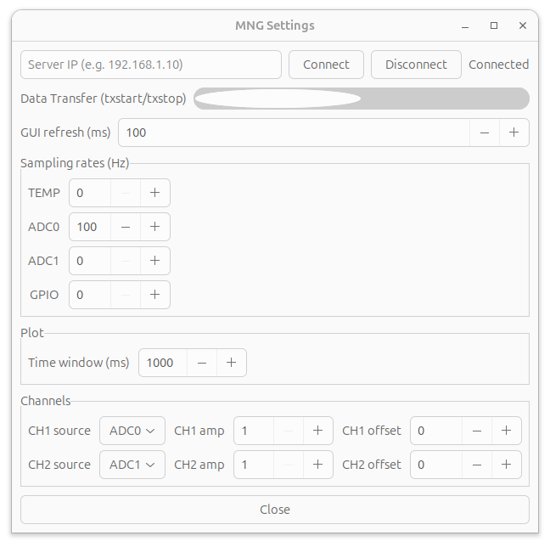
Graphical User Interface – Settings Window
Server connection management
Control of data transfer (txstart / txstop)
Configuration of sensor sampling rates
Plot window and channel mapping settings
Notes:
The settings window allows configuration of system parameters. It includes options for connecting to the server, controlling data transmission, configuring sampling rates, and adjusting visualization settings such as the plot time window.

Slide 15
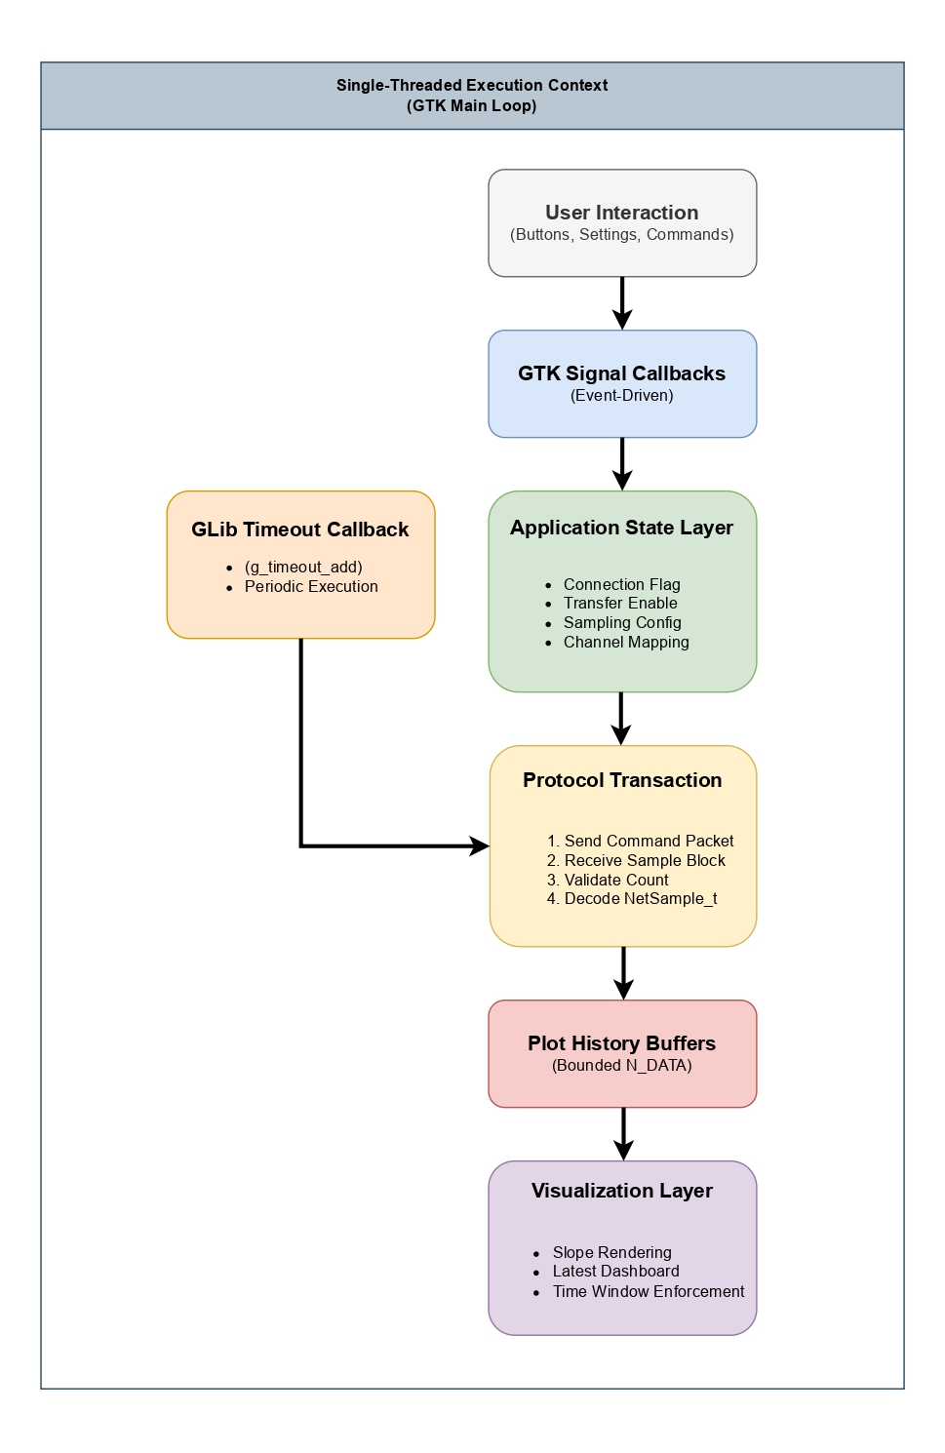
GUI Execution Model
Event-driven execution model of the GUI application. User actions trigger GTK signal callbacks that update the application state. Periodic data acquisition is handled by a GLib timeout callback, which performs protocol transactions with the server and updates visualization buffers.
Notes:
The GUI follows an event-driven execution model based on the GTK framework. User actions trigger signal callbacks that update the application state. Periodic communication with the server is handled by a GLib timeout function, which retrieves measurement samples and updates the visualization buffers.

Slide 16
System Validation and Testing
Several validation tests were performed to verify correct operation of the Measurement Network Gateway system.
Validation objectives:
• Verify stable sensor sampling behavior • Confirm correct TCP communication between server and client • Validate correct decoding of measurement packets in the GUI • Test system behavior during start-up and shutdown
The tests confirmed that the system reliably acquires, transmits, and visualizes measurement data.
Notes:
Several validation tests were performed to verify the correct operation of the system. These tests confirmed stable sensor sampling, reliable TCP communication, correct decoding of measurement packets, and proper system behavior during start-up and shutdown.

Slide 17
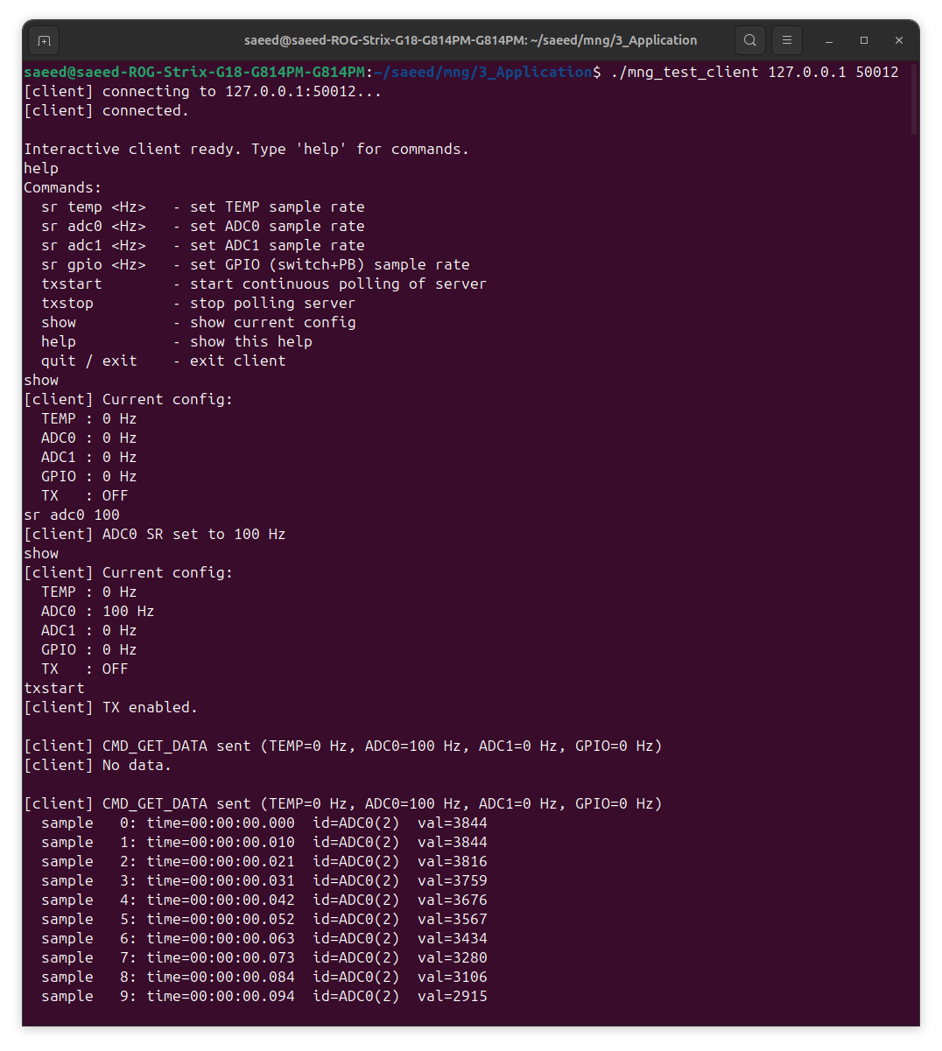
Experimental Results
Experimental tests were performed to evaluate the behavior of the Measurement Network Gateway system under normal operating conditions.
Key observations:
• Sensor data was successfully acquired at the configured sampling rates • Timestamp spacing confirmed stable timing behavior • TCP communication transmitted measurement packets reliably • The GUI displayed measurement data continuously in real time
These results demonstrate that the system operates as intended and provides reliable data acquisition and visualization.
Notes:
Experimental tests showed that the system acquires sensor data at the configured sampling rates and maintains stable timing behavior. TCP communication reliably transmitted measurement packets, and the GUI displayed the data continuously in real time.

Slide 18
Key Contributions
The main contributions of the Measurement Network Gateway project include:
• Design and implementation of an Embedded Linux measurement server • Development of a multithreaded architecture for stable sensor acquisition • Implementation of an efficient TCP-based communication protocol • Design of a graphical user interface for real-time monitoring and control • Integration of hardware acquisition, network communication, and visualization into a complete system
Notes:
The main contributions of this project include the design of an embedded Linux measurement server, the implementation of a multithreaded acquisition architecture, the development of a TCP communication protocol, and the creation of a GUI for real-time monitoring and control.

Slide 19
Conclusion and Future Work
The Measurement Network Gateway (MNG) project demonstrates a complete embedded system for reliable sensor data acquisition, network transmission, and real-time visualization. The implemented multithreaded server architecture enables deterministic sensor sampling while maintaining responsive TCP communication with the client application. By combining a periodic 1 kHz acquisition loop, an efficient binary packet protocol optimized for Ethernet MTU limits, and a GTK-based graphical user interface, the system provides stable measurement timing and continuous monitoring of sensor data. Experimental validation confirmed correct sampling behavior, reliable packet transmission, and real-time visualization in the GUI. Future work may focus on extending the system with support for additional sensor interfaces, enabling multiple simultaneous client connections, and further improving real-time performance through advanced scheduling or hardware acceleration.
Notes:
In conclusion, the Measurement Network Gateway demonstrates a complete system for reliable sensor acquisition, network communication, and real-time visualization. Future work could extend the system by supporting additional sensor interfaces, enabling multiple client connections, and improving real-time performance through advanced scheduling or hardware acceleration.

Slide 20
Thank you for your attention.
Questions?
Notes:
Thank you for your attention. I will be happy to answer your questions.

