Slide 1

Direction Estimation of Sound Sources Using Microphone Arrays and Signal Strength
Mahdi Alipour Zahra Habibzadeh
Sabancı University University of Tehran
Istanbul, Turkey Tehran, Iran
32nd International Conference on Systems Engineering (ICSEng'2025)
October 26th and 27th

Slide 2

Outline
Introduction
Motivation
Methodology
Experiment setup
Result
Conclusion

Slide 3


Introduction
Sound-tracking determines the direction of a sound source.
Important for smart homes, robotics, and surveillance.

Slide 4

Sound Source Localization (SSL)
SSL aims to find sound position/direction using sensors.
Common methods:
TDOA (Time Difference of Arrival)
Beamforming
Phase & Bayesian methods
These require multiple microphones and high computation.

Slide 5
Sound Source Tracking
Tracking follows a moving sound source over time.
Common approaches: Kalman filters, particle filters.
Intensity-based methods are faster but may lose accuracy.
Our approach balances simplicity and reliability.

Slide 6
Motivation
Traditional sound localization methods require complex arrays.
Heavy computation → not suitable for low-cost systems.
Our solution provides accurate direction estimation with simple hardware.
Focus: Direction tracking, not full 3D localization.
Goal: lightweight, affordable, and accurate direction estimation.
Our approach uses 3 microphones and a simple vector-based algorithm.

Slide 7
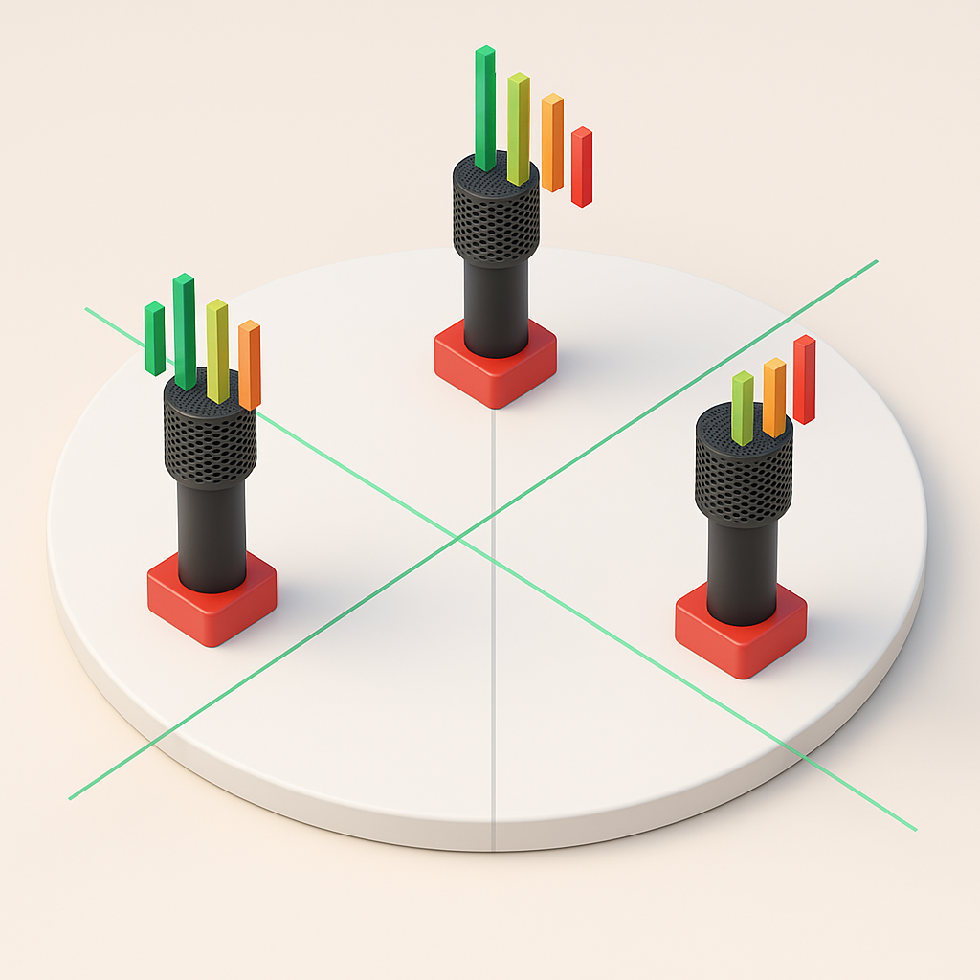
Methodology Overview
Three microphones placed at 0°, 120°, and 240°.
Compare sound intensity from each microphone.
Convert intensity readings to vectors in polar form.
Sum the vectors → resulting vector gives sound direction.

Slide 8
Localization Algorithm
Detect if sound > threshold.
Collect N samples from each microphone.
Compute average power → convert to polar vector.
Sum x, y components to find resultant vector.
Compute angle using atan2(Y, X).
Rotate servo motor to indicate direction.

Slide 9

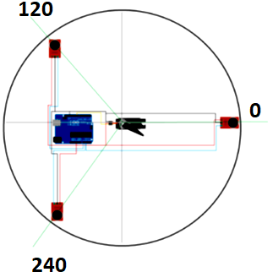
Hardware Implementation
Components:
3 electret microphones (0°, 120°, 240°)
LM358 Op-Amps for amplification
Arduino Uno R3 for processing
Servo motor for visual feedback
Sampling rate: 50 Hz
Distance between microphones and center: 15 cm
Tested with sound source 35 cm away.

Slide 10
Experimental Design
60 tests using 2-second audio clip.
Sound played from mobile phone at 20° and 120°.
Data: We collected amplitude samples and estimates direction.
Results visualized in polar plots for direction consistency.

Slide 11

Results Overview
Consistent directional estimation for both 20° and 120°.
Minimal deviation due to environmental noise.
Accuracy and precision computed after outlier trimming.

Slide 12
Accuracy and Precision
26 trimmed data points per angle.
At 120°:
accuracy = 5.26°, precision = 3.26°.
At 20°:
accuracy = 7.11°, precision = 4.01°.
Corresponds to ≈98.9% precision.
Demonstrates high reliability with simple setup.

Slide 13
Advantages over Traditional Methods
Low-cost and easy to implement.
No need for large arrays or heavy computation.
Accurate for short-range tracking.
Ideal for smart homes, robotics, and security systems.

Slide 14
Limitations and Future Work
Limited by Arduino’s sampling rate and memory.
Effective only for nearby sound sources.
Future improvements:
Higher sampling rate hardware.
Additional microphones.
Integration with beamforming and ML.

Slide 15
Conclusion
Developed a simple, affordable, and accurate sound-tracking system.
Based on vector-sum of intensity readings.
Achieved <6° error and ~98% precision.
Strong potential for real-world applications.

Slide 16

Resources and Acknowledgment
GitHub:
https://github.com/mahdi943/soundlocalization
Authors:
Mahdi Ali Pour – Sabancı University, Turkey
mahdialipour@sabanciuniv.edu
Zahra Habibzadeh – University of Tehran
z.haibzadeh213@ut.ac.ir
Thank you!

