Slide 1
CSCI – 490 (ISD)
Mohammad Yehya Al Saabi
Mahdi Fadel Assi

Slide 2
ANSAR’S PORTAL

Slide 3

Our idea
A comprehensive village guide app designed to help users explore local stores and services within a community. This project includes a mobile app built with Flutter, a web interface using PHP, and a MySQL backend. Each store's information, including images, categories, and special offers, is managed by the admin through a secure panel.

Slide 4
Key features :
Mobile app and web interface for easy accessibility. Admin panel to manage store information, special offers, and reviews. Secure user authentication for admin access. Monthly payment tracking for store subscriptions. User registration for enhanced engagement with likes and ratings. Explore the vibrant offerings of local businesses and create a connected community through Ansar Portal.
Technology Stacks :
Flutter for the mobile app.
PHP and MySQL for the backend.
GitHub Actions for CI/CD (Continuous Integration/Continuous Deployment).

Slide 5
Motivation :
To create our own business app to earn money and be well known and improve communication skills
Challenges :
We needed to learn new Programing languages and took time to get information about stores
Innovation :
Facilitating the search process and increasing sales

Slide 6

Business process:
Week 1
Week 2
Week 3
ISD IDEA
Storyboard
& BP
Use Case/
Narrative
Final Implementation
(full App )
Second Implementation
(More features in the App)
ER Diagram/
First Implementation1
(Mobile App)
Final Weeks
Week 6/7
Week 4/5

Slide 7
Project TimeLine (Mobile App)
Activities | Start Date | End Date | Duration
Project Planning | 1/3/2024 | 7/3/2024 | 6
Requirements Analysis | 8/3/2024 | 13/3/2024 | 5
Design | 8/3/2024 | 13/3/2024 | 5
Development | 14/3/2024 | 14/4/2024 | 30
Testing | 15/3/2024 | 20/5/2024 | 65
Deployment | 15/3/2024 | 20/5/2024 | 65
Documentation | 15/3/2024 | 20/5/2024 | 65

Slide 8
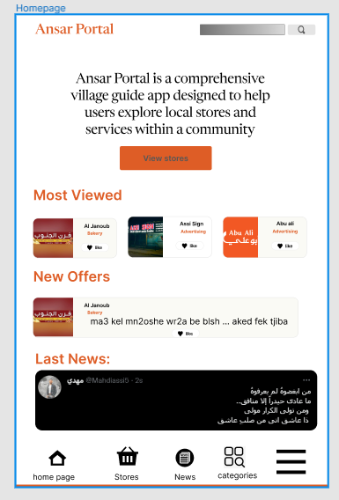
Storyboard
Search button that helps search categories and stores
Shows the most viewed stores
Shows the latest offers
Shows the latest news
A navigation bar that includes , home page, store page , news page , all categories , and the settings

Slide 9
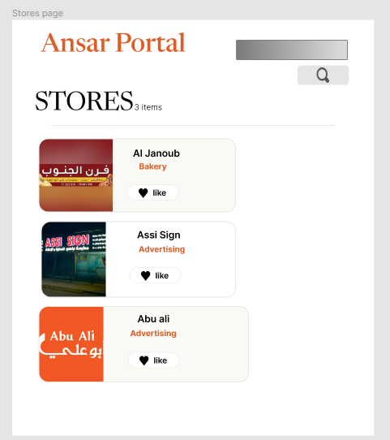
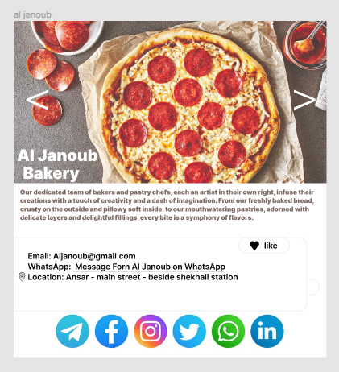
When you click on any of these this will appear :
Store page
A carousel that contains images of the store
Can like the store but must have an account. If not it will take you to a sign in page
Can visits the store on all social media platforms (links)

Slide 10
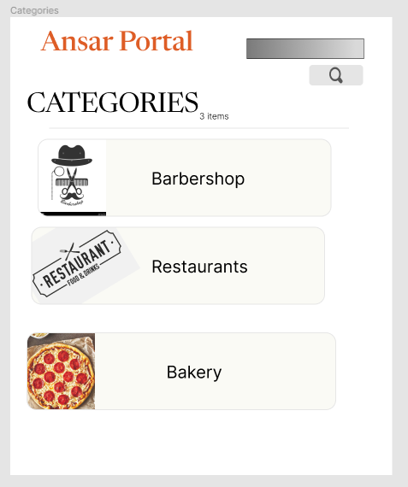
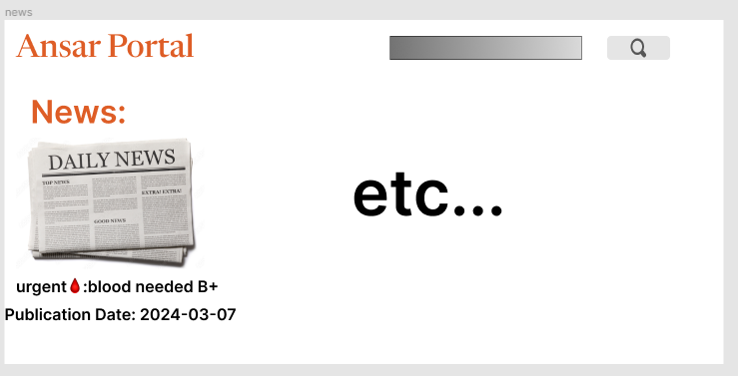
Categories page
News Page
Contains the daily news of ansar
Contains all categories and each category has stores that are associated with it

Slide 11
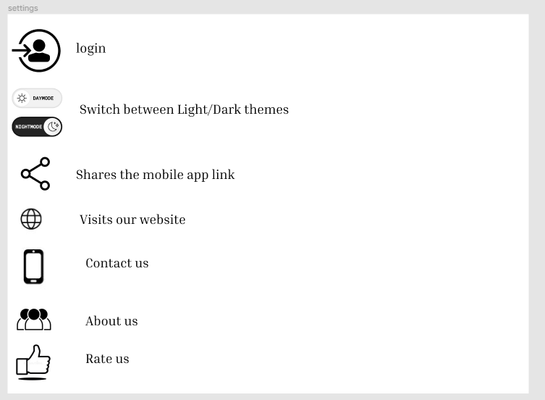
settings page
Opens the login/sign in page
Light /dark App appearance
Link to our app
Link to our website
Includes our email and phone number
More information about our team
Takes you to the app store to rate our Application

Slide 12
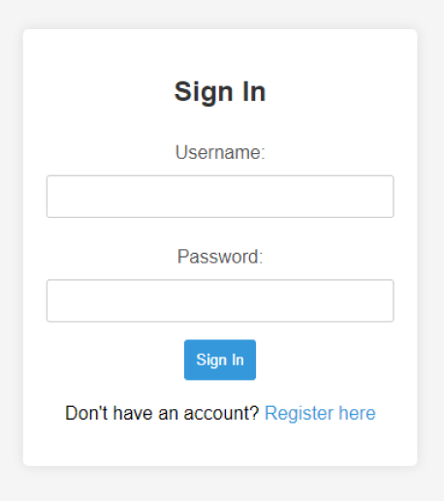
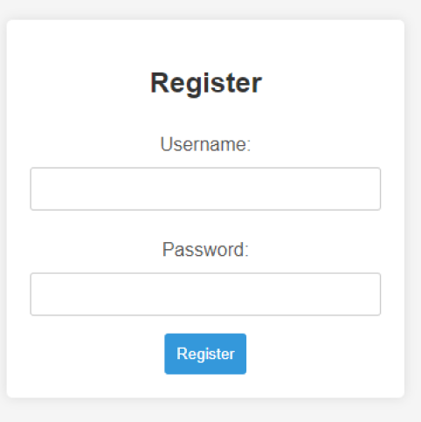
Sign in page
Register page
A register page will pop up when clicking on the register button

Slide 13
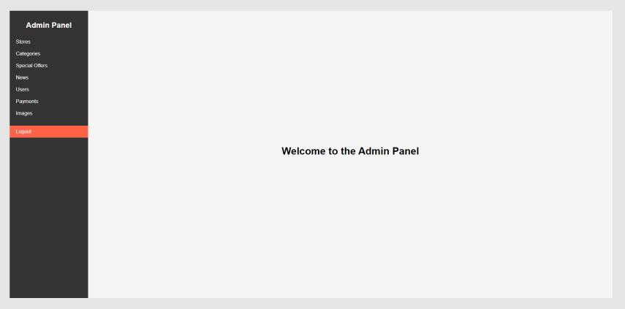
Admin page
Admin panel where the admin has access to all the pages in the app

Slide 14
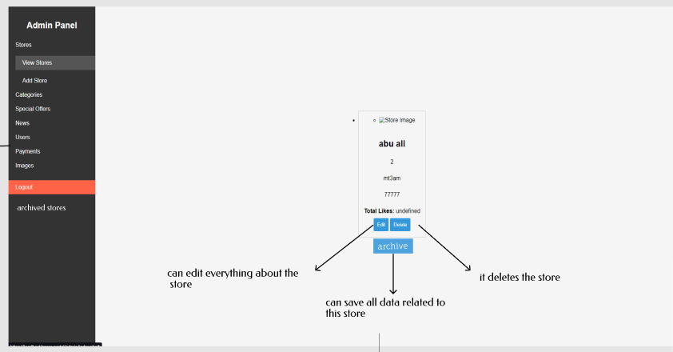
Admin - View Stores

Slide 15
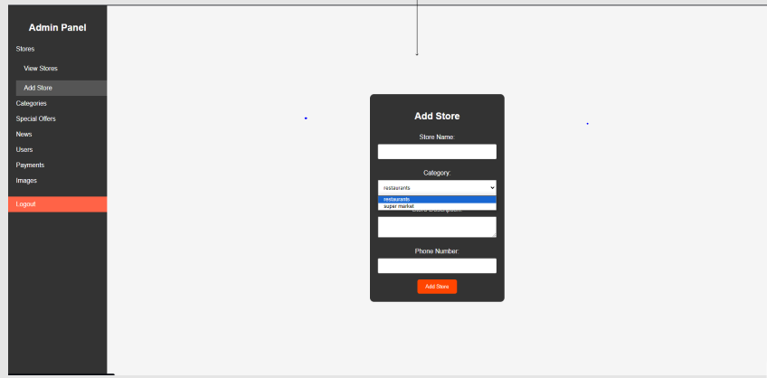
Admin – Add Stores
All information (Name , Phone number , what category) about the store

Slide 16
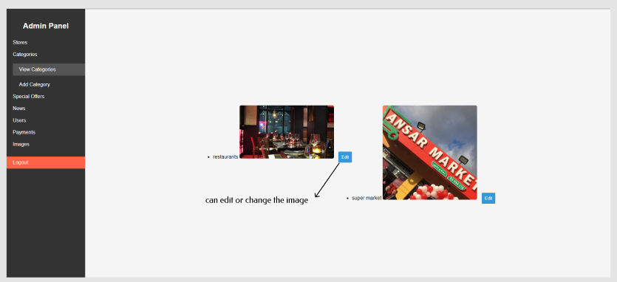
Admin – View Categories

Slide 17
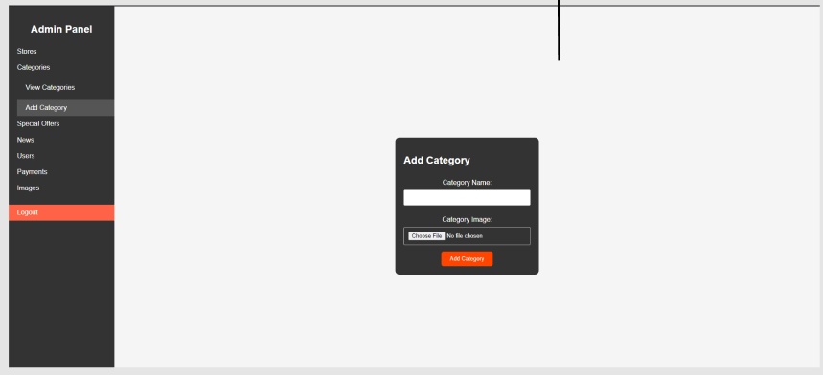
Admin – Add Categories
Title of the category and its image

Slide 18
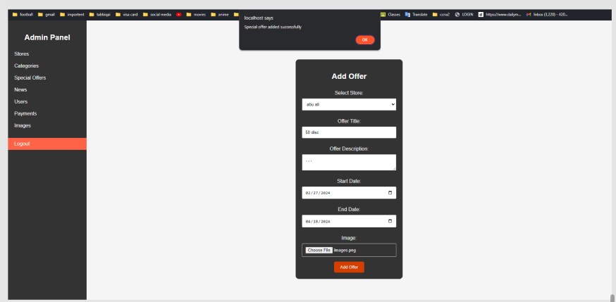
Admin – Add Offers
The admin can add a special offer to any store by adding the store information , the start date and the end date of the offer

Slide 19
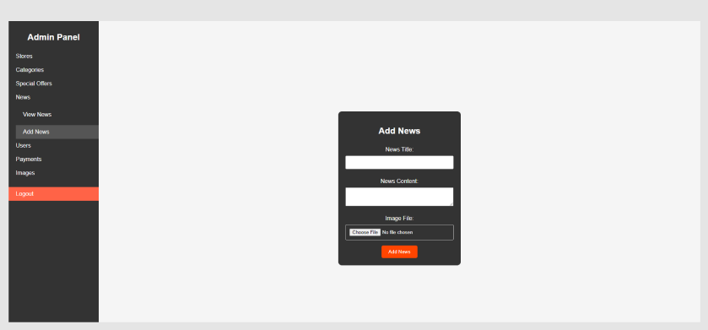
Admin – News
Admin can add the daily news

Slide 20
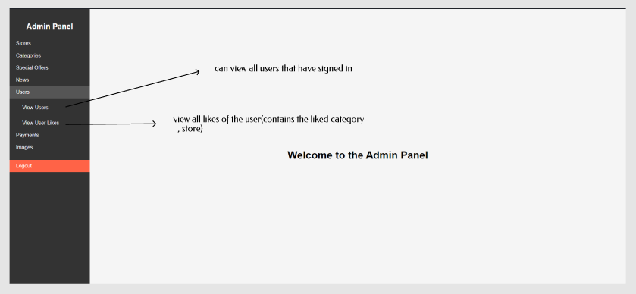
Admin – Users

Slide 21
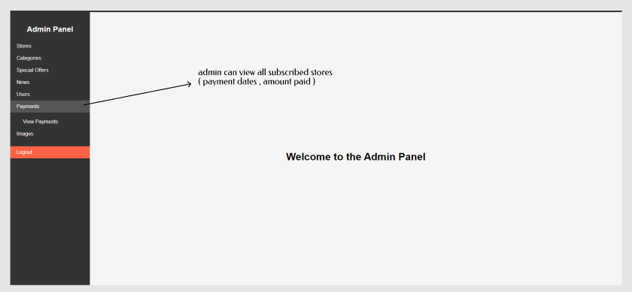
Admin – Payments

Slide 22
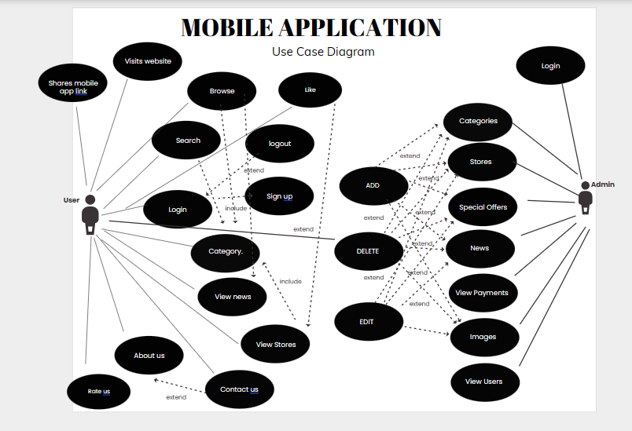

Slide 23
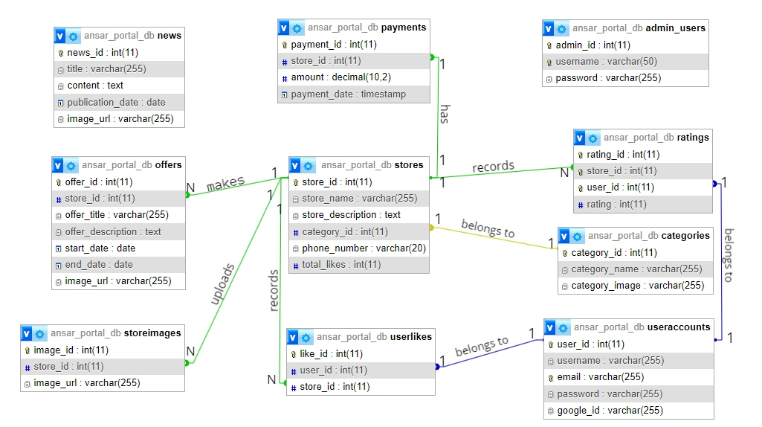
ER Diagram (Mobile App)

Slide 24
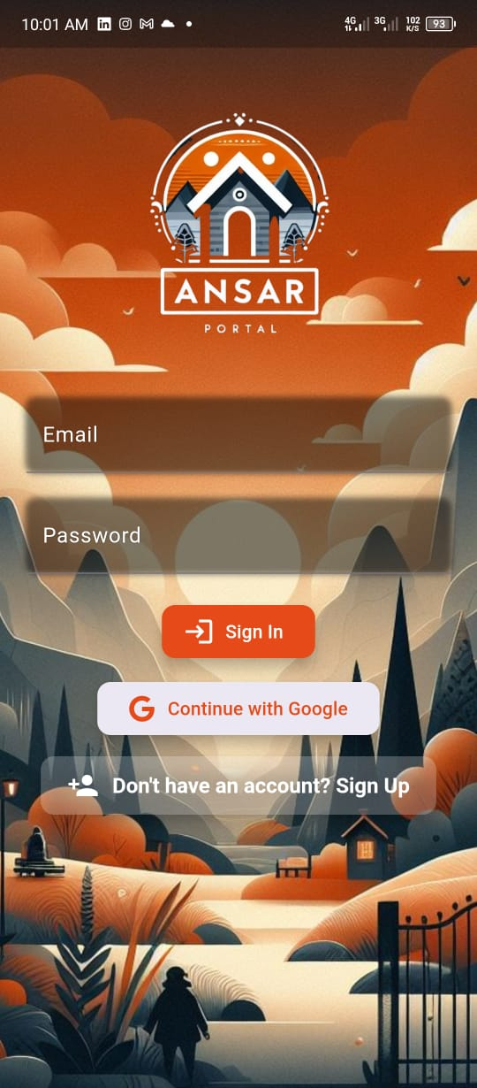
SIGN-IN Page
This sign in page let you fill in you credentials to sign in to the application
As you can see there is a “Continue with google ” that helps facilitate the sign in process
Also if you don’t have an account you can register one free of charge

Slide 25
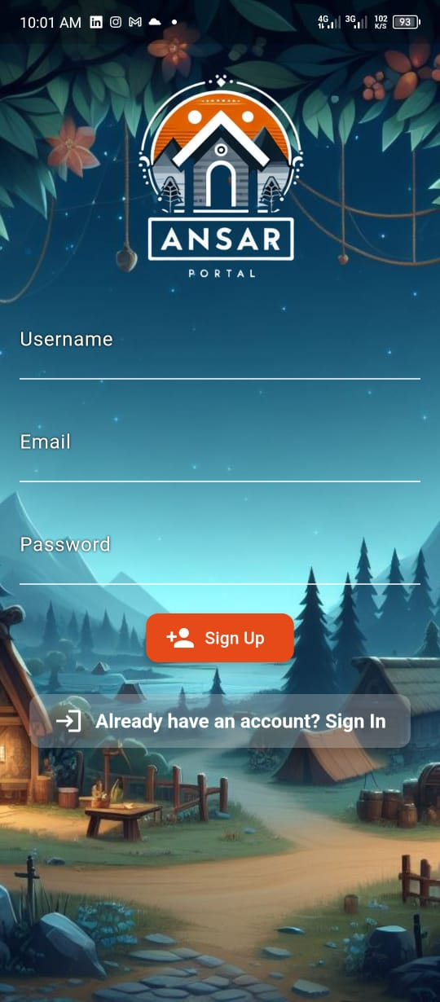
SIGN-UP Page
This is the sign-up page that appears when you click sign-up here on the page before
Same as the page before you need to add the necessary credentials in order to create your account

Slide 26
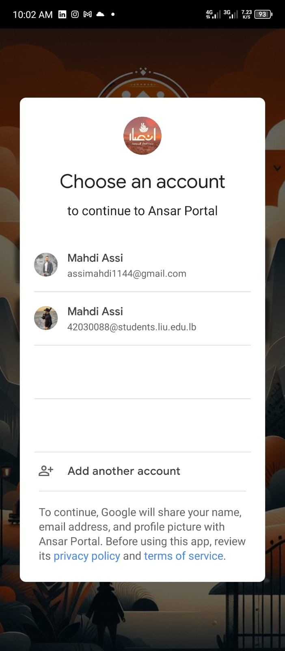
Continue With google button
When clicked it will require you to choose which google account you need to sign in with just like the photo

Slide 27
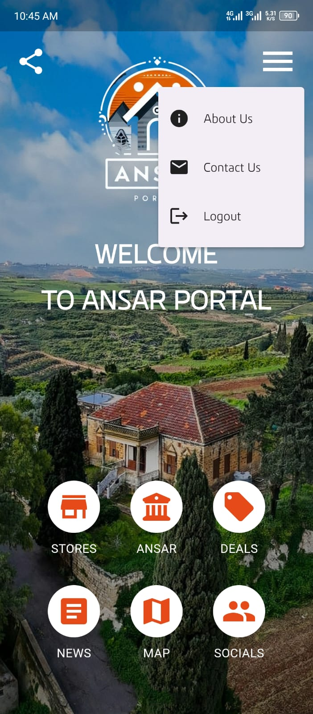
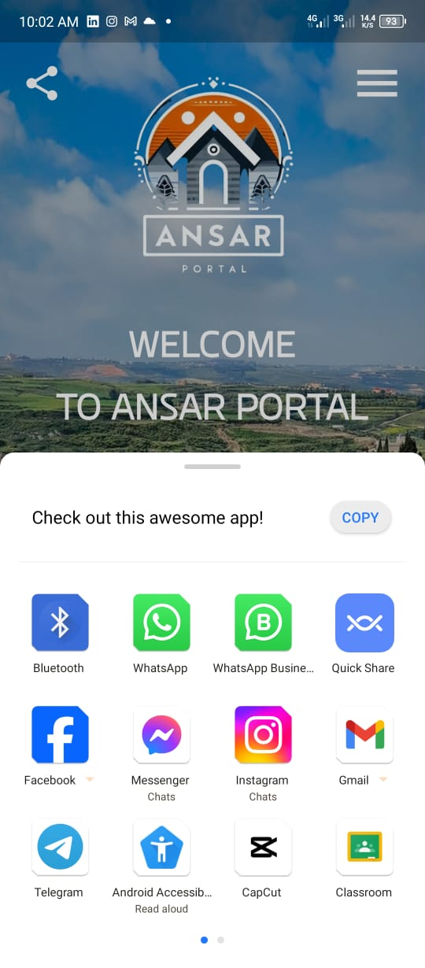
Home Page
When you log in to the app this page appears with 6 buttons that are in the bottom of the page and as you can see the settings appear when you click on the top right icon in the corner
And if you click on the share icon found on the top left corner of the page you can share the link of the app to anyone on any platform as shown in the second picture

Slide 28
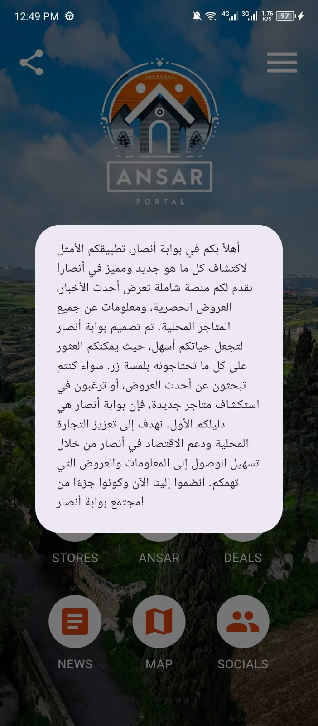
Home Page
As you click on the about us that is found in the settings icon
A paragraph appears
And talks about what the app is about and what can it do

Slide 29
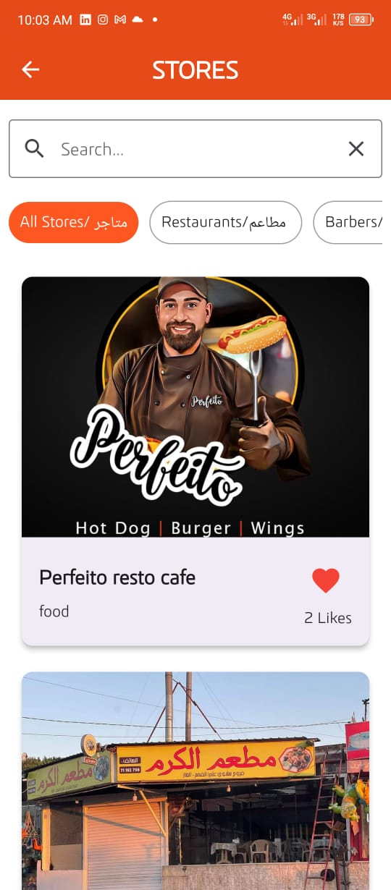
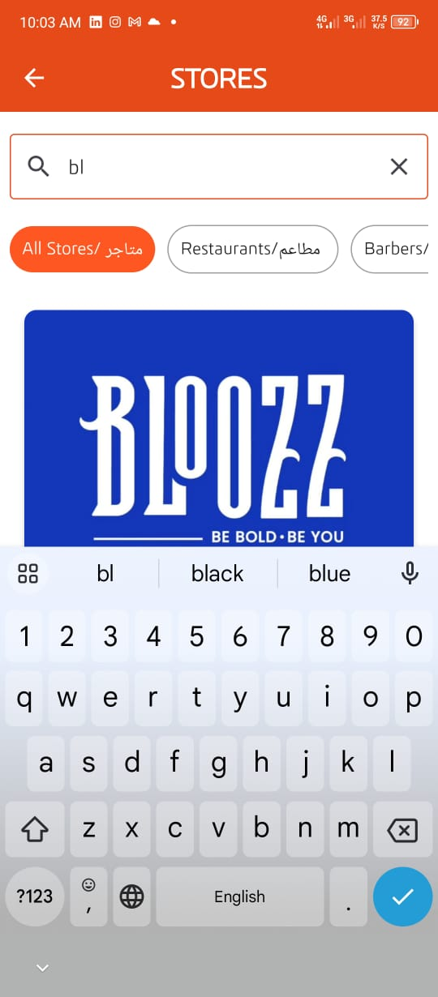
Store Page
The stores page includes all the stores in ansar where you can scroll down to see and like them
As you can see in the picture there is a search bar to search for any store name you want as shown in the second photo
Beneath the search bar you can see a navigation bar where you can scroll between the category you are looking for

Slide 30
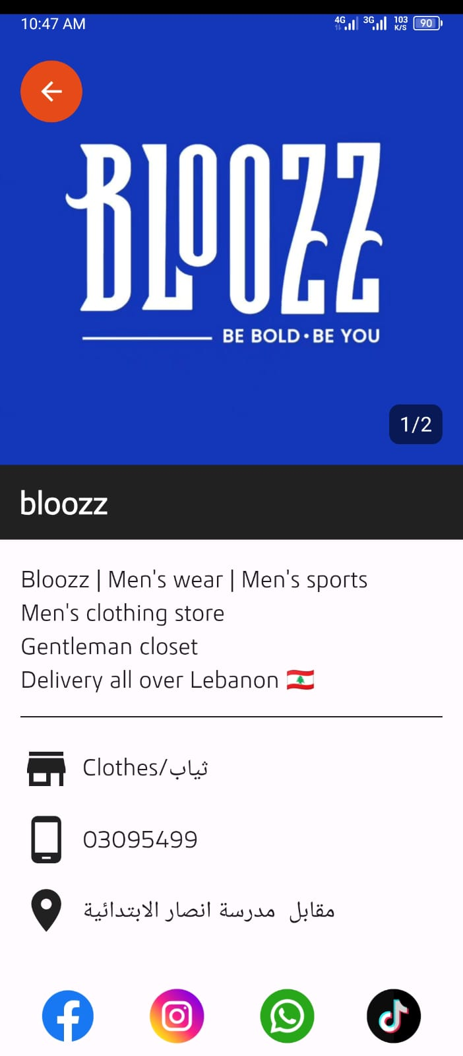
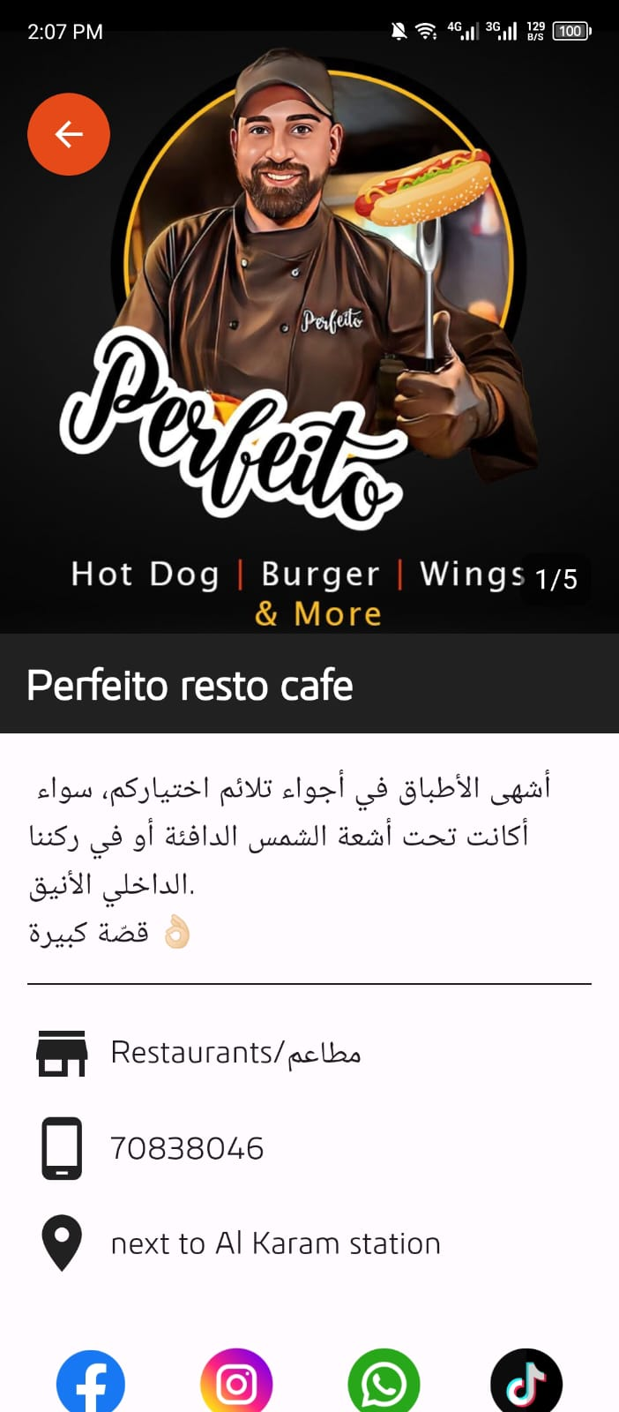
Store Page
When you click on any store you need it shows more information about it like the description of the store , phone number and location of the store . Furthermore , you can see and visit all social media related to the store

Slide 31
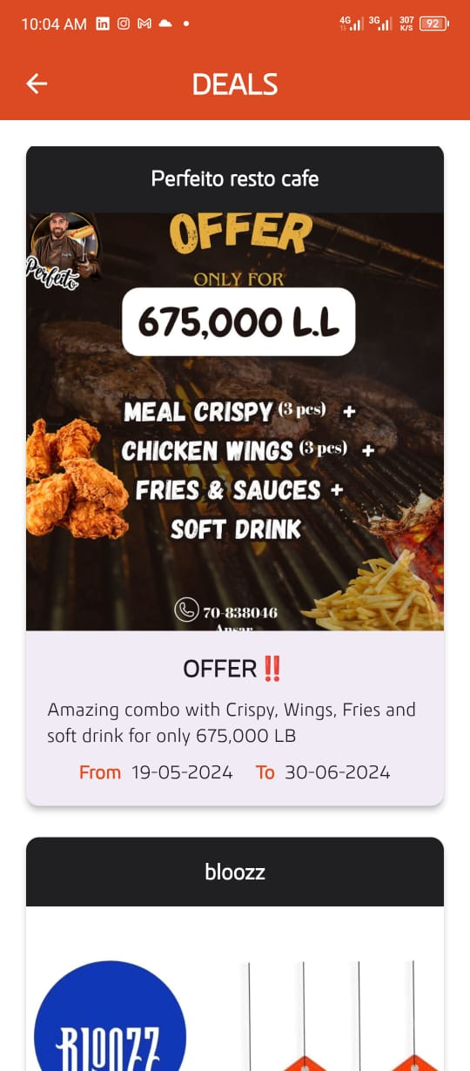
Deals Page
The deals page includes all the recent deals and its description beneath it also for how long is the deal available
You can scroll down to see more deals of more stores

Slide 32
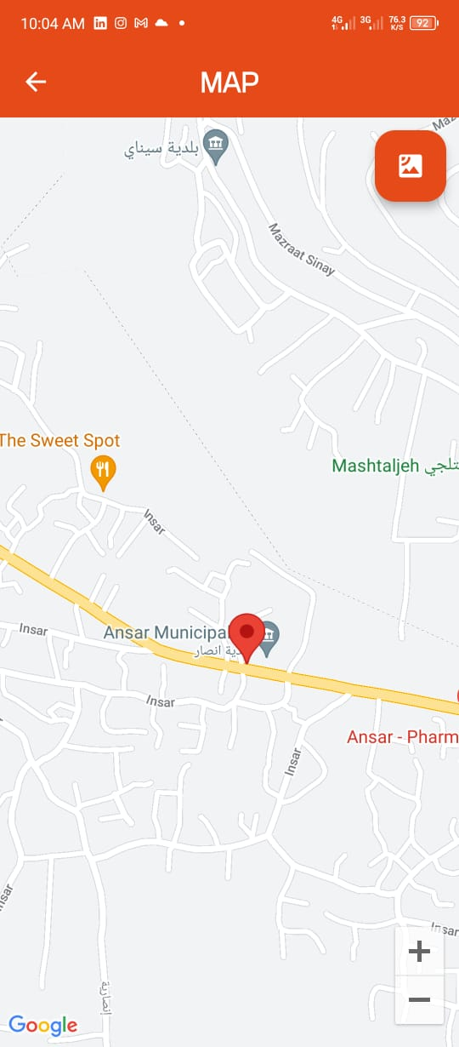
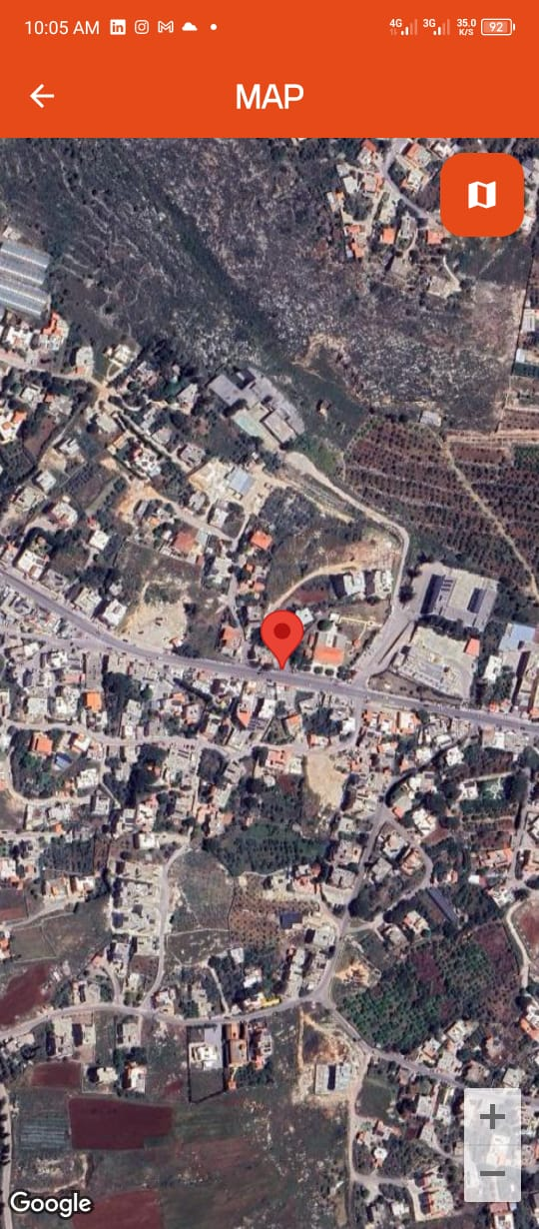
Maps Page
The maps page takes you to the location of ansar where you can see where each store is located
The top right button gives you a live view of the area you are in

Slide 33

Socials Page
In the socials page you can contact us via
WhatsApp
Instagram
TikTok
Facebook
To learn more about us and the application

Slide 34
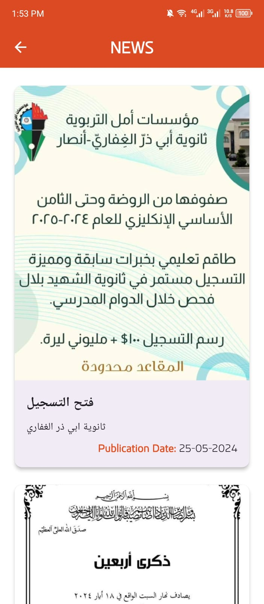
News Page
In the news page you can find the daily news of what’s happening in ansar either its new construction , new accidents , events and many more
It also shows you the publication date to be able to know if the news is recent or not

Slide 35
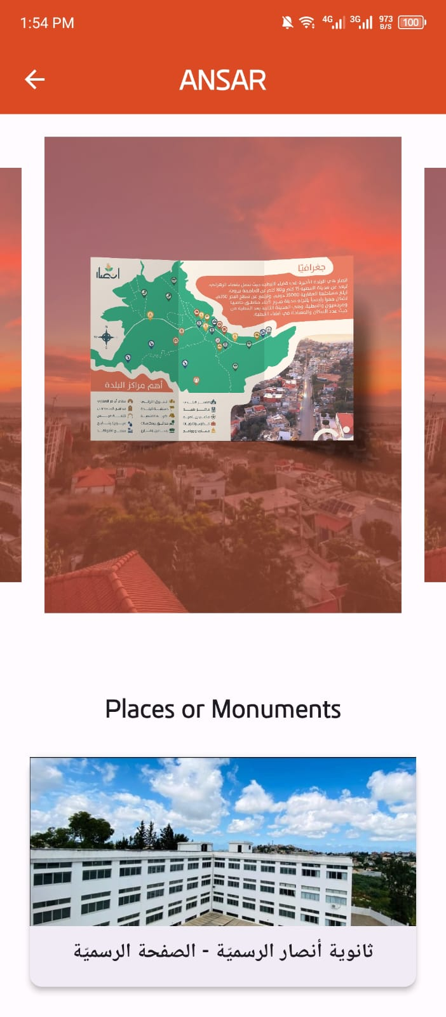
Ansar Page
In this page you can see the beautiful landmarks that are spread across ansar
It’s carousel based so you can scroll either left or right to see more

Slide 36
NOW LET’S RUN THE APPLICATON…

