Slide 1
The Dawn of a New Era: Solid-State Batteries
Introduce solid-state batteries and their transformative potential for the electric vehicle industry.
Title concept
A dynamic, abstract visual representing energy flow and advanced materials, with the title and subtitle prominently displayed.
Solid-state batteries represent a paradigm shift in energy storage for electric vehicles, promising enhanced safety, greater energy density, and faster charging capabilities. This technology moves beyond traditional liquid electrolytes to solid materials, unlocking new performance benchmarks and addressing key limitations of current lithium-ion batteries.
Solid-state batteries utilize solid electrolytes, eliminating fire risks associated with liquid electrolytes.
They offer significantly higher energy density, enabling longer EV ranges.
Potential for faster charging times compared to conventional lithium-ion technology.
Represents the next frontier in EV battery innovation.
Speaker note
Welcome everyone. Today, we're diving into a technology that could redefine the electric vehicle landscape: solid-state batteries. This isn't just an incremental improvement; it's a fundamental leap forward.
Slide 1 | Evidence: reasoned synthesis

Slide 2
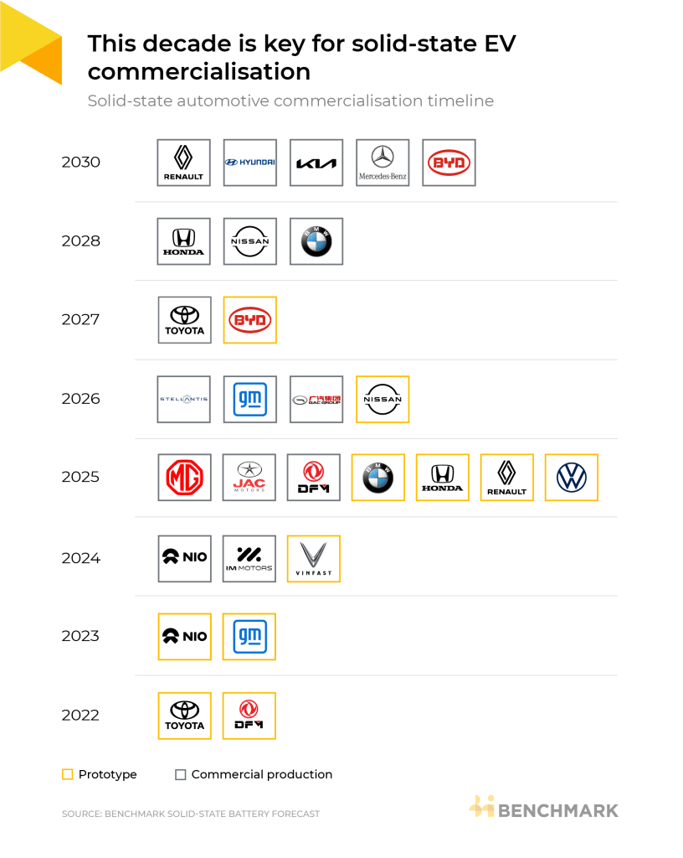
The Road to 2026: Commercialization Milestones
Outline the critical timeline for solid-state battery commercialization, focusing on 2026-2027.
The EV market is on the cusp of solid-state battery integration, with major automakers and OEMs committing to demonstration vehicles by 2027. Initial commercial launches are anticipated as early as 2026, marking a pivotal period for this advanced technology. This accelerated timeline reflects significant R&D progress and strategic investments across the industry.
Automakers and OEMs are targeting demonstration vehicles by 2027.
Initial commercial EV launches featuring solid-state batteries are projected for 2026.
This decade is crucial for the commercialization of solid-state batteries in EVs.
Key players like Toyota, BYD, LG, Samsung, and Panasonic are actively involved.
A clear, forward-looking timeline graphic highlighting 2026 and 2027 as key years for initial SSB deployments and demons
Speaker note
The industry is moving rapidly. We're seeing concrete commitments from major players, setting the stage for initial market entry within the next two years. This isn't theoretical; it's becoming a reality.
Slide 2 | Evidence: ORB-8d9023c5, ORB-fade08f1, ORB-9ce9241a, ORB-d247bf02, ORB-a436b14e

Slide 3
The Titans of Tomorrow: Key Players and Strategies
Identify the leading companies and their strategic approaches to solid-state battery development and commercialization.
Comparison concept
A visual comparing key players (automakers, battery manufacturers, tech developers) and their general approaches to SSB commercialization, perhaps using logos and brief strategy descriptions.
The race to commercialize solid-state batteries involves a dynamic ecosystem of established automotive giants, innovative battery manufacturers, and specialized technology developers. Companies are pursuing diverse strategies, from in-house development to strategic partnerships and licensing agreements, all aiming to secure a leading position in this burgeoning market.
Major automakers are investing heavily in SSB technology and partnerships.
Leading battery manufacturers (e.g., Panasonic, LG, Samsung, BYD) are developing next-generation solid-state solutions.
Technology developers are licensing their innovations to OEMs to accelerate scale-up.
Collaboration is key to overcoming manufacturing and performance hurdles.
Speaker note
The competitive landscape is intense and collaborative. We're seeing a mix of internal development and external partnerships as companies vie for leadership in this critical technology.
Slide 3 | Evidence: ORB-8d9023c5

Slide 4
Bridging the Gap: Technological Hurdles
Examine the primary technological challenges that must be overcome for widespread solid-state battery adoption.
Process concept
A diagram illustrating the key technological challenges in SSB development, such as electrolyte conductivity, interfacial resistance, and material stability.
Despite their immense promise, solid-state batteries face significant technological hurdles that impede mass commercialization. Key challenges include ensuring the long-term stability and conductivity of solid electrolytes, achieving efficient ion transport across interfaces, and developing robust cell designs that can withstand repeated cycling and thermal stress.
Achieving high ionic conductivity in solid electrolytes at operating temperatures.
Managing interfacial resistance between electrodes and solid electrolytes.
Ensuring mechanical stability and preventing dendrite formation.
Developing scalable manufacturing processes for solid electrolyte materials and cell assembly.
Speaker note
While the potential is clear, we must acknowledge the technical complexities. Overcoming these fundamental scientific and engineering challenges is paramount to unlocking the full capabilities of SSBs.
Slide 4 | Evidence: reasoned synthesis

Slide 5
Scaling Up: Manufacturing and Cost Realities
Analyze the manufacturing scale-up challenges and cost implications for solid-state batteries.
The transition from laboratory prototypes to mass-produced solid-state batteries presents substantial manufacturing and cost challenges. Scaling up the production of novel solid electrolyte materials and integrating them into high-volume battery cell manufacturing lines requires significant capital investment and process innovation. High initial production costs remain a barrier to widespread adoption compared to mature lithium-ion technologies.
Scalability of manufacturing processes for solid-state electrolytes and battery cells is a major concern.
Production costs are currently higher than traditional lithium-ion batteries.
Developing cost-effective methods for synthesizing and processing solid electrolyte materials.
Establishing robust supply chains for new materials required for SSB production.
A visual representing the complexity of scaling up SSB manufacturing, perhaps showing a simplified factory layout or a f
Speaker note
Manufacturing scale and cost are critical business considerations. The industry needs to innovate not just in battery chemistry, but also in production techniques to make SSBs economically viable for mass-market EVs.
Slide 5 | Evidence: ORB-fade08f1, ORB-9ce9241a, ORB-d247bf02, ORB-a436b14e

Slide 6
Market Momentum: Drivers and Competitive Edge
Identify the key drivers pushing market adoption and the competitive advantages offered by solid-state batteries.
Chart concept
A bar chart or infographic illustrating the key market drivers and the comparative advantages of SSBs (e.g., range, safety, charging speed) versus current Li-ion batteries.
Several factors are accelerating the adoption of solid-state batteries in the EV market, primarily driven by the demand for enhanced safety and longer driving ranges. The superior energy density of SSBs directly translates to more competitive EVs, while their inherent safety features address consumer concerns and regulatory pressures. This technological leap provides a significant competitive edge for early adopters.
Consumer demand for longer EV ranges and improved safety.
Regulatory push for safer and more efficient battery technologies.
Performance advantages: higher energy density and enhanced safety.
Potential for faster charging to improve user experience.
Speaker note
The market is ripe for disruption. Consumer expectations for performance and safety, coupled with regulatory trends, are creating a strong pull for solid-state battery technology.
Slide 6 | Evidence: ORB-8d9023c5

Slide 7
Investing in the Future: Opportunities and Risks
Assess the investment landscape, highlighting key opportunities and potential risks for stakeholders.
The commercialization of solid-state batteries presents a compelling investment opportunity, driven by the anticipated disruption in the EV market. However, investors must navigate significant risks, including technological uncertainties, manufacturing scale-up challenges, and the potential for supply chain bottlenecks. Strategic investments in R&D, manufacturing capabilities, and key partnerships will be crucial for success.
Significant market opportunity driven by EV electrification.
Risks include unproven long-term performance and high initial costs.
Potential for supply chain disruptions for novel materials.
Strategic partnerships and targeted R&D funding are critical for mitigating risks.
A visual representing investment opportunities and risks, perhaps using a SWOT analysis framework or a risk-reward matri
Speaker note
For investors, the potential rewards are substantial, but so are the risks. A pragmatic approach, focusing on companies with robust technology and clear manufacturing roadmaps, is essential.
Slide 7 | Evidence: ORB-fade08f1, ORB-9ce9241a, ORB-d247bf02, ORB-a436b14e

Slide 8
Charting the Course: Strategic Recommendations
Provide actionable recommendations for automotive stakeholders to navigate the transition to solid-state batteries.
Closing concept
A concluding slide with a strong call to action, summarizing key strategic imperatives and contact information.
To capitalize on the solid-state battery revolution, automotive stakeholders must adopt a proactive and strategic approach. This includes fostering key partnerships, investing in advanced manufacturing capabilities, and closely monitoring technological advancements and market dynamics. By understanding and addressing the inherent challenges, companies can position themselves for leadership in the next generation of electric vehicles.
Prioritize strategic partnerships with SSB technology developers and manufacturers.
Invest in pilot production lines to de-risk manufacturing scale-up.
Develop a flexible supply chain strategy for next-generation battery materials.
Continuously evaluate market readiness and consumer adoption trends.
Speaker note
The future of EVs is being written with solid-state batteries. By acting decisively and strategically today, we can ensure our place at the forefront of this transformative technology. Thank you.
Slide 8 | Evidence: reasoned synthesis

