Slide 1
The Solid-State Battery Horizon
Introduce solid-state batteries (SSBs) and their transformative potential for the electric vehicle market.
Title concept
A dynamic, abstract visual representing energy flow or a futuristic battery cell, with the deck title prominently displayed.
Solid-state batteries represent a paradigm shift in energy storage for electric vehicles. Moving beyond traditional liquid electrolytes, SSBs promise enhanced safety, higher energy density, and faster charging capabilities, positioning them as the next evolutionary leap in EV technology.
Introduction to Solid-State Battery (SSB) technology.
Overview of potential benefits: safety, energy density, charging speed.
Significance for the future of electric mobility.
Setting the stage for commercialization timelines.
Speaker note
Welcome everyone. Today, we're diving into a technology poised to redefine the EV landscape: Solid-State Batteries. This presentation will explore their imminent arrival and strategic implications.
Slide 1 | Evidence: reasoned synthesis

Slide 2
The SSB Opportunity: Why Now?
Explain the key drivers and advantages that make SSBs a critical development for the EV market.
Chart concept
A comparative chart visually highlighting the key performance advantages of SSBs (e.g., energy density, safety, charging speed) against current Li-ion technology.
The push towards solid-state batteries is fueled by the relentless demand for safer, longer-range, and faster-charging EVs. SSBs offer a compelling solution to overcome the limitations of current lithium-ion technology, addressing consumer concerns and unlocking new performance benchmarks.
Addressing limitations of current Li-ion batteries (safety, energy density).
Enhanced safety through non-flammable solid electrolytes.
Potential for significantly higher energy density, enabling longer EV ranges.
Faster charging capabilities to improve user experience.
Market demand for superior EV performance and safety features.
Speaker note
The advantages of SSBs are not theoretical; they directly address the core challenges facing widespread EV adoption. This technological leap is essential for meeting evolving consumer expectations and regulatory demands.
Slide 2 | Evidence: reasoned synthesis

Slide 3
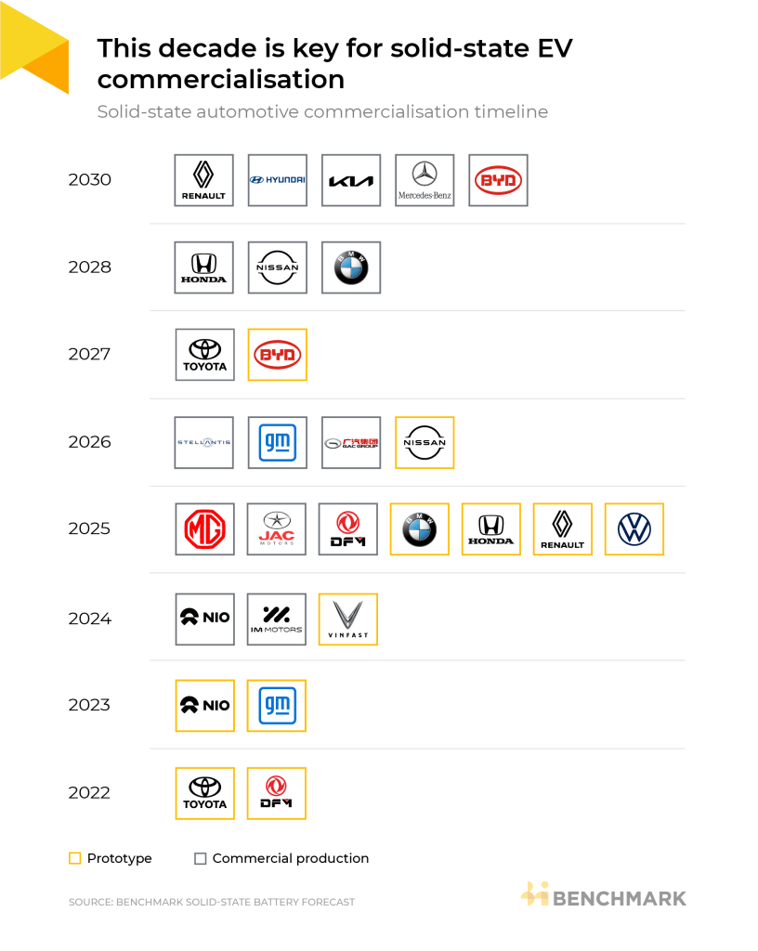
Who's Leading the Charge? Key Players & Timelines
Identify major automotive and battery manufacturers committed to SSB development and their projected timelines.
The race to commercialize solid-state batteries is heating up, with industry giants like Toyota, BYD, LG, Samsung, and Panasonic making significant investments and commitments. These players are targeting initial deployments and demonstration vehicles within the 2026-2027 timeframe, signaling a tangible shift.
Toyota's long-standing commitment and projected timelines.
BYD's advancements in SSB technology.
LG Energy Solution, Samsung SDI, and Panasonic's R&D efforts.
Other key automakers and battery producers involved.
Focus on demonstration vehicles and initial production targets for 2026-2027.
A visual timeline showcasing key companies and their announced milestones or target years for SSB integration, with a fo
Speaker note
The landscape is dynamic, with significant R&D and strategic partnerships driving progress. The commitments from these major players underscore the industry's belief in SSBs as the next generation of battery technology.
Slide 3 | Evidence: ORB-8d9023c5, ORB-9ce9241a, ORB-cb333aae, ORB-fade08f1, ORB-a436b14e

Slide 4
The Road to Commercialization: 2026-2027 Launch Window
Detail the anticipated timeline for the first commercial deployments of solid-state batteries in EVs.
The critical window for initial SSB commercialization is set for 2026-2027. While mass adoption will take longer, this period will see the first wave of EVs featuring SSB technology, likely in niche or premium segments, serving as crucial real-world demonstrations of capability and reliability.
Confirmation of 2026-2027 as the target for initial commercial SSB launches.
Anticipated market segments for early adoption (e.g., luxury EVs, specific performance vehicles).
The role of demonstration vehicles in validating technology.
Phased approach to market entry, moving from niche to broader applications.
Industry-wide commitment to achieving these near-term milestones.
A focused timeline highlighting the 2026-2027 period, illustrating the transition from R&D to initial market entry for S
Speaker note
This near-term launch window is pivotal. It represents the industry's collective effort to move SSBs from the lab to the road, proving their viability and paving the way for future scaling.
Slide 4 | Evidence: ORB-8d9023c5, ORB-9ce9241a, ORB-cb333aae, ORB-fade08f1, ORB-a436b14e

Slide 5
Navigating the Hurdles: Manufacturing & Cost Realities
Address the primary challenges related to manufacturing scalability and cost reduction for SSBs.
Process concept
A flowchart or infographic illustrating the key stages and challenges in scaling SSB manufacturing, from material processing to mass production, highlighting cost as a major factor.
Despite the promise, significant hurdles remain before SSBs can achieve widespread adoption. The key challenges lie in scaling up manufacturing processes to meet automotive demands and reducing the current high cost premiums associated with SSB production. Overcoming these will be critical for competitive pricing and market penetration.
The complexity of scaling SSB manufacturing processes.
High production costs compared to established Li-ion technology.
Challenges in material sourcing and supply chain development for solid electrolytes.
Ensuring consistent quality and performance at mass production volumes.
The need for significant investment in new manufacturing infrastructure.
Speaker note
It's crucial to maintain a pragmatic view. While the technology is exciting, the path to mass production is fraught with engineering and economic challenges that require substantial innovation and investment.
Slide 5 | Evidence: reasoned synthesis

Slide 6
Strategic Recommendations: Preparing for the SSB Transition
Provide actionable insights for businesses to navigate the integration of SSB technology.
Architecture concept
A strategic framework or roadmap visual showing key areas of focus for businesses preparing for SSB adoption, such as R&D, supply chain, partnerships, and product strategy.
To capitalize on the SSB opportunity and mitigate risks, strategic preparation is essential. This involves staying abreast of technological advancements, evaluating supply chain readiness, considering strategic partnerships, and planning for phased integration into product roadmaps. Proactive engagement will be key to securing a competitive edge.
Monitor SSB technology advancements and industry commitments closely.
Assess current supply chain capabilities and identify potential gaps for SSB materials.
Explore strategic partnerships with SSB developers or manufacturers.
Develop phased integration plans for SSB technology into future EV models.
Invest in R&D and talent development related to next-generation battery technologies.
Speaker note
The transition to SSBs is not just a technological shift; it's a strategic imperative. Companies that proactively plan and adapt will be best positioned to lead in the evolving EV market.
Slide 6 | Evidence: reasoned synthesis

Slide 7
Risks and Uncertainties in the SSB Landscape
Highlight potential risks and uncertainties associated with SSB commercialization.
Comparison concept
A visual representation of key risks and uncertainties, perhaps using icons or a risk matrix, to illustrate potential challenges.
While the outlook for SSBs is promising, several uncertainties warrant careful consideration. These include the precise timelines for widespread adoption beyond initial demonstrations, the potential for significant cost premiums impacting consumer affordability, and the ongoing competition from rapid advancements in conventional lithium-ion battery technology.
Uncertainty in exact commercialization timelines beyond initial demonstrations.
Potential for significant cost premiums impacting consumer adoption.
Scalability of manufacturing processes remains a key unknown.
Competition from advancements in traditional lithium-ion battery technology.
Geopolitical factors influencing raw material sourcing and supply chain stability.
Speaker note
A balanced perspective requires acknowledging the potential pitfalls. Understanding these risks allows for more robust strategic planning and risk mitigation.
Slide 7 | Evidence: reasoned synthesis

Slide 8
The Future is Solid: Embracing the SSB Evolution
Conclude by summarizing the strategic importance of SSBs and the long-term outlook for their integration into the EV market.
Closing concept
An inspiring visual that encapsulates the future of EVs powered by advanced battery technology, with contact information or a call to action.
Solid-state batteries are set to become a cornerstone of future electric vehicles, offering unparalleled safety and performance. While challenges in manufacturing and cost persist, the industry is on a clear trajectory towards commercialization, beginning in 2026-2027. Strategic preparation and investment today will unlock significant value and competitive advantage in the coming era of electric mobility.
Recap of SSB's transformative potential for EVs.
Reinforcement of the 2026-2027 commercialization window.
Emphasis on the strategic imperative for market players.
Long-term outlook for SSB dominance in the EV market.
Call to action: Prepare for the solid-state future.
Speaker note
In conclusion, the solid-state battery revolution is not a question of 'if,' but 'when.' By understanding the timelines, challenges, and strategic imperatives, we can confidently navigate this exciting transition and shape the future of electric mobility.
Slide 8 | Evidence: reasoned synthesis

